Slide 1
Playing to learn, or learning to play?
ANTF Symposium, 2016
21st March 2016
Phil Race
BSc PhD PGCE FCIPD PFHEA NTF
(from Newcastle-upon-Tyne)
Follow Phil on Twitter: @RacePhil
Visiting Professor: University of Plymouth and University Campus Suffolk
Emeritus Professor, Leeds Beckett University

Slide 2
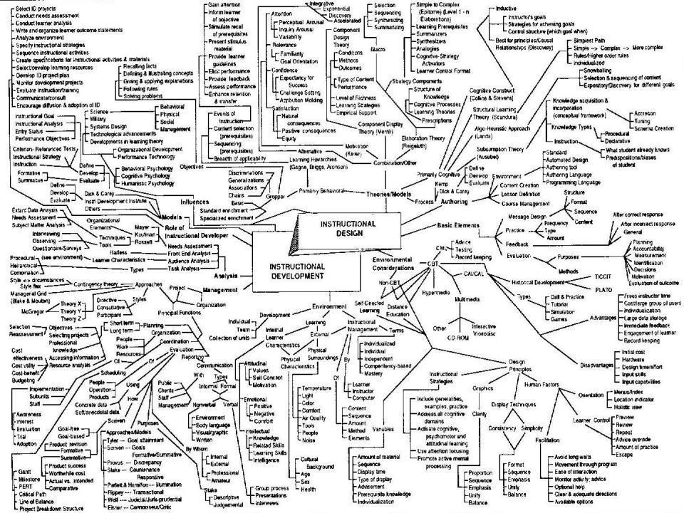
This slide has two purposes….
To focus the data projector, when necessary, and…
...to persuade colleagues never to put this sort of detail onto a slide!

Slide 3
Announcement about mobile phones and laptops...
Good day everyone – please turn on your ‘phones, tablets and computers.
Please post your thoughts, comments and ideas to the hashtag #antf16 if you’d. Thanks!
(PS: thanks for some lovely Tweets!)

Slide 4
About Phil…
First a musician
Then a writer
Then a scientist
Then a researcher
Then a lecturer and warden
Got interested in how students learn
And the effects assessment and feedback have on them
And how we teach them
Gradually became an educational developer
And now ‘retired’!
(1995, 2009, 2016!)
Currently…
Visiting Prof: Plymouth
Emeritus Prof: Leeds Beckett
Travelling around as usual!
Based at Newcastle, UK
And on trains
And an expert…
on train routes and timetables!
Notes:
2
2

Slide 5
Phil...
Phil Race plays every day, both as a Grandpa and as an experienced educational developer contributing to the learning and teaching community, particularly in relation to making learning happen. He is well known for his interactive workshops in which silent non-participation is simply a non-possibility, and regularly gets everyone using post-its. Over the years Phil has contributed significantly to the literature in the field of higher education learning and teaching.

Slide 6
Ludicrous?
The ludic approach to learning has always been a constant feature of my practice, whether as a Physical Chemist teaching thermodynamics or as an Educational Developer helping new staff to overcome crises of confidence when facing their first class of unruly students.

Slide 7
Blurb
Within this interactive workshop (which will run exactly to time) participants will be involved in a range of activities which will encourage you to take liberties with one or more established pedagogical theory, create an artefact, learn something you never thought you would learn and had a chance to win something. Along the way, you can expect to have some fun, entered into dialogue with fellow participants, played seriously and produced an outcome worth sharing with others, that might even stimulate you into writing something for publication.

Slide 8

3rd edition
Phil Race
2014: Sage: London
Three short videos
(1) About making learning happen in general: http://tinyurl.com/l7yddya
(2) Five top tips for lecturers: http://tinyurl.com/nxhohe3
(3) On being an author, and the changes in the 3rd edition: http://tinyurl.com/oqfkkdc

Slide 9
Multimedia
Media which will be used may include:
Post-its, music, vision and Twitter (certainly), manual dexterity and one of Phil’s iPods (probably), a conductor’s baton, and rubber bands, pipe-cleaners, stickers and glitter (possibly).
I won’t be using an UHP, but may mention it if requested. (Thanks, Peter Hartley, for permission to use a few of the many slides we did for the SEDA Museum of Antiquities).

Slide 10
The Underhand Projector
Sorry, the slides are too big to add here, but you should be able to get at the whole presentation from which they were taken by clicking the link below...
http://phil-race.co.uk/seda-museum-curiosities/

Slide 11
You will be able to download my main slides
You don’t need to take notes.
I’ll put the main slides up on my website as soon as I can: (http://phil-race.co.uk/)
I won’t include any pictures and video-clips, as this would make the file-size too large.
I may sometimes go through slides quite fast, but you can study them as you wish at your leisure.

Slide 12
Thanks to students
I could not do what I do nowadays if I did not continue to spend a fair bit of my time working with students – they’ve taught me most of what I know.

Slide 13
Name labels…
Please write your first name, big and bold, on a coded sticky label, and stick it to your clothing (not onto a fabric which would be damaged).
Phil

Slide 14
Getting to know each other
In turn, please..
Say one or two sentences about...
  who you are,
  where you come from, and
  what you do.
  In one breath!
(Optional) Share with us one thing that not many people know about you!

Slide 15
Post-it exercise 1
On a post-it, in your best handwriting, please write your own completion of the starter:
“Bringing play into learning would be much better if only I …”
Please swap post-its so that you’ve no idea who has yours.
If chosen, please read out with passion and drama the post-it you now have.
Please place them all on the chart as directed.
All your entries follow – great stuff, thanks.

Slide 16
“Bringing play into learning would be much better if only I …” (1)
Had a bank of examples to use.
Was not restricted by what management might think is ‘right’.
I didn’t have to worry about risk assessments.
Had a classroom with mobile furniture.
Was a better sporting player myself.
Could convince colleagues of its value.
Would only dare, would only share.
Could think more laterally – more like the students.

Slide 17
“Bringing play into learning would be much better if only I …” (2)
Wasn’t timetabled in lecture halls.
Had more opportunities.
Understood the most effective way to get students in computer science to engage.
Wasn’t frightened that colleagues and students wouldn’t appreciate its importance or consider it childish.
Wasn’t already doing it.
Could encourage more of my peers to join in.
Had access to a university stationery cupboard.

Slide 18
“Bringing play into learning would be much better if only I …” (3)
Had a little more time to develop my ideas for the diverse cohort I teach.
Didn’t have to explain its benefits constantly!
Had the teaching rooms to do it in.
Was teaching primary school children.
Had time to develop some of my wilder ideas.
Could think of games the students would like to play.
Could get into the pot of Playdoh!
I’d grown up in the first place.

Slide 19
“Bringing play into learning would be much better if only I …” (4)
Could trust the (weaker) students to engage.
Had greater resources and toys.
Had more time.
Didn’t have to make it look ‘professional’.
Had a box of tricks to dip into.
Could write my own gaming code.
Could choose my own room, and layout (which could be different every time).
Had the confidence it would work.
Had fewer bloody DEADLINES! Grrrr.

Slide 20
“Bringing play into learning would be much better if only I …”(5)
The whole educational system from primary and secondary (in particular) rediscovered the joy of play in learning.
Thought the students would actually enjoy it and cope with it.
Could lighten up and be more relaxed about losing my dignity.
Worked (or didn’t) with colleagues with open minds.
Didn’t keep wanting to use glitter but worry about environment impact.

Slide 21
Face-to-face communication
Making all the channels work

Slide 22
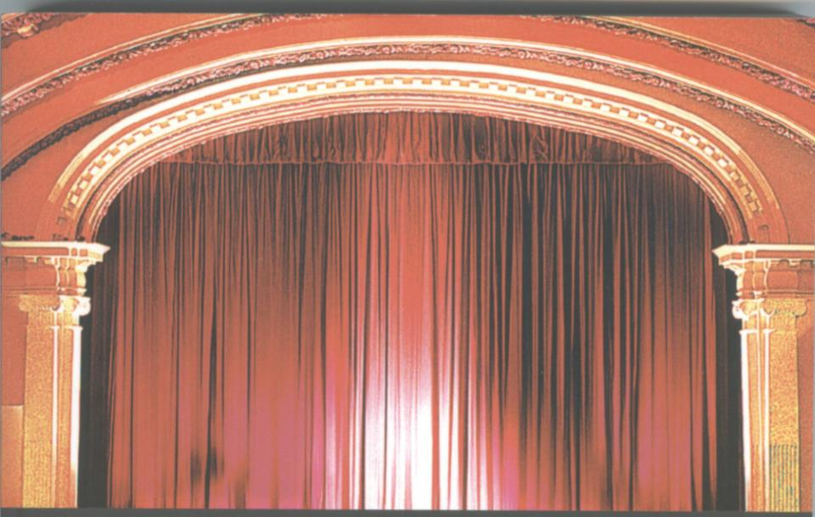
Thirty Second Theatre

Slide 23

Face-to-face one-to-one feedback activity
On the signal to start, please stand up, and work in pairs, moving around the room, talking to different people using the script which follows…
The script:
A ‘Hello’ (or equivalent).
B ‘Hello’ (or equivalent).
A ‘You are late’.
B ‘I know’.
Try to do it completely differently each time.

Slide 24
The power of face-to-face communication
What will I be expected to show for this?
What does a good one look like, and a bad one?
Where does this fit into the big picture?
When explaining assessment criteria to students, and when linking these to evidence of achievement of the intended learning outcomes, we need to make the most of face-to-face whole group contexts and...
  Tone of voice
  Body language
  Facial expression
  Eye contact
  The chance to repeat things
  The chance to respond to puzzled looks
Some things can’t work nearly so well just on paper or on screens.

Slide 25
Group competition: playing the band
In your group, use one or more rubber bands (and fingers, furniture, whatever).
The aim is to design, rehearse, then perform a 30-second musical composition.
This will be judged by someone, not me.
PS: the performances were wonderful – trust a roomful of NTFs to be so creative.

Slide 26
Post-it exercise 2
On another post-it, please write your own response to the following:
“An established pedagogical theory I would really like liberties to be taken with is…”
Sadly time ran out when we did this bit, but I was delighted that a common choice was ‘learning cycles’ – which I too hate!

Slide 27
Thanks!
Sorry I didn’t get round to playing some musical extracts and getting you to identify them, but I think the things you did were even more interesting.
And many thanks for all the post-its – what a great round you did.
And thanks for playing.

Slide 28
Thank you…
http://phil-race.co.uk/
Follow Phil on Twitter
@RacePhil
e-mail:
phil@phil-race.co.uk

