Slide 1
Phil Race:
How Students Really Learn
‘Ripples’ model of learning
(updated April 2016)
Ripples on a pond….
Wanting
Needing
Doing
Making sense
Feedback
Verbalising
Assessing

Slide 2
Making learning happen making feedback and self/peer assessment work
Phil Race
(from Newcastle-upon-Tyne)
BSc PhD PGCE FCIPD PFHEA NTF
Follow Phil on Twitter: @RacePhil
Visiting Professor: University of Plymouth and University Campus Suffolk
(Adjunct Professor: James Cook University, and Central Queensland University)
Emeritus Professor, Leeds Beckett University

Slide 3
How students really learn
Evidence-based practice
– seven factors underpinning successful learning based on asking 200,000 people about their learning in the last 20 years

Slide 4
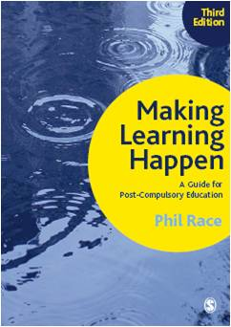
3rd edition
Phil Race
2014: Sage: London
Three short videos
(1) About making learning happen in general: http://tinyurl.com/l7yddya
(2) Five top tips for lecturers: http://tinyurl.com/nxhohe3
(3) On being an author, and the changes in the 3rd edition: http://tinyurl.com/oqfkkdc

Slide 5
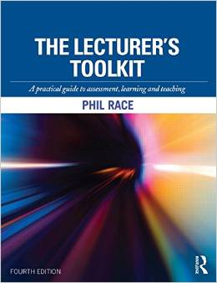
The Lecturer’s Toolkit
4th Edition
Phil Race
Routledge, London, 2015.

Slide 6
Mind our language?
Everyone learns. Not just students, not just teachers, not just professors, not just writers…
Yet the language we use to describe learning has got silly in the last fifty years or so.
It’s become remote, cold, psychological, exclusive, elitist – not a sensible way of talking about something everyone does.
My mission is to get back to using language about learning which everyone can relate to.

Slide 7
A fresh look at learning
We’ll explore how learning is underpinned by seven straightforward factors, which:
  we can address in our teaching,
  we can help our students to take more control over, to make their learning happen successfully.

Slide 8
For more details
Versions of the discussion of these factors are written up in Chapter 2 of ‘Making Learning Happen’ (2014) and also Chapter 1 of ‘The Lecturer’s Toolkit’ (2015).

Slide 9
Making learning happen
Asking students questions has been an essential part of making learning happen ever since the time of Socrates.
But we’ve got to use all the tricks in the book to make sure that all our students actually answer the questions.
The default state is for students to be inert! We’ve got to prevent this from happening.

Slide 10
Things are changing fast
In the age of online resources, TED-talks and MOOCs, the role of staff in higher and further education is no longer ‘giving students content’, but is much more about supporting their learning with feedback, and assessing and accrediting their evidence of achievement.

Slide 11
Now is the decade of Post-compulsory Education’s dis-content!
Never mind the content – feel the learning

Slide 12
I predict a move of educational institutions away from being the guardians of content, (where everything was about ‘delivery’), towards two major functions:
Recognising and accrediting achievement, wherever learning has taken place (i.e. getting the assessment right);
Supporting student learning and engagement (not least by making feedback work well for students).

Slide 13
So now, it’s time to re-think:
How students really learn – and how we can help make learning happen for them;
How to make feedback really work for students;
How best to measure and accredit students’ achievement (not just more of the same old tired methods).
In this presentation, we’ll explore all three of these areas.

Slide 14
One of my main worries...
We still tend to try to measure...
...what’s in students’ heads, and what they can do with what’s there
in terms of two unsatisfactory proxies ...
what comes out of students’ pens in exams;
2. what comes out of their keyboards in essays and reports.

Slide 15
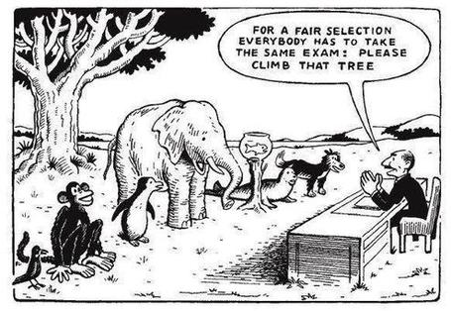

Slide 16
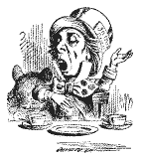
“[The] pupils got it all by heart; and, when Examination-time came, they wrote it down; and the Examiner said ‘Beautiful! What depth!’
They became teachers in their turn, and they said all these things over again; and their pupils wrote it down, and the examiner accepted it; and nobody had the ghost of an idea what it meant”
Lewis Carroll, 1893
Active
Experimentation
Abstract
Conceptualisation
Concrete
Experience
Reflective
Observation

Slide 17
12 sources about assessment, feedback and learning in higher education
Knight, P. and Yorke, M. (2003) Assessment, learning and employability Maidenhead, UK SRHE/Open University Press.
Flint, N. R. and Johnson, B. (2011) Towards fairer university assessment – recognising the concerns of students London: Routledge.
HEA (2012) A Marked Improvement: transforming assessment in higher education York: Higher Education Academy (http://www.heacademy.ac.uk/assets/documents/assessment/A_Marked_Improvement.pdf )
Boud, D. and Associates (2010) Assessment 2020: seven propositions for assessment reform in higher education Sydney: Australian Learning and Teaching Council.
Morgan, M. (2011) (ed.) Improving the Student Experience: A practical guide for universities and colleges, London: Routledge.
Blue Skies (2011) new thinking about the future of higher education: download free from http://pearsonblueskies.com/

Slide 18
12 sources about assessment, feedback and learning in higher education
Race, P. (2014) Making learning happen: 3rd edition London: Sage Publications.
Hunt, D. and Chalmers, L. (eds) (2012) University Teaching in Focus: a learning-centred approach see Chapter 5: Using effective assessment to promote learning, Sally Brown and Phil Race Australia: ACER Press, and London: Routledge.
Price, M., Rust, C., O’Donovan, B. and Handley, K. (2012) Assessment Literacy, Oxford: the Oxford Centre for Staff and Learning Development (based on the ‘ASKe’ Project).
Sambell, K., McDowell, L. and Montgomery, C. (2013) Assessment for Learning in Higher Education, London: Routledge.
Brown, S. (2015) Learning, teaching and assessment in higher education: global perspectives, Basingstoke: Palgrave-Macmillan.
Race, P. (2015) The Lecturer’s Toolkit: 4th edition, London, Routledge.

Slide 19
What sorts of learners have we?
Which different approaches to engagement do we have in any group of students?

Slide 20

Surface learners?
Deep learners?
Rote
learners?
What kinds of learners have we got?
Strategic learners?
Cue-conscious learners?
Cue-oblivious learners?
Cue-seeking learners?

Slide 21
Surface learners?
Deep learners?
Rote
learners?
What kinds of learners have we got?
Strategic learners?
Cue-conscious learners?
Cue-oblivious learners?
Cue-seeking learners?

Slide 22
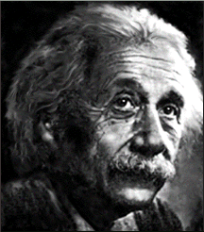
Task: who said this?
‘Everything should be made as simple as possible,
but not simpler’.
(Jot your answer down anywhere, just guess).
(Albert Einstein, 1879-1955).

Slide 23
Three more Einstein quotes
‘Knowledge is experience, everything else is just information’.
And…
‘Imagination is more important than knowledge’.
And…
‘I never teach my pupils; I only attempt to provide the conditions in which they can learn’.

Slide 24
Information and communication?
Information can be communicated, in large amounts, in books and articles, or downloaded to our computers.
But it’s not knowledge till we do things with it… apply it, extend it, interrogate it, analyse it, disagree with it, compare and contrast it, and so on.

Slide 25
Teaching…
Other people’s knowledge is just information.
Teaching is helping people to turn information into knowledge…
…by getting them to do things with the information…
…and giving them feedback about their attempts.

Slide 26
Timing of feedback is critical
Feedback only really works after we’ve got students to do something.
Feedback on something they’ve actually done is far more powerful than feedback on something they’ve merely thought.

Slide 27
Face-to-face communication
Making all the channels work

Slide 28

Thirty Second Theatre

Slide 29
Face-to-face one-to-one feedback activity
Please work in pairs, moving around the room, talking to different people using the script which follows…
The script:
A ‘Hello’ (or equivalent).
B ‘Hello’ (or equivalent).
A ‘You are late’.
B ‘I know’.
Try to do it completely differently each time.

Slide 30
The power of face-to-face communication
When explaining assessment criteria to students, and when linking these to evidence of achievement of the intended learning outcomes, we need to make the most of face-to-face whole group contexts and,,,
  Tone of voice
  Body language
  Facial expression
  Eye contact
  The chance to repeat things
  The chance to respond to puzzled looks
Some things can’t work nearly so well just
on paper or on screens.

Slide 31
Learning
– a natural human process

Slide 32
Learning
at
school
Learning
at home
‘early’
learning
Learning
at
university
Seven factors
underpinning
all forms
of learning
Learning
to be
old
Learning
with the
Internet
Learning
at
work
Distance
learning
Vocational
Training

Slide 33
Seven factors underpinning successful learning
I’m going to ask you four questions about how you learn…

Slide 34
‘Ripples on a pond’
Over the last 20 years, I’ve asked over 200,000 people four two-part questions about how they learn.
I’ve also asked two further questions about how people found they deepened their learning.
All sorts of people, all ages, in many countries.
Their responses to my questions are surprisingly similar.
I’ll ask you these questions shortly.

Slide 35
How you learn:
Please make a little grid with four boxes, with numbers 1-4 in the corners.
1
2
3
4

Slide 36
Prepare to jot down your answers to the
second parts of each of four questions
– no more than six words or so.
1
2
3
4

Slide 37
1: How do you learn well?
Think (don’t write anything yet) of something that you’re good at, something that you know you do well.
How did you become good at it? Write a few words in box 1.

Slide 38
Most people’s views...
practice
trial and error
having a go
repetition
experimenting

Slide 39
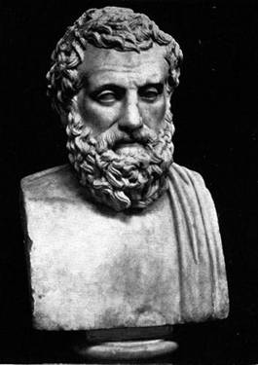
The first quote on experiential learning?
“One must learn by doing the thing; though you think you know it, you have no certainty until you try”.
(Sophocles, 495-406 BC)

Slide 40
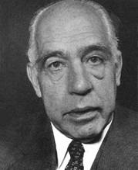
Another...
An expert is a man who has made all the mistakes,
which can be made,
in a very narrow field.
(Niels Bohr, 1885-1962)
Therefore we need to allow learners to make mistakes, and help them to gain feedback in a constructive environment, to help them towards becoming experts.

Slide 41
But sometimes we really need teachers…
Someone who already knows;
Someone who has already learned by getting it wrong at first;
And can help us to do the same…
Sometimes without saying a word…

Slide 42
Next to feelings
The educational psychologists got it wrong last century.
They went into cognition, metacognition, memory and that sort of stuff.
Interesting, but dull.
Much more important: feelings.
Professor Alan Mortiboys gets right into this with his lifechanging work on emotional intelligence.
Meanwhile....

Slide 43
2: What makes you feel good?
Think of something about yourself that you feel good about.
How can you justify feeling good about this? What’s your evidence to support this feeling? Write a few words in box 2.

Slide 44
Most people’s views...
feedback
other people’s reactions
praise
gaining confidence
seeing the results

Slide 45

Fishing for feedback?
Feedback is like fish.
If it is not used quickly, it becomes useless.
(Sally Brown).
Give a man a fish,
Feed him for a day.
Teach a man to fish,
Feed him for a lifetime.
(Maimonides: 1135-1204)
Make feedback timely, while it still matters to students, in time for them to use it towards further learning, or to receive further assistance.
(Graham Gibbs)
And he’ll learn to drink beer in boats
And you won’t see him for weeks!
(Australian proverb).

Slide 46
3: What can go wrong?
Think of something that you’re not good at, perhaps as a result of a bad learning experience.
What went wrong, and whose (if anyone’s) fault it may have been? Write a few words in box 3.

Slide 47
Most people’s views...
did not really want to learn it
could not see the point
bad teaching
could not make sense of it

Slide 48
Is there anyone there?
What station are you broadcasting on?

Slide 49
Try WIIFM
What’s in it for me?
Consciously address the ‘so what’ in learners’ minds;
Warm up their ‘want’ to learn.
Clarify their ‘need’ to learn.
Learners learn far more readily if they are continuously aware of the benefits for them of putting energy into their learning.

Slide 50
4: And if there isn’t a ‘want’?
Think of something that you did learn successfully, but at the time you didn’t want to learn it.
What kept you going, so that you did indeed succeed in learning it? Write a few words in box 4.

Slide 51
Most people’s views...
strong support and encouragement
did not want to be seen not able to do it
needed to do it for what I wanted next

Slide 52
Five of the seven factors underpinning successful learning
learning by doing
learning from feedback
wanting to learn
needing to learn
...

Slide 53
‘Do you understand?’ lecturer asks student.
‘Understand what?’ thinks student.
‘What am I supposed to understand?’
‘What will he/she think of me if I say “no”?’
‘If I say “yes” will he/she ask me a difficult question to catch me out?’
‘Why am I being asked this anyway?’
‘Is it going to be important for me to understand this?’.
‘How will I know when I understand it?’.
‘What will I be able to do when I understand it?’.
‘How will I be able to demonstrate my understanding of it?’.
‘Do I actually have to understand it, or will it be enough simply to demonstrate my understanding of it, by doing something I can do, even when I don’t understand it?’.
‘Does he/she understand it, anyway?’
‘Mmmm’ replies student (as soon as possible after all that thinking). … continued…

Slide 54
‘So you don’t understand it then?’ alleges lecturer.
‘Well, …’ replies student.
‘So you understand it well?’ smiles lecturer.
‘Just about’ replies student.
‘Ah, good’ says lecturer. ‘I made myself clear then?’
‘Of course’ replies student.
[Because of things like this, the word ‘understand’ is best avoided in intended learning outcomes – and in life in general, except to get people thinking].

Slide 55
Five of the seven factors underpinning successful learning
learning by doing
learning from feedback
wanting to learn
needing to learn
making sense – ‘getting one’s head round it’

Slide 56
Traditional views...
active experimentation
concrete experience
reflective observation
abstract conceptualisation

Slide 57
Is it a cycle?
Active
Experimentation
Abstract
Conceptualisation
Concrete
Experience
Reflective
Observation

Slide 58
What’s missing?
Engagement?
Feelings?
Active
Experimentation
Emotions?
Judgments?
Desire?
Abstract
Conceptualisation
Concrete
Experience
Communication?
People?
Reflective
Observation

Slide 60
Coffield et al on Kolb…
“Kolb clearly believes that learning takes place in a cycle and that learners should use all four phases of that cycle to become effective... But if Wierstra and de Jong’s (2002) analysis, which reduces Kolb’s model to a one-dimensional bipolar structure of reflection versus doing, proves to be accurate, then the notion of a learning cycle may be seriously flawed”.

Slide 61
Coffield et al on Kolb
“Finally, it may be asked if too much is being expected of a relatively simple test which consists of nine (1976) or 12 (1985 and 1999) sets of four words to choose from. What is indisputable is that such simplicity has generated complexity, controversy and an enduring and frustrating lack of clarity”.
Frank Coffield, David Moseley, Elaine Hall and Kathryn Ecclestone (2004) ‘Learning styles and pedagogy in post-16 learning: a systematic and critical review’ London, Learning Skills Research Centre, now LSN.

Slide 62
And on learning styles....
The most telling argument, however, against any large-scale adoption of matching is that it is simply ‘unrealistic, given the demands for flexibility it would make on teachers and trainers’ (Reynolds 1997, 121). It is hard to imagine teachers routinely changing their teaching style to accommodate up to 30 different learning styles in each class, or even to accommodate four...
... Should research into learning styles be discontinued, as Reynolds has argued?

Slide 63
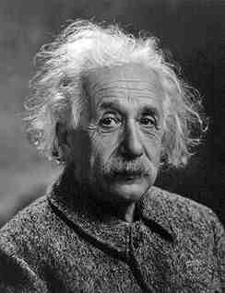
Albert Einstein
“It is simply madness to keep doing the same thing, and expect different results”

Slide 64
Back to our five factors:
is this a cycle?
- No! Too simple.
Wanting/Needing
Making sense
Doing
Feedback

Slide 65
Ripples on a pond….
Wanting/
Needing

Slide 66
Ripples on a pond….
Wanting/
Needing
Doing

Slide 67
Ripples on a pond….
Wanting/
Needing
Doing
Making sense

Slide 68
Ripples on a pond….
Wanting/
Needing
Doing
Making sense
Feedback

Slide 69
But there are still two things missing
One has never really ‘got’ something until one has done both of two more things...

Slide 70
Another question
Think of something you’ve taught for some time. Think back particularly to the first time you taught it.
To what extent did you find that you ‘had your head around it’ much better after teaching it for the first time?
  Very much better: raise two hands
  Somewhat better: raise one hand
  No better: raise no hand

Slide 71
Ripples on a pond….
Verbalising
Wanting/
Needing
Doing
Making sense
Feedback

Slide 72
And one final question...
Still thinking of the first time you taught that particular topic, think back to the first time you measured students’ learning of the topic.
To what extent did you find that after assessing students work, you yourself had ‘made sense’ of the topic even more deeply?
  Very much better: raise two hands
  Somewhat better: raise one hand
  No better: raise no hand

Slide 73
Ripples on a pond….
Verbalising
Assessing
making informed judgements
Wanting/
Needing
Doing
Making sense
Feedback

Slide 74
The guru Royce Sadler
“The indispensable conditions for improvement are that the student comes to hold a concept of quality roughly similar to that held by the teacher, is able to monitor continuously the quality of what is being produced during the act of production itself, and has a repertoire of alternative moves or strategies from which to draw at any given point. In other words, students have to be able to judge the quality of what they are producing and be able to regulate what they are doing during the doing of it”. (Sadler 1989). (my italics)

Slide 75
Royce Sadler...
...is the most cited author on formative feedback, writing about it since the mid-1980s. He is doing his absolute best work now.
Sadler, D R (2009) Indeterminacy in the use of preset criteria for assessment and grading Assessment and Evaluation in Higher Education 34:2 159-179
Sadler, D R (2009) Grade integrity and the representation of academic achievement Studies in Higher Education, 34:7, 807-826
Sadler, D R (2007) Perils in the meticulous specification of goals and assessment criteria Studies in Higher Education I34:7 807-26.
Sadler, D R (2005) Interpretations of criteria-based assessment and grading in higher education Assessment and Evaluation in Higher Education 30 175-194.
Sadler, D R (2002) Ah! ... So that’s ‘Quality’ In Schartz, P and Webb, G (eds) Assessment Case Studies: experience and practice from higher education London, Kogan Page.

Slide 76
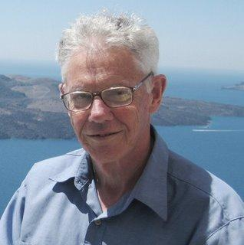
But what about standards and assessment – the ‘depth’ of the pond?
‘Constructive alignment’ as John Biggs (2003), and Biggs and Tang (2011) call it

Slide 77
How do we measure learning?
Evidence of achievement of the intended learning outcomes?
including
Learning
outcomes
Evidence
Assessment
Feedback

Slide 78
Teaching smarter: we need to:
Ripples on a pond….
Verbalising
Assessing
making informed judgements
Strive to enhance our students’ want to learn;
Help students to develop ownership of the need to learn;
Keep students learning by doing, practice, trial-and-error, repetition;
Ensure students get quick and useful feedback – from us and from each other;
Help students to make sense of what they learn.
Get students deepening their learning by coaching other students, explaining things to them.
Allow students to further deepen their learning by assessing their own learning, and assessing others’ learning – making informed judgements.
Wanting/
Needing
Doing
Doing
Making sense
Feedback

Slide 79
Seven things we can try to do
Intent – make the intended outcomes really clear.
Need – find out what students think they need, and respond to this.
Support students in every way possible.
People: students are people, they’re human, like us.
Interact with students in large groups, small groups, online and one-to-one.
Remember names, faces, what you said to each student last time, ...
Evidence: keep students aware of the evidence which will lead to their success.

Slide 80
Seven practical things you can do to make learning happen
Phil Race
BSc PhD PGCE FCIPD PFHEA NTF
(from Newcastle-upon-Tyne)
Follow Phil on Twitter: @RacePhil
Visiting Professor: University of Plymouth and University Campus Suffolk
Emeritus Professor, Leeds Beckett University

Slide 81
1 Capture your reflections
7 Make good use of praise
Seven
practical
things
you can
do
2 Find out where your learners are at
6 Keep talking about links to assessment
3 Keep watching how others teach
5 Get learners talking
4 Make students’ targets clear and interesting

Slide 82
1 Capture your reflections
After every teaching session, give yourself five minutes to jot down the following:
Date, time, place, title of session (to help you keep track of how your teaching develops).
The thing that went best about this particular session, and that you’ll do again.
One thing you would do differently if you were able to rewind the tape.
Something else you may want to think about !

Slide 83
1 Capture your reflections
Seven
practical
things
you can
do
2 Find out where your learners are at

Slide 84
2 Find out where your learners are at
Try different ways at different sessions
Chat to a few of them before you start.
Use a ‘smiley-face’ round to find out about the mood.
Use post-its for ‘so-and-so would be much better for me if only I ...’.
Give them a quick quiz on last week’s session using show of hands, clickers, coloured cards, mobile phone apps, and so on.

Slide 85
1 Capture your reflections
Seven
practical
things
you can
do
2 Find out where your learners are at
3 Keep watching how others teach

Slide 86
3 Keep watching how others teach
Make the most of peer-observation, for example by:
Seeing things colleagues do, that work well, and which you could try out yourself.
Watching things that don’t work, and which you can avoid yourself.
Taking time to watch the students, and see what works for them, and what doesn’t.
Benefit from an informal chat with the colleague observing your sessions.

Slide 87
1 Capture your reflections
Seven
practical
things
you can
do
2 Find out where your learners are at
3 Keep watching how others teach
4 Make students’ targets clear and interesting

Slide 88
4 Make students’ targets clear and interesting
Show intended outcomes of this particular session on a slide.
Talk through them, adding tone-of-voice and body language to make them clearer to learners.
At the end, show them again, asking:
  Raise two hands if you know you’ve achieved this one’;
  Raise one hand if you think you’ve partly achieved this one’;
  Raise no hands if you’re still at sea.

Slide 89
1 Capture your reflections
Seven
practical
things
you can
do
2 Find out where your learners are at
3 Keep watching how others teach
5 Get learners talking
4 Make students’ targets clear and interesting

Slide 90
5 Get learners talking
Get them talking to each other, rather than just listening to you or just watching you.
Make it comfortable for learners to talk.
Putting things into their own words, orally’ is really good for helping them to crystallise their thinking.

Slide 91
1 Capture your reflections
Seven
practical
things
you can
do
2 Find out where your learners are at
6 Keep talking about links to assessment
3 Keep watching how others teach
5 Get learners talking
4 Make students’ targets clear and interesting

Slide 92
6 Keep talking about links to assessment
Clarify to learners what they’ll need to become able to do.
Illustrate the range of evidence of achievement – ‘a good one’, ‘a poor one’, and ‘in-between one’, and one that’s really difficult to judge.
Use your warm tone of voice, body-language, facial expression, gesture, and dialogue to help learners get a real grip on what they’re intended to show for their learning.

Slide 93
1 Capture your reflections
7 Make good use of praise
Seven
practical
things
you can
do
2 Find out where your learners are at
6 Keep talking about links to assessment
3 Keep watching how others teach
5 Get learners talking
4 Make students’ targets clear and interesting

Slide 94
7 Make good use of praise
‘That’s a really good point, thanks’
‘I really like what you’ve done here, keep doing this’
‘The best thing about this is...’
‘That’s a great step forward’
‘That’s a really good answer’
‘This is one of the best I’ve seen’
‘That’s exactly what we’re looking for’

Slide 95
1 Capture your reflections
7 Make good use of praise
Make
Learning
Happen
2 Find out where your learners are at
6 Keep talking about links to assessment
3 Keep watching how others teach
5 Get learners talking
4 Make students’ targets clear and interesting

Slide 96
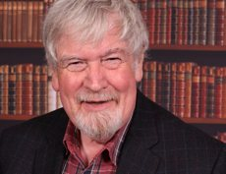
Thank you……
http://phil-race.co.uk
Follow Phil on Twitter
@RacePhil
e-mail:
phil@phil-race.co.uk

