Slide 1
Exam Technique
Tensions, timing and tricks
Chelmsford
18th June 2015
Phil Race
BSc PhD PGCE FCIPD PFHEA NTF
(from Newcastle-upon-Tyne)
Follow Phil on Twitter: @RacePhil
Visiting Professor: University of Plymouth and University Campus Suffolk
Emeritus Professor, Leeds Metropolitan University

Slide 2
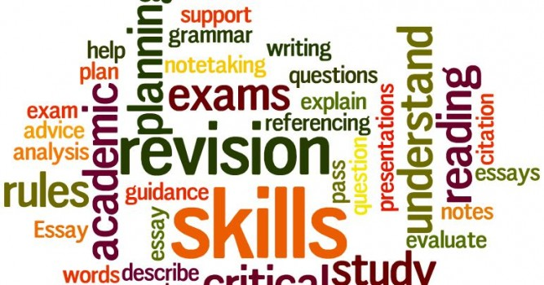
What it’s all about?

Slide 3

The read-write industry

Slide 4
About Phil…
Born a Geordie
First a musician
Then a writer
Then a scientist
Then a researcher
Then a lecturer and warden
Got interested in how students learn
And the effects assessment and feedback have on them
And how we teach them
Gradually became an educational developer
And now ‘retired’! (1995, 2009)
Working with students on learning techniques
And lecturers on teaching and assessment strategies
And trainers on training design
Currently…
Visiting Prof: Plymouth
Emeritus Prof: Leeds Beckett
Travelling around as usual!
Based at Newcastle, UK
And on trains
And still a Geordie.
And an expert…
on train routes and timetables!
Notes:
2
2

Slide 5
You will be able to download my main slides
You don’t need to take notes.
I’ll put the main slides up on my website this evening: (http://phil-race.co.uk/)
I won’t include the pictures and video-clips, as this would make the file-size too large.
I may sometimes go through slides quite fast, but you can study them as you wish at your leisure.

Slide 6
Thanks to students
I could not do what I do nowadays if I did not continue to spend a fair bit of my time working with students – they’ve taught me most of what I know.

Slide 7
Thanks also to Bill Tipping
It was great hearing exactly how papers are marked, and how much care examiners take to try to give you credit for what you have written.

Slide 8
Name labels…
Please write your first name, big and bold, on a sticky label, and stick it to your clothing (not onto a fabric which would be damaged).
Phil

Slide 9
Intended learning outcomes…
After participating in today’s workshop, you should be able to:
Work smarter towards passing your exams well.
Get better marks!
Have a better life.

Slide 10
18th June...
1429: Joan of Arc defeated the English in Patay;
1583: first life insurance policy issued;
1812: US declared war against Britain;
1815: French defeated at Waterloo;
1999: G7 waived $70bn owed by poor countries;
2015: ????

Slide 11

Attitude
is important

Slide 12
Announcement about mobile phones and laptops...
Good afternoon everyone – please turn on your ‘phones and computers.
Please post your thoughts, comments and ideas to the hashtag #philatchelmsford

Slide 13
I’ve published many of the ideas I’m including in this session in:
“How to Get a Good Degree” (Phil Race, Open University Press, 2007);
“How to Win as a Final Year Student” (Phil Race, Open University Press, 2000);
“How to Study: Practical Tips for Students” (Phil Race, Blackwell, 2003).
Some of the most useful bits are on my website:
http://phil-race.co.uk

Slide 14
How to Get a Good Degree
(2nd edition)
Phil Race
Open University Press , 2007

Slide 15
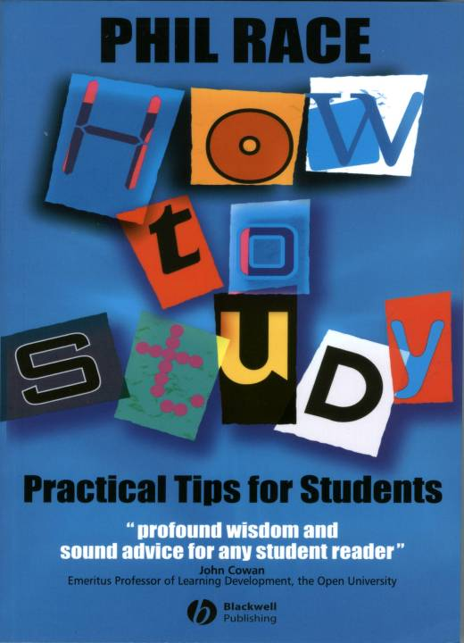
How to Study
Practical Tips for Students
Phil Race
2003, Blackwell, Oxford

Slide 16
One man is as good as another until he has written a book
Benjamin Jowett, 1897
(then he gets worse?)
Much better: Google Stella Cottrell
for really excellent study skills books.

Slide 17
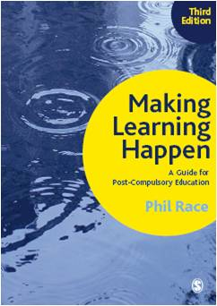
3rd edition
Phil Race
2014: Sage: London
Three short videos
(1) About making learning happen in general: http://tinyurl.com/l7yddya
(2) Five top tips for lecturers: http://tinyurl.com/nxhohe3
(3) On being an author, and the changes in the 3rd edition: http://tinyurl.com/oqfkkdc

Slide 18
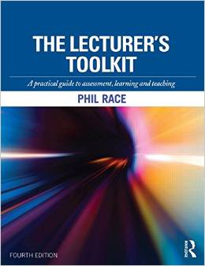
The Lecturer’s Toolkit
4th Edition
Phil Race
Routledge, London, 2015.

Slide 19
Exams!
Timings
Tensions
Tricks
The quality of the rest of your life can be improved a lot if you do well in your exams!

Slide 20
Post-it task
Please follow these instructions really carefully.
On a post-it, in your best handwriting, jot down your completion of the following starter:
‘Exams would be much better for me
if only I ...’
Now swap post-its, until you no longer know who has yours.
If chosen, please read out with passion and drama what’s on the post-it you now have.

Slide 21
Exams!
What do they really measure?

Slide 22
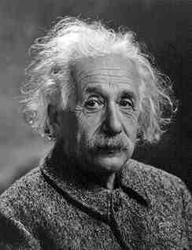
Albert Einstein
“It is simply madness to keep doing the same thing, and expect different results”

Slide 23
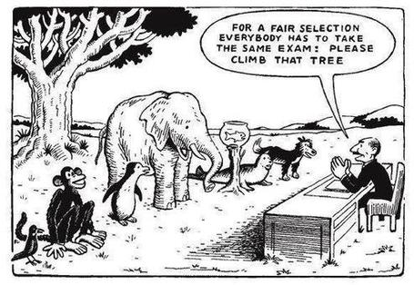

Slide 24
Organising your studying…
Jot down your immediate gut responses to the following questions..
Where will you (or do you) do your studying?
When (time of day) do you do your studying?
When you’re studying, how long does it take you to actually put pen to paper, or fingers to keyboard?
Who knows about your studying plans?
Jot down (in hours or minutes) what you think is a sensible minimum element of time which could be used to make some progress with your studying.
How many times, per week, does this time element become available to you?
Danger!

Slide 25
What do exams really measure?
Think back to your existing experience of exams – particularly the most-common sort – time-constrained, unseen, written exams;…
Decide what they actually measure, using the 21 criteria in your table.

Slide 26
Grid…
Numbers 1-21… | Measured very well | To some extent | Not really
1
2
….
21

Slide 27
Measured very well, to some extent, or not really?
1 How much you know about your subject.
2 How much you don’t know about your subject.
3 The quantity of revision that you’ve done.
4 The quality of revision that you’ve done.
5 How intelligent you are.

Slide 28
Measured very well, to some extent, or not really?
6 How much work you’ve done the night before.
7 How well you keep your cool.
8 How good your memory is.
9 How good you are at question-spotting.
10 How fast you think.
11 How fast you write.
12 How legible your handwriting is.

Slide 29
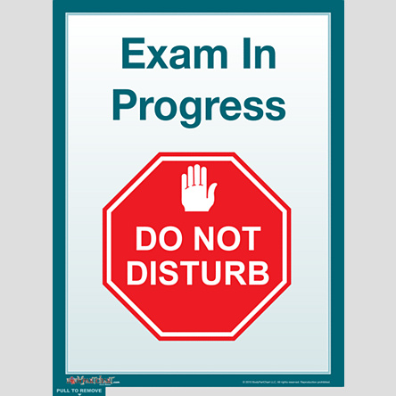
Peace and quiet at last!

Slide 30
Measured very well, to some extent, or not really?
13 How practised you are at answering exam questions.
14 How carefully you read the questions.
15 How wisely you choose the questions that you attempt.
16 How well you manage your time during exams.
17 How well you keep exactly to the questions in your answers.

Slide 31
Measured very well, to some extent, or not really?
18 How well you set out your answers to the questions.
19 How skilled you are at solving problems.
20 How carefully you read your answers after writing them.
21 How well you edit/improve your answers after reading them.

Slide 32
Face-to-face communication
Making all the channels work

Slide 33

Face-to-face one-to-one feedback activity
Please work in pairs, moving around the room, talking to different people using the script which follows…
The script:
A ‘Hello’ (or equivalent).
B ‘Hello’ (or equivalent).
A ‘You are late’.
B ‘I know’.
Try to do it completely differently each time.

Slide 34
The power of face-to-face communication
Exams measure what we write about what we know. However, getting to know something well is aided by making full use of face-to-face contact, using and responding to:
  Tone of voice
  Body language
  Facial expression
  Eye contact
  The chance to repeat things
  The chance to respond to puzzled looks
This adds a lot to just working with words in print, or on-screen.

Slide 35
If you’ve ever failed an exam
It doesn’t mean you are a failure.
It just means that..
on that day..
you didn’t answer those particular questions..
with what was being looked for..
on that particular occasion..
by the person marking your answers!

Slide 36
Ten things you can do to reduce exam tension
Composed by Professor Sally Brown
specially for today

Slide 37
Ten things you can do to reduce exam tension
Start to plan ahead in plenty of time to get your revision done.
If you draw up over-ambitious plans, you won’t achieve everything but steady and regular revision will give you confidence and puts you under less pressure than leaving it all to the last minute. (You know this in your heart anyway, but don’t always listen to yourself!)

Slide 38
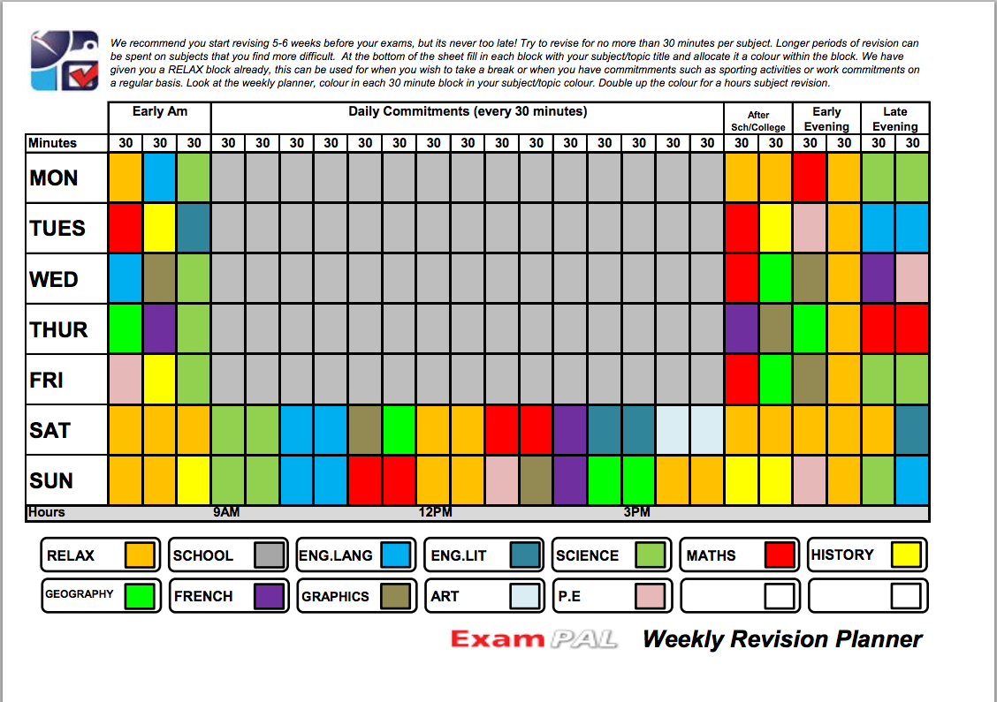

Slide 39
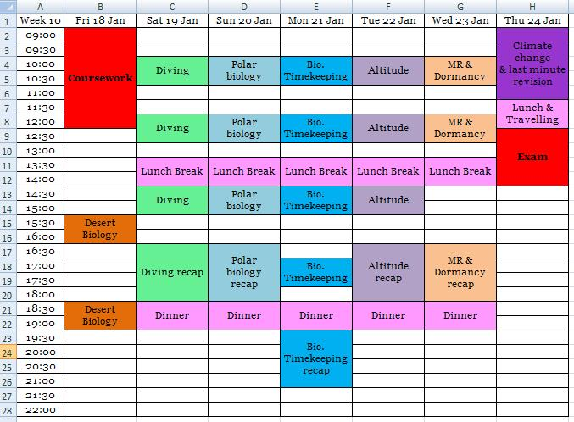

Slide 40
Ten things you can do to reduce exam tension
Explore different ways of looking at material.
If you are principally working from notes you have downloaded on-line from a virtual resource bank, maybe try making some summarised notes to help you engage with the material. If you are working mainly with your own lecture notes, consider making mind-maps, diagrams and other personal resources to aid retention of material.

Slide 41
Ten things you can do to reduce exam tension
Use diverse resources.
For example if you have been working mainly from a single text book, buy or borrow a book that approaches the topic from a different angle. Search out and use material on YouTube, MOOCs, TED talks and Open Educational Resources (OERs) from universities which make their materials available through Creative Commons licenses (e.g. much is readily available from the Open University).

Slide 42
Ten things you can do to reduce exam tension
Work with fellow students in informal or formal peer support groups.
Often helping explain something to another person helps you get a stronger grip on it yourself, and making arrangements to work with others in person or online can be more motivating than just slogging it out on your own. Maybe you could share out topics and take responsibility for preparing revision notes or other materials, and then leading others through what you’ve prepared.

Slide 43
Ten things you can do to reduce exam tension:
Keep in mind what you are really trying to achieve.
The idea is not just to cram material short term, but to understand it well enough to use it in the exam, but also importantly in your subsequent professional experiences.

Slide 44
Ten things you can do to reduce exam tension
Don’t over-concentrate on learning one area to the detriment of others.
Over a programme of revision you will keep yourself fresher if you cover different areas even within a single evening. By its nature revision can be boring so you need to incentivise yourself to keep going.

Slide 45
Ten things you can do to reduce exam tension
Don’t endlessly compare what you are doing with your peers.
You can frighten or demoralise yourself by repeatedly trying to find out how much work your peers are doing. Often people exaggerate or pretend to be doing less than they actually are in order not to look like a swot. In the end, it only really matters what you are doing in the way of preparation and revision;

Slide 46
Ten things you can do to reduce exam tension
Don’t pull “all-nighters”.
If you miss out on sleep you are less likely to perform well the next day, so resting (even if you find it difficult to sleep soundly) will do you more good, especially if you can avoid over-thinking about the material when you are lying awake. Use the radio, music or relaxation techniques to give your brain a rest.

Slide 47

Don’t pull all nighters!

Slide 48
Ten things you can do to reduce exam tension
Don’t use stimulants to keep you awake so you can revise for excessively long hours.
They can be harmful to your health and often leave you with such jangly nerves during the exam itself that you can’t concentrate properly, or perhaps feel ill.

Slide 49
Ten things you can do to reduce exam tension
Don’t lose your sense of proportion
Don’t forget that while exams are important, it is normally possible to recover from failure fairly readily on a future occasion. However high the stakes feel, it’s important to retain a sense of balance and try not to think about letting yourself or others down. As most people’s mums would say, all you can do is to do your best!

Slide 50
Revision
- the more often you’ve explained something, the faster and better you can explain it next time.
Revision is the key to the quality of the rest of your life!

Slide 51
Have you started ‘serious’ revision yet?
Two hands: ‘yes, of course’
One hand: ‘just about to start’
Left ear: ‘what revision?’

Slide 52
Why I’ve not started revising yet...
I’m not motivated enough
I’m still learning the content
I always find time for more important things to do
I don’t manage my time very well
I haven’t an exam till November
I haven’t picked up my book yet, because I haven’t bothered to collect it

Slide 53
Some favourites: ‘I’ll not start revising yet because…’
Other things to do.
It’s far too early,…
Too busy, sock draws,….
I won’t remember it again – too far away.
I can’t be asked.
Work best under pressure
I’m not comfortable enough.
The pub’s just opened…
I’m leaving you unless you…
There’s a y in the day...

Slide 54
Revision processes: learning payoff: high, medium or low?
1 Reading your notes, books and articles over and over again.
2 Making summaries of your source materials as you read them.
3 Writing important things out over and over again.

Slide 55
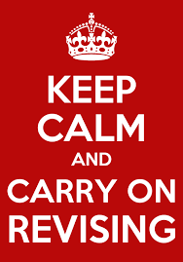

Slide 56
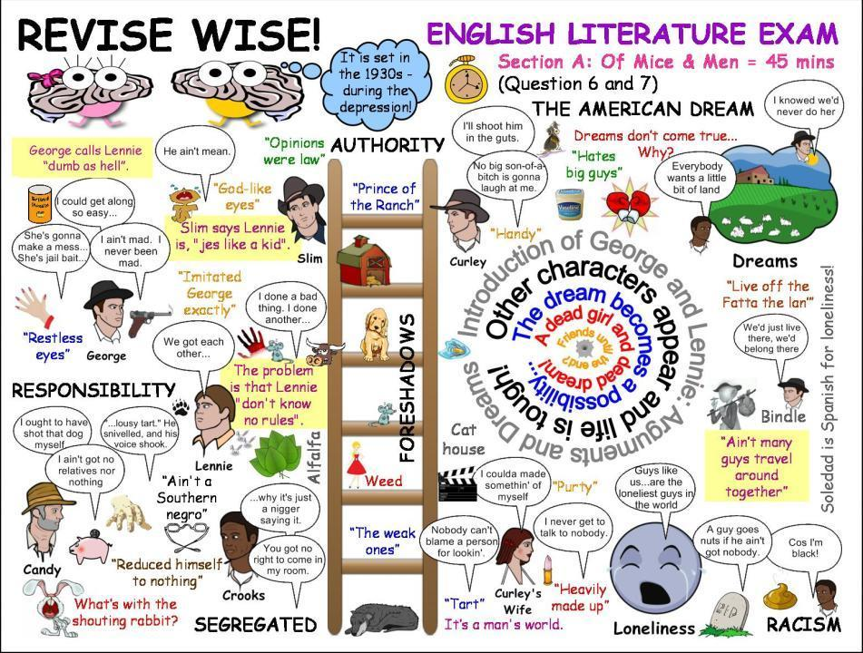

Slide 57
Revision processes: learning payoff:
high, medium or low?
4 Practising writing out full essay-answers.
5 Making essay-plans for essay-question possibilities.
6 Practising writing out answers to old exam questions.

Slide 58
Revision processes: learning payoff:
high, medium or low?
7 Working out hundreds of short sharp questions of your own, and practising writing out answers to these.
8 Practising speaking the answers to past questions, and to short, sharp questions that you have written for yourself.

Slide 59
Revision processes: learning payoff:
high, medium or low?
9 Practising thinking through how you would answer questions.
10 Practising solving problems.
11 Getting fellow-students to quiz you, and quizzing them.

Slide 60
All eleven: which is the best?
Reading your notes, books and articles over and over again.
Making summaries of your source materials as you read them.
Writing important things out over and over again.
Practising writing out full essay-answers.
Making essay-plans for essay-question possibilities.
Practising writing out answers to old exam questions.
Working out hundreds of short sharp questions of your own, and practising writing out answers to these.
Practising speaking the answers to past questions, and to short, sharp questions that you have written for yourself.
Practising thinking through how you would answer questions.
Practising solving problems.
Getting fellow-students to quiz you, and quizzing them.

Slide 61
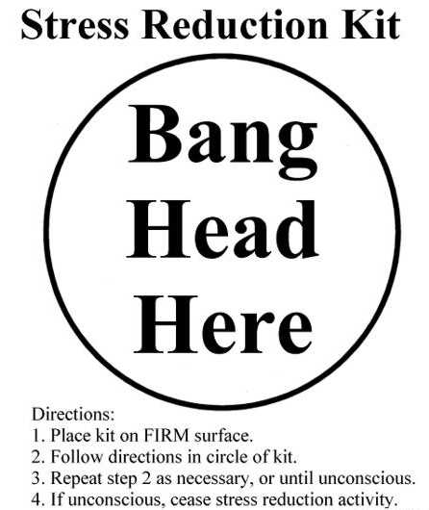
Stress reduction:

Slide 62
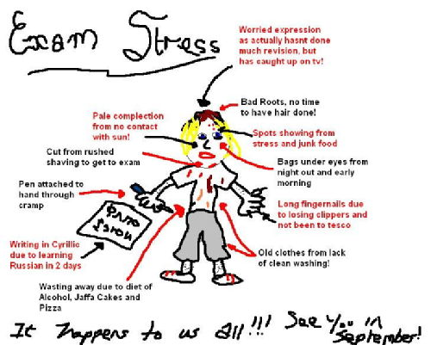
Exam stress affects different people in different ways

Slide 63
Make your own question bank
Imagine how pleased you’d feel if you could have a list, weeks in advance, of all the possible exam questions you needed to prepare to be able to answer. You can have exactly this!
You can make just such a list for yourself. Making – and using – such a list of questions can be the key to effective, efficient revision. This in turn leads to good exam results, and everything which follows on from that.
But what’s a ‘question bank’ and how can you make one? The following tips explain more.

Slide 64
Some tips on question banks
(Many more on http://phil-race.co.uk)
If you know all of the questions, you’re well on the way to being able to give all of the answers.
What sort of questions? The questions which are most useful as part of your question bank are the short, sharp ones. Most of these questions will be one-liners – sometimes containing only a few words each.
Keep asking yourself ‘what am I reasonably expected to become able to do with this?’.
What’s a question word or phrase? These almost all have a word containing ‘w’ in them. Such words and phrases include ‘Why…?’ ‘What…?’, ‘Where…?’, ‘Who…?’, ‘How…?’ ‘When…?’.

Slide 65
Questions such as...
What is ….?
Why does …. happen?
Who discovered ….?
How does …. work?
When do you need …?
Where do you find …?
If you know the answers to all the ‘w’ questions, you know it all.

Slide 66
Exam Technique timing and tricks
It’s not too late to improve it!

Slide 67
The main stages...
Before your exam
At the start
Writing your answers
Towards the end
After an exam
For more detailed suggestions, please download from http://phil-race.co.uk/preparing-for-and-doing-exams-18th-may/

Slide 68
A great exam answer is something else

Slide 69
Writing great exam answers the most important ten things to address
Why?
What?
Who?
Where?
When?
How?
Which?
So what?
Wow?
And the most powerful four-letter word in the English language...
????

Slide 70
‘what’ is getting ever less important
Columbia University research published recently (2011) in Science magazine shows that people are much less prepared to remember ‘what’, but better at remembering where to access information, and how to do so.
Betsy Sparrow, one of the principal researchers, concludes that the internet has become ‘an external memory source that we can access at any time. ... Just as we learn through transactive memory who knows what in our families and offices, we are learning what the computer ‘knows’ and when we should attend to where we have stored information in our computer-based memories. We are becoming symbiotic with our computer tools.
Published Online July 14 2011 < Science Express Index Science DOI: 10.1126/science.1207745
Report: Google Effects on Memory: Cognitive Consequences of Having Information at Our Fingertips Betsy Sparrow,*, Jenny Liu, Daniel M. Wegner

Slide 71
Writing great exam answers
the most important ten things to address
Why? (rationale)
What? (content)
Who? (people, you, me, them)
Where? (locations)
When? (times)
How? (processes)
Which? (decisions)
So what? (importance?)
Wow? (impact?)
And the most powerful four-letter word in the English language...
????

Slide 72
Before your exam...
Don’t revise too hard.
Get things together.
Don’t talk about it.
Get there early.

Slide 73
The first few minutes
Read the instructions.
Don’t start yet!
Plan your time.
Plan some time for editing.
Work out which questions to do.

Slide 74
Writing your answers
Stick to time (within reason)
Plan your answers first
Show all calculations
Look again and again and again at the question!
If stuck, move on to something else for a while

Slide 75
Getting started: lay an egg...
Draw an egg in the middle of a blank sheet of paper.
Write in the egg keywords of the topic or draft title that you’re going to be writing about.
Start brainstorming ideas and questions.

Slide 76
Getting started: lay an egg...
1
6
4
7
X-1
Title
keywords
X
3
2
5

Slide 77
Editing - gaining more marks
Read through everything you’ve written…
Adding things you’ve remembered since…
Correcting mistakes you notice…
Tidying up your script.

Slide 78
After an exam...
What do you normally do?
Don’t do a post-mortem - the exam is quite dead.
Do a little gentle revision for your next exam.
Flush out the old knowledge, and replace it with what you need next.

Slide 79
Action planning statements
One thing I’m going to do is…
One idea I’m taking away is…
I’m going to think more about…
I have found out that …
I’d like to know …
In future, I’m not going to…
Friday, 19 June 2015

Slide 80
Back to our intended outcomes…
Do you now feel enabled to…
two hands = very much better,
one hand = somewhat better,
no hands = no better
Work smarter towards passing your exams well.
Get better marks!
Have a better life.

Slide 81
Thank you…
http://phil-race.co.uk/
Follow Phil on Twitter
@RacePhil
e-mail:
phil@phil-race.co.uk

