Slide 1
Four key literacies students need, to succeed in higher education (Based on Sally Brown, 2015)
Academic literacy: getting their heads around how higher education works;
Information literacy: achieving skills regarding how to locate and, most importantly, select information, and then make good use of it;
Assessment literacy: becoming able to address how assessment systems work in higher education;
Social literacy: gaining the ability to apply emotional intelligence to work effectively with others.

Slide 2
Academic literacy: getting their heads around how higher education works includes recognising:
What comprises poor academic conduct;
What plagiarism looks like and how to avoid it;
What extenuating circumstances comprise, and when and how to apply for late submission of work;
When to use third person or first person, active or passive voice, register, tone and vocabulary, when writing for academic purposes;
How to balance reading for deep thinking, reading for information, skim reading and seeking quotes to back up arguments when reading for academic purposes.

Slide 3
Information literacy includes the capacity to:
Reference texts and other sources appropriately;
Select from the vast number of sources available;
Take into account how the quality of information can be assured;
Use trusted web systems (e.g. Google Scholar rather than just Google, and question the trustworthiness of Wikipedia, or the value of personal postings on websites);
Take into account the importance of peer review i.e. what differentiates a peer-reviewed journal article from, for example, a vanity publication.

Slide 4
Assessment literacy: students do better if they can:
Make sense of key terms such as criteria, weightings, and level;
Handle a variety of assessment methods (e.g. presentations, portfolios, posters, assessed web participation, practicals, vivas etc) and get practice in using them;
Be wisely strategic in their behaviours, putting more work into aspects of an assignment with high weightings, interrogating criteria to find out what is really required and so on;
Gain clarity on how the assessment regulations work in their University.

Slide 5
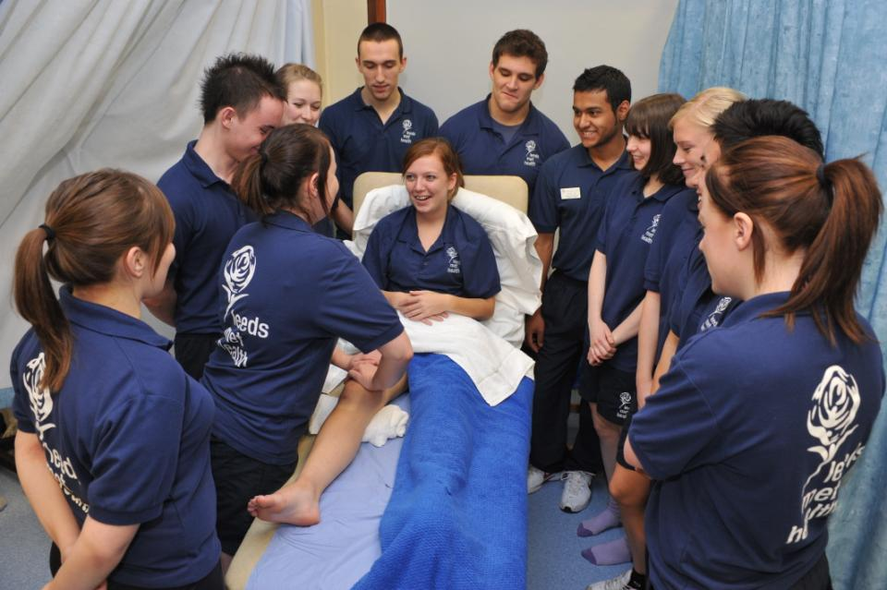
Authentic assessment helps learning

Slide 6
Social literacy can help students to:
Relate better to each other, and other people in general;
Employ empathy to achieve the ends they are seeking;
Notice and use non-verbal cues from others;
Productively consider how their own non-verbal cues are being perceived;
Accept, express and regulate their own of emotions.

