Slide 1
Fifteen ideas for re-inventing assessment
Institute of Technology, Blanchardstown
Friday January 20th 2017
Phil Race
(from Newcastle-upon-Tyne)
BSc PhD PGCE FCIPD PFHEA NTF
Follow Phil on Twitter: @RacePhil
Visiting Professor: University of Plymouth and University of Suffolk
Emeritus Professor, Leeds Beckett University and University of South Wales

Slide 2
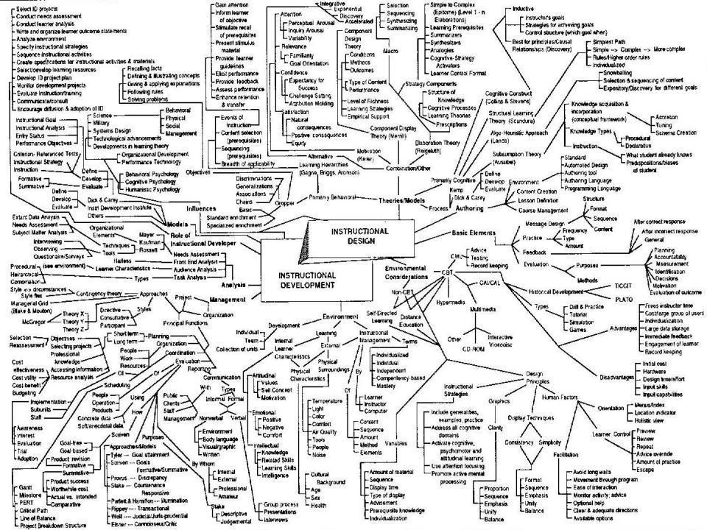
This slide has two purposes….
To focus the data projector, if necessary, and…
...to persuade colleagues never to put this sort of detail onto a slide!

Slide 3
About Phil…
First a musician
Then a writer
Then a scientist
Then a researcher
Then a lecturer and warden at what is now USW
Got interested in how students learn
And the effects assessment and feedback have on them
And how we teach them
Gradually became an educational developer
And now ‘retired’!?
Currently…
Visiting Prof: Plymouth
Emeritus Prof: Leeds Beckett
Based at Newcastle, UK
And on trains
And an expert…
on train routes and timetables!
Notes:
2
2

Slide 4
Intended learning outcomes
After participating in this workshop you should be better able to:
Make life better – for you and for students – by making assessment more manageable!
Explore 15 ideas for making assessment and feedback work better for students and for us.

Slide 5
Downloadable resource materials
Expanded discussion of many aspects of today’s ideas can be found at:
http://phil-race.co.uk/2016/10/feedback-digest-lthechat65/ (Most of the stuff on feedback from my latest two books!)
http://phil-race.co.uk/2016/10/lthe-tweetchat-lthechat-wed-oct-19-8-00-9-00-pm/
http://phil-race.co.uk/2015/01/assessment-bits-new-editions/ (Most of the stuff on assessment from my latest two books!)

Slide 6
Announcement about mobile phones and laptops...
Good morning everyone – please turn on your ‘phones and computers.
Please post your thoughts, comments and ideas to the hashtag #philatblanchardstown1 Thanks!
Try #LTHEchat on Wednesday evenings from 20.00-21.00.

Slide 7
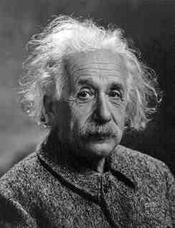
Albert Einstein
“It is simply madness to keep doing the same thing, and expect different results”

Slide 8
Teaching – and research – and reflection: the ten most important words
Why?
What?
Who?
Where?
When?
How?
Which?
So what?
Wow?
And the most powerful four-letter word in the English language...
????

Slide 9
‘what’ is getting ever less important
Columbia University research published recently (2011) in Science magazine shows that people are much less prepared to remember ‘what’, but better at remembering where to access information, and how to do so.
Betsy Sparrow, one of the principal researchers, concludes that the internet has become ‘an external memory source that we can access at any time. ... Just as we learn through transactive memory who knows what in our families and offices, we are learning what the computer ‘knows’ and when we should attend to where we have stored information in our computer-based memories. We are becoming symbiotic with our computer tools.
Published Online July 14 2011 < Science Express Index Science DOI: 10.1126/science.1207745
Report: Google Effects on Memory: Cognitive Consequences of Having Information at Our Fingertips Betsy Sparrow,*, Jenny Liu, Daniel M. Wegner

Slide 10
Teaching – and research – and reflection:
the ten most important words
Why? (rationale)
What? (content)
Who? (people, you, me, them)
Where? (locations)
When? (times)
How? (processes)
Which? (decisions)
So what? (importance?)
Wow? (impact?)
And the most powerful four-letter word in the English language...
????

Slide 11
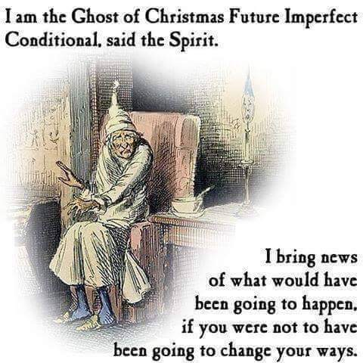

Slide 12
Fifteen ideas for making assessment and feedback more effective, efficient and manageable for us, and for students
Phil Race
(from Newcastle-upon-Tyne)
BSc PhD PGCE FCIPD PFHEA NTF
Follow Phil on Twitter: @RacePhil
Visiting Professor: University of Plymouth and University of Suffolk
Emeritus Professor, Leeds Beckett University and University of South Wales

Slide 13
Why re-invent assessment and feedback now?
They take far too much of our time and energy. Staff are burning themselves out trying to apply old assessment and feedback methods to much larger cohorts of students.
Assessment and feedback are vitally important to students.
Feedback from students continues to show their relative dissatisfaction with assessment and feedback.
Assessment and feedback contribute strongly to the NSS, and likely also the forthcoming TEF.
It is madness just to keep trying to do the same things better – we need to try something else.

Slide 14
Fifteen ideas for making assessment and feedback more effective, efficient and manageable for us, and for students
Design much shorter assessments.
Increase formative assessment and reduce summative assessment.
Don’t just use essays.
Make more use of oral feedback rather than written feedback.
Speed up feedback so students still care about it when they receive it.
Get students giving feedback to each other, and sharing feedback.
Let students right into the meaning of assessment criteria, by explaining and illustrating these in whole-group contexts such as lectures.
Show students a range of evidence of achievement.
Get students themselves formulating evidence of achievement.
Get students themselves designing and applying assessment criteria.
Make the most of feedback to students in small-group contexts, such as tutorials.
Use statement banks to speed up formulating useful feedback.
Get students self-assessing, and give them feedback on their self-assessment.
Try to avoid ‘final language’ in feedback.
Always make assignment design a team effort.

Slide 15
Fifteen ideas for making assessment and feedback more effective, efficient and manageable for us, and for students
Design much shorter assessments.
Increase formative assessment and reduce summative assessment.
Don’t just use essays.
Make more use of oral feedback rather than written feedback.
Speed up feedback so students still care about it when they receive it.
Get students giving feedback to each other, and sharing feedback.
Let students right into the meaning of assessment criteria, by explaining and illustrating these in whole-group contexts such as lectures.

Slide 16
Fifteen ideas for making assessment and feedback more effective, efficient and manageable for us, and for students
Show students a range of evidence of achievement.
Get students themselves formulating evidence of achievement.
Get students themselves designing and applying assessment criteria.
Make the most of feedback to students in small-group contexts, such as tutorials.
Use statement banks to speed up formulating useful feedback.
Get students self-assessing, and give them feedback on their self-assessment.
Try to avoid ‘final language’ in feedback.
Always make assignment design a team effort.

Slide 17
A Design much shorter assessments
(e.g. a 300-word annotated bibliography instead of a 3000-word essay).
We tend to keep using long assessments, because that’s what we’ve always done. As a result, we spend ages marking, and too little time assessing.
Students learn to ‘waffle’ with long assessments. A short assessment can be harder, and more intense. And we achieve better discrimination between best and worst.
Shorter assessments are much, much faster to assess.

Slide 18
B Increase formative assessment and reduce summative assessment
We know that students learn little or nothing from feedback on summative assessments.
Some don’t even collect their marked work.
Students often don’t learn from feedback on supposedly-formative assessments, as they’ve already moved on to the next task.
Formative assessment can be a great learning experience. Students’ final results can benefit enormously from formative feedback.

Slide 19
C Don’t just use essays
Essays take ages to write, and ages to mark. And we may not know who wrote them! http://phil-race.co.uk/whodunit/
Essays can be fine for giving students feedback, but not for assessment!
Research shows we’re not at all good at assessing essays. Yet the mark or grade becomes much more important to students than the feedback.
Marking can degenerate into copy-editing rather than assessing.
Students are well aware whenever assessment is at all unfair.

Slide 20
D Make more use of oral feedback rather than written feedback
Face-to-face feedback can make good use of tone of voice, encouraging facial gestures, speed of speech, repetition where needed, body language, and so on.
Students in large groups can learn from oral feedback on other students’ triumphs and disasters (with due anonymity).
Even one-to-one, oral feedback can be much more powerful than written.
Oral feedback can be retained and reviewed if ‘packaged up’ in podcasts or audio files.

Slide 21
E Speed up feedback so students still care about it when they receive it
We’ve become preoccupied with the turn-around time for a batch of work for large groups of students.
A lot of feedback can be given at the moment the work is submitted, before marking has even begun.
Immediate feedback means that students still remember what they did – and what they had problems with.
Ideally, give feedback within 24 hours of students doing the work?

Slide 22
F Get students giving feedback to each other, and sharing feedback
Students learn a great deal from the process of explaining things to someone else.
It’s often easier to learn from someone who has just mastered a concept than from someone who can’t remember the difficulties learning it.
Students can benefit from much more feedback than we could give them.
Students can learn much more from our feedback to their friends, than our feedback on their own work.

Slide 23
G Let students right into the meaning of assessment criteria, by explaining and illustrating these in whole-group contexts such as lectures
There should be no hidden agendas. Talk assessment every time you see whole groups of students.
Try to avoid talking assessment to individual students seeking to ‘get ahead’.
Make it clear how assessment criteria link to evidence of achievement of published learning outcomes.
Give students safe practice at evidencing their achievement of assessment criteria.

Slide 24
H Show students a range of evidence of achievement
Don’t just show students exemplars of ‘excellent work’.
Let them see what can easily go wrong, and can lose them marks.
When students are aware of a range between ‘excellent’ and ‘poor’, they can strive to be even better than excellent.
The tendency to simply imitate excellent work is diminished.
(See the work of Royce Sadler)

Slide 25
I Get students themselves formulating evidence of achievement
When students have a feeling of ownership of their targets, they put much more into achieving the targets.
When students formulate ‘good’ evidence, we can praise their choices.
When students formulate ‘poor’ evidence, we can point them in a better direction.
We can adopt their targets, when they are better than the ones we first thought of!

Slide 26
J Get students themselves designing and applying assessment criteria
Learning by assessing – making informed judgements’ – is one of the deepest forms of learning.
We can easily give students relevant things to assess in class time, and benefit from dialogue.
Students can often think of better assessment criteria than the ones we first thought of ourselves.
Applying assessment criteria helps students to internalise how to achieve them in their own work.

Slide 27
K Make the most of feedback to students in small-group contexts, such as tutorials
This can be less threatening than one-to-one feedback, especially critical feedback, and can be much more manageable for us.
Let students hear feedback on work that is better than theirs (retaining anonymity).
Let students hear feedback on other students’ disasters (retaining anonymity).
Allow students to see ‘where they’re at’ compared to others in the cohort.

Slide 28
L Use statement banks to speed up formulating useful feedback
Especially with online feedback, compile a bank of useful feedback statements.
Make sure that there are sufficient ‘praise’ comments, to counterbalance critical ones.
Get students themselves to compose statements, so that they get a sharper idea of what is wanted in their work.
Make sure that the feedback that different students receive is sufficiently different and personal, rather than just ‘out of the box’.

Slide 29
M Get students self-assessing, and give them feedback on their self-assessment.
Turn self-assessment into a productive dialogue with us.
Ask students what mark or grade they believe the work should be earning.
Ask students what they think they did best, and praise them when indeed they did do this well.
Ask students what they found the hardest part of the task, and praise them when they succeeded, and empathise when they didn’t.
Ask students what they might change if they had another hour to do the task.

Slide 30
N Try to avoid ‘final language’ in feedback
‘Final language’ includes words such as ‘excellent’, ‘good’, ‘poor’, ‘adequate’, ‘satisfactory’, and so on.
It is better to say things such as:
  ‘I really like how you approached so-and-so’
  ‘It might have helped if you’d done such-and such’
  ‘One thing you did really well was so-and-so’
  ‘You probably know that such-and-such didn’t really work’

Slide 31
O Always make assessment design a team effort
It doesn't make sense to do this alone without running your ideas past a colleague, quality assurer, student or all three.
This can help avoid the biggest pitfalls around assuring manageability, authenticity, relevance and validity.
Students can be particularly useful sounding boards to ensure that what you are asking students to do is clear and readily understandable.
You won't get into glitches around university systems and regulations if you talk things through in advance with a Faculty manager or registrar.

Slide 32
Fifteen ideas for making assessment and feedback more effective, efficient and manageable for us, and for students
Design much shorter assessments.
Increase formative assessment and reduce summative assessment.
Don’t just use essays.
Make more use of oral feedback rather than written feedback.
Speed up feedback so students still care about it when they receive it.
Get students giving feedback to each other, and sharing feedback.
Let students right into the meaning of assessment criteria, by explaining and illustrating these in whole-group contexts such as lectures.
Show students a range of evidence of achievement.
Get students themselves formulating evidence of achievement.
Get students themselves designing and applying assessment criteria.
Make the most of feedback to students in small-group contexts, such as tutorials.
Use statement banks to speed up formulating useful feedback.
Get students self-assessing, and give them feedback on their self-assessment.
Try to avoid ‘final language’ in feedback.
Always make assignment design a team effort.

Slide 33
Post-it ‘Diamond 9’ prioritisation
In your group, please write the letters ‘A’ to ‘O’ on fifteen post-its, and discuss the relative pros and cons for each in your own practice, and as a group, arrange the top 9 in a ‘diamond 9’ pattern.
At any point, insert one better choice, and place it in order among your top 9.
Be ready to justify your top choices to the rest of us.

Slide 34
Pick the best 9 ideas:
Diamond 9
best
next best
3
4
5
6
7
8
9

Slide 35
Back to our intended learning outcomes…
Do you now feel better able to:
2 hands = very much better,
one hand = somewhat better,
touch left ear = no better...
Make life better – for you and for students – by making assessment more manageable!
Explore 15 ideas for making assessment and feedback work better for students and for us.
Wanting/
Needing
Doing
Making sense
Feedback

Slide 36
Useful references: 1
Assessment Reform Group (1999) Assessment for Learning : Beyond the black box, Cambridge UK, University of Cambridge School of Education.
Biggs, J. and Tang, C. (2007) Teaching for Quality Learning at University, Maidenhead: Open University Press.
Bloxham, S. and Boyd, P. (2007) Developing effective assessment in higher education: a practical guide, Maidenhead, Open University Press.
Brown, S. Rust, C. & Gibbs, G. (1994) Strategies for Diversifying Assessment, Oxford: Oxford Centre for Staff Development.
Boud, D. (1995) Enhancing learning through self-assessment, London: Routledge.
Boud, D. and Associates (2010) Assessment 2020: seven propositions for assessment reform in higher education Sydney: Australian Learning and Teaching Council.
Brown, S. and Glasner, A. (eds.) (1999) Assessment Matters in Higher Education, Choosing and Using Diverse Approaches, Maidenhead: Open University Press.
Brown, S. and Knight, P. (1994) Assessing Learners in Higher Education, London: Kogan Page.

Slide 37
Useful references: 2
Brown, S. and Race, P. (2012) Using effective assessment to promote learning in Hunt, L. and Chambers, D. (2012) University Teaching in Focus, Victoria, Australia, Acer Press. P74-91
Brown, S. (2015) Learning, teaching and assessment in higher education: global perspectives, London: Palgrave-MacMillan.
Carless, D., Joughin, G., Ngar-Fun Liu et al (2006) How Assessment supports learning: Learning orientated assessment in action Hong Kong: Hong Kong University Press.
Carroll, J. and Ryan, J. (2005) Teaching International students: improving learning for all. London: Routledge SEDA series.
Crosling, G., Thomas, L. and Heagney, M. (2008) Improving student retention in Higher Education, London and New York: Routledge
Crooks, T. (1988) Assessing student performance, HERDSA Green Guide No 8 HERDSA (reprinted 1994).
Falchikov, N. (2004) Improving Assessment through Student Involvement: Practical Solutions for Aiding Learning in Higher and Further Education, London: Routledge.

Slide 38
Useful references: 3
Gibbs, G. (1999) Using assessment strategically to change the way students learn, in Brown S. & Glasner, A. (eds.), Assessment Matters in Higher Education: Choosing and Using Diverse Approaches, Maidenhead: SRHE/Open University Press.
Higher Education Academy (2012) A marked improvement; transforming assessment in higher education, York: HEA.
Hounsell, D. (2008). The trouble with feedback: New challenges, emerging strategies, Interchange, Spring, Accessed at www.tla.ed.ac.uk/interchange.
Knight, P. and Yorke, M. (2003) Assessment, learning and employability Maidenhead, UK: SRHE/Open University Press.
Mentkowski, M. and associates (2000) p.82 Learning that lasts: integrating learning development and performance in college and beyond, San Francisco: Jossey-Bass.
McDowell, L. and Brown, S. (1998) Assessing students: cheating and plagiarism, Newcastle: Red Guide 10/11 University of Northumbria.

Slide 39
Useful references: 4
Nicol, D. J. and Macfarlane-Dick, D. (2006) Formative assessment and self-regulated learning: A model and seven principles of good feedback practice, Studies in Higher Education Vol 31(2), 199-218.
NUS (2010) NUS Charter on Assessment and Feedback, http://www.nusconnect.org.uk/asset/news/6010/FeedbackCharter-toview.pdf).
PASS project Bradford http://www.pass.brad.ac.uk/ Accessed November 2013
Pickford, R. and Brown, S. (2006) Assessing skills and practice, London: Routledge.
QAA (2013) UK Quality Code for Higher Education: Part B: Assuring and enhancing academic quality, accessed at www.qaa.ac.uk (June 2014)
Race, P. (2001) A Briefing on Self, Peer & Group Assessment, in LTSN Generic Centre Assessment Series No 9, LTSN York.
Race, P. (2015) The lecturer’s toolkit (4th edition), London: Routledge.
Ryan, J. (2000) A Guide to Teaching International Students, Oxford Centre for Staff and Learning Development

Slide 40
Useful references: 5
Rust, C., Price, M. and O’Donovan, B. (2003) Improving students’ learning by developing their understanding of assessment criteria and processes, Assessment and Evaluation in Higher Education. 28 (2), 147-164.
Stefani, L. and Carroll, J. (2001) A Briefing on Plagiarism http://www.ltsn.ac.uk/application.asp?app=resources.asp&process=full_record&section=generic&id=10
Sadler, D. R. (2010a). Beyond feedback: Developing student capability in complex appraisal. Assessment & Evaluation in Higher Education, 35(5), 535-550.
Sadler, D. R. (2010b) Fidelity as a precondition for integrity in grading academic achievement. Assessment and Evaluation in Higher Education, 35, 727‑743.
Sadler, D. R. (2010c). Assessment in higher education. In P. Peterson, E. Baker, & B. McGaw (eds). International encyclopedia of education. Vol. 3, 249‑255. Oxford: Elsevier.
Sadler, D. R. (2013b). Opening up feedback: Teaching learners to see. In Merry, S., Price, M., Carless, D., & Taras, M. (Eds.) Reconceptualising feedback in higher education: Developing Yorke, M. (1999) Leaving Early: Undergraduate Non-completion in Higher Education, London: Routledge.

Slide 41
Thank you…
http://phil-race.co.uk
Follow Phil on Twitter
@RacePhil
e-mail:
phil@phil-race.co.uk

