Slide 1
Key factors ensuring assessment is integral to learning
29th March, 2017
Sally Brown and Phil Race

Slide 2
Ten things that really matter about assessment
1. SB: Assessment must be for not just of learning
2. PR: Constructive alignment must work in practice for students and for us
3. SB: Assessment must be fit for purpose and authentic
4. PR: Feedback must support the other factors underpinning learning
5. SB: Assessment must engage students in active tasks
6. PR: Assessment must be valid
7. SB: We need to rebalance formative and summative assessment
8. PR: Assessment must be fair (reliable)
9. SB: Good assessment practice can help retention and achievement
10. PR: Assessment must be manageable for us and for students

Slide 3
1. Assessment must be for not just of learning
Every assessment task must be productive rather than just reproductive: i.e. students must demonstrate how they use learning rather than just repeating it;
Assignments that model the kinds of activities that graduates will be undertaking in later life are more valuable than ones which focus on content;
If students are learning while they are actually undertaking the assessed task, this is a valuable use of their time;
Feedback must help students to improve next time and therefore become feedforward. (See HEA, 2012)

Slide 4
2. Constructive alignment must work in practice for students and for us
What will I be expected to show for this?
What does a good one look like, and a bad one?
Where does this fit into the big picture?
When explaining assessment criteria to students, and when linking these to evidence of achievement of the intended learning outcomes, we need to make the most of face-to-face whole group contexts and...
  Tone of voice
  Body language
  Facial expression
  Eye contact
  The chance to repeat things
  The chance to respond to puzzled looks
Some things don’t work nearly so well just on paper or on screens.
Constructive Alignment: John Biggs
Some of the
tools we can
use in
face-to-face
contexts

Slide 5
3. Assessment must be fit-for-purpose and authentic
Before designing any assessed activity we should ask:
What is the purpose of this activity (building confidence, checking understanding, assuring fitness for practice etc.);
What is it that we are assessing (product or process? Theory or application? What is easy to assess? What we’ve always assessed?
How are we assessing (methods e.g. exams, presentations, MCQs, portfolios see Brown and Race 2012) and approaches e.g. group assessment, CAA)?
Who is best placed to assess (tutors, selves, peers, practice managers employers)?
When should we be assessing (incrementally? end point?)?

Slide 6
Ripples on a pond….
Motivates students – helps them to want to learn;
Helps students to identify what they need to do next;
Helps students to take action to improve their learning;
Helps students to make sense of what they are learning;
Helps them to further make sense of their learning by engaging in real dialogue with tutors and peers;
Helps them to make informed judgements on their own work, and each others’ work:
Helps them to reflect on their past work in ways they can use to improve their future work.
4. Feedback must support the other factors underpinning learning
Verbalising
Assessing
making informed judgements
Wanting/
Needing
Doing
Doing
Making sense
Feedback

Slide 7
5. Assessment must engage students in active tasks, for example:
Studio critiques
Simulations
Multiple choice questions in class
Oral report (individual or group)
Business/Elevator pitches
Case studies
Annotated bibliographies
Executive summaries
Performances
Artefacts e.g. Paintings, sculptures, engineering drawings
Objective structured clinical exams (OSCEs)
Conference presentations
student-led and managed conferences
Action plans
Reports
Portfolios
Live projects
Final shows
In-tray exercises
Assessed placements
Field work notebooks
Lab books produced in real time
Short-answer questions
Reflective diaries
Logs
Vivas (live oral tests)
Storyboards
Critical incident accounts
Teaching packs
Group process tasks
Procedure manuals
Software designs
Presentations (individual or group)
Posters

Slide 8
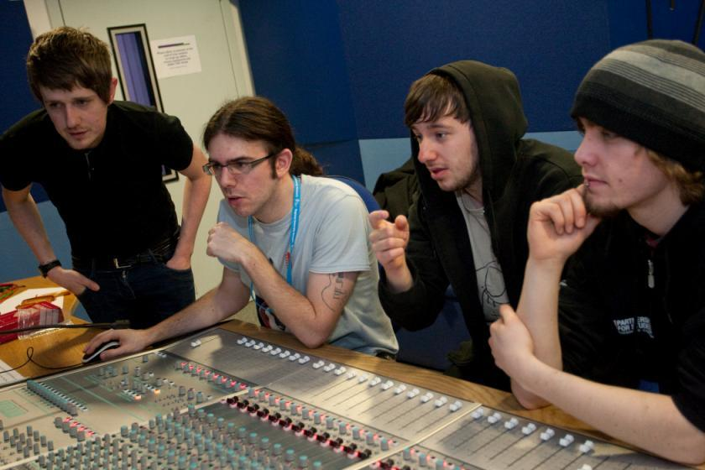
Are these students engaged?

Slide 9
6. Assessment must be valid
Are we measuring what we set out to measure?
Or are we measuring other things that are less important?
…such as what students can write about what they can remember about what they learned...
For example, most traditional time-constrained exams may be quite reliable, quite transparent, but not at all valid.
i.e. not really measuring in the most sensible possible way students’ achievement of the published intended learning outcomes.

Slide 10
7. We need to rebalance formative and summative assessment
The principal purpose of formative assessment is to form, inform, transform student behaviour: it tends to contain many words and is incremental;
Summative assessment is about summing up/judging performance and achievement, it tends to be end point and contain numbers and grades.
We often over-use summative and under-use formative assessment.

Slide 11
8. Assessment must be fair (reliable)
Are we getting away from ‘putting down the number we first thought of’?
Would double-marking reveal serious inconsistencies?
I mean, of course, blind anonymous double marking – but this is not always possible (not to mention not manageable).
Can we justify our marks or grades to students?

Slide 12
9. Good assessment practice can help retention and achievement
Students drop out if they don’t know how they are doing, if they feel overwhelmed by competing deadlines, if they can’t see the point of tasks, if they think cheating is condoned, if they don’t feel up to the task, if they don’t know what they are doing;
Assessment therefore needs to be fair, clear, developmental, informative, purposeful and building resilience (Dweck, 2000);
Students need clear briefings and opportunities to see what good work looks like, to practice before the summative event, to have the chance to ask questions without looking stupid and to get formative feedback.

Slide 13
10. Assessment must be manageable
Manageable for us, and manageable for students.
We don’t want to drive them (further) towards surface learning, nor do we want to diminish our reliability or validity.
In particular, the time spent on assessment needs to deliver rich harvests of feedback to students, which they use – feed-forward in particular.

Slide 14
Conclusions
Assessment that is integral to learning has a significant positive impact on the student experience in higher education.
We need to address how students really learn in designing assessment and feedback.
Designing good assessment and feedback is difficult, complicated, demanding and hugely worthwhile.

Slide 15
References
Brown, S. (2015) Learning, teaching and assessment in higher education: global perspectives, London:
Brown, S. and Race, P. (2012) Using effective assessment to promote learning, in Hunt, L and Chalmers, D. University Teaching in Focus: a learning-centred approach, Victoria, Australia, Acer Press, and Abingdon: Routledge.
Dweck, C. S. (2000) Self Theories: Their Role in Motivation, Personality and Development, Lillington, NC: Taylor & Francis.
HEA (2012) A Marked Improvement: transforming assessment in higher education, York: Higher Education Academy. (http://www.heacademy.ac.uk/assets/documents/assessment/A_Marked_Improvement.pdf

