Slide 1
Reinventing Assessment: Towards Assessment and Feedback as learning - exploring what the gurus say about assessment, and some ideas from Phil!
Robert Gordon University
May 3rd 2017
Phil Race
(from Newcastle-upon-Tyne)
BSc PhD PGCE FCIPD PFHEA NTF
Follow Phil on Twitter: @RacePhil
Visiting Professor: University of Plymouth and University of Suffolk
Emeritus Professor, Leeds Beckett University and University of South Wales

Slide 2
This slide has two purposes….
To focus the data projector, if necessary, and…
...to persuade colleagues never to put this sort of detail onto a slide!

Slide 3
Great to be back at RGU
I was offered a job here in 1981 – but couldn’t afford to move!
I was external examiner here for several years.
I’ve enjoyed several conferences in Aberdeen over the years.
I watched Sally give her first inaugural professorial lecture here.

Slide 4
About Phil…
First a musician
Then a writer
Then a scientist
Then a researcher
Then a lecturer and warden at what is now USW
Got interested in how students learn
And the effects assessment and feedback have on them
And how we teach them
Gradually became an educational developer
And now ‘retired’!?
Currently…
Visiting Prof: Plymouth
Emeritus Prof: Leeds Beckett
Based at Newcastle, UK
And on trains
And an expert…
on train routes and timetables!
Notes:
2
2

Slide 5
Thanks to students
I could not do what I do nowadays if I did not continue to spend a fair bit of my time working with students – they’ve taught me most of what I know.

Slide 6
Rationale
We spend a great deal of our time and energy trying to make assessment and feedback work well for students - how on earth could we do better?
Phil will summarise some key pointers from the literature on assessment and feedback, and propose some tactics for making both more effective, more efficient, better linked to learning – and (most important perhaps) more manageable.

Slide 7
Time to re-invent assessment and feedback?
Einstein suggested that ‘it is simply madness to keep doing the same things and expect different results’; it is therefore timely to explore how assessment and feedback can now be ‘reinvented’ to make all the processes more effective, efficient and manageable.

Slide 8
Themes and targets
This conference has great targets for making assessment and feedback work well.
Assessment literacy: the more students know about how it all works better, the more justice they can do to themselves.
Sustainable: among many things, this means ‘manageable’ – for us and for students.
Innovative: the conference will be full of new ideas, and thoughts about what’s wrong with some old ideas.
Inclusive: one problem is that in its own way, assessment always discriminates between students.

Slide 9
Outline programme
Introductory exercise: ‘Assessment and feedback would be much better for me if only I…’
‘What the gurus tell us’ about assessment and feedback in higher education.
Ideas and exercises on learning, student experience, assessment and feedback.
Prelude to workshop tomorrow?

Slide 10
Reference materials
Race, P. (2014) Making learning happen: 3rd edition, London: Sage.
Race, P. (2015) The Lecturer’s Toolkit: 4th edition, London: Routledge.
HEA (2012) A Marked Improvement: transforming assessment in higher education, York: Higher Education Academy.
Boud, D. and Associates (2010). Assessment 2020: Seven propositions for assessment reform in higher education, Sydney: Australian Learning and Teaching Council.

Slide 11
You will be able to download my main slides
You don’t need to take notes.
I’ll put the main slides up on my website by lunchtime tomorrow: (http://phil-race.co.uk/)
I won’t include pictures and video-clips, as this would make the file-size too large.
I may sometimes go through slides quite fast, but you can study them as you wish at your leisure.

Slide 12
Intended learning outcomes
After participating in this session you should be better able to:
Make life better – for you and for students – by making assessment and feedback more manageable!
Put assessment and feedback in context in the 2017 university sector (not forgetting NSS 2017 and TEF!).
Explore some ideas for making assessment and feedback work better for students, and for us.
Involve students more in their own assessment.

Slide 13
Task: agree, disagree, or don’t know
A week last Sunday, I tweeted…twote? (@RacePhil)
“word count = credit points: I can think of no idea more stupid, banal and counter-educative that this! Wordspinning for a degree? Rubbish!”
If you agree, please raise two hands
If you disagree, please raise one hand
If you don’t know, please scratch your head.
Please also make your views known by ‘liking’ or ‘retweeting’ the Tweet, or by replying to it.

Slide 14
Downloadable resource materials
Expanded discussion of many aspects of today’s ideas can be found at:
http://phil-race.co.uk/2016/10/feedback-digest-lthechat65/ (Most of the stuff on feedback from my latest two books!)
http://phil-race.co.uk/2016/10/lthe-tweetchat-lthechat-wed-oct-19-8-00-9-00-pm/
http://phil-race.co.uk/2015/01/assessment-bits-new-editions/ (Most of the stuff on assessment from my latest two books!)

Slide 15
Announcement about mobile phones and laptops...
Good morning everyone – please turn on your ‘phones and computers.
Please post your thoughts, comments and ideas to the conference hashtag #LTC17RGU Thanks!
Try #LTHEchat on Wednesday evenings from 20.00-21.00.

Slide 16
17 sources about assessment, feedback and learning in higher education
Knight, P. and Yorke, M. (2003) Assessment, learning and employability, Maidenhead, UK SRHE/Open University Press.
The TESTA project (http://www.testa.ac.uk/) Transforming the Experience of Students through Assessment, (Bath Spa, Chichester, Winchester and Worcester)
Flint, N. R. and Johnson, B. (2011) Towards fairer university assessment – recognising the concerns of students, London: Routledge.
ETC Toolkit (2015) (Enhancing the Curriculum) www.etctoolkit.org.uk
HEA (2012) A Marked Improvement: transforming assessment in higher education, York: Higher Education Academy (http://www.heacademy.ac.uk/assets/documents/assessment/A_Marked_Improvement.pdf )

Slide 17
17 sources about assessment, feedback and learning in higher education
Boud, D. and Associates (2010) Assessment 2020: seven propositions for assessment reform in higher education Sydney: Australian Learning and Teaching Council.
Carless, D. (2015) Excellence in University Assessment: Learning from award-winning practice, London: Routledge.
Race, P. (2014) Making learning happen: 3rd edition London: Sage. (lots of bits free on my website!)
Hunt, D. and Chalmers, L. (eds) (2012) University Teaching in Focus: a learning-centred approach Australia: ACER Press, and London: Routledge.
Price, M., Rust, C., O’Donovan, B. and Handley, K. (2012) Assessment Literacy, Oxford: the Oxford Centre for Staff and Learning Development (based on the ‘ASKe’ Project).
Evans, C. (2013) Making Sense of Assessment Feedback in Higher Education, Review of Educational Research Vol. 83, No. 1, pp. 70–120. http://journals.sagepub.com/doi/abs/10.3102/0034654312474350

Slide 18
17 sources about assessment, feedback and learning in higher education
Sambell, K., McDowell, L. and Montgomery, C. (2013) Assessment for Learning in Higher Education, London: Routledge.
Brown, S. (2015) Learning, teaching and assessment in higher education: global perspectives, Basingstoke: Palgrave-Macmillan.
Race, P. (2015) The Lecturer’s Toolkit: 4th edition, London, Routledge. (lots of bits free on my website!)
Parkin, D (2017) Leading Learning and Teaching in Higher Education – the key guide to designing and delivering courses, London: Routledge.
Lea, J. (ed.) (2015) Enhancing Learning And Teaching In Higher Education: Engaging With The Dimensions Of Practice, London, Open University Press.
Sambell, K, Brown, S and Graham, L (2017, Professionalism in Practice: Key directions in higher education: Learning, Teaching and Assessment, Basingstoke: Palgrave-Macmillan.

Slide 19
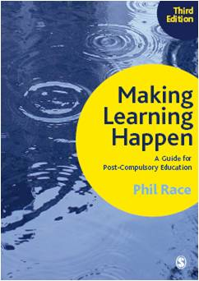
3rd edition
Phil Race
2014: Sage: London
Three short videos
(1) About making learning happen in general: http://tinyurl.com/l7yddya
(2) Five top tips for lecturers: http://tinyurl.com/nxhohe3
(3) On being an author, and the changes in the 3rd edition: http://tinyurl.com/oqfkkdc

Slide 20
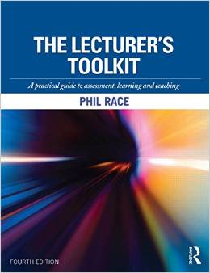
The Lecturer’s Toolkit
4th Edition
Phil Race
London: Routledge,
2015.

Slide 21
Post-it exercise
On a post-it, in your best handwriting, please write your own completion of the starter:
“making assessment and feedback work more effectively and efficiently for myself and my students would be much better if only I …”
Please swap post-its so that you’ve no idea who has yours.
If chosen, please read out with passion and drama the post-it you now have.
Please place them all on the chart as directed.

Slide 22
Boud et al 2010: ‘Assessment 2020’
Assessment has most effect when...:
It is used to engage students in learning that is productive.
Feedback is used to actively improve student learning.
Students and teachers become responsible partners in learning and assessment.
Students are inducted into the assessment practices and cultures of higher education.
Assessment for learning is placed at the centre of subject and program design.
Assessment for learning is a focus for staff and institutional development.
Assessment provides inclusive and trustworthy representation of student achievement.

Slide 23
Boud et al, 2010
David Boud (University of Technology, Sydney), Royce Sadler (Griffith University), Gordon Joughin (University of Wollongong), Richard James (University of Melbourne), Mark Freeman (University of Sydney), Sally Kift (Queensland University of Technology), Filip Dochy (University of Leuven), Dai Hounsell (University of Edinburgh), Margaret Price (Oxford Brookes University), Tom Angelo (La Trobe University), Angela Brew (Macquarie University), Ian Cameron (University of Queensland), Denise Chalmers (University of Western Australia), Paul Hager (University of Technology, Sydney), Kerri-Lee Harris (University of Melbourne), Claire Hughes (University of Queensland), Peter Hutchings (Australian Learning and Teaching Council), Kerri-Lee Krause (Griffith University), Duncan Nulty (Griffith University), Ron Oliver (Edith Cowan University), Jon Yorke (Curtin University), Iouri Belski (RMIT University), Ben Bradley (Charles Sturt University), Simone Buzwell (Swinburne University of Technology), Stuart Campbell (University of Western Sydney), Philip Candy (University of Southern Queensland), Peter Cherry (Central Queensland University), Rick Cummings (Murdoch University), Anne Cummins (Australian Catholic University), Elizabeth Deane (Australian National University), Marcia Devlin (Deakin University), Christine Ewan (Australian Learning and Teaching Council), Paul Gadek (James Cook University), Susan Hamilton (University of Queensland), Margaret Hicks (University of South Australia), Marnie Hughes-Warrington (Monash University), Gail Huon (University of Newcastle), Margot Kearns (University of Notre Dame, Sydney), Don Maconachie (University of the Sunshine Coast), Vi McLean (Queensland University of Technology,) Raoul Mortley (Bond University), Kylie O’Brien (Victoria University), Gary O’Donovan (University of Tasmania), Beverley Oliver (Curtin University), Simon Pyke (University of Adelaide), Heather Smigiel (Flinders University), Janet Taylor (Southern Cross University), Keith Trigwell (University of Sydney), Neil Trivett (University of Ballarat), Graham Webb (University of New England).

Slide 24
Evans, C. (2013) Making Sense of Assessment Feedback in Higher Education Review of Educational Research Vol. 83, No. 1, pp. 70–120
‘A fundamental requirement of HE is to facilitate high-quality feedback exchanges. However, there is much more we need to know about a host of contributory factors to allow us to develop such quality. In order for students to make the most of these feedback exchanges, we need to know more about the development of self- and co-regulation mechanisms and how best to promote student self-judgment skills (Boud & Lawson, 2011)’.
http://rer.sagepub.com/cgi/reprint/83/1/70?ijkey=x/CimNd6vjZWI&keytype=ref&siteid=sprer

Slide 25
A marked improvement: HEA, 2012
This publication was developed through collaborative working and writing involving a group of experts in the field of higher education (including 7 NTFs):
Dr Simon Ball (JISC TechDis),
Carolyn Bew (Higher Education Academy),
Professor Sue Bloxham NTF (University of Cumbria),
Professor Sally Brown NTF (Independent Consultant),
Dr Paul Kleiman (Higher Education Academy),
Dr Helen May (Higher Education Academy),
Professor Liz McDowell NTF (Northumbria University),
Dr Erica Morris (Higher Education Academy),
Professor Susan Orr NTF (Sheffield Hallam University),
Elaine Payne (Higher Education Academy),
Professor Margaret Price NTF (Oxford Brookes University),
Professor Chris Rust NTF (Oxford Brookes University),
Professor Brenda Smith (Independent Consultant)
Judith Waterfield NTF (Independent Consultant).

Slide 26
More formative, less summative
The change that has the greatest potential to improve student learning is a shift in the balance of summative and formative assessment. Summative assessment has important purposes in selection, certification and institutional accountability, but its dominance has distorted the potential of assessment to promote learning (assessment for learning). (HEA, 2012, p.9)

Slide 27
Marks get in the way
The imperatives of summative assessment necessarily limit the use of assessment methods that have demonstrable value for learning, such as feedback on drafts, group assessment, peer learning and work-based assessment. The need to provide a reliable, verifiable mark for each individual for each assignment can either limit the methods we use or create justifiable concerns about consistency and fairness in marking. (HEA 2012, p.9)

Slide 28
Now is the decade of Universities’ dis-content!
Never mind the content – feel the learning

Slide 29
Modern universities are moving away from being the guardians of content, (where everything was about ‘delivery’), towards foregrounding two major functions:
Recognising and accrediting achievement, wherever learning has taken place (i.e. getting the assessment right);
Supporting student learning and engagement (not least by making feedback work well for students).

Slide 30
The NSS Assessment and Feedback Agenda (2005-16)
The criteria used in marking have been clear in advance.
Assessment arrangements and marking have been fair.
Feedback on my work has been prompt.
I have received detailed comments on my work.
Feedback on my work has helped me to clarify things I did not understand.

Slide 31
The new NSS statements (2017)
Assessment and feedback
The criteria used in marking have been clear in advance
Marking and assessment have been fair
Feedback on my work has been timely
I have received helpful comments on my work
Student voice
I have had the right opportunities to provide feedback on my course
Staff value students’ views and opinions about the course
It is clear how students’ feedback on the course has been acted on

Slide 32
One of my main worries...
We still tend to try to measure...
...what’s in students’ heads, and what they can do with what’s there...
in terms of two unsatisfactory proxies ...
what comes out of students’ pens in exams;
2. what comes out of their keyboards in essays and reports.

Slide 33
The read-write industry

Slide 34
In the exam room you’re on your own

Slide 35
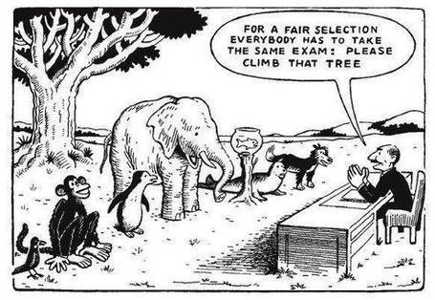

Slide 36
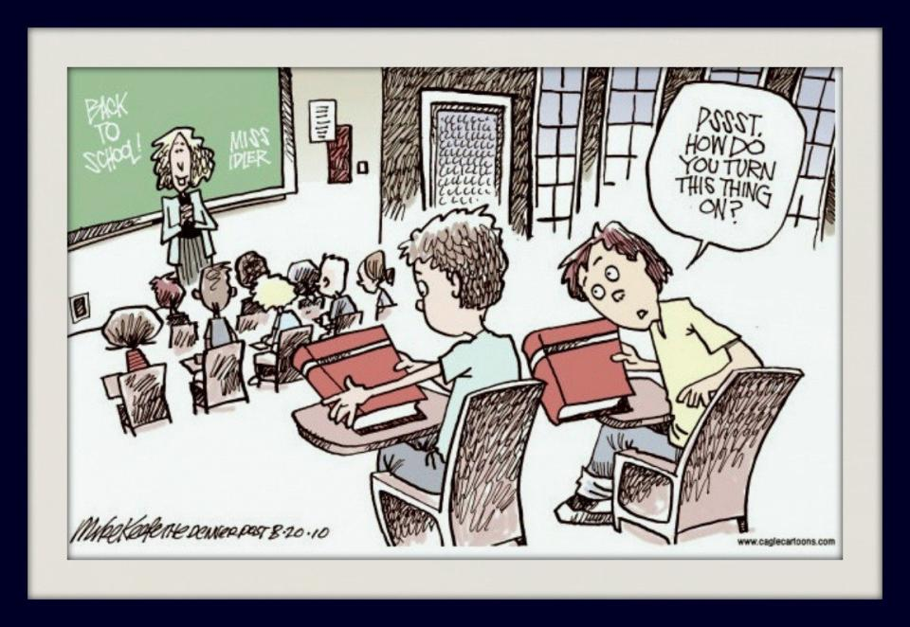

Slide 37
Drives most learning
Is assessment broken?
Some
assessment
issues
What students think
Assessment as learning
Validity
Whodunit?
Fairness

Slide 38
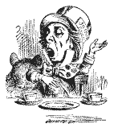
“[The] pupils got it all by heart; and, when Examination-time came, they wrote it down; and the Examiner said ‘Beautiful! What depth!’
They became teachers in their turn, and they said all these things over again; and their pupils wrote it down, and the examiner accepted it; and nobody had the ghost of an idea what it meant” Lewis Carroll, 1893
Active
Experimentation
Abstract
Conceptualisation
Concrete
Experience
Reflective
Observation

Slide 39
So now, it’s time to re-think:
How students really learn – and how we can help make learning happen for them;
How to make feedback really work for students;
How best to measure and accredit students’ achievement (not just more of the same old tired methods).

Slide 40
But what about learning styles?
https://www.theguardian.com/education/2017/mar/12/no-evidence-to-back-idea-of-learning-styles?CMP=share_btn_tw
(Link from my Tweet on March 13th to a letter in the Guardian by prominent folk around the world of education)
“No evidence to back idea of learning styles”

Slide 41
Constructive Alignment: John Biggs
What will I be expected to show for this?
What does a good one look like, and a bad one?
Where does this fit into the big picture?
When explaining assessment criteria to students, and when linking these to evidence of achievement of the intended learning outcomes, we need to make the most of face-to-face whole group contexts and...
Tone of voice
Body language
Facial expression
Eye contact
The chance to repeat things
The chance to respond to puzzled looks
Some things don’t work nearly so well just on paper or on screens.
Some of the
tools we can
use in
face-to-face
contexts

Slide 42
Teaching – and research – and reflection: the ten most important words
Why?
What?
Who?
Where?
When?
How?
Which?
So what?
(Wtf?)
Wow?
And the most powerful four-letter word in the English language...
????

Slide 43
‘what’ is getting ever less important
Columbia University research published recently (2011) in Science magazine shows that people are much less prepared to remember ‘what’, but better at remembering where to access information, and how to do so.
Betsy Sparrow, one of the principal researchers, concludes that the internet has become ‘an external memory source that we can access at any time. ... Just as we learn through transactive memory who knows what in our families and offices, we are learning what the computer ‘knows’ and when we should attend to where we have stored information in our computer-based memories. We are becoming symbiotic with our computer tools.
Published Online July 14 2011 < Science Express Index Science DOI: 10.1126/science.1207745
Report: Google Effects on Memory: Cognitive Consequences of Having Information at Our Fingertips Betsy Sparrow,*, Jenny Liu, Daniel M. Wegner

Slide 44
Teaching – and research – and reflection: the ten most important words
Why? (rationale)
What? (content)
Who? (people, you, me, them)
Where? (locations)
When? (times)
How? (processes)
Which? (decisions)
So what? (importance?)
Wow? (impact?)
And the most powerful four-letter word in the English language...
????

Slide 45
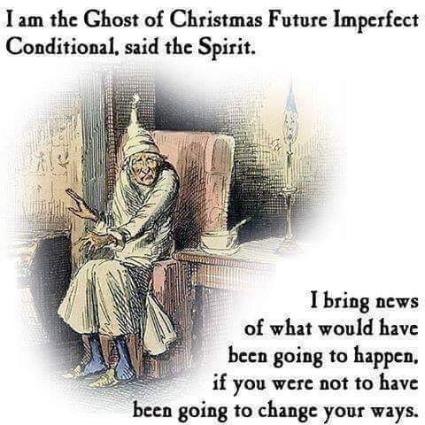

Slide 46
Making assessment manageable: we need to:
Ripples on a pond….
Verbalising
Strive to enhance our students’ want to learn;
Help students to develop ownership of the need to learn;
Keep students learning by doing, practice, trial-and-error, repetition;
Ensure students get quick and useful feedback – from us and from each other;
Help students to make sense of what they learn.
Get students deepening their learning by coaching other students, explaining things to them.
Allow students to further deepen their learning by assessing their own learning, and assessing others’ learning – making informed judgements.
Assessing
making informed judgements
Wanting/
Needing
Doing
Doing
Making sense
Feedback

Slide 47
The guru Royce Sadler
“The indispensable conditions for improvement are that the student comes to hold a concept of quality roughly similar to that held by the teacher, is able to monitor continuously the quality of what is being produced during the act of production itself, and has a repertoire of alternative moves or strategies from which to draw at any given point. In other words, students have to be able to judge the quality of what they are producing and be able to regulate what they are doing during the doing of it”. (Sadler 1989). (my italics)

Slide 48
Sadler, D. R. (2010). Beyond feedback: Developing student capability in complex appraisal. Assessment & Evaluation in Higher Education, 35(5), 535-550.
Students need to be exposed to, and gain experience in making judgements about a variety of works of different quality…They need planned rather than random exposure to exemplars, and experience in making judgements about quality. They need to create verbalised rationales and accounts of how various works could have been done better. ...

Slide 49
Sadler, D. R. (2010). Beyond feedback: Developing student capability in complex appraisal. Assessment & Evaluation in Higher Education, 35(5), 535-550.
Finally, they need to engage in evaluative conversations with teachers and other students. Together, these three provide the means by which students can develop a concept of quality that is similar in essence to that which the teacher possesses, and in particular to understand what makes for high quality (p. 544).

Slide 50
Back to our intended learning outcomes…
Do you now feel better able to:
2 hands = very much better,
one hand = somewhat better,
touch left ear = no better...
Make life better – for you and for students – by making assessment and feedback more manageable!
Put assessment and feedback in context in the 2017 university sector (not forgetting NSS 2017 and TEF!).
Explore some ideas for making assessment and feedback work better for students, and for us.
Involve students more in their own assessment.
Wanting/
Needing
Doing
Making sense
Feedback

Slide 51
Useful references: 1
Assessment Reform Group (1999) Assessment for Learning : Beyond the black box, Cambridge UK, University of Cambridge School of Education.
Biggs, J. and Tang, C. (2007) Teaching for Quality Learning at University, Maidenhead: Open University Press.
Bloxham, S. and Boyd, P. (2007) Developing effective assessment in higher education: a practical guide, Maidenhead, Open University Press.
Brown, S. Rust, C. & Gibbs, G. (1994) Strategies for Diversifying Assessment, Oxford: Oxford Centre for Staff Development.
Boud, D. (1995) Enhancing learning through self-assessment, London: Routledge.
Boud, D. and Associates (2010) Assessment 2020: seven propositions for assessment reform in higher education Sydney: Australian Learning and Teaching Council.
Brown, S. and Glasner, A. (eds.) (1999) Assessment Matters in Higher Education, Choosing and Using Diverse Approaches, Maidenhead: Open University Press.
Brown, S. and Knight, P. (1994) Assessing Learners in Higher Education, London: Kogan Page.

Slide 52
Useful references: 2
Brown, S. and Race, P. (2012) Using effective assessment to promote learning in Hunt, L. and Chambers, D. (2012) University Teaching in Focus, Victoria, Australia, Acer Press. P74-91
Brown, S. (2015) Learning, teaching and assessment in higher education: global perspectives, London: Palgrave-MacMillan.
Carless, D., Joughin, G., Ngar-Fun Liu et al (2006) How Assessment supports learning: Learning orientated assessment in action Hong Kong: Hong Kong University Press.
Carroll, J. and Ryan, J. (2005) Teaching International students: improving learning for all. London: Routledge SEDA series.
Crosling, G., Thomas, L. and Heagney, M. (2008) Improving student retention in Higher Education, London and New York: Routledge
Crooks, T. (1988) Assessing student performance, HERDSA Green Guide No 8 HERDSA (reprinted 1994).
Falchikov, N. (2004) Improving Assessment through Student Involvement: Practical Solutions for Aiding Learning in Higher and Further Education, London: Routledge.

Slide 53
Useful references: 3
Gibbs, G. (1999) Using assessment strategically to change the way students learn, in Brown S. & Glasner, A. (eds.), Assessment Matters in Higher Education: Choosing and Using Diverse Approaches, Maidenhead: SRHE/Open University Press.
Higher Education Academy (2012) A marked improvement; transforming assessment in higher education, York: HEA.
Hounsell, D. (2008). The trouble with feedback: New challenges, emerging strategies, Interchange, Spring, Accessed at www.tla.ed.ac.uk/interchange.
Knight, P. and Yorke, M. (2003) Assessment, learning and employability Maidenhead, UK: SRHE/Open University Press.
Mentkowski, M. and associates (2000) p.82 Learning that lasts: integrating learning development and performance in college and beyond, San Francisco: Jossey-Bass.
McDowell, L. and Brown, S. (1998) Assessing students: cheating and plagiarism, Newcastle: Red Guide 10/11 University of Northumbria.

Slide 54
Useful references: 4
Nicol, D. J. and Macfarlane-Dick, D. (2006) Formative assessment and self-regulated learning: A model and seven principles of good feedback practice, Studies in Higher Education Vol 31(2), 199-218.
NUS (2010) NUS Charter on Assessment and Feedback, http://www.nusconnect.org.uk/asset/news/6010/FeedbackCharter-toview.pdf).
PASS project Bradford http://www.pass.brad.ac.uk/ Accessed November 2013
Pickford, R. and Brown, S. (2006) Assessing skills and practice, London: Routledge.
QAA (2013) UK Quality Code for Higher Education: Part B: Assuring and enhancing academic quality, accessed at www.qaa.ac.uk (June 2014)
Race, P. (2001) A Briefing on Self, Peer & Group Assessment, in LTSN Generic Centre Assessment Series No 9, LTSN York.
Race, P. (2015) The lecturer’s toolkit (4th edition), London: Routledge.
Ryan, J. (2000) A Guide to Teaching International Students, Oxford Centre for Staff and Learning Development

Slide 55
Useful references: 5
Rust, C., Price, M. and O’Donovan, B. (2003) Improving students’ learning by developing their understanding of assessment criteria and processes, Assessment and Evaluation in Higher Education. 28 (2), 147-164.
Stefani, L. and Carroll, J. (2001) A Briefing on Plagiarism http://www.ltsn.ac.uk/application.asp?app=resources.asp&process=full_record&section=generic&id=10
Sadler, D. R. (2010a). Beyond feedback: Developing student capability in complex appraisal. Assessment & Evaluation in Higher Education, 35(5), 535-550.
Sadler, D. R. (2010b) Fidelity as a precondition for integrity in grading academic achievement. Assessment and Evaluation in Higher Education, 35, 727‑743.
Sadler, D. R. (2010c). Assessment in higher education. In P. Peterson, E. Baker, & B. McGaw (eds). International encyclopedia of education. Vol. 3, 249‑255. Oxford: Elsevier.
Sadler, D. R. (2013b). Opening up feedback: Teaching learners to see. In Merry, S., Price, M., Carless, D., & Taras, M. (Eds.) Reconceptualising feedback in higher education: Developing Yorke, M. (1999) Leaving Early: Undergraduate Non-completion in Higher Education, London: Routledge.

Slide 56
Thank you…
http://phil-race.co.uk
Follow Phil on Twitter
@RacePhil
e-mail:
phil@phil-race.co.uk

