Slide 1
Learning Transitions – a fresh look at how students really learn
Student Transitions Symposium
University of Dundee
Friday 9th June, 2017
Phil Race
(from Newcastle-upon-Tyne)
BSc PhD PGCE FCIPD PFHEA NTF
Follow Phil on Twitter: @RacePhil
Visiting Professor: University of Plymouth and Edge Hill University
Emeritus Professor, Leeds Beckett University and University of South Wales

Slide 2
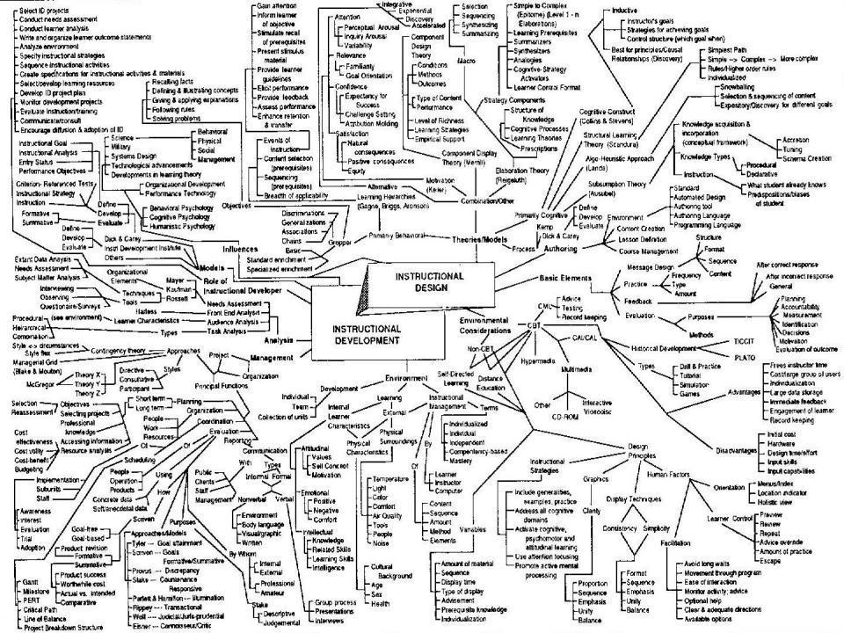
This slide has two purposes….
To focus the data projector, if necessary, and…
...to persuade colleagues never to put this sort of detail onto a slide!

Slide 3
About Phil…
First a musician
Then a writer
Then a scientist
Then a researcher
Then a lecturer and warden at what is now USW
Got interested in how students learn
And the effects assessment and feedback have on them
And how we teach them
Gradually became an educational developer
And now ‘retired’!?
Currently…
Visiting Prof: Plymouth
Emeritus Prof: Leeds Beckett
Based at Newcastle, UK
And on trains
And an expert…
on train routes and timetables!
Notes:
2
2

Slide 4
Thanks to students
I could not do what I do nowadays if I did not continue to spend a fair bit of my time working with students – they’ve taught me most of what I know.

Slide 5
Intentions
In this interactive session, we’ll explore six questions I’ve asked countless people in the last 30 years, about how they learn well or badly, and draw out seven factors which underpin successful learning.
My claim is that the best way of making learning happen is to address these factors purposefully in every kind of learning context we design for students, and in assessment and feedback too.

Slide 6
You will be able to download my main slides
You don’t need to take notes.
I’ll put the main slides up on my website by lunchtime tomorrow: (http://phil-race.co.uk/)
I won’t post pictures and video-clips, as this would make the file-size too large.
I may sometimes go through slides quite fast, but you can study them as you wish at your leisure.

Slide 7
Announcement about mobile phones and laptops...
Good morning everyone – please turn on your ‘phones and computers.
Please post your thoughts, comments and ideas to the hashtag #uodtransitions
Thanks!
Try #LTHEchat on Wednesday evenings from 20.00-21.00. (Sally’s hosting it next week on ‘Challenges’, except she’s on a train from London, so I’ll be helping!!!)

Slide 8
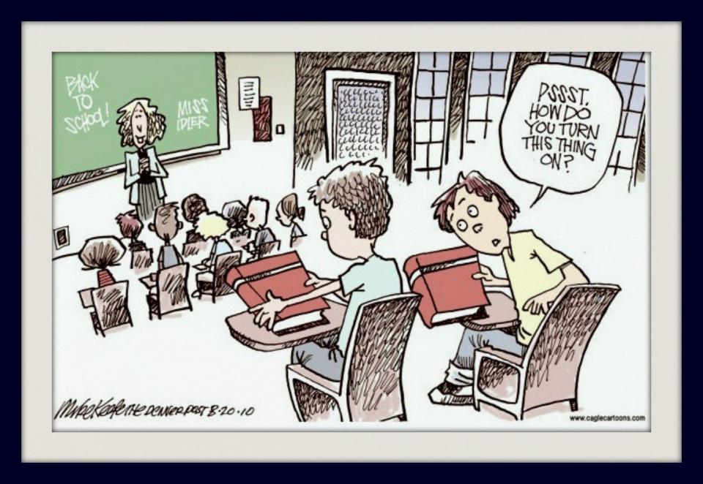

Slide 9

The read-write industry

Slide 10

In the exam room you’re on your own

Slide 11
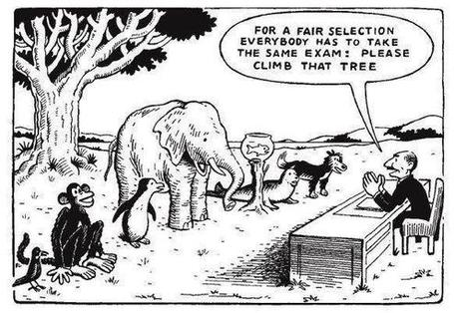

Slide 12
Task: agree, disagree, or don’t know
Recently, I tweeted…twote? (@RacePhil)
“word count = credit points: I can think of no idea more stupid, banal and counter-educative that this! Wordspinning for a degree? Rubbish!”
If you agree, please raise two hands
If you disagree, please raise one hand
If you don’t know, please scratch your head.
Please also make your views known by ‘liking’ or ‘retweeting’ the Tweet, or by replying to it.

Slide 13
Some of Phil’s materials on feedback and assessment
Expanded discussion of how the factors underpinning learning in this session link to feedback and assessment:
http://phil-race.co.uk/2016/10/feedback-digest-lthechat65/ (from my most recent two books)
http://phil-race.co.uk/2016/10/lthe-tweetchat-lthechat-wed-oct-19-8-00-9-00-pm/ (extracts on feedback)
http://phil-race.co.uk/2015/01/assessment-bits-new-editions/ (extracts on assessment)

Slide 14
Intended learning outcomes
By the end of this workshop, I hope you’ll be better able to:
Think of how students’ learning already is before they ever get to university;
To address the transitions we need to help them achieve while they’re here.

Slide 15
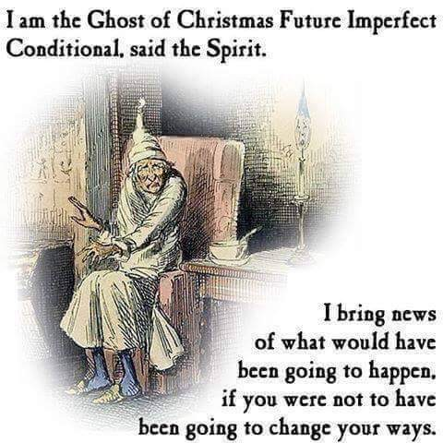

Slide 16
Evidence-based practice
In the last decade, there’s been a great deal of international evidence-based research in assessment, feedback, learning and teaching. I’d like to alert you to how some of this can help us enhance students’ learning.
The next three slides show just 17 sources selected from the published evidence.

Slide 17
17 sources about assessment, feedback and learning in higher education
Knight, P. and Yorke, M. (2003) Assessment, learning and employability, Maidenhead, UK SRHE/Open University Press.
The TESTA project (http://www.testa.ac.uk/) Transforming the Experience of Students through Assessment, (Bath Spa, Chichester, Winchester and Worcester)
Flint, N. R. and Johnson, B. (2011) Towards fairer university assessment – recognising the concerns of students, London: Routledge.
ETC Toolkit (2015) (Enhancing the Curriculum) www.etctoolkit.org.uk
HEA (2012) A Marked Improvement: transforming assessment in higher education, York: Higher Education Academy (http://www.heacademy.ac.uk/assets/documents/assessment/A_Marked_Improvement.pdf )

Slide 18
17 sources about assessment, feedback and learning in higher education
Boud, D. and Associates (2010) Assessment 2020: seven propositions for assessment reform in higher education Sydney: Australian Learning and Teaching Council.
Carless, D. (2015) Excellence in University Assessment: Learning from award-winning practice, London: Routledge.
Race, P. (2014) Making learning happen: 3rd edition London: Sage. (lots of bits free on my website!)
Hunt, D. and Chalmers, L. (eds) (2012) University Teaching in Focus: a learning-centred approach Australia: ACER Press, and London: Routledge.
Price, M., Rust, C., O’Donovan, B. and Handley, K. (2012) Assessment Literacy, Oxford: the Oxford Centre for Staff and Learning Development (based on the ‘ASKe’ Project).
Evans, C. (2013) Making Sense of Assessment Feedback in Higher Education, Review of Educational Research Vol. 83, No. 1, pp. 70–120. http://journals.sagepub.com/doi/abs/10.3102/0034654312474350

Slide 19
17 sources about assessment, feedback and learning in higher education
Sambell, K., McDowell, L. and Montgomery, C. (2013) Assessment for Learning in Higher Education, London: Routledge.
Brown, S. (2015) Learning, teaching and assessment in higher education: global perspectives, Basingstoke: Palgrave-Macmillan.
Race, P. (2015) The Lecturer’s Toolkit: 4th edition, London, Routledge. (lots of bits free on my website!)
Parkin, D (2017) Leading Learning and Teaching in Higher Education – the key guide to designing and delivering courses, London: Routledge.
Lea, J. (ed.) (2015) Enhancing Learning And Teaching In Higher Education: Engaging With The Dimensions Of Practice, London, Open University Press.
Sambell, K, Brown, S and Graham, L (2017, Professionalism in Practice: Key directions in higher education: Learning, Teaching and Assessment, Basingstoke: Palgrave-Macmillan.

Slide 20
Now is the decade of Universities’ dis-content! Universities in transition
Never mind the content – feel the learning

Slide 21
Modern institutions are moving away from being the providers of content, (where everything was about ‘delivery’), towards foregrounding two major functions:
Recognising and accrediting students’ achievement, wherever learning has taken place (i.e. getting the assessment right);
Supporting student learning and engagement (not least by making feedback work well for students).

Slide 22
Face-to-face communication
Making all the channels work

Slide 23

Face-to-face one-to-one feedback activity
On the signal to start, please stand up, and work in pairs, moving around the room, talking to different people using the script which follows…
The script:
A ‘Hello’ (or equivalent).
B ‘Hello’ (or equivalent).
A ‘You are late’.
B ‘I know’.
Try to do it completely differently each time.

Slide 24
Constructive Alignment: John Biggs
What will I be expected to show for this?
What does a good one look like, and a bad one?
Where does this fit into the big picture?
When explaining assessment criteria to students, and when linking these to evidence of achievement of the intended learning outcomes, we need to make the most of face-to-face whole group contexts and...
Tone of voice
Body language
Facial expression
Eye contact
The chance to repeat things
The chance to respond to puzzled looks
Some things don’t work nearly so well just on paper or on screens.
Some of the
tools we can
use in
face-to-face
contexts

Slide 25
How students really learn
Seven factors underpinning successful learning based on asking 200,000 people about their learning in the last 20 years – ditching learning theories which don’t work!

Slide 26
How Students Really Learn ‘Ripples’ model of learning
Phil Race

Slide 27
Seven factors underpinning successful learning
I’m going to ask you six questions about how you learn…

Slide 28
How you learn: the first four questions:
Please make a little grid with four boxes, with numbers 1-4 in the corners.
1
2
3
4

Slide 29
Prepare to jot down your answers to the
second parts of each of four questions
– no more than six words or so.
1
2
3
4

Slide 30
1: How do you learn well?
Think (don’t write anything yet) of something that you’re good at, something that you know you do well.
How did you become good at it? Write a few words in box 1.

Slide 31
Most people’s views...
practice
trial and error
having a go
repetition
experimenting

Slide 32
The first quote on experiential learning?
“One must learn by doing the thing; though you think you know it, you have no certainty until you try”.
(Sophocles, 495-406 BC)

Slide 33
What’s an expert?
An expert is a man who has made all the mistakes,
which can be made,
in a very narrow field.
(Niels Bohr, 1885-1962)
Therefore we need to allow learners to make mistakes, and help them to gain feedback in a constructive environment, to help them towards becoming experts.

Slide 34
But sometimes we really need teachers…
Someone who already knows;
Someone who has already learned by getting it wrong at first;
And can help us to do the same…
Sometimes without saying a word…

Slide 35
Next to feelings
The educational psychologists got it wrong last century.
They went into cognition, metacognition, memory and that sort of stuff.
Interesting, but dull.
Much more important: feelings.
Professor Alan Mortiboys gets right into this with his lifechanging work on emotional intelligence.
Meanwhile....

Slide 36
2: What makes you feel good?
Think of something about yourself that you feel good about.
How can you justify feeling good about this? What’s your evidence to support this feeling? Write a few words in box 2.

Slide 37
Most people’s views...
feedback
other people’s reactions
praise
gaining confidence
seeing the results

Slide 38
Fishing for feedback?
Feedback is like fish.
If it is not used quickly, it becomes useless.
(Sally Brown).
Give a man a fish,
Feed him for a day.
Teach a man to fish,
Feed him for a lifetime.
(Maimonides: 1135-1204)
Make feedback timely, while it still matters to students, in time for them to use it towards further learning, or to receive further assistance.
(Graham Gibbs)
And he’ll learn to drink beer in boats
And you won’t see him for weeks!
(Australian proverb).

Slide 39
3: What can go wrong?
Think of something that you’re not good at, perhaps as a result of a bad learning experience.
What went wrong, and whose (if anyone’s) fault may it have been? Write a few words in box 3.

Slide 40
Most people’s views...
did not really want to learn it
could not see the point
bad teaching
could not make sense of it

Slide 41
Is there anyone there?
What station are you broadcasting on?

Slide 42
Try WIIFM
What’s in it for me?
Consciously address the ‘so what’ in learners’ minds;
Or indeed the ‘wtf’?
Warm up their ‘want’ to learn.
Clarify their ‘need’ to learn.
Learners learn far more readily if they are continuously aware of the benefits for them of putting energy into their learning.

Slide 43
4: And if there isn’t a ‘want’?
Think of something that you did learn successfully, but at the time you didn’t want to learn it.
What kept you going, so that you did indeed succeed in learning it? Jot a few words in box 4.

Slide 44
Most people’s views...
strong support and encouragement
did not want to be seen not able to do it
needed to do it for what I wanted next

Slide 45
Five of the seven factors underpinning successful learning
learning by doing
learning from feedback
wanting to learn
needing to learn
...

Slide 46
‘Do you understand?’ lecturer asks student.
‘Understand what?’ thinks student.
‘What am I supposed to understand?’
‘What will he/she think of me if I say “no”?’
‘If I say “yes” will he/she ask me a difficult question to catch me out?’
‘Why am I being asked this anyway?’
‘Is it going to be important for me to understand this?’.
‘How will I know when I understand it?’.
‘What will I be able to do when I understand it?’.
‘How will I be able to demonstrate my understanding of it?’.
‘Do I actually have to understand it, or will it be enough simply to demonstrate my understanding of it, by doing something I can do, even when I don’t understand it?’.
‘Does he/she understand it, anyway?’
‘Mmmm’ replies student (as soon as possible after all that thinking). … continued…

Slide 47
‘So you don’t understand it then?’ alleges lecturer.
‘Well, …’ replies student.
‘So you understand it well?’ smiles lecturer.
‘Just about’ replies student.
‘Ah, good’ says lecturer. ‘I made myself clear then?’
‘Of course’ replies student.
[Because of things like this, the word ‘understand’ is best avoided in intended learning outcomes – and in life in general, except to get people thinking].

Slide 48
Five of the seven factors underpinning successful learning
learning by doing
learning from feedback
wanting to learn
needing to learn
making sense – ‘getting one’s head round it’

Slide 49
Traditional views...
active experimentation
concrete experience
reflective observation
abstract conceptualisation

Slide 50
But what about learning styles?
https://www.theguardian.com/education/2017/mar/12/no-evidence-to-back-idea-of-learning-styles?CMP=share_btn_tw
(Link from my Tweet on March 13th to a letter in the Guardian by prominent folk around the world of education)
“No evidence to back idea of learning styles”

Slide 51
Is it a cycle?
Active
Experimentation
Abstract
Conceptualisation
Concrete
Experience
Reflective
Observation

Slide 52
What’s missing?
Engagement?
Feelings?
Active
Experimentation
Emotions?
Judgments?
Desire?
Abstract
Conceptualisation
Concrete
Experience
Communication?
People?
Reflective
Observation

Slide 53
Is this a cycle?
- No! It’s not a cycle
Wanting/Needing
Making sense
Doing
Feedback

Slide 54
Ripples on a pond….
Wanting/
Needing

Slide 55
Ripples on a pond….
Wanting/
Needing
Doing

Slide 56
Ripples on a pond….
Wanting/
Needing
Doing
Making sense

Slide 57
Ripples on a pond….
Wanting/
Needing
Doing
Making sense
Feedback

Slide 58
But there are still two things missing
One has never really ‘got’ something until one has done both of two more things...

Slide 59
5: Think back to your own teaching
Think of something you’ve taught for some time. Think back particularly to the first time you taught it.
To what extent did you find that you ‘had your head around it’ much better after teaching it for the first time?
Very much better: raise two hands
Somewhat better: raise one hand
No better: touch left ear!

Slide 60
Ripples on a pond….
Verbalising
Wanting/
Needing
Doing
Making sense
Feedback

Slide 61
6: Now think about assessing
Still thinking of the first time you taught that particular topic, think back to the first time you measured students’ learning of the topic.
To what extent did you find that after assessing students work, you yourself had ‘made sense’ of the topic even more deeply?
Very much better: raise two hands
Somewhat better: raise one hand
No better: touch left ear!

Slide 62
Ripples on a pond….
Verbalising
Assessing
making informed judgements
Wanting/
Needing
Doing
Making sense
Feedback

Slide 63
The guru Royce Sadler
“The indispensable conditions for improvement are that the student comes to hold a concept of quality roughly similar to that held by the teacher, is able to monitor continuously the quality of what is being produced during the act of production itself, and has a repertoire of alternative moves or strategies from which to draw at any given point. In other words, students have to be able to judge the quality of what they are producing and be able to regulate what they are doing during the doing of it”. (Sadler 1989). (my italics)

Slide 64
Ripples on a pond….
Striving to enhance our students’ want to learn;
Helping students to develop ownership of the need to learn;
Keeping students learning by doing, practice, trial-and-error, repetition;
Ensuring students get quick and useful feedback – from us and from each other;
Helping students to make sense of what they learn.
Getting students deepening their learning by verbalising, explaining things to each other, and to us.
Allowing students to further deepen their learning by assessing their own learning, and assessing others’ learning – making informed judgements.
We can make learning happen by:
Verbalising
Assessing
making informed judgements
Wanting/
Needing
Doing
Doing
Making sense
Feedback

Slide 65
Seven things we can try to do
Intent – make the intended outcomes really clear.
Need – find out what students think they need, and respond to this.
Support students in every way possible.
People: students are people, they’re human, like us.
Interact with students in large groups, small groups, online and one-to-one.
Remember names, faces, what you said to each student last time, ...
Evidence: keep students aware of the evidence which will lead to their success.

Slide 66
Back to our intended learning outcomes…
Do you now feel better able to:
2 hands = very much better,
one hand = somewhat better,
touch left ear = no better...
Think of how students’ learning already is before they ever get to university?
Address the transitions we need to help them achieve while they’re here?
Wanting/
Needing
Doing
Making sense
Feedback

Slide 67
Thank you…
Website: http://phil-race.co.uk
Follow Phil on Twitter @RacePhil
e-mail: phil@phil-race.co.uk

