Slide 1
Activating Learning – addressing the factors underpinning how students really learn Napier University, Edinburgh
Wednesday 11th October, 2017
Phil Race
(from Newcastle-upon-Tyne)
BSc PhD PGCE FCIPD PFHEA NTF
Follow Phil on Twitter: @RacePhil
Visiting Professor: University of Plymouth and Edge Hill University
Emeritus Professor, Leeds Beckett University

Slide 2
This slide has two purposes….
To focus the data projector, if necessary, and…
...to persuade colleagues never to put this sort of detail onto a slide!

Slide 3
About Phil…
First a musician
Then a writer
Then a scientist
Then a researcher
Then a lecturer and warden at what is now USW
Got interested in how students learn
And the effects assessment and feedback have on them
And how we teach them
Gradually became an educational developer
And now ‘retired’!?
Currently…
Visiting Prof: Plymouth & Edge Hill
Emeritus Prof: Leeds Beckett
Based at Newcastle, UK
And on trains
And an expert…
on train routes and timetables!
Notes:
2
2

Slide 4
Thanks to students
I could not do what I do nowadays if I did not continue to spend a fair bit of my time working with students – they’ve taught me most of what I know.

Slide 5
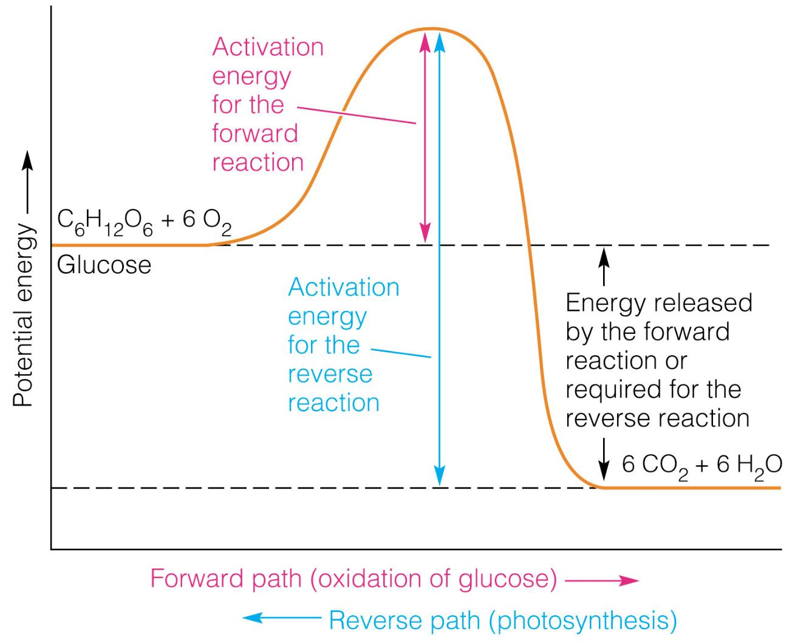

Slide 6
Intentions
In this interactive session, we’ll explore six questions I’ve asked countless people in the last 30 years, about how they learn well or badly, and draw out seven factors which underpin successful learning.
My claim is that the best way of making learning happen is to address these factors purposefully in every kind of learning context we design for students, and in assessment and feedback too.

Slide 7
Getting to know each other
In turn, please..
Say one or two sentences about...
who you are,
where you come from, and
what you do.
In one breath!
(Optional) Share with us one thing that you’re dead good at or really proud of.

Slide 8
Intended learning outcomes
After participating in this session, you should be better able to:
Identify and explore seven factors which underpin successful learning.
Address these factors purposefully in your own work with students.

Slide 9
You will be able to download my main slides
You don’t need to take notes.
I’ll put the main slides up on my website by 22.00 tonight: (http://phil-race.co.uk/)
I won’t post pictures and video-clips, as this would make the file-size too large.
I may sometimes go through slides quite fast, but you can study them as you wish at your leisure.

Slide 10
Announcement about mobile phones and laptops...
Good afternoon everyone – please turn on your ‘phones and computers.
Please post your thoughts, comments and ideas to the hashtag #philatnapier17 Thanks!
Try #LTHEchat on Wednesday evenings from 20.00-21.00. (Sadly, I won’t be with you this evening due to travel)

Slide 11
Task: agree, disagree, or don’t know
Earlier this year, I tweeted…twote? (@RacePhil)
“word count = credit points: I can think of no idea more stupid, banal and counter-educative that this! Wordspinning for a degree? Rubbish!”
If you agree, please raise two hands
If you disagree, please raise one hand
If you don’t know, please scratch your head.
Please also make your views known by ‘liking’ or ‘retweeting’ the Tweet, or by replying to it.

Slide 12
Download Phil’s materials on feedback, assessment, learning and lecturing
Expanded discussion of how the factors underpinning learning link to feedback, assessment and large-group teaching:
http://phil-race.co.uk/2016/10/feedback-digest-lthechat65/ (feedback stuff from my most recent two books)
http://phil-race.co.uk/2016/10/lthe-tweetchat-lthechat-wed-oct-19-8-00-9-00-pm/ (extracts on feedback)
http://phil-race.co.uk/2015/01/assessment-bits-new-editions/ (extracts on assessment)
https://phil-race.co.uk/2017/05/lectures-and-learning/ (extracts on lecturing)

Slide 13
Time-constrained Post-it exercise
On a post-it, in your best handwriting, please write your own completion of the starter:
“Activating learning with my students would be much better if only I …”
Please swap post-its so that you’ve no idea who has yours.
If chosen, please read out with passion and drama the post-it you now have.
Please keep them for now, and place them all as directed after the session.

Slide 14
Evidence-based practice
In the last decade, there’s been a great deal of international evidence-based research in assessment, feedback, learning and teaching. I’d like to alert you to how some of this can help us enhance students’ learning.
The next three slides show just 17 sources selected from the published evidence.

Slide 15
17 sources about assessment, feedback and learning in higher education
Knight, P. and Yorke, M. (2003) Assessment, learning and employability, Maidenhead, UK SRHE/Open University Press.
The TESTA project (http://www.testa.ac.uk/) Transforming the Experience of Students through Assessment, (Bath Spa, Chichester, Winchester and Worcester)
Flint, N. R. and Johnson, B. (2011) Towards fairer university assessment – recognising the concerns of students, London: Routledge.
ETC Toolkit (2015) (Enhancing the Curriculum) www.etctoolkit.org.uk
HEA (2012) A Marked Improvement: transforming assessment in higher education, York: Higher Education Academy (http://www.heacademy.ac.uk/assets/documents/assessment/A_Marked_Improvement.pdf )

Slide 16
17 sources about assessment, feedback and learning in higher education
Boud, D. and Associates (2010) Assessment 2020: seven propositions for assessment reform in higher education Sydney: Australian Learning and Teaching Council.
Carless, D. (2015) Excellence in University Assessment: Learning from award-winning practice, London: Routledge.
Race, P. (2014) Making learning happen: 3rd edition London: Sage. (lots of bits free on my website!)
Hunt, D. and Chalmers, L. (eds) (2012) University Teaching in Focus: a learning-centred approach Australia: ACER Press, and London: Routledge.
Price, M., Rust, C., O’Donovan, B. and Handley, K. (2012) Assessment Literacy, Oxford: the Oxford Centre for Staff and Learning Development (based on the ‘ASKe’ Project).
Evans, C. (2013) Making Sense of Assessment Feedback in Higher Education, Review of Educational Research Vol. 83, No. 1, pp. 70–120. http://journals.sagepub.com/doi/abs/10.3102/0034654312474350

Slide 17
17 sources about assessment, feedback and learning in higher education
Sambell, K., McDowell, L. and Montgomery, C. (2013) Assessment for Learning in Higher Education, London: Routledge.
Brown, S. (2015) Learning, teaching and assessment in higher education: global perspectives, Basingstoke: Palgrave-Macmillan. (great discussion on plagiarism).
Race, P. (2015) The Lecturer’s Toolkit: 4th edition, London, Routledge. (lots of bits on my website!)
Parkin, D (2017) Leading Learning and Teaching in Higher Education – the key guide to designing and delivering courses, London: Routledge.
Lea, J. (ed.) (2015) Enhancing Learning And Teaching In Higher Education: Engaging With The Dimensions Of Practice, London, Open University Press.
Sambell, K, Brown, S and Graham, L. (2017) Professionalism in Practice: Key directions in higher education: Learning, Teaching and Assessment, Basingstoke: Palgrave-Macmillan.

Slide 18
3rd edition
Phil Race
2014: Sage: London
Three short videos
(1) About making learning happen in general: http://tinyurl.com/l7yddya
(2) Five top tips for lecturers: http://tinyurl.com/nxhohe3
(3) On being an author, and the changes in the 3rd edition: http://tinyurl.com/oqfkkdc

Slide 19
The Lecturer’s Toolkit
4th Edition
Phil Race
London: Routledge,
2015.

Slide 20
Now is the decade of Universities’ dis-content!
Never mind the content – feel the learning

Slide 21
Modern institutions are moving away from being the providers of content, (where everything was about ‘delivery’), towards foregrounding two major functions:
Recognising and accrediting students’ achievement, wherever learning has taken place (i.e. getting the assessment right);
Supporting student learning and engagement (not least by making feedback work well for students).

Slide 22
Teaching – and research – and reflection: the ten most important words
Why?
What?
Who?
Where?
When?
How?
Which?
So what?
Wow?
And the most powerful four-letter word in the English language...
????

Slide 23
‘what’ is getting ever less important
Columbia University research published recently (2011) in Science magazine shows that people are much less prepared to remember ‘what’, but better at remembering where to access information, and how to do so.
Betsy Sparrow, one of the principal researchers, concludes that the internet has become ‘an external memory source that we can access at any time. ... Just as we learn through transactive memory who knows what in our families and offices, we are learning what the computer ‘knows’ and when we should attend to where we have stored information in our computer-based memories. We are becoming symbiotic with our computer tools.
Published Online July 14 2011 < Science Express Index Science DOI: 10.1126/science.1207745
Report: Google Effects on Memory: Cognitive Consequences of Having Information at Our Fingertips Betsy Sparrow,*, Jenny Liu, Daniel M. Wegner

Slide 24
Teaching – and research – and reflection: the ten most important words
Why? (rationale)
What? (content)
Who? (people, you, me, them)
Where? (locations)
When? (times)
How? (processes)
Which? (decisions)
So what? (importance?)
Wow? (impact?)
And the most powerful four-letter word in the English language...
????

Slide 25
Constructive Alignment: John Biggs
What will I be expected to show for this?
What does a good one look like, and a bad one?
Where does this fit into the big picture?
When explaining assessment criteria to students, and when linking these to evidence of achievement of the intended learning outcomes, we need to make the most of face-to-face whole group contexts and...
Tone of voice
Body language
Facial expression
Eye contact
The chance to repeat things
The chance to respond to puzzled looks
Some things don’t work nearly so well just on paper or on screens.
Some of the
tools we can
use in
face-to-face
contexts

Slide 26
How students really learn
Seven factors underpinning successful learning based on asking 200,000 people about their learning in the last 30 years – ditching learning theories which don’t work!

Slide 27
How Students Really Learn ‘Ripples’ model of learning
Phil Race

Slide 28
Seven factors underpinning successful learning
I’m going to ask you six questions about how you learn…

Slide 29
How you learn: the first four questions:
Please make a little grid with four boxes, with numbers 1-4 in the corners.
1
2
3
4

Slide 30
Prepare to jot down your answers to the
second parts of each of four questions
– no more than six words or so.
1
2
3
4

Slide 31
1: How do you learn well?
Think (don’t write anything yet) of something that you’re good at, something that you know you do well.
How did you become good at it? Write a few words in box 1.

Slide 32
Most people’s views...
practice
trial and error
having a go
repetition
experimenting

Slide 33
The first quote on experiential learning?
“One must learn by doing the thing; though you think you know it, you have no certainty until you try”.
(Sophocles, 495-406 BC)

Slide 34
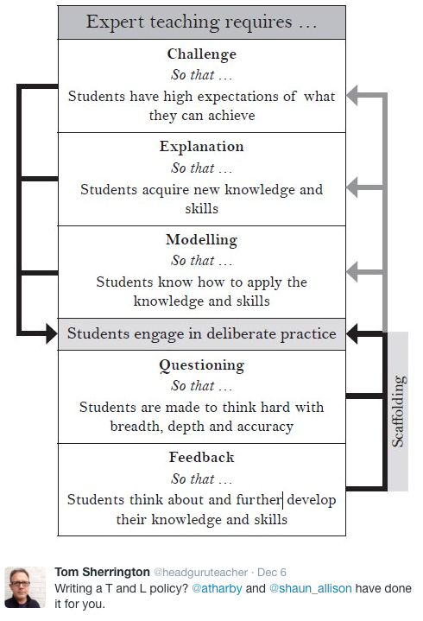

Slide 35
What’s an expert?
An expert is a man who has made all the mistakes,
which can be made,
in a very narrow field.
(Niels Bohr, 1885-1962)
Therefore we need to allow learners to make mistakes, and help them to gain feedback in a constructive environment, to help them towards becoming experts.

Slide 36
But sometimes we really need teachers…
Someone who already knows;
Someone who has already learned by getting it wrong at first;
And can help us to do the same…
Sometimes without saying a word…

Slide 37
Next to feelings
The educational psychologists got it wrong last century.
They went into cognition, metacognition, memory and that sort of stuff.
Interesting, but dull.
Much more important: feelings.
Professor Alan Mortiboys gets right into this with his lifechanging work on emotional intelligence.
Meanwhile....

Slide 38
2: What makes you feel good?
Think of something about yourself that you feel good about.
How can you justify feeling good about this? What’s your evidence to support this feeling? Write a few words in box 2.

Slide 39
Most people’s views...
feedback
other people’s reactions
praise
gaining confidence
seeing the results

Slide 40
Fishing for feedback?
Feedback is like fish.
If it is not used quickly, it becomes useless.
(Sally Brown).
Give a man a fish,
Feed him for a day.
Teach a man to fish,
Feed him for a lifetime.
(Maimonides: 1135-1204)
Make feedback timely, while it still matters to students, in time for them to use it towards further learning, or to receive further assistance.
(Graham Gibbs)
And he’ll learn to drink beer in boats
And you won’t see him for weeks!
(Australian proverb).

Slide 41
3: What can go wrong?
Think of something that you’re not good at, perhaps as a result of a bad learning experience.
What went wrong, and whose (if anyone’s) fault may it have been? Write a few words in box 3.

Slide 42
Most people’s views...
did not really want to learn it
could not see the point
bad teaching
could not make sense of it

Slide 43
Is there anyone there?
What station are you broadcasting on?

Slide 44
Try WIIFM
What’s in it for me?
Consciously address the ‘so what’ in learners’ minds;
Or indeed the ‘wtf’?
Warm up their ‘want’ to learn.
Clarify their ‘need’ to learn.
Learners learn far more readily if they are continuously aware of the benefits for them of putting energy into their learning.

Slide 45
4: And if there isn’t a ‘want’?
Think of something that you did learn successfully, but at the time you didn’t want to learn it.
What kept you going, so that you did indeed succeed in learning it? Jot a few words in box 4.

Slide 46
Most people’s views...
strong support and encouragement
did not want to be seen not able to do it
needed to do it for what I wanted next

Slide 47
Five of the seven factors underpinning successful learning
learning by doing
learning from feedback
wanting to learn
needing to learn
...

Slide 48
‘Do you understand?’ lecturer asks student.
‘Understand what?’ thinks student.
‘What am I supposed to understand?’
‘What will he/she think of me if I say “no”?’
‘If I say “yes” will he/she ask me a difficult question to catch me out?’
‘Why am I being asked this anyway?’
‘Is it going to be important for me to understand this?’.
‘How will I know when I understand it?’.
‘What will I be able to do when I understand it?’.
‘How will I be able to demonstrate my understanding of it?’.
‘Do I actually have to understand it, or will it be enough simply to demonstrate my understanding of it, by doing something I can do, even when I don’t understand it?’.
‘Does he/she understand it, anyway?’
‘Mmmm’ replies student (as soon as possible after all that thinking). … continued…

Slide 49
‘So you don’t understand it then?’ alleges lecturer.
‘Well, …’ replies student.
‘So you understand it well?’ smiles lecturer.
‘Just about’ replies student.
‘Ah, good’ says lecturer. ‘I made myself clear then?’
‘Of course’ replies student.
[Because of things like this, the word ‘understand’ is best avoided in intended learning outcomes – and in life in general, except to get people thinking].

Slide 50
Five of the seven factors underpinning successful learning
learning by doing
learning from feedback
wanting to learn
needing to learn
making sense – ‘getting one’s head round it’

Slide 51
Traditional views...
active experimentation
concrete experience
reflective observation
abstract conceptualisation

Slide 52
But what about learning styles?
https://www.theguardian.com/education/2017/mar/12/no-evidence-to-back-idea-of-learning-styles?CMP=share_btn_tw
(Link from my Tweet on March 13th to a letter in the Guardian by prominent folk around the world of education)
Or link to a word document: https://phil-race.co.uk/2017/09/swansea-university-school-management-21st-September/
“No evidence to back idea of learning styles”

Slide 53
Is it a cycle?
Active
Experimentation
Abstract
Conceptualisation
Concrete
Experience
Reflective
Observation

Slide 54
What’s missing?
Engagement?
Feelings?
Active
Experimentation
Emotions?
Judgments?
Desire?
Abstract
Conceptualisation
Concrete
Experience
Communication?
People?
Reflective
Observation

Slide 55
Is this a cycle?
- No! It’s not a cycle
Wanting/Needing
Making sense
Doing
Feedback

Slide 56
Ripples on a pond….
Wanting/
Needing

Slide 57
Ripples on a pond….
Wanting/
Needing
Doing

Slide 58
Ripples on a pond….
Wanting/
Needing
Doing
Making sense

Slide 59
Ripples on a pond….
Wanting/
Needing
Doing
Making sense
Feedback

Slide 60
But there are still two things missing
One has never really ‘got’ something until one has done both of two more things...

Slide 61
5: Think back to your own teaching
Think of something you’ve taught for some time. Think back particularly to the first time you taught it.
To what extent did you find that you ‘had your head around it’ much better after teaching it for the first time?
Very much better: raise two hands
Somewhat better: raise one hand
No better: touch left ear!

Slide 62
Ripples on a pond….
Verbalising
Wanting/
Needing
Doing
Making sense
Feedback

Slide 63
6: Now think about assessing
Still thinking of the first time you taught that particular topic, think back to the first time you measured students’ learning of the topic.
To what extent did you find that after assessing students work, you yourself had ‘made sense’ of the topic even more deeply?
Very much better: raise two hands
Somewhat better: raise one hand
No better: touch left ear!

Slide 64
Ripples on a pond….
Verbalising
Assessing
making informed judgements
Wanting/
Needing
Doing
Making sense
Feedback

Slide 65
The guru Royce Sadler
“The indispensable conditions for improvement are that the student comes to hold a concept of quality roughly similar to that held by the teacher, is able to monitor continuously the quality of what is being produced during the act of production itself, and has a repertoire of alternative moves or strategies from which to draw at any given point. In other words, students have to be able to judge the quality of what they are producing and be able to regulate what they are doing during the doing of it”. (Sadler 1989). (my italics)

Slide 66
Ripples on a pond….
Striving to enhance our students’ want to learn;
Helping students to develop ownership of the need to learn;
Keeping students learning by doing, practice, trial-and-error, repetition;
Ensuring students get quick and useful feedback – from us and from each other;
Helping students to make sense of what they learn.
Getting students deepening their learning by verbalising, explaining things to each other, and to us.
Allowing students to further deepen their learning by assessing their own learning, and assessing others’ learning – making informed judgements.
We can make learning happen by:
Verbalising
Assessing
making informed judgements
Wanting/
Needing
Doing
Doing
Making sense
Feedback

Slide 67
Seven things we can try to do
Intent – make the intended outcomes really clear.
Need – find out what students think they need, and respond to this.
Support students in every way possible.
People: students are people, they’re human, like us.
Interact with students in large groups, small groups, online and one-to-one.
Remember names, faces, what you said to each student last time, ...
Evidence: keep students aware of the evidence which will lead to their success.

Slide 68
How to get feedback to a large group of students within 24 hours
There are serious reservations about written feedback, but we can make even this work much better than it did.
The next few slides are about a way of giving students feedback on their work within 24 hours of them doing it.
There are three or more ‘yes, but...’s with this idea, but please hold these for around four minutes.

Slide 69
Set the hand-in time to be at a whole-group session
E.g. next Tuesday’s 10-11 lecture,
Deadline = 1003.
Let them pile up all their work at the front.
At 1003, hand out to everyone a coloured sheet, containing numbered points.
(so you can say in feedback ‘please see point 3, blue sheet’ and so on).

Slide 70
The blue sheet can contain....
Illustration of what is expected as evidence of achievement of each of the intended learning outcomes
Likely mistakes
Features of a good answer
Frequently needed explanations
Things you otherwise would have to write time and time again on students’ work.
Let the students study this for 3 minutes until 1006 – it goes rather quiet!

Slide 71
At 1006...
Go into face-to-face oral mode, until 1009....
Spend a few minutes de-briefing the whole group and talking them through one point on the handout…
…adding tone-of-voice, facial expression, body language, emphasis, and so on to the feedback.

Slide 72
The rationale...
Since most of the students will still have been doing the work in the last 24 hours before handing it in, you’re giving them feedback while they still remember what they were doing.
They know what they didn’t do.
They know what they missed out because they couldn’t understand it.

Slide 73
Now take away their work to mark – in a third of the time it used to take you!
You waste far less writing the same old things on one piece of work after another, regarding frequently occurring mistakes;
Instead, you need just to write ‘please see point 4, blue sheet’ (which takes seconds).
You can now make your comments relate more to each individual piece of work;
This means when students get their marked work back with feedback, they are more likely to use it, as it’s personal to them.

Slide 74
Set
hand-in deadline to be at lecture
Prepare ‘blue sheet’ with anticipated
generic feedback
Summary: providing feedback within 24 hours
Collect students’ work at start of lecture
Take away work to mark in a third of the time
Hand out ‘blue sheet’
Talk class through one important point, then resume lecture
Let students read blue sheet for short while

Slide 75
Back to our intended learning outcomes…
Do you now feel better able to:
2 hands = very much better,
one hand = somewhat better,
touch left ear = no better...
Identify and explore seven factors which underpin successful learning?
Address these factors purposefully in your own work with students?
Wanting/
Needing
Doing
Making sense
Feedback

Slide 76
Thank you…
Website: http://phil-race.co.uk
Follow Phil on Twitter @RacePhil
e-mail: phil@phil-race.co.uk

