Slide 1
Activating Learning Theme 1 Smarter Feedback and Feed-forward – giving better feedback to more students in less time University of Glasgow
7th February, 2018
Phil Race
(from Newcastle-upon-Tyne)
BSc PhD PGCE FCIPD PFHEA NTF
Follow Phil on Twitter: @RacePhil
Visiting Professor: University of Plymouth and Edge Hill University
Emeritus Professor, Leeds Beckett University

Slide 2
This slide has two purposes….
To focus the data projector, if necessary, and…
...to persuade colleagues never to put this sort of detail onto a slide!

Slide 3
About Phil…
First a musician
Then a writer
Then a scientist
Then a researcher
Then a lecturer and warden at what is now USW
Got interested in how students learn
And the effects assessment and feedback have on them
And how we teach them
Gradually became an educational developer
And now ‘retired’!?
Currently…
Visiting Prof: Plymouth & Edge Hill
Emeritus Prof: Leeds Beckett
Based at Newcastle, UK
And on trains
And an expert…
on train routes and timetables!
Notes:
2
2

Slide 4
Thanks to students
I could not do what I do nowadays if I did not continue to spend a fair bit of my time working with students – they’ve taught me most of what I know.

Slide 5
Students change
Students are changing fast, as are their expectations of how, what and why they are learning. As teachers, we need to use the best of innovative techniques, as what worked for us when we were learners may no longer work for today’s students.

Slide 6
Linking everything to learning
In this interactive programme, we will touch on how students really learn, and how we can respond to factors underpinning their successful learning. We will link this to the ever-important dimension of feedback to students, particularly feed-forward to students, allowing them to continuously adjust their learning to best effect.

Slide 7
Name labels…
Please write your first name, big and bold, on a sticky label, and stick it to your clothing (not onto a fabric which would be damaged).
Phil

Slide 8
Outline Programme
0900-0915: Tea/coffee
0915-1045: Theme 1 - Smarter feedback and feed-forward: giving better feedback to more students in less time
1045-1100: Break
1100-1230: Theme 2 - Making learning happen in larger groups: smarter lecturing
1230-1300: Lunch

Slide 9
Intended learning outcomes
After participating in this session, you should be better able to:
Theme 1
Ensure that students benefit from feedback and feed-forward;
Make feedback more manageable for us, as well as students.
Theme 2
Make better learning happen in large-group contexts.
Make lectures more participative for students.

Slide 10
You will be able to download my main slides
You don’t need to take notes.
I’ll put the main slides I use up on my website later today (http://phil-race.co.uk/)
I won’t post pictures and video-clips, as this would make the file-size too large.
I may sometimes go through slides quite fast, but you can study them as you wish at your leisure.

Slide 11
Announcement about mobile phones and laptops...
Good morning everyone – please turn on your ‘phones and computers.
Please post your thoughts, comments and ideas during this session to the hashtag #philatglasgow18 Thanks!
Try #LTHEchat on Wednesday evenings from 20.00-21.00. The #LTHE Chat on Wednesday 7th February 2018 will be jointly led by @adamL50 and @simonprattadams from Anglia Learning and Teaching (@AngliaLTA) on the topic of Enhancing the supervision experience of undergraduate students

Slide 12
Download Phil’s materials on feedback, assessment, learning and lecturing
Expanded discussion of how the factors underpinning learning link to feedback, assessment and large-group teaching:
http://phil-race.co.uk/2016/04/updated-powerpoint-ripples-model/ (Chapter 1 from ‘The Lecturer’s Toolkit, 2015)
https://phil-race.co.uk/2016/10/lthe-tweetchat-lthechat-wed-oct-19-8-00-9-00-pm/ (feedback stuff from my most recent two books)
http://phil-race.co.uk/2015/01/assessment-bits-new-editions/ (extracts on assessment)
http://phil-race.co.uk/2017/05/lectures-and-learning/ (extracts on lecturing)

Slide 13
Time-constrained Post-it exercise
On a post-it, in your best handwriting, please write your own completion of the starter:
“Getting feedback to my students would be much better for me in only …”
Please swap post-its so that you’ve no idea who has yours.
If chosen, please read out with passion and drama the post-it you now have.
Please place them all on the chart.

Slide 14
Evidence-based practice
In the last decade, there’s been a great deal of international evidence-based research in assessment, feedback, learning and teaching. I’d like to alert you to how some of this can help us enhance students’ learning.
The next three slides show just 17 sources selected from the published evidence.

Slide 15
17 sources about assessment, feedback and learning in higher education
Knight, P. and Yorke, M. (2003) Assessment, learning and employability, Maidenhead, UK SRHE/Open University Press.
The TESTA project (http://www.testa.ac.uk/) Transforming the Experience of Students through Assessment, (Bath Spa, Chichester, Winchester and Worcester)
Flint, N. R. and Johnson, B. (2011) Towards fairer university assessment – recognising the concerns of students, London: Routledge.
ETC Toolkit (2015) (Enhancing the Curriculum) www.etctoolkit.org.uk
HEA (2012) A Marked Improvement: transforming assessment in higher education, York: Higher Education Academy (http://www.heacademy.ac.uk/assets/documents/assessment/A_Marked_Improvement.pdf )

Slide 16
17 sources about assessment, feedback and learning in higher education
Boud, D. and Associates (2010) Assessment 2020: seven propositions for assessment reform in higher education Sydney: Australian Learning and Teaching Council.
Carless, D. (2015) Excellence in University Assessment: Learning from award-winning practice, London: Routledge.
Race, P. (2014) Making learning happen: 3rd edition London: Sage. (lots of bits free on my website!)
Hunt, D. and Chalmers, L. (eds) (2012) University Teaching in Focus: a learning-centred approach Australia: ACER Press, and London: Routledge.
Price, M., Rust, C., O’Donovan, B. and Handley, K. (2012) Assessment Literacy, Oxford: the Oxford Centre for Staff and Learning Development (based on the ‘ASKe’ Project).
Evans, C. (2013) Making Sense of Assessment Feedback in Higher Education, Review of Educational Research Vol. 83, No. 1, pp. 70–120. http://journals.sagepub.com/doi/abs/10.3102/0034654312474350

Slide 17
17 sources about assessment, feedback and learning in higher education
Sambell, K., McDowell, L. and Montgomery, C. (2013) Assessment for Learning in Higher Education, London: Routledge.
Brown, S. (2015) Learning, teaching and assessment in higher education: global perspectives, Basingstoke: Palgrave-Macmillan. (great discussion on plagiarism).
Race, P. (2015) The Lecturer’s Toolkit: 4th edition, London, Routledge. (lots of bits on my website!)
Parkin, D (2017) Leading Learning and Teaching in Higher Education – the key guide to designing and delivering courses, London: Routledge.
Lea, J. (ed.) (2015) Enhancing Learning And Teaching In Higher Education: Engaging With The Dimensions Of Practice, London, Open University Press.
Sambell, K, Brown, S and Graham, L. (2017) Professionalism in Practice: Key directions in higher education: Learning, Teaching and Assessment, Basingstoke: Palgrave-Macmillan.

Slide 18
Now is the decade of Universities’ dis-content!
Never mind the content – feel the learning

Slide 19
Modern institutions are moving away from being the providers of content, (where everything was about ‘delivery’), towards foregrounding two major functions:
Recognising and accrediting students’ achievement, wherever learning has taken place (i.e. getting the assessment right);
Supporting student learning and engagement (not least by making feedback work well for students, and using simulation to bring learning to life).

Slide 20
How students really learn
Seven factors underpinning successful learning based on asking 200,000 people about their learning in the last 30 years – ditching learning theories which don’t work!

Slide 21
How Students Really Learn ‘Ripples’ model of learning
Phil Race

Slide 22
What’s missing?
Engagement?
Feelings?
Active
Experimentation
Emotions?
Judgments?
Desire?
Abstract
Conceptualisation
Concrete
Experience
Communication?
People?
Reflective
Observation

Slide 23
Ripples on a pond….
Striving to enhance our students’ want to learn;
Helping students to develop ownership of the need to learn;
Keeping students learning by doing, practice, trial-and-error, repetition;
Ensuring students get quick and useful feedback – from us and from each other;
Helping students to make sense of what they learn.
Getting students deepening their learning by verbalising, explaining things to each other, and to us.
Allowing students to further deepen their learning by assessing their own learning, and assessing others’ learning – making informed judgements.
We can make learning happen by:
Verbalising
Assessing
making informed judgements
Wanting/
Needing
Doing
Doing
Making sense
Feedback

Slide 24
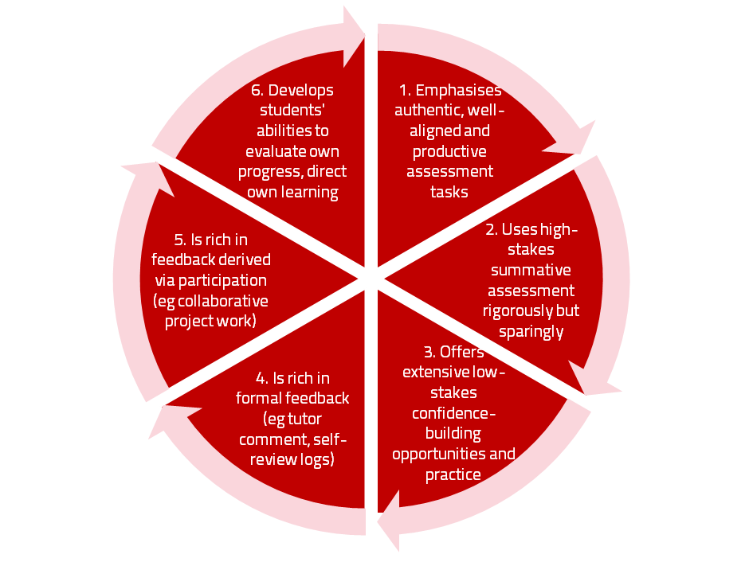
A4L the Northumbria model

Slide 25
Use link below to download the new materials on feedback and assessment produced in 2017 by Kay Sambell, Sally Brown and Phil Race for Edinburgh Napier University
http://staff.napier.ac.uk/services/dlte/ENhance/Pages/ENhanceQuickGuides.aspx

Slide 26
How’s your feedback? (After Nicol and MacFarlane-Dick, 2006)
1. Helps clarify what good performance is (goals, criteria, expected standards);
2. Facilitates the development of self-assessment (reflection) in learning;
3. Delivers high quality information to students about their learning, so that they can address deficiencies and built on strengths;
4. Encourages teacher and peer dialogue around learning;
5. Encourages positive motivational beliefs and self-esteem;
6. Provides opportunities to close the gap between current and desired performance;
7. Provides information to teachers that can be used to help shape the teaching.

Slide 27
Boud et al 2010: ‘Assessment 2020’
Assessment has most effect when...:
It is used to engage students in learning that is productive.
Feedback is used to actively improve student learning.
Students and teachers become responsible partners in learning and assessment.
Students are inducted into the assessment practices and cultures of higher education.
Assessment for learning is placed at the centre of subject and program design.
Assessment for learning is a focus for staff and institutional development.
Assessment provides inclusive and trustworthy representation of student achievement.

Slide 28
Boud et al, 2010
David Boud (University of Technology, Sydney), Royce Sadler (Griffith University), Gordon Joughin (University of Wollongong), Richard James (University of Melbourne), Mark Freeman (University of Sydney), Sally Kift (Queensland University of Technology), Filip Dochy (University of Leuven), Dai Hounsell (University of Edinburgh), Margaret Price (Oxford Brookes University), Tom Angelo (La Trobe University), Angela Brew (Macquarie University), Ian Cameron (University of Queensland), Denise Chalmers (University of Western Australia), Paul Hager (University of Technology, Sydney), Kerri-Lee Harris (University of Melbourne), Claire Hughes (University of Queensland), Peter Hutchings (Australian Learning and Teaching Council), Kerri-Lee Krause (Griffith University), Duncan Nulty (Griffith University), Ron Oliver (Edith Cowan University), Jon Yorke (Curtin University), Iouri Belski (RMIT University), Ben Bradley (Charles Sturt University), Simone Buzwell (Swinburne University of Technology), Stuart Campbell (University of Western Sydney), Philip Candy (University of Southern Queensland), Peter Cherry (Central Queensland University), Rick Cummings (Murdoch University), Anne Cummins (Australian Catholic University), Elizabeth Deane (Australian National University), Marcia Devlin (Deakin University), Christine Ewan (Australian Learning and Teaching Council), Paul Gadek (James Cook University), Susan Hamilton (University of Queensland), Margaret Hicks (University of South Australia), Marnie Hughes-Warrington (Monash University), Gail Huon (University of Newcastle), Margot Kearns (University of Notre Dame, Sydney), Don Maconachie (University of the Sunshine Coast), Vi McLean (Queensland University of Technology,) Raoul Mortley (Bond University), Kylie O’Brien (Victoria University), Gary O’Donovan (University of Tasmania), Beverley Oliver (Curtin University), Simon Pyke (University of Adelaide), Heather Smigiel (Flinders University), Janet Taylor (Southern Cross University), Keith Trigwell (University of Sydney), Neil Trivett (University of Ballarat), Graham Webb (University of New England).

Slide 29
The NSS Assessment and Feedback Agenda (2005-16)
The criteria used in marking have been clear in advance.
Assessment arrangements and marking have been fair.
Feedback on my work has been prompt.
I have received detailed comments on my work.
Feedback on my work has helped me to clarify things I did not understand.

Slide 30
The new NSS statements (2017)
Assessment and feedback
The criteria used in marking have been clear in advance
Marking and assessment have been fair
Feedback on my work has been timely
I have received helpful comments on my work
Student voice
I have had the right opportunities to provide feedback on my course
Staff value students’ views and opinions about the course
It is clear how students’ feedback on the course has been acted on

Slide 31
Feed-forward
Language of feedback
Some feedback
issues
National Student Survey
Timing:
24-hours!
Written, printed,
on-screen
Efficiency
Face to face
oral

Slide 32
Face-to-face communication
Making all the channels work

Slide 33
Face-to-face one-to-one feedback activity
On the signal to start, please stand up, and work in pairs, moving around the room, talking to different people using the script which follows…
The script:
A ‘Hello’ (or equivalent).
B ‘Hello’ (or equivalent).
A ‘You are late’.
B ‘I know’.
Try to do it completely differently each time.

Slide 34
Constructive Alignment: John Biggs
What will I be expected to show for this?
What does a good one look like, and a bad one?
Where does this fit into the big picture?
When explaining assessment criteria to students, and when linking these to evidence of achievement of the intended learning outcomes, we need to make the most of face-to-face whole group contexts and...
Tone of voice
Body language
Facial expression
Eye contact
The chance to repeat things
The chance to respond to puzzled looks
Some things don’t work nearly so well just on paper or on screens.
Some of the
tools we can
use in
face-to-face
contexts

Slide 35
What’s wrong with feedback?
Students get it too late.
And too often, it’s just words on paper.
It doesn’t help them enough.
They often don’t take enough notice of it.

Slide 36
But what’s really wrong with feedback?
Too often it’s one-way – monologic.
What students want is dialogue.
They want to talk to us about their work.
But they’re scared to talk to us, for various reasons:
In case it leads to lower marks;
In case they’re ‘found out’;
In case they feel stupid.

Slide 37
Royce Sadler on feedback:
Higher education teachers are often frustrated by the modest impact feedback has in improving learning. The status of feedback deserves to be challenged on the grounds that it is essentially about telling. For students to become self-sustaining producers of high quality intellectual and professional goods, they must be equipped to take control of their own learning and performance. (Sadler, 2013)
Sadler, D. R. (2013). Opening up feedback: Teaching learners to see. In Merry, S., Price, M., Carless, D., & Taras, M. (Eds.) Reconceptualising feedback in higher education: Developing dialogue with students. (Ch. 5, 54‑63). London: Routledge.

Slide 38
Sally Brown on Feedback
From ‘Learning, teaching and assessment: global perspectives’
2015, Palgrave-Macmillan

Slide 39
Five things students really hate about feedback
Poorly written comments that are nigh on impossible to decode, especially when impenetrable acronyms or abbreviations are used, or where handwriting is in an unfamiliar alphabet and is illegible.
Cursory and derogatory remarks that leave them feeling demoralised ‘Weak argument’, ‘Shoddy work’, ‘Hopeless’, ‘Under-developed’, and so on.
Value judgements on them as people rather than on the work in hand.

Slide 40
Five things students really hate about feedback
Vague comments which give few hints on how to improve or remediate errors: ‘OK as far as it goes’, ‘Needs greater depth of argument’, ‘Inappropriate methodology used’, ‘Not written at the right level’.
Feedback that arrives so late that there are no opportunities to put into practice any guidance suggested in time for the submission of the next assignment.

Slide 41
Good feedback:
Is dialogic, rather than mono-directional, giving students chances to respond to comments from their markers and seek clarification where necessary.
Helps clarify what good work looks like, so students are really clear about goals, criteria and expected standards, and provides opportunities to close the gap between current and desired performance.

Slide 42
Good feedback:
Actively facilitates students reviewing their own work and reflecting on it, so that they become good judges of the quality of their own work.
Doesn’t just correct errors and indicate problems, potentially leaving students discouraged and demotivated, but also highlights good work and encourages them to believe they can improve and succeed.

Slide 43
Good feedback:
Actively facilitates students reviewing their own work and reflecting on it, so that they become good judges of the quality of their own work.
Doesn’t just correct errors and indicate problems, potentially leaving students discouraged and demotivated, but also highlights good work and encourages them to believe they can improve and succeed.

Slide 44
Good feedback:
Delivers high-quality information to students about their achievements to date and how they can improve their future work. Where there are errors, students should be able to see what needs to be done to remediate them, and where they are undershooting in terms of achievement, they should be able to perceive how to make their work even better.

Slide 45
Good feedback:
Offers ‘feed-forward’ aiming to ‘increase the value of feedback to the students by focusing comments not only on the past and present … but also on the future – what the student might aim to do, or do differently in the next assignment or assessment if they are to continue to do well or to do better’ (Hounsell, 2008, p. 5).
Ensures that the mark isn’t the only thing that students take note of when work is returned, but that they are encouraged to read and use the advice given in feedback and apply it to future assignments.

Slide 46
Ten tips for formative feedback (many more expanded upon in the handout which was already on the tables)
Help students to want feedback.
Stop them concentrating on the mark.
Get the timing right, while students still care about what they’ve done.
Make feedback interesting - not routine or mundane.
Give at least some feedback very quickly.

Slide 47
Ten tips for formative feedback
Link feedback to the achievement of learning outcomes.
Provide most feedback at the beginning – ‘scaffolding’.
Use feedback to clarify targets, standards and expectations.
Ensure that students know that your feedback is about their work, not about them as people.
Make full use of auditory, visual and kinaesthetic – don’t give feedback just in the read-write domain.

Slide 48
Feedback without marks
Marks often destroy the value of our feedback to students!

Slide 49
Feedback versus marks or grades
Feedback may be eclipsed by marks or grades.
Students may be blinded by the mark or grade, and not even try to make sense of the feedback they receive.

Slide 50
Just a mark (or grade) is the least effective form of feedback!
It’s what students look at first.
If the mark is good, they smile and file – quite often they don’t even read the feedback.
If it’s low, they frown and bin it – very often without reading the feedback.

Slide 51
But there are ways round this...
Give students back their work with feedback but with no marks or grades (keeping your record of their marks).
Ask them to work out their marks from the feedback you have given them (and from the feedback you gave to others too).

Slide 52
Suggest that their marks will count!
Tell them that if their self-assessment scores are within (say) 5% of your own scores, the higher number will go forward into their assessment record.
But explain that you will talk individually to those students whose score is different by more than 5% from yours.

Slide 53
Get them to self-assess...
Collect their scores or grades – e.g. pass a sheet round in a lecture.
Most students (e.g. 9 in 10) will be within the 5%.
Arrange to talk to those where the difference is more than 5% or one grade.

Slide 54
Students who under-estimate their grade…
These students often need their esteem boosted.
Remind them about the assessment criteria, and how these illustrate the intended standards associated with the learning outcomes.
Check that they weren’t just trying not to be seen as over-confident.

Slide 55
Students who over-estimate their grade…
This usually indicates they’ve got a blind spot.
Talk them through their work, and find out exactly where they’ve lost marks which they thought they had gained.
Check with them that they can now see what was being looked for.

Slide 56
Developing this idea further…
Think about getting students to indicate their expected score or grade at the point of handing their work in – for example on a self-assessment proforma.
Think about getting students to work out how well they believe they have achieved each of the intended learning outcomes for the work concerned…
Or how well they believe they have met each of the assessment criteria for the work.

Slide 57
Get students to self-assess their work
At the point of handing it in to us!

Slide 58
Using student self-assessment to deepen their learning…
…and to make tutor-marking more effective, and efficient – and to start tutor-student dialogues

Slide 59
Self-Assessment of your Assignment Please respond to the following questions at the point just before handing your work in. This will help me to give you useful feedback about your work, and also will give me useful feedback about how you are finding the programme to date. Thanks.
 | Questions | Your replies to the questions | Tutor’s responses | Your action points
1 | Ωηατ μαρκ (ουτ οφ 100) δο ψου τηινκ τηισ ωορκ δεσερϖεσ?
2 | Ωηατ διδ ψου λικε μοστ αβουτ δοινγ τηισ παρτιχυλαρ πιεχε οφ ωορκ?
3 | Ωηατ διδ ψου λικε λεαστ αβουτ δοινγ τηισ πιεχε οφ ωορκ?
4 | Ωηατ δο ψου τηινκ ισ τηε τηινγ ψου διδ βεστ?
5 | Ωηατ δο ψου τηινκ ψου διδ λεαστ ωελλ?

Slide 60
Self-assessment tutor dialogues
Getting students to really reflect:
A way of evidencing good feedback practice for inspection purposes;
Avoiding wasting your time – and students’ time;
Making sure students actually read your feedback;
Making sure you give your students the feedback they want as well as the feedback they need;
Finding out more about your students;
…and much more.

Slide 61
Some questions to consider for self-assessment-tutor dialogues
1 What do you honestly consider will be a fair score or grade for the work you are handing in?

Slide 62
Some questions to consider for self-assessment-tutor dialogues
2 What do you think was the thing you did best in this assignment?

Slide 63
Some questions to consider for self-assessment-tutor dialogues
3 If you had the chance to do the assignment again from scratch, how (if at all) might you decide to go about it differently?

Slide 64
Some questions to consider for self-assessment-tutor dialogues
4 What did you find the hardest aspect of this assignment?

Slide 65
Some questions to consider for self-assessment-tutor dialogues
5 Please jot down three short questions you would like me to answer about this example of your work:
(1)
(2)
(3)

Slide 66
Back to our intended learning outcomes…
Do you now feel better able to:
2 hands = very much better,
one hand = somewhat better,
touch left ear = no better...
Ensure that students benefit from feedback and feed-forward?
Make feedback more manageable for us, as well as students?
Wanting/
Needing
Doing
Making sense
Feedback

Slide 67
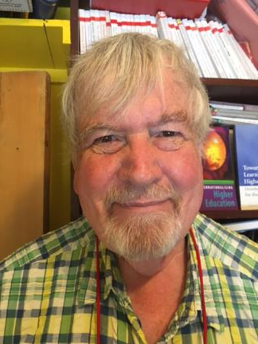
Thank you…
Website: http://phil-race.co.uk
Follow Phil on Twitter @RacePhil
e-mail: phil@phil-race.co.uk

Slide 68
Activating Learning Theme 2 Making learning happen in larger groups of students University of Glasgow
7th February, 2018
Phil Race
(from Newcastle-upon-Tyne)
BSc PhD PGCE FCIPD PFHEA NTF
Follow Phil on Twitter: @RacePhil
Visiting Professor: University of Plymouth and Edge Hill University
Emeritus Professor, Leeds Beckett University

Slide 69
Lectures
Lectures were once useful, but now, when all can read, and books are so numerous, lectures are unnecessary.
(Samuel Johnson, 1709-1784)

Slide 70
Intended learning outcomes
After participating in this session, you should be better able to:
Make better learning happen in large-group contexts.
Make lectures more participative for students.

Slide 71
Time-constrained exercise
“Making learning happen in large-group contexts would be much better for me if only …”

Slide 72
1
Staff are good at explaining things
10
I have
received
sufficient
support and
advice with
my studies
2
Staff have made the subject interesting
National
Student Survey: 2005 statements relevant to lectures
11
I have been able to contact staff when I needed to
3
Staff are enthusiastic about what they are teaching
4
The course is intellectually stimulating

Slide 73
1
Staff are good at explaining things
25
I feel part
of a
community
of staff
and
students
2
Staff have made the subject interesting
National
Student Survey: 2017 statements relevant to lectures
8
The criteria used in marking have been clear in advance
3
The course is intellectually stimulating
4
The course has challenged me to achieve my best work

Slide 74
Ripples on a pond….
Striving to enhance our students’ want to learn;
Helping students to develop ownership of the need to learn;
Keeping students learning by doing, practice, trial-and-error, repetition;
Ensuring students get quick and useful feedback – from us and from each other;
Helping students to make sense of what they learn.
Getting students deepening their learning by verbalising, explaining things to each other, and to us.
Allowing students to further deepen their learning by assessing their own learning, and assessing others’ learning – making informed judgements.
We can make learning happen by:
Verbalising
Assessing
making informed judgements
Wanting/
Needing
Doing
Doing
Making sense
Feedback

Slide 75
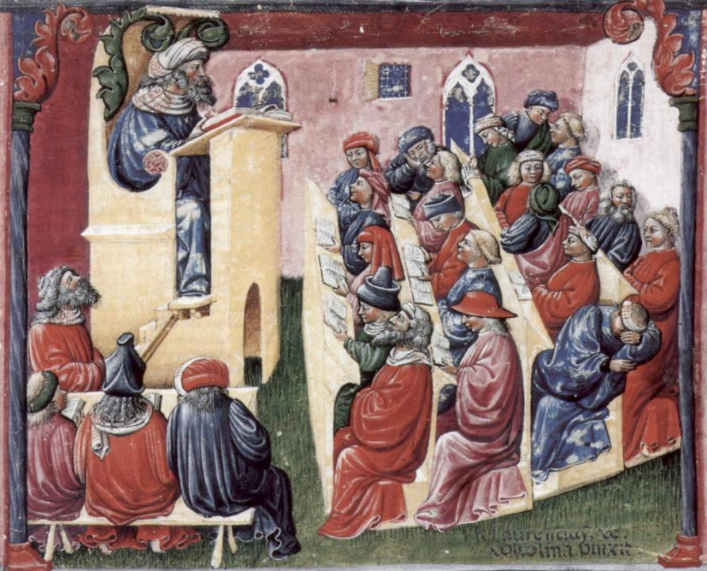
Laurentius de Voltolina
2nd half of 14th Century
Italian Painter

Slide 76
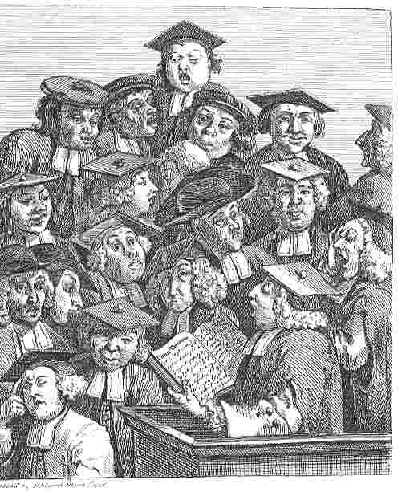
William Hogarth
1736
‘Scholars at a lecture’

Slide 77
What are lectures for, in 2018?
Nowadays, we don't need lectures simply to give students information, as so much is available to them online worldwide, but we do need to help them to negotiate the sea of available information so that their learning is focused and successful.

Slide 78
So what can we do in lectures?
We still meet students in lecture theatres and other large-group sessions, so what should we do? Four things:...
We’ve got to inspire them, arouse their curiosity, get them thinking, and (above all) start making their learning happen, there and then while they’re with us.

Slide 79
Lectures should be fun!
They should be fun for us.
They should be fun for students.
There are lots of good reasons to get a large group of students together in the same room at the same time.
One of them is not ‘to give them lots of stuff’ however.

Slide 80
What is likely to annoy students in lectures?
Staff who don’t appear to have done good preparation of content material;
Material at the wrong level, that is too easy or goes right over their heads;
Lecturers who seem jaded, unenthusiastic or uninterested in what they are teaching (or the level of students);
Lecture formats that never change, and over-use Power Point;
Lack of interaction between the lecturer and students;
Issues around timing, particularly over-running and rushing at the end.

Slide 81
But now...
In our digital age, things have changed rather a lot. Many students don’t come with pens for a start – they do have smartphones, laptops and tablets.
The amount of information around has grown exponentially. Students may see hundreds of screens of it per lecture by the time they’ve downloaded the slides, explored the weblinks and digested the ebooks.

Slide 82
Sally Brown on lectures (2015)
Many argue that the era of lectures has passed, that it is archaic to expect students to sit physically present in the same room as the lecturer, passively listening to and noting what is said, and thereby absorbing content.
If you sit at the back of the lecture theatre and watch what students are actually doing on their laptops and mobile devices, it is evident that few students nowadays simply sit and make traditional lecture notes with pens and paper.

Slide 83
Teaching – and research – and reflection: the ten most important words
Why?
What?
Who?
Where?
When?
How?
Which?
So what?
Wow?
And the most powerful four-letter word in the English language...
????

Slide 84
‘what’ is getting ever less important
Columbia University research published recently (2011) in Science magazine shows that people are much less prepared to remember ‘what’, but better at remembering where to access information, and how to do so.
Betsy Sparrow, one of the principal researchers, concludes that the internet has become ‘an external memory source that we can access at any time. ... Just as we learn through transactive memory who knows what in our families and offices, we are learning what the computer ‘knows’ and when we should attend to where we have stored information in our computer-based memories. We are becoming symbiotic with our computer tools.
Published Online July 14 2011 < Science Express Index Science DOI: 10.1126/science.1207745
Report: Google Effects on Memory: Cognitive Consequences of Having Information at Our Fingertips Betsy Sparrow,*, Jenny Liu, Daniel M. Wegner

Slide 85
Teaching – and research – and reflection: the ten most important words
Why? (rationale)
What? (content)
Who? (people, you, me, them)
Where? (locations)
When? (times)
How? (processes)
Which? (decisions)
So what? (importance?)
Wow? (impact?)
And the most powerful four-letter word in the English language...
????

Slide 86
Attendance
There are strong correlations between student attrition / failure to achieve potential and student attendance;
However, just being there isn’t enough: the key is engagement rather than physical presence;
We need to think through the rationale for students wanting to be there, and some of the things we do to support students, e.g. providing materials on the VLE may not support attendance;
It’s not easy, but we have to find ways to engage students while they are in class to make them feel it is worth the effort of turning up.

Slide 87
Making Lectures Unmissable in our digital age
Start reasonably punctually. (Punctuality is about respect).
Make good use of intended learning outcomes. (Targets).
Always link lectures to assessment. (That’s what they need)
Lecturers should be seen and heard.
Don’t keep slides up too long. (Use ‘B’)
Avoid death by bullet point.
Try to cause the learners to like you. (Smile).
Think of what learners will be doing during the lecture.
Get learners note-making, not just note-taking.
Don’t put too much into that first lecture. (No second chance to make the right first impression).

Slide 88
Making Lectures Unmissable
Be kind to learners’ brains. (Concentration spans minutes)
Bring in some appropriate humour.
But don’t use humour if it’s not working!
Give learners something to take away.
Flag up related sessions.
Think twice about giving out handout copies of your PowerPoint slides.
Keep yourself tuned into WIIFM.
Don’t be unkind to learners who missed your last lecture.
Don’t over-run. (You might over-run, but they won’t).
Pave the way towards your next lecture.

Slide 89
Characteristics of excellent university teachers (common ground from a range of recent literature)
Knows subject material thoroughly
Adopts a scholarly approach to the practice of teaching
Is reflective and regularly reviews own practice
Is well organised and plans curriculum effectively
Is passionate about teaching
Has a student-centred orientation to teaching
Regularly reviews innovations in learning and teaching and tries out ones relevant to own context
Ensures that assessment practices are fit for purpose and contribute to learning
Demonstrates empathy and emotional intelligence

Slide 90
Characteristics of excellent teachers: diamond-9
1
2
3
4
5
6
7
8
9

Slide 91
Back to our intended learning outcomes…
Do you now feel better able to:
2 hands = very much better,
one hand = somewhat better,
touch left ear = no better...
Make better learning happen in large-group contexts?
Make lectures more participative for students?
Wanting/
Needing
Doing
Making sense
Feedback

Slide 92
Thank you…
Website: http://phil-race.co.uk
Follow Phil on Twitter @RacePhil
e-mail: phil@phil-race.co.uk

