Slide 1
Activating Learning Rethinking feedback for 2018: improving effectiveness, speed, and satisfaction – (ours, as well as students’) Coventry University
14-15th March, 2018
Phil Race
(from Newcastle-upon-Tyne)
BSc PhD PGCE FCIPD PFHEA NTF
Follow Phil on Twitter: @RacePhil
Visiting Professor: University of Plymouth and Edge Hill University
Emeritus Professor, Leeds Beckett University

Slide 2
This slide has two purposes….
To focus the data projector, if necessary, and…
...to persuade colleagues never to put this sort of detail onto a slide!

Slide 3
About Phil…
First a musician
Then a writer
Then a scientist
Then a researcher
Then a lecturer and warden at what is now USW
Got interested in how students learn
And the effects assessment and feedback have on them
And how we teach them
Gradually became an educational developer
And now ‘retired’!?
Currently…
Visiting Prof: Plymouth & Edge Hill
Emeritus Prof: Leeds Beckett
Based at Newcastle, UK
And on trains
And an expert…
on train routes and timetables!
Notes:
2
2

Slide 4
Thanks to students
I could not do what I do nowadays if I did not continue to spend a fair bit of my time working with students – they’ve taught me most of what I know.

Slide 5
Students change
Great to be with you again (last on 25th September in 2013 I believe?)
Students are changing fast, as are their expectations of how, what and why they are learning. As teachers, we need to use the best of innovative techniques, as what worked for us when we were learners may no longer work for today’s students. For a start, student groups are far bigger than used to be the case, and we’re in a digital age, not a paper-based one.

Slide 6
Linking everything to learning
In this interactive programme, we will start from how students really learn, and how we can respond to factors underpinning their successful learning, above all, the central factor of feedback – perhaps best thought of as feedforward.
We will dig into to the ever-important dimension of feedback to students – (and feedback from students) – and look at ways of making feedforward more manageable for us as well as for students.

Slide 7
Feedback, knowledge and enthusiasm
Knowledge isn’t infectious (unfortunately) but enthusiasm is, and we need to help our students to catch enthusiasm – (and on a wet Monday morning that doesn’t happen automatically!).
We certainly don’t want feedback to damage enthusiasm.

Slide 8
Name labels…
Please write your first name, big and bold, on a sticky label, and stick it to your clothing (not onto a fabric which would be damaged).
Phil

Slide 9
Outline Programme: March 14th
1400 Reminder of How students really learn – role of feedback in the factors underpinning successful learning. Post-it exercise: “making feedback work for my students would be much better if only I..”. Issues arising about feedback, including the 2017 NSS and satisfaction measures.
1430 What the gurus say about feedback in today’s environments, including exemplars and the work of David Carless and others; the advantages of face-to-face feedback over written feedback.
1450 Getting better feedback to more students more quickly and in less of our time: group exercise and discussion.
1520 Coffee break
1540 Marks and feedback: the problems and some solutions. Involving students in self- and peer-assessment: and how this can lead to better feedback.
1610 Questions, action-planning and discussion.
1630 Close of workshop.

Slide 10
Outline Programme: March 15th
0930 Reminder of How students really learn – role of feedback in the factors underpinning successful learning. Post-it exercise: “making feedback work for my students would be much better if only I..”. Issues arising about feedback, including the 2017 NSS and satisfaction measures.
1000 What the gurus say about feedback in today’s environments, including exemplars and the work of David Carless and others; the advantages of face-to-face feedback over written feedback.
1020 Getting better feedback to more students more quickly and in less of our time: group exercise and discussion.
1050 Coffee break
1100 Marks and feedback: the problems and some solutions. Involving students in self- and peer-assessment: and how this can lead to better feedback.
Questions, action-planning and discussion.
Close of workshop.
1200 Phil gets taxi!!

Slide 11
Intended learning outcomes
After participating in this half-day workshop, you should be better-able to:
Identify and confront the problems involved in making feedback and feedforward work for us and for our students;
Examine what the gurus now say about feedback techniques;
Consider the cons of written feedback, and the pros of oral feedback;
Explore ways of making feedforward more manageable for us.

Slide 12
You will be able to download my main slides
You don’t need to take notes.
I’ll put the main slides I use up on my website when I get home on the 15th (http://phil-race.co.uk/)
I won’t post pictures and video-clips, as this would make the file-size too large.
I may sometimes go through slides quite fast, but you can study them as you wish at your leisure.

Slide 13
Announcement about mobile phones and laptops...
Good day everyone – please turn on your ‘phones, tablets and computers.
Please post your thoughts, questions, comments and ideas during this session to the hashtag #philatcoventry18 Thanks!
Try #LTHEchat on Wednesday evenings from 20.00-21.00.

Slide 14
Download Phil’s published stuff on feedback, assessment, and learning
Expanded discussion of how the factors underpinning learning link to feedback, assessment and large-group teaching:
http://phil-race.co.uk/2016/04/updated-powerpoint-ripples-model/ (Chapter 1 from ‘The Lecturer’s Toolkit, 2015)
https://phil-race.co.uk/2016/10/lthe-tweetchat-lthechat-wed-oct-19-8-00-9-00-pm/ (feedback stuff from my most recent two books)
http://phil-race.co.uk/2015/01/assessment-bits-new-editions/ (extracts on assessment)

Slide 15
Time-constrained Post-it exercise
On a post-it, in your best handwriting, please write your own completion of the starter:
“making feedback work for my students would be much better if only I..…”
Please swap post-its so that you’ve no idea who has yours.
If chosen, please read out with passion and drama the post-it you now have.
Please place them all on the chart.

Slide 16
Thought for the day: Einstein
It is simply madness
to keep doing the same things,
and expect different results.

Slide 17
Evidence-based practice
In the last decade, there’s been a great deal of international evidence-based research in assessment, feedback, learning and teaching. I’d like to alert you to how some of this can help us enhance students’ learning.
The next three slides show just 17 sources selected from the published evidence.

Slide 18
17 sources about assessment, feedback and learning in higher education
Knight, P. and Yorke, M. (2003) Assessment, learning and employability, Maidenhead, UK SRHE/Open University Press.
The TESTA project (http://www.testa.ac.uk/) Transforming the Experience of Students through Assessment, (Bath Spa, Chichester, Winchester and Worcester)
Flint, N. R. and Johnson, B. (2011) Towards fairer university assessment – recognising the concerns of students, London: Routledge.
ETC Toolkit (2015) (Enhancing the Curriculum) www.etctoolkit.org.uk
HEA (2012) A Marked Improvement: transforming assessment in higher education, York: Higher Education Academy (http://www.heacademy.ac.uk/assets/documents/assessment/A_Marked_Improvement.pdf )

Slide 19
17 sources about assessment, feedback and learning in higher education
Boud, D. and Associates (2010) Assessment 2020: seven propositions for assessment reform in higher education Sydney: Australian Learning and Teaching Council.
Carless, D. (2015) Excellence in University Assessment: Learning from award-winning practice, London: Routledge.
Race, P. (2014) Making learning happen: 3rd edition London: Sage. (lots of bits free on my website!)
Hunt, D. and Chalmers, L. (eds) (2012) University Teaching in Focus: a learning-centred approach Australia: ACER Press, and London: Routledge.
Price, M., Rust, C., O’Donovan, B. and Handley, K. (2012) Assessment Literacy, Oxford: the Oxford Centre for Staff and Learning Development (based on the ‘ASKe’ Project).
Evans, C. (2013) Making Sense of Assessment Feedback in Higher Education, Review of Educational Research Vol. 83, No. 1, pp. 70–120. http://journals.sagepub.com/doi/abs/10.3102/0034654312474350

Slide 20
17 sources about assessment, feedback and learning in higher education
Sambell, K., McDowell, L. and Montgomery, C. (2013) Assessment for Learning in Higher Education, London: Routledge.
Brown, S. (2015) Learning, teaching and assessment in higher education: global perspectives, Basingstoke: Palgrave-Macmillan. (great discussion on plagiarism).
Race, P. (2015) The Lecturer’s Toolkit: 4th edition, London, Routledge. (lots of bits on my website!)
Parkin, D (2017) Leading Learning and Teaching in Higher Education – the key guide to designing and delivering courses, London: Routledge.
Lea, J. (ed.) (2015) Enhancing Learning And Teaching In Higher Education: Engaging With The Dimensions Of Practice, London, Open University Press.
Sambell, K, Brown, S and Graham, L. (2017) Professionalism in Practice: Key directions in higher education: Learning, Teaching and Assessment, Basingstoke: Palgrave-Macmillan.

Slide 21
Now is the decade of Universities’ dis-content!
Never mind the content – feel the learning

Slide 22
Modern institutions are moving away from being the providers of content, (where everything used to be about ‘delivery’), towards foregrounding two major functions:
Recognising and accrediting students’ achievement, wherever learning has taken place (i.e. getting the assessment right);
Supporting student learning and engagement (not least by making feedback work well for students, and using real-world situations and simulations to bring learning to life).

Slide 23
Quality feedback: three vital functions
“There is wide consensus within the education literature that ‘quality’ feedback should serve three overlapping functions:
an ‘orientational’ purpose that clarifies the student’s performance and achievement;
a ‘transformational’ purpose that enables the student to reflect, improve their performance, and become more autonomous (often termed ‘feed-forward); and
an ‘affective/interpersonal’ dimension that gives the student confidence and motivation, and builds a strong teacher-student relationship”
(Dunworth & Sanchez, 2016, quoted by Winstone and Nash, 2016).

Slide 24
Task: think about ghastly feedback
Think back to some occasions, academic or otherwise, historic or recent when you received feedback that you would rather not have received.
How did it make you feel?
Thinking of a single example of ghastly feedback that you are prepared to share with another person, briefly outline the context and say why it was such a negative experience.

Slide 25
Is your provision of feedback fair?
Do you review feedback across a cohort of markers to ensure there is some consistency between them in the amount, quality and promptness of feedback they give?
Do students who visit staff offices persistently or enter into extended email discussions with staff on a one-to-one basis for additional feedback (the ‘worried well’) get significantly more and better feedback than those that do not?
Do you as an assessor become noticeably more tetchy and sketchy in your feedback the later in the day you are doing it? – also … later down the pile of work?
Do you play fair by students by avoiding opacity and obscurity in your comments?

Slide 26
What are exemplars, and how can we use them productively?
Exemplars are not model answers. They are carefully selected examples of authentic student work from previous cohorts (anonymised and with permission) or teacher-constructed examples (based on your extensive experience of the kinds of responses and common mistakes students make). They are chosen to typify and illustrate designated levels of quality or competence.
The concrete nature of exemplars means that they are able to convey messages in a way that nothing else can (Sadler, 2002). Carefully selected examples can not only help students to ‘see’ what the teacher expects with regard to the task in hand (Scoles et al, 2013), but also guide their action.

Slide 27
Exemplars can enable students to:
gain a feel for what the final product looks like in terms of layout, size, structure and language;
develop their insights into the nature of academic writing;
raise awareness of the diverse ways a task might fruitfully (or erroneously) be tackled;
hone students’ evaluative skills;
Act as powerful learning tools (Sadler, 2010), helping students gain insight into the nature of quality and standards, ideally through close analysis and discussion (Hendry et al, 2016);
Students typically find exemplars to be more useful than standalone lists of criteria, grids and rubrics (Hawe et al, 2017).

Slide 28
What can we do when using exemplars?
Choose examples which will help students firmly grasp task requirements;
Help students practise applying criteria to samples of work;
Enable students to reflect deeply on, and discuss, what high quality work looks like;
Carefully orchestrate discussion activities to promote understanding of fruitful learning strategies and approaches;
Use exemplars-based activities to develop students’ skills to monitor their own work while they are producing it;
Help students to rate their work by comparison with their peers.

Slide 29
How students really learn
Seven factors underpinning successful learning based on asking 200,000 people about their learning in the last 30 years!

Slide 30
How Students Really Learn ‘Ripples’ model of learning
Phil Race

Slide 31
What’s missing?
Engagement?
Feelings?
Active
Experimentation
Emotions?
Judgments?
Desire?
Abstract
Conceptualisation
Concrete
Experience
Communication?
People?
Reflective
Observation

Slide 32
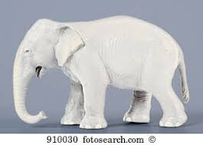
But what about learning styles?
https://www.theguardian.com/education/2017/mar/12/no-evidence-to-back-idea-of-learning-styles?CMP=share_btn_tw
(Link from my Tweet on March 13th 2017 to a letter in the Guardian by prominent folk around the world of education)
Or link to a word document: https://phil-race.co.uk/2017/09/swansea-university-school-management-21st-September/
“No evidence to back idea of learning styles”

Slide 34
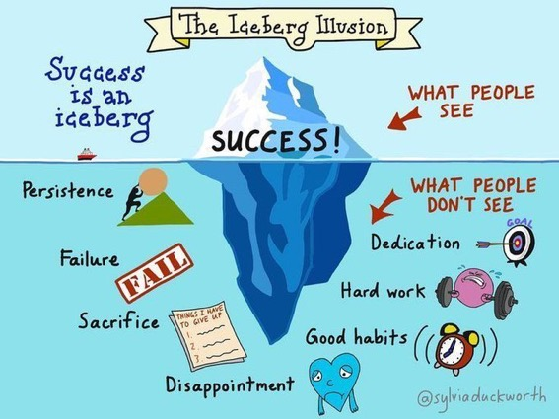

Slide 35
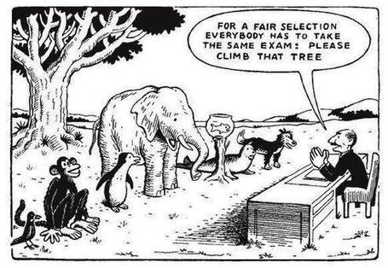

Slide 36
Ripples on a pond….
Striving to enhance our students’ want to learn;
Helping students to develop ownership of the need to learn;
Keeping students learning by doing, practice, trial-and-error, repetition;
Ensuring students get quick and useful feedback – from us and from each other;
Helping students to make sense of what they learn.
Getting students deepening their learning by verbalising, explaining things to each other, and to us.
Allowing students to further deepen their learning by assessing their own learning, and assessing others’ learning – making informed judgements.
We can make learning happen by:
Verbalising
Assessing
making informed judgements
Wanting/
Needing
Doing
Doing
Making sense
Feedback

Slide 38
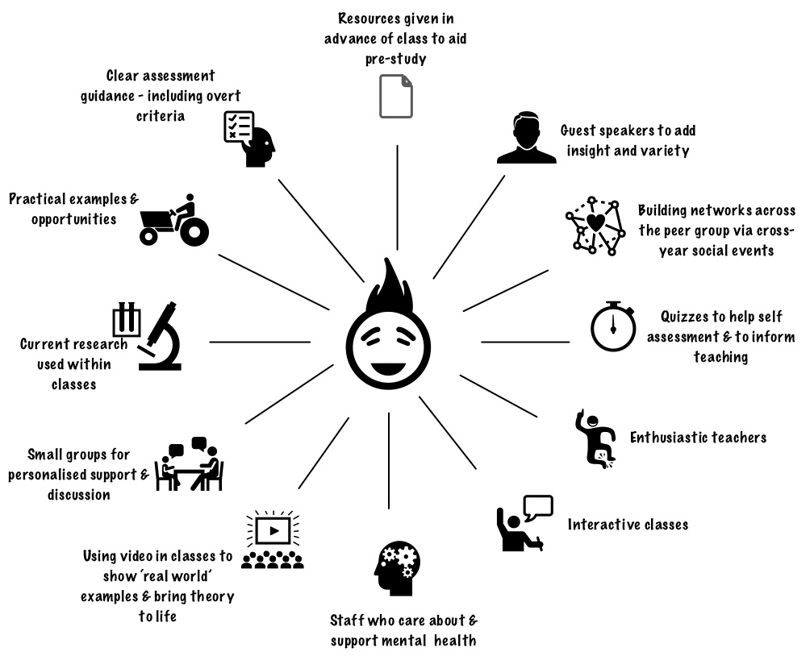
Coventry
University
What works?

Slide 39
Learning is not linear! Feedback is not unidirectional. But sometimes we pretend that they are! #sketchnote by @SGroshell and @MrZachG #edchat #learning #teachchat

Slide 40
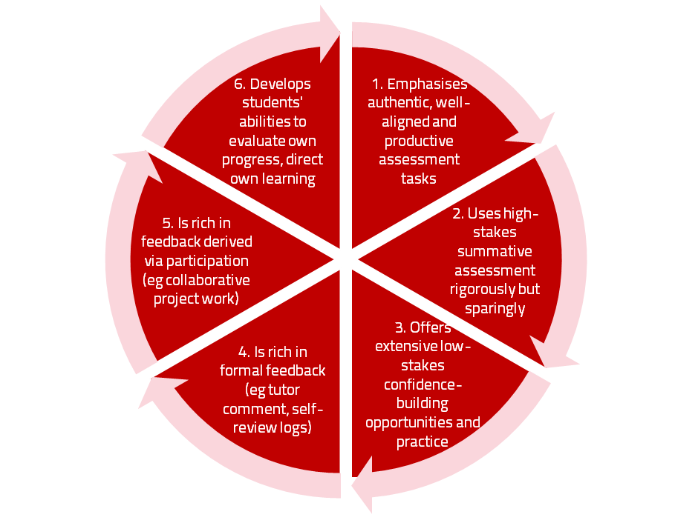
A4L the Northumbria model

Slide 41
Use link below to download the new materials on feedback and assessment produced in 2017 by Kay Sambell, Sally Brown and Phil Race for Edinburgh Napier University
http://staff.napier.ac.uk/services/dlte/ENhance/Pages/ENhanceQuickGuides.aspx

Slide 42
How’s your feedback? (After Nicol and MacFarlane-Dick, 2006)
1. Helps clarify what good performance is (goals, criteria, expected standards);
2. Facilitates the development of self-assessment (reflection) in learning;
3. Delivers high quality information to students about their learning – and how to progress it;
4. Encourages teacher and peer dialogue around learning;
5. Encourages positive motivational beliefs and self-esteem;
6. Provides opportunities to close the gap between current and desired performance;
7. Provides information to teachers that can be used to help shape the teaching.

Slide 43
Boud et al 2010: ‘Assessment 2020’
Assessment has most effect when...:
It is used to engage students in learning that is productive.
Feedback is used to actively improve student learning.
Students and teachers become responsible partners in learning and assessment.
Students are inducted into the assessment practices and cultures of higher education.
Assessment for learning is placed at the centre of subject and program design.
Assessment for learning is a focus for staff and institutional development.
Assessment provides inclusive and trustworthy representation of student achievement.

Slide 44
Boud et al, 2010
David Boud (University of Technology, Sydney), Royce Sadler (Griffith University), Gordon Joughin (University of Wollongong), Richard James (University of Melbourne), Mark Freeman (University of Sydney), Sally Kift (Queensland University of Technology), Filip Dochy (University of Leuven), Dai Hounsell (University of Edinburgh), Margaret Price (Oxford Brookes University), Tom Angelo (La Trobe University), Angela Brew (Macquarie University), Ian Cameron (University of Queensland), Denise Chalmers (University of Western Australia), Paul Hager (University of Technology, Sydney), Kerri-Lee Harris (University of Melbourne), Claire Hughes (University of Queensland), Peter Hutchings (Australian Learning and Teaching Council), Kerri-Lee Krause (Griffith University), Duncan Nulty (Griffith University), Ron Oliver (Edith Cowan University), Jon Yorke (Curtin University), Iouri Belski (RMIT University), Ben Bradley (Charles Sturt University), Simone Buzwell (Swinburne University of Technology), Stuart Campbell (University of Western Sydney), Philip Candy (University of Southern Queensland), Peter Cherry (Central Queensland University), Rick Cummings (Murdoch University), Anne Cummins (Australian Catholic University), Elizabeth Deane (Australian National University), Marcia Devlin (Deakin University), Christine Ewan (Australian Learning and Teaching Council), Paul Gadek (James Cook University), Susan Hamilton (University of Queensland), Margaret Hicks (University of South Australia), Marnie Hughes-Warrington (Monash University), Gail Huon (University of Newcastle), Margot Kearns (University of Notre Dame, Sydney), Don Maconachie (University of the Sunshine Coast), Vi McLean (Queensland University of Technology,) Raoul Mortley (Bond University), Kylie O’Brien (Victoria University), Gary O’Donovan (University of Tasmania), Beverley Oliver (Curtin University), Simon Pyke (University of Adelaide), Heather Smigiel (Flinders University), Janet Taylor (Southern Cross University), Keith Trigwell (University of Sydney), Neil Trivett (University of Ballarat), Graham Webb (University of New England).

Slide 45
The NSS Assessment and Feedback Agenda (2005-16)
The criteria used in marking have been clear in advance.
Assessment arrangements and marking have been fair.
Feedback on my work has been prompt.
I have received detailed comments on my work.
Feedback on my work has helped me to clarify things I did not understand.

Slide 46
The new NSS statements (2017)
Assessment and feedback
The criteria used in marking have been clear in advance
Marking and assessment have been fair
Feedback on my work has been timely
I have received helpful comments on my work
Student voice
I have had the right opportunities to provide feedback on my course
Staff value students’ views and opinions about the course
It is clear how students’ feedback on the course has been acted on

Slide 47
Feed-forward
Language of feedback
Some feedback
issues
National Student Survey
Timing:
24-hours!
Written, printed,
on-screen
Efficiency
Face to face
oral

Slide 48
Face-to-face communication
Making all the channels work

Slide 49
Face-to-face one-to-one feedback activity
On the signal to start, please stand up, and work in pairs, moving around the room, talking to different people using the script which follows…
The script:
A ‘Hello’ (or equivalent).
B ‘Hello’ (or equivalent).
A ‘You are late’.
B ‘I know’.
Try to do it completely differently each time.

Slide 50
Constructive Alignment: John Biggs
What will I be expected to show for this?
What does a good one look like, and a bad one?
Where does this fit into the big picture?
When explaining assessment criteria to students, and when linking these to evidence of achievement of the intended learning outcomes, we need to make the most of face-to-face whole group contexts and...
Tone of voice
Body language
Facial expression
Eye contact
The chance to repeat things
The chance to respond to puzzled looks
Some things don’t work nearly so well just on paper or on screens.
Some of the
tools we can
use in
face-to-face
contexts

Slide 51
Face to face feedback

Slide 52
Hands-on feedback?

Slide 53
What’s wrong with feedback?
Students get it too late.
And too often, it’s just words on paper.
It doesn’t help them enough.
They often don’t take enough notice of it.

Slide 54
But what’s really wrong with feedback?
Too often it’s one-way – monologic.
What students want is dialogue.
They want to talk to us about their work.
But they’re scared to talk to us, for various reasons:
In case it leads to lower marks;
In case they’re ‘found out’;
In case they feel stupid.

Slide 55
Royce Sadler on feedback:
Higher education teachers are often frustrated by the modest impact feedback has in improving learning. The status of feedback deserves to be challenged on the grounds that it is essentially about telling. For students to become self-sustaining producers of high quality intellectual and professional goods, they must be equipped to take control of their own learning and performance. (Sadler, 2013)
Sadler, D. R. (2013). Opening up feedback: Teaching learners to see. In Merry, S., Price, M., Carless, D., & Taras, M. (Eds.) Reconceptualising feedback in higher education: Developing dialogue with students. (Ch. 5, 54‑63). London: Routledge.

Slide 56
The importance of dialogic assessment
Students need to be exposed to, and gain experience in making judgements about, a variety of works of different quality... They need planned rather than random exposure to exemplars, and experience in making judgements about quality. They need to create verbalised rationales and accounts of how various works could have been done better. Finally, they need to engage in evaluative conversations with teachers and other students. Together, these three provide the means by which students can develop a concept of quality that is similar in essence to that which the teacher possesses, and in particular to understand what makes for high quality. Although providing these experiences for students may appear to add more layers to the task of teaching, it is possible to organise this approach to peer assessment so that it becomes a powerful strategy for higher education teaching. (Sadler 2010)

Slide 57
Sally Brown on Feedback
From ‘Learning, teaching and assessment: global perspectives’
2015, Palgrave-Macmillan

Slide 58
Five things students really hate about feedback
Poorly written comments that are nigh on impossible to decode, especially when impenetrable acronyms or abbreviations are used, or where handwriting is in an unfamiliar alphabet and is illegible.
Cursory and derogatory remarks that leave them feeling demoralised ‘Weak argument’, ‘Shoddy work’, ‘Hopeless’, ‘Under-developed’, and so on.
Value judgements on them as people rather than on the work in hand.

Slide 59
Five things students really hate about feedback
Vague comments which give few hints on how to improve or remediate errors: ‘OK as far as it goes’, ‘Needs greater depth of argument’, ‘Inappropriate methodology used’, ‘Not written at the right level’.
Feedback that arrives so late that there are no opportunities to put into practice any guidance suggested in time for the submission of the next assignment.

Slide 60
Good feedback:
Is dialogic, rather than mono-directional, giving students chances to respond to comments from their markers and seek clarification where necessary.
Helps clarify what good work looks like, so students are really clear about goals, criteria and expected standards, and provides opportunities to close the gap between current and desired performance.

Slide 61
Good feedback:
Actively facilitates students reviewing their own work and reflecting on it, so that they become good judges of the quality of their own work.
Doesn’t just correct errors and indicate problems, potentially leaving students discouraged and demotivated, but also highlights good work and encourages them to believe they can improve and succeed.

Slide 62
Good feedback:
Actively facilitates students reviewing their own work and reflecting on it, so that they become good judges of the quality of their own work.
Doesn’t just correct errors and indicate problems, potentially leaving students discouraged and demotivated, but also highlights good work and encourages them to believe they can improve and succeed.

Slide 63
Good feedback:
Delivers high-quality information to students about their achievements to date and how they can improve their future work. Where there are errors, students should be able to see what needs to be done to remediate them, and where they are undershooting in terms of achievement, they should be able to perceive how to make their work even better.

Slide 64
Good feedback:
Offers ‘feed-forward’ aiming to ‘increase the value of feedback to the students by focusing comments not only on the past and present … but also on the future – what the student might aim to do, or do differently in the next assignment or assessment if they are to continue to do well or to do better’ (Hounsell, 2008, p. 5).
Ensures that the mark isn’t the only thing that students take note of when work is returned, but that they are encouraged to read and use the advice given in feedback and apply it to future assignments.

Slide 65
Feedback, and…
Feed-forward

Slide 66
Ripples on a pond….
Motivates students – helps them to want to learn;
Helps students to identify what they need to do next;
Helps students to take action to improve their learning;
Helps students to make sense of what they are learning;
Helps them to further make sense of their learning by engaging in real dialogue with tutors and peers;
Helps them to make informed judgements on their own work, and each others’ work:
Helps them to reflect on their past work in ways they can use to improve their future work.
Feedback (including feed forward) works well when it:
Coaching,
explaining, teaching
Assessing
making informed judgements
Wanting/
Needing
Doing
Doing
Making sense
Feedback

Slide 67
Feedback works badly when it…
Is just a monologue from tutors to students;
Saps students’ confidence;
Directs students’ activities in inappropriate directions;
Fails to articulate with learning outcomes;
Fails to relate clearly to evidence of achievement of the assessment criteria;
Relates only to what is easy to assess rather than what is at the heart of learning;
Focuses on failings rather than achievements.

Slide 68
Individual task on ways of giving students feedback
Think of the main ways you give feedback to your students. Think also of other ways they get feedback without you being involved.
Privately, make a list of the ways your students get feedback on their learning (not just on their work) – aim for ten or more different ways students get feedback.

Slide 69
Group task
Please go into groups as directed.
As a group, please write each feedback method on a separate post-it, and place the post-its in position on a flipchart as follows…

Slide 70
High learning payoff
for students
Highly efficient
for us
Not highly efficient
for us
Low learning payoff
for students

Slide 71
25
5
High learning payoff
We need to be making
better use of the feedback
processes in this quadrant
16
4
Highly efficient
Not highly efficient
3
5
4
2
1
2
4
Low learning payoff
We need to be making
much less use of the feedback
processes in this quadrant
1
1

Slide 72
Your feedback methods..
Low scoring
8 written individual feedback
4 face to face with large groups
5 individual meetings
2 written feedback on script
1 individual written summative feedback
1 drop in feedback
High scoring:(if done well)
25 feedback from professionals
25 oral recorded feedback
25 share exemplars and students mark them
20 observing good examples of other students’ work
16 oral to a presentation
16 group discussion

Slide 73
Your feedback methods..
Low scoring
1 just a grade
1 email feedback
1 written feedback on essays
3 written feedback on summative assessments
3 email feedback
5 grade or mark
High scoring:(if done well)
25 verbal 1:many
25 tests on real life knowledge
20 self assessment
20 generic feedback on assignments
20 online resources with Q and A
16 self assessment against marking scheme

Slide 74
Others’ scores (one of hundreds of examples)
High scoring:
25 verbal feedback to whole group
25 general feedback to the whole group with individual comments
25 instant feedback by self assessment
16 reflective journal self evaluation
16 peer feedback
14 whole group verbal feedback
Low scoring
1 written individual (ditto)
5 no feedback

Slide 75
Feedback without marks
Marks often destroy the value of our feedback to students!

Slide 76
Feedback versus marks or grades
Feedback may be eclipsed by marks or grades.
Students may be blinded by the mark or grade, and not even try to make sense of the feedback they receive.

Slide 77
Just a mark (or grade) is the least effective form of feedback!
It’s what students look at first.
If the mark is good, they smile and file – quite often they don’t even read the feedback.
If it’s low, they frown and bin it – very often without reading the feedback.

Slide 78
But there are ways round this...
Give students back their work with feedback but with no marks or grades (keeping your record of their marks).
Ask them to work out their marks from the feedback you have given them (and from the feedback you gave to others too).

Slide 79
Suggest that their marks will count!
Tell them that if their self-assessment scores are within (say) 5% of your own scores, the higher number will go forward into their assessment record.
But explain that you will talk individually to those students whose score is different by more than 5% from yours.

Slide 80
Get them to self-assess...
Collect their scores or grades – e.g. pass a sheet round in a lecture.
Most students (e.g. 9 in 10) will be within the 5%.
Arrange to talk to those where the difference is more than 5% or one grade.

Slide 81
Students who under-estimate their grade…
These students often need their esteem boosted.
Remind them about the assessment criteria, and how these illustrate the intended standards associated with the learning outcomes.
Check that they weren’t just trying not to be seen as over-confident.

Slide 82
Students who over-estimate their grade…
This usually indicates they’ve got a blind spot.
Talk them through their work, and find out exactly where they’ve lost marks which they thought they had gained.
Check with them that they can now see what was being looked for.

Slide 83
Useful references and further reading (1)
Bain, K. (2004) What the best College Teachers do, Cambridge: Harvard University Press.
Biggs, J. and Tang, C. (2011) Teaching for Quality Learning at University, Maidenhead: Open University Press.
Bloxham, S. and Boyd, P. (2007) Developing effective assessment in higher education: a practical guide, Maidenhead, Open University Press.
Boud, D. (1995) Enhancing learning through self-assessment, London: Routledge.
Brown, S. and Glasner, A. (eds.) (1999) Assessment Matters in Higher Education, Choosing and Using Diverse Approaches, Maidenhead: Open University Press.
Brown, S. and Race, P. (2012) Using effective assessment to promote learning in Hunt, L. and Chambers, D. (2012) University Teaching in Focus, Victoria, Australia, Acer Press. P74-91.
Brown, S. (2015) Learning , Teaching and Assessment in Higher Education: Global perspectives, London, Palgrave.

Slide 84
Useful references and further reading (2)
Carless, D., Joughin, G., Ngar-Fun Liu et al (2006) How Assessment supports learning: Learning orientated assessment in action Hong Kong: Hong Kong University Press.
Carroll, J. and Ryan, J. (2005) Teaching International students: improving learning for all. London: Routledge SEDA series.
Crosling, G., Thomas, L. and Heagney, M. (2008) Improving student retention in Higher Education, London and New York: Routledge
Crooks, T. (1988) Assessing student performance, HERDSA Green Guide No 8 HERDSA (reprinted 1994).
Dunworth, K. and Sanchez, H.S., (2016). Perceptions of quality in staff-student written feedback in higher education: a case study. Teaching in Higher Education, 21(5), pp.576-589.
Dweck, C. S. (2000) Self Theories: Their Role in Motivation, Personality and Development, Lillington, NC: Taylor & Francis.
Falchikov, N. (2004) Improving Assessment through Student Involvement: Practical Solutions for Aiding Learning in Higher and Further Education, London: Routledge.
Gibbs, G. (1999) Using assessment strategically to change the way students learn, in Brown S. & Glasner, A. (eds.), Assessment Matters in Higher Education: Choosing and Using Diverse Approaches, Maidenhead: SRHE/Open University Press.
Higher Education Academy (2012) A marked improvement; transforming assessment in higher education, York: HEA.

Slide 85
Useful references and further reading (3)
Hawe, E., Lightfoot, U., & Dixon, H. (2017). First-year students working with exemplars: Promoting self-efficacy, self-monitoring and self-regulation. Journal of Further and Higher Education, 1-15.
Hendry, G. D., White, P., & Herbert, C. (2016). Providing Exemplar-Based “Feedforward” before an Assessment: The Role of Teacher Explanation. Active Learning in Higher Education, 17(2), 99-109.
Hounsell, D., McCune, V., Hounsell, J. and Litjens, J., (2008). The quality of guidance and feedback to students. Higher Education Research & Development, 27(1), pp.55-67.
McDowell, L. and Brown, S. (1998) Assessing students: cheating and plagiarism, Newcastle: Red Guide 10/11 University of Northumbria.
Meyer, J.H.F. and Land, R. (2003) ‘Threshold Concepts and Troublesome Knowledge 1 – Linkages to Ways of Thinking and Practising within the Disciplines’ in C. Rust (ed.) Improving Student Learning – Ten years on. Oxford: OCSLD.
Nicol, D. J. and Macfarlane-Dick, D. (2006) Formative assessment and self-regulated learning: A model and seven principles of good feedback practice, Studies in Higher Education Vol 31(2), 199-218.
PASS project Bradford http://www.pass.brad.ac.uk/ Accessed November 2013.
Peelo, M. T., & Wareham, T. (Eds.). (2002). Failing students in higher education. Society for Research into Higher Education.
Pickford, R. and Brown, S. (2006) Assessing skills and practice, London: Routledge.
Rotheram, B. (2009) Sounds Good, JISC project http://www.jisc.ac.uk/whatwedo/programmes/usersandinnovation/soundsgood.aspx

Slide 86
Useful references and further reading (4)
Race, P. (2001) A Briefing on Self, Peer & Group Assessment, in LTSN Generic Centre Assessment Series No 9, LTSN York.
Race P. (2015) The lecturer’s toolkit (4th edition), London: Routledge.
Rust, C., Price, M. and O’Donovan, B. (2003) Improving students’ learning by developing their understanding of assessment criteria and processes, Assessment and Evaluation in Higher Education. 28 (2), 147-164.
Ryan, J. (2000) A Guide to Teaching International Students, Oxford Centre for Staff and Learning Development.
Scoles, J., Huxham, M., & Mcarthur, J. (2013). No longer exempt from good practice: Using exemplars to close the feedback gap for exams. Assessment & Evaluation in Higher Education, 38(6), 631-645.
Stefani, L. and Carroll, J. (2001) A Briefing on Plagiarism, LTSN
Sadler, D. Royce (2010) Beyond feedback: developing student capability in complex appraisal, Assessment & Evaluation in Higher Education, 35: 5, 535-550.
Yorke, M. (1999) Leaving Early: Undergraduate Non-completion in Higher Education, London: Routledge.

Slide 87
Teaching – and research – and reflection: the ten most important words
Why?
What?
Who?
Where?
When?
How?
Which?
So what?
Wow?
And the most powerful four-letter word in the English language...
????

Slide 88
‘what’ is getting ever less important
Columbia University research published recently (2011) in Science magazine shows that people are much less prepared to remember ‘what’, but better at remembering where to access information, and how to do so.
Betsy Sparrow, one of the principal researchers, concludes that the internet has become ‘an external memory source that we can access at any time. ... Just as we learn through transactive memory who knows what in our families and offices, we are learning what the computer ‘knows’ and when we should attend to where we have stored information in our computer-based memories. We are becoming symbiotic with our computer tools.
Published Online July 14 2011 < Science Express Index Science DOI: 10.1126/science.1207745
Report: Google Effects on Memory: Cognitive Consequences of Having Information at Our Fingertips Betsy Sparrow,*, Jenny Liu, Daniel M. Wegner

Slide 89
Teaching – and research – and reflection: the ten most important words
Why? (rationale)
What? (content)
Who? (people, you, me, them)
Where? (locations)
When? (times)
How? (processes)
Which? (decisions)
So what? (importance?)
Wow? (impact?)
And the most powerful four-letter word in the English language...
????

Slide 90
Fishing for feedback?
Feedback is like fish.
If it is not used quickly, it becomes useless.
(Sally Brown).
Give a man a fish,
Feed him for a day.
Teach a man to fish,
Feed him for a lifetime.
(Maimonides: 1135-1204)
Make feedback timely, while it still matters to students, in time for them to use it towards further learning, or to receive further assistance.
(Graham Gibbs)
And he’ll learn to drink beer in boats
And you won’t see him for weeks!
(Australian proverb).

Slide 91
How to get feedback to a large group of students within 24 hours
There are serious reservations about written feedback, but we can make even this work much better than it did.
The next few slides are about a way of giving students feedback on their work within 24 hours of them doing it.
There are three or more ‘yes, but...’s with this idea, but please hold these for around four minutes.

Slide 92
Set the hand-in time to be at a whole-group session
E.g. next Tuesday’s 10-11 lecture,
Deadline = 1003.
Let them pile up all their work at the front.
At 1003, hand out to everyone a coloured sheet, containing numbered points.
(so you can say in feedback ‘please see point 3, blue sheet’ and so on).

Slide 93
The blue sheet can contain....
Illustration of what is expected as evidence of achievement of each of the intended learning outcomes
Likely mistakes
Features of a good answer
Frequently needed explanations
Things you otherwise would have to write time and time again on students’ work.
Let the students study this for 3 minutes until 1006 – it goes rather quiet!

Slide 94
At 1006...
Go into face-to-face oral mode, until 1009....
Spend a few minutes de-briefing the whole group and talking them through one point on the handout…
…adding tone-of-voice, facial expression, body language, emphasis, and so on to the feedback.

Slide 95
The rationale...
Since most of the students will still have been doing the work in the last 24 hours before handing it in, you’re giving them feedback while they still remember what they were doing.
They know what they didn’t do.
They know what they missed out because they couldn’t understand it.

Slide 96
Now take away their work to mark – in a third of the time it used to take you!
You waste far less writing the same old things on one piece of work after another, regarding frequently occurring mistakes;
Instead, you need just to write ‘please see point 4, blue sheet’ (which takes seconds).
You can now make your comments relate more to each individual piece of work;
This means when students get their marked work back with feedback, they are more likely to use it, as it’s personal to them.

Slide 97
Set
hand-in deadline to be at lecture
Prepare ‘blue sheet’ with anticipated
generic feedback
Summary: providing feedback within 24 hours
Collect students’ work at start of lecture
Take away work to mark in a third of the time
Hand out ‘blue sheet’
Talk class through one important point, then resume lecture
Let students read blue sheet for short while

Slide 98
Furthermore...
When they get their marked work back, they’ve already had the chance to make sense of their own piece of work in the light of the generic feedback you gave them when they handed it in, and the additional oral ‘deepening’ of one important point.

Slide 99
Back to our intended learning outcomes…
Do you now feel better able to:
2 hands = very much better,
one hand = somewhat better,
touch left ear = no better...
Identify and confront the problems involved in making feedback and feedforward work for us and for our students?
Examine what the gurus now say about feedback techniques?
Consider the cons of written feedback, and the pros on oral feedback?
Explore ways of making feedforward more manageable for us?
Wanting/
Needing
Doing
Making sense
Feedback

Slide 100
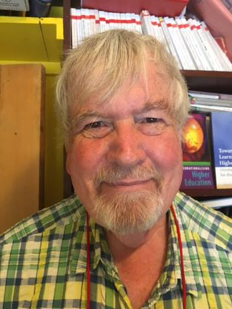
Thank you…
Website: http://phil-race.co.uk
Follow Phil on Twitter @RacePhil
e-mail: phil@phil-race.co.uk

