Slide 1
Activating Learning Making engagement happen Myerscough College
23rd March, 2018
Phil Race
(from Newcastle-upon-Tyne)
BSc PhD PGCE FCIPD PFHEA NTF
Follow Phil on Twitter: @RacePhil
Visiting Professor: University of Plymouth and Edge Hill University
Emeritus Professor, Leeds Beckett University

Slide 2
This slide has two purposes….
To focus the data projector, if necessary, and…
...to persuade colleagues never to put this sort of detail onto a slide!

Slide 3
About Phil…
First a musician
Then a writer
Then a scientist
Then a researcher
Then a lecturer and warden at what is now USW
Got interested in how students learn
And the effects assessment and feedback have on them
And how we teach them
Gradually became an educational developer
And now ‘retired’!?
Currently…
Visiting Prof: Plymouth & Edge Hill
Emeritus Prof: Leeds Beckett
Based at Newcastle, UK
And on trains
And an expert…
on train routes and timetables!
Notes:
2
2

Slide 4
Thanks to students
I could not do what I do nowadays if I did not continue to spend a fair bit of my time working with students – they’ve taught me most of what I know.

Slide 5
Making engagement happen
Engagement is right at the centre of successful learning. Learning can’t happen without it. But engagement is a two-way process – it has to involve students – and us. Engagement should be fun – for us as well as for them.
Knowledge isn’t infectious (unfortunately) but enthusiasm is, and we need to help our students to catch enthusiasm (and on a wet Monday morning that doesn’t happen automatically!). This session should get you thinking about some of the many things we can do to get students engaged – and to be engaged ourselves.

Slide 6
Name labels…
Please write your first name, big and bold, on a sticky label, and stick it to your clothing (not onto a fabric which would be damaged).
Phil

Slide 7
Getting to know each other
In turn, please..
Say one or two sentences about...
who you are,
where you come from, and
what you do.
In one breath!
(Optional) Share with us one thing that you’re dead good at or really proud of.

Slide 8
Linking everything to learning
In this interactive programme, we will touch on how students really learn, and how we can respond to factors underpinning their successful learning. We will link this to the ever-important dimension of feedback to students – and feedback from students, and to preparing them to succeed not only in the various kinds of assessment they will encounter on their journey to qualified status, but also in rapidly developing practice in the world outside education.

Slide 9
Outline Programme
0930 Introduction (there’s no second chance to make a good first impression!)
0940 Post-it task: ‘I’d get my students engaged better if only I could…..’
0950 What are colleges for in 2018?
1000 Getting groups of students engaged: inputs and exercises
1045 Coffee/tea
1100 Engagement and assessment and feedback: inputs and exercises
1145 Action planning round
1200 Close of session

Slide 10
Intended learning outcomes
After participating in this half-day workshop, you should be better-able to:
Got to know some of your colleagues better – engaged with them;
Gained ideas of some of the things you can do in class sessions to help students to catch enthusiasm;
Analysed some of the characteristics of the most engaging teachers;
Become enthused about engagement.

Slide 11
You will be able to download my main slides
You don’t need to take notes.
I’ll put the main slides I use up on my website when I get home (http://phil-race.co.uk/)
I won’t post pictures and video-clips, as this would make the file-size too large.
I may sometimes go through slides quite fast, but you can study them as you wish at your leisure.

Slide 12
Announcement about mobile phones and laptops...
Good day everyone – please turn on your ‘phones, tablets and computers.
Please post your thoughts, questions, comments and ideas during this session to the hashtag #philatmyerscough18 Thanks!
Try #LTHEchat on Wednesday evenings from 20.00-21.00.

Slide 13
Download Phil’s materials on feedback, assessment, learning and lecturing
Expanded discussion of how the factors underpinning learning link to feedback, assessment and large-group teaching:
http://phil-race.co.uk/2016/04/updated-powerpoint-ripples-model/ (Chapter 1 from ‘The Lecturer’s Toolkit, 2015)
https://phil-race.co.uk/2016/10/lthe-tweetchat-lthechat-wed-oct-19-8-00-9-00-pm/ (feedback stuff from my most recent two books)
http://phil-race.co.uk/2015/01/assessment-bits-new-editions/ (extracts on assessment)
http://phil-race.co.uk/2017/05/lectures-and-learning/ (extracts on lecturing)

Slide 14
Time-constrained Post-it exercise
On a post-it, in your best handwriting, please write your own completion of the starter:
‘I’d get my students engaged better if only I could…..’
Please swap post-its so that you’ve no idea who has yours.
If chosen, please read out with passion and drama the post-it you now have.
Please place them all on the chart.

Slide 15
Thought for the day: Einstein
It is simply madness
to keep doing the same things,
and expect different results.

Slide 16
Evidence-based practice
In the last decade, there’s been a great deal of international evidence-based research in assessment, feedback, learning and teaching. I’d like to alert you to how some of this can help us enhance students’ learning.
The next three slides show just 17 sources selected from the published evidence.

Slide 17
17 sources about assessment, feedback and learning in higher education
Knight, P. and Yorke, M. (2003) Assessment, learning and employability, Maidenhead, UK SRHE/Open University Press.
The TESTA project (http://www.testa.ac.uk/) Transforming the Experience of Students through Assessment, (Bath Spa, Chichester, Winchester and Worcester)
Flint, N. R. and Johnson, B. (2011) Towards fairer university assessment – recognising the concerns of students, London: Routledge.
ETC Toolkit (2015) (Enhancing the Curriculum) www.etctoolkit.org.uk
HEA (2012) A Marked Improvement: transforming assessment in higher education, York: Higher Education Academy (http://www.heacademy.ac.uk/assets/documents/assessment/A_Marked_Improvement.pdf )

Slide 18
17 sources about assessment, feedback and learning in higher education
Boud, D. and Associates (2010) Assessment 2020: seven propositions for assessment reform in higher education Sydney: Australian Learning and Teaching Council.
Carless, D. (2015) Excellence in University Assessment: Learning from award-winning practice, London: Routledge.
Race, P. (2014) Making learning happen: 3rd edition London: Sage. (lots of bits free on my website!)
Hunt, D. and Chalmers, L. (eds) (2012) University Teaching in Focus: a learning-centred approach Australia: ACER Press, and London: Routledge.
Price, M., Rust, C., O’Donovan, B. and Handley, K. (2012) Assessment Literacy, Oxford: the Oxford Centre for Staff and Learning Development (based on the ‘ASKe’ Project).
Evans, C. (2013) Making Sense of Assessment Feedback in Higher Education, Review of Educational Research Vol. 83, No. 1, pp. 70–120. http://journals.sagepub.com/doi/abs/10.3102/0034654312474350

Slide 19
17 sources about assessment, feedback and learning in higher education
Sambell, K., McDowell, L. and Montgomery, C. (2013) Assessment for Learning in Higher Education, London: Routledge.
Brown, S. (2015) Learning, teaching and assessment in higher education: global perspectives, Basingstoke: Palgrave-Macmillan. (great discussion on plagiarism).
Race, P. (2015) The Lecturer’s Toolkit: 4th edition, London, Routledge. (lots of bits on my website!)
Parkin, D (2017) Leading Learning and Teaching in Higher Education – the key guide to designing and delivering courses, London: Routledge.
Lea, J. (ed.) (2015) Enhancing Learning And Teaching In Higher Education: Engaging With The Dimensions Of Practice, London, Open University Press.
Sambell, K, Brown, S and Graham, L. (2017) Professionalism in Practice: Key directions in higher education: Learning, Teaching and Assessment, Basingstoke: Palgrave-Macmillan.

Slide 20
Now is the decade of colleges’ dis-content!
Never mind the content – feel the learning

Slide 21
Modern institutions are moving away from being the providers of content, (where everything used to be about ‘delivery’), towards foregrounding two major functions:
Recognising and accrediting students’ achievement, wherever learning has taken place (i.e. getting the assessment right);
Supporting student learning and engagement (not least by making feedback work well for students, and using real-world situations and simulations to bring learning to life).

Slide 22
How students really learn
Seven factors underpinning successful learning based on asking 200,000 people about their learning in the last 30 years!

Slide 23
How Students Really Learn ‘Ripples’ model of learning
Phil Race

Slide 24
What’s missing?
Engagement?
Feelings?
Active
Experimentation
Emotions?
Judgments?
Desire?
Abstract
Conceptualisation
Concrete
Experience
Communication?
People?
Reflective
Observation

Slide 25
But what about learning styles?
https://www.theguardian.com/education/2017/mar/12/no-evidence-to-back-idea-of-learning-styles?CMP=share_btn_tw
(Link from my Tweet on March 13th 2017 to a letter in the Guardian by prominent folk around the world of education)
Or link to a word document: https://phil-race.co.uk/2017/09/swansea-university-school-management-21st-September/
“No evidence to back idea of learning styles”

Slide 27
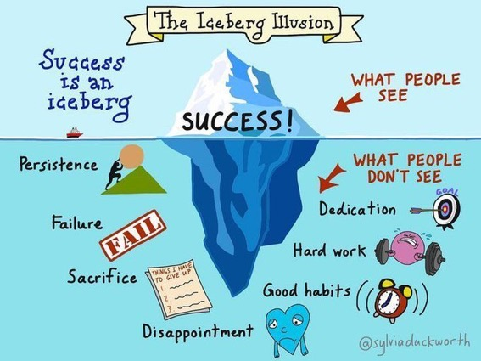

Slide 28
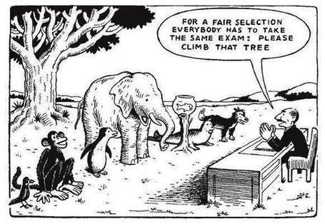

Slide 29
Ripples on a pond….
Striving to enhance our students’ want to learn;
Helping students to develop ownership of the need to learn;
Keeping students learning by doing, practice, trial-and-error, repetition;
Ensuring students get quick and useful feedback – from us and from each other;
Helping students to make sense of what they learn.
Getting students deepening their learning by verbalising, explaining things to each other, and to us.
Allowing students to further deepen their learning by assessing their own learning, and assessing others’ learning – making informed judgements.
We can make learning happen by:
Verbalising
Assessing
making informed judgements
Wanting/
Needing
Doing
Doing
Making sense
Feedback

Slide 31
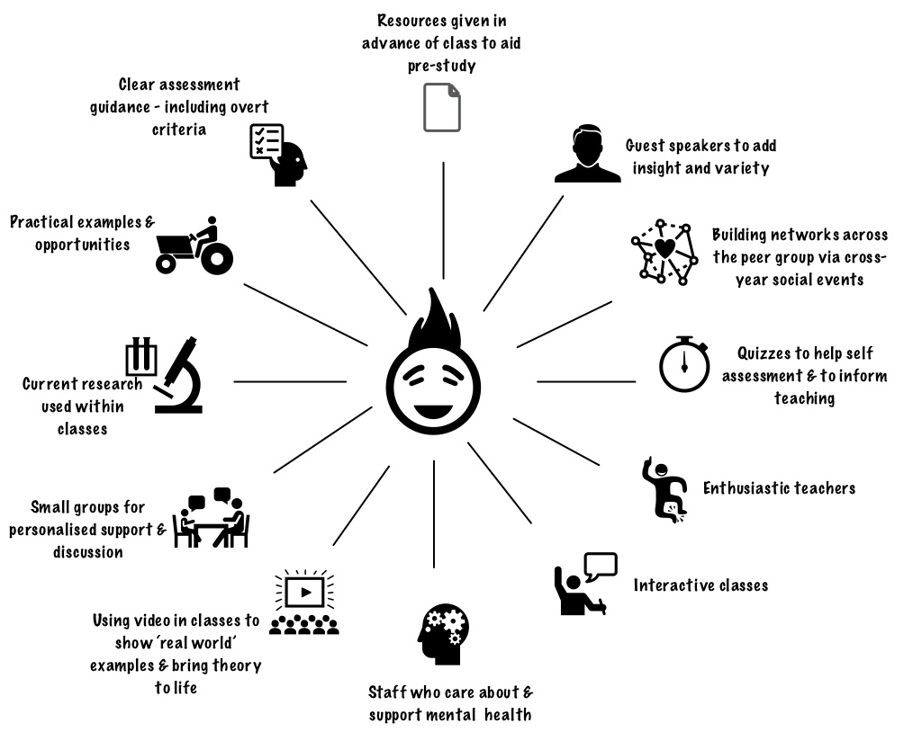
Myerscough College
What works?

Slide 32
Learning is not linear! Feedback is not unidirectional. But sometimes we pretend that they are! #sketchnote by @SGroshell and @MrZachG #edchat #learning #teachchat

Slide 33
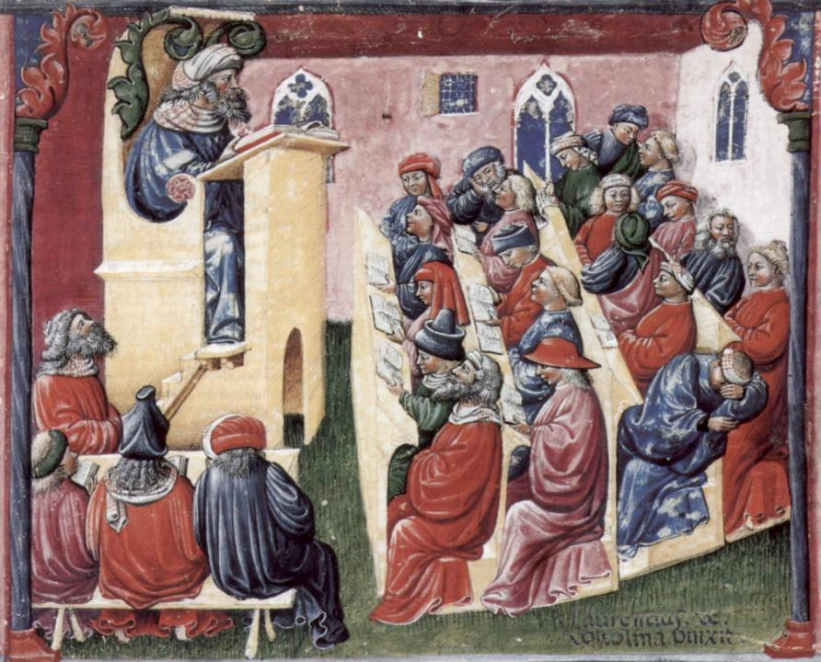
Laurentius de Voltolina
2nd half of 14th Century
Italian Painter

Slide 34
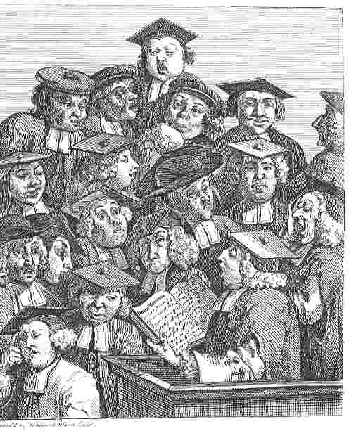
William Hogarth
1736
‘Scholars at a lecture’

Slide 35
What are lectures for, in 2018?
Nowadays, we don't need lectures simply to give students information, as so much is available to them online worldwide, but we do need to help them to negotiate the sea of available information so that their learning is focused and successful.

Slide 36
So what can we do in classes?
We still meet students in lecture theatres and other large-group sessions, so what should we do? Four things:...
We’ve got to inspire them, arouse their curiosity, get them thinking, and (above all) start making their learning happen, there and then while they’re with us.

Slide 37
Classes should be fun!
They should be fun for us.
They should be fun for students.
There are lots of good reasons to get a large group of students together in the same room at the same time.
One of them is not ‘to give them lots of stuff’ however.

Slide 38
What is likely to annoy students in class?
Staff who don’t appear to have done good preparation of content material;
Material at the wrong level, that is too easy or goes right over their heads;
Lecturers who seem jaded, unenthusiastic or uninterested in what they are teaching (or the level of students);
Lecture formats that never change, and over-use Power Point;
Lack of interaction between the lecturer and students;
Issues around timing, particularly over-running and rushing at the end.

Slide 39
Face-to-face communication
Making all the channels work

Slide 40
Face-to-face one-to-one feedback activity
On the signal to start, please stand up, and work in pairs, moving around the room, talking to different people using the script which follows…
The script:
A ‘Hello’ (or equivalent).
B ‘Hello’ (or equivalent).
A ‘You are late’.
B ‘I know’.
Try to do it completely differently each time.

Slide 41
Constructive Alignment: John Biggs
What will I be expected to show for this?
What does a good one look like, and a bad one?
Where does this fit into the big picture?
When explaining assessment criteria to students, and when linking these to evidence of achievement of the intended learning outcomes, we need to make the most of face-to-face whole group contexts and...
Tone of voice
Body language
Facial expression
Eye contact
The chance to repeat things
The chance to respond to puzzled looks
Some things don’t work nearly so well just on paper or on screens.
Some of the
tools we can
use in
face-to-face
contexts

Slide 42
Teaching – and research – and reflection: the ten most important words
Why?
What?
Who?
Where?
When?
How?
Which?
So what?
Wow?
And the most powerful four-letter word in the English language...
????

Slide 43
‘what’ is getting ever less important
Columbia University research published recently (2011) in Science magazine shows that people are much less prepared to remember ‘what’, but better at remembering where to access information, and how to do so.
Betsy Sparrow, one of the principal researchers, concludes that the internet has become ‘an external memory source that we can access at any time. ... Just as we learn through transactive memory who knows what in our families and offices, we are learning what the computer ‘knows’ and when we should attend to where we have stored information in our computer-based memories. We are becoming symbiotic with our computer tools.
Published Online July 14 2011 < Science Express Index Science DOI: 10.1126/science.1207745
Report: Google Effects on Memory: Cognitive Consequences of Having Information at Our Fingertips Betsy Sparrow,*, Jenny Liu, Daniel M. Wegner

Slide 44
Teaching – and research – and reflection: the ten most important words
Why? (rationale)
What? (content)
Who? (people, you, me, them)
Where? (locations)
When? (times)
How? (processes)
Which? (decisions)
So what? (importance?)
Wow? (impact?)
And the most powerful four-letter word in the English language...
????

Slide 45
Characteristics of teachers who get engagement going (Sally Brown)
Knows subject material thoroughly
Adopts a scholarly approach to the practice of teaching
Is reflective and regularly reviews own practice
Is well organised and plans curriculum effectively
Is passionate about teaching
Has a student-centred orientation to teaching
Regularly reviews innovations in learning and teaching and tries out ones relevant to own context
Ensures that assessment practices are fit for purpose and contribute to learning
Demonstrates empathy and emotional intelligence

Slide 46
Characteristics of teachers who get engagement going (Sally Brown)
Knows subject material thoroughly
Adopts a scholarly approach to the practice of teaching
Is reflective and regularly reviews own practice
Is well organised and plans curriculum effectively
Is passionate about teaching
Has a student-centred orientation to teaching
Regularly reviews innovations in learning and teaching and tries out ones relevant to own context
Ensures that assessment practices are fit for purpose and contribute to learning
Demonstrates empathy and emotional intelligence
Communicates effectively with students, and responds in an open-minded fashion
Personal hygiene: presentation and cleanliness
Approachability
Taking into account student feedback

Slide 47
Characteristics of excellent teachers: diamond-9
1
2
3
4
5
6
7
8
9

Slide 48
Characteristics of excellent teachers: diamond-9
E, I, e, e.
I, I, A, I
A, F, I, F
4
5
6
7
8
B, B, B, B

Slide 49
Disengaged students
Don’t live up to their potential and fail to achieve their very best;
Make life more difficult for the staff who teach and support them;
Don’t achieve as highly as they might, and underperform;
Drop out of higher education, thereby damaging their own prospects and HEIs’ performance indicators;
HEIs suffer both financially and in terms of their status and reputation from high attrition rates.

Slide 50
Back to our intended learning outcomes…
Do you now feel better able to:
2 hands = very much better,
one hand = somewhat better,
touch left ear = no better...
Got to know some of your colleagues better – engaged with them?
Gained ideas of some of the things you can do in class sessions to help students to catch enthusiasm?
Analysed some of the characteristics of the most engaging teachers?
Become enthused about engagement?
Wanting/
Needing
Doing
Making sense
Feedback

Slide 51
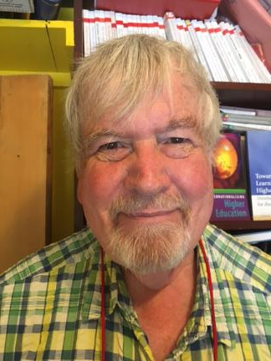
Thank you…
Website: http://phil-race.co.uk
Follow Phil on Twitter @RacePhil
e-mail: phil@phil-race.co.uk

Slide 52
Useful references and further reading (1)
Bain, K. (2004) What the best College Teachers do, Cambridge: Harvard University Press.
Biggs, J. and Tang, C. (2011) Teaching for Quality Learning at University, Maidenhead: Open University Press.
Bloxham, S. and Boyd, P. (2007) Developing effective assessment in higher education: a practical guide, Maidenhead, Open University Press.
Boud, D. (1995) Enhancing learning through self-assessment, London: Routledge.
Brown, S. and Glasner, A. (eds.) (1999) Assessment Matters in Higher Education, Choosing and Using Diverse Approaches, Maidenhead: Open University Press.
Brown, S. and Race, P. (2012) Using effective assessment to promote learning in Hunt, L. and Chambers, D. (2012) University Teaching in Focus, Victoria, Australia, Acer Press. P74-91.
Brown, S. (2015) Learning , Teaching and Assessment in Higher Education: Global perspectives, London, Palgrave.

Slide 53
Useful references and further reading (2)
Carless, D., Joughin, G., Ngar-Fun Liu et al (2006) How Assessment supports learning: Learning orientated assessment in action Hong Kong: Hong Kong University Press.
Carroll, J. and Ryan, J. (2005) Teaching International students: improving learning for all. London: Routledge SEDA series.
Crosling, G., Thomas, L. and Heagney, M. (2008) Improving student retention in Higher Education, London and New York: Routledge
Crooks, T. (1988) Assessing student performance, HERDSA Green Guide No 8 HERDSA (reprinted 1994).
Dunworth, K. and Sanchez, H.S., (2016). Perceptions of quality in staff-student written feedback in higher education: a case study. Teaching in Higher Education, 21(5), pp.576-589.
Dweck, C. S. (2000) Self Theories: Their Role in Motivation, Personality and Development, Lillington, NC: Taylor & Francis.
Falchikov, N. (2004) Improving Assessment through Student Involvement: Practical Solutions for Aiding Learning in Higher and Further Education, London: Routledge.
Gibbs, G. (1999) Using assessment strategically to change the way students learn, in Brown S. & Glasner, A. (eds.), Assessment Matters in Higher Education: Choosing and Using Diverse Approaches, Maidenhead: SRHE/Open University Press.
Higher Education Academy (2012) A marked improvement; transforming assessment in higher education, York: HEA.

Slide 54
Useful references and further reading (3)
Hawe, E., Lightfoot, U., & Dixon, H. (2017). First-year students working with exemplars: Promoting self-efficacy, self-monitoring and self-regulation. Journal of Further and Higher Education, 1-15.
Hendry, G. D., White, P., & Herbert, C. (2016). Providing Exemplar-Based “Feedforward” before an Assessment: The Role of Teacher Explanation. Active Learning in Higher Education, 17(2), 99-109.
Hounsell, D., McCune, V., Hounsell, J. and Litjens, J., (2008). The quality of guidance and feedback to students. Higher Education Research & Development, 27(1), pp.55-67.
McDowell, L. and Brown, S. (1998) Assessing students: cheating and plagiarism, Newcastle: Red Guide 10/11 University of Northumbria.
Meyer, J.H.F. and Land, R. (2003) ‘Threshold Concepts and Troublesome Knowledge 1 – Linkages to Ways of Thinking and Practising within the Disciplines’ in C. Rust (ed.) Improving Student Learning – Ten years on. Oxford: OCSLD.
Nicol, D. J. and Macfarlane-Dick, D. (2006) Formative assessment and self-regulated learning: A model and seven principles of good feedback practice, Studies in Higher Education Vol 31(2), 199-218.
PASS project Bradford http://www.pass.brad.ac.uk/ Accessed November 2013.
Peelo, M. T., & Wareham, T. (Eds.). (2002). Failing students in higher education. Society for Research into Higher Education.
Pickford, R. and Brown, S. (2006) Assessing skills and practice, London: Routledge.
Rotheram, B. (2009) Sounds Good, JISC project http://www.jisc.ac.uk/whatwedo/programmes/usersandinnovation/soundsgood.aspx

Slide 55
Useful references and further reading (4)
Race, P. (2001) A Briefing on Self, Peer & Group Assessment, in LTSN Generic Centre Assessment Series No 9, LTSN York.
Race P. (2015) The lecturer’s toolkit (4th edition), London: Routledge.
Rust, C., Price, M. and O’Donovan, B. (2003) Improving students’ learning by developing their understanding of assessment criteria and processes, Assessment and Evaluation in Higher Education. 28 (2), 147-164.
Ryan, J. (2000) A Guide to Teaching International Students, Oxford Centre for Staff and Learning Development.
Scoles, J., Huxham, M., & Mcarthur, J. (2013). No longer exempt from good practice: Using exemplars to close the feedback gap for exams. Assessment & Evaluation in Higher Education, 38(6), 631-645.
Stefani, L. and Carroll, J. (2001) A Briefing on Plagiarism, LTSN
Sadler, D. Royce (2010) Beyond feedback: developing student capability in complex appraisal, Assessment & Evaluation in Higher Education, 35: 5, 535-550.
Yorke, M. (1999) Leaving Early: Undergraduate Non-completion in Higher Education, London: Routledge.

