Slide 1
Activating Learning Digital Learning: engage, enthuse, inspire Optimising Learning in a Digital Environment University of Nottingham
Thursday 19th April 2018
Phil Race
(from Newcastle-upon-Tyne)
BSc PhD PGCE FCIPD PFHEA NTF
Follow Phil on Twitter: @RacePhil
Visiting Professor: University of Plymouth and Edge Hill University
Emeritus Professor, Leeds Beckett University

Slide 2
This slide has two purposes….
To focus the data projector, if necessary, and…
...to persuade colleagues never to put this sort of detail onto a slide!

Slide 3
It’s great to be here
What an impressive turnout!
I was last in Nottingham in 2014. Anyone remember what I did?
Anyone seen me before somewhere else, and know my tricks?

Slide 4
About Phil…
First a musician
Then a writer
Then a scientist
Then a researcher
Then a lecturer and warden at what is now USW
Got interested in how students learn
And the effects assessment and feedback have on them
And how we teach them
Gradually became an educational developer
And now ‘retired’!?
Currently…
Visiting Prof: Plymouth & Edge Hill
Emeritus Prof: Leeds Beckett
Based at Newcastle, UK
And on trains
And an expert…
on train routes and timetables!
Notes:
2
2

Slide 5
By coincidence, released by Advance HE this morning!
http://ow.ly/tpB930jysOz

Slide 6
chalk

Slide 7
The underhand projector

Slide 8
Announcement about mobile phones and laptops...
Good afternoon everyone – please turn on your ‘phones and computers.
Please post your thoughts, comments and ideas to the hashtag #philatnottingham18 Thanks!
Try #LTHEchat on Wednesday evenings from 20.00-21.00.

Slide 9
Thanks to Cassie and Fiona
Thanks to Cassie for reminding us all that digital has to be real and used, not just watched.
Thanks to Fiona, for reminding us that there is no ‘I’ in team, and that we in education need to be learning experience architects.

Slide 10
Thanks to students
I could not do what I do nowadays if I did not continue to spend a fair bit of my time working with students – they’ve taught me most of what I know.

Slide 11
Intended learning outcomes
After participating in this session, you should be better able to:
Identify and explore seven factors which underpin successful learning.
Ponder how best to address these factors in our digital age.
Decide whether when digital learning ‘grows up’ we won’t bother with the label ‘digital’ any more, because it will be just normal.

Slide 12
You will be able to download my main slides
You don’t need to take notes.
I’ll put the main slides up on my website when I get home tonight: (http://phil-race.co.uk/)
I won’t post pictures and video-clips, as this would make the file-size too large.
I may sometimes go through slides quite fast, but you can study them as you wish at your leisure.

Slide 13
Intentions
In this interactive session, we’ll look at the factors underpinning successful learning as gathered from thousands of folk in their responses to six questions I’ve asked in the last 30 years.
My claim is that the best way of making learning happen is to address these factors purposefully in every kind of learning context we design for students, not least digital, and in assessment and feedback too.

Slide 14
Getting to know each other: an analogue approach…
In turn, please..
Say one or two sentences about...
who you are,
where you come from, and
what you do.
In one breath!
(Optional) Share with us one thing that you’re dead good at or really proud of.

Slide 15
What can we do in theatres like this?
We still meet students in lecture theatres and other large-group sessions, so what should we do? Four things:...
We’ve got to inspire them, arouse their curiosity, get them thinking, and (above all) start making their learning happen, there and then while they’re with us.
In other words – get them engaging.

Slide 16
Making engagement happen
Engagement is right at the centre of successful learning. Learning can’t happen without it. But engagement is a two-way process – it has to involve students – and us. Engagement should be fun – for us as well as for them.
Knowledge isn’t infectious (unfortunately) but enthusiasm is, and we need to help our students to catch enthusiasm (and on a wet Monday morning that doesn’t happen automatically!).

Slide 17
MCQ 1
My brain is:
Digital
Analogue
Both
Neither
Don’t know
Voting: A = 2 hands, B = 1 hand
C = touch left ear, D = touch right ear
E = scratch your head

Slide 18
Time-constrained analogue Post-it exercise
On a post-it, in your best handwriting, please write your own completion of the starter:
“Optimising learning with my students in this digital age would be much better if only I …”
Please swap post-its so that you’ve no idea who has yours.
If chosen, please read out with passion and drama the post-it you now have.
Please keep them for now, and place them all as directed after the session.

Slide 19
Even in a digital age: the read-write industry

Slide 20
In the exam room you’re on your own,
and not usually digitally

Slide 21
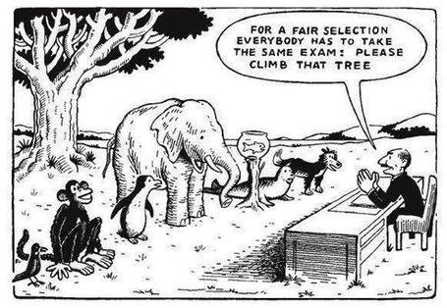

Slide 22
MCQ 3
When my students are assessed on content I’ve taught:
They use a keyboard
They use a pen
They use both
They speak
They use their wits
Voting: A = 2 hands, B = 1 hand, C = touch left ear,
D = touch right ear, E = scratch your head

Slide 23
One of my main worries...
We still tend to try to measure...
...what’s in students’ heads, and what they can do with what’s there...
in terms of two unsatisfactory proxies ...
what comes out of students’ pens in exams;
2. what comes out of their keyboards in essays and reports.

Slide 25
Download Phil’s materials on feedback, assessment, learning and lecturing
Expanded discussion of how the factors underpinning learning link to feedback, assessment and large-group teaching:
http://phil-race.co.uk/2016/10/feedback-digest-lthechat65/ (feedback stuff from my most recent two books)
http://phil-race.co.uk/2016/10/lthe-tweetchat-lthechat-wed-oct-19-8-00-9-00-pm/ (extracts on feedback)
http://phil-race.co.uk/2015/01/assessment-bits-new-editions/ (extracts on assessment)
https://phil-race.co.uk/2017/05/lectures-and-learning/ (extracts on lecturing)

Slide 26
MCQ 2
In the last 12 months, I’ve completed a MOOC
Indeed
Started one
Helped to design one
Found one
What’s a MOOC?
Voting: A = 2 hands, B = 1 hand, C = touch left ear,
D = touch right earE = scratch your head

Slide 28
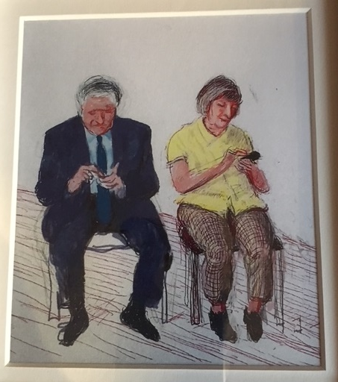
David Hockney?
(It reminded a friend of Sally and me)
But are we digital?

Slide 29
Einstein
Knowledge is experience, everything else is just information.
It is sheer madness to keep doing the same thing, and expect different results.

Slide 30
Evidence-based practice
In the last decade, there’s been a great deal of international evidence-based research in assessment, feedback, learning and teaching. I’d like to alert you to how some of this can help us enhance students’ learning.
The next three slides show just 17 sources selected from the published evidence.

Slide 31
17 sources about assessment, feedback and learning in higher education
Knight, P. and Yorke, M. (2003) Assessment, learning and employability, Maidenhead, UK SRHE/Open University Press.
The TESTA project (http://www.testa.ac.uk/) Transforming the Experience of Students through Assessment, (Bath Spa, Chichester, Winchester and Worcester)
Flint, N. R. and Johnson, B. (2011) Towards fairer university assessment – recognising the concerns of students, London: Routledge.
ETC Toolkit (2015) (Enhancing the Curriculum) www.etctoolkit.org.uk
HEA (2012) A Marked Improvement: transforming assessment in higher education, York: Higher Education Academy (http://www.heacademy.ac.uk/assets/documents/assessment/A_Marked_Improvement.pdf )

Slide 32
17 sources about assessment, feedback and learning in higher education
Boud, D. and Associates (2010) Assessment 2020: seven propositions for assessment reform in higher education Sydney: Australian Learning and Teaching Council.
Carless, D. (2015) Excellence in University Assessment: Learning from award-winning practice, London: Routledge.
Race, P. (2014) Making learning happen: 3rd edition London: Sage. (lots of bits free on my website!)
Hunt, D. and Chalmers, L. (eds) (2012) University Teaching in Focus: a learning-centred approach Australia: ACER Press, and London: Routledge.
Price, M., Rust, C., O’Donovan, B. and Handley, K. (2012) Assessment Literacy, Oxford: the Oxford Centre for Staff and Learning Development (based on the ‘ASKe’ Project).
Evans, C. (2013) Making Sense of Assessment Feedback in Higher Education, Review of Educational Research Vol. 83, No. 1, pp. 70–120. http://journals.sagepub.com/doi/abs/10.3102/0034654312474350

Slide 33
17 sources about assessment, feedback and learning in higher education
Sambell, K., McDowell, L. and Montgomery, C. (2013) Assessment for Learning in Higher Education, London: Routledge.
Brown, S. (2015) Learning, teaching and assessment in higher education: global perspectives, Basingstoke: Palgrave-Macmillan. (great discussion on plagiarism).
Race, P. (2015) The Lecturer’s Toolkit: 4th edition, London, Routledge. (lots of bits on my website!)
Parkin, D (2017) Leading Learning and Teaching in Higher Education – the key guide to designing and delivering courses, London: Routledge.
Lea, J. (ed.) (2015) Enhancing Learning And Teaching In Higher Education: Engaging With The Dimensions Of Practice, London, Open University Press.
Sambell, K, Brown, S and Graham, L. (2017) Professionalism in Practice: Key directions in higher education: Learning, Teaching and Assessment, Basingstoke: Palgrave-Macmillan.

Slide 34
Now is the decade of Universities’ dis-content!
Never mind the content – feel the learning

Slide 35
Modern institutions are moving away from being the providers of content, (where everything was about ‘delivery’), towards foregrounding two major functions:
Recognising and accrediting students’ achievement, wherever learning has taken place (i.e. getting the assessment right);
Supporting student learning and engagement (not least by making feedback work well for students).

Slide 36
Drives most learning
Is assessment broken?
Some
assessment
issues
What students think
Assessment as learning
Validity
Whodunit?
Fairness

Slide 37
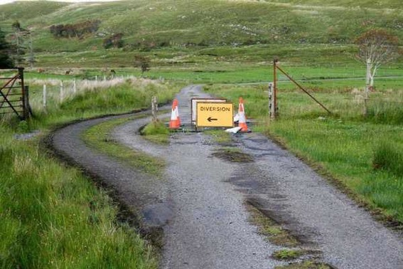

Slide 38
Teaching – and research – and reflection: the ten most important words
Why?
What?
Who?
Where?
When?
How?
Which?
So what?
wtf?
Wow?
And the most powerful four-letter word in the English language...
????

Slide 39
‘what’ is getting ever less important
Columbia University research published recently (2011) in Science magazine shows that people are much less prepared to remember ‘what’, but better at remembering where to access information, and how to do so.
Betsy Sparrow, one of the principal researchers, concludes that the internet has become ‘an external memory source that we can access at any time. ... Just as we learn through transactive memory who knows what in our families and offices, we are learning what the computer ‘knows’ and when we should attend to where we have stored information in our computer-based memories. We are becoming symbiotic with our computer tools.
Published Online July 14 2011 < Science Express Index Science DOI: 10.1126/science.1207745
Report: Google Effects on Memory: Cognitive Consequences of Having Information at Our Fingertips Betsy Sparrow,*, Jenny Liu, Daniel M. Wegner

Slide 40
Teaching – and research – and reflection: the ten most important words
Why? (rationale)
What? (content)
Who? (people, you, me, them)
Where? (locations)
When? (times)
How? (processes)
Which? (decisions)
So what? (importance?)
Wow? (impact?)
And the most powerful four-letter word in the English language...
????

Slide 41
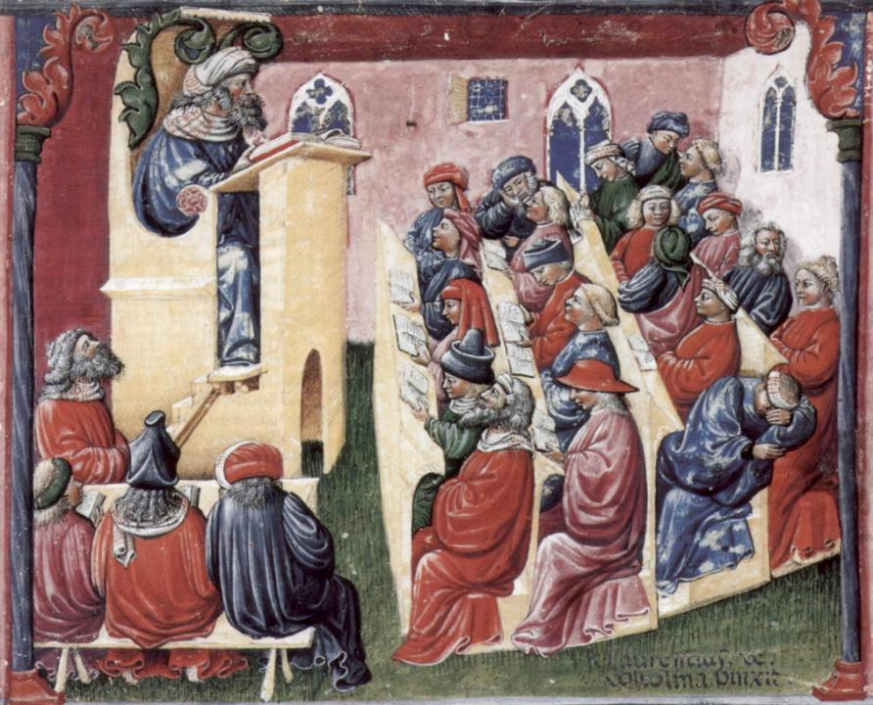
Laurentius de Voltolina
2nd half of 14th Century
Italian Painter

Slide 42
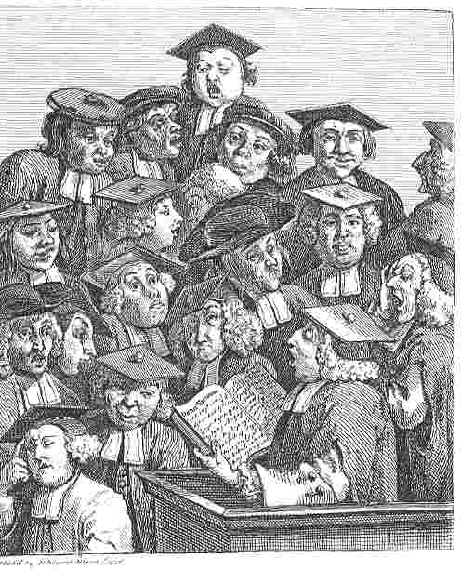
William Hogarth
1736
‘Scholars at a lecture’

Slide 43
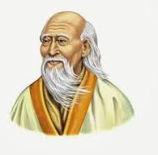
Lao Tzu
Laozi was an ancient Chinese philosopher and writer. He is known as the reputed author of the Tao Te Ching, the founder of philosophical Taoism, and a deity in religious Taoism and traditional Chinese religions. Wikipedia
Born: 604 BC, China
Died: 531 BC, China

Slide 44
After Lao Tsu
The best leader is hardly noticed.
The next-best leader is honoured and acclaimed.
The worst leader is feared and despised.
When the work of the best leader is done, the people say “we did this ourselves.”

Slide 45
After Lao Tsu
The best teacher is hardly noticed.
The next-best teacher is honoured and acclaimed.
The worst teacher is feared and despised.
When the work of the best teacher is done, the learners say “we did this ourselves.”

Slide 46
After Lao Tsu
The best medium is hardly noticed.
The next-best medium is honoured and acclaimed.
The worst medium is feared and despised.
When the work of the best medium is done, the learners say “we did this ourselves.”

Slide 47
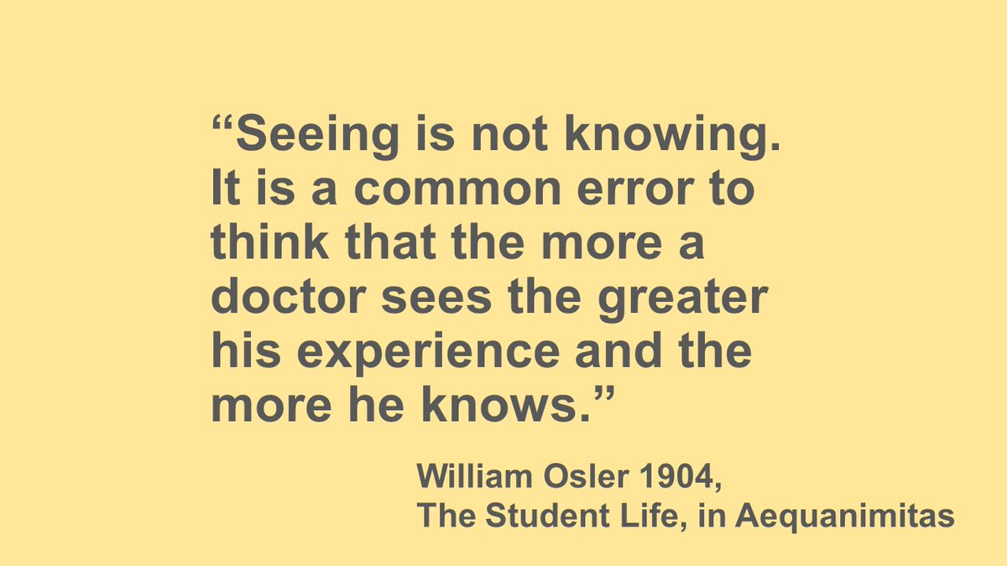

Slide 48
Face-to-face communication
Making all the channels work

Slide 49
Face-to-face one-to-one feedback activity
On the signal to start, please stand up, and work in pairs, moving around the room, talking to different people using the script which follows…
The script:
A ‘Hello’ (or equivalent).
B ‘Hello’ (or equivalent).
A ‘You are late’.
B ‘I know’.
Try to do it completely differently each time.

Slide 50
Constructive Alignment: John Biggs
What will I be expected to show for this?
What does a good one look like, and a bad one?
Where does this fit into the big picture?
When explaining assessment criteria to students, and when linking these to evidence of achievement of the intended learning outcomes, we need to make the most of face-to-face whole group contexts and...
Tone of voice
Body language
Facial expression
Eye contact
The chance to repeat things
The chance to respond to puzzled looks
Some things don’t work nearly so well just on paper or on screens.
Some of the
tools we can
use in
face-to-face
contexts

Slide 51
How students really learn
Seven factors underpinning successful learning based on asking 200,000 people about their learning in the last 30 years – ditching learning theories which don’t work!

Slide 52
How Students Really Learn ‘Ripples’ model of learning
Phil Race

Slide 53
How did you get good at things?: most people’s views...
practice
trial and error
having a go
repetition
experimenting

Slide 54
What made you feel good? Most people’s views...
feedback
other people’s reactions
praise
gaining confidence
seeing the results

Slide 55
What made learning go wrong for you? Most people’s views...
did not really want to learn it
could not see the point
bad teaching
could not make sense of it

Slide 56
What kept you at it, when you succeeded against the odds? Most people’s views...
strong support and encouragement
did not want to be seen not able to do it
needed to do it for what I wanted next

Slide 57
Five of the seven factors underpinning successful learning
learning by doing
learning from feedback
wanting to learn
needing to learn
...

Slide 58
Five of the seven factors underpinning successful learning
learning by doing
learning from feedback
wanting to learn
needing to learn
making sense – ‘getting one’s head round it’

Slide 59
Ripples on a pond….
Verbalising
Assessing
making informed judgements
Wanting/
Needing
Doing
Making sense
Feedback

Slide 60
But there aren’t any likes and each individual mixes the colours in his/her own unique way

Slide 61
Ripples on a pond….
Striving to enhance our students’ want to learn;
Helping students to develop ownership of the need to learn;
Keeping students learning by doing, practice, trial-and-error, repetition;
Ensuring students get quick and useful feedback – from us and from each other;
Helping students to make sense of what they learn.
Getting students deepening their learning by verbalising, explaining things to each other, and to us.
Allowing students to further deepen their learning by assessing their own learning, and assessing others’ learning – making informed judgements.
We can make learning happen by:
Verbalising
Assessing
making informed judgements
Wanting/
Needing
Doing
Doing
Making sense
Feedback

Slide 62
Seven things we can try to do
Intent – make the intended outcomes really clear.
Need – find out what students think they need, and respond to this.
Support students in every way possible.
People: students are people, they’re human, like us.
Interact with students in large groups, small groups, online and one-to-one.
Remember names, faces, what you said to each student last time, ...
Evidence: keep students aware of the evidence which will lead to their success.

Slide 63
Back to our intended learning outcomes…
Do you now feel better able to:
2 hands = very much better,
one hand = somewhat better,
touch left ear = no better...
Identify and explore seven factors which underpin successful learning?
Ponder how best to address these factors in our digital age?
Decide whether when digital learning ‘grows up’ we won’t bother with the label ‘digital’ any more, because it will be just normal?
Wanting/
Needing
Doing
Making sense
Feedback

Slide 64
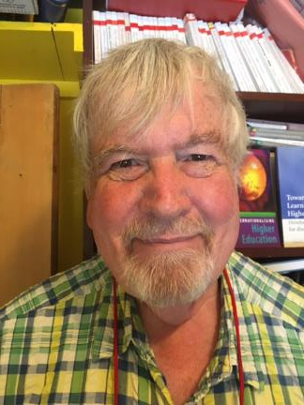
Thank you…
Website: http://phil-race.co.uk
Follow Phil on Twitter @RacePhil
e-mail: phil@phil-race.co.uk

