Slide 1
Activating Learning Rethinking Assessment and Feedback
24th April, 2018
Edge Hill University
Phil Race
(from Newcastle-upon-Tyne)
BSc PhD PGCE FCIPD PFHEA NTF
Follow Phil on Twitter: @RacePhil
Visiting Professor: University of Plymouth and Edge Hill University
Emeritus Professor, Leeds Beckett University

Slide 2
This slide has two purposes….
To focus the data projector, if necessary, and…
...to persuade colleagues never to put this sort of detail onto a slide!

Slide 3
About Phil…
First a musician
Then a writer
Then a scientist
Then a researcher
Then a lecturer and warden at what is now USW
Got interested in how students learn
And the effects assessment and feedback have on them
And how we teach them
Gradually became an educational developer
And now ‘retired’!?
Currently…
Visiting Prof: Plymouth & Edge Hill
Emeritus Prof: Leeds Beckett
Based at Newcastle, UK
And on trains
And an expert…
on train routes and timetables!
Notes:
2
2

Slide 4
Thanks to students
I could not do what I do nowadays if I did not continue to spend a fair bit of my time working with students – they’ve taught me most of what I know.

Slide 5
Rationale
We spend a great deal of our energy and time assessing students’ work, and giving them feedback. Too much time? Is our assessment valid, reliable, authentic, and manageable? Is the time we spend actually well-spent? Is the feedback really used, or is much of it ignored, or even not read? This session will start exploring these and related issues about assessment and feedback.

Slide 6
Feedback, assessment and enthusiasm
Knowledge isn’t infectious (unfortunately) but enthusiasm is, and we need to help our students to catch enthusiasm.
We certainly don’t want assessment or feedback to damage that enthusiasm.

Slide 7
Outline Programme: March 14th
2.00 Welcome and introductions
2.10 Post-it exercise on assessment and feedback, and analysis.
2.30 What the gurus say about assessment and feedback.
3.00 Some problems with essays and exams
3.10 Some problems with written or printed feedback
3.20 Creative brainstorm: what else can we do?
3.30 Close of session

Slide 8
Intended learning outcomes
After participating in this session, you should be better-able to:
Reflect on how assessment and feedback link (or don’t link) to the factors underpinning successful student learning;
Examine what’s wrong with some traditional forms of assessment;
Think of what else we may be able to do to make assessment fit for purpose in 2018.

Slide 9
You will be able to download my main slides
You don’t need to take notes.
I’ll put the main slides I use up on my website when I get home tonight (http://phil-race.co.uk/)
I won’t post pictures and video-clips, as this would make the file-size too large.
I may sometimes go through slides quite fast, but you can study them as you wish at your leisure.

Slide 10
Announcement about mobile phones and laptops...
Good afternoon everyone – please turn on your ‘phones, tablets and computers.
Please post your thoughts, questions, comments and ideas during this session to the hashtag #philatedgehill18 Thanks!
Try #LTHEchat on Wednesday evenings from 20.00-21.00.

Slide 11
Download Phil’s published stuff on feedback, assessment, and learning
Expanded discussion of how the factors underpinning learning link to feedback, assessment and large-group teaching:
http://phil-race.co.uk/2016/04/updated-powerpoint-ripples-model/ (Chapter 1 from ‘The Lecturer’s Toolkit, 2015)
https://phil-race.co.uk/2016/10/lthe-tweetchat-lthechat-wed-oct-19-8-00-9-00-pm/ (feedback stuff from my most recent two books)
https://phil-race.co.uk/2018/02/feedback-feedforward-just-tips-including-students/ (just the feedback tips!)
http://phil-race.co.uk/2015/01/assessment-bits-new-editions/ (extracts on assessment)

Slide 12
Time-constrained Post-it exercise
On a post-it, in your best handwriting, please write your own completion of the starter:
“making assessment and feedback work for my students would be much better if only I..…”
Please swap post-its so that you’ve no idea who has yours.
If chosen, please read out with passion and drama the post-it you now have.
Please place them all on the chart as directed.

Slide 13
Thought for the day: Einstein
It is simply madness
to keep doing the same things,
and expect different results.

Slide 14
Bringing assessment and feedback to life Questions employers might ask students at interview. that could help us frame some of our assessment and feedback
Can you tell us about an occasion when:
you worked together with colleagues in a group to produce a collective outcome?
you had to work autonomously with incomplete information and self-derived data sources?
you developed strategies to solve real life problems and tested them out?
you had a leadership role in a team, and could you tell us your strategies to influence and persuade your colleagues to achieve a collective task?
you had to communicate outcomes from your project work orally, in writing, through social media and/or through a visual medium?
If you want it to happen,
build it into assessment and
let student get feedback on it.

Slide 15
Evidence-based practice
In the last decade, there’s been a great deal of international evidence-based research in assessment, feedback, learning and teaching. I’d like to alert you to how some of this can help us enhance students’ learning.
The next three slides show just 17 sources selected from the published evidence.

Slide 16
17 sources about assessment, feedback and learning in higher education
Knight, P. and Yorke, M. (2003) Assessment, learning and employability, Maidenhead, UK SRHE/Open University Press.
The TESTA project (http://www.testa.ac.uk/) Transforming the Experience of Students through Assessment, (Bath Spa, Chichester, Winchester and Worcester)
Flint, N. R. and Johnson, B. (2011) Towards fairer university assessment – recognising the concerns of students, London: Routledge.
ETC Toolkit (2015) (Enhancing the Curriculum) www.etctoolkit.org.uk
HEA (2012) A Marked Improvement: transforming assessment in higher education, York: Higher Education Academy (http://www.heacademy.ac.uk/assets/documents/assessment/A_Marked_Improvement.pdf )

Slide 17
17 sources about assessment, feedback and learning in higher education
Boud, D. and Associates (2010) Assessment 2020: seven propositions for assessment reform in higher education Sydney: Australian Learning and Teaching Council.
Carless, D. (2015) Excellence in University Assessment: Learning from award-winning practice, London: Routledge.
Race, P. (2014) Making learning happen: 3rd edition London: Sage. (lots of bits free on my website!)
Hunt, D. and Chalmers, L. (eds) (2012) University Teaching in Focus: a learning-centred approach Australia: ACER Press, and London: Routledge.
Price, M., Rust, C., O’Donovan, B. and Handley, K. (2012) Assessment Literacy, Oxford: the Oxford Centre for Staff and Learning Development (based on the ‘ASKe’ Project).
Evans, C. (2013) Making Sense of Assessment Feedback in Higher Education, Review of Educational Research Vol. 83, No. 1, pp. 70–120. http://journals.sagepub.com/doi/abs/10.3102/0034654312474350

Slide 18
17 sources about assessment, feedback and learning in higher education
Sambell, K., McDowell, L. and Montgomery, C. (2013) Assessment for Learning in Higher Education, London: Routledge.
Brown, S. (2015) Learning, teaching and assessment in higher education: global perspectives, Basingstoke: Palgrave-Macmillan. (great discussion on plagiarism).
Race, P. (2015) The Lecturer’s Toolkit: 4th edition, London, Routledge. (lots of bits on my website!)
Parkin, D (2017) Leading Learning and Teaching in Higher Education – the key guide to designing and delivering courses, London: Routledge.
Lea, J. (ed.) (2015) Enhancing Learning And Teaching In Higher Education: Engaging With The Dimensions Of Practice, London, Open University Press.
Sambell, K, Brown, S and Graham, L. (2017) Professionalism in Practice: Key directions in higher education: Learning, Teaching and Assessment, Basingstoke: Palgrave-Macmillan.

Slide 19
Now is the decade of Universities’ dis-content!
Never mind the content – feel the learning

Slide 20
Modern institutions are moving away from being the providers of content, (where everything used to be about ‘delivery’), towards foregrounding two major functions:
Recognising and accrediting students’ achievement, wherever learning has taken place (i.e. getting the assessment right);
Supporting student learning and engagement (not least by making feedback work well for students, and using real-world situations and simulations to bring learning to life).

Slide 21
How students really learn
Seven factors underpinning successful learning based on asking 200,000 people about their learning in the last 30 years!

Slide 22
How Students Really Learn ‘Ripples’ model of learning
Phil Race

Slide 23
What’s missing?
Engagement?
Feelings?
Active
Experimentation
Inspiration?
Judgments?
Desire?
Abstract
Conceptualisation
Concrete
Experience
Communication?
Enthusiasm?
Reflective
Observation

Slide 24
But what about learning styles?
https://www.theguardian.com/education/2017/mar/12/no-evidence-to-back-idea-of-learning-styles?CMP=share_btn_tw
(Link from my Tweet on March 13th 2017 to a letter in the Guardian by prominent folk around the world of education)
Or link to a word document: https://phil-race.co.uk/2017/09/swansea-university-school-management-21st-September/
“No evidence to back idea of learning styles”

Slide 26
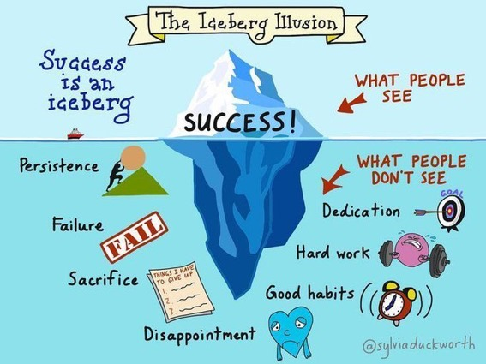

Slide 27
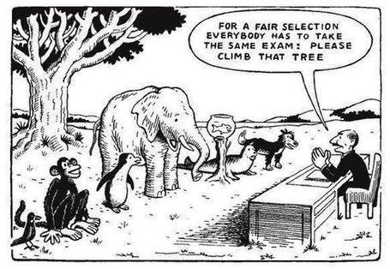

Slide 28
Ripples on a pond….
Striving to enhance our students’ want to learn;
Helping students to develop ownership of the need to learn;
Keeping students learning by doing, practice, trial-and-error, repetition;
Ensuring students get quick and useful feedback – from us and from each other;
Helping students to make sense of what they learn.
Getting students deepening their learning by verbalising, explaining things to each other, and to us.
Allowing students to further deepen their learning by assessing their own learning, and assessing others’ learning – making informed judgements.
We can make learning happen by:
Verbalising
Assessing
making informed judgements
Wanting/
Needing
Doing
Doing
Making sense
Feedback

Slide 30
Drives most learning
Is assessment broken?
Some
assessment
issues
What students think
Assessment as learning
Validity
Whodunit?
Fairness

Slide 31
My main worries about assessment...
Too often, we still tend to try to measure...
...what’s in students’ heads, and what they can do with what’s there...
in terms of two unsatisfactory proxies ...
what comes out of students’ pens in exams;
2. what comes out of their keyboards in essays and reports.

Slide 32
The read-write industry

Slide 33
In the exam room you’re on your own

Slide 34
Boud et al 2010: ‘Assessment 2020’
Assessment has most effect when...:
It is used to engage students in learning that is productive.
Feedback is used to actively improve student learning.
Students and teachers become responsible partners in learning and assessment.
Students are inducted into the assessment practices and cultures of higher education.
Assessment for learning is placed at the centre of subject and program design.
Assessment for learning is a focus for staff and institutional development.
Assessment provides inclusive and trustworthy representation of student achievement.

Slide 35
Boud et al, 2010
David Boud (University of Technology, Sydney), Royce Sadler (Griffith University), Gordon Joughin (University of Wollongong), Richard James (University of Melbourne), Mark Freeman (University of Sydney), Sally Kift (Queensland University of Technology), Filip Dochy (University of Leuven), Dai Hounsell (University of Edinburgh), Margaret Price (Oxford Brookes University), Tom Angelo (La Trobe University), Angela Brew (Macquarie University), Ian Cameron (University of Queensland), Denise Chalmers (University of Western Australia), Paul Hager (University of Technology, Sydney), Kerri-Lee Harris (University of Melbourne), Claire Hughes (University of Queensland), Peter Hutchings (Australian Learning and Teaching Council), Kerri-Lee Krause (Griffith University), Duncan Nulty (Griffith University), Ron Oliver (Edith Cowan University), Jon Yorke (Curtin University), Iouri Belski (RMIT University), Ben Bradley (Charles Sturt University), Simone Buzwell (Swinburne University of Technology), Stuart Campbell (University of Western Sydney), Philip Candy (University of Southern Queensland), Peter Cherry (Central Queensland University), Rick Cummings (Murdoch University), Anne Cummins (Australian Catholic University), Elizabeth Deane (Australian National University), Marcia Devlin (Deakin University), Christine Ewan (Australian Learning and Teaching Council), Paul Gadek (James Cook University), Susan Hamilton (University of Queensland), Margaret Hicks (University of South Australia), Marnie Hughes-Warrington (Monash University), Gail Huon (University of Newcastle), Margot Kearns (University of Notre Dame, Sydney), Don Maconachie (University of the Sunshine Coast), Vi McLean (Queensland University of Technology,) Raoul Mortley (Bond University), Kylie O’Brien (Victoria University), Gary O’Donovan (University of Tasmania), Beverley Oliver (Curtin University), Simon Pyke (University of Adelaide), Heather Smigiel (Flinders University), Janet Taylor (Southern Cross University), Keith Trigwell (University of Sydney), Neil Trivett (University of Ballarat), Graham Webb (University of New England).

Slide 36
The importance of dialogic assessment
Students need to be exposed to, and gain experience in making judgements about, a variety of works of different quality... They need planned rather than random exposure to exemplars, and experience in making judgements about quality. They need to create verbalised rationales and accounts of how various works could have been done better. Finally, they need to engage in evaluative conversations with teachers and other students. Together, these three provide the means by which students can develop a concept of quality that is similar in essence to that which the teacher possesses, and in particular to understand what makes for high quality. Although providing these experiences for students may appear to add more layers to the task of teaching, it is possible to organise this approach to peer assessment so that it becomes a powerful strategy for higher education teaching. (Sadler 2010)

Slide 37
Five main problems with assessed essays
They take a great deal of time to mark, let alone the time it takes for students to prepare, draft and compose them.
When most assessment is in the form of essays, students’ skills at essay-writing are repeatedly tested, as the expense sometimes of their understanding of the subject.
Lots of research shows that we’re not at all good at marking essays fairly – different assessors often give the same essay very different marks.
Essay marks in the UK tend to lie between 35% for a poor one and 75% for a very good one, whereas in many other disciplines the marks for an assignment like a lab report can range across the whole 0-100% span more evenly.
With coursework essays, there can be doubt about veracity – i.e. ‘whodunit?’!

Slide 38
Why is it important to tackle the problem?
There is a strong argument to be made for using authentic assessments, that is those that “can demonstrate the knowledge behaviours, qualities and attributes that were described in the course programme or specification” (Brown, 2015 p118). In some disciplines, assessed essays are rarely or never used – for example in many science, engineering, maths and technology fields. But in many other disciplines, the essay as the main form of assessment still dominates, both in coursework and exams. We don’t do enough to help students understand what is required of them: “Often the criteria for the assessment of written communication in essays are not made explicit to students who learn appropriate essay technique through trial and error”
(Morgan et al, 2004 p 90)

Slide 39
What else can we do? (1)
Reduce the length.
If we want students to demonstrate the skills of synthesis and assimilation, asking them to write fewer words may be more effective than seeking long discursive responses to open essay titles. We can address the time taken marking factor by requiring much shorter essays. Word-constrained (e.g. 200 plus or minus 10) word counts can make marking a great deal faster, and student thinking deeper – it can be a lot harder to write a good short essay than a long ‘woolly’ one.

Slide 40
What else can we do? (2)
Require more-personal essays.
To avoid mechanistic or reproductive approaches when writing about a topic, rather than asking students simply to reframe content they have derived from reference sources, we can ask them to adopt a personal position in an argument, or ask them to draw on specialist knowledge from professional backgrounds to demonstrate a thorough understanding of a topic. We can therefore ask students to include where relevant their own views, opinions, experiences, predictions and reflections. Personalised essays are more interesting to mark, too and have the positive side-effect of being more difficult to re-use or plagiarise.

Slide 41
What else can we do? (3)
Couple written work with oral presentation.
If we want students to demonstrate the ability to communicate effectively in a range of media, we can ask students to produce linked oral and written elements within an assignment. We can therefore allot some marks to the written work, but give further marks for face-to-face communication, for example through a presentation to peers, or answering questions about the written work, where probing questions can be used to gauge depth of understanding.

Slide 42
What else can we do? (4)
Get students themselves practiced as assessing essays.
A core skill for effective students is the ability to evaluate how good their work is during the actual production of it (Sadler, 2010) so gaining practice in seeing what comprises a really good essay can help them write better ones themselves. This can be one of the fastest ways of letting them know how we might assess essays, and inducts them quickly into the tips and wrinkles which can make their forays in essay design more successful.

Slide 43
What else can we do? (5)
Help students understand what good essays look like.
Early in any course, discuss in class good, medium and poor examples of essays, so students learn how best to evidence their learning in this particular medium, and what is valued in the discipline or field being studied.

Slide 44
What else can we do? (6)
Familiarise students from an early stage with the importance of the processes of planning, drafting, re-drafting and editing their essays.
In previous learning contexts, they may have had lots of help from teachers in improving drafts, which they can’t expect to receive in UK HE contexts, so they need to learn how to review and improve their own work and to appreciate that essays are usually best not just written ‘straight from the brain’, and must be adjusted, fine-tuned and improved before submission.

Slide 45
Feed-forward
Language of feedback
Some feedback
issues
National Student Survey
Timing:
24-hours!
Written, printed,
on-screen
Efficiency
Face to face
oral

Slide 46
Quality feedback: three vital functions
“There is wide consensus within the education literature that ‘quality’ feedback should serve three overlapping functions:
an ‘orientational’ purpose that clarifies the student’s performance and achievement;
a ‘transformational’ purpose that enables the student to reflect, improve their performance, and become more autonomous (often termed ‘feed-forward); and
an ‘affective/interpersonal’ dimension that gives the student confidence and motivation, and builds a strong teacher-student relationship”
(Dunworth & Sanchez, 2016, quoted by Winstone and Nash, 2016).

Slide 47
Task: think about ghastly feedback
Think back to some occasions, academic or otherwise, historic or recent when you received feedback that you would rather not have received.
How did it make you feel?
Thinking of a single example of ghastly feedback that you are prepared to share with another person, briefly outline the context and say why it was such a negative experience.

Slide 48
Learning is not linear! Feedback is not unidirectional. But sometimes we pretend that they are! #sketchnote by @SGroshell and @MrZachG #edchat #learning #teachchat

Slide 49
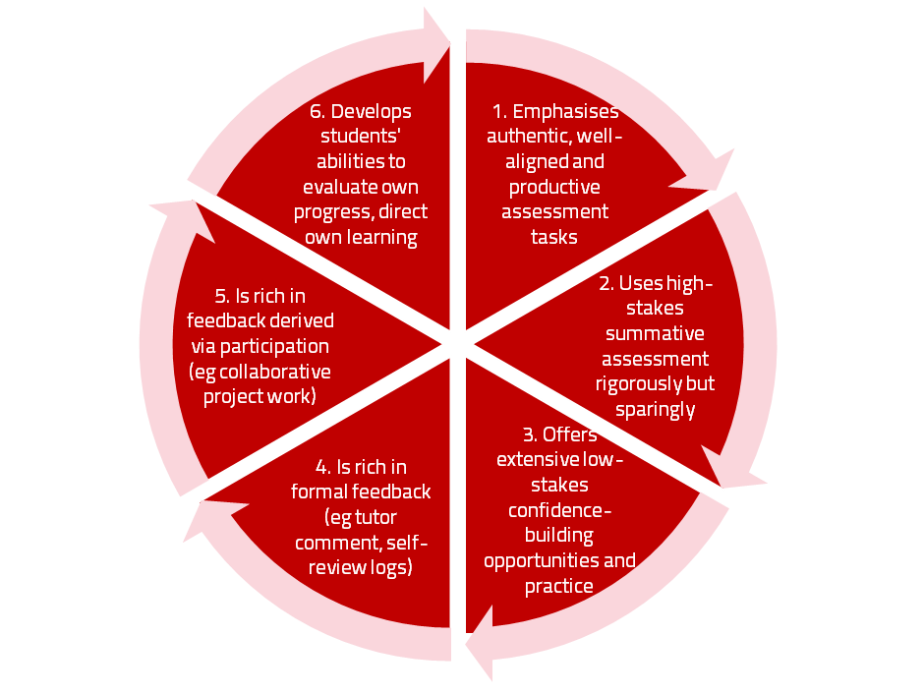
A4L the Northumbria model

Slide 50
Use link below to download the new materials on feedback and assessment produced in 2017 by Kay Sambell, Sally Brown and Phil Race for Edinburgh Napier University
http://staff.napier.ac.uk/services/dlte/ENhance/Pages/ENhanceQuickGuides.aspx

Slide 51
What’s wrong with feedback?
Students get it too late.
And too often, it’s just words on paper.
It doesn’t help them enough.
They often don’t take enough notice of it.

Slide 52
Fishing for feedback?
Feedback is like fish.
If it is not used quickly, it becomes useless.
(Sally Brown).
Give a man a fish,
Feed him for a day.
Teach a man to fish,
Feed him for a lifetime.
(Maimonides: 1135-1204)
Make feedback timely, while it still matters to students, in time for them to use it towards further learning, or to receive further assistance.
(Graham Gibbs)
And he’ll learn to drink beer in boats
And you won’t see him for weeks!
(Australian proverb).

Slide 53
But what’s really wrong with feedback?
Too often it’s one-way – monologic.
What students want is dialogue.
They want to talk to us about their work.
But they’re scared to talk to us, for various reasons:
In case it leads to lower marks;
In case they’re ‘found out’;
In case they feel stupid.

Slide 54
Royce Sadler on feedback:
Higher education teachers are often frustrated by the modest impact feedback has in improving learning. The status of feedback deserves to be challenged on the grounds that it is essentially about telling. For students to become self-sustaining producers of high quality intellectual and professional goods, they must be equipped to take control of their own learning and performance. (Sadler, 2013)
Sadler, D. R. (2013). Opening up feedback: Teaching learners to see. In Merry, S., Price, M., Carless, D., & Taras, M. (Eds.) Reconceptualising feedback in higher education: Developing dialogue with students. (Ch. 5, 54‑63). London: Routledge.

Slide 55
How’s your feedback? (After Nicol and MacFarlane-Dick, 2006)
1. Helps clarify what good performance is (goals, criteria, expected standards);
2. Facilitates the development of self-assessment (reflection) in learning;
3. Delivers high quality information to students about their learning – and how to progress it;
4. Encourages teacher and peer dialogue around learning;
5. Encourages positive motivational beliefs and self-esteem;
6. Provides opportunities to close the gap between current and desired performance;
7. Provides information to teachers that can be used to help shape the teaching.

Slide 56
The NSS Assessment and Feedback Agenda (2005-16)
The criteria used in marking have been clear in advance.
Assessment arrangements and marking have been fair.
Feedback on my work has been prompt.
I have received detailed comments on my work.
Feedback on my work has helped me to clarify things I did not understand.

Slide 57
The new NSS statements (2017)
Assessment and feedback
The criteria used in marking have been clear in advance
Marking and assessment have been fair
Feedback on my work has been timely
I have received helpful comments on my work
Student voice
I have had the right opportunities to provide feedback on my course
Staff value students’ views and opinions about the course
It is clear how students’ feedback on the course has been acted on

Slide 58
Face-to-face communication
Making all the channels work

Slide 59
Face-to-face one-to-one feedback activity
On the signal to start, please stand up, and work in pairs, moving around the room, talking to different people using the script which follows…
The script:
A ‘Hello’ (or equivalent).
B ‘Hello’ (or equivalent).
A ‘You are late’.
B ‘I know’.
Try to do it completely differently each time.

Slide 60
Constructive Alignment: John Biggs
What will I be expected to show for this?
What does a good one look like, and a bad one?
Where does this fit into the big picture?
When explaining assessment criteria to students, and when linking these to evidence of achievement of the intended learning outcomes, we need to make the most of face-to-face whole group contexts and...
Tone of voice
Body language
Facial expression
Eye contact
The chance to repeat things
The chance to respond to puzzled looks
Some things don’t work nearly so well just on paper or on screens.
Some of the
tools we can
use in
face-to-face
contexts

Slide 61
Face to face feedback

Slide 62
Hands-on feedback?

Slide 63
Ripples on a pond….
Motivates students – helps them to want to learn;
Helps students to identify what they need to do next;
Helps students to take action to improve their learning;
Helps students to make sense of what they are learning;
Helps them to further make sense of their learning by engaging in real dialogue with tutors and peers;
Helps them to make informed judgements on their own work, and each others’ work:
Helps them to reflect on their past work in ways they can use to improve their future work.
Feedback (including feed forward) works well when it:
Coaching,
explaining, teaching
Assessing
making informed judgements
Wanting/
Needing
Doing
Doing
Making sense
Feedback

Slide 64
Feedback works badly when it…
Is just a monologue from tutors to students;
Saps students’ confidence;
Directs students’ activities in inappropriate directions;
Fails to articulate with learning outcomes;
Fails to relate clearly to evidence of achievement of the assessment criteria;
Relates only to what is easy to assess rather than what is at the heart of learning;
Focuses on failings rather than achievements.

Slide 65
Five tips for formative feedback
Help students to want feedback.
Stop them concentrating on the mark.
Get the timing right, while students still care about what they’ve done.
Make feedback interesting - not routine or mundane.
Give at least some feedback very quickly.

Slide 66
Conclusions
Assessment and feedback can be powerful means of focusing student effort and enhancing achievement if well designed and constructively aligned (Biggs and Tang, 2011);
Students in the early stages of their learning journey are likely to need more support and positive feedback than later, when they are more robust and confident;
The first six weeks of the first semester are crucial in helping students understand how assessment works;
No single method of giving feedback is likely to be ubiquitously successful, so it’s worth using a variety of approaches;
Assessment needs to be manageable for staff and students if it is going to engage students in learning activities.

Slide 67
Back to our intended learning outcomes…
Do you now feel better able to:
2 hands = very much better,
one hand = somewhat better,
touch left ear = no better...
Reflect on how assessment and feedback link (or don’t link) to the factors underpinning successful student learning;
Examine what’s wrong with some traditional forms of assessment;
Think of what else we may be able to do to make assessment fit for purpose in 2018.
Wanting/
Needing
Doing
Making sense
Feedback

Slide 68
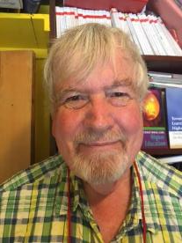
Thank you…
Website: http://phil-race.co.uk
Follow Phil on Twitter @RacePhil
e-mail: phil@phil-race.co.uk

Slide 69
Useful references and further reading (1)
Bain, K. (2004) What the best College Teachers do, Cambridge: Harvard University Press.
Biggs, J. and Tang, C. (2011) Teaching for Quality Learning at University, Maidenhead: Open University Press.
Bloxham, S. and Boyd, P. (2007) Developing effective assessment in higher education: a practical guide, Maidenhead, Open University Press.
Boud, D. (1995) Enhancing learning through self-assessment, London: Routledge.
Brown, S. and Glasner, A. (eds.) (1999) Assessment Matters in Higher Education, Choosing and Using Diverse Approaches, Maidenhead: Open University Press.
Brown, S. and Race, P. (2012) Using effective assessment to promote learning in Hunt, L. and Chambers, D. (2012) University Teaching in Focus, Victoria, Australia, Acer Press. P74-91.
Brown, S. (2015) Learning , Teaching and Assessment in Higher Education: Global perspectives, London, Palgrave.

Slide 70
Useful references and further reading (2)
Carless, D., Joughin, G., Ngar-Fun Liu et al (2006) How Assessment supports learning: Learning orientated assessment in action Hong Kong: Hong Kong University Press.
Carroll, J. and Ryan, J. (2005) Teaching International students: improving learning for all. London: Routledge SEDA series.
Crosling, G., Thomas, L. and Heagney, M. (2008) Improving student retention in Higher Education, London and New York: Routledge
Crooks, T. (1988) Assessing student performance, HERDSA Green Guide No 8 HERDSA (reprinted 1994).
Dunworth, K. and Sanchez, H.S., (2016). Perceptions of quality in staff-student written feedback in higher education: a case study. Teaching in Higher Education, 21(5), pp.576-589.
Dweck, C. S. (2000) Self Theories: Their Role in Motivation, Personality and Development, Lillington, NC: Taylor & Francis.
Falchikov, N. (2004) Improving Assessment through Student Involvement: Practical Solutions for Aiding Learning in Higher and Further Education, London: Routledge.
Gibbs, G. (1999) Using assessment strategically to change the way students learn, in Brown S. & Glasner, A. (eds.), Assessment Matters in Higher Education: Choosing and Using Diverse Approaches, Maidenhead: SRHE/Open University Press.
Higher Education Academy (2012) A marked improvement; transforming assessment in higher education, York: HEA.

Slide 71
Useful references and further reading (3)
Hawe, E., Lightfoot, U., & Dixon, H. (2017). First-year students working with exemplars: Promoting self-efficacy, self-monitoring and self-regulation. Journal of Further and Higher Education, 1-15.
Hendry, G. D., White, P., & Herbert, C. (2016). Providing Exemplar-Based “Feedforward” before an Assessment: The Role of Teacher Explanation. Active Learning in Higher Education, 17(2), 99-109.
Hounsell, D., McCune, V., Hounsell, J. and Litjens, J., (2008). The quality of guidance and feedback to students. Higher Education Research & Development, 27(1), pp.55-67.
McDowell, L. and Brown, S. (1998) Assessing students: cheating and plagiarism, Newcastle: Red Guide 10/11 University of Northumbria.
Meyer, J.H.F. and Land, R. (2003) ‘Threshold Concepts and Troublesome Knowledge 1 – Linkages to Ways of Thinking and Practising within the Disciplines’ in C. Rust (ed.) Improving Student Learning – Ten years on. Oxford: OCSLD.
Nicol, D. J. and Macfarlane-Dick, D. (2006) Formative assessment and self-regulated learning: A model and seven principles of good feedback practice, Studies in Higher Education Vol 31(2), 199-218.
PASS project Bradford http://www.pass.brad.ac.uk/ Accessed November 2013.
Peelo, M. T., & Wareham, T. (Eds.). (2002). Failing students in higher education. Society for Research into Higher Education.
Pickford, R. and Brown, S. (2006) Assessing skills and practice, London: Routledge.
Rotheram, B. (2009) Sounds Good, JISC project http://www.jisc.ac.uk/whatwedo/programmes/usersandinnovation/soundsgood.aspx

Slide 72
Useful references and further reading (4)
Race, P. (2001) A Briefing on Self, Peer & Group Assessment, in LTSN Generic Centre Assessment Series No 9, LTSN York.
Race P. (2015) The lecturer’s toolkit (4th edition), London: Routledge.
Rust, C., Price, M. and O’Donovan, B. (2003) Improving students’ learning by developing their understanding of assessment criteria and processes, Assessment and Evaluation in Higher Education. 28 (2), 147-164.
Ryan, J. (2000) A Guide to Teaching International Students, Oxford Centre for Staff and Learning Development.
Scoles, J., Huxham, M., & Mcarthur, J. (2013). No longer exempt from good practice: Using exemplars to close the feedback gap for exams. Assessment & Evaluation in Higher Education, 38(6), 631-645.
Stefani, L. and Carroll, J. (2001) A Briefing on Plagiarism, LTSN
Sadler, D. Royce (2010) Beyond feedback: developing student capability in complex appraisal, Assessment & Evaluation in Higher Education, 35: 5, 535-550.
Yorke, M. (1999) Leaving Early: Undergraduate Non-completion in Higher Education, London: Routledge.

