Slide 1
Activating Learning Re-inventing Feedback and Feed-forward
30th April, 2018
Newcastle College
Phil Race
(from Newcastle-upon-Tyne)
BSc PhD PGCE FCIPD PFHEA NTF
Follow Phil on Twitter: @RacePhil
Visiting Professor: University of Plymouth and Edge Hill University
Emeritus Professor, Leeds Beckett University

Slide 2
This slide has two purposes….
To focus the data projector, if necessary, and…
...to persuade colleagues never to put this sort of detail onto a slide!

Slide 3
About Phil…
First a musician
Then a writer
Then a scientist
Then a researcher
Then a lecturer and warden at what is now USW
Got interested in how students learn
And the effects assessment and feedback have on them
And how we teach them
Gradually became an educational developer
And now ‘retired’!?
Currently…
Visiting Prof: Plymouth & Edge Hill
Emeritus Prof: Leeds Beckett
Based at Newcastle, UK
And on trains
And an expert…
on train routes and timetables!
Notes:
2
2

Slide 4
Hounsell, D. (2008). The trouble with feedback: New challenges, emerging strategies. Interchange, 2, pp.1-10.
Feedforward is a strategy that aims to ‘increase the value of feedback to the students by focusing comments not only on the past and present…but also on the future – what the student might aim to do, or do differently in the next assignment or assessment if they are to continue to do well or to do better’ (Hounsell, 2008, p. 5).

Slide 5
Thanks to students
I could not do what I do nowadays if I did not continue to spend a fair bit of my time working with students – they’ve taught me most of what I know.

Slide 6
Rationale
We spend a great deal of our energy and time assessing students’ work, and giving them feedback. Do we spend too much time composing feedback and getting it to students? Is the time we spend actually well-spent? Is the feedback really used, or is much of it ignored, or even not read?
This session will start exploring how feedback links to the student learning experience, and the workshop this afternoon will go into more detail with exercises and discussion.

Slide 7
Feedback, knowledge and enthusiasm
Knowledge isn’t infectious (unfortunately) but enthusiasm is, and we need to help our students to catch enthusiasm.
We certainly don’t want assessment or feedback to damage that enthusiasm.

Slide 8
Students change
Students are changing fast, as are their expectations of how, what and why they are learning. As teachers, we need to use the best of innovative techniques, as what worked for us when we were learners may no longer work for today’s students. For a start, student groups are often bigger than used to be the case, and we’re in a digital age, not a paper-based one.

Slide 9
Intended learning outcomes
After participating in this session, you should be better-able to:
Reflect on how assessment and feedback link (or don’t link) to the factors underpinning successful student learning;
Look at the fact that many of the problems we have making feedback work originate from the kinds of assessment we find ourselves using (not least, essays)
Examine what’s wrong with some traditional forms of feedback;
Think of what else we may be able to do to make feedback fit for purpose in 2018.

Slide 10
The NSS Assessment and Feedback Agenda (2005-16)
The criteria used in marking have been clear in advance.
Assessment arrangements and marking have been fair.
Feedback on my work has been prompt.
I have received detailed comments on my work.
Feedback on my work has helped me to clarify things I did not understand.

Slide 11
The new NSS statements (2017)
Assessment and feedback
The criteria used in marking have been clear in advance
Marking and assessment have been fair
Feedback on my work has been timely
I have received helpful comments on my work
Student voice
I have had the right opportunities to provide feedback on my course
Staff value students’ views and opinions about the course
It is clear how students’ feedback on the course has been acted on

Slide 12
You will be able to download my main slides
You don’t need to take notes.
I’ll put the main slides I use up on my website when I get home tonight (http://phil-race.co.uk/)
I won’t post pictures and video-clips, as this would make the file-size too large.
I may sometimes go through slides quite fast, but you can study them as you wish at your leisure.

Slide 13
Announcement about mobile phones and laptops...
Good morning everyone – please turn on your ‘phones, tablets and computers.
Please post your thoughts, questions, comments and ideas during this session to the hashtag #philatnewcastle18 Thanks!
Try #LTHEchat on Wednesday evenings from 20.00-21.00.

Slide 14
Download Phil’s published stuff on feedback, assessment, and learning
Expanded discussion of how the factors underpinning learning link to feedback, assessment and large-group teaching:
http://phil-race.co.uk/2016/04/updated-powerpoint-ripples-model/ (Chapter 1 from ‘The Lecturer’s Toolkit, 2015)
https://phil-race.co.uk/2016/10/lthe-tweetchat-lthechat-wed-oct-19-8-00-9-00-pm/ (feedback stuff from my most recent two books)
https://phil-race.co.uk/2018/02/feedback-feedforward-just-tips-including-students/ (just the feedback tips!)
http://phil-race.co.uk/2015/01/assessment-bits-new-editions/ (extracts on assessment)

Slide 15
Getting to know each other: an analogue approach…
In turn, please..
Say one or two sentences about...
who you are,
where you come from, and
what you do.
In one breath!
(Optional) Share with us one thing that you’re dead good at, or really proud of.

Slide 16
Making engagement happen
Engagement is right at the centre of successful learning. Learning can’t happen without it. But engagement is a two-way process – it has to involve students – and us. Engagement should be fun – for us as well as for them.

Slide 17
Time-constrained Post-it exercise
On a post-it, in your best handwriting, please write your own completion of the starter:
“making feedback work for my students would be much better if only I..…”
Please swap post-its so that you’ve no idea who has yours.
If chosen, please read out with passion and drama the post-it you now have.
Please place them all on the chart as directed.

Slide 18
Thought for the day: Einstein
It is simply madness
to keep doing the same things,
and expect different results.

Slide 19
Bringing assessment and feedback to life Questions employers might ask students at interview. that could help us frame some of our assessment and feedback
Can you tell us about an occasion when:
you worked together with colleagues in a group to produce a collective outcome?
you had to work autonomously with incomplete information and self-derived data sources?
you developed strategies to solve real life problems and tested them out?
you had a leadership role in a team, and could you tell us your strategies to influence and persuade your colleagues to achieve a collective task?
you had to communicate outcomes from your project work orally, in writing, through social media and/or through a visual medium?
If you want it to happen,
build it into assessment and
let student get feedback on it.

Slide 20
Evidence-based practice
In the last decade, there’s been a great deal of international evidence-based research in assessment, feedback, learning and teaching. I’d like to alert you to how some of this can help us enhance students’ learning.
The next three slides show just 17 sources selected from the published evidence.

Slide 21
17 sources about assessment, feedback and learning in higher education
Knight, P. and Yorke, M. (2003) Assessment, learning and employability, Maidenhead, UK SRHE/Open University Press.
The TESTA project (http://www.testa.ac.uk/) Transforming the Experience of Students through Assessment, (Bath Spa, Chichester, Winchester and Worcester)
Flint, N. R. and Johnson, B. (2011) Towards fairer university assessment – recognising the concerns of students, London: Routledge.
ETC Toolkit (2015) (Enhancing the Curriculum) www.etctoolkit.org.uk
HEA (2012) A Marked Improvement: transforming assessment in higher education, York: Higher Education Academy (http://www.heacademy.ac.uk/assets/documents/assessment/A_Marked_Improvement.pdf )

Slide 22
17 sources about assessment, feedback and learning in higher education
Boud, D. and Associates (2010) Assessment 2020: seven propositions for assessment reform in higher education Sydney: Australian Learning and Teaching Council.
Carless, D. (2015) Excellence in University Assessment: Learning from award-winning practice, London: Routledge.
Race, P. (2014) Making learning happen: 3rd edition London: Sage. (lots of bits free on my website!)
Hunt, D. and Chalmers, L. (eds) (2012) University Teaching in Focus: a learning-centred approach Australia: ACER Press, and London: Routledge.
Price, M., Rust, C., O’Donovan, B. and Handley, K. (2012) Assessment Literacy, Oxford: the Oxford Centre for Staff and Learning Development (based on the ‘ASKe’ Project).
Evans, C. (2013) Making Sense of Assessment Feedback in Higher Education, Review of Educational Research Vol. 83, No. 1, pp. 70–120. http://journals.sagepub.com/doi/abs/10.3102/0034654312474350

Slide 23
17 sources about assessment, feedback and learning in higher education
Sambell, K., McDowell, L. and Montgomery, C. (2013) Assessment for Learning in Higher Education, London: Routledge.
Brown, S. (2015) Learning, teaching and assessment in higher education: global perspectives, Basingstoke: Palgrave-Macmillan. (great discussion on plagiarism).
Race, P. (2015) The Lecturer’s Toolkit: 4th edition, London, Routledge. (lots of bits on my website!)
Parkin, D (2017) Leading Learning and Teaching in Higher Education – the key guide to designing and delivering courses, London: Routledge.
Lea, J. (ed.) (2015) Enhancing Learning And Teaching In Higher Education: Engaging With The Dimensions Of Practice, London, Open University Press.
Sambell, K, Brown, S and Graham, L. (2017) Professionalism in Practice: Key directions in higher education: Learning, Teaching and Assessment, Basingstoke: Palgrave-Macmillan.

Slide 24
Now is the decade of Colleges’ dis-content!
Never mind the content – feel the learning

Slide 25
Modern institutions are moving away from being the providers of content, (where everything used to be about ‘delivery’), towards foregrounding two major functions:
Recognising and accrediting students’ achievement, wherever learning has taken place (i.e. getting the assessment right);
Supporting student learning and engagement (not least by making feedback work well for students, and using real-world situations and simulations to bring learning to life).

Slide 26
How students really learn
Seven factors underpinning successful learning based on asking 200,000 people about their learning in the last 30 years!

Slide 27
How Students Really Learn ‘Ripples’ model of learning
Phil Race

Slide 28
What’s missing?
Engagement?
Feelings?
Active
Experimentation
Inspiration?
Judgments?
Desire?
Abstract
Conceptualisation
Concrete
Experience
Communication?
Enthusiasm?
Reflective
Observation

Slide 29
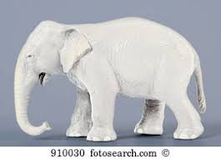
But what about learning styles?
https://www.theguardian.com/education/2017/mar/12/no-evidence-to-back-idea-of-learning-styles?CMP=share_btn_tw
(Link from my Tweet on March 13th 2017 to a letter in the Guardian by prominent folk around the world of education)
Or link to a word document: https://phil-race.co.uk/2017/09/swansea-university-school-management-21st-September/
“No evidence to back idea of learning styles”

Slide 31
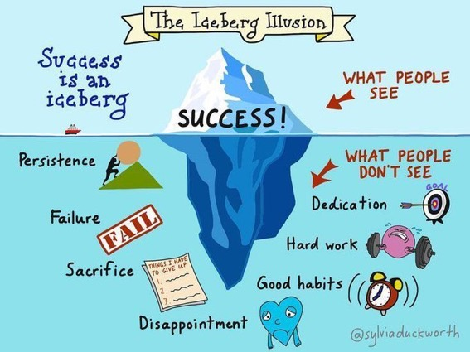

Slide 32
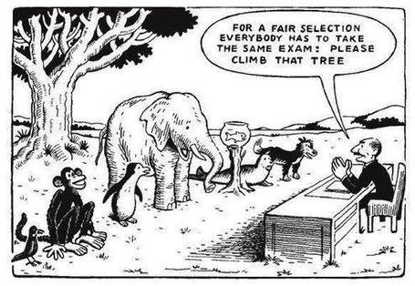

Slide 33
Ripples on a pond….
Striving to enhance our students’ want to learn;
Helping students to develop ownership of the need to learn;
Keeping students learning by doing, practice, trial-and-error, repetition;
Ensuring students get quick and useful feedback – from us and from each other;
Helping students to make sense of what they learn.
Getting students deepening their learning by verbalising, explaining things to each other, and to us.
Allowing students to further deepen their learning by assessing their own learning, and assessing others’ learning – making informed judgements.
We can make learning happen by:
Verbalising
Assessing
making informed judgements
Wanting/
Needing
Doing
Doing
Making sense
Feedback

Slide 35
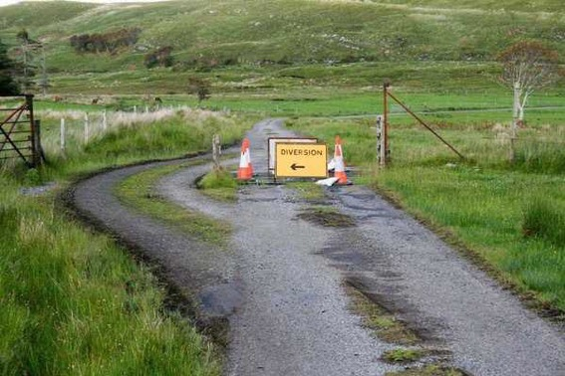

Slide 36
Teaching – and research – and reflection: the ten most important words
Why?
What?
Who?
Where?
When?
How?
Which?
So what?
wtf?
Wow?
And the most powerful four-letter word in the English language...
????

Slide 37
‘what’ is getting ever less important
Columbia University research published recently (2011) in Science magazine shows that people are much less prepared to remember ‘what’, but better at remembering where to access information, and how to do so.
Betsy Sparrow, one of the principal researchers, concludes that the internet has become ‘an external memory source that we can access at any time. ... Just as we learn through transactive memory who knows what in our families and offices, we are learning what the computer ‘knows’ and when we should attend to where we have stored information in our computer-based memories. We are becoming symbiotic with our computer tools.
Published Online July 14 2011 < Science Express Index Science DOI: 10.1126/science.1207745
Report: Google Effects on Memory: Cognitive Consequences of Having Information at Our Fingertips Betsy Sparrow,*, Jenny Liu, Daniel M. Wegner

Slide 38
Teaching – and research – and reflection: the ten most important words
Why? (rationale)
What? (content)
Who? (people, you, me, them)
Where? (locations)
When? (times)
How? (processes)
Which? (decisions)
So what? (importance?)
Wow? (impact?)
And the most powerful four-letter word in the English language...
????

Slide 39
Drives most learning
Is assessment broken?
Some
assessment
issues
What students think
Assessment as learning
Validity
Whodunit?
Fairness

Slide 40
My main worries about assessment...
Too often, we still tend to try to measure...
...what’s in students’ heads, and what they can do with what’s there...
in terms of two unsatisfactory proxies ...
what comes out of students’ pens in exams;
2. what comes out of their keyboards in essays and reports.

Slide 41
The read-write industry

Slide 42
In the exam room you’re on your own

Slide 43
Boud et al 2010: ‘Assessment 2020’
Assessment has most effect when...:
It is used to engage students in learning that is productive.
Feedback is used to actively improve student learning.
Students and teachers become responsible partners in learning and assessment.
Students are inducted into the assessment practices and cultures of higher education.
Assessment for learning is placed at the centre of subject and program design.
Assessment for learning is a focus for staff and institutional development.
Assessment provides inclusive and trustworthy representation of student achievement.

Slide 44
Boud et al, 2010
David Boud (University of Technology, Sydney), Royce Sadler (Griffith University), Gordon Joughin (University of Wollongong), Richard James (University of Melbourne), Mark Freeman (University of Sydney), Sally Kift (Queensland University of Technology), Filip Dochy (University of Leuven), Dai Hounsell (University of Edinburgh), Margaret Price (Oxford Brookes University), Tom Angelo (La Trobe University), Angela Brew (Macquarie University), Ian Cameron (University of Queensland), Denise Chalmers (University of Western Australia), Paul Hager (University of Technology, Sydney), Kerri-Lee Harris (University of Melbourne), Claire Hughes (University of Queensland), Peter Hutchings (Australian Learning and Teaching Council), Kerri-Lee Krause (Griffith University), Duncan Nulty (Griffith University), Ron Oliver (Edith Cowan University), Jon Yorke (Curtin University), Iouri Belski (RMIT University), Ben Bradley (Charles Sturt University), Simone Buzwell (Swinburne University of Technology), Stuart Campbell (University of Western Sydney), Philip Candy (University of Southern Queensland), Peter Cherry (Central Queensland University), Rick Cummings (Murdoch University), Anne Cummins (Australian Catholic University), Elizabeth Deane (Australian National University), Marcia Devlin (Deakin University), Christine Ewan (Australian Learning and Teaching Council), Paul Gadek (James Cook University), Susan Hamilton (University of Queensland), Margaret Hicks (University of South Australia), Marnie Hughes-Warrington (Monash University), Gail Huon (University of Newcastle), Margot Kearns (University of Notre Dame, Sydney), Don Maconachie (University of the Sunshine Coast), Vi McLean (Queensland University of Technology,) Raoul Mortley (Bond University), Kylie O’Brien (Victoria University), Gary O’Donovan (University of Tasmania), Beverley Oliver (Curtin University), Simon Pyke (University of Adelaide), Heather Smigiel (Flinders University), Janet Taylor (Southern Cross University), Keith Trigwell (University of Sydney), Neil Trivett (University of Ballarat), Graham Webb (University of New England).

Slide 45
The importance of dialogic assessment
Students need to be exposed to, and gain experience in making judgements about, a variety of works of different quality... They need planned rather than random exposure to exemplars, and experience in making judgements about quality. They need to create verbalised rationales and accounts of how various works could have been done better. Finally, they need to engage in evaluative conversations with teachers and other students.
(Sadler 2010)

Slide 46
Five main problems with assessed essays
They take a great deal of time to mark, let alone the time it takes for students to prepare, draft and compose them.
When most assessment is in the form of essays, students’ skills at essay-writing are repeatedly tested, as the expense sometimes of their understanding of the subject.
Lots of research shows that we’re not at all good at marking essays fairly – different assessors often give the same essay very different marks.
Essay marks in the UK tend to lie between 35% for a poor one and 75% for a very good one, whereas in many other disciplines the marks for an assignment like a lab report can range across the whole 0-100% span more evenly.
With coursework essays, there can be doubt about veracity – i.e. ‘whodunit?’!

Slide 47
Why is it important to tackle the problem?
There is a strong argument to be made for using authentic assessments, that is those that “can demonstrate the knowledge behaviours, qualities and attributes that were described in the course programme or specification” (Brown, 2015 p.118). In some disciplines, assessed essays are rarely or never used – for example in many science, engineering, maths and technology fields. But in many other disciplines, the essay as the main form of assessment still dominates, both in coursework and exams.

Slide 48
What else can we do? (1)
Reduce the length.
If we want students to demonstrate the skills of synthesis and assimilation, asking them to write fewer words may be more effective than seeking long discursive responses to open essay titles. We can address the time taken marking factor by requiring much shorter essays. Word-constrained (e.g. 200 plus or minus 10) word counts can make marking a great deal faster, and student thinking deeper – it can be a lot harder to write a good short essay than a long ‘woolly’ one.

Slide 49
What else can we do? (2)
Require more-personal essays.
To avoid mechanistic or reproductive approaches when writing about a topic, rather than asking students simply to reframe content they have derived from reference sources, we can ask them to adopt a personal position in an argument, or ask them to draw on specialist knowledge from professional backgrounds to demonstrate a thorough understanding of a topic. We can therefore ask students to include where relevant their own views, opinions, experiences, predictions and reflections. Personalised essays are more interesting to mark, too and have the positive side-effect of being more difficult to re-use or plagiarise.

Slide 50
What else can we do? (3)
Couple written work with oral presentation.
If we want students to demonstrate the ability to communicate effectively in a range of media, we can ask students to produce linked oral and written elements within an assignment. We can therefore allot some marks to the written work, but give further marks for face-to-face communication, for example through a presentation to peers, or answering questions about the written work, where probing questions can be used to gauge depth of understanding.

Slide 51
What else can we do? (4)
Get students themselves practised as assessing essays.
A core skill for effective students is the ability to evaluate how good their work is during the actual production of it (Sadler, 2010) so gaining practice in seeing what comprises a really good essay can help them write better ones themselves. This can be one of the fastest ways of letting them know how we might assess essays, and inducts them quickly into the tips and wrinkles which can make their forays in essay design more successful.

Slide 52
What else can we do? (5)
Help students understand what good essays look like.
Early in any course, discuss in class good, medium and poor examples of essays, so students learn how best to evidence their learning in this particular medium, and what is valued in the discipline or field being studied.

Slide 53
What else can we do? (6)
Familiarise students from an early stage with the importance of the processes of planning, drafting, re-drafting and editing their essays.
In previous learning contexts, they may have had lots of help from teachers in improving drafts, which they can’t expect to receive in UK HE contexts, so they need to learn how to review and improve their own work and to appreciate that essays are usually best not just written ‘straight from the brain’, and must be adjusted, fine-tuned and improved before submission.

Slide 54
Feed-forward
Language of feedback
Some feedback
issues
National Student Survey
Timing:
24-hours!
Written, printed,
on-screen
Efficiency
Face to face
oral

Slide 55
Quality feedback: three vital functions
“There is wide consensus within the education literature that ‘quality’ feedback should serve three overlapping functions:
an ‘orientational’ purpose that clarifies the student’s performance and achievement;
a ‘transformational’ purpose that enables the student to reflect, improve their performance, and become more autonomous (often termed ‘feed-forward); and
an ‘affective/interpersonal’ dimension that gives the student confidence and motivation, and builds a strong teacher-student relationship”
(Dunworth & Sanchez, 2016, quoted by Winstone and Nash, 2016).

Slide 56
Task: think about ghastly feedback
Think back to some occasions, academic or otherwise, historic or recent when you received feedback that you would rather not have received.
How did it make you feel?
Thinking of a single example of ghastly feedback that you are prepared to share with another person, briefly outline the context and say why it was such a negative experience.

Slide 57
Is your provision of feedback fair?
Do you review feedback across a cohort of markers to ensure there is some consistency between them in the amount, quality and promptness of feedback they give?
Do students who visit staff offices persistently or enter into extended email discussions with staff on a one-to-one basis for additional feedback (the ‘worried well’) get significantly more and better feedback than those that do not?
Do you as an assessor become noticeably more tetchy and sketchy in your feedback the later in the day you are doing it? – also … later down the pile of work?
Do you play fair by students by avoiding opacity and obscurity in your comments?

Slide 58
What are exemplars, and how can we use them productively?
Exemplars are not model answers. They are carefully selected examples of authentic student work from previous cohorts (anonymised and with permission) or teacher-constructed examples (based on your extensive experience of the kinds of responses and common mistakes students make). They are chosen to typify and illustrate designated levels of quality or competence.
The concrete nature of exemplars means that they are able to convey messages in a way that nothing else can (Sadler, 2002). Carefully selected examples can not only help students to ‘see’ what the teacher expects with regard to the task in hand (Scoles et al, 2013), but also guide their action.

Slide 59
Exemplars can enable students to:
gain a feel for what the final product looks like in terms of layout, size, structure and language;
develop their insights into the nature of academic writing;
raise awareness of the diverse ways a task might fruitfully (or erroneously) be tackled;
hone students’ evaluative skills;
Act as powerful learning tools (Sadler, 2010), helping students gain insight into the nature of quality and standards, ideally through close analysis and discussion (Hendry et al, 2016);
Students typically find exemplars to be more useful than standalone lists of criteria, grids and rubrics (Hawe et al, 2017).

Slide 60
What can we do when using exemplars?
Choose examples which will help students firmly grasp task requirements;
Help students practise applying criteria to samples of work;
Enable students to reflect deeply on, and discuss, what high quality work looks like;
Carefully orchestrate discussion activities to promote understanding of fruitful learning strategies and approaches;
Use exemplars-based activities to develop students’ skills to monitor their own work while they are producing it;
Help students to rate their work by comparison with their peers.

Slide 61
Learning is not linear! Feedback is not unidirectional. But sometimes we pretend that they are! #sketchnote by @SGroshell and @MrZachG #edchat #learning #teachchat

Slide 62
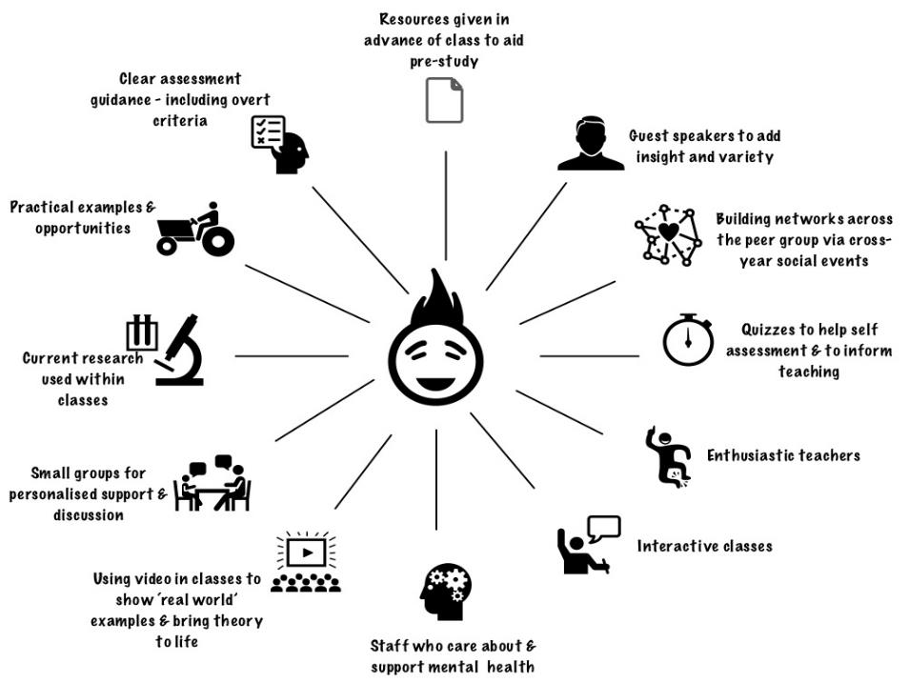
Newcastle College
What works?

Slide 63
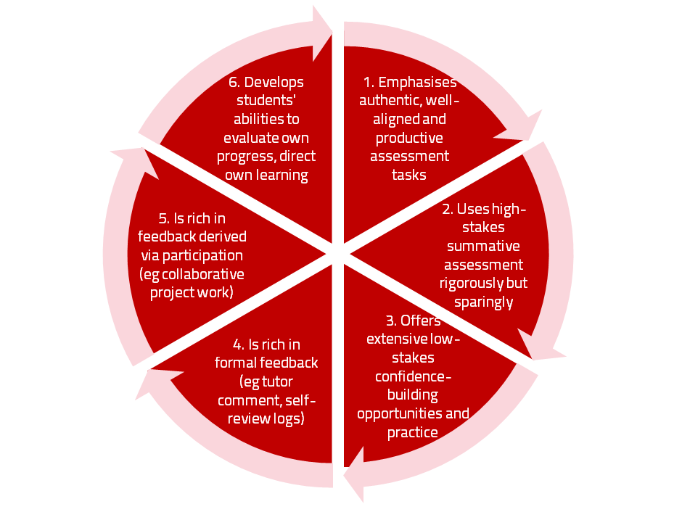
A4L the Northumbria model

Slide 64
Use link below to download the new materials on feedback and assessment produced in 2017 by Kay Sambell, Sally Brown and Phil Race for Edinburgh Napier University
http://staff.napier.ac.uk/services/dlte/ENhance/Pages/ENhanceQuickGuides.aspx

Slide 65
What’s wrong with feedback?
Students get it too late.
And too often, it’s just words on paper.
It doesn’t help them enough.
They often don’t take enough notice of it.

Slide 66
Fishing for feedback?
Feedback is like fish.
If it is not used quickly, it becomes useless.
(Sally Brown).
Give a man a fish,
Feed him for a day.
Teach a man to fish,
Feed him for a lifetime.
(Maimonides: 1135-1204)
Make feedback timely, while it still matters to students, in time for them to use it towards further learning, or to receive further assistance.
(Graham Gibbs)
And he’ll learn to drink beer in boats
And you won’t see him for weeks!
(Australian proverb).

Slide 67
But what’s really wrong with feedback?
Too often it’s one-way – monologic.
What students want is dialogue.
They want to talk to us about their work.
But they’re scared to talk to us, for various reasons:
In case it leads to lower marks;
In case they’re ‘found out’;
In case they feel stupid.

Slide 68
Royce Sadler on feedback:
Higher education teachers are often frustrated by the modest impact feedback has in improving learning. The status of feedback deserves to be challenged on the grounds that it is essentially about telling. For students to become self-sustaining producers of high quality intellectual and professional goods, they must be equipped to take control of their own learning and performance. (Sadler, 2013)
Sadler, D. R. (2013). Opening up feedback: Teaching learners to see. In Merry, S., Price, M., Carless, D., & Taras, M. (Eds.) Reconceptualising feedback in higher education: Developing dialogue with students. (Ch. 5, 54‑63). London: Routledge.

Slide 69
Dylan Wiliam on feedback (online)
There really is a lot of rot talked about how feedback should and should not be given.
...people forget that the only good feedback is that which is acted upon, which is why the only thing that matters is the relationship between the teacher and the student.
Every teacher knows that the same feedback given to one student will improve that student’s learning but to another student, of similar achievement, will make that student give up. Teachers need to know their students, so that they know when to push, and they know when to back off. ...hardly any studies look at the responses cued in the individual recipient by the feedback.

Slide 70
Damaging feedback...
(From #LTHE digest, available in full on my website)
I got some student evaluation feedback that really stung ... wasn't that long ago either! .
I recall - "could do better" - what's that all about?
''weak'" for art on successive school reports. (Showed sustainability though?)
'don't bother getting up on Monday morning' after a failed assignment by a maths teacher at secondary school
missing out on an A as I read the question slightly wrong
A big red cross through something I'd put some effort into, devastating
I wear my feedback like scars. Some of the wounds still fester.
Being told that I was holding up everyone because I didn't understand maths GCSE lesson
my only consolation was they pulled apart my punctuation and grammar but their feedback was full of typos!
'Kerry has ability to do well when she puts her mind to it' Response, Kerry will put her mind to it when she's not bored to death
The worst feedback I eve received on a sweated-over assignment was 'Fine as far as it goes' Grrrh!

Slide 71
How’s your feedback? (After Nicol and MacFarlane-Dick, 2006)
1. Helps clarify what good performance is (goals, criteria, expected standards);
2. Facilitates the development of self-assessment (reflection) in learning;
3. Delivers high quality information to students about their learning – and how to progress it;
4. Encourages teacher and peer dialogue around learning;
5. Encourages positive motivational beliefs and self-esteem;
6. Provides opportunities to close the gap between current and desired performance;
7. Provides information to teachers that can be used to help shape the teaching.

Slide 72
Face-to-face communication
Making all the channels work

Slide 73
Face-to-face one-to-one feedback activity
On the signal to start, please stand up, and work in pairs, moving around the room, talking to different people using the script which follows…
The script:
A ‘Hello’ (or equivalent).
B ‘Hello’ (or equivalent).
A ‘You are late’.
B ‘I know’.
Try to do it completely differently each time.

Slide 74
Constructive Alignment: John Biggs
What will I be expected to show for this?
What does a good one look like, and a bad one?
Where does this fit into the big picture?
When explaining assessment criteria to students, and when linking these to evidence of achievement of the intended learning outcomes, we need to make the most of face-to-face whole group contexts and...
Tone of voice
Body language
Facial expression
Eye contact
The chance to repeat things
The chance to respond to puzzled looks
Some things don’t work nearly so well just on paper or on screens.
Some of the
tools we can
use in
face-to-face
contexts

Slide 75
Face to face feedback

Slide 76
Hands-on feedback?

Slide 77
Five tips for formative feedback
Help students to want feedback.
Stop them concentrating on the mark.
Get the timing right, while students still care about what they’ve done.
Make feedback interesting - not routine or mundane.
Give at least some feedback very quickly.

Slide 78
Useful references and further reading (1)
Bain, K. (2004) What the best College Teachers do, Cambridge: Harvard University Press.
Biggs, J. and Tang, C. (2011) Teaching for Quality Learning at University, Maidenhead: Open University Press.
Bloxham, S. and Boyd, P. (2007) Developing effective assessment in higher education: a practical guide, Maidenhead, Open University Press.
Boud, D. (1995) Enhancing learning through self-assessment, London: Routledge.
Brown, S. and Glasner, A. (eds.) (1999) Assessment Matters in Higher Education, Choosing and Using Diverse Approaches, Maidenhead: Open University Press.
Brown, S. and Race, P. (2012) Using effective assessment to promote learning in Hunt, L. and Chambers, D. (2012) University Teaching in Focus, Victoria, Australia, Acer Press. P74-91.
Brown, S. (2015) Learning , Teaching and Assessment in Higher Education: Global perspectives, London, Palgrave.

Slide 79
Useful references and further reading (2)
Carless, D., Joughin, G., Ngar-Fun Liu et al (2006) How Assessment supports learning: Learning orientated assessment in action Hong Kong: Hong Kong University Press.
Carroll, J. and Ryan, J. (2005) Teaching International students: improving learning for all. London: Routledge SEDA series.
Crosling, G., Thomas, L. and Heagney, M. (2008) Improving student retention in Higher Education, London and New York: Routledge
Crooks, T. (1988) Assessing student performance, HERDSA Green Guide No 8 HERDSA (reprinted 1994).
Dunworth, K. and Sanchez, H.S., (2016). Perceptions of quality in staff-student written feedback in higher education: a case study. Teaching in Higher Education, 21(5), pp.576-589.
Dweck, C. S. (2000) Self Theories: Their Role in Motivation, Personality and Development, Lillington, NC: Taylor & Francis.
Falchikov, N. (2004) Improving Assessment through Student Involvement: Practical Solutions for Aiding Learning in Higher and Further Education, London: Routledge.
Gibbs, G. (1999) Using assessment strategically to change the way students learn, in Brown S. & Glasner, A. (eds.), Assessment Matters in Higher Education: Choosing and Using Diverse Approaches, Maidenhead: SRHE/Open University Press.
Higher Education Academy (2012) A marked improvement; transforming assessment in higher education, York: HEA.

Slide 80
Useful references and further reading (3)
Hawe, E., Lightfoot, U., & Dixon, H. (2017). First-year students working with exemplars: Promoting self-efficacy, self-monitoring and self-regulation. Journal of Further and Higher Education, 1-15.
Hendry, G. D., White, P., & Herbert, C. (2016). Providing Exemplar-Based “Feedforward” before an Assessment: The Role of Teacher Explanation. Active Learning in Higher Education, 17(2), 99-109.
Hounsell, D., McCune, V., Hounsell, J. and Litjens, J., (2008). The quality of guidance and feedback to students. Higher Education Research & Development, 27(1), pp.55-67.
McDowell, L. and Brown, S. (1998) Assessing students: cheating and plagiarism, Newcastle: Red Guide 10/11 University of Northumbria.
Meyer, J.H.F. and Land, R. (2003) ‘Threshold Concepts and Troublesome Knowledge 1 – Linkages to Ways of Thinking and Practising within the Disciplines’ in C. Rust (ed.) Improving Student Learning – Ten years on. Oxford: OCSLD.
Nicol, D. J. and Macfarlane-Dick, D. (2006) Formative assessment and self-regulated learning: A model and seven principles of good feedback practice, Studies in Higher Education Vol 31(2), 199-218.
PASS project Bradford http://www.pass.brad.ac.uk/ Accessed November 2013.
Peelo, M. T., & Wareham, T. (Eds.). (2002). Failing students in higher education. Society for Research into Higher Education.
Pickford, R. and Brown, S. (2006) Assessing skills and practice, London: Routledge.
Rotheram, B. (2009) Sounds Good, JISC project http://www.jisc.ac.uk/whatwedo/programmes/usersandinnovation/soundsgood.aspx

Slide 81
Useful references and further reading (4)
Race, P. (2001) A Briefing on Self, Peer & Group Assessment, in LTSN Generic Centre Assessment Series No 9, LTSN York.
Race P. (2015) The lecturer’s toolkit (4th edition), London: Routledge.
Rust, C., Price, M. and O’Donovan, B. (2003) Improving students’ learning by developing their understanding of assessment criteria and processes, Assessment and Evaluation in Higher Education. 28 (2), 147-164.
Ryan, J. (2000) A Guide to Teaching International Students, Oxford Centre for Staff and Learning Development.
Scoles, J., Huxham, M., & Mcarthur, J. (2013). No longer exempt from good practice: Using exemplars to close the feedback gap for exams. Assessment & Evaluation in Higher Education, 38(6), 631-645.
Stefani, L. and Carroll, J. (2001) A Briefing on Plagiarism, LTSN
Sadler, D. Royce (2010) Beyond feedback: developing student capability in complex appraisal, Assessment & Evaluation in Higher Education, 35: 5, 535-550.
Yorke, M. (1999) Leaving Early: Undergraduate Non-completion in Higher Education, London: Routledge.

Slide 82
Feedback, and…
Feed-forward

Slide 83
Ripples on a pond….
Motivates students – helps them to want to learn;
Helps students to identify what they need to do next;
Helps students to take action to improve their learning;
Helps students to make sense of what they are learning;
Helps them to further make sense of their learning by engaging in real dialogue with tutors and peers;
Helps them to make informed judgements on their own work, and each others’ work:
Helps them to reflect on their past work in ways they can use to improve their future work.
Feedback (including feed forward) works well when it:
Coaching,
explaining, teaching
Assessing
making informed judgements
Wanting/
Needing
Doing
Doing
Making sense
Feedback

Slide 84
Feedback works badly when it…
Is just a monologue from tutors to students;
Saps students’ confidence;
Directs students’ activities in inappropriate directions;
Fails to articulate with learning outcomes;
Fails to relate clearly to evidence of achievement of the assessment criteria;
Relates only to what is easy to assess rather than what is at the heart of learning;
Focuses on failings rather than achievements.

Slide 85
Individual task on ways of giving students feedback
Think of the main ways you give feedback to your students. Think also of other ways they get feedback without you being involved.
Privately, make a list of the ways your students get feedback on their learning (not just on their work) – aim for ten or more different ways students get feedback.

Slide 86
Group task
Please go into groups as directed.
As a group, please write each feedback method on a separate post-it, and place the post-its in position on a flipchart as follows…

Slide 87
High learning payoff
for students
Highly efficient
for us
Not highly efficient
for us
Low learning payoff
for students

Slide 88
25
5
High learning payoff
We need to be making
better use of the feedback
processes in this quadrant
16
4
Highly efficient
Not highly efficient
3
5
4
2
1
2
4
Low learning payoff
We need to be making
much less use of the feedback
processes in this quadrant
1
1

Slide 89
Your feedback methods..
Low scoring
1 written feedback
1 turnitin
2 written feedback
4 written feedback end of module
4 written annotations
4 written
4 traffic lights
5 general feedback
High scoring:(if done well)
25 client feedback
25 peer teaching
25 spoken feedback
25 peer critique
25 verbal one to one studio
25 group critique
20 informal feedback comments in class
16 guided self assessment

Slide 90
Others’ feedback methods..
Low scoring
1 just a grade
1 email feedback
1 written feedback on essays
3 written feedback on summative assessments
3 email feedback
5 grade or mark
High scoring:(if done well)
25 verbal 1:many
25 tests on real life knowledge
20 self assessment
20 generic feedback on assignments
20 online resources with Q and A
16 self assessment against marking scheme

Slide 91
Others’ scores (one of hundreds of examples)
High scoring:
25 verbal feedback to whole group
25 general feedback to the whole group with individual comments
25 instant feedback by self assessment
16 reflective journal self evaluation
16 peer feedback
14 whole group verbal feedback
Low scoring
1 written individual (ditto)
5 no feedback

Slide 92
How to get feedback to a large group of students within 24 hours
There are serious reservations about written feedback, but we can make even this work much better than it did.
The next few slides are about a way of giving students feedback on their work within 24 hours of them doing it.
There are three or more ‘yes, but...’s with this idea, but please hold these for around four minutes.

Slide 93
Set the hand-in time to be at a whole-group session
E.g. next Tuesday’s 10-11 lecture,
Deadline = 1003.
Let them pile up all their work at the front.
At 1003, hand out to everyone a coloured sheet, containing numbered points.
(so you can say in feedback ‘please see point 3, blue sheet’ and so on).

Slide 94
The blue sheet can contain....
Illustration of what is expected as evidence of achievement of each of the intended learning outcomes
Likely mistakes
Features of a good answer
Frequently needed explanations
Things you otherwise would have to write time and time again on students’ work.
Let the students study this for 3 minutes until 1006 – it goes rather quiet!

Slide 95
At 1006...
Go into face-to-face oral mode, until 1009....
Spend a few minutes de-briefing the whole group and talking them through one point on the handout…
…adding tone-of-voice, facial expression, body language, emphasis, and so on to the feedback.

Slide 96
The rationale...
Since most of the students will still have been doing the work in the last 24 hours before handing it in, you’re giving them feedback while they still remember what they were doing.
They know what they didn’t do.
They know what they missed out because they couldn’t understand it.

Slide 97
Now take away their work to mark – in a third of the time it used to take you!
You waste far less writing the same old things on one piece of work after another, regarding frequently occurring mistakes;
Instead, you need just to write ‘please see point 4, blue sheet’ (which takes seconds).
You can now make your comments relate more to each individual piece of work;
This means when students get their marked work back with feedback, they are more likely to use it, as it’s personal to them.

Slide 98
Furthermore...
When they get their marked work back, they’ve already had the chance to make sense of their own piece of work in the light of the generic feedback you gave them when they handed it in, and the additional oral ‘deepening’ of one important point.

Slide 99
Set
hand-in deadline to be at lecture
Prepare ‘blue sheet’ with anticipated
generic feedback
Summary: providing feedback within 24 hours
Collect students’ work at start of lecture
Take away work to mark in a third of the time
Hand out ‘blue sheet’
Talk class through one important point, then resume lecture
Let students read blue sheet for short while

Slide 100
Feedback without marks
Marks often destroy the value of our feedback to students!

Slide 101
Feedback versus marks or grades
Feedback may be eclipsed by marks or grades.
Students may be blinded by the mark or grade, and not even try to make sense of the feedback they receive.

Slide 102
Just a mark (or grade) is the least effective form of feedback!
It’s what students look at first.
If the mark is good, they smile and file – quite often they don’t even read the feedback.
If it’s low, they frown and bin it – very often without reading the feedback.

Slide 103
But there are ways round this...
Give students back their work with feedback but with no marks or grades (keeping your record of their marks).
Ask them to work out their marks from the feedback you have given them (and from the feedback you gave to others too).

Slide 104
Suggest that their marks will count!
Tell them that if their self-assessment scores are within (say) 5% of your own scores, the higher number will go forward into their assessment record.
But explain that you will talk individually to those students whose score is different by more than 5% from yours.

Slide 105
Get them to self-assess...
Collect their scores or grades – e.g. pass a sheet round in a lecture.
Most students (e.g. 9 in 10) will be within the 5%.
Arrange to talk to those where the difference is more than 5% or one grade.

Slide 106
Students who under-estimate their grade…
These students often need their esteem boosted.
Remind them about the assessment criteria, and how these illustrate the intended standards associated with the learning outcomes.
Check that they weren’t just trying not to be seen as over-confident.

Slide 107
Students who over-estimate their grade…
This usually indicates they’ve got a blind spot.
Talk them through their work, and find out exactly where they’ve lost marks which they thought they had gained.
Check with them that they can now see what was being looked for.

Slide 108
Developing this idea further…
Think about getting students to indicate their expected score or grade at the point of handing their work in – for example on a self-assessment proforma.
Think about getting students to work out how well they believe they have achieved each of the intended learning outcomes for the work concerned…
Or how well they believe they have met each of the assessment criteria for the work.

Slide 109
Get students to self-assess their work
At the point of handing it in to us!

Slide 110
Using student self-assessment to deepen their learning…
…and to make tutor-marking more effective, and efficient – and to start tutor-student dialogues

Slide 111
Self-Assessment of your Assignment Please respond to the following questions at the point just before handing your work in. This will help me to give you useful feedback about your work, and also will give me useful feedback about how you are finding the programme to date. Thanks.
 | Questions | Your replies to the questions | Tutor’s responses | Your action points
1 | Ωηατ μαρκ (ουτ οφ 100) δο ψου τηινκ τηισ ωορκ δεσερϖεσ?
2 | Ωηατ διδ ψου λικε μοστ αβουτ δοινγ τηισ παρτιχυλαρ πιεχε οφ ωορκ?
3 | Ωηατ διδ ψου λικε λεαστ αβουτ δοινγ τηισ πιεχε οφ ωορκ?
4 | Ωηατ δο ψου τηινκ ισ τηε τηινγ ψου διδ βεστ?
5 | Ωηατ δο ψου τηινκ ψου διδ λεαστ ωελλ?

Slide 112
Self-assessment tutor dialogues
Getting students to really reflect:
A way of evidencing good feedback practice for inspection purposes;
Avoiding wasting your time – and students’ time;
Making sure students actually read your feedback;
Making sure you give your students the feedback they want as well as the feedback they need;
Finding out more about your students;
…and much more.

Slide 113
Some questions to consider for self-assessment-tutor dialogues
1 What do you honestly consider will be a fair score or grade for the work you are handing in?

Slide 114
Some questions to consider for self-assessment-tutor dialogues
2 What do you think was the thing you did best in this assignment?

Slide 115
Some questions to consider for self-assessment-tutor dialogues
3 If you had the chance to do the assignment again from scratch, how (if at all) might you decide to go about it differently?

Slide 116
Some questions to consider for self-assessment-tutor dialogues
4 What did you find the hardest aspect of this assignment?

Slide 117
Some questions to consider for self-assessment-tutor dialogues
5 Please jot down three short questions you would like me to answer about this example of your work:
(1)
(2)
(3)

Slide 118
But this is just a start...
Students would soon get bored if they were to answer the same questions for several successive assignments.
It is best to make the dialogue specific to the subject-matter of the assignment.

Slide 119
Back to our intended learning outcomes…
Do you now feel better able to:
2 hands = very much better, one hand = somewhat better, touch left ear = no better...
Reflect on how assessment and feedback link (or don’t link) to the factors underpinning successful student learning?
Look at the fact that many of the problems we have making feedback work originate from the kinds of assessment we find ourselves using (not least, essays)?
Examine what’s wrong with some traditional forms of feedback?
Think of what else we may be able to do to make feedback fit for purpose in 2018?
Wanting/
Needing
Doing
Making sense
Feedback

Slide 120
Thank you…
Website: http://phil-race.co.uk
Follow Phil on Twitter @RacePhil
e-mail: phil@phil-race.co.uk

