Slide 1
Activating Learning Teaching and Learning Masterclass Knowledge isn’t infectious – but enthusiasm is!
Cork Institute of Technology
14th May, 2018
Phil Race
(from Newcastle-upon-Tyne)
BSc PhD PGCE FCIPD PFHEA NTF
Follow Phil on Twitter: @RacePhil
Visiting Professor: University of Plymouth and Edge Hill University
Emeritus Professor, Leeds Beckett University

Slide 2
This slide has two purposes….
To focus the data projector, if necessary, and…
...to persuade colleagues never to put this sort of detail onto a slide!

Slide 3
About Phil…
First a musician
Then a writer
Then a scientist
Then a researcher
Then a lecturer and warden at what is now USW
Got interested in how students learn
And the effects assessment and feedback have on them
And how we teach them
Gradually became an educational developer
And now ‘retired’!?
Currently…
Visiting Prof: Plymouth & Edge Hill
Emeritus Prof: Leeds Beckett
Based at Newcastle, UK
And on trains
And an expert…
on train routes and timetables!
Notes:
2
2

Slide 4
Thanks to students
I could not do what I do nowadays if I did not continue to spend a fair bit of my time working with students – they’ve taught me most of what I know.

Slide 5
Rationale
How can we inspire our students to learn?
How can we engage them, and keep them engaged?
How best can we use the tools available to us in this digital age to enthuse them?
What are the processes which underpin successful learning now?
How can we ourselves be inspired and enthused, so that we enjoy our work as teachers more than ever?
These are some of the questions we will explore in this interactive workshop on learning and teaching in the 21st Century.

Slide 6
Intended learning outcomes
By the end of this workshop, participants will have:
Explored some answers to the questions on the previous slide, and thought of better ones;
Shared ideas with each other and with Phil;
Confronted the need to re-invent feedback and assessment for the 21st Century

Slide 7
Knowledge and enthusiasm
Knowledge isn’t infectious (unfortunately) but enthusiasm is, and we need to help our students to catch enthusiasm.
Students are quick to notice if we don’t radiate enthusiasm.
We certainly don’t want assessment or feedback to damage that enthusiasm.

Slide 8
Students change
Students are changing fast, as are their expectations of how, what and why they are learning.
As teachers, we need to use the best of learning-centred techniques, as what worked for us when we were learners may no longer work for today’s students.
Not least, we’re in a digital age, not a paper-based one.

Slide 9
You will be able to download my main slides
You don’t need to take notes.
I’ll put the main slides I use up on my website when I get home this afternoon (http://phil-race.co.uk/)
I won’t post pictures and video-clips, as this would make the file-size too large.
I may sometimes go through slides quite fast, but you can study them as you wish at your leisure.

Slide 10
Announcement about mobile phones and laptops...
Good morning everyone – please turn on your ‘phones, tablets and computers.
Please post your thoughts, questions, comments and ideas during this session to the hashtag #philatcit18 Thanks!
Try #LTHEchat on Wednesday evenings from 20.00-21.00.

Slide 11
You can download lots of Phil’s published stuff on learning and teaching, for example:
http://phil-race.co.uk/2016/04/updated-powerpoint-ripples-model/ (Chapter 1 from ‘The Lecturer’s Toolkit, 2015)
https://phil-race.co.uk/2016/10/lthe-tweetchat-lthechat-wed-oct-19-8-00-9-00-pm/ (feedback stuff from my most recent two books)
https://phil-race.co.uk/2018/02/feedback-feedforward-just-tips-including-students/ (just the feedback tips!)
http://phil-race.co.uk/2015/01/assessment-bits-new-editions/ (extracts on assessment)

Slide 12
Name labels…
Please write your first name, big and bold, on a coded sticky label, and stick it to your clothing (not onto a fabric which would be damaged).
βA3
Phil

Slide 13
Getting to know each other: an analogue approach…
In turn, please..
Say one or two sentences about...
who you are,
where you come from, and
what you do.
In one breath!
(Optional) Share with us one thing that you’re dead good at, or really proud of.

Slide 14
Time-constrained Post-it exercise
On a post-it, in your best handwriting, please write your own completion of the starter:
“I’d be much better at inspiring students, engaging them, and enthusing them if only I..…”
Please swap post-its so that you’ve no idea who has yours.
If chosen, please read out with passion and drama the post-it you now have.
Please place them all on the chart as directed.

Slide 15
Making engagement happen
Engagement is right at the centre of successful learning. Learning can’t happen without it. But engagement is a two-way process – it has to involve students – and us.
Engagement should be fun – for us as well as for them.

Slide 16
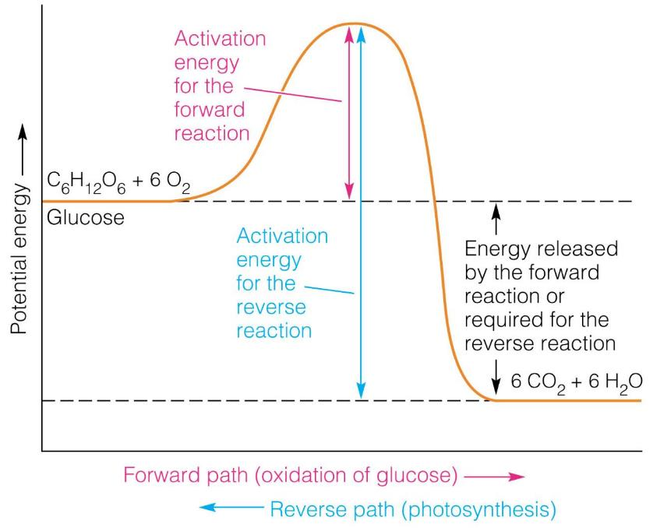

Slide 17
Learning is not linear! Feedback is not unidirectional. But sometimes we pretend that they are! #sketchnote by @SGroshell and @MrZachG #edchat #learning #teachchat

Slide 18
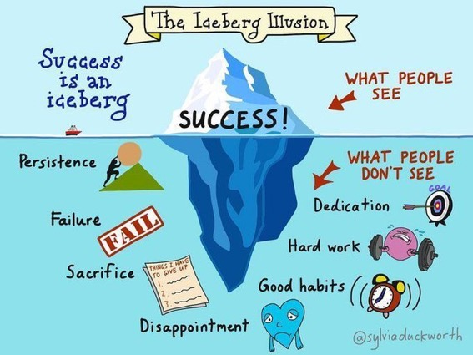

Slide 19
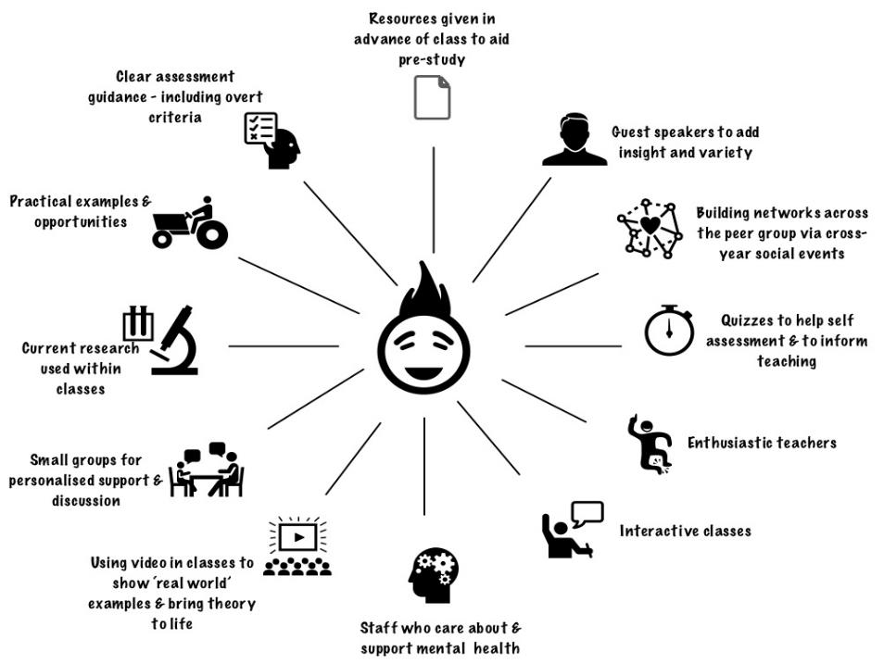
CIT
What works?

Slide 20
Thought for the day: Einstein
It is simply madness,
to keep doing the same things,
and expect different results.

Slide 21
Evidence-based practice
In the last decade, there’s been a great deal of international evidence-based research in assessment, feedback, learning and teaching. I’d like to alert you to how some of this can help us enhance students’ learning.
The next three slides show just 17 sources selected from the published evidence.

Slide 22
17 sources about assessment, feedback and learning in higher education
Knight, P. and Yorke, M. (2003) Assessment, learning and employability, Maidenhead, UK SRHE/Open University Press.
The TESTA project (http://www.testa.ac.uk/) Transforming the Experience of Students through Assessment, (Bath Spa, Chichester, Winchester and Worcester)
Flint, N. R. and Johnson, B. (2011) Towards fairer university assessment – recognising the concerns of students, London: Routledge.
ETC Toolkit (2015) (Enhancing the Curriculum) www.etctoolkit.org.uk
HEA (2012) A Marked Improvement: transforming assessment in higher education, York: Higher Education Academy (http://www.heacademy.ac.uk/assets/documents/assessment/A_Marked_Improvement.pdf )

Slide 23
17 sources about assessment, feedback and learning in higher education
Boud, D. and Associates (2010) Assessment 2020: seven propositions for assessment reform in higher education Sydney: Australian Learning and Teaching Council.
Carless, D. (2015) Excellence in University Assessment: Learning from award-winning practice, London: Routledge.
Race, P. (2014) Making learning happen: 3rd edition London: Sage. (lots of bits free on my website!)
Hunt, D. and Chalmers, L. (eds) (2012) University Teaching in Focus: a learning-centred approach Australia: ACER Press, and London: Routledge.
Price, M., Rust, C., O’Donovan, B. and Handley, K. (2012) Assessment Literacy, Oxford: the Oxford Centre for Staff and Learning Development (based on the ‘ASKe’ Project).
Evans, C. (2013) Making Sense of Assessment Feedback in Higher Education, Review of Educational Research Vol. 83, No. 1, pp. 70–120. http://journals.sagepub.com/doi/abs/10.3102/0034654312474350

Slide 24
17 sources about assessment, feedback and learning in higher education
Sambell, K., McDowell, L. and Montgomery, C. (2013) Assessment for Learning in Higher Education, London: Routledge.
Brown, S. (2015) Learning, teaching and assessment in higher education: global perspectives, Basingstoke: Palgrave-Macmillan. (great discussion on plagiarism).
Race, P. (2015) The Lecturer’s Toolkit: 4th edition, London, Routledge. (lots of bits on my website!)
Parkin, D (2017) Leading Learning and Teaching in Higher Education – the key guide to designing and delivering courses, London: Routledge.
Lea, J. (ed.) (2015) Enhancing Learning And Teaching In Higher Education: Engaging With The Dimensions Of Practice, London, Open University Press.
Sambell, K, Brown, S and Graham, L. (2017) Professionalism in Practice: Key directions in higher education: Learning, Teaching and Assessment, Basingstoke: Palgrave-Macmillan.

Slide 25
Now is the decade of Institutions’ dis-content!
Never mind the content – feel the learning

Slide 26
Modern institutions are moving away from being the providers of content, (where everything used to be about ‘delivery’), towards foregrounding two major functions:
Recognising and accrediting students’ achievement, wherever learning has taken place (i.e. getting the assessment right);
Supporting student learning and engagement (not least by making feedback work well for students, and using real-world situations and simulations to bring learning to life).

Slide 27
How students really learn
Seven factors underpinning successful learning based on asking 200,000 people about their learning in the last 30 years!

Slide 28
How students really learn ‘Ripples’ model of learning
Phil Race

Slide 29
What’s missing in this old idea of how we learn?
Engagement?
Feelings?
Active
Experimentation
Inspiration?
Judgments?
Desire?
Abstract
Conceptualisation
Concrete
Experience
Communication?
Enthusiasm?
Reflective
Observation

Slide 30
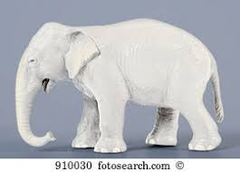
But what about learning styles?
https://www.theguardian.com/education/2017/mar/12/no-evidence-to-back-idea-of-learning-styles?CMP=share_btn_tw
(Link from my Tweet on March 13th 2017 to a letter in the Guardian by prominent folk around the world of education)
Or link to a word document: https://phil-race.co.uk/2017/09/swansea-university-school-management-21st-September/
“No evidence to back idea of learning styles”

Slide 32
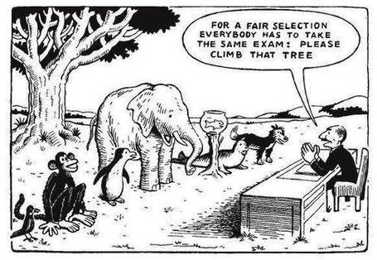

Slide 33
Ripples on a pond….
Striving to enhance our students’ want to learn;
Helping students to develop ownership of the need to learn;
Keeping students learning by doing, practice, trial-and-error, repetition;
Ensuring students get quick and useful feedback – from us and from each other;
Helping students to make sense of what they learn.
Getting students deepening their learning by verbalising, explaining things to each other, and to us.
Allowing students to further deepen their learning by assessing their own learning, and assessing others’ learning – making informed judgements.
We can make learning happen by:
Verbalising
Assessing
making informed judgements
Wanting/
Needing
Doing
Doing
Making sense
Feedback

Slide 34
What’s wrong
with
this?
Verbalising
Assessing
Feedback
Making sense
Doing
Wanting/
Needing

Slide 36
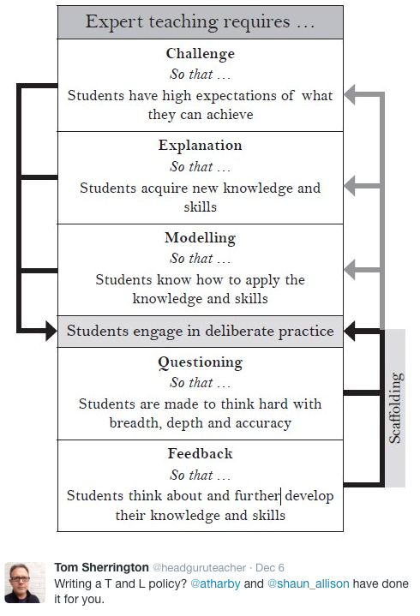

Slide 37
Use WIIFM to enthuse students
What’s in it for me?
Consciously address the ‘so what’ in learners’ minds;
Or indeed the ‘wtf’?
Warm up their ‘want’ to learn.
Clarify their ‘need’ to learn.
Learners learn far more readily if they are continuously aware of the benefits for them of putting energy into their learning.

Slide 38
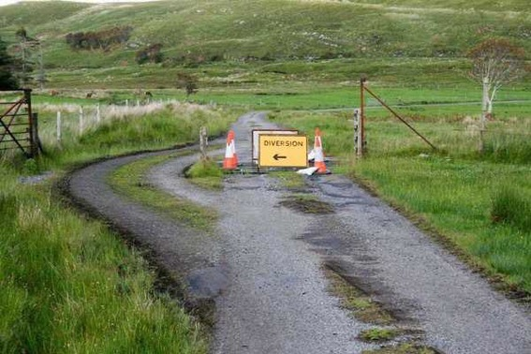

Slide 39
Teaching – and research – and reflection: the ten most important words
Why?
What?
Who?
Where?
When?
How?
Which?
So what?
wtf?
Wow?
And the most powerful four-letter word in the English language...
????

Slide 40
‘what’ is getting ever less important
Columbia University research published recently (2011) in Science magazine shows that people are much less prepared to remember ‘what’, but better at remembering where to access information, and how to do so.
Betsy Sparrow, one of the principal researchers, concludes that the internet has become ‘an external memory source that we can access at any time. ... Just as we learn through transactive memory who knows what in our families and offices, we are learning what the computer ‘knows’ and when we should attend to where we have stored information in our computer-based memories. We are becoming symbiotic with our computer tools.
Published Online July 14 2011 < Science Express Index Science DOI: 10.1126/science.1207745
Report: Google Effects on Memory: Cognitive Consequences of Having Information at Our Fingertips Betsy Sparrow,*, Jenny Liu, Daniel M. Wegner

Slide 41
Teaching – and research – and reflection: the ten most important words
Why? (rationale)
What? (content)
Who? (people, you, me, them)
Where? (locations)
When? (times)
How? (processes)
Which? (decisions)
So what? (importance?)
Wow? (impact?)
And the most powerful four-letter word in the English language...
????

Slide 42
Drives most learning
Is assessment broken?
Some
assessment
issues
What students think
Assessment as learning
Validity
Whodunit?
Fairness

Slide 43
What are lectures for, in 2018?
Nowadays, we don't need lectures simply to give students information, as so much is available to them online worldwide, but we do need to help them to negotiate the sea of available information so that their learning is focused and successful.

Slide 44
So what can we do in classes?
We still meet students in lecture theatres and other large-group sessions, so what should we do? Four things:...
We’ve got to inspire them, arouse their curiosity, get them thinking, and (above all) start making their learning happen, there and then while they’re with us.

Slide 45
Classes should be fun!
They should be fun for us.
They should be fun for students.
Time flies when we – and they – are enjoying ourselves.
There are lots of good reasons to get a large group of students together in the same room at the same time.
One of them is not ‘to give them lots of stuff’ however.

Slide 46
What is likely to annoy students in class?
Staff who don’t appear to have done good preparation of content material;
Material at the wrong level, that is too easy or goes right over their heads;
Lecturers who seem jaded, unenthusiastic or uninterested in what they are teaching (or the level of students);
Lecture formats that never change, and over-use Power Point;
Lack of interaction between the lecturer and students;
Issues around timing, particularly over-running and rushing at the end.

Slide 47
Characteristics of teachers who get engagement going (Sally Brown)
Knows subject material thoroughly
Adopts a scholarly approach to the practice of teaching
Is reflective and regularly reviews own practice
Is well organised and plans curriculum effectively
Is passionate about teaching
Has a student-centred orientation to teaching
Regularly reviews innovations in learning and teaching and tries out ones relevant to own context
Ensures that assessment practices are fit for purpose and contribute to learning
Demonstrates empathy and emotional intelligence

Slide 48
Characteristics of excellent teachers: diamond-9
1
2
3
4
5
6
7
8
9

Slide 49
Characteristics of excellent teachers: diamond-9
F,e,e,f,e,e,e,f
E,f.f.e.f.f.f.e
3
4
5
6
7
8
B,b,b,b,b,b,b,b

Slide 50
Feed-forward
Language of feedback
Some feedback
issues
National Student Survey
Timing:
24-hours!
Written, printed,
on-screen
Efficiency
Face to face
oral

Slide 51
Fishing for feedback?
Feedback is like fish.
If it is not used quickly, it becomes useless.
(Sally Brown).
Give a man a fish,
Feed him for a day.
Teach a man to fish,
Feed him for a lifetime.
(Maimonides: 1135-1204)
Make feedback timely, while it still matters to students, in time for them to use it towards further learning, or to receive further assistance.
(Graham Gibbs)
And he’ll learn to drink beer in boats
And you won’t see him for weeks!
(Australian proverb).

Slide 52
But what’s really wrong with feedback?
Too often it’s one-way – monologic.
What students want is dialogue.
They want to talk to us about their work.
But they’re scared to talk to us, for various reasons:
In case it leads to lower marks;
In case they’re ‘found out’;
In case they feel stupid.

Slide 53
Face-to-face communication
Making all the channels work

Slide 54
Face-to-face one-to-one feedback activity
On the signal to start, please stand up, and work in pairs, moving around the room, talking to different people using the script which follows…
The script:
A ‘Hello’ (or equivalent).
B ‘Hello’ (or equivalent).
A ‘You are late’.
B ‘I know’.
Try to do it completely differently each time.

Slide 55
Constructive Alignment: John Biggs
What will I be expected to show for this?
What does a good one look like, and a bad one?
Where does this fit into the big picture?
When explaining assessment criteria to students, and when linking these to evidence of achievement of the intended learning outcomes, we need to make the most of face-to-face whole group contexts and...
Tone of voice
Body language
Facial expression
Eye contact
The chance to repeat things
The chance to respond to puzzled looks
Some things don’t work nearly so well just on paper or on screens.
Some of the
tools we can
use in
face-to-face
contexts

Slide 56
Face to face feedback

Slide 57
Hands-on feedback?

Slide 59
Rationale: reminder…
How can we inspire our students to learn?
How can we engage them, and keep them engaged?
How best can we use the tools available to us in this digital age to enthuse them?
What are the processes which underpin successful learning now?
How can we ourselves be inspired and enthused, so that we enjoy our work as teachers more than ever?

Slide 60
Back to our intended learning outcomes…
Do you now feel better able to:
2 hands = very much better, one hand = somewhat better, touch left ear = no better...
Explored some answers to the questions on the previous slide, and thought of better ones?
Shared ideas with each other and with Phil?
Confronted the need to re-invent feedback and assessment for the 21st Century?
Wanting/
Needing
Doing
Making sense
Feedback

Slide 61
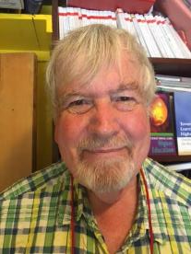
Thank you…
Website: http://phil-race.co.uk
Follow Phil on Twitter @RacePhil
e-mail: phil@phil-race.co.uk

