Slide 1
Activating Learning Towards Authentic Assessment – and making assessmet and feedback more manageable
23rd May, 2018
Imperial College, London
Faculty of Medicine Master's Staff Conference
Phil Race
(from Newcastle-upon-Tyne)
BSc PhD PGCE FCIPD PFHEA NTF
Follow Phil on Twitter: @RacePhil
Visiting Professor: University of Plymouth and Edge Hill University
Emeritus Professor, Leeds Beckett University

Slide 2
This slide has two purposes….
To focus the data projector, if necessary, and…
...to persuade colleagues never to put this sort of detail onto a slide!

Slide 3
About Phil…
First a musician
Then a writer
Then a scientist
Then a researcher
Then a lecturer and warden at what is now USW
Got interested in how students learn
And the effects assessment and feedback have on them
And how we teach them
Gradually became an educational developer
And now ‘retired’!?
Currently…
Visiting Prof: Plymouth & Edge Hill
Emeritus Prof: Leeds Beckett
Based at Newcastle, UK
And on trains
And an expert…
on train routes and timetables!
Notes:
2
2

Slide 4
Rationale
Phil Race will lead a practical, interactive workshop on Authentic Assessment, and ways of building it into your programmes. What do you want your students to accomplish by the end of your module, or programme? How can they show their learning, and how can you measure it? If you have problems of marking, turnaround, scheduling, feedback, alignment of LOs, or just lack of variety, could you solve them by changing the assessment type? Bring your priorities to the workshop.

Slide 5
Ideas drawn from…
Race, P. (2014) Making learning happen: 3rd edition London: Sage. (lots of bits free on my website!)
Brown, S. (2015) Learning, teaching and assessment in higher education: global perspectives, Basingstoke: Palgrave-Macmillan. (great discussion on plagiarism).
Race, P. (2015) The Lecturer’s Toolkit: 4th edition, London, Routledge. (lots of bits on my website!)
Sambell, K, Brown, S and Graham, L. (2017) Professionalism in Practice: Key directions in higher education: Learning, Teaching and Assessment, Basingstoke: Palgrave-Macmillan.

Slide 6
Hounsell, D. (2008). The trouble with feedback: New challenges, emerging strategies. Interchange, 2, pp.1-10.
Feedforward is a strategy that aims to ‘increase the value of feedback to the students by focusing comments not only on the past and present…but also on the future – what the student might aim to do, or do differently in the next assignment or assessment if they are to continue to do well or to do better’ (Hounsell, 2008, p. 5).

Slide 7
What does ‘authentic’ mean?
Authenticity is about how well the assessment correlates to the sorts of things students need to be able to do in their career after leaving the educational institution. It’s about the real-world relevance of the assessment activity.

Slide 8
Ownership of targets
Doctors, lawyers, accountants and managers don’t, in their day-to-day work sit writing about medicine, law, accountancy and management – they do these things. There is often a considerable gap between what we get learners to do in our assessment, and what they will need to be good at throughout their careers. The more we can bridge that gap by making assessment feel relevant to learners, the more we can expect them to take ownership of the need to become able to evidence their achievement in assessed contexts.

Slide 9
Thanks to students
I could not do what I do nowadays if I did not continue to spend a fair bit of my time working with students – they’ve taught me most of what I know.

Slide 10
Time…
We spend a great deal of our energy and time assessing students’ work, and giving them feedback. Do we spend too much time composing feedback and getting it to students?
Is the time we spend actually well-spent?
Is the feedback really used – or is some of it ignored, or even not read?

Slide 11
Feedback, knowledge and enthusiasm
Knowledge isn’t infectious (unfortunately) but enthusiasm is, and we need to help our students to catch enthusiasm.
We certainly don’t want assessment or feedback to damage that enthusiasm, particularly at Masters-level study.

Slide 12
The digital age?
The world around us has changed a lot, yet assessment – particularly at M-level – still remains relatively unchanged.
Students are changing fast, as are their expectations of how, what and why they are learning, and how assessment will work.

Slide 13
Intended learning outcomes
After participating in this session, you should be better-able to:
Reflect on how assessment and feedback link (or don’t link) to seven factors underpinning successful student learning;
Look at the fact that many of the problems we have making feedback work originate from the kinds of assessment we find ourselves using (not least, essays)
Examine what’s wrong with some traditional forms of feedback;
Think of what else we may be able to do to make assessment and feedback authentic and fit for purpose in 2018.

Slide 14
You will be able to download my main slides
You don’t need to take notes.
I’ll put the main slides I use up on my website tonight (http://phil-race.co.uk/)
I won’t post pictures and video-clips, as this would make the file-size too large.
I may sometimes go through slides quite fast, but you can study them as you wish at your leisure.

Slide 15
Announcement about mobile phones and laptops...
Good afternoon everyone – please turn on your ‘phones, tablets and computers.
Please post your thoughts, questions, comments and ideas during this session to the hashtag #philatimperial18 Thanks!
Try #LTHEchat on Wednesday evenings from 20.00-21.00. Tonight’s is on ‘Innovative Education in the Age of GDPR’.

Slide 16
Download Phil’s published stuff on feedback, assessment, and learning
Expanded discussion of how the factors underpinning learning link to feedback, assessment and large-group teaching:
http://phil-race.co.uk/2016/04/updated-powerpoint-ripples-model/ (Chapter 1 from ‘The Lecturer’s Toolkit, 2015, and related slides)
https://phil-race.co.uk/2016/10/lthe-tweetchat-lthechat-wed-oct-19-8-00-9-00-pm/ (feedback stuff from my most recent two books)
https://phil-race.co.uk/2018/02/feedback-feedforward-just-tips-including-students/ (just the feedback tips!)
http://phil-race.co.uk/2015/01/assessment-bits-new-editions/ (extracts on assessment)

Slide 17
Time-constrained Post-it exercise
On a post-it, in your best handwriting, please write your own completion of the starter:
“making assessment more authentic for my students would be much better if only I..…”
Please swap post-its so that you’ve no idea who has yours.
If chosen, please read out with passion and drama the post-it you now have.
Please place them all on the chart as directed.

Slide 18
Thought for the day: Einstein
It is simply madness,
to keep doing the same things,
and expect different results.

Slide 19
What is authentic assessment?
Authentic assessment sends signals to students which direct them towards the kinds of learning goals and processes that are representative of meaningful learning in their subject area.
It uses a range of methods and approaches that get students working hard on activities relevant to their life and career plans on graduation;
Authentic summative assessment tasks are designed to ensure that students learn what they need to learn in recognisably appropriate ways.

Slide 20
The benefits of authentic assessment can be significant for all stakeholders.
Students undertaking authentic assessments tend to be more fully engaged in learning and hence tend to achieve more highly because they see the sense of what they are doing (Sadler, 2005).
University teachers adopting authentic approaches can use realistic and live contexts within which to frame assessment tasks, which help to make theoretical elements of the course come to life.
Employers value students who can quickly engage in real-life tasks immediately on employment, having practiced and developed relevant skills and competences through their assignments.

Slide 21
Wiggins (1990) says assessment can be regarded as authentic if we can draw valid inferences from the work they produce
He proposes that we should aim to offer students assignments that present the student with the full array of tasks that mirror the priorities and challenges found in the best [teaching] activities and that attend to whether the student can craft polished, thorough and justifiable answers, performances or products.
He says they must involve students being able to cope with potentially ill-structured challenges and roles, with incomplete information, that help them rehearse for the complex ambiguities of adult and professional life.

Slide 22
How can authentic assessment engage students?
Using types of assessment that are much more like the ‘real things’ that academics or professionals do in their chosen fields can engage students in much more meaningful ways.
A useful way to help you ascertain how authentic your assessment is could be to ask yourself where in the programme you help students answer questions in job interviews (Sambell, Brown and Graham, 2017)

Slide 23
Review practice: what can we do to build authenticity in to our assessment?
We need to design assignments that stretch students beyond mechanistic tasks and make assessment fully integral to the learning experience (Sambell et al, 2012). Such authentic assignments and activities could include:
Action-orientated tasks, that are underpinned by relevant evidence-based scholarship and where students are learning by doing (Race, 2014);
Ones that are truly representative of student effort, maximising time-on-task, with marks reflecting the achievement of learning outcomes specified in the programme outlines and which are coherent, constructively aligned (Biggs and Tang, 2011) and challenging;
Processes that are nuanced, clearly articulated and transparent in demonstrating the way that decisions are reached on assessment grades (QAA, 2014);

Slide 24
Bringing assessment and feedback to life Questions employers might ask our students at interview, that could help us improve the authenticity of assessment and feedback
Can you tell us about an occasion when:
you worked together with colleagues in a group to produce a collective outcome?
you had to work autonomously with incomplete information and self-derived data sources?
you developed strategies to solve real life problems and tested them out?
you had a leadership role in a team, and could you tell us your strategies to influence and persuade your colleagues to achieve a collective task?
you had to communicate outcomes from your project work orally, in writing, through social media and/or through a visual medium?
If you want it to happen,
build it into assessment and
let students get feedback on it.

Slide 25
Now is the decade of Universities’ dis-content!
Never mind the content – feel the learning

Slide 26
Modern institutions are moving away from being the providers of content, (where everything used to be about ‘delivery’), towards foregrounding two major functions:
Recognising and accrediting students’ achievement, wherever learning has taken place (i.e. getting the assessment right);
Supporting student learning and engagement (not least by making feedback work well for students, and using authentic situations and simulations to bring learning to life).

Slide 27
How students really learn
Seven factors underpinning successful learning based on asking 200,000 people about their learning in the last 30 years!

Slide 28
How Students Really Learn ‘Ripples’ model of learning
Phil Race

Slide 29
What’s missing in this old idea of how we learn?
Engagement?
Feelings?
Active
Experimentation
Inspiration?
Judgments?
Desire?
Abstract
Conceptualisation
Concrete
Experience
Communication?
Enthusiasm?
Reflective
Observation

Slide 30
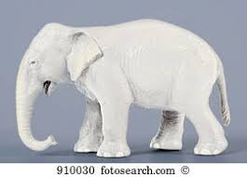
But what about learning styles?
https://www.theguardian.com/education/2017/mar/12/no-evidence-to-back-idea-of-learning-styles?CMP=share_btn_tw
(Link from my Tweet on March 13th 2017 to a letter in the Guardian by prominent folk around the world of education)
Or link to a word document: https://phil-race.co.uk/2017/09/swansea-university-school-management-21st-September/
“No evidence to back idea of learning styles”

Slide 32
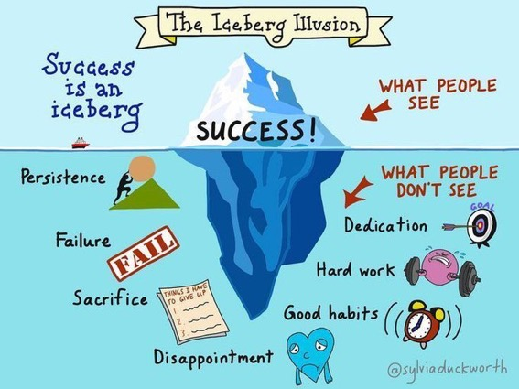

Slide 33
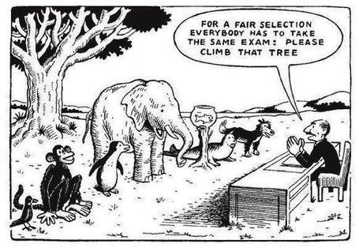

Slide 34
Ripples on a pond….
Striving to enhance our students’ want to learn;
Helping students to develop ownership of the need to learn;
Keeping students learning by doing, practice, trial-and-error, repetition;
Ensuring students get quick and useful feedback – from us and from each other;
Helping students to make sense of what they learn.
Getting students deepening their learning by verbalising, explaining things to each other, and to us.
Allowing students to further deepen their learning by assessing their own learning, and assessing others’ learning – making informed judgements.
We can make learning happen by:
Verbalising
Assessing
making informed judgements
Wanting/
Needing
Doing
Doing
Making sense
Feedback

Slide 35
What’s wrong
with
this?
Verbalising
Assessing
Feedback
Making sense
Doing
Wanting/
Needing

Slide 36
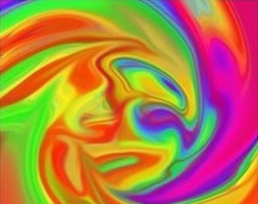

Slide 37
Face-to-face communication
Making all the channels work

Slide 38
Thirty Second Theatre

Slide 39
Face-to-face one-to-one feedback activity
On the signal to start, please stand up, and work in pairs, moving around the room, talking to different people using the script which follows…
The script:
A ‘Hello’ (or equivalent).
B ‘Hello’ (or equivalent).
A ‘You are late’.
B ‘I know’.
Try to do it completely differently each time.

Slide 40
Constructive Alignment: John Biggs
What will I be expected to show for this?
What does a good one look like, and a bad one?
Where does this fit into the big picture?
When explaining assessment criteria to students, and when linking these to evidence of achievement of the intended learning outcomes, we need to make the most of face-to-face whole group contexts and...
Tone of voice
Body language
Facial expression
Eye contact
The chance to repeat things
The chance to respond to puzzled looks
Some things don’t work nearly so well just on paper or on screens.
Some of the
tools we can
use in
face-to-face
contexts

Slide 41
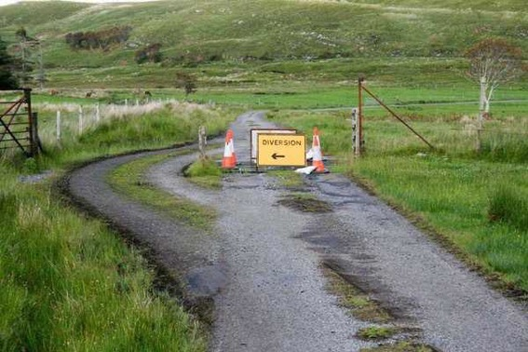

Slide 42
Learning, feedback and assessmen: the ten most important words
Why?
What?
Who?
Where?
When?
How?
Which?
So what?
wtf?
Wow?
And the most powerful four-letter word in the English language...
????

Slide 43
‘what’ is getting ever less important
Columbia University research published recently (2011) in Science magazine shows that people are much less prepared to remember ‘what’, but better at remembering where to access information, and how to do so.
Betsy Sparrow, one of the principal researchers, concludes that the internet has become ‘an external memory source that we can access at any time. ... Just as we learn through transactive memory who knows what in our families and offices, we are learning what the computer ‘knows’ and when we should attend to where we have stored information in our computer-based memories. We are becoming symbiotic with our computer tools.
Published Online July 14 2011 < Science Express Index Science DOI: 10.1126/science.1207745
Report: Google Effects on Memory: Cognitive Consequences of Having Information at Our Fingertips Betsy Sparrow,*, Jenny Liu, Daniel M. Wegner

Slide 44
Learning, feedback and assessment:
the ten most important words
Why? (rationale)
What? (content)
Who? (people, you, me, them)
Where? (locations)
When? (times)
How? (processes)
Which? (decisions)
So what? (importance?)
Wow? (impact?)
And the most powerful four-letter word in the English language...
????

Slide 45
Go forth and
…….!

Slide 46
My main worries about assessment...
Too often, we still tend to try to measure...
...what’s in students’ heads, and what they can do with what’s there...
in terms of two unsatisfactory proxies ...
what comes out of students’ pens in exams;
2. what comes out of their keyboards in essays and reports.

Slide 47
Five main problems with assessed essays
They take a great deal of time to mark, let alone the time it takes for students to prepare, draft and compose them.
When most assessment is in the form of essays, students’ skills at essay-writing are repeatedly tested, as the expense sometimes of their understanding of the subject.
Lots of research shows that we’re not at all good at marking essays fairly – different assessors often give the same essay very different marks.
Essay marks in the UK tend to lie between 35% for a poor one and 75% for a very good one, whereas in many other disciplines the marks for an assignment like a lab report can range across the whole 0-100% span more evenly.
With coursework essays, there can be doubt about veracity – i.e. ‘whodunit?’!

Slide 48
Quality feedback: three vital functions
“There is wide consensus within the education literature that ‘quality’ feedback should serve three overlapping functions:
an ‘orientational’ purpose that clarifies the student’s performance and achievement;
a ‘transformational’ purpose that enables the student to reflect, improve their performance, and become more autonomous (often termed ‘feed-forward); and
an ‘affective/interpersonal’ dimension that gives the student confidence and motivation, and builds a strong teacher-student relationship”
(Dunworth & Sanchez, 2016, quoted by Winstone and Nash, 2016).

Slide 49
Conclusions
Authentic assessment and feedback can be powerful means of focusing student effort and enhancing achievement if well designed (Biggs and Tang, 2011);
Students near the start of their Master’s learning journey are likely to need more support and positive feedback than later, when they are more robust and confident;
The first six weeks can be crucial in helping students understand how assessment will work;
No single method of assessing students’ progress or giving feedback is likely to be ubiquitously successful, so it’s worth using a variety of approaches;
Assessment needs to be manageable for staff and students if it is going to engage students in learning activities.

Slide 50
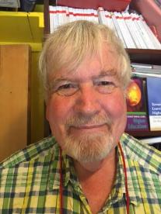
Thank you…
Website: http://phil-race.co.uk
Follow Phil on Twitter @RacePhil
e-mail: phil@phil-race.co.uk

Slide 51
Useful references and further reading (1)
Bain, K. (2004) What the best College Teachers do, Cambridge: Harvard University Press.
Biggs, J. and Tang, C. (2011) Teaching for Quality Learning at University, Maidenhead: Open University Press.
Bloxham, S. and Boyd, P. (2007) Developing effective assessment in higher education: a practical guide, Maidenhead, Open University Press.
Boud, D. (1995) Enhancing learning through self-assessment, London: Routledge.
Brown, S. and Glasner, A. (eds.) (1999) Assessment Matters in Higher Education, Choosing and Using Diverse Approaches, Maidenhead: Open University Press.
Brown, S. and Race, P. (2012) Using effective assessment to promote learning in Hunt, L. and Chambers, D. (2012) University Teaching in Focus, Victoria, Australia, Acer Press. P74-91.
Brown, S. (2015) Learning , Teaching and Assessment in Higher Education: Global perspectives, London, Palgrave.

Slide 52
Useful references and further reading (2)
Carless, D., Joughin, G., Ngar-Fun Liu et al (2006) How Assessment supports learning: Learning orientated assessment in action Hong Kong: Hong Kong University Press.
Carroll, J. and Ryan, J. (2005) Teaching International students: improving learning for all. London: Routledge SEDA series.
Crosling, G., Thomas, L. and Heagney, M. (2008) Improving student retention in Higher Education, London and New York: Routledge
Crooks, T. (1988) Assessing student performance, HERDSA Green Guide No 8 HERDSA (reprinted 1994).
Dunworth, K. and Sanchez, H.S., (2016). Perceptions of quality in staff-student written feedback in higher education: a case study. Teaching in Higher Education, 21(5), pp.576-589.
Dweck, C. S. (2000) Self Theories: Their Role in Motivation, Personality and Development, Lillington, NC: Taylor & Francis.
Falchikov, N. (2004) Improving Assessment through Student Involvement: Practical Solutions for Aiding Learning in Higher and Further Education, London: Routledge.
Gibbs, G. (1999) Using assessment strategically to change the way students learn, in Brown S. & Glasner, A. (eds.), Assessment Matters in Higher Education: Choosing and Using Diverse Approaches, Maidenhead: SRHE/Open University Press.
Higher Education Academy (2012) A marked improvement; transforming assessment in higher education, York: HEA.

Slide 53
Useful references and further reading (3)
Hawe, E., Lightfoot, U., & Dixon, H. (2017). First-year students working with exemplars: Promoting self-efficacy, self-monitoring and self-regulation. Journal of Further and Higher Education, 1-15.
Hendry, G. D., White, P., & Herbert, C. (2016). Providing Exemplar-Based “Feedforward” before an Assessment: The Role of Teacher Explanation. Active Learning in Higher Education, 17(2), 99-109.
Hounsell, D., McCune, V., Hounsell, J. and Litjens, J., (2008). The quality of guidance and feedback to students. Higher Education Research & Development, 27(1), pp.55-67.
McDowell, L. and Brown, S. (1998) Assessing students: cheating and plagiarism, Newcastle: Red Guide 10/11 University of Northumbria.
Meyer, J.H.F. and Land, R. (2003) ‘Threshold Concepts and Troublesome Knowledge 1 – Linkages to Ways of Thinking and Practising within the Disciplines’ in C. Rust (ed.) Improving Student Learning – Ten years on. Oxford: OCSLD.
Nicol, D. J. and Macfarlane-Dick, D. (2006) Formative assessment and self-regulated learning: A model and seven principles of good feedback practice, Studies in Higher Education Vol 31(2), 199-218.
PASS project Bradford http://www.pass.brad.ac.uk/ Accessed November 2013.
Peelo, M. T., & Wareham, T. (Eds.). (2002). Failing students in higher education. Society for Research into Higher Education.
Pickford, R. and Brown, S. (2006) Assessing skills and practice, London: Routledge.
Rotheram, B. (2009) Sounds Good, JISC project http://www.jisc.ac.uk/whatwedo/programmes/usersandinnovation/soundsgood.aspx

Slide 54
Useful references and further reading (4)
Race, P. (2001) A Briefing on Self, Peer & Group Assessment, in LTSN Generic Centre Assessment Series No 9, LTSN York.
Race P. (2015) The lecturer’s toolkit (4th edition), London: Routledge.
Rust, C., Price, M. and O’Donovan, B. (2003) Improving students’ learning by developing their understanding of assessment criteria and processes, Assessment and Evaluation in Higher Education. 28 (2), 147-164.
Ryan, J. (2000) A Guide to Teaching International Students, Oxford Centre for Staff and Learning Development.
Scoles, J., Huxham, M., & Mcarthur, J. (2013). No longer exempt from good practice: Using exemplars to close the feedback gap for exams. Assessment & Evaluation in Higher Education, 38(6), 631-645.
Stefani, L. and Carroll, J. (2001) A Briefing on Plagiarism, LTSN
Sadler, D. Royce (2010) Beyond feedback: developing student capability in complex appraisal, Assessment & Evaluation in Higher Education, 35: 5, 535-550.
Yorke, M. (1999) Leaving Early: Undergraduate Non-completion in Higher Education, London: Routledge.

