Slide 1
Activating Learning Supporting Progress, Changing Lives Making assessment and feedback more efficient, effective and manageable
GBMET: 25th May, 2018
Phil Race
(from Newcastle-upon-Tyne)
BSc PhD PGCE FCIPD PFHEA NTF
Follow Phil on Twitter: @RacePhil
Visiting Professor: University of Plymouth and Edge Hill University
Emeritus Professor, Leeds Beckett University

Slide 2
This slide has two purposes….
To focus the data projector, if necessary, and…
...to persuade colleagues never to put this sort of detail onto a slide!

Slide 3
About Phil…
First a musician
Then a writer
Then a scientist
Then a researcher
Then a lecturer and warden at what is now USW
Got interested in how students learn
And the effects assessment and feedback have on them
And how we teach them
Gradually became an educational developer
And now ‘retired’!?
Currently…
Visiting Prof: Plymouth & Edge Hill
Emeritus Prof: Leeds Beckett
Based at Newcastle, UK
And on trains
And an expert…
on train routes and timetables!
Notes:
2
2

Slide 4
Hounsell, D. (2008). The trouble with feedback: New challenges, emerging strategies. Interchange, 2, pp.1-10.
Feedforward is a strategy that aims to ‘increase the value of feedback to the students by focusing comments not only on the past and present…but also on the future – what the student might aim to do, or do differently in the next assignment or assessment if they are to continue to do well or to do better’ (Hounsell, 2008, p. 5).

Slide 5
Thanks to students
I could not do what I do nowadays if I did not continue to spend a fair bit of my time working with students – they’ve taught me most of what I know.

Slide 6
Ideas drawn from…
Race, P. (2014) Making learning happen: 3rd edition London: Sage. (lots of bits free on my website!)
Brown, S. (2015) Learning, teaching and assessment in higher education: global perspectives, Basingstoke: Palgrave-Macmillan. (great discussion on plagiarism).
Race, P. (2015) The Lecturer’s Toolkit: 4th edition, London, Routledge. (lots of bits on my website!)
Sambell, K, Brown, S and Graham, L. (2017) Professionalism in Practice: Key directions in higher education: Learning, Teaching and Assessment, Basingstoke: Palgrave-Macmillan.

Slide 7
Rationale
We spend a great deal of our energy and time assessing students’ work, and giving them feedback.
Do we spend too much time composing feedback and getting it to students?
Is the time we spend actually well-spent? Is the feedback really used, or is much of it ignored, or even not read?
This session will explore how assessment and feedback best link to the student learning experience.

Slide 8
Feedback, knowledge and enthusiasm
Knowledge isn’t infectious (unfortunately) but enthusiasm is, and we need to help our students to catch enthusiasm.
We certainly don’t want assessment or feedback to damage that enthusiasm.

Slide 9
Students change
Students are changing fast, as are their expectations of how, what and why they are learning.
Not least, we’re now in a digital age, not a paper-based one.

Slide 10
Intended learning outcomes
After participating in this session, you should be better-able to:
Reflect on how assessment and feedback link (or don’t link) to the factors underpinning successful student learning;
Support progress and change lives (ours and theirs) by adjusting our assessment and feedback;
Make the time and energy we spend assessing students’ work and getting feedback to them time well spent;
Think of what else we may be able to do to make assessment and feedback fit for purpose in 2018.

Slide 11
You will be able to download my main slides
You don’t need to take notes.
I’ll put the main slides I use up on my website when I get home tonight (http://phil-race.co.uk/)
I won’t post pictures and video-clips, as this would make the file-size too large.
I may sometimes go through slides quite fast, but you can study them as you wish at your leisure.

Slide 12
Announcement about mobile phones and laptops...
Good afternoon everyone – please turn on your ‘phones, tablets and computers.
Please post your thoughts, questions, comments and ideas during this session to the hashtag #philatgbmet18 Thanks!
Try #LTHEchat on Wednesday evenings from 20.00-21.00.

Slide 13
Download Phil’s published stuff on feedback, assessment, and learning
Expanded discussion of how the factors underpinning learning link to feedback and assessment:
http://phil-race.co.uk/2016/04/updated-powerpoint-ripples-model/ (Chapter 1 from ‘The Lecturer’s Toolkit, 2015, and related slides)
https://phil-race.co.uk/2016/10/lthe-tweetchat-lthechat-wed-oct-19-8-00-9-00-pm/ (feedback stuff from my most recent two books)
https://phil-race.co.uk/2018/02/feedback-feedforward-just-tips-including-students/ (just the feedback tips!)
http://phil-race.co.uk/2015/01/assessment-bits-new-editions/ (extracts on assessment)

Slide 14
Getting to know each other: an analogue approach…
In turn, please..
Say one or two sentences about...
who you are,
where you come from, and
what you do.
In one breath!
(Optional) Share with us one thing that you’re dead good at, or really proud of.

Slide 15
Making engagement happen
Engagement is right at the centre of successful learning. Learning can’t happen without it. But engagement is a two-way process – it has to involve students – and us. Engagement should be fun – for us as well as for them.

Slide 16
Time-constrained Post-it exercise
On a post-it, in your best handwriting, please write your own completion of the starter:
“making assessment and feedback work for my students would be much better if only I..…”
Please swap post-its so that you’ve no idea who has yours.
If chosen, please read out with passion and drama the post-it you now have.
Please place them all on the chart as directed.

Slide 17
Thought for the day: Einstein
It is simply madness,
to keep doing the same things,
and expect different results.

Slide 18
Bringing assessment and feedback to life Questions employers might ask students at interview, that could help us frame some of our assessment and feedback
Can you tell us about an occasion when:
you worked together with colleagues in a group to produce a collective outcome?
you had to work autonomously with incomplete information and self-derived data sources?
you developed strategies to solve real life problems and tested them out?
you had a leadership role in a team, and could you tell us your strategies to influence and persuade your colleagues to achieve a collective task?
you had to communicate outcomes from your project work orally, in writing, through social media and/or through a visual medium?
If you want it to happen,
build it into assessment and
let students get feedback on it.

Slide 19
Evidence-based practice
In the last decade, there’s been a great deal of international evidence-based research in assessment, feedback, learning and teaching. I’d like to alert you to how some of this can help us enhance students’ learning.
The next three slides show just 17 sources selected from the published evidence.

Slide 20
17 sources about assessment, feedback and learning in higher education
Knight, P. and Yorke, M. (2003) Assessment, learning and employability, Maidenhead, UK SRHE/Open University Press.
The TESTA project (http://www.testa.ac.uk/) Transforming the Experience of Students through Assessment, (Bath Spa, Chichester, Winchester and Worcester)
Flint, N. R. and Johnson, B. (2011) Towards fairer university assessment – recognising the concerns of students, London: Routledge.
ETC Toolkit (2015) (Enhancing the Curriculum) www.etctoolkit.org.uk
HEA (2012) A Marked Improvement: transforming assessment in higher education, York: Higher Education Academy (http://www.heacademy.ac.uk/assets/documents/assessment/A_Marked_Improvement.pdf )

Slide 21
17 sources about assessment, feedback and learning in higher education
Boud, D. and Associates (2010) Assessment 2020: seven propositions for assessment reform in higher education Sydney: Australian Learning and Teaching Council.
Carless, D. (2015) Excellence in University Assessment: Learning from award-winning practice, London: Routledge.
Race, P. (2014) Making learning happen: 3rd edition London: Sage. (lots of bits free on my website!)
Hunt, D. and Chalmers, L. (eds) (2012) University Teaching in Focus: a learning-centred approach Australia: ACER Press, and London: Routledge.
Price, M., Rust, C., O’Donovan, B. and Handley, K. (2012) Assessment Literacy, Oxford: the Oxford Centre for Staff and Learning Development (based on the ‘ASKe’ Project).
Evans, C. (2013) Making Sense of Assessment Feedback in Higher Education, Review of Educational Research Vol. 83, No. 1, pp. 70–120. http://journals.sagepub.com/doi/abs/10.3102/0034654312474350

Slide 22
17 sources about assessment, feedback and learning in higher education
Sambell, K., McDowell, L. and Montgomery, C. (2013) Assessment for Learning in Higher Education, London: Routledge.
Brown, S. (2015) Learning, teaching and assessment in higher education: global perspectives, Basingstoke: Palgrave-Macmillan. (great discussion on plagiarism).
Race, P. (2015) The Lecturer’s Toolkit: 4th edition, London, Routledge. (lots of bits on my website!)
Parkin, D (2017) Leading Learning and Teaching in Higher Education – the key guide to designing and delivering courses, London: Routledge.
Lea, J. (ed.) (2015) Enhancing Learning And Teaching In Higher Education: Engaging With The Dimensions Of Practice, London, Open University Press.
Sambell, K, Brown, S and Graham, L. (2017) Professionalism in Practice: Key directions in higher education: Learning, Teaching and Assessment, Basingstoke: Palgrave-Macmillan.

Slide 23
Now is the decade of Colleges’ dis-content!
Never mind the content – feel the learning

Slide 24
Modern institutions are moving away from being the providers of content, (where everything used to be about ‘delivery’), towards foregrounding two major functions:
Recognising and accrediting students’ achievement, wherever learning has taken place (i.e. getting the assessment right);
Supporting student learning and engagement (not least by making feedback work well for students, and using real-world situations and simulations to bring learning to life).

Slide 25
How students really learn
Seven factors underpinning successful learning based on asking 200,000 people about their learning in the last 30 years!

Slide 26
How Students Really Learn ‘Ripples’ model of learning
Phil Race

Slide 27
What’s missing in this old idea of how we learn?
Engagement?
Feelings?
Active
Experimentation
Inspiration?
Judgments?
Desire?
Abstract
Conceptualisation
Concrete
Experience
Communication?
Enthusiasm?
Reflective
Observation

Slide 28
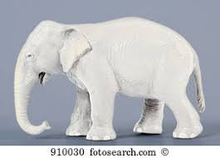
But what about learning styles?
https://www.theguardian.com/education/2017/mar/12/no-evidence-to-back-idea-of-learning-styles?CMP=share_btn_tw
(Link from my Tweet on March 13th 2017 to a letter in the Guardian by prominent folk around the world of education)
Or link to a word document: https://phil-race.co.uk/2017/09/swansea-university-school-management-21st-September/
“No evidence to back idea of learning styles”

Slide 30
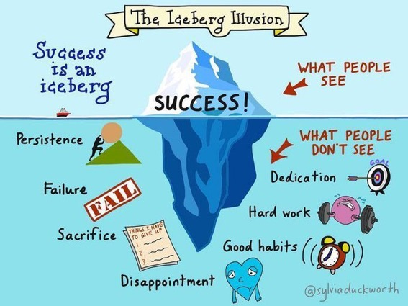

Slide 31
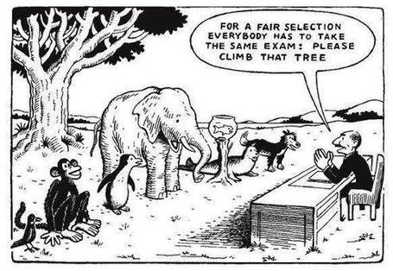

Slide 32
Ripples on a pond….
Striving to enhance our students’ want to learn;
Helping students to develop ownership of the need to learn;
Keeping students learning by doing, practice, trial-and-error, repetition;
Ensuring students get quick and useful feedback – from us and from each other;
Helping students to make sense of what they learn.
Getting students deepening their learning by verbalising, explaining things to each other, and to us.
Allowing students to further deepen their learning by assessing their own learning, and assessing others’ learning – making informed judgements.
We can make learning happen by:
Verbalising
Assessing
making informed judgements
Wanting/
Needing
Doing
Doing
Making sense
Feedback

Slide 33
What’s wrong
with
this?
Verbalising
Assessing
Feedback
Making sense
Doing
Wanting/
Needing

Slide 35
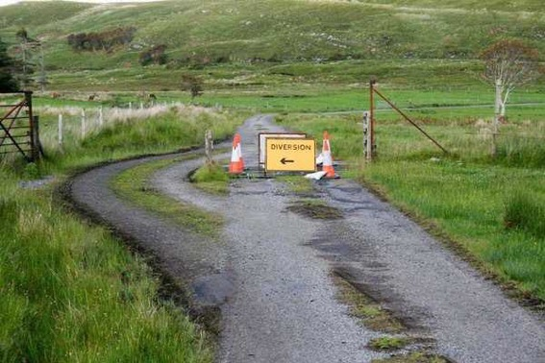

Slide 36
Learning, feedback and assessment: the ten most important words
Why?
What?
Who?
Where?
When?
How?
Which?
So what?
wtf?
Wow?
And the most powerful four-letter word in the English language...
????

Slide 37
‘what’ is getting ever less important
Columbia University research published recently (2011) in Science magazine shows that people are much less prepared to remember ‘what’, but better at remembering where to access information, and how to do so.
Betsy Sparrow, one of the principal researchers, concludes that the internet has become ‘an external memory source that we can access at any time. ... Just as we learn through transactive memory who knows what in our families and offices, we are learning what the computer ‘knows’ and when we should attend to where we have stored information in our computer-based memories. We are becoming symbiotic with our computer tools.
Published Online July 14 2011 < Science Express Index Science DOI: 10.1126/science.1207745
Report: Google Effects on Memory: Cognitive Consequences of Having Information at Our Fingertips Betsy Sparrow,*, Jenny Liu, Daniel M. Wegner

Slide 38
Learning, feedback and assessment:
the ten most important words
Why? (rationale)
What? (content)
Who? (people, you, me, them)
Where? (locations)
When? (times)
How? (processes)
Which? (decisions)
So what? (importance?)
Wow? (impact?)
And the most powerful four-letter word in the English language...
????

Slide 39
Drives most learning
Is assessment broken?
Some
assessment
issues
What students think
Assessment as learning
Validity
Whodunit?
Fairness

Slide 40
My main worries about assessment...
Too often, we still tend to try to measure...
...what’s in students’ heads, and what they can do with what’s there...
in terms of two unsatisfactory proxies ...
what comes out of students’ pens in exams;
2. what comes out of their keyboards in essays and reports.

Slide 41
The read-write industry

Slide 42
In the exam room you’re on your own

Slide 43
Boud et al 2010: ‘Assessment 2020’
Assessment has most effect when...:
It is used to engage students in learning that is productive.
Feedback is used to actively improve student learning.
Students and teachers become responsible partners in learning and assessment.
Students are inducted into the assessment practices and cultures of higher education.
Assessment for learning is placed at the centre of subject and program design.
Assessment for learning is a focus for staff and institutional development.
Assessment provides inclusive and trustworthy representation of student achievement.

Slide 44
Boud et al, 2010
David Boud (University of Technology, Sydney), Royce Sadler (Griffith University), Gordon Joughin (University of Wollongong), Richard James (University of Melbourne), Mark Freeman (University of Sydney), Sally Kift (Queensland University of Technology), Filip Dochy (University of Leuven), Dai Hounsell (University of Edinburgh), Margaret Price (Oxford Brookes University), Tom Angelo (La Trobe University), Angela Brew (Macquarie University), Ian Cameron (University of Queensland), Denise Chalmers (University of Western Australia), Paul Hager (University of Technology, Sydney), Kerri-Lee Harris (University of Melbourne), Claire Hughes (University of Queensland), Peter Hutchings (Australian Learning and Teaching Council), Kerri-Lee Krause (Griffith University), Duncan Nulty (Griffith University), Ron Oliver (Edith Cowan University), Jon Yorke (Curtin University), Iouri Belski (RMIT University), Ben Bradley (Charles Sturt University), Simone Buzwell (Swinburne University of Technology), Stuart Campbell (University of Western Sydney), Philip Candy (University of Southern Queensland), Peter Cherry (Central Queensland University), Rick Cummings (Murdoch University), Anne Cummins (Australian Catholic University), Elizabeth Deane (Australian National University), Marcia Devlin (Deakin University), Christine Ewan (Australian Learning and Teaching Council), Paul Gadek (James Cook University), Susan Hamilton (University of Queensland), Margaret Hicks (University of South Australia), Marnie Hughes-Warrington (Monash University), Gail Huon (University of Newcastle), Margot Kearns (University of Notre Dame, Sydney), Don Maconachie (University of the Sunshine Coast), Vi McLean (Queensland University of Technology,) Raoul Mortley (Bond University), Kylie O’Brien (Victoria University), Gary O’Donovan (University of Tasmania), Beverley Oliver (Curtin University), Simon Pyke (University of Adelaide), Heather Smigiel (Flinders University), Janet Taylor (Southern Cross University), Keith Trigwell (University of Sydney), Neil Trivett (University of Ballarat), Graham Webb (University of New England).

Slide 45
The importance of dialogic assessment
Students need to be exposed to, and gain experience in making judgements about, a variety of works of different quality... They need planned rather than random exposure to exemplars, and experience in making judgements about quality. They need to create verbalised rationales and accounts of how various works could have been done better. Finally, they need to engage in evaluative conversations with teachers and other students.
(Sadler 2010)

Slide 46
Feed-forward
Language of feedback
Some feedback
issues
National Student Survey
Timing:
24-hours!
Written, printed,
on-screen
Efficiency
Face to face
oral

Slide 47
Quality feedback: three vital functions
“There is wide consensus within the education literature that ‘quality’ feedback should serve three overlapping functions:
an ‘orientational’ purpose that clarifies the student’s performance and achievement;
a ‘transformational’ purpose that enables the student to reflect, improve their performance, and become more autonomous (often termed ‘feed-forward); and
an ‘affective/interpersonal’ dimension that gives the student confidence and motivation, and builds a strong teacher-student relationship”
(Dunworth & Sanchez, 2016, quoted by Winstone and Nash, 2016).

Slide 48
Task: think about ghastly feedback
Think back to some occasions, academic or otherwise, historic or recent when you received feedback that you would rather not have received.
How did it make you feel?
Thinking of a single example of ghastly feedback that you are prepared to share with another person, briefly outline the context and say why it was such a negative experience.

Slide 49
Learning is not linear! Feedback is not unidirectional. But sometimes we pretend that they are! #sketchnote by @SGroshell and @MrZachG #edchat #learning #teachchat

Slide 50
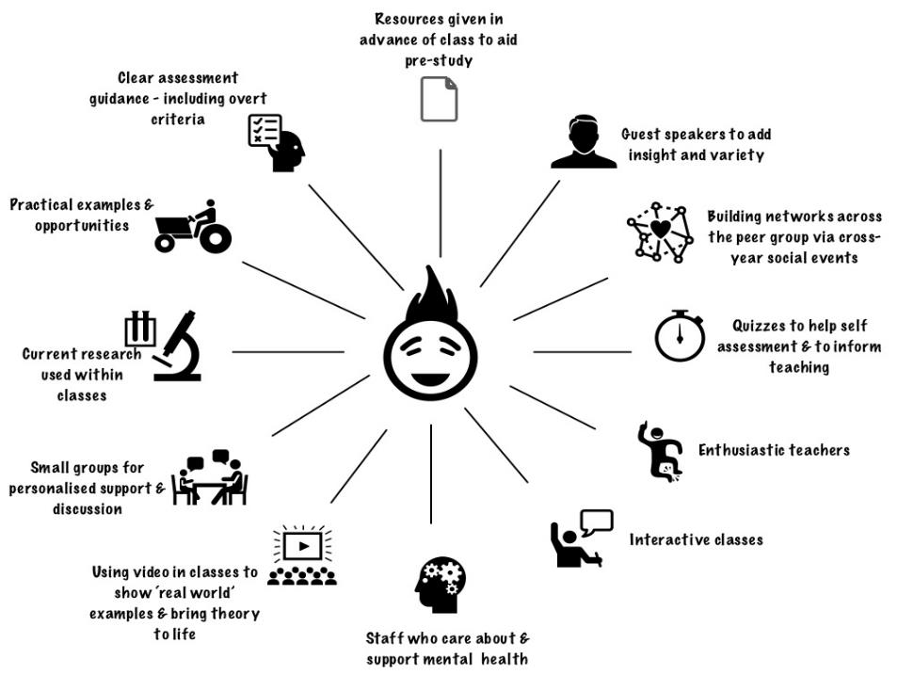
GBMET
What works?

Slide 51
What’s wrong with feedback?
Students get it too late.
And too often, it’s just words on paper.
It doesn’t help them enough.
They often don’t take enough notice of it.

Slide 52
Fishing for feedback?
Feedback is like fish.
If it is not used quickly, it becomes useless.
(Sally Brown).
Give a man a fish,
Feed him for a day.
Teach a man to fish,
Feed him for a lifetime.
(Maimonides: 1135-1204)
Make feedback timely, while it still matters to students, in time for them to use it towards further learning, or to receive further assistance.
(Graham Gibbs)
And he’ll learn to drink beer in boats
And you won’t see him for weeks!
(Australian proverb).

Slide 53
But what’s really wrong with feedback?
Too often it’s one-way – monologic.
What students want is dialogue.
They want to talk to us about their work.
But they’re scared to talk to us, for various reasons:
In case it leads to lower marks;
In case they’re ‘found out’;
In case they feel stupid.

Slide 54
Royce Sadler on feedback:
Higher education teachers are often frustrated by the modest impact feedback has in improving learning. The status of feedback deserves to be challenged on the grounds that it is essentially about telling. For students to become self-sustaining producers of high quality intellectual and professional goods, they must be equipped to take control of their own learning and performance. (Sadler, 2013)
Sadler, D. R. (2013). Opening up feedback: Teaching learners to see. In Merry, S., Price, M., Carless, D., & Taras, M. (Eds.) Reconceptualising feedback in higher education: Developing dialogue with students. (Ch. 5, 54‑63). London: Routledge.

Slide 55
Dylan Wiliam on feedback (online)
There really is a lot of rot talked about how feedback should and should not be given.
...people forget that the only good feedback is that which is acted upon, which is why the only thing that matters is the relationship between the teacher and the student.
Every teacher knows that the same feedback given to one student will improve that student’s learning but to another student, of similar achievement, will make that student give up. Teachers need to know their students, so that they know when to push, and they know when to back off. ...hardly any studies look at the responses cued in the individual recipient by the feedback.

Slide 56
Damaging feedback...
(From #LTHE digest, available in full on my website)
I got some student evaluation feedback that really stung ... wasn't that long ago either! .
I recall - "could do better" - what's that all about?
''weak'" for art on successive school reports. (Showed sustainability though?)
'don't bother getting up on Monday morning' after a failed assignment by a maths teacher at secondary school
missing out on an A as I read the question slightly wrong
A big red cross through something I'd put some effort into, devastating
I wear my feedback like scars. Some of the wounds still fester.
Being told that I was holding up everyone because I didn't understand maths GCSE lesson
my only consolation was they pulled apart my punctuation and grammar but their feedback was full of typos!
'Kerry has ability to do well when she puts her mind to it' Response, Kerry will put her mind to it when she's not bored to death
The worst feedback I eve received on a sweated-over assignment was 'Fine as far as it goes' Grrrh!

Slide 57
How’s your feedback? (After Nicol and MacFarlane-Dick, 2006)
1. Helps clarify what good performance is (goals, criteria, expected standards);
2. Facilitates the development of self-assessment (reflection) in learning;
3. Delivers high quality information to students about their learning – and how to progress it;
4. Encourages teacher and peer dialogue around learning;
5. Encourages positive motivational beliefs and self-esteem;
6. Provides opportunities to close the gap between current and desired performance;
7. Provides information to teachers that can be used to help shape the teaching.

Slide 58
Face-to-face communication
Making all the channels work

Slide 59
Thirty Second Theatre

Slide 60
Face-to-face one-to-one feedback activity
On the signal to start, please stand up, and work in pairs, moving around the room, talking to different people using the script which follows…
The script:
A ‘Hello’ (or equivalent).
B ‘Hello’ (or equivalent).
A ‘You are late’.
B ‘I know’.
Try to do it completely differently each time.

Slide 61
Constructive Alignment: John Biggs
What will I be expected to show for this?
What does a good one look like, and a bad one?
Where does this fit into the big picture?
When explaining assessment criteria to students, and when linking these to evidence of achievement of the intended learning outcomes, we need to make the most of face-to-face whole group contexts and...
Tone of voice
Body language
Facial expression
Eye contact
The chance to repeat things
The chance to respond to puzzled looks
Some things don’t work nearly so well just on paper or on screens.
Some of the
tools we can
use in
face-to-face
contexts

Slide 62
Face to face feedback

Slide 63
Hands-on feedback?

Slide 64
Characteristics of teachers who get engagement going (Sally Brown)
Knows subject material thoroughly
Adopts a scholarly approach to the practice of teaching
Is reflective and regularly reviews own practice
Is well organised and plans curriculum effectively
Is passionate about teaching
Has a student-centred orientation to teaching
Regularly reviews innovations in learning and teaching and tries out ones relevant to own context
Ensures that assessment practices are fit for purpose and contribute to learning
Demonstrates empathy and emotional intelligence

Slide 65
Characteristics of excellent teachers: diamond-9
1
2
3
4
5
6
7
8
9

Slide 66
Five tips for formative feedback
Help students to want feedback.
Stop them concentrating on the mark.
Get the timing right, while students still care about what they’ve done.
Make feedback interesting - not routine or mundane.
Give at least some feedback very quickly.

Slide 67
Back to our intended learning outcomes…
Do you now feel better able to:
2 hands = very much better, one hand = somewhat better, touch left ear = no better...
Reflect on how assessment and feedback link (or don’t link) to the factors underpinning successful student learning;
Support progress and change lives (ours and theirs) by adjusting our assessment and feedback;
Make the time and energy we spend assessing students’ work and getting feedback to them time well spent;
Think of what else we may be able to do to make assessment and feedback fit for purpose in 2018.
Wanting/
Needing
Doing
Making sense
Feedback

Slide 68
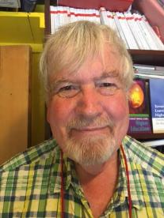
Thank you…
Website: http://phil-race.co.uk
Follow Phil on Twitter @RacePhil
e-mail: phil@phil-race.co.uk

