Slide 1
Activating Learning
Developing Assessment
– fine-tuning assessment for the 21st century
29th May, 2018
RCPI: Dublin
Phil Race
(from Newcastle-upon-Tyne)
BSc PhD PGCE FCIPD PFHEA NTF
Follow Phil on Twitter: @RacePhil
Visiting Professor: University of Plymouth and Edge Hill University
Emeritus Professor, Leeds Beckett University

Slide 2
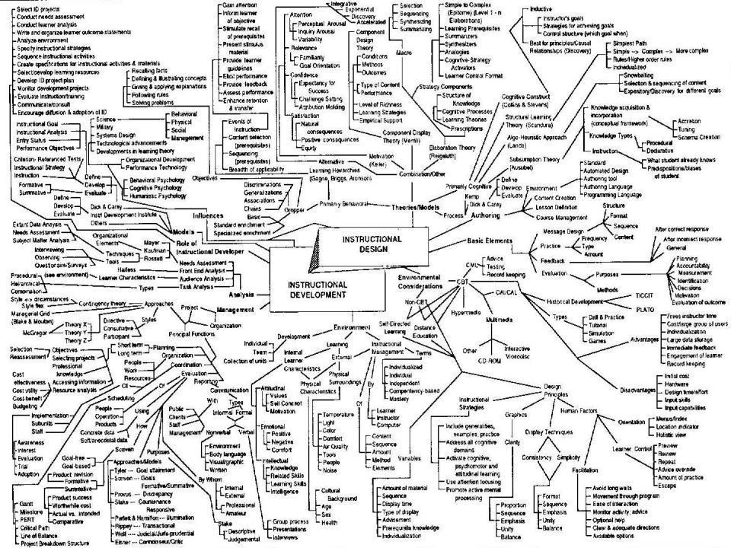
This slide has two purposes….
To focus the data projector, if necessary, and…
...to persuade colleagues never to put this sort of detail onto a slide!

Slide 3
About Phil…
First a musician
Then a writer
Then a scientist
Then a researcher
Then a lecturer and warden at what is now USW
Got interested in how students learn
And the effects assessment and feedback have on them
And how we teach them
Gradually became an educational developer
And now ‘retired’!?
Currently…
Visiting Prof: Plymouth & Edge Hill
Emeritus Prof: Leeds Beckett
Based at Newcastle, UK
And on trains
And an expert…
on train routes and timetables!
Notes:
2
2

Slide 4
Rationale
How can we best go about making exam-based assessment as authentic as possible?
What types of assessment are more relevant to professional development?
What problems have we in designing assessment questions and marking schemes?
What are the problems with essay-type questions and answers?
What else can we do?

Slide 5
Ideas drawn from…
Race, P. (2014) Making learning happen: 3rd edition London: Sage. (lots of bits free on my website!)
Brown, S. (2015) Learning, teaching and assessment in higher education: global perspectives, Basingstoke: Palgrave-Macmillan. (great discussion on plagiarism).
Race, P. (2015) The Lecturer’s Toolkit: 4th edition, London, Routledge. (lots of bits on my website!)
Sambell, K, Brown, S and Graham, L. (2017) Professionalism in Practice: Key directions in higher education: Learning, Teaching and Assessment, Basingstoke: Palgrave-Macmillan.

Slide 6
Hounsell, D. (2008). The trouble with feedback: New challenges, emerging strategies. Interchange, 2, pp.1-10.
Feedforward is a strategy that aims to ‘increase the value of feedback to the students by focusing comments not only on the past and present…but also on the future – what the student might aim to do, or do differently in the next assignment or assessment if they are to continue to do well or to do better’ (Hounsell, 2008, p. 5).

Slide 7
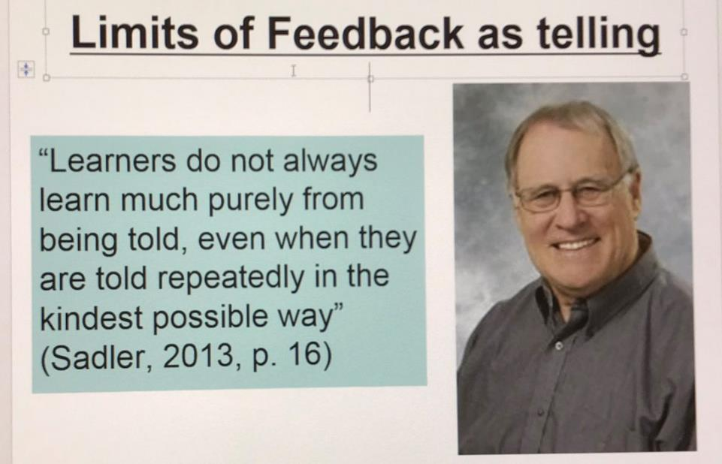
David Carless (on Twitter): (yesterday!)
Feedback as telling is seriously overrated!

Slide 8
What does ‘authentic’ mean?
Authenticity is about how well the assessment correlates to the sorts of things students need to be able to do in their career after leaving the educational institution. It’s about the real-world relevance of the assessment activity.

Slide 9
Ownership of targets
Doctors, lawyers, accountants and managers don’t, in their day-to-day work sit writing about medicine, law, accountancy and management – they do these things. There is often a considerable gap between what we get learners to do in our assessment, and what they will need to be good at throughout their careers.
The more we can bridge that gap by making assessment feel relevant to learners, the more we can expect them to take ownership of the need to become able to evidence their achievement in assessed contexts.

Slide 10
Thanks to students
I could not do what I do nowadays if I did not continue to spend a fair bit of my time working with students – they’ve taught me most of what I know.

Slide 11
Time…
We spend a great deal of our energy and time assessing students’ work, and giving them feedback. Do we spend too much time composing feedback and getting it to students?
Is the time we spend actually well-spent?
Is the feedback really used – or is some of it ignored, or even not read?

Slide 12
Feedback, knowledge and enthusiasm
Knowledge isn’t infectious (unfortunately) but enthusiasm is, and we need to help our students to catch enthusiasm.
We certainly don’t want assessment or feedback to damage that enthusiasm.

Slide 13
The digital age?
The world around us has changed a lot, yet assessment still remains relatively unchanged.
Students are changing fast, as are their expectations of how, what and why they are learning, and how assessment will work.

Slide 14
Intended learning outcomes
After participating in this session, you should be better-able to:
Reflect on how assessment and feedback link (or don’t link) to seven factors underpinning successful student learning;
Look at the fact that many of the problems we have making feedback work originate from the kinds of assessment we find ourselves using (not least, essays)
Examine what’s wrong with some traditional forms of feedback;
Think of what else we may be able to do to make assessment and feedback authentic and fit for purpose in 2018.

Slide 15
You will be able to download my main slides
You don’t need to take notes.
I’ll put the main slides I use up on my website tonight (http://phil-race.co.uk/)
I won’t post pictures and video-clips, as this would make the file-size too large.
I may sometimes go through slides quite fast, but you can study them as you wish at your leisure.

Slide 16
Announcement about mobile phones and laptops...
Good afternoon everyone – please turn on your ‘phones, tablets and computers.
Please post your thoughts, questions, comments and ideas during this session to the hashtag #philatdublin18 Thanks!
Try #LTHEchat on Wednesday evenings from 20.00-21.00.

Slide 17
Download Phil’s published stuff on feedback, assessment, and learning
Expanded discussion of how the factors underpinning learning link to feedback, assessment and large-group teaching:
http://phil-race.co.uk/2016/04/updated-powerpoint-ripples-model/ (Chapter 1 from ‘The Lecturer’s Toolkit, 2015, and related slides)
https://phil-race.co.uk/2016/10/lthe-tweetchat-lthechat-wed-oct-19-8-00-9-00-pm/ (feedback stuff from my most recent two books)
https://phil-race.co.uk/2018/02/feedback-feedforward-just-tips-including-students/ (just the feedback tips!)
http://phil-race.co.uk/2015/01/assessment-bits-new-editions/ (extracts on assessment)

Slide 18
Time-constrained Post-it exercise
On a post-it, in your best handwriting, please write your own completion of the starter:
“assessment would work much better for me (and for students) if only ..…”
Please swap post-its so that you’ve no idea who has yours.
If chosen, please read out with passion and drama the post-it you now have.
Please place them all on the chart as directed.

Slide 19
Thought for the day: Einstein
It is simply madness,
to keep doing the same things,
and expect different results.

Slide 20
What is authentic assessment?
Authentic assessment sends signals to students which direct them towards the kinds of learning goals and processes that are representative of meaningful learning in their subject area.
It uses a range of methods and approaches that get students working hard on activities relevant to their life and career plans on graduation;
Authentic summative assessment tasks are designed to ensure that students learn what they need to learn in recognisably appropriate ways.

Slide 21
The benefits of authentic assessment can be significant for all stakeholders.
Students undertaking authentic assessments tend to be more fully engaged in learning and hence tend to achieve more highly because they see the sense of what they are doing (Sadler, 2005).
Assessors adopting authentic approaches can use realistic and live contexts within which to frame assessment tasks, which help to make theoretical elements of the course come to life.
Employers value students who can quickly engage in real-life tasks immediately on employment, having practiced and developed relevant skills and competences through their assignments.

Slide 22
Wiggins (1990) says assessment can be regarded as authentic if we can draw valid inferences from the work they produce
Among other things Wiggins says that authentic assessment tasks must involve students being able to cope with potentially ill-structured challenges and roles, with incomplete information, that help them rehearse for the complex ambiguities of adult and professional life.

Slide 23
Review practice: what can we do to build authenticity in to our assessment?
We need to design assignments that stretch students beyond mechanistic tasks and make assessment fully integral to the learning experience (Sambell et al, 2012). Such authentic assignments and activities could include:
Action-orientated tasks, that are underpinned by relevant evidence-based scholarship and where students are learning by doing (Race, 2014);
Ones that are truly representative of student effort, maximising time-on-task, with marks reflecting the achievement of learning outcomes specified in the programme outlines and which are coherent, constructively aligned (Biggs and Tang, 2011) and challenging.

Slide 24
Now is the decade of
Universities’ dis-content!
Never mind the content – feel the learning

Slide 25
Modern institutions are moving away from being the providers of content, (where everything used to be about ‘delivery’), towards foregrounding two major functions:
Recognising and accrediting students’ achievement, wherever learning has taken place (i.e. getting the assessment right);
Supporting student learning and engagement (not least by making feedback work well for students, and using authentic situations and simulations to bring learning to life).

Slide 26
How students really learn
Seven factors underpinning successful learning based on asking 200,000 people about their learning in the last 30 years!

Slide 27
Getting to know each other: an analogue approach…
In turn, please..
Say one or two sentences about...
  who you are,
  where you come from, and
  what you do.
  In one breath!
(Optional) Share with us one thing that you’re dead good at, or really proud of.

Slide 28
How Students Really Learn
‘Ripples’ model of learning
Phil Race

Slide 29
What’s missing in this old idea of how we learn?
Engagement?
Feelings?
Active
Experimentation
Inspiration?
Judgments?
Desire?
Abstract
Conceptualisation
Concrete
Experience
Communication?
Enthusiasm?
Reflective
Observation

Slide 30
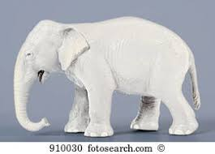
But what about learning styles?
https://www.theguardian.com/education/2017/mar/12/no-evidence-to-back-idea-of-learning-styles?CMP=share_btn_tw
(Link from my Tweet on March 13th 2017 to a letter in the Guardian by prominent folk around the world of education)
Or link to a word document: https://phil-race.co.uk/2017/09/swansea-university-school-management-21st-September/
“No evidence to back idea of learning styles”

Slide 31
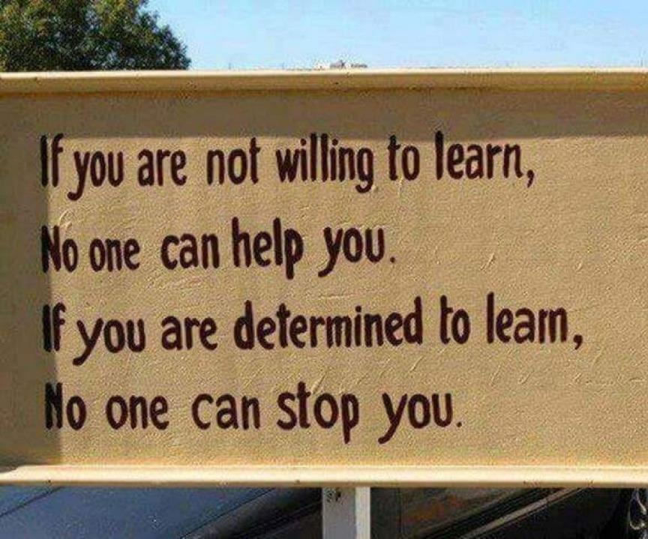

Slide 32
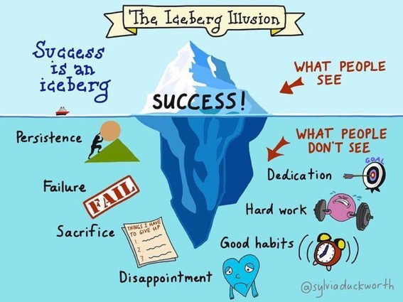

Slide 33
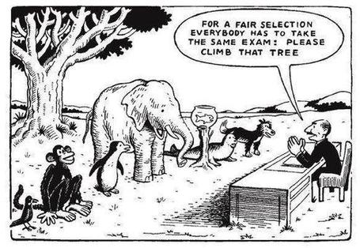

Slide 34
Ripples on a pond….
Striving to enhance our students’ want to learn;
Helping students to develop ownership of the need to learn;
Keeping students learning by doing, practice, trial-and-error, repetition;
Ensuring students get quick and useful feedback – from us and from each other;
Helping students to make sense of what they learn.
Getting students deepening their learning by verbalising, explaining things to each other, and to us.
Allowing students to further deepen their learning by assessing their own learning, and assessing others’ learning – making informed judgements.
We can make learning happen by:
Verbalising
Assessing
making informed judgements
Wanting/
Needing
Doing
Doing
Making sense
Feedback

Slide 35
What’s wrong
with
this?
Verbalising
Assessing
Feedback
Making sense
Doing
Wanting/
Needing

Slide 36
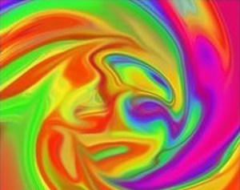

Slide 37
Face-to-face communication
Making all the channels work

Slide 38

Thirty Second Theatre

Slide 39

Face-to-face one-to-one feedback activity
On the signal to start, please stand up, and work in pairs, moving around the room, talking to different people using the script which follows…
The script:
A ‘Hello’ (or equivalent).
B ‘Hello’ (or equivalent).
A ‘You are late’.
B ‘I know’.
Try to do it completely differently each time.

Slide 40
Constructive Alignment: John Biggs
What will I be expected to show for this?
What does a good one look like, and a bad one?
Where does this fit into the big picture?
When explaining assessment criteria to students, and when linking these to evidence of achievement of the intended learning outcomes, we need to make the most of face-to-face whole group contexts and...
  Tone of voice
  Body language
  Facial expression
  Eye contact
  The chance to repeat things
  The chance to respond to puzzled looks
Some things don’t work nearly so well just on paper or on screens.
Some of the
tools we can
use in
face-to-face
contexts

Slide 41
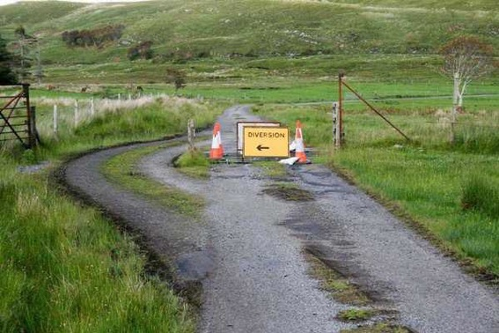

Slide 42
Learning, feedback and assessment: the ten most important words
Why?
What?
Who?
Where?
When?
How?
Which?
So what?
wtf?
Wow?
And the most powerful four-letter word in the English language...
????

Slide 43
‘what’ is getting ever less important
Columbia University research published recently (2011) in Science magazine shows that people are much less prepared to remember ‘what’, but better at remembering where to access information, and how to do so.
Betsy Sparrow, one of the principal researchers, concludes that the internet has become ‘an external memory source that we can access at any time. ... Just as we learn through transactive memory who knows what in our families and offices, we are learning what the computer ‘knows’ and when we should attend to where we have stored information in our computer-based memories. We are becoming symbiotic with our computer tools.
Published Online July 14 2011 < Science Express Index Science DOI: 10.1126/science.1207745
Report: Google Effects on Memory: Cognitive Consequences of Having Information at Our Fingertips Betsy Sparrow,*, Jenny Liu, Daniel M. Wegner

Slide 44
Learning, feedback and assessment:
the ten most important words
Why? (rationale)
What? (content)
Who? (people, you, me, them)
Where? (locations)
When? (times)
How? (processes)
Which? (decisions)
So what? (importance?)
Wow? (impact?)
And the most powerful four-letter word in the English language...
????

Slide 45
Learning, feedback and assessment:
the ten most important words
Why? (rationale)
What? (content)
Who? (people, you, me, them)
Where? (locations)
When? (times)
How? (processes)
Which? (decisions)
So what? (importance?)
Wow? (impact?)
And the most powerful four-letter word in the English language...
else

Slide 46
Go forth and
elsify!

Slide 47
Drives most learning
Is assessment broken?
Some
assessment
issues
What students think
Assessment as learning
Validity
Whodunit?
Fairness

Slide 48
Evidence-based practice
In the last decade, there’s been a great deal of international evidence-based research in assessment, feedback, learning and teaching. I’d like to alert you to how some of this can help us enhance students’ learning.
The next three slides show just 17 sources selected from the published evidence.

Slide 49
17 sources about assessment, feedback and learning in higher education
Knight, P. and Yorke, M. (2003) Assessment, learning and employability, Maidenhead, UK SRHE/Open University Press.
The TESTA project (http://www.testa.ac.uk/) Transforming the Experience of Students through Assessment, (Bath Spa, Chichester, Winchester and Worcester)
Flint, N. R. and Johnson, B. (2011) Towards fairer university assessment – recognising the concerns of students, London: Routledge.
ETC Toolkit (2015) (Enhancing the Curriculum) www.etctoolkit.org.uk
HEA (2012) A Marked Improvement: transforming assessment in higher education, York: Higher Education Academy (http://www.heacademy.ac.uk/assets/documents/assessment/A_Marked_Improvement.pdf )

Slide 50
17 sources about assessment, feedback and learning in higher education
Boud, D. and Associates (2010) Assessment 2020: seven propositions for assessment reform in higher education Sydney: Australian Learning and Teaching Council.
Carless, D. (2015) Excellence in University Assessment: Learning from award-winning practice, London: Routledge.
Race, P. (2014) Making learning happen: 3rd edition London: Sage. (lots of bits free on my website!)
Hunt, D. and Chalmers, L. (eds) (2012) University Teaching in Focus: a learning-centred approach Australia: ACER Press, and London: Routledge.
Price, M., Rust, C., O’Donovan, B. and Handley, K. (2012) Assessment Literacy, Oxford: the Oxford Centre for Staff and Learning Development (based on the ‘ASKe’ Project).
Evans, C. (2013) Making Sense of Assessment Feedback in Higher Education, Review of Educational Research Vol. 83, No. 1, pp. 70–120. http://journals.sagepub.com/doi/abs/10.3102/0034654312474350

Slide 51
17 sources about assessment, feedback and learning in higher education
Sambell, K., McDowell, L. and Montgomery, C. (2013) Assessment for Learning in Higher Education, London: Routledge.
Brown, S. (2015) Learning, teaching and assessment in higher education: global perspectives, Basingstoke: Palgrave-Macmillan. (great discussion on plagiarism).
Race, P. (2015) The Lecturer’s Toolkit: 4th edition, London, Routledge. (lots of bits on my website!)
Parkin, D (2017) Leading Learning and Teaching in Higher Education – the key guide to designing and delivering courses, London: Routledge.
Lea, J. (ed.) (2015) Enhancing Learning And Teaching In Higher Education: Engaging With The Dimensions Of Practice, London, Open University Press.
Sambell, K, Brown, S and Graham, L. (2017) Professionalism in Practice: Key directions in higher education: Learning, Teaching and Assessment, Basingstoke: Palgrave-Macmillan.

Slide 52
My main worries about assessment...
Too often, we still tend to try to measure...
...what’s in students’ heads, and what they can do with what’s there...
in terms of two unsatisfactory proxies ...
what comes out of students’ pens in exams;
2. what comes out of their keyboards in essays and reports.

Slide 53

The read-write industry

Slide 54

In the exam room you’re on your own

Slide 55
Boud et al 2010: ‘Assessment 2020’
Assessment has most effect when...:
It is used to engage students in learning that is productive.
Feedback is used to actively improve student learning.
Students and teachers become responsible partners in learning and assessment.
Students are inducted into the assessment practices and cultures of higher education.
Assessment for learning is placed at the centre of subject and program design.
Assessment for learning is a focus for staff and institutional development.
Assessment provides inclusive and trustworthy representation of student achievement.

Slide 56
Boud et al, 2010
David Boud (University of Technology, Sydney), Royce Sadler (Griffith University), Gordon Joughin (University of Wollongong), Richard James (University of Melbourne), Mark Freeman (University of Sydney), Sally Kift (Queensland University of Technology), Filip Dochy (University of Leuven), Dai Hounsell (University of Edinburgh), Margaret Price (Oxford Brookes University), Tom Angelo (La Trobe University), Angela Brew (Macquarie University), Ian Cameron (University of Queensland), Denise Chalmers (University of Western Australia), Paul Hager (University of Technology, Sydney), Kerri-Lee Harris (University of Melbourne), Claire Hughes (University of Queensland), Peter Hutchings (Australian Learning and Teaching Council), Kerri-Lee Krause (Griffith University), Duncan Nulty (Griffith University), Ron Oliver (Edith Cowan University), Jon Yorke (Curtin University), Iouri Belski (RMIT University), Ben Bradley (Charles Sturt University), Simone Buzwell (Swinburne University of Technology), Stuart Campbell (University of Western Sydney), Philip Candy (University of Southern Queensland), Peter Cherry (Central Queensland University), Rick Cummings (Murdoch University), Anne Cummins (Australian Catholic University), Elizabeth Deane (Australian National University), Marcia Devlin (Deakin University), Christine Ewan (Australian Learning and Teaching Council), Paul Gadek (James Cook University), Susan Hamilton (University of Queensland), Margaret Hicks (University of South Australia), Marnie Hughes-Warrington (Monash University), Gail Huon (University of Newcastle), Margot Kearns (University of Notre Dame, Sydney), Don Maconachie (University of the Sunshine Coast), Vi McLean (Queensland University of Technology,) Raoul Mortley (Bond University), Kylie O’Brien (Victoria University), Gary O’Donovan (University of Tasmania), Beverley Oliver (Curtin University), Simon Pyke (University of Adelaide), Heather Smigiel (Flinders University), Janet Taylor (Southern Cross University), Keith Trigwell (University of Sydney), Neil Trivett (University of Ballarat), Graham Webb (University of New England).

Slide 57
The importance of dialogic assessment
Students need to be exposed to, and gain experience in making judgements about, a variety of works of different quality... They need planned rather than random exposure to exemplars, and experience in making judgements about quality. They need to create verbalised rationales and accounts of how various works could have been done better. Finally, they need to engage in evaluative conversations with teachers and other students.
(Sadler 2010)

Slide 58
Five main problems with assessed essays
They take a great deal of time to mark, let alone the time it takes for students to prepare, draft and compose them.
When most assessment is in the form of essays, students’ skills at essay-writing are repeatedly tested, as the expense sometimes of their understanding of the subject.
Lots of research shows that we’re not at all good at marking essays fairly – different assessors often give the same essay very different marks.
Essay marks in the UK tend to lie between 35% for a poor one and 75% for a very good one, whereas in many other disciplines the marks for an assignment like a lab report can range across the whole 0-100% span more evenly.
With coursework essays, there can be doubt about veracity – i.e. ‘whodunit?’!

Slide 59
Why is it important to tackle the problem?
There is a strong argument to be made for using authentic assessments, that is those that “can demonstrate the knowledge behaviours, qualities and attributes that were described in the course programme or specification” (Brown, 2015 p.118).
In some disciplines, assessed essays are rarely or never used – for example in many science, engineering, maths and technology fields. But in many other disciplines, the essay as the main form of assessment still dominates, both in coursework and exams.

Slide 60
Feed-forward
Language of feedback
Some feedback
issues
National Student Survey
Timing:
24-hours!
Written, printed,
on-screen
Efficiency
Face to face
oral

Slide 61
Quality feedback: three vital functions
“There is wide consensus within the education literature that ‘quality’ feedback should serve three overlapping functions:
an ‘orientational’ purpose that clarifies the student’s performance and achievement;
a ‘transformational’ purpose that enables the student to reflect, improve their performance, and become more autonomous (often termed ‘feed-forward); and
an ‘affective/interpersonal’ dimension that gives the student confidence and motivation, and builds a strong teacher-student relationship”
(Dunworth & Sanchez, 2016, quoted by Winstone and Nash, 2016).

Slide 62
Task: think about ghastly feedback
Think back to some occasions, academic or otherwise, historic or recent when you received feedback that you would rather not have received.
How did it make you feel?
Thinking of a single example of ghastly feedback that you are prepared to share with another person, briefly outline the context and say why it was such a negative experience.

Slide 63
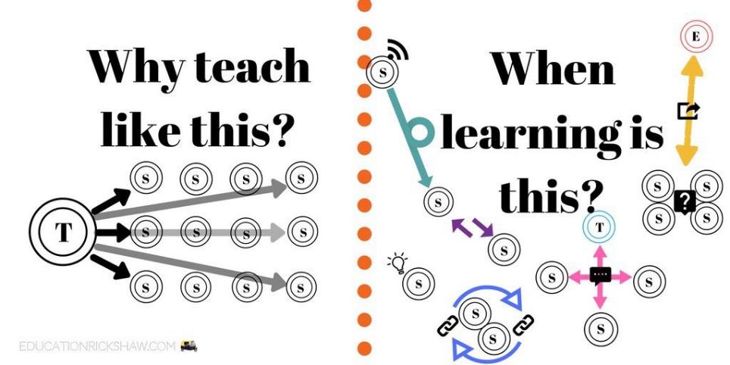
Learning is not linear! Feedback is not unidirectional. But sometimes we pretend that they are! #sketchnote by @SGroshell and @MrZachG #edchat #learning #teachchat

Slide 64
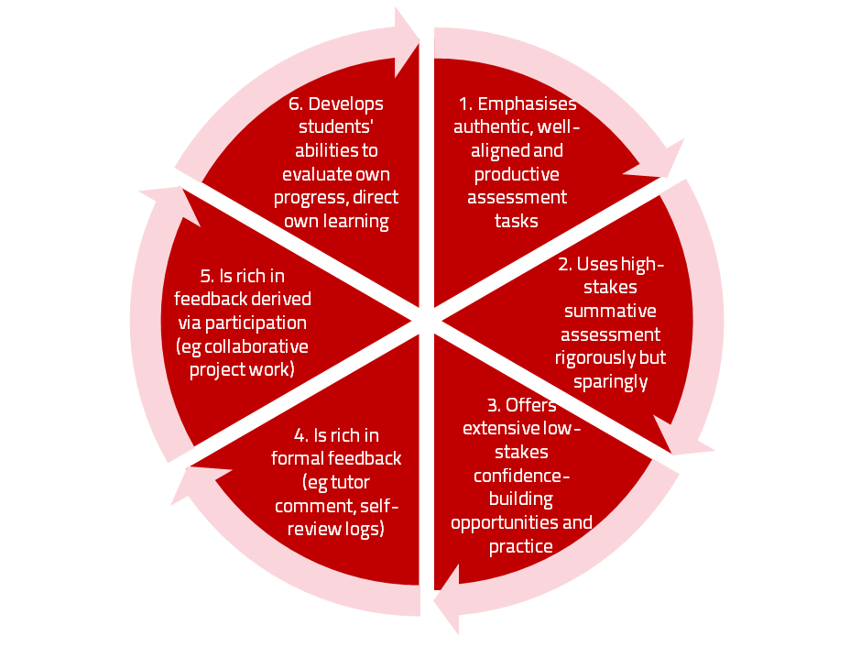
A4L the Northumbria model

Slide 65
Use link below to download the new materials on feedback and assessment produced in 2017 by Kay Sambell, Sally Brown and Phil Race for Edinburgh Napier University
http://staff.napier.ac.uk/services/dlte/ENhance/Pages/ENhanceQuickGuides.aspx

Slide 66
What’s wrong with feedback?
Students get it too late.
And too often, it’s just words on paper.
It doesn’t help them enough.
They often don’t take enough notice of it.

Slide 67
Fishing for feedback?
Feedback is like fish.
If it is not used quickly, it becomes useless.
(Sally Brown).
Give a man a fish,
Feed him for a day.
Teach a man to fish,
Feed him for a lifetime.
(Maimonides: 1135-1204)
Make feedback timely, while it still matters to students, in time for them to use it towards further learning, or to receive further assistance.
(Graham Gibbs)
And he’ll learn to drink beer in boats
And you won’t see him for weeks!
(Australian proverb).

Slide 68
But what’s really wrong with feedback?
Too often it’s one-way – monologic.
What students want is dialogue.
They want to talk to us about their work.
But they’re scared to talk to us, for various reasons:
  In case it leads to lower marks;
  In case they’re ‘found out’;
  In case they feel stupid.

Slide 69
Royce Sadler on feedback:
Higher education teachers are often frustrated by the modest impact feedback has in improving learning. The status of feedback deserves to be challenged on the grounds that it is essentially about telling. For students to become self-sustaining producers of high quality intellectual and professional goods, they must be equipped to take control of their own learning and performance. (Sadler, 2013)
Sadler, D. R. (2013). Opening up feedback: Teaching learners to see. In Merry, S., Price, M., Carless, D., & Taras, M. (Eds.) Reconceptualising feedback in higher education: Developing dialogue with students. (Ch. 5, 54‑63). London: Routledge.

Slide 70
Dylan Wiliam on feedback (online)
There really is a lot of rot talked about how feedback should and should not be given.
...people forget that the only good feedback is that which is acted upon, which is why the only thing that matters is the relationship between the teacher and the student.
Every teacher knows that the same feedback given to one student will improve that student’s learning but to another student, of similar achievement, will make that student give up. Teachers need to know their students, so that they know when to push, and they know when to back off. ...hardly any studies look at the responses cued in the individual recipient by the feedback.

Slide 71
Damaging feedback...
(From #LTHE digest, available in full on my website)
I got some student evaluation feedback that really stung ... wasn't that long ago either! .
I recall - "could do better" - what's that all about?
''weak'" for art on successive school reports. (Showed sustainability though?)
'don't bother getting up on Monday morning' after a failed assignment by a maths teacher at secondary school
missing out on an A as I read the question slightly wrong
A big red cross through something I'd put some effort into, devastating
I wear my feedback like scars. Some of the wounds still fester.
Being told that I was holding up everyone because I didn't understand maths GCSE lesson
my only consolation was they pulled apart my punctuation and grammar but their feedback was full of typos!
'Kerry has ability to do well when she puts her mind to it' Response, Kerry will put her mind to it when she's not bored to death
The worst feedback I eve received on a sweated-over assignment was 'Fine as far as it goes' Grrrh!

Slide 72
How’s your feedback?
(After Nicol and MacFarlane-Dick, 2006)
1. Helps clarify what good performance is (goals, criteria, expected standards);
2. Facilitates the development of self-assessment (reflection) in learning;
3. Delivers high quality information to students about their learning – and how to progress it;
4. Encourages teacher and peer dialogue around learning;
5. Encourages positive motivational beliefs and self-esteem;
6. Provides opportunities to close the gap between current and desired performance;
7. Provides information to teachers that can be used to help shape the teaching.

Slide 73

Face to face feedback

Slide 74

Hands-on feedback?

Slide 75
Conclusions
Authentic assessment and feedback can be powerful means of focusing student effort and enhancing achievement if well designed (Biggs and Tang, 2011);
Students near the start of their Master’s learning journey are likely to need more support and positive feedback than later, when they are more robust and confident;
The first six weeks can be crucial in helping students understand how assessment will work;
No single method of assessing students’ progress or giving feedback is likely to be ubiquitously successful, so it’s worth using a variety of approaches;
Assessment needs to be manageable for staff and students if it is going to engage students in learning activities.

Slide 76

Thank you…
Website: http://phil-race.co.uk
Follow Phil on Twitter @RacePhil
e-mail: phil@phil-race.co.uk

Slide 77
Useful references and further reading (1)
Bain, K. (2004) What the best College Teachers do, Cambridge: Harvard University Press.
Biggs, J. and Tang, C. (2011) Teaching for Quality Learning at University, Maidenhead: Open University Press.
Bloxham, S. and Boyd, P. (2007) Developing effective assessment in higher education: a practical guide, Maidenhead, Open University Press.
Boud, D. (1995) Enhancing learning through self-assessment, London: Routledge.
Brown, S. and Glasner, A. (eds.) (1999) Assessment Matters in Higher Education, Choosing and Using Diverse Approaches, Maidenhead: Open University Press.
Brown, S. and Race, P. (2012) Using effective assessment to promote learning in Hunt, L. and Chambers, D. (2012) University Teaching in Focus, Victoria, Australia, Acer Press. P74-91.
Brown, S. (2015) Learning , Teaching and Assessment in Higher Education: Global perspectives, London, Palgrave.

Slide 78
Useful references and further reading (2)
Carless, D., Joughin, G., Ngar-Fun Liu et al (2006) How Assessment supports learning: Learning orientated assessment in action Hong Kong: Hong Kong University Press.
Carroll, J. and Ryan, J. (2005) Teaching International students: improving learning for all. London: Routledge SEDA series.
Crosling, G., Thomas, L. and Heagney, M. (2008) Improving student retention in Higher Education, London and New York: Routledge
Crooks, T. (1988) Assessing student performance, HERDSA Green Guide No 8 HERDSA (reprinted 1994).
Dunworth, K. and Sanchez, H.S., (2016). Perceptions of quality in staff-student written feedback in higher education: a case study. Teaching in Higher Education, 21(5), pp.576-589.
Dweck, C. S. (2000) Self Theories: Their Role in Motivation, Personality and Development, Lillington, NC: Taylor & Francis.
Falchikov, N. (2004) Improving Assessment through Student Involvement: Practical Solutions for Aiding Learning in Higher and Further Education, London: Routledge.
Gibbs, G. (1999) Using assessment strategically to change the way students learn, in Brown S. & Glasner, A. (eds.), Assessment Matters in Higher Education: Choosing and Using Diverse Approaches, Maidenhead: SRHE/Open University Press.
Higher Education Academy (2012) A marked improvement; transforming assessment in higher education, York: HEA.

Slide 79
Useful references and further reading (3)
Hawe, E., Lightfoot, U., & Dixon, H. (2017). First-year students working with exemplars: Promoting self-efficacy, self-monitoring and self-regulation. Journal of Further and Higher Education, 1-15.
Hendry, G. D., White, P., & Herbert, C. (2016). Providing Exemplar-Based “Feedforward” before an Assessment: The Role of Teacher Explanation. Active Learning in Higher Education, 17(2), 99-109.
Hounsell, D., McCune, V., Hounsell, J. and Litjens, J., (2008). The quality of guidance and feedback to students. Higher Education Research & Development, 27(1), pp.55-67.
McDowell, L. and Brown, S. (1998) Assessing students: cheating and plagiarism, Newcastle: Red Guide 10/11 University of Northumbria.
Meyer, J.H.F. and Land, R. (2003) ‘Threshold Concepts and Troublesome Knowledge 1 – Linkages to Ways of Thinking and Practising within the Disciplines’ in C. Rust (ed.) Improving Student Learning – Ten years on. Oxford: OCSLD.
Nicol, D. J. and Macfarlane-Dick, D. (2006) Formative assessment and self-regulated learning: A model and seven principles of good feedback practice, Studies in Higher Education Vol 31(2), 199-218.
PASS project Bradford http://www.pass.brad.ac.uk/ Accessed November 2013.
Peelo, M. T., & Wareham, T. (Eds.). (2002). Failing students in higher education. Society for Research into Higher Education.
Pickford, R. and Brown, S. (2006) Assessing skills and practice, London: Routledge.
Rotheram, B. (2009) Sounds Good, JISC project http://www.jisc.ac.uk/whatwedo/programmes/usersandinnovation/soundsgood.aspx

Slide 80
Useful references and further reading (4)
Race, P. (2001) A Briefing on Self, Peer & Group Assessment, in LTSN Generic Centre Assessment Series No 9, LTSN York.
Race P. (2015) The lecturer’s toolkit (4th edition), London: Routledge.
Rust, C., Price, M. and O’Donovan, B. (2003) Improving students’ learning by developing their understanding of assessment criteria and processes, Assessment and Evaluation in Higher Education. 28 (2), 147-164.
Ryan, J. (2000) A Guide to Teaching International Students, Oxford Centre for Staff and Learning Development.
Scoles, J., Huxham, M., & Mcarthur, J. (2013). No longer exempt from good practice: Using exemplars to close the feedback gap for exams. Assessment & Evaluation in Higher Education, 38(6), 631-645.
Stefani, L. and Carroll, J. (2001) A Briefing on Plagiarism, LTSN
Sadler, D. Royce (2010) Beyond feedback: developing student capability in complex appraisal,
Assessment & Evaluation in Higher Education, 35: 5, 535-550.
Yorke, M. (1999) Leaving Early: Undergraduate Non-completion in Higher Education, London: Routledge.

