Slide 1


National Seminar Series at MIC 2017/18
Students as Partners in
Assessment and Feedback
Convener: Dr Gwen Moore
Director of Teaching and Learning, MIC
National Forum for the Enhancement of Teaching and Learning in Higher Education
Notes:
The National Forum for the Enhancement of Teaching and Learning is a new sectoral network established to enhance teaching and learning in Irish Higher Education through:
Advocacy and leadership
Connecting excellent practice
Collaboration
Innovation and the mobilisation of expertise throughout the entire higher education system in Ireland
In addition, it aims to find efficient ways of maximising teaching and learning excellence by focusing the energy and expertise of the sector on specific, strategic enhancement themes – with a view to addressing challenges of collective importance to the sector.

Slide 2
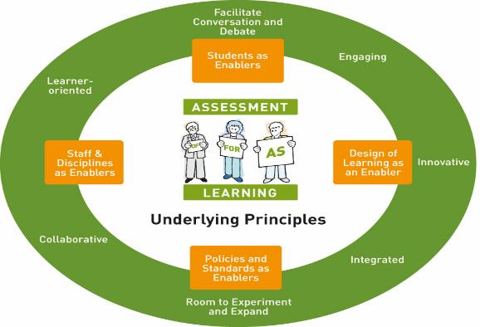
National Forum Project’s Framework, Activities &
Target Groups
Seminars
(Staff and wider stakeholders group)
Students As Partners Insight (with USI)
(Students, staff, and wider stakeholders group)
Professional Development Framework
(for all who teach in the sector)
Approaches to Programme Assessment
(Senior academic and administrative staff)
Sectoral Definition of Assessment
(for the whole sector)
Authentic & Work-Based Assessment
(Disciplines, employers, and wider stakeholders)

Slide 3
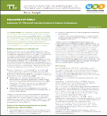
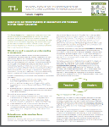
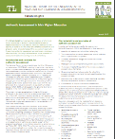

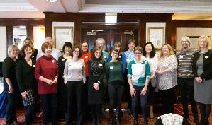
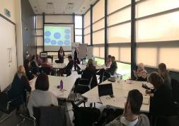
National Forum Insights
Students as Partners
Expanding our Understanding of
Assessment and Feedback
Authentic Assessment
with
with NF expert group
with network & disciplines group
National Forum (2016a)
National Forum (2017a)
National Forum (2017b)

Slide 4
Local Context – MIC Strategic Plan 2018-2023
MARY IMMACULATE COLLEGE
T&L Strategy
Plan Outcomes
Greater understanding of assessment & feedback
Champion good practice at MIC through sharing of exemplars
Identifying/addressing potential barriers with solutions/support mechanisms
Students as partners in assessment – developing multiple modes of communication around feedback
A&F Policy
Principles/enablers of action
Demonstrate learning outcomes
Module and assessment information must inform students when, where and how feedback is offered on the module/assessment concerned
Feedback is a joint and shared responsibility

Slide 5

National Seminar Series at MIC 2017/18
Twitter:
@CTLMIC @ForumTL @MICLimerick
@RacePhil
National Forum for the Enhancement of Teaching and Learning in Higher Education

Slide 6
Activating Learning
National Seminar at MIC
Students as Partners in Assessment and Feedback
MIC Limerick: 31st May, 2018
Phil Race
(from Newcastle-upon-Tyne)
BSc PhD PGCE FCIPD PFHEA NTF
Follow Phil on Twitter: @RacePhil
Visiting Professor: University of Plymouth and Edge Hill University
Emeritus Professor, Leeds Beckett University

Slide 7
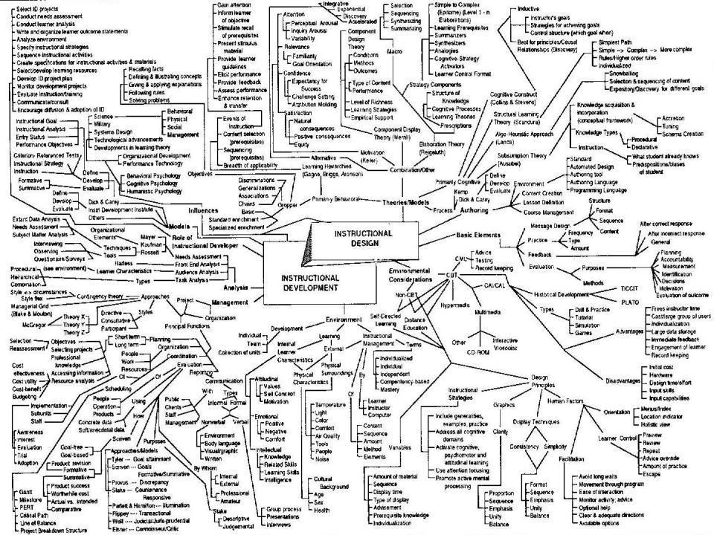
This slide has two purposes….
To focus the data projector, if necessary, and…
...to persuade colleagues never to put this sort of detail onto a slide!

Slide 8
About Phil…
First a musician
Then a writer
Then a scientist
Then a researcher
Then a lecturer and warden at what is now USW
Got interested in how students learn
And the effects assessment and feedback have on them
And how we teach them
Gradually became an educational developer
And now ‘retired’!?
Currently…
Visiting Prof: Plymouth & Edge Hill
Emeritus Prof: Leeds Beckett
Based at Newcastle, UK
And on trains
And an expert…
on train routes and timetables!
Notes:
2
2

Slide 9
Hounsell, D. (2008). The trouble with feedback: New challenges, emerging strategies. Interchange, 2, pp.1-10.
Feedforward is a strategy that aims to ‘increase the value of feedback to the students by focusing comments not only on the past and present…but also on the future – what the student might aim to do, or do differently in the next assignment or assessment if they are to continue to do well or to do better’ (Hounsell, 2008, p. 5).

Slide 10
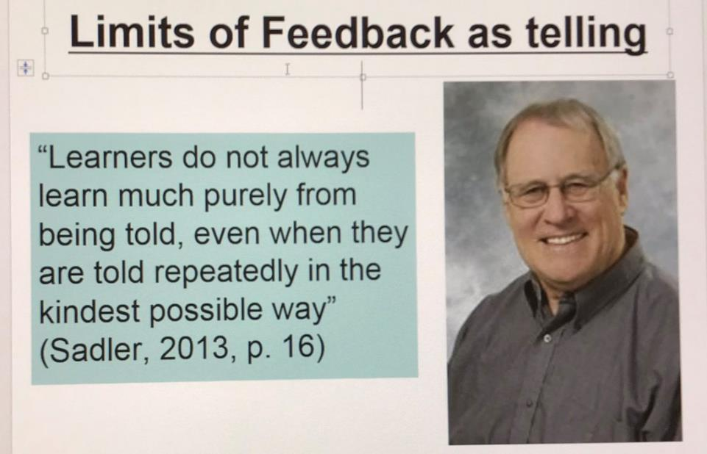
David Carless (on Twitter): (earlier this week)
Feedback as telling is seriously overrated!

Slide 11
Students as partners…
Students are partners in learning.
They always have been.
We can’t ‘learn them’!
We haven’t always made it an optimal partnership.
We can.
I could not do what I do nowadays if I did not continue to spend a fair bit of my time working with students – they’ve taught me most of what I know.

Slide 12
Ideas drawn from…
Race, P. (2014) Making learning happen: 3rd edition London: Sage. (lots of bits free on my website!)
Brown, S. (2015) Learning, teaching and assessment in higher education: global perspectives, Basingstoke: Palgrave-Macmillan.
Race, P. (2015) The Lecturer’s Toolkit: 4th edition, London, Routledge. (lots of bits free on my website!)
Sambell, K., Brown, S. and Graham, L. (2017) Professionalism in Practice: Key directions in higher education: Learning, Teaching and Assessment, Basingstoke: Palgrave-Macmillan.

Slide 13
Rationale
We spend a great deal of our energy and time assessing students’ work, and giving them feedback.
Do we spend too much time composing feedback and getting it to students?
Is the time we spend actually well-spent?
Is the feedback really used, or is much of it ignored, or even not read?
This session will explore how assessment and feedback best link to the student learning experience.

Slide 14
Feedback, knowledge and enthusiasm
Knowledge isn’t infectious (unfortunately) but enthusiasm is, and we need to help our students to catch enthusiasm.
We certainly don’t want assessment or feedback to damage that enthusiasm.

Slide 15
Students change
Students are changing fast, as are their expectations of how, what and why they are learning.
Not least, we’re now in a digital age, not a paper-based one.

Slide 16
Intended learning outcomes
After participating in this session, you should be better-able to:
Reflect on how assessment and feedback link (or don’t link) to the factors underpinning successful student learning;
Support progress and change lives (student’s lives and ours) by adjusting our assessment and feedback;
Make the time and energy we spend assessing students’ work and getting feedback to them time well spent;
Think of what else we may be able to do to make assessment and feedback fit for purpose in 2018.

Slide 17
Beyond the tyranny of intended learning outcomes?
What about our learning aspirations?
What about their learning aspirations?
What about their learning incomes?
What about their learning outputs?
What about their emergent learning outcomes?
What about our intended learning outgoings?

Slide 18
You will be able to download my main slides
You don’t need to take notes.
I’ll put the main slides I use up on my website tonight (http://phil-race.co.uk/)
I won’t post pictures and video-clips, as this would make the file-size too large.
I may sometimes go through slides quite fast, but you can study them as you wish at your leisure.

Slide 19
Announcement about mobile phones and laptops...
Good morning everyone – please turn on your ‘phones, tablets and computers.
Please post your thoughts, questions, comments and ideas during this session to the hashtag #philatmic18 Thanks!
Try #LTHEchat on Wednesday evenings from 20.00-21.00.

Slide 20
Download Phil’s published stuff on feedback, assessment, and learning
Expanded discussion of how the factors underpinning learning link to feedback and assessment:
http://phil-race.co.uk/2016/04/updated-powerpoint-ripples-model/ (Chapter 1 from ‘The Lecturer’s Toolkit, 2015, and related slides)
https://phil-race.co.uk/2016/10/lthe-tweetchat-lthechat-wed-oct-19-8-00-9-00-pm/ (feedback stuff from my most recent two books)
https://phil-race.co.uk/2018/02/feedback-feedforward-just-tips-including-students/ (just the feedback tips!)
http://phil-race.co.uk/2015/01/assessment-bits-new-editions/ (extracts on assessment)

Slide 21
Name labels…
Please write your first name, big and bold, on a coded sticky label, and stick it to your clothing (not onto a fabric which would be damaged).
βA3
Phil

Slide 22
Getting to know each other: an analogue approach…
In turn, please..
Say one or two sentences about...
  who you are,
  where you come from, and
  what you do.
  In one breath!
(Optional) Share with us one thing that you’re dead good at, or really proud of.

Slide 23
Making engagement happen
Engagement is right at the centre of successful learning. Learning can’t happen without it. But engagement is a two-way process – it has to involve students – and us. Engagement should be fun – for us as well as for them.

Slide 24
Time-constrained Post-it exercise
On a post-it, in your best handwriting, please write your own completion of the starter:
“making assessment and feedback work for my students (and for me) would be much better if only I..…”
Please swap post-its so that you’ve no idea who has yours.
If chosen, please read out with passion and drama the post-it you now have.
Please place them all on the chart as directed.

Slide 25
Thought for the day: Einstein
It is simply madness,
to keep doing the same things,
and expect different results.

Slide 26
Bringing assessment and feedback to life
Questions employers might ask students at interview, that could help us frame some of our assessment and feedback
Can you tell us about an occasion when:
you worked together with colleagues in a group to produce a collective outcome?
you had to work autonomously with incomplete information and self-derived data sources?
you developed strategies to solve real life problems and tested them out?
you had a leadership role in a team, and could you tell us your strategies to influence and persuade your colleagues to achieve a collective task?
you had to communicate outcomes from your project work orally, in writing, through social media and/or through a visual medium?
If you want it to happen,
build it into assessment and
let students get feedback on it.

Slide 27
Evidence-based practice
In the last decade, there’s been a great deal of international evidence-based research in assessment, feedback, learning and teaching. I’d like to alert you to how some of this can help us enhance students’ learning.
The next three slides show just 17 sources selected from the published evidence.

Slide 28
17 sources about assessment, feedback and learning in higher education
Knight, P. and Yorke, M. (2003) Assessment, learning and employability, Maidenhead, UK SRHE/Open University Press.
The TESTA project (http://www.testa.ac.uk/) Transforming the Experience of Students through Assessment, (Bath Spa, Chichester, Winchester and Worcester)
Flint, N. R. and Johnson, B. (2011) Towards fairer university assessment – recognising the concerns of students, London: Routledge.
ETC Toolkit (2015) (Enhancing the Curriculum) www.etctoolkit.org.uk
HEA (2012) A Marked Improvement: transforming assessment in higher education, York: Higher Education Academy (http://www.heacademy.ac.uk/assets/documents/assessment/A_Marked_Improvement.pdf )

Slide 29
17 sources about assessment, feedback and learning in higher education
Boud, D. and Associates (2010) Assessment 2020: seven propositions for assessment reform in higher education Sydney: Australian Learning and Teaching Council.
Carless, D. (2015) Excellence in University Assessment: Learning from award-winning practice, London: Routledge.
Race, P. (2014) Making learning happen: 3rd edition London: Sage. (lots of bits free on my website!)
Hunt, D. and Chalmers, L. (eds) (2012) University Teaching in Focus: a learning-centred approach Australia: ACER Press, and London: Routledge.
Price, M., Rust, C., O’Donovan, B. and Handley, K. (2012) Assessment Literacy, Oxford: the Oxford Centre for Staff and Learning Development (based on the ‘ASKe’ Project).
Evans, C. (2013) Making Sense of Assessment Feedback in Higher Education, Review of Educational Research Vol. 83, No. 1, pp. 70–120. http://journals.sagepub.com/doi/abs/10.3102/0034654312474350

Slide 30
17 sources about assessment, feedback and learning in higher education
Sambell, K., McDowell, L. and Montgomery, C. (2013) Assessment for Learning in Higher Education, London: Routledge.
Brown, S. (2015) Learning, teaching and assessment in higher education: global perspectives, Basingstoke: Palgrave-Macmillan. (great discussion on plagiarism).
Race, P. (2015) The Lecturer’s Toolkit: 4th edition, London, Routledge. (lots of bits on my website!)
Parkin, D (2017) Leading Learning and Teaching in Higher Education – the key guide to designing and delivering courses, London: Routledge.
Lea, J. (ed.) (2015) Enhancing Learning And Teaching In Higher Education: Engaging With The Dimensions Of Practice, London, Open University Press.
Sambell, K, Brown, S and Graham, L. (2017) Professionalism in Practice: Key directions in higher education: Learning, Teaching and Assessment, Basingstoke: Palgrave-Macmillan.

Slide 31
Now is the decade of
Colleges’ dis-content!
Never mind the content – feel the learning

Slide 32
Modern institutions are moving away from being the providers of content, (where everything used to be about ‘delivery’), towards foregrounding two major functions:
Recognising and accrediting students’ achievement, wherever learning has taken place (i.e. getting the assessment right);
Supporting student learning and engagement (not least by making feedback work well for students, and using real-world situations and simulations to bring learning to life).

Slide 33
How students really learn
Seven factors underpinning successful learning based on asking 200,000 people about their learning in the last 30 years!

Slide 34
How Students Really Learn
‘Ripples’ model of learning
Phil Race

Slide 35
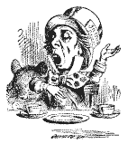
“[The] pupils got it all by heart; and, when Examination-time came, they wrote it down; and the Examiner said ‘Beautiful! What depth!’
They became teachers in their turn, and they said all these things over again; and their pupils wrote it down, and the examiner accepted it; and nobody had the ghost of an idea what it meant”
Lewis Carroll, 1893
Active
Experimentation
Abstract
Conceptualisation
Concrete
Experience
Reflective
Observation

Slide 36
Traditional (obsolete) views...
active experimentation
concrete experience
reflective observation
abstract conceptualization

Slide 37
What’s missing in this old idea of how we learn?
Engagement?
Feelings?
Active
Experimentation
Inspiration?
Judgments?
Desire?
Abstract
Conceptualisation
Concrete
Experience
Communication?
Enthusiasm?
Reflective
Observation

Slide 38
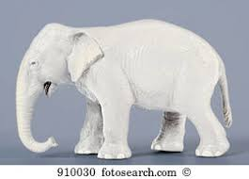
But what about learning styles?
https://www.theguardian.com/education/2017/mar/12/no-evidence-to-back-idea-of-learning-styles?CMP=share_btn_tw
(Link from my Tweet on March 13th 2017 to a letter in the Guardian by prominent folk around the world of education)
Or link to a word document: https://phil-race.co.uk/2017/09/swansea-university-school-management-21st-September/
“No evidence to back idea of learning styles”

Slide 39
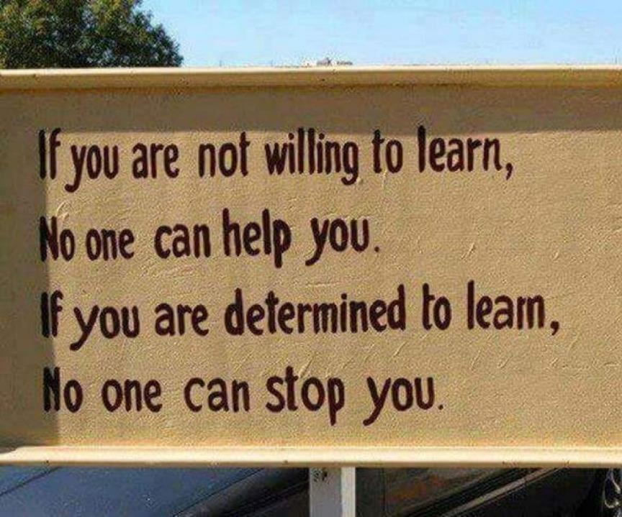

Slide 40
What wavelength should I teach on?
The only one that works is WIIFM
What’s in it for me?
Consciously address the ‘so what’ in learners’ minds;
Warm up their ‘want’ to learn.
Clarify their ‘need’ to learn.
Learners learn far more readily if they are continuously aware of the benefits for them of putting energy into their learning.

Slide 41
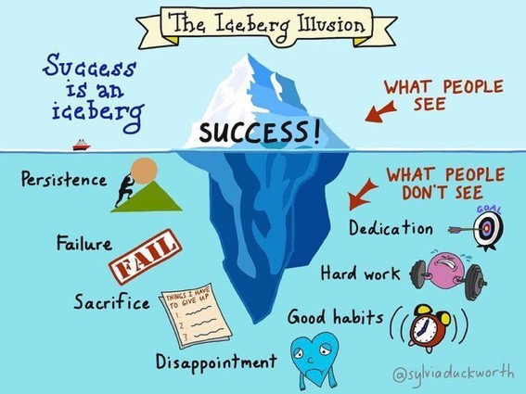

Slide 42
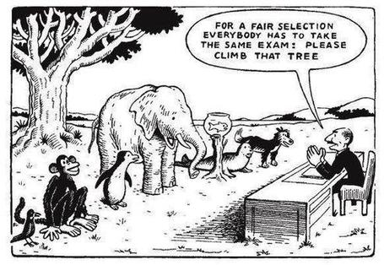

Slide 43
Ripples on a pond….
Striving to enhance our students’ want to learn;
Helping students to develop ownership of the need to learn;
Keeping students learning by doing, practice, trial-and-error, repetition;
Ensuring students get quick and useful feedback – from us and from each other;
Helping students to make sense of what they learn.
Getting students deepening their learning by verbalising, explaining things to each other, and to us.
Allowing students to further deepen their learning by assessing their own learning, and assessing others’ learning – making informed judgements.
We can make learning happen by:
Verbalising
Assessing
making informed judgements
Wanting/
Needing
Doing
Doing
Making sense
Feedback

Slide 44
What’s wrong
with
this?
Verbalising
Assessing
Feedback
Making sense
Doing
Wanting/
Needing

Slide 45

Thanks, Dr Paul Kleiman

Slide 46
Face-to-face communication
Making all the channels work

Slide 47

Face-to-face one-to-one feedback activity
On the signal to start, please stand up, and work in pairs, moving around the room, talking to different people using the script which follows…
The script:
A ‘Hello’ (or equivalent).
B ‘Hello’ (or equivalent).
A ‘You are late’.
B ‘I know’.
Try to do it completely differently each time.

Slide 48
Constructive Alignment: John Biggs
What will I be expected to show for this?
What does a good one look like, and a bad one?
Where does this fit into the big picture?
When explaining assessment criteria to students, and when linking these to evidence of achievement of the intended learning outcomes, we need to make the most of face-to-face whole group contexts and...
  Tone of voice
  Body language
  Facial expression
  Eye contact
  The chance to repeat things
  The chance to respond to puzzled looks
Some things don’t work nearly so well just on paper or on screens.
Some of the
tools we can
use in
face-to-face
contexts

Slide 49

Face to face feedback

Slide 50

Hands-on feedback?

Slide 51
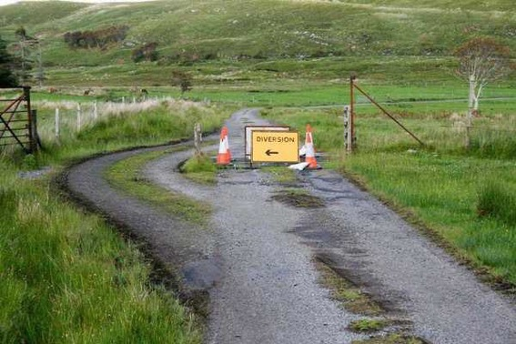

Slide 52
Learning, feedback and assessment: the ten most important words
Why?
What?
Who?
Where?
When?
How?
Which?
So what?
wtf?
Wow?
And the most powerful four-letter word in the English language...
????

Slide 53
‘what’ is getting ever less important
Columbia University research published recently (2011) in Science magazine shows that people are much less prepared to remember ‘what’, but better at remembering where to access information, and how to do so.
Betsy Sparrow, one of the principal researchers, concludes that the internet has become ‘an external memory source that we can access at any time. ... Just as we learn through transactive memory who knows what in our families and offices, we are learning what the computer ‘knows’ and when we should attend to where we have stored information in our computer-based memories. We are becoming symbiotic with our computer tools.
Published Online July 14 2011 < Science Express Index Science DOI: 10.1126/science.1207745
Report: Google Effects on Memory: Cognitive Consequences of Having Information at Our Fingertips Betsy Sparrow,*, Jenny Liu, Daniel M. Wegner

Slide 54
Learning, feedback and assessment:
the ten most important words
Why? (rationale)
What? (content)
Who? (people, you, me, them)
Where? (locations)
When? (times)
How? (processes)
Which? (decisions)
So what? (importance?)
Wow? (impact?)
And the most powerful four-letter word in the English language...
????

Slide 55
Learning, feedback and assessment:
the ten most important words
Why? (rationale)
What? (content)
Who? (people, you, me, them)
Where? (locations)
When? (times)
How? (processes)
Which? (decisions)
So what? (importance?)
Wow? (impact?)
And the most powerful four-letter word in the English language...
else

Slide 56
Go forth and
elsify!

Slide 57
Drives most learning
Is assessment broken?
Some
assessment
issues
What students think
Assessment as learning
Validity
Whodunit?
Fairness

Slide 58
My main worries about assessment...
Too often, we still tend to try to measure...
...what’s in students’ heads, and what they can do with what’s there...
in terms of two unsatisfactory proxies ...
what comes out of students’ pens in exams;
2. what comes out of their keyboards in essays and reports.

Slide 59

The read-write industry

Slide 60

In the exam room you’re on your own

Slide 61
Boud et al 2010: ‘Assessment 2020’
Assessment has most effect when...:
It is used to engage students in learning that is productive.
Feedback is used to actively improve student learning.
Students and teachers become responsible partners in learning and assessment.
Students are inducted into the assessment practices and cultures of higher education.
Assessment for learning is placed at the centre of subject and program design.
Assessment for learning is a focus for staff and institutional development.
Assessment provides inclusive and trustworthy representation of student achievement.

Slide 62
Boud et al, 2010
David Boud (University of Technology, Sydney), Royce Sadler (Griffith University), Gordon Joughin (University of Wollongong), Richard James (University of Melbourne), Mark Freeman (University of Sydney), Sally Kift (Queensland University of Technology), Filip Dochy (University of Leuven), Dai Hounsell (University of Edinburgh), Margaret Price (Oxford Brookes University), Tom Angelo (La Trobe University), Angela Brew (Macquarie University), Ian Cameron (University of Queensland), Denise Chalmers (University of Western Australia), Paul Hager (University of Technology, Sydney), Kerri-Lee Harris (University of Melbourne), Claire Hughes (University of Queensland), Peter Hutchings (Australian Learning and Teaching Council), Kerri-Lee Krause (Griffith University), Duncan Nulty (Griffith University), Ron Oliver (Edith Cowan University), Jon Yorke (Curtin University), Iouri Belski (RMIT University), Ben Bradley (Charles Sturt University), Simone Buzwell (Swinburne University of Technology), Stuart Campbell (University of Western Sydney), Philip Candy (University of Southern Queensland), Peter Cherry (Central Queensland University), Rick Cummings (Murdoch University), Anne Cummins (Australian Catholic University), Elizabeth Deane (Australian National University), Marcia Devlin (Deakin University), Christine Ewan (Australian Learning and Teaching Council), Paul Gadek (James Cook University), Susan Hamilton (University of Queensland), Margaret Hicks (University of South Australia), Marnie Hughes-Warrington (Monash University), Gail Huon (University of Newcastle), Margot Kearns (University of Notre Dame, Sydney), Don Maconachie (University of the Sunshine Coast), Vi McLean (Queensland University of Technology,) Raoul Mortley (Bond University), Kylie O’Brien (Victoria University), Gary O’Donovan (University of Tasmania), Beverley Oliver (Curtin University), Simon Pyke (University of Adelaide), Heather Smigiel (Flinders University), Janet Taylor (Southern Cross University), Keith Trigwell (University of Sydney), Neil Trivett (University of Ballarat), Graham Webb (University of New England).

Slide 63
The importance of dialogic assessment
Students need to be exposed to, and gain experience in making judgements about, a variety of works of different quality... They need planned rather than random exposure to exemplars, and experience in making judgements about quality. They need to create verbalised rationales and accounts of how various works could have been done better. Finally, they need to engage in evaluative conversations with teachers and other students.
(Sadler 2010)

Slide 64
Feed-forward
Language of feedback
Some feedback
issues
National Student Survey
Timing:
24-hours!
Written, printed,
on-screen
Efficiency
Face to face
oral

Slide 65
Quality feedback: three vital functions
“There is wide consensus within the education literature that ‘quality’ feedback should serve three overlapping functions:
an ‘orientational’ purpose that clarifies the student’s performance and achievement;
a ‘transformational’ purpose that enables the student to reflect, improve their performance, and become more autonomous (often termed ‘feed-forward); and
an ‘affective/interpersonal’ dimension that gives the student confidence and motivation, and builds a strong teacher-student relationship”
(Dunworth & Sanchez, 2016, quoted by Winstone and Nash, 2016).

Slide 66
Task: think about ghastly feedback
Think back to some occasions, academic or otherwise, historic or recent when you received feedback that you would rather not have received.
How did it make you feel?
Thinking of a single example of ghastly feedback that you are prepared to share with another person, briefly outline the context and say why it was such a negative experience.

Slide 67
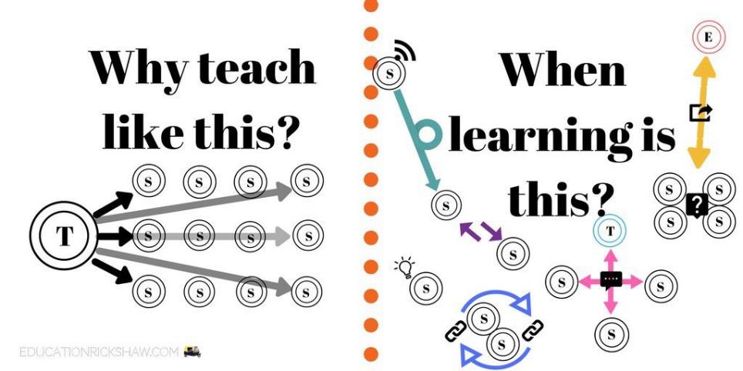
Learning is not linear! Feedback is not unidirectional. But sometimes we pretend that they are! #sketchnote by @SGroshell and @MrZachG #edchat #learning #teachchat

Slide 68
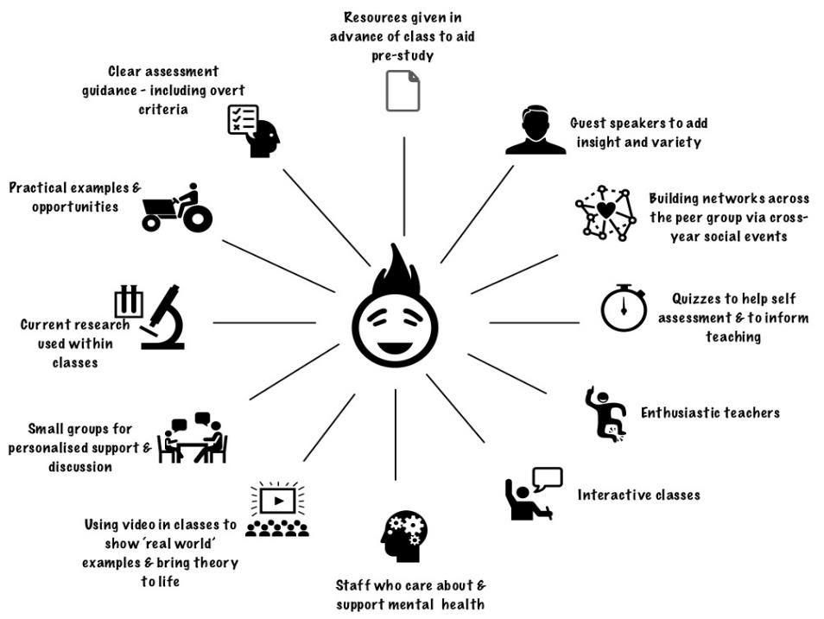
What works?

Slide 69
What’s wrong with feedback?
Students get it too late.
And too often, it’s just words on paper.
It doesn’t help them enough.
They often don’t take enough notice of it.

Slide 70
Fishing for feedback?
Feedback is like fish.
If it is not used quickly, it becomes useless.
(Sally Brown).
Give a man a fish,
Feed him for a day.
Teach a man to fish,
Feed him for a lifetime.
(Maimonides: 1135-1204)
Make feedback timely, while it still matters to students, in time for them to use it towards further learning, or to receive further assistance.
(Graham Gibbs)
And he’ll learn to drink beer in boats
And you won’t see him for weeks!
(Australian proverb).

Slide 71
But what’s really wrong with feedback?
Too often it’s one-way – monologic.
What students want is dialogue.
They want to talk to us about their work.
But they’re scared to talk to us, for various reasons:
  In case it leads to lower marks;
  In case they’re ‘found out’;
  In case they feel stupid.

Slide 72
Royce Sadler on feedback:
Higher education teachers are often frustrated by the modest impact feedback has in improving learning. The status of feedback deserves to be challenged on the grounds that it is essentially about telling. For students to become self-sustaining producers of high quality intellectual and professional goods, they must be equipped to take control of their own learning and performance. (Sadler, 2013)
Sadler, D. R. (2013). Opening up feedback: Teaching learners to see. In Merry, S., Price, M., Carless, D., & Taras, M. (Eds.) Reconceptualising feedback in higher education: Developing dialogue with students. (Ch. 5, 54‑63). London: Routledge.

Slide 73
Dylan Wiliam on feedback (online)
There really is a lot of rot talked about how feedback should and should not be given.
...people forget that the only good feedback is that which is acted upon, which is why the only thing that matters is the relationship between the teacher and the student.
Every teacher knows that the same feedback given to one student will improve that student’s learning but to another student, of similar achievement, will make that student give up. Teachers need to know their students, so that they know when to push, and they know when to back off. ...hardly any studies look at the responses cued in the individual recipient by the feedback.

Slide 74
Damaging feedback...
(From #LTHE digest, available in full on my website)
I got some student evaluation feedback that really stung ... wasn't that long ago either! .
I recall - "could do better" - what's that all about?
''weak'" for art on successive school reports. (Showed sustainability though?)
'don't bother getting up on Monday morning' after a failed assignment by a maths teacher at secondary school
missing out on an A as I read the question slightly wrong
A big red cross through something I'd put some effort into, devastating
I wear my feedback like scars. Some of the wounds still fester.
Being told that I was holding up everyone because I didn't understand maths GCSE lesson
my only consolation was they pulled apart my punctuation and grammar but their feedback was full of typos!
'Kerry has ability to do well when she puts her mind to it' Response, Kerry will put her mind to it when she's not bored to death
The worst feedback I eve received on a sweated-over assignment was 'Fine as far as it goes' Grrrh!

Slide 75
Conclusions
Assessment and feedback can be powerful means of focusing student effort and enhancing achievement if well designed (Biggs and Tang, 2011);
Students in the early stages of their learning journey are likely to need more support and positive feedback than later, when they are more robust and confident;
The first six weeks are crucial in helping students understand how assessment and feedback work;
No single method of giving feedback is likely to be ubiquitously successful, so it’s worth using a variety of approaches;
Assessment needs to be manageable for staff and students if it is going to engage students in learning activities.

Slide 76
How’s your feedback?
(After Nicol and MacFarlane-Dick, 2006)
1. Helps clarify what good performance is (goals, criteria, expected standards);
2. Facilitates the development of self-assessment (reflection) in learning;
3. Delivers high quality information to students about their learning – and how to progress it;
4. Encourages teacher and peer dialogue around learning;
5. Encourages positive motivational beliefs and self-esteem;
6. Provides opportunities to close the gap between current and desired performance;
7. Provides information to teachers that can be used to help shape the teaching.

Slide 77
Five tips for formative feedback
Help students to want feedback.
Stop them concentrating on the mark.
Get the timing right, while students still care about what they’ve done.
Make feedback interesting - not routine or mundane.
Give at least some feedback very quickly.

Slide 78
Back to our intended learning outcomes…
Do you now feel better able to:
2 hands = very much better, one hand = somewhat better, touch left ear = no better...
Reflect on how assessment and feedback link (or don’t link) to the factors underpinning successful student learning?
Support progress and change lives (ours and theirs) by adjusting our assessment and feedback?
Make the time and energy we spend assessing students’ work and getting feedback to them time well spent?
Think of what else we may be able to do to make assessment and feedback fit for purpose in 2018?
Wanting/
Needing
Doing
Making sense
Feedback

Slide 79

Thank you…
Website: http://phil-race.co.uk
Follow Phil on Twitter @RacePhil
e-mail: phil@phil-race.co.uk

Slide 80
Useful references and further reading (1)
Bain, K. (2004) What the best College Teachers do, Cambridge: Harvard University Press.
Biggs, J. and Tang, C. (2011) Teaching for Quality Learning at University, Maidenhead: Open University Press.
Bloxham, S. and Boyd, P. (2007) Developing effective assessment in higher education: a practical guide, Maidenhead, Open University Press.
Boud, D. (1995) Enhancing learning through self-assessment, London: Routledge.
Brown, S. and Glasner, A. (eds.) (1999) Assessment Matters in Higher Education, Choosing and Using Diverse Approaches, Maidenhead: Open University Press.
Brown, S. and Race, P. (2012) Using effective assessment to promote learning in Hunt, L. and Chambers, D. (2012) University Teaching in Focus, Victoria, Australia, Acer Press. P74-91.
Brown, S. (2015) Learning , Teaching and Assessment in Higher Education: Global perspectives, London, Palgrave.

Slide 81
Useful references and further reading (2)
Carless, D., Joughin, G., Ngar-Fun Liu et al (2006) How Assessment supports learning: Learning orientated assessment in action Hong Kong: Hong Kong University Press.
Carroll, J. and Ryan, J. (2005) Teaching International students: improving learning for all. London: Routledge SEDA series.
Crosling, G., Thomas, L. and Heagney, M. (2008) Improving student retention in Higher Education, London and New York: Routledge
Crooks, T. (1988) Assessing student performance, HERDSA Green Guide No 8 HERDSA (reprinted 1994).
Dunworth, K. and Sanchez, H.S., (2016). Perceptions of quality in staff-student written feedback in higher education: a case study. Teaching in Higher Education, 21(5), pp.576-589.
Dweck, C. S. (2000) Self Theories: Their Role in Motivation, Personality and Development, Lillington, NC: Taylor & Francis.
Falchikov, N. (2004) Improving Assessment through Student Involvement: Practical Solutions for Aiding Learning in Higher and Further Education, London: Routledge.
Gibbs, G. (1999) Using assessment strategically to change the way students learn, in Brown S. & Glasner, A. (eds.), Assessment Matters in Higher Education: Choosing and Using Diverse Approaches, Maidenhead: SRHE/Open University Press.
Higher Education Academy (2012) A marked improvement; transforming assessment in higher education, York: HEA.

Slide 82
Useful references and further reading (3)
Hawe, E., Lightfoot, U., & Dixon, H. (2017). First-year students working with exemplars: Promoting self-efficacy, self-monitoring and self-regulation. Journal of Further and Higher Education, 1-15.
Hendry, G. D., White, P., & Herbert, C. (2016). Providing Exemplar-Based “Feedforward” before an Assessment: The Role of Teacher Explanation. Active Learning in Higher Education, 17(2), 99-109.
Hounsell, D., McCune, V., Hounsell, J. and Litjens, J., (2008). The quality of guidance and feedback to students. Higher Education Research & Development, 27(1), pp.55-67.
McDowell, L. and Brown, S. (1998) Assessing students: cheating and plagiarism, Newcastle: Red Guide 10/11 University of Northumbria.
Meyer, J.H.F. and Land, R. (2003) ‘Threshold Concepts and Troublesome Knowledge 1 – Linkages to Ways of Thinking and Practising within the Disciplines’ in C. Rust (ed.) Improving Student Learning – Ten years on. Oxford: OCSLD.
Nicol, D. J. and Macfarlane-Dick, D. (2006) Formative assessment and self-regulated learning: A model and seven principles of good feedback practice, Studies in Higher Education Vol 31(2), 199-218.
PASS project Bradford http://www.pass.brad.ac.uk/ Accessed November 2013.
Peelo, M. T., & Wareham, T. (Eds.). (2002). Failing students in higher education. Society for Research into Higher Education.
Pickford, R. and Brown, S. (2006) Assessing skills and practice, London: Routledge.
Rotheram, B. (2009) Sounds Good, JISC project http://www.jisc.ac.uk/whatwedo/programmes/usersandinnovation/soundsgood.aspx

Slide 83
Useful references and further reading (4)
Race, P. (2001) A Briefing on Self, Peer & Group Assessment, in LTSN Generic Centre Assessment Series No 9, LTSN York.
Race P. (2015) The lecturer’s toolkit (4th edition), London: Routledge.
Rust, C., Price, M. and O’Donovan, B. (2003) Improving students’ learning by developing their understanding of assessment criteria and processes, Assessment and Evaluation in Higher Education. 28 (2), 147-164.
Ryan, J. (2000) A Guide to Teaching International Students, Oxford Centre for Staff and Learning Development.
Scoles, J., Huxham, M., & Mcarthur, J. (2013). No longer exempt from good practice: Using exemplars to close the feedback gap for exams. Assessment & Evaluation in Higher Education, 38(6), 631-645.
Stefani, L. and Carroll, J. (2001) A Briefing on Plagiarism, LTSN
Sadler, D. Royce (2010) Beyond feedback: developing student capability in complex appraisal,
Assessment & Evaluation in Higher Education, 35: 5, 535-550.
Yorke, M. (1999) Leaving Early: Undergraduate Non-completion in Higher Education, London: Routledge.

Slide 84
And now for the extras!
You asked some great questions, thanks.
I’ve appended next the slides I used to address the main two questions.

Slide 85
How to get feedback to a large group of students within 24 hours
There are serious reservations about written feedback, but we can make even this work much better than it did.
The next few slides are about a way of giving students feedback on their work within 24 hours of them doing it.
There are three or more ‘yes, but...’s with this idea, but please hold these for around four minutes.

Slide 86
Set the hand-in time to be at a whole-group session
E.g. next Tuesday’s 10-11 lecture,
Deadline = 1003.
Let them pile up all their work at the front.
At 1003, hand out to everyone a coloured sheet, containing numbered points.
(so you can say in feedback ‘please see point 3, blue sheet’ and so on).

Slide 87
The blue sheet can contain....
  Illustration of what is expected as evidence of achievement of each of the intended learning outcomes
  Likely mistakes
  Features of a good answer
  Frequently needed explanations
  Things you otherwise would have to write time and time again on students’ work.
  Let the students study this for 3 minutes until 1006 – it goes rather quiet!

Slide 88
At 1006...
Go into face-to-face oral mode, until 1009....
Spend a few minutes de-briefing the whole group and talking them through one point on the handout…
…adding tone-of-voice, facial expression, body language, emphasis, and so on to the feedback.

Slide 89
The rationale...
Since most of the students will still have been doing the work in the last 24 hours before handing it in, you’re giving them feedback while they still remember what they were doing.
They know what they didn’t do.
They know what they missed out because they couldn’t understand it.

Slide 90
Now take away their work to mark – in a third of the time it used to take you!
You waste far less writing the same old things on one piece of work after another, regarding frequently occurring mistakes;
Instead, you need just to write ‘please see point 4, blue sheet’ (which takes seconds).
You can now make your comments relate more to each individual piece of work;
This means when students get their marked work back with feedback, they are more likely to use it, as it’s personal to them.

Slide 91
Furthermore...
When they get their marked work back, they’ve already had the chance to make sense of their own piece of work in the light of the generic feedback you gave them when they handed it in, and the additional oral ‘deepening’ of one important point.

Slide 92
Set
hand-in deadline to be at lecture
Prepare ‘blue sheet’ with anticipated
generic feedback
Summary: providing feedback within 24 hours
Collect students’ work at start of lecture
Take away work to mark in a third of the time
Hand out ‘blue sheet’
Talk class through one important point, then resume lecture
Let students read blue sheet for short while

Slide 93
Feedback without marks
Marks often destroy the value of our feedback to students!

Slide 94
Feedback versus marks or grades
Feedback may be eclipsed by marks or grades.
Students may be blinded by the mark or grade, and not even try to make sense of the feedback they receive.

Slide 95
Just a mark (or grade) is the least effective form of feedback!
It’s what students look at first.
If the mark is good, they smile and file – quite often they don’t even read the feedback.
If it’s low, they frown and bin it – very often without reading the feedback.

Slide 96
But there are ways round this...
Give students back their work with feedback but with no marks or grades (keeping your record of their marks).
Ask them to work out their marks from the feedback you have given them (and from the feedback you gave to others too).

Slide 97
Suggest that their marks will count!
Tell them that if their self-assessment scores are within (say) 5% of your own scores, the higher number will go forward into their assessment record.
But explain that you will talk individually to those students whose score is different by more than 5% from yours.

Slide 98
Get them to self-assess...
Collect their scores or grades – e.g. pass a sheet round in a lecture.
Most students (e.g. 9 in 10) will be within the 5%.
Arrange to talk to those where the difference is more than 5% or one grade.

Slide 99
Students who under-estimate their grade…
These students often need their esteem boosted.
Remind them about the assessment criteria, and how these illustrate the intended standards associated with the learning outcomes.
Check that they weren’t just trying not to be seen as over-confident.

Slide 100
Students who over-estimate their grade…
This usually indicates they’ve got a blind spot.
Talk them through their work, and find out exactly where they’ve lost marks which they thought they had gained.
Check with them that they can now see what was being looked for.

Slide 101
Thank you…
Website: http://phil-race.co.uk
Follow Phil on Twitter @RacePhil
e-mail: phil@phil-race.co.uk

