Slide 1
Go forth and elsify! (What else can we do with feedback, teaching and assessment to make learning happen better?)
7th June, 2018
Solstice Conference, Edge Hill University
Phil Race
(from Newcastle-upon-Tyne)
BSc PhD PGCE FCIPD PFHEA NTF
Follow Phil on Twitter: @RacePhil
Visiting Professor: University of Plymouth and Edge Hill University
Emeritus Professor, Leeds Beckett University

Slide 2
This slide has two purposes….
To focus the data projector, if necessary, and…
...to persuade colleagues never to put this sort of detail onto a slide!

Slide 3
About Phil…
First a musician
Then a writer
Then a scientist
Then a researcher
Then a lecturer and warden at what is now USW
Got interested in how students learn
And the effects assessment and feedback have on them
And how we teach them
Gradually became an educational developer
And now ‘retired’!?
Currently…
Visiting Prof: Plymouth & Edge Hill
Emeritus Prof: Leeds Beckett
Based at Newcastle, UK
And on trains
And an expert…
on train routes and timetables!
Notes:
2
2

Slide 4
Were any of you here with me on 24th April?
This session isn’t about me telling you all about stuff – it’s about you (and I) thinking creatively about what else we can do.
[Slides from then are here: http://phil-race.co.uk/2018/04/edge-hill-university-24th-april/ ]
I’d like this session to be a signpost for the rest of this great conference, helping us all to look out for what else we can do in our work with students.
There will be post-its, Tweets and plenty of talking to each other.

Slide 5
Thought for the day: Einstein
It is simply madness,
to keep doing the same things,
and expect different results.

Slide 6
The agenda
At several previous Solstice conferences, I played with ideas about factors underpinning successful learning, reinventing assessment, making feedback work and many such things. In this session, we’re going to be creative, pathfinding, innovative and have fun – all the hallmarks of Solstice conferences.
What we’ll try to do, is to think of ‘else’ things – other things we can try to enhance students’ learning experiences – and indeed to make our own work happier, more efficient and effective – and more fun.

Slide 7
Students as partners…
Students are partners in learning.
They always have been.
We can’t ‘learn them’!
We haven’t always made it an optimal partnership.
We can.
I could not do what I do nowadays if I did not continue to spend a fair bit of my time working with students – they’ve taught me most of what I know.

Slide 8
Rationale
We spend a great deal of our energy and time trying to teach students, assessing their work, and giving them feedback.
Too much time?
Is our assessment valid, reliable, authentic, and manageable?
Is the time we spend actually well-spent?
Is the feedback really used, or is much of it ignored, or even not read?
What else is wrong? What else can we do?

Slide 9
What’s wrong? Seven challenges as I see them….
Handwritten exams – 18th century stuff still in 2018! (Cambridge, 1791).
Essays – good for feedback, but we can’t grade them (and whodunit?).
Lectures: did they ever work for learning? (Large group learning is great of course).
‘Knowledge transfer’: delivery: can’t ‘deliver’ learning – can only deliver info.
Written feedback: is it used by students? Does it work?
‘Telling’: does this ever work?
‘Capture’: ‘I’ve got it, but I haven’t got it’.
What else can we do?

Slide 10
David Carless (on Twitter): (last week)
Feedback as telling is seriously overrated!

Slide 11
Learning, feedback and assessment:
the ten most important words
Why?
What?
Who?
Where?
When?
How?
Which?
So what?
wtf?
Wow?
And the most powerful four-letter word in the English language...
????

Slide 12
‘what’ is getting ever less important
Columbia University research published recently (2011) in Science magazine shows that people are much less prepared to remember ‘what’, but better at remembering where to access information, and how to do so.
Betsy Sparrow, one of the principal researchers, concludes that the internet has become ‘an external memory source that we can access at any time. ... Just as we learn through transactive memory who knows what in our families and offices, we are learning what the computer ‘knows’ and when we should attend to where we have stored information in our computer-based memories. We are becoming symbiotic with our computer tools.
Published Online July 14 2011 < Science Express Index Science DOI: 10.1126/science.1207745
Report: Google Effects on Memory: Cognitive Consequences of Having Information at Our Fingertips Betsy Sparrow,*, Jenny Liu, Daniel M. Wegner

Slide 13
Learning, feedback and assessment:
the ten most important words
Why? (rationale)
What? (content)
Who? (people, you, me, them)
Where? (locations)
When? (times)
How? (processes)
Which? (decisions)
So what? (importance?)
Wow? (impact?)
And the most powerful four-letter word in the English language...
????

Slide 14
Learning, feedback and assessment: the ten most important words
Why? (rationale)
What? (content)
Who? (people, you, me, them)
Where? (locations)
When? (times)
How? (processes)
Which? (decisions)
So what? (importance?)
Wow? (impact?)
And the most powerful four-letter word in the English language...
else

Slide 15
Go forth and
elsify!

Slide 16
Teaching, learning and enthusiasm
Knowledge isn’t infectious (unfortunately) but enthusiasm is, and we need to help our students to catch enthusiasm.
We certainly don’t want teaching, assessment or feedback to damage that enthusiasm.

Slide 17
Intended learning outcomes
After participating in this session, you should be better-able to:
Reflect on how our attempts at teaching, assessment and feedback link (or don’t link) to the factors underpinning successful student learning;
Think of what else we may be able to do to make teaching, assessment and feedback fit for purpose.

Slide 18
You will be able to download my main slides
You don’t need to take notes.
I’ll put the main slides I use up on my website later today (http://phil-race.co.uk/)
I may sometimes go through slides quite fast, but you can study them as you wish at your leisure.

Slide 19
Announcement about mobile phones and laptops...
Good morning everyone – please turn on your ‘phones, tablets and computers.
Please post your thoughts, questions, comments and ideas during this session to the hashtag #philatsolstice18. (The overall hashtag for the conference is #Solstice2018). Thanks!
Try #LTHEchat on Wednesday evenings from 20.00-21.00.

Slide 20
Freebies when you get bored!
http://phil-race.co.uk/2016/04/updated-powerpoint-ripples-model/ (Chapter 1 from ‘The Lecturer’s Toolkit, 2015)
https://phil-race.co.uk/2016/10/lthe-tweetchat-lthechat-wed-oct-19-8-00-9-00-pm/ (feedback stuff from my most recent two books)
https://phil-race.co.uk/2018/02/feedback-feedforward-just-tips-including-students/ (just the feedback tips!)
http://phil-race.co.uk/2015/01/assessment-bits-new-editions/ (extracts on assessment)

Slide 21
Time-constrained Post-it exercise
On a post-it, in your best handwriting, please write your own completion of the starter:
“What I’d most like to take away from this session is….”
Please swap post-its so that you’ve no idea who has yours.
If chosen, please read out with passion and drama the post-it you now have.
Please place them all on the chart as directed.
(That’s a kind of measure of your ‘learning incomes’)

Slide 22
How students really learn
Seven factors underpinning successful learning based on asking everyone about their learning in the last 30 years!

Slide 23
How Students Really Learn ‘Ripples’ model of learning
Phil Race

Slide 24
Unless we do something else…
“[The] pupils got it all by heart; and, when Examination-time came, they wrote it down; and the Examiner said ‘Beautiful! What depth!’
They became teachers in their turn, and they said all these things over again; and their pupils wrote it down, and the examiner accepted it; and nobody had the ghost of an idea what it meant” Lewis Carroll, 1893
Active
Experimentation
Abstract
Conceptualisation
Concrete
Experience
Reflective
Observation

Slide 25
What’s missing in this old cycle?
Engagement?
Feelings?
Active
Experimentation
Inspiration?
Judgments?
Desire?
Abstract
Conceptualisation
Concrete
Experience
Communication?
Enthusiasm?
Reflective
Observation

Slide 26
But what about learning styles?
https://www.theguardian.com/education/2017/mar/12/no-evidence-to-back-idea-of-learning-styles?CMP=share_btn_tw
(Link from my Tweet on March 13th 2017 to a letter in the Guardian by prominent folk around the world of education)
Or link to a word document: https://phil-race.co.uk/2017/09/swansea-university-school-management-21st-September/
“No evidence to back idea of learning styles”

Slide 28
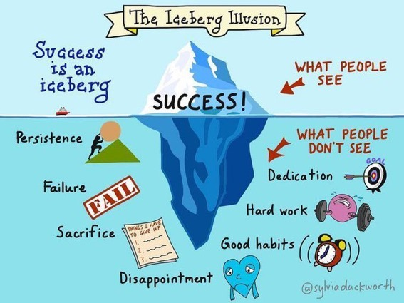

Slide 29
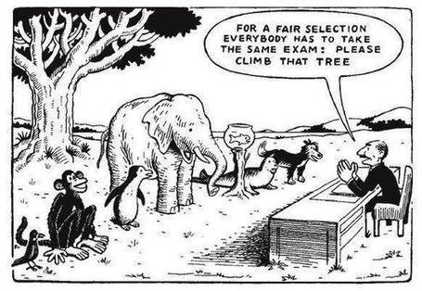

Slide 30
What wavelength should I teach on?
The only one that works is WIIFM
What’s in it for me?
Consciously address the ‘so what’ in learners’ minds;
Warm up their ‘want’ to learn.
Clarify their ‘need’ to learn.
Learners learn far more readily if they are continuously aware of the benefits for them of putting energy into their learning.

Slide 31
Ripples on a pond….
Enhance our students’ want to learn?
Help students to develop ownership of the need to learn?
Keep students learning by doing, practice, trial-and-error, repetition?
Ensure students really use feedback – from us and from each other?
Help students to make sense of what they learn?
Get students deepening their learning by verbalising, explaining things to each other, and to us?
Allow students to deepen their learning by assessing their own learning, and assessing others’ learning – making informed judgements?
What else can we do to use
teaching, assessment and feedback to:
Verbalising
Assessing
making informed judgements
Wanting/
Needing
Doing
Doing
Making sense
Feedback

Slide 32
What’s wrong
with
this?
Verbalising
Assessing
Feedback
Making sense
Doing
Wanting/
Needing

Slide 33
Thanks, Dr Paul Kleiman

Slide 34
Drives most learning
Is assessment broken?
Some
assessment
issues
What students think
Assessment as learning
Validity
Whodunit?
Fairness

Slide 35
Feed-forward
Language of feedback
Some feedback
issues
National Student Survey
Timing:
24-hours!
Written, printed,
on-screen
Efficiency
Face to face
oral

Slide 36
Learning is not linear! Feedback is not unidirectional. But sometimes we pretend that they are! #sketchnote by @SGroshell and @MrZachG #edchat #learning #teachchat

Slide 37
Constructive Alignment: John Biggs
What will I be expected to show for this?
What does a good one look like, and a bad one?
Where does this fit into the big picture?
When explaining assessment criteria to students, and when linking these to evidence of achievement of the intended learning outcomes, we need to make the most of face-to-face whole group contexts and...
Tone of voice
Body language
Facial expression
Eye contact
The chance to repeat things
The chance to respond to puzzled looks
Some things don’t work nearly so well just on paper or on screens.
Some of the
tools we can
use in
face-to-face
contexts

Slide 38
Beyond the tyranny of intended learning outcomes?
At the November SEDA conference, I’m planning to run a session along these lines:
What about our learning aspirations?
What about their learning aspirations?
What about their learning incomes?
What about their learning outputs?
What about their emergent learning outcomes?
What about our intended learning outgoings?

Slide 39
Creative post-it exercise
Write your name clearly on the wrong side of a post-it.
Think of else things we can do.
Write down an idea (on the front of the post-it), ready for someone else to read it out…
(and for me to add to these slides during the conference, with your name);
There was not time to complete this, so please continue to give me your post-its, or Tweet them to #philatsolstice18, and I’ll edit them into a separate file at the weekend. Thanks.

Slide 40
Back to our intended learning outcomes…
Do you now feel better able to:
2 hands = very much better,
one hand = somewhat better,
touch left ear = no better...
Reflect on how our attempts at teaching, assessment and feedback link (or don’t link) to the factors underpinning successful student learning?
Think of what else we may be able to do to make teaching, assessment and feedback fit for purpose?
Wanting/
Needing
Doing
Making sense
Feedback

Slide 41
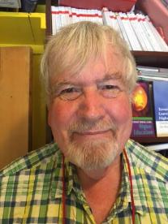
Thank you…
Keep looking out
for ‘else’ during this
Conference
Website: http://phil-race.co.uk
Follow Phil on Twitter @RacePhil
e-mail: phil@phil-race.co.uk

