Slide 1
Activating Learning Bringing assessment and feedback to life for today’s students University of Lincoln
21st June, 2018
Phil Race
(from Newcastle-upon-Tyne)
BSc PhD PGCE FCIPD PFHEA NTF
Follow Phil on Twitter: @RacePhil
Visiting Professor: University of Plymouth and Edge Hill University
Emeritus Professor, Leeds Beckett University

Slide 2
This slide has two purposes….
To focus the data projector, if necessary, and…
...to persuade colleagues never to put this sort of detail onto a slide!

Slide 3
About Phil…
First a musician
Then a writer
Then a scientist
Then a researcher
Then a lecturer and warden at what is now USW
Got interested in how students learn
And the effects assessment and feedback have on them
And how we teach them
Gradually became an educational developer
And now ‘retired’!?
Currently…
Visiting Prof: Plymouth & Edge Hill
Emeritus Prof: Leeds Beckett
Based at Newcastle, UK
And on trains
And an expert…
on train routes and timetables!
Notes:
2
2

Slide 4
Good to be back in Lincoln
Were any of you with me when I ran workshops on ‘Smarter Lectures’ and on ‘Smarter Feedback’ on 16th September 2013?

Slide 5
Students as partners…
Students are partners in learning.
They always have been.
We can’t ‘learn them’!
We haven’t always made it an optimal partnership.
We can.
I could not do what I do nowadays if I did not continue to spend a fair bit of my time working with students – they’ve taught me most of what I know.

Slide 6
Announcement about mobile phones and laptops...
Good afternoon everyone – please turn on your ‘phones and computers.
Please post your thoughts, comments and ideas during this session to the hashtag #philatlincoln18 Thanks!
Try #LTHEchat on Wednesday evenings from 20.00-21.00.

Slide 7
You will be able to download my main slides
You don’t need to take notes.
I’ll put the main slides I use up on my website later today (http://phil-race.co.uk/)
I won’t post pictures and video-clips, as this would make the file-size too large.
I may sometimes go through slides quite fast, but you can study them as you wish at your leisure.

Slide 8
Thought for the day: Einstein
It is simply madness,
to keep doing the same things,
and expect different results.

Slide 9
What’s wrong in 2018? 7 challenges as I see them...
Handwritten exams – 18th century stuff still in 2018! (Cambridge, 1791).
Essays – good for feedback, but we can’t grade them (and we don’t know for certain ‘whodunit?’).
Lectures: did they ever work for learning? (Large group learning is great of course).
‘Knowledge transfer’: delivery: can’t ‘deliver’ learning – we can only deliver info.
Written feedback: is it used by students? Does is take us ages to compose? Does it work?
‘Telling’: does this ever work?
‘Capture’: ‘I’ve got it, but I haven’t got it’.
8 Metrics! If we can measure
it, it probably isn’t what we
were hoping to get!

Slide 11
Today: Too many firsts?
BBC News: Too many firsts risk universities' credibility, says think tank”
https://www.bbc.co.uk/news/education-44548322
#toomanyfirsts

Slide 12
David Carless (on Twitter):
Feedback as telling is seriously overrated!

Slide 13
The most important part of our work
Assessing students’ work, and providing them with feedback is an ever-increasing proportion of the work of teaching staff in universities nowadays, but remains the most important side of our work.
A problem is that we sometimes try to soldier-on using the tools of the last century, hence the need to innovate, and make assessment and feedback fit for purpose in the 21st century.

Slide 14
What’s really wrong – and what can we do about it?
This interactive presentation will look critically at some of the flaws of traditional assessment and feedback practices, and point towards innovations which can bridge the gap between student learning and assessment practice, including developing students’ own skills to self-assess their work as they do it.

Slide 15
Intended learning outcomes?
By the end of this presentation, you should be better-able to:
Think how assessment and feedback can be made for learning, not just about learning.
Worry a little more about the risks of continuing to do some of the things which we know don’t really work!

Slide 16
Beyond the tyranny of intended learning outcomes?
At the November SEDA conference, I’m planning to run a session along these lines:
What about our learning aspirations?
What about their learning aspirations?
What about their learning incomes?
What about their learning outputs?
What about their emergent learning outcomes?
What about our intended learning outgoings?

Slide 17
Download anytime Phil’s materials on feedback, assessment, learning and lecturing
Expanded discussion of how the factors underpinning learning link to feedback, assessment and large-group teaching:
http://phil-race.co.uk/2016/04/updated-powerpoint-ripples-model/ (Chapter 1 from ‘The Lecturer’s Toolkit, 2015)
https://phil-race.co.uk/2016/10/lthe-tweetchat-lthechat-wed-oct-19-8-00-9-00-pm/ (feedback stuff from my most recent two books)
http://phil-race.co.uk/2015/01/assessment-bits-new-editions/ (extracts on assessment)
http://phil-race.co.uk/2017/05/lectures-and-learning/ (extracts on lecturing)

Slide 18
Teaching, learning and enthusiasm
Knowledge isn’t infectious (unfortunately) but enthusiasm is, and we need to help our students to catch enthusiasm.
We certainly don’t want teaching, assessment or feedback to damage that enthusiasm.

Slide 19
Time-constrained assessed written Post-it exercise
On a post-it, in your best handwriting, please write your own completion of the starter:
“Bringing assessment and feedback to life for my students nowadays would be much better for me if only I …”
Please swap post-its so that you’ve no idea who has yours.
If chosen, please read out with passion and drama what’s on the post-it you now have.
Please place them all as directed.

Slide 20
Now is the decade of Universities’ dis-content!
Never mind the content – feel the learning

Slide 21
Teaching in modern institutions is moving away from providing subject content, (where everything was about ‘delivery’), towards foregrounding two major functions:
Recognising and accrediting students’ achievement, wherever learning has taken place (i.e. getting the assessment right);
Supporting student learning and engagement (not least by making feedback work well for students).

Slide 22
My main worries about assessment...
Too often, we still tend to try to measure...
...what’s in students’ heads, and what they can do with what’s there...
in terms of two unsatisfactory proxies ...
what comes out of students’ pens in exams;
2. what comes out of their keyboards in essays and reports.

Slide 23
Learning, feedback and assessment:
the ten most important words
Why?
What?
Who?
Where?
When?
How?
Which?
So what?
wtf?
Wow?
And the most powerful four-letter word in the English language...
????

Slide 24
Learning, feedback and assessment: the ten most important words
Why? (rationale)
What? (content)
Who? (people, you, me, them)
Where? (locations)
When? (times)
How? (processes)
Which? (decisions)
So what? (importance?)
Wow? (impact?)
And the most powerful four-letter word in the English language...
else

Slide 25
Go forth and
elsify!

Slide 26
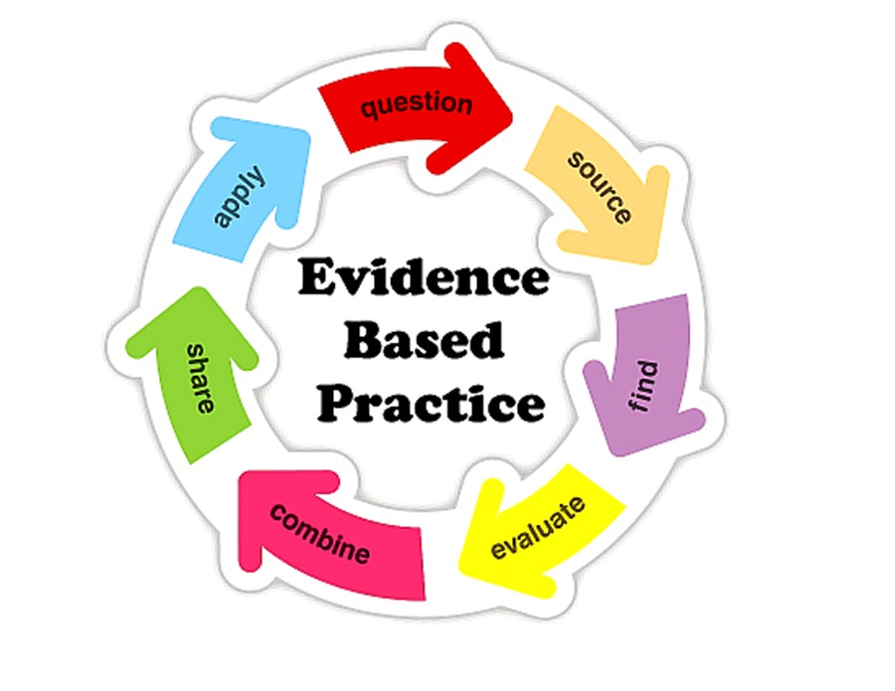

Slide 27
Evidence-based practice: what kinds of evidence do students need?
Examples of good, bad and indifferent work, so they can see what they’re trying to do, and surpass the good examples.
Examples of feedback (feed-forward) on mixed examples of work, so they can fine-tune their approaches.
Examples of assessment criteria they can apply to given examples of work (and indeed their own work) so they can see where they’re at in their learning.
Rehearsal opportunities for new assessment formats, so they can fine-tune their approaches.

Slide 28
The NSS Assessment and Feedback Agenda (2005-16)
The criteria used in marking have been clear in advance.
Assessment arrangements and marking have been fair.
Feedback on my work has been prompt.
I have received detailed comments on my work.
Feedback on my work has helped me to clarify things I did not understand.

Slide 29
The new NSS statements (2017)
Assessment and feedback
The criteria used in marking have been clear in advance
Marking and assessment have been fair
Feedback on my work has been timely
I have received helpful comments on my work
Student voice
I have had the right opportunities to provide feedback on my course
Staff value students’ views and opinions about the course
It is clear how students’ feedback on the course has been acted on

Slide 30
Feed-forward
Language of feedback
Some feedback
issues
National Student Survey
Timing:
24-hours!
Written, printed,
on-screen
Efficiency
Face to face
oral

Slide 31
Task: think about ghastly feedback
Think back to some occasions, academic or otherwise, historic or recent when you received feedback that you would rather not have received;
How did it make you feel?
Thinking of a single example of ghastly feedback that you are prepared to share with another person, briefly outline the context and say why it was such a negative experience.

Slide 32
Would this feedback help or hinder?
NO REALISATION OF THE NEW REALISM OR PARTNERSHIP WITHIN THE COMPANY.
LITTLE THEORY.
NO CLEAR UNDERSTANDING OF THE ISSUES.
NOT FOCUSED.

Slide 33
Feedback needs to have a future focus
Hounsell et al argue that we need to:
‘increase the value of feedback to the students by focusing comments not only on the past and present … but also on the future – what the student might aim to do, or do differently in the next assignment or assessment if they are to continue to do well or to do better’
(Hounsell, McCune, Hounsell and Litjens 2008, p.5).

Slide 34
Suggestions from Hong Kong

Slide 35
Quality feedback: 3 functions
“There is wide consensus within the education literature that ‘quality’ feedback should serve three overlapping functions:
an ‘orientational’ purpose that clarifies the student’s performance and achievement;
a ‘transformational’ purpose that enables the student to reflect, improve their performance, and become more autonomous (often termed ‘feed-forward); and
an ‘affective/interpersonal’ dimension that gives the student confidence and motivation, and builds a strong teacher-student relationship”
(Dunworth & Sanchez, 2016, quoted by Winstone and Nash, 2016).

Slide 36
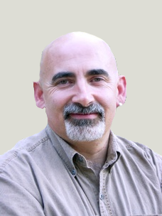
Dylan Wiliam on feedback
There really is a lot of rot talked about how feedback should and should not be given.
...people forget that the only good feedback is that which is acted upon, which is why the only thing that matters is the relationship between the teacher and the student.

Slide 37
Damaging feedback...
(From #LTHE digest, available in full on my website)
I got some student evaluation feedback that really stung ... wasn't that long ago either! .
I recall - "could do better" - what's that all about?
''weak'" for art on successive school reports. (Showed sustainability though?)
'don't bother getting up on Monday morning' after a failed assignment by a maths teacher at secondary school
missing out on an A as I read the question slightly wrong
A big red cross through something I'd put some effort into, devastating
I wear my feedback like scars. Some of the wounds still fester.
Being told that I was holding up everyone because I didn't understand maths GCSE lesson
my only consolation was they pulled apart my punctuation and grammar but their feedback was full of typos!
'Kerry has ability to do well when she puts her mind to it' Response, Kerry will put her mind to it when she's not bored to death
The worst feedback I eve received on a sweated-over assignment was 'Fine as far as it goes' Grrrh!

Slide 38
Fishing for feedback?
Feedback is like fish.
If it is not used quickly, it becomes useless.
(Sally Brown).
Give a man a fish,
Feed him for a day.
Teach a man to fish,
Feed him for a lifetime.
(Maimonides: 1135-1204)
Make feedback timely, while it still matters to students, in time for them to use it towards further learning, or to receive further assistance.
(Graham Gibbs)
And he’ll learn to drink beer in boats
And you won’t see him for weeks!
(Australian proverb).

Slide 40
Drives most learning
Is assessment broken?
Some
assessment
issues
What students think
Assessment as learning
Validity
Whodunit?
Fairness

Slide 41
The read-write industry

Slide 42
In the exam room you’re on your own

Slide 43
Boud et al 2010: ‘Assessment 2020’
Assessment has most effect when...:
It is used to engage students in learning that is productive.
Feedback is used to actively improve student learning.
Students and teachers become responsible partners in learning and assessment.
Students are inducted into the assessment practices and cultures of higher education.
Assessment for learning is placed at the centre of subject and program design.
Assessment for learning is a focus for staff and institutional development.
Assessment provides inclusive and trustworthy representation of student achievement.

Slide 44
Boud et al, 2010
David Boud (University of Technology, Sydney), Royce Sadler (Griffith University), Gordon Joughin (University of Wollongong), Richard James (University of Melbourne), Mark Freeman (University of Sydney), Sally Kift (Queensland University of Technology), Filip Dochy (University of Leuven), Dai Hounsell (University of Edinburgh), Margaret Price (Oxford Brookes University), Tom Angelo (La Trobe University), Angela Brew (Macquarie University), Ian Cameron (University of Queensland), Denise Chalmers (University of Western Australia), Paul Hager (University of Technology, Sydney), Kerri-Lee Harris (University of Melbourne), Claire Hughes (University of Queensland), Peter Hutchings (Australian Learning and Teaching Council), Kerri-Lee Krause (Griffith University), Duncan Nulty (Griffith University), Ron Oliver (Edith Cowan University), Jon Yorke (Curtin University), Iouri Belski (RMIT University), Ben Bradley (Charles Sturt University), Simone Buzwell (Swinburne University of Technology), Stuart Campbell (University of Western Sydney), Philip Candy (University of Southern Queensland), Peter Cherry (Central Queensland University), Rick Cummings (Murdoch University), Anne Cummins (Australian Catholic University), Elizabeth Deane (Australian National University), Marcia Devlin (Deakin University), Christine Ewan (Australian Learning and Teaching Council), Paul Gadek (James Cook University), Susan Hamilton (University of Queensland), Margaret Hicks (University of South Australia), Marnie Hughes-Warrington (Monash University), Gail Huon (University of Newcastle), Margot Kearns (University of Notre Dame, Sydney), Don Maconachie (University of the Sunshine Coast), Vi McLean (Queensland University of Technology,) Raoul Mortley (Bond University), Kylie O’Brien (Victoria University), Gary O’Donovan (University of Tasmania), Beverley Oliver (Curtin University), Simon Pyke (University of Adelaide), Heather Smigiel (Flinders University), Janet Taylor (Southern Cross University), Keith Trigwell (University of Sydney), Neil Trivett (University of Ballarat), Graham Webb (University of New England).

Slide 45
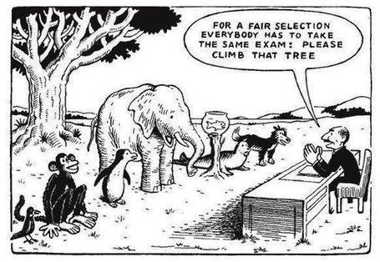

Slide 46
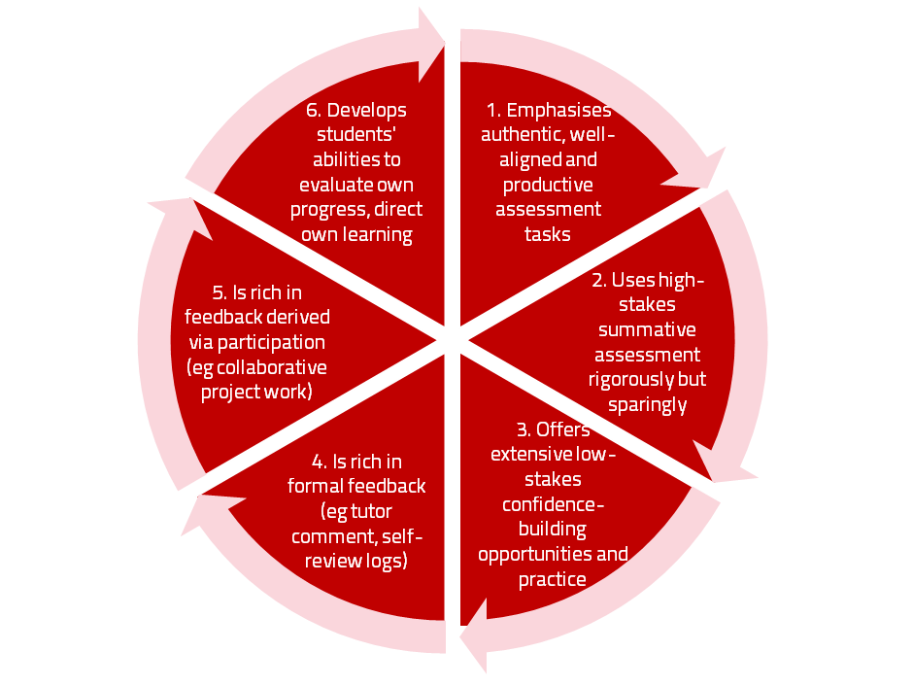
A4L the Northumbria model

Slide 47
Use link below to download the new materials on feedback and assessment produced in 2017 by Kay Sambell, Sally Brown and Phil Race for Edinburgh Napier University
http://staff.napier.ac.uk/services/dlte/ENhance/Pages/ENhanceQuickGuides.aspx

Slide 48
Five main problems with assessed essays
They take a great deal of time to mark, let alone the time it takes for students to prepare, draft and compose them.
When most assessment is in the form of essays, students’ skills at essay-writing are repeatedly tested, as the expense sometimes of their understanding of the subject.
Lots of research shows that we’re not at all good at marking essays fairly – different assessors often give the same essay very different marks.
Essay marks in the UK tend to lie between 35% for a poor one and 75% for a very good one, whereas in many other disciplines the marks for an assignment like a lab report can range across the whole 0-100% span more evenly.
With coursework essays, there can be doubt about ‘whodunit?’!

Slide 49
How students really learn
Seven factors underpinning successful learning based on asking lots of people about their learning in the last 30 years

Slide 50
How Students Really Learn ‘Ripples’ model of learning
Phil Race

Slide 52
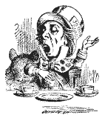
Unless we do something else…
“[The] pupils got it all by heart; and, when Examination-time came, they wrote it down; and the Examiner said ‘Beautiful! What depth!’
They became teachers in their turn, and they said all these things over again; and their pupils wrote it down, and the examiner accepted it; and nobody had the ghost of an idea what it meant” Lewis Carroll, 1893
Active
Experimentation
Abstract
Conceptualisation
Concrete
Experience
Reflective
Observation

Slide 53
What’s missing in this old cycle?
Engagement?
Feelings?
Active
Experimentation
Inspiration?
Judgments?
Desire?
Abstract
Conceptualisation
Concrete
Experience
Communication?
Enthusiasm?
Reflective
Observation

Slide 54
But what about learning styles?
https://www.theguardian.com/education/2017/mar/12/no-evidence-to-back-idea-of-learning-styles?CMP=share_btn_tw
(Link from my Tweet on March 13th 2017 to a letter in the Guardian by prominent folk around the world of education)
Or link to a word document: https://phil-race.co.uk/2017/09/swansea-university-school-management-21st-September/
“No evidence to back idea of learning styles”

Slide 55
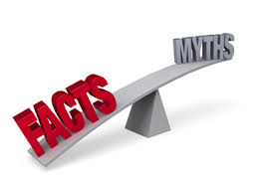

Slide 56
What’s wrong
with
this?
Verbalising
Assessing
Feedback
Making sense
Doing
Wanting/
Needing

Slide 57
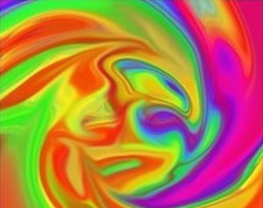
Thanks, Dr Paul Kleiman

Slide 58
Ripples on a pond….
Concerns about traditional exams
Coaching,
explaining, teaching
Assessing
making informed judgements
They don’t do much to increase the ‘want’ to learn.
They are not ideal occasions for learning-by-doing.
The amount of feedback that students receive is not optimal.
They don’t do much to help students to make sense of what they have learned.
Wanting/
Needing
Doing
Doing
Making sense
Feedback

Slide 59
Concerns about traditional exams
We mark them in a rush.
We’re often tired and stressed when we mark them.
We’re not good at marking them objectively.
They favour candidates who happen to be skilled at taking exams.
They force students into surface learning, and into rapidly clearing their minds of previous knowledge when preparing for the next exam.
There are many important things which they don’t measure.

Slide 60
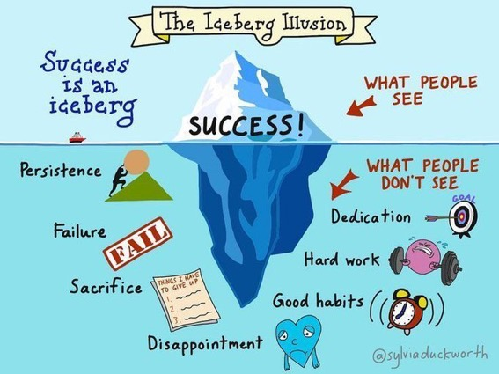

Slide 61
Which wavelength should I teach on?
The only one that works for today’s students is WIIFM
What’s in it for me?
Consciously address the ‘so what’ in students’ minds;
Warm up their ‘want’ to learn.
Clarify their ‘need’ to learn.
They learn far more readily if they are continuously aware of the benefits for them of putting energy into their learning.

Slide 62
Ripples on a pond….
Enhance our students’ want to learn?
Help students to develop ownership of the need to learn?
Keep students learning by doing, practice, trial-and-error, repetition?
Ensure students really use feedback – from us and from each other?
Help students to make sense of what they learn?
Get students deepening their learning by verbalising, explaining things to each other, and to us?
Allow students to deepen their learning by assessing their own learning, and assessing others’ learning – making informed judgements?
What else can we do to use
teaching, assessment and feedback to:
Verbalising
Assessing
making informed judgements
Wanting/
Needing
Doing
Doing
Making sense
Feedback

Slide 63
Constructive Alignment: John Biggs
What will I be expected to show for this?
What does a good one look like, and a bad one?
Where does this fit into the big picture?
When explaining assessment criteria to students, and when linking these to evidence of achievement of the intended learning outcomes, we need to make the most of face-to-face whole group contexts and...
Tone of voice
Body language
Facial expression
Eye contact
The chance to repeat things
The chance to respond to puzzled looks
Some things don’t work nearly so well just on paper or on screens.
Some of the
tools we can
use in
face-to-face
contexts

Slide 64
Action plan: what else are you going to do?
Jot down three things you’re going to try, to bring assessment and feedback to life for your students.

Slide 65
Back to our intended learning outcomes…
Do you now feel better able to:
2 hands = very much better,
one hand = somewhat better,
touch left ear = no better...
Think how assessment and feedback can be made for learning, not just about learning?
Worry a little more about the risks of continuing to do some of the things which we know don’t really work?
Wanting/
Needing
Doing
Making sense
Feedback

Slide 66
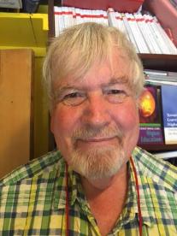
Thank you…
Website: http://phil-race.co.uk
Follow Phil on Twitter @RacePhil
e-mail: phil@phil-race.co.uk

Slide 67
Useful references and further reading (1)
Bain, K. (2004) What the best College Teachers do, Cambridge: Harvard University Press.
Biggs, J. and Tang, C. (2011) Teaching for Quality Learning at University, Maidenhead: Open University Press.
Bloxham, S. and Boyd, P. (2007) Developing effective assessment in higher education: a practical guide, Maidenhead, Open University Press.
Boud, D. (1995) Enhancing learning through self-assessment, London: Routledge.
Brown, S. and Glasner, A. (eds.) (1999) Assessment Matters in Higher Education, Choosing and Using Diverse Approaches, Maidenhead: Open University Press.
Brown, S. and Race, P. (2012) Using effective assessment to promote learning in Hunt, L. and Chambers, D. (2012) University Teaching in Focus, Victoria, Australia, Acer Press. P74-91.
Brown, S. (2015) Learning , Teaching and Assessment in Higher Education: Global perspectives, London, Palgrave.

Slide 68
Useful references and further reading (2)
Carless, D., Joughin, G., Ngar-Fun Liu et al (2006) How Assessment supports learning: Learning orientated assessment in action Hong Kong: Hong Kong University Press.
Carroll, J. and Ryan, J. (2005) Teaching International students: improving learning for all. London: Routledge SEDA series.
Crosling, G., Thomas, L. and Heagney, M. (2008) Improving student retention in Higher Education, London and New York: Routledge
Crooks, T. (1988) Assessing student performance, HERDSA Green Guide No 8 HERDSA (reprinted 1994).
Dunworth, K. and Sanchez, H.S., (2016). Perceptions of quality in staff-student written feedback in higher education: a case study. Teaching in Higher Education, 21(5), pp.576-589.
Dweck, C. S. (2000) Self Theories: Their Role in Motivation, Personality and Development, Lillington, NC: Taylor & Francis.
Falchikov, N. (2004) Improving Assessment through Student Involvement: Practical Solutions for Aiding Learning in Higher and Further Education, London: Routledge.
Gibbs, G. (1999) Using assessment strategically to change the way students learn, in Brown S. & Glasner, A. (eds.), Assessment Matters in Higher Education: Choosing and Using Diverse Approaches, Maidenhead: SRHE/Open University Press.
Higher Education Academy (2012) A marked improvement; transforming assessment in higher education, York: HEA.

Slide 69
Useful references and further reading (3)
Hawe, E., Lightfoot, U., & Dixon, H. (2017). First-year students working with exemplars: Promoting self-efficacy, self-monitoring and self-regulation. Journal of Further and Higher Education, 1-15.
Hendry, G. D., White, P., & Herbert, C. (2016). Providing Exemplar-Based “Feedforward” before an Assessment: The Role of Teacher Explanation. Active Learning in Higher Education, 17(2), 99-109.
Hounsell, D., McCune, V., Hounsell, J. and Litjens, J., (2008). The quality of guidance and feedback to students. Higher Education Research & Development, 27(1), pp.55-67.
McDowell, L. and Brown, S. (1998) Assessing students: cheating and plagiarism, Newcastle: Red Guide 10/11 University of Northumbria.
Meyer, J.H.F. and Land, R. (2003) ‘Threshold Concepts and Troublesome Knowledge 1 – Linkages to Ways of Thinking and Practising within the Disciplines’ in C. Rust (ed.) Improving Student Learning – Ten years on. Oxford: OCSLD.
Nicol, D. J. and Macfarlane-Dick, D. (2006) Formative assessment and self-regulated learning: A model and seven principles of good feedback practice, Studies in Higher Education Vol 31(2), 199-218.
PASS project Bradford http://www.pass.brad.ac.uk/ Accessed November 2013.
Peelo, M. T., & Wareham, T. (Eds.). (2002). Failing students in higher education. Society for Research into Higher Education.
Pickford, R. and Brown, S. (2006) Assessing skills and practice, London: Routledge.
Rotheram, B. (2009) Sounds Good, JISC project http://www.jisc.ac.uk/whatwedo/programmes/usersandinnovation/soundsgood.aspx

Slide 70
Useful references and further reading (4)
Race, P. (2001) A Briefing on Self, Peer & Group Assessment, in LTSN Generic Centre Assessment Series No 9, LTSN York.
Race P. (2015) The lecturer’s toolkit (4th edition), London: Routledge.
Rust, C., Price, M. and O’Donovan, B. (2003) Improving students’ learning by developing their understanding of assessment criteria and processes, Assessment and Evaluation in Higher Education. 28 (2), 147-164.
Ryan, J. (2000) A Guide to Teaching International Students, Oxford Centre for Staff and Learning Development.
Scoles, J., Huxham, M., & Mcarthur, J. (2013). No longer exempt from good practice: Using exemplars to close the feedback gap for exams. Assessment & Evaluation in Higher Education, 38(6), 631-645.
Stefani, L. and Carroll, J. (2001) A Briefing on Plagiarism, LTSN
Sadler, D. Royce (2010) Beyond feedback: developing student capability in complex appraisal, Assessment & Evaluation in Higher Education, 35: 5, 535-550.
Yorke, M. (1999) Leaving Early: Undergraduate Non-completion in Higher Education, London: Routledge.

