Slide 1
Activating Learning 50 years … 50 ways to help learning to happen? University College, Birmingham
3rd July, 2018
Phil Race
(from Newcastle-upon-Tyne)
BSc PhD PGCE FCIPD PFHEA NTF
Follow Phil on Twitter: @RacePhil
Visiting Professor: University of Plymouth and Edge Hill University
Emeritus Professor, Leeds Beckett University

Slide 2
This slide has two purposes….
To focus the data projector, if necessary, and…
...to persuade colleagues never to put this sort of detail onto a slide!

Slide 3
About Phil…
First a musician
Then a writer
Then a scientist
Then a researcher
Then a lecturer and warden at what is now USW
Got interested in how students learn
And the effects assessment and feedback have on them
And how we teach them
Gradually became an educational developer
And now ‘retired’!?
Currently…
Visiting Prof: Plymouth & Edge Hill
Emeritus Prof: Leeds Beckett
Based at Newcastle, UK
And on trains
And an expert…
on train routes and timetables!
Notes:
2
2

Slide 4
50 years … 50 ways to help learning to happen?
It’s 50 years this month since I was awarded my PhD, but I’m not going to be talking about my subject of those days – ‘Interfacial electrochemical kinetics and thermodynamics’, that’s well past its ‘use by’ date (and very boring).
I might however reflect a little on the things which have come and gone in the 50-odd years I’ve been working with students, trying to help them to learn – and on some of the things that I’d like to see abolished.

Slide 5
Announcement about mobile phones and laptops...
Good morning everyone – please turn on your ‘phones and computers.
Please post your thoughts, comments and ideas during this session to the hashtag #philatucb18 Thanks!
Try #LTHEchat on Wednesday evenings from 20.00-21.00.

Slide 6
Finding out more about you…
In the last 12 months, I’ve completed a MOOC
Indeed
Started one
Helped to design one
Found one
What’s a MOOC?
Voting: A = 2 hands, B = 1 hand
C = touch left ear, D = touch right ear
E = scratch your head

Slide 7
You will be able to download my main slides
You don’t need to take notes.
I’ll put the main slides I use up on my website later today (http://phil-race.co.uk/)
I won’t post pictures and video-clips, as this would make the file-size too large.
I may sometimes go through slides quite fast, but you can study them as you wish at your leisure.

Slide 8
Getting to know each other: an audio-visual approach…
In turn, please..
Say one or two sentences about...
who you are,
where you come from, and
what you do.
In one breath!
(Optional) Share with us one thing that you’re dead good at, or really proud of.

Slide 9
In the bad old days…
There used to be a computer, which took up a whole (very hot) room, and never really worked as it was impossible to get all the valves working. There was of course chalk. There used to be slides – which really did slide, and often got upside down and the wrong way round. Then came the ‘underhand projector’ for example and piles of acetates. And now we’ve got the internet, and Twitter, and PowerPoint.

Slide 10
chalk

Slide 11
chalk
Visual stimulation reading awful handwriting;
Audio properties: ability to wake up students by screeching;
Kinesthetic properties: can throw selected chalks at selected students.
Spectrophotometric possibilities.

Slide 12
Banda

Slide 13
The underhand projector
Ability to heat room on cold day;
Can draw on slides live in class;
Can move bottom line to the top of the screen.
Mobile version available.
Roller version can go backwards and forwards at various speeds.

Slide 14
The underhand projector

Slide 15
Learning through observing
I’m a strong believer in learning by sitting on others’ sessions.
Seeing how students respond to different things.
Seeing things to try to do myself next time.
Seeing things to try to avoid myself next time.
Even when not a word is written down or spoken between the observer and the observee.

Slide 17
Intended learning outcomes?
By the end of this presentation, you should be better-able to:
Think about how learning really happens, and how it doesn’t happen, and what we can do to make learning happen.
Identify some of the things which need to be forgotten or stopped!

Slide 18
Beyond the tyranny of intended learning outcomes?
At the November SEDA conference, I’m planning to run a session along these lines:
What about our learning aspirations?
What about their learning aspirations?
What about their learning incomes?
What about their learning outputs?
What about their emergent learning outcomes?
What about our intended learning outgoings?

Slide 19
Students as partners…
Students are partners in learning.
They always have been.
We can’t ‘learn them’!
We haven’t always made it an optimal partnership.
We can.
I could not do what I do nowadays if I did not continue to spend a fair bit of my time working with students – they’ve taught me most of what I know.

Slide 20
Thought for the day: Einstein
It is simply madness,
to keep doing the same things,
and expect different results.

Slide 21
What’s wrong in 2018? 7 challenges as I see them...
Handwritten exams – 18th century stuff still in 2018! (Cambridge, 1791).
Essays – good for feedback, but we can’t grade them (and we don’t know for certain ‘whodunit?’).
Lectures: did they ever work for learning? (Large group learning is great of course).
‘Knowledge transfer’: delivery: can’t ‘deliver’ learning – we can only deliver info.
Written feedback: is it used by students? Does is take us ages to compose? Does it work?
‘Telling’: does this ever work?
‘Capture’: ‘I’ve got it, but I haven’t got it’.
8 Metrics! If we can measure
it, it probably isn’t what we
were hoping to get!

Slide 22
From @_simeonsmith

Slide 23
David Carless (on Twitter):
Feedback as telling is seriously overrated!

Slide 24
Download anytime Phil’s materials on feedback, assessment, learning and lecturing
Expanded discussion of how the factors underpinning learning link to feedback, assessment and large-group teaching:
http://phil-race.co.uk/2016/04/updated-powerpoint-ripples-model/ (Chapter 1 from ‘The Lecturer’s Toolkit, 2015)
https://phil-race.co.uk/2016/10/lthe-tweetchat-lthechat-wed-oct-19-8-00-9-00-pm/ (feedback stuff from my most recent two books)
http://phil-race.co.uk/2015/01/assessment-bits-new-editions/ (extracts on assessment)
http://phil-race.co.uk/2017/05/lectures-and-learning/ (extracts on lecturing)

Slide 25
Teaching, learning and enthusiasm
Knowledge isn’t infectious (unfortunately) but enthusiasm is, and we need to help our students to catch enthusiasm.
We certainly don’t want teaching, assessment or feedback to damage that enthusiasm.

Slide 26
Time-constrained assessed written Post-it exercise
On a post-it, in your best handwriting, please write your own completion of the starter:
“Making learning happen with my students nowadays would be much better for me if only I …”
Please swap post-its so that you’ve no idea who has yours.
If chosen, please read out with passion and drama what’s on the post-it you now have.
Please place them all as directed.

Slide 27
Now is the decade of Colleges’ dis-content!
Never mind the content – feel the learning

Slide 28
Teaching in modern institutions is moving away from providing subject content, (where everything was about ‘delivery’), towards foregrounding two major functions:
Recognising and accrediting students’ achievement, wherever learning has taken place (i.e. getting the assessment right);
Supporting student learning and engagement (not least by making feedback work well for students).

Slide 29
Face-to-face communication
Making all the channels work

Slide 30
Face-to-face one-to-one feedback activity
On the signal to start, please stand up, and work in pairs, moving around the room, talking to different people using the script which follows…
The script:
A ‘Hello’ (or equivalent).
B ‘Hello’ (or equivalent).
A ‘You are late’.
B ‘I know’.
Try to do it completely differently each time.

Slide 31
Constructive Alignment: John Biggs
What will I be expected to show for this?
What does a good one look like, and a bad one?
Where does this fit into the big picture?
When explaining assessment criteria to students, and when linking these to evidence of achievement of the intended learning outcomes, we need to make the most of face-to-face whole group contexts and...
Tone of voice
Body language
Facial expression
Eye contact
The chance to repeat things
The chance to respond to puzzled looks
Some things don’t work nearly so well just on paper or on screens.
Some of the
tools we can
use in
face-to-face
contexts

Slide 32
Face to face feedback

Slide 33
Hands-on feedback?

Slide 34
My main worries about assessment...
Too often, we still tend to try to measure...
...what’s in students’ heads, and what they can do with what’s there...
in terms of two unsatisfactory proxies ...
what comes out of students’ pens in exams;
2. what comes out of their keyboards in essays and reports.

Slide 35
Learning is not linear! Feedback is not unidirectional. But sometimes we pretend that they are! #sketchnote by @SGroshell and @MrZachG #edchat #learning #teachchat

Slide 36
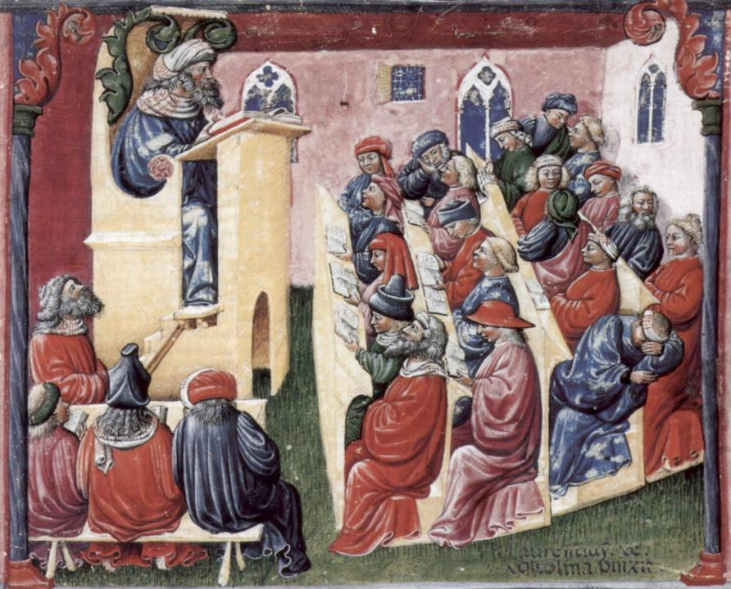
Laurentius de Voltolina
2nd half of 14th Century
Italian Painter

Slide 37
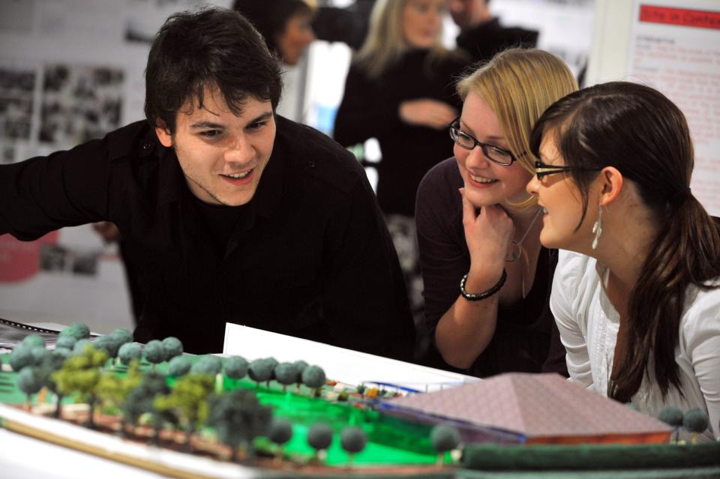
Working together interactively

Slide 38
How’s your brain?
My brain is:
Digital
Analogue
Both
Neither
Don’t know
Voting: A = 2 hands, B = 1 hand
C = touch left ear, D = touch right ear
E = scratch your head

Slide 39
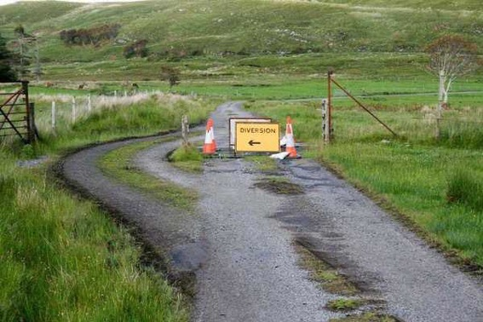

Slide 40
Learning, feedback and assessment:
the ten most important words
Why?
What?
Who?
Where?
When?
How?
Which?
So what?
wtf?
Wow?
And the most powerful four-letter word in the English language...
????

Slide 41
Learning, feedback and assessment: the ten most important words
Why? (rationale)
What? (content)
Who? (people, you, me, them)
Where? (locations)
When? (times)
How? (processes)
Which? (decisions)
So what? (importance?)
Wow? (impact?)
And the most powerful four-letter word in the English language...
else

Slide 42
Go forth and
elsify!

Slide 43
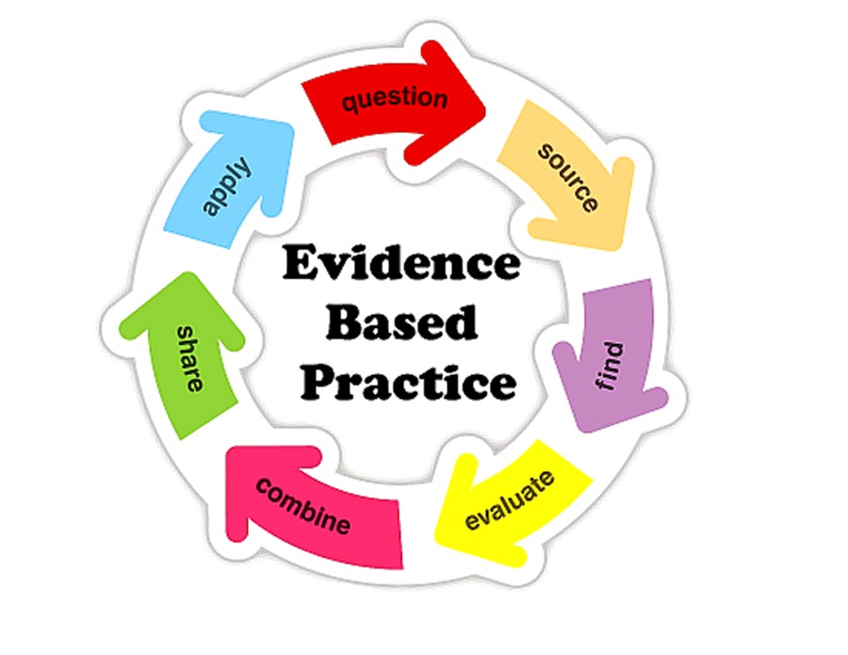

Slide 44
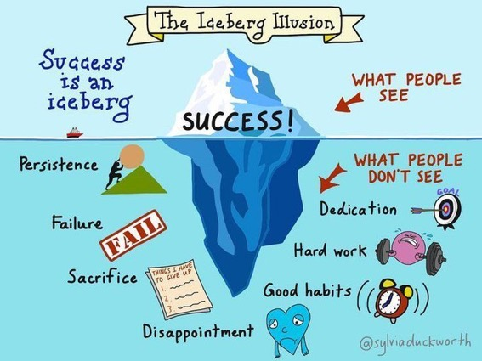

Slide 45
How students really learn
Seven factors underpinning successful learning based on asking lots of people about their learning in the last 30 years

Slide 46
How Students Really Learn ‘Ripples’ model of learning
Phil Race

Slide 48
Unless we do something else…
“[The] pupils got it all by heart; and, when Examination-time came, they wrote it down; and the Examiner said ‘Beautiful! What depth!’
They became teachers in their turn, and they said all these things over again; and their pupils wrote it down, and the examiner accepted it; and nobody had the ghost of an idea what it meant” Lewis Carroll, 1893
Active
Experimentation
Abstract
Conceptualisation
Concrete
Experience
Reflective
Observation

Slide 50
Traditional views...
active experimentation
concrete experience
reflective observation
abstract conceptualisation

Slide 51
What’s missing in this old cycle?
Engagement?
Feelings?
Active
Experimentation
Inspiration?
Judgments?
Desire?
Abstract
Conceptualisation
Concrete
Experience
Communication?
Enthusiasm?
Reflective
Observation

Slide 52
Another MCQ
About learning styles,
I think they’re very important
I think they’re a load of rubbish
I know what mine is (or are)
They can’t be changed
They change over time
Voting: A = 2 hands, B = 1 hand
C = touch left ear, D = touch right ear
E = scratch your head

Slide 53
So what about learning styles?
https://www.theguardian.com/education/2017/mar/12/no-evidence-to-back-idea-of-learning-styles?CMP=share_btn_tw
(Link from my Tweet on March 13th 2017 to a letter in the Guardian by prominent folk around the world of education)
Or link to a word document: https://phil-race.co.uk/2017/09/swansea-university-school-management-21st-September/
“No evidence to back idea of learning styles”

Slide 55
What’s wrong
with
this?
Verbalising
Assessing
Feedback
Making sense
Doing
Wanting/
Needing

Slide 56
What’s wrong
with
this?
Verbalising
Assessing
Feedback
Making sense
Doing
Wanting/
Needing

Slide 57
Thanks, Dr Paul Kleiman

Slide 58
Ripples on a pond….
Enhance our students’ want to learn?
Help students to develop ownership of the need to learn?
Keep students learning by doing, practice, trial-and-error, repetition?
Ensure students really use feedback – from us and from each other?
Help students to make sense of what they learn?
Get students deepening their learning by verbalising, explaining things to each other, and to us?
Allow students to deepen their learning by assessing their own learning, and assessing others’ learning – making informed judgements?
What else can we do to use
teaching, assessment and feedback to:
Verbalising
Assessing
making informed judgements
Wanting/
Needing
Doing
Doing
Making sense
Feedback

Slide 59
Which wavelength should I teach on?
The only one that works for today’s students is WIIFM
What’s in it for me?
Consciously address the ‘so what’ in students’ minds;
Warm up their ‘want’ to learn.
Clarify their ‘need’ to learn.
They learn far more readily if they are continuously aware of the benefits for them of putting energy into their learning.

Slide 60
Sally’s Conclusions about assessment and feedback
Assessment can be a powerful means of focusing student effort if it is well designed and constructively aligned (Biggs and Tang, 2011);
Students in the early stages of their learning journey are likely to need more support and positive feedback than later, when they are more robust and confident;
The first six weeks of the first semester are crucial in helping students understand how assessment works;
No single method of giving feedback is likely to be ubiquitously successful, so it’s worth using a variety of approaches;
Assessment and feedback need to be manageable for staff and students if they is going to engage students in valuable learning activities.

Slide 61
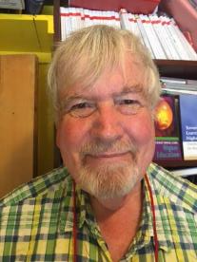
Thank you…
Website: http://phil-race.co.uk
Follow Phil on Twitter @RacePhil
e-mail: phil@phil-race.co.uk

