Slide 1
Making Learning Happen
20th September, 2018
UCLAN: School of Medicine
Phil Race
(from Newcastle-upon-Tyne)
BSc PhD PGCE FCIPD PFHEA NTF
Follow Phil on Twitter: @RacePhil
Visiting Professor: University of Plymouth and Edge Hill University
Emeritus Professor, Leeds Beckett University

Slide 2
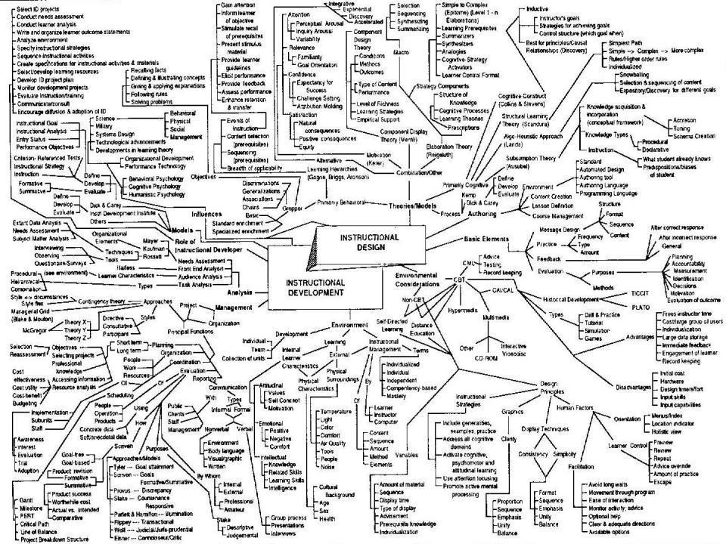
This slide has two purposes….
To focus the data projector, if necessary, and…
...to persuade colleagues never to put this sort of detail onto a slide!

Slide 3
About Phil…
First a musician
Then a writer
Then a scientist
Then a researcher
Then a lecturer and warden at what is now USW
Got interested in how students learn
And the effects assessment and feedback have on them
And how we teach them
Gradually became an educational developer
And now ‘retired’!?
Currently…
Visiting Prof: Plymouth & Edge Hill
Emeritus Prof: Leeds Beckett
Based at Newcastle, UK
And on trains
And an expert…
on train routes and timetables!
Notes:
2
2

Slide 4
Making learning happen
20th September: Factors underpinning successful teaching.
6th December: Giving effective feedback.
7th March: Effective assessment.
6th June?: Lecturing styles and methods.

Slide 5
Factors underpinning successful teaching
In this first of four sessions over the year, we’ll look at the factors underpinning successful learning, and how these link to assessment, and feedback.
Then we’ll explore some of the ways we can address these factors in teaching, cast a critical eye towards learning outcomes, (and essays!) and explore and prioritise some of the attributes of successful teachers.

Slide 6
Thought for the day: Einstein
It is simply madness,
to keep doing the same things,
and expect different results.

Slide 7
The agenda
In this session, I’d like to get you thinking afresh about how learning happens, and how best we can help students to learn effectively, efficiently, and enjoyably.
I’d like to share my worries about some of the things which I think can get in the way of effective learning, and share ideas about what we can do with teaching, feedback and assessment to make learning happen well.
In the three subsequent sessions, we’ll follow up by looking at feedback, assessment, and large-group teaching in much more detail.

Slide 8
Intended learning outcomes
After participating in this session, you should be better-able to:
Explore seven factors which underpin successful learning;
Look broadly at some of the tensions between how students learn, and common ways of providing feedback and assessing learning.
Discuss some of the attributes of excellent teachers, and prioritise them.

Slide 9
Learning, feedback and assessment:
the ten most important words
Why?
What?
Who?
Where?
When?
How?
Which?
So what?
wtf?
Wow?
And the most powerful four-letter word in the English language...
????

Slide 10
‘what’ is getting ever less important
Columbia University research published recently (2011) in Science magazine shows that people are much less prepared to remember ‘what’, but better at remembering where to access information, and how to do so.
Betsy Sparrow, one of the principal researchers, concludes that the internet has become ‘an external memory source that we can access at any time. ... Just as we learn through transactive memory who knows what in our families and offices, we are learning what the computer ‘knows’ and when we should attend to where we have stored information in our computer-based memories. We are becoming symbiotic with our computer tools.
Published Online July 14 2011 < Science Express Index Science DOI: 10.1126/science.1207745
Report: Google Effects on Memory: Cognitive Consequences of Having Information at Our Fingertips Betsy Sparrow,*, Jenny Liu, Daniel M. Wegner

Slide 11
Learning, feedback and assessment:
the ten most important words
Why? (rationale)
What? (content)
Who? (people, you, me, them)
Where? (locations)
When? (times)
How? (processes)
Which? (decisions)
So what? (importance?)
Wow? (impact?)
And the most powerful four-letter word in the English language...
????

Slide 12
Teaching, learning and enthusiasm
Knowledge isn’t infectious (unfortunately) but enthusiasm is, and we need to help our students to catch enthusiasm.
We certainly don’t want teaching, assessment or feedback to damage that enthusiasm.

Slide 13
You will be able to download my main slides
You don’t need to take notes.
I’ll put the main slides I use up on my website later today (http://phil-race.co.uk/)
I may sometimes go through slides quite fast, but you can study them as you wish at your leisure.

Slide 14
Announcement about mobile phones and laptops...
Good morning everyone – please turn on your ‘phones, tablets and computers.
Please post your thoughts, questions, comments and ideas during this session to the hashtag #philatuclan18-1 Thanks!
Try #LTHEchat on Wednesday evenings from 20.00-21.00.

Slide 15
Download anytime Phil’s materials on feedback, assessment, learning and lecturing, from ‘Making Learning Happen’ (Sage, 2014) and ‘The Lecturer’s Toolkit’ Routledge, 2015),
Expanded discussion of how the factors underpinning learning link to feedback, assessment and large-group teaching:
http://phil-race.co.uk/2016/04/updated-powerpoint-ripples-model/ (Chapter 1 from ‘The Lecturer’s Toolkit, 2015)
https://phil-race.co.uk/2016/10/lthe-tweetchat-lthechat-wed-oct-19-8-00-9-00-pm/ (feedback stuff from my most recent two books)
https://phil-race.co.uk/2018/02/feedback-feedforward-just-tips-including-students/ (just the feedback tips!)
http://phil-race.co.uk/2015/01/assessment-bits-new-editions/ (extracts on assessment)
http://phil-race.co.uk/2017/05/lectures-and-learning/ (extracts on lecturing)

Slide 16
Finding out more about you…
In the last 12 months, I’ve completed a MOOC
Indeed
Started one
Helped to design one
Found one
What’s a MOOC?
Voting: A = 2 hands, B = 1 hand
C = touch left ear, D = touch right ear
E = scratch your head

Slide 18
Time-constrained Post-it exercise
On a post-it, in your best handwriting, please write your own completion of the starter:
“my students would learn much more effectively if only I …”
Please swap post-its so that you’ve no idea who has yours.
If chosen, please read out with passion and drama the post-it you now have.
Please place them all on the chart as directed.

Slide 19
Modern institutions are moving away from being the providers of content, (where everything used to be about ‘delivery’), towards foregrounding two major functions:
Recognising and accrediting students’ achievement, wherever learning has taken place (i.e. getting the assessment right);
Supporting student learning and engagement (not least by making feedback work well for students, and using real-world situations and simulations to bring learning to life).

Slide 20
Evidence-based learning
Evidence: ‘the available body of facts or information indicating whether a belief or proposition is true or valid’.
There’s now a huge literature in thinking and practice about teaching, learning and assessment.
Our approaches can use the wisest parts of this literature to be evidence-based.
But I believe that students’ learning also needs to be evidence-based.

Slide 21
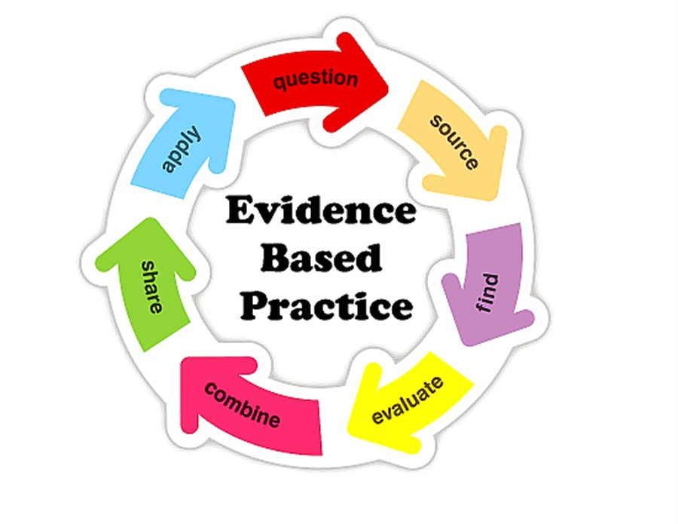

Slide 22
What sorts of evidence do students need?
Examples of good, bad and indifferent work, so they can see what they’re trying to do, and surpass the good examples.
Examples of feedback (feed-forward) on examples of work, so they can fine-tune their approaches.
Examples of assessment criteria they can apply to given examples of work (and indeed their own work) so they can see where they’re at in their learning.
Rehearsal opportunities for new assessment formats, so they can fine-tune their approaches.

Slide 23
Drives most learning
Is assessment broken?
Some
assessment
issues
What students think
Assessment as learning
Validity
Whodunit?
Fairness

Slide 24

The read-write industry

Slide 25

In the exam room you’re on your own

Slide 26
My main worries about assessment...
Too often, we still tend to try to measure...
...what’s in students’ heads, and what they can do with what’s there...
in terms of two unsatisfactory proxies ...
what comes out of students’ pens in exams;
2. what comes out of their keyboards in essays and reports.

Slide 27

THE last week: The essay is failing us. Discuss

Slide 28
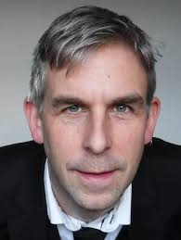
Phil Newton: Swansea Medical School
‘How Common Is Commercial Contract Cheating in Higher Education and Is It Increasing? A Systematic Review’
Front. Educ., 30 August 2018
https://doi.org/10.3389/feduc.2018.00067
https://www.frontiersin.org/articles/10.3389/feduc.2018.00067/full

Slide 29
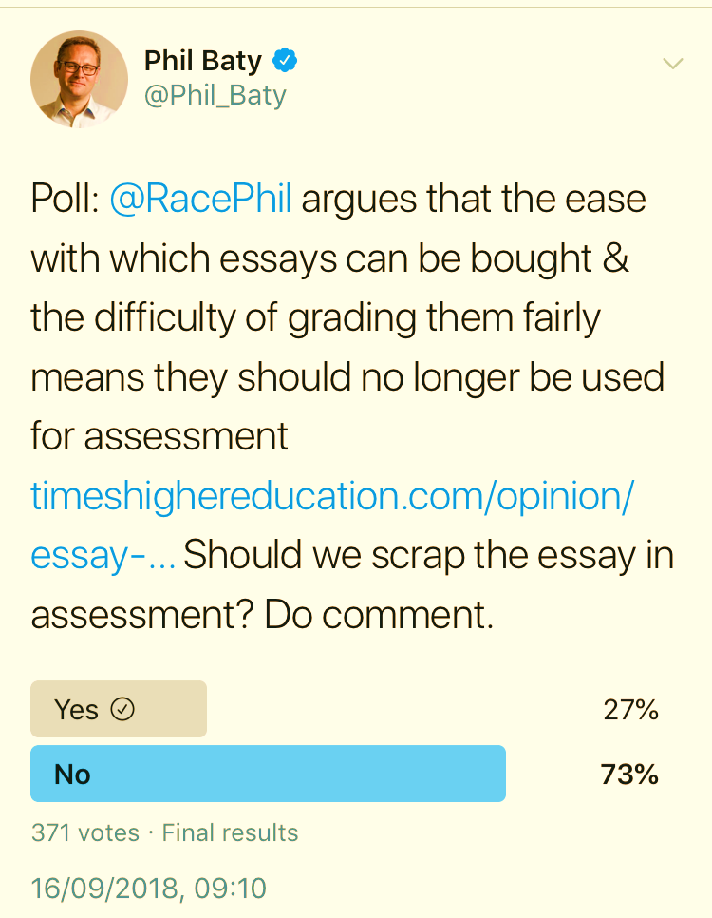
The result of Phil Baty’s poll.
I’m quite pleased that 27% seem to agree with me – that’s progress.

Slide 30
Five main problems with assessed essays
They take a great deal of time to mark, let alone the time it takes for students to prepare, draft and compose them.
When most assessment is in the form of essays, students’ skills at essay-writing are repeatedly tested, as the expense sometimes of their understanding of the subject.
Lots of research shows that we’re not at all good at marking essays fairly – different assessors often give the same essay very different marks.
Essay marks in the UK tend to lie between 35% for a poor one and 75% for a very good one, whereas in many other disciplines the marks for an assignment like a lab report can range across the whole 0-100% span more evenly.
With coursework essays, there can be doubt about ‘whodunit?’! (See Phil Newton 2018 on essay mills, academic integrity and contract cheating)

Slide 31
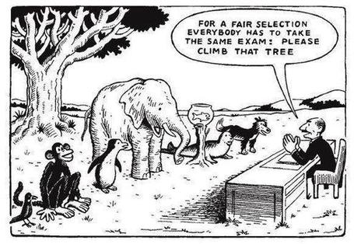

Slide 32
Numbers?
One for sorrow,
Two for joy,
Three for a girl,
Four for a boy,
Five for silver,
Six for gold,
Seven for Customer Service,
Eight to listen to these options again.

Slide 33
How students really learn
Seven factors underpinning successful learning based on asking everyone about their learning in the last 30 years!

Slide 34
How students really learn
‘Ripples’ model of learning
Phil Race

Slide 35
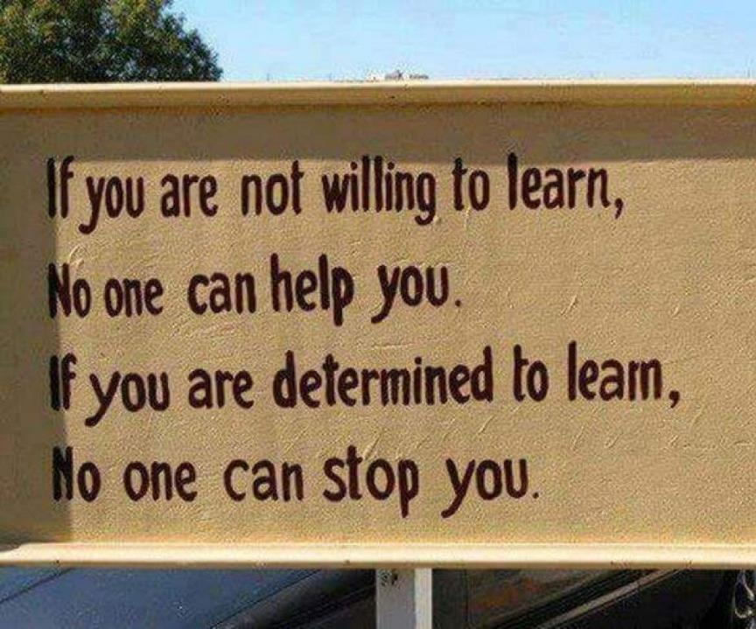

Slide 36
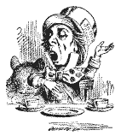
Unless we do something else…
“[The] pupils got it all by heart; and, when Examination-time came, they wrote it down; and the Examiner said ‘Beautiful! What depth!’
They became teachers in their turn, and they said all these things over again; and their pupils wrote it down, and the examiner accepted it; and nobody had the ghost of an idea what it meant”
Lewis Carroll, 1893
Active
Experimentation
Abstract
Conceptualisation
Concrete
Experience
Reflective
Observation

Slide 37
Another MCQ
About learning styles,
I think they’re very important
I think they’re a load of rubbish
I know what mine is (or are)
They can’t be changed
They change over time
Voting: A = 2 hands, B = 1 hand
C = touch left ear, D = touch right ear
E = scratch your head

Slide 38
What’s missing in this old cycle?
Engagement?
Feelings?
Active
Experimentation
Inspiration?
Judgments?
Desire?
Abstract
Conceptualisation
Concrete
Experience
Communication?
Enthusiasm?
Reflective
Observation

Slide 39
But what about learning styles?
https://www.theguardian.com/education/2017/mar/12/no-evidence-to-back-idea-of-learning-styles?CMP=share_btn_tw
(Link from my Tweet on March 13th 2017 to a letter in the Guardian by prominent folk around the world of education)
Or link to a word document: https://phil-race.co.uk/2017/09/swansea-university-school-management-21st-September/
“No evidence to back idea of learning styles”

Slide 40


Slide 41
Five of the seven factors underpinning successful learning
learning by doing
learning from feedback
wanting to learn
needing to learn
...

Slide 42
‘Do you understand?’ lecturer asks student.
‘Understand what?’ thinks student.
‘What am I supposed to understand?’
‘What will he/she think of me if I say “no”?’
‘If I say “yes” will he/she ask me a difficult question to catch me out?’
‘Why am I being asked this anyway?’
‘Is it going to be important for me to understand this?’.
‘How will I know when I understand it?’.
‘What will I be able to do when I understand it?’.
‘How will I be able to demonstrate my understanding of it?’.
‘Do I actually have to understand it, or will it be enough simply to demonstrate my understanding of it, by doing something I can do, even when I don’t understand it?’.
‘Does he/she understand it, anyway?’
‘Mmmm’ replies student (as soon as possible after all that thinking). … continued…

Slide 43
‘So you don’t understand it then?’ alleges lecturer.
‘Well, …’ replies student.
‘So you understand it well?’ smiles lecturer.
‘Just about’ replies student.
‘Ah, good’ says lecturer. ‘I made myself clear then?’
‘Of course’ replies student.
[Because of things like this, the word ‘understand’ is best avoided in intended learning outcomes – and in life in general, except to get people thinking].

Slide 44
Five of the seven factors underpinning successful learning
learning by doing
learning from feedback
wanting to learn
needing to learn
making sense – ‘getting one’s head round it’

Slide 45
But there are still two things missing
One has never really ‘got’ something until one has done both of two more things...

Slide 46
Think back to your own teaching
Think of something you’ve taught for some time. Think back particularly to the first time you taught it.
To what extent did you find that you ‘had your head around it’ much better after teaching it for the first time?
  Very much better: raise two hands
  Somewhat better: raise one hand
  No better: touch left ear!

Slide 47
Ripples on a pond….
Verbalising
Wanting/
Needing
Doing
Making sense
Feedback

Slide 48
Now think about assessing
Still thinking of the first time you taught that particular topic, think back to the first time you measured students’ learning of the topic.
To what extent did you find that after assessing students work, you yourself had ‘made sense’ of the topic even more deeply?
  Very much better: raise two hands
  Somewhat better: raise one hand
  No better: touch left ear!

Slide 49
Ripples on a pond….
Enhance our students’ want to learn?
Help students to develop ownership of the need to learn?
Keep students learning by doing, practice, trial-and-error, repetition?
Ensure students really us feedback – from us and from each other?
Help students to make sense of what they learn?
Get students deepening their learning by verbalising, explaining things to each other, and to us?
Allow students to deepen their learning by assessing their own learning, and assessing others’ learning – making informed judgements?
What else can we do to use
teaching, assessment and feedback to:
Verbalising
Assessing
making informed judgements
Wanting/
Needing
Doing
Doing
Making sense
Feedback

Slide 50
What’s wrong
with
this?
Verbalising
Assessing
Feedback
Making sense
Doing
Wanting/
Needing

Slide 51
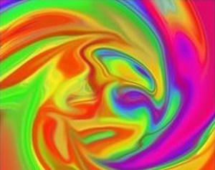
Thanks, Dr Paul Kleiman

Slide 52
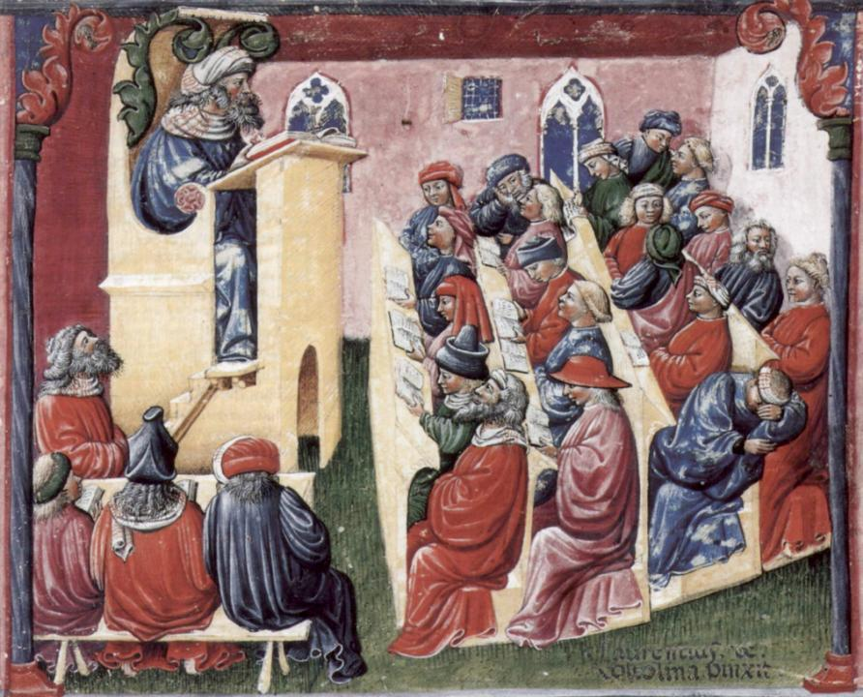
Laurentius de Voltolina
2nd half of 14th Century
Italian Painter

Slide 53
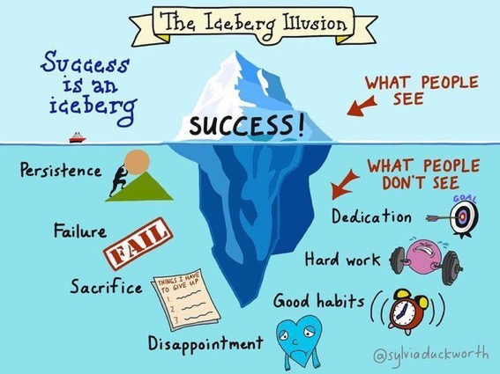

Slide 54
What wavelength should I teach on?
The only one that works is WIIFM
What’s in it for me?
Consciously address the ‘so what’ in learners’ minds;
Warm up their ‘want’ to learn.
Clarify their ‘need’ to learn.
Learners learn far more readily if they are continuously aware of the benefits for them of putting energy into their learning.

Slide 55
Feed-forward
Language of feedback
Some feedback
issues
National Student Survey
Timing:
24-hours!
Written, printed,
on-screen
Efficiency
Face to face
oral

Slide 56
Quality feedback: three vital functions
“There is wide consensus within the education literature that ‘quality’ feedback should serve three overlapping functions:
an ‘orientational’ purpose that clarifies the student’s performance and achievement;
a ‘transformational’ purpose that enables the student to reflect, improve their performance, and become more autonomous (often termed ‘feed-forward); and
an ‘affective/interpersonal’ dimension that gives the student confidence and motivation, and builds a strong teacher-student relationship”
(Dunworth & Sanchez, 2016, quoted by Winstone and Nash, 2016).

Slide 57
Hounsell, D. (2008). The trouble with feedback: New challenges, emerging strategies. Interchange, 2, pp.1-10.
Feedforward is a strategy that aims to ‘increase the value of feedback to the students by focusing comments not only on the past and present…but also on the future – what the student might aim to do, or do differently in the next assignment or assessment if they are to continue to do well or to do better’ (Hounsell, 2008, p. 5).

Slide 58
What’s wrong with feedback?
Students get it too late.
And too often, it’s just words on paper.
It doesn’t help them enough.
They often don’t take enough notice of it.

Slide 59
Fishing for feedback?
Feedback is like fish.
If it is not used quickly, it becomes useless.
(Sally Brown).
Give a man a fish,
Feed him for a day.
Teach a man to fish,
Feed him for a lifetime.
(Maimonides: 1135-1204)
Make feedback timely, while it still matters to students, in time for them to use it towards further learning, or to receive further assistance.
(Graham Gibbs)
And he’ll learn to drink beer in boats
And you won’t see him for weeks!
(Australian proverb).

Slide 60
But what’s really wrong with feedback?
Too often it’s one-way – monologic.
What students want is dialogue.
They want to talk to us about their work.
But they’re scared to talk to us, for various reasons:
  In case it leads to lower marks;
  In case they’re ‘found out’;
  In case they feel stupid.

Slide 61
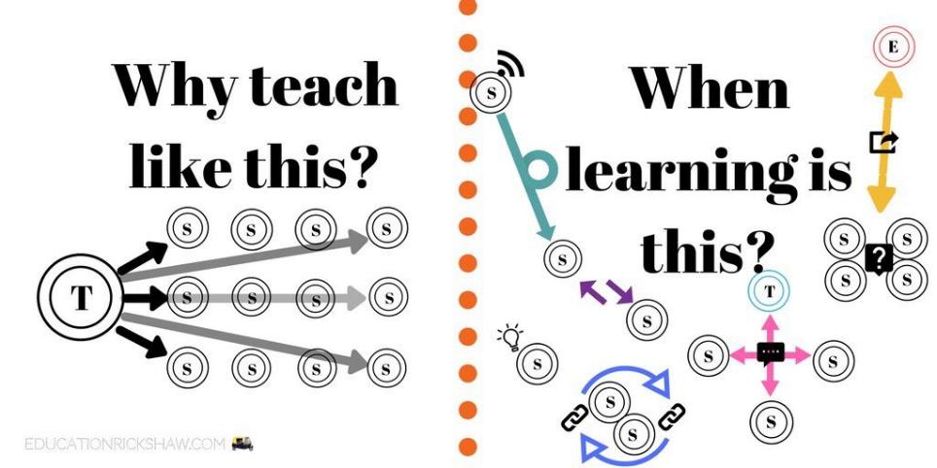
Learning is not linear! Feedback is not unidirectional. But sometimes we pretend that they are! #sketchnote by @SGroshell and @MrZachG #edchat #learning #teachchat

Slide 62
Face-to-face communication
Making all the channels work

Slide 63

Face-to-face one-to-one feedback activity
On the signal to start, please stand up, and work in pairs, moving around the room, talking to different people using the script which follows…
The script:
A ‘Hello’ (or equivalent).
B ‘Hello’ (or equivalent).
A ‘You are late’.
B ‘I know’.
Try to do it completely differently each time.

Slide 64
Constructive Alignment: John Biggs
What will I be expected to show for this?
What does a good one look like, and a bad one?
Where does this fit into the big picture?
When explaining assessment criteria to students, and when linking these to evidence of achievement of the intended learning outcomes, we need to make the most of face-to-face whole group contexts and...
  Tone of voice
  Body language
  Facial expression
  Eye contact
  The chance to repeat things
  The chance to respond to puzzled looks
Some things don’t work nearly so well just on paper or on screens.
Some of the
tools we can
use in
face-to-face
contexts

Slide 65
Beyond the tyranny of intended learning outcomes?
At the November SEDA conference, I’m planning to run a session along these lines:
What about our learning aspirations?
What about their learning aspirations?
What about their learning incomes?
What about their learning outputs?
What about their emergent learning outcomes?
What about our intended learning outgoings?

Slide 66

Face to face feedback

Slide 67

Hands-on feedback?

Slide 68
Characteristics of excellent teachers (Sally Brown)
Knows subject material thoroughly
Adopts a scholarly approach to the practice of teaching
Is reflective and regularly reviews own practice
Is well organised and plans curriculum effectively
Is passionate about teaching
Has a student-centred orientation to teaching
Regularly reviews innovations in learning and teaching and tries out ones relevant to own context
Ensures that assessment practices are fit for purpose and contribute to learning
Demonstrates empathy and emotional intelligence

Slide 69
Characteristics of excellent teachers: diamond-9
1
2
3
4
5
6
7
8
9

Slide 70
Your order of characteristics of excellent teachers: diamond-9
1
2
3
4
5
6
7
8
9

Slide 71
Looking ahead to the next sessions
Assessment and feedback can be powerful means of focusing student effort and enhancing achievement if well designed (Biggs and Tang, 2011);
Students in the early stages of their learning journey are likely to need more support and positive feedback than later, when they are more robust and confident;
The first six weeks are crucial in helping students understand how assessment and feedback work;
No single method of giving feedback is likely to be ubiquitously successful, so it’s worth using a variety of approaches;
Assessment needs to be manageable for staff and students if it is going to engage students in learning activities.

Slide 72
Back to our intended learning outcomes…
Do you now feel better able to:
2 hands = very much better,
one hand = somewhat better,
touch left ear = no better...
Explore seven factors which underpin successful learning?
Look broadly at some of the tensions between how students learn, and common ways of providing feedback and assessing learning?
Discuss some of the attributes of excellent teachers, and prioritise them?
Wanting/
Needing
Doing
Making sense
Feedback

Slide 73

Thank you…
Website: http://phil-race.co.uk
Follow Phil on Twitter @RacePhil
e-mail: phil@phil-race.co.uk

Slide 74
Useful references and further reading (1)
Bain, K. (2004) What the best College Teachers do, Cambridge: Harvard University Press.
Biggs, J. and Tang, C. (2011) Teaching for Quality Learning at University, Maidenhead: Open University Press.
Bloxham, S. and Boyd, P. (2007) Developing effective assessment in higher education: a practical guide, Maidenhead, Open University Press.
Boud, D. (1995) Enhancing learning through self-assessment, London: Routledge.
Brown, S. and Glasner, A. (eds.) (1999) Assessment Matters in Higher Education, Choosing and Using Diverse Approaches, Maidenhead: Open University Press.
Brown, S. and Race, P. (2012) Using effective assessment to promote learning in Hunt, L. and Chambers, D. (2012) University Teaching in Focus, Victoria, Australia, Acer Press. P74-91.
Brown, S. (2015) Learning , Teaching and Assessment in Higher Education: Global perspectives, London, Palgrave.

Slide 75
Useful references and further reading (2)
Carless, D., Joughin, G., Ngar-Fun Liu et al (2006) How Assessment supports learning: Learning orientated assessment in action Hong Kong: Hong Kong University Press.
Carroll, J. and Ryan, J. (2005) Teaching International students: improving learning for all. London: Routledge SEDA series.
Crosling, G., Thomas, L. and Heagney, M. (2008) Improving student retention in Higher Education, London and New York: Routledge
Crooks, T. (1988) Assessing student performance, HERDSA Green Guide No 8 HERDSA (reprinted 1994).
Dunworth, K. and Sanchez, H.S., (2016). Perceptions of quality in staff-student written feedback in higher education: a case study. Teaching in Higher Education, 21(5), pp.576-589.
Dweck, C. S. (2000) Self Theories: Their Role in Motivation, Personality and Development, Lillington, NC: Taylor & Francis.
Falchikov, N. (2004) Improving Assessment through Student Involvement: Practical Solutions for Aiding Learning in Higher and Further Education, London: Routledge.
Gibbs, G. (1999) Using assessment strategically to change the way students learn, in Brown S. & Glasner, A. (eds.), Assessment Matters in Higher Education: Choosing and Using Diverse Approaches, Maidenhead: SRHE/Open University Press.
Higher Education Academy (2012) A marked improvement; transforming assessment in higher education, York: HEA.

Slide 76
Useful references and further reading (3)
Hawe, E., Lightfoot, U., & Dixon, H. (2017). First-year students working with exemplars: Promoting self-efficacy, self-monitoring and self-regulation. Journal of Further and Higher Education, 1-15.
Hendry, G. D., White, P., & Herbert, C. (2016). Providing Exemplar-Based “Feedforward” before an Assessment: The Role of Teacher Explanation. Active Learning in Higher Education, 17(2), 99-109.
Hounsell, D., McCune, V., Hounsell, J. and Litjens, J., (2008). The quality of guidance and feedback to students. Higher Education Research & Development, 27(1), pp.55-67.
Newton, P. M. (2018) How Common Is Commercial Contract Cheating in Higher Education and Is It Increasing? A Systematic Review https://www.frontiersin.org/articles/10.3389/feduc.2018.00067/full
Nicol, D. J. and Macfarlane-Dick, D. (2006) Formative assessment and self-regulated learning: A model and seven principles of good feedback practice, Studies in Higher Education Vol 31(2), 199-218.
PASS project Bradford http://www.pass.brad.ac.uk/ Accessed November 2013.
Pickford, R. and Brown, S. (2006) Assessing skills and practice, London: Routledge.
Rotheram, B. (2009) Sounds Good, JISC project http://www.jisc.ac.uk/whatwedo/programmes/usersandinnovation/soundsgood.aspx

Slide 77
Useful references and further reading (4)
Race, P. (2001) A Briefing on Self, Peer & Group Assessment, in LTSN Generic Centre Assessment Series No 9, LTSN York.
Race P. (2015) The lecturer’s toolkit (4th edition), London: Routledge.
Rust, C., Price, M. and O’Donovan, B. (2003) Improving students’ learning by developing their understanding of assessment criteria and processes, Assessment and Evaluation in Higher Education. 28 (2), 147-164.
Ryan, J. (2000) A Guide to Teaching International Students, Oxford Centre for Staff and Learning Development.
Scoles, J., Huxham, M., & Mcarthur, J. (2013). No longer exempt from good practice: Using exemplars to close the feedback gap for exams. Assessment & Evaluation in Higher Education, 38(6), 631-645.
Stefani, L. and Carroll, J. (2001) A Briefing on Plagiarism, LTSN
Sadler, D. Royce (2010) Beyond feedback: developing student capability in complex appraisal,
Assessment & Evaluation in Higher Education, 35: 5, 535-550.
Yorke, M. (1999) Leaving Early: Undergraduate Non-completion in Higher Education, London: Routledge.

