Slide 1

Activating Learning in large-group contexts Bournemouth University
8th November, 2018
Phil Race
(from Newcastle-upon-Tyne)
BSc PhD PGCE FCIPD PFHEA NTF
Follow Phil on Twitter: @RacePhil
Visiting Professor: University of Plymouth and Edge Hill University
Emeritus Professor, Leeds Beckett University

Slide 2
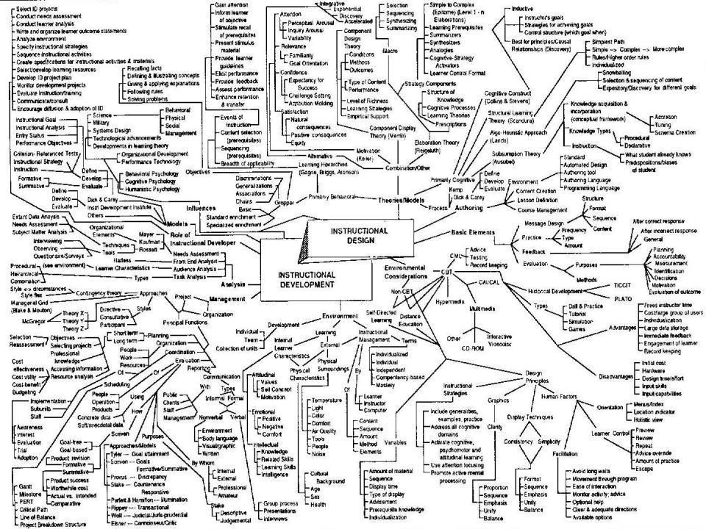
This slide has two purposes….
To focus the data projector, if necessary, and…
...to persuade colleagues never to put this sort of detail onto a slide!

Slide 3
About Phil…
First a musician
Then a writer
Then a scientist
Then a researcher
Then a lecturer and warden at what is now USW
Got interested in how students learn
And the effects assessment and feedback have on them
And how we teach them
Gradually became an educational developer
And now ‘retired’!?
Currently…
Visiting Prof: Plymouth & Edge Hill
Emeritus Prof: Leeds Beckett
Based at Newcastle, UK
And on trains
And an expert…
on train routes and timetables!
Notes:
2
2

Slide 4
Activating learning in large-group contexts
In this session, I’d like to get us all thinking about ways in which we can address the situation we find ourselves in when preparing and running a session with large groups of students.
In particular, I hope to get you planning how we can address seven factors underpinning successful student learning.

Slide 5
Announcement about mobile phones and laptops...
Good morning everyone – please turn on your ‘phones and computers.
Please post your thoughts, comments and ideas during this session to the hashtag #philatbournemouth18 Thanks!
Try #LTHEchat on Wednesday evenings from 20.00-21.00.

Slide 6
Sorry
I’m not Sally Brown.
She’s in Edinburgh today, but will be in Bournemouth tomorrow, where she’s getting an Hon. Doc.

Slide 7
Getting to know each other: a face-to-face thing…
In turn, please..
Say one or two sentences about...
who you are,
where you come from, and
what you do.
In one breath!
(Optional) Share with us one thing that you’re dead good at, or really proud of.

Slide 8
Finding out more about you…
In the last 12 months, I’ve completed a MOOC
Indeed
Started one
Helped to design one
Found one
What’s a MOOC?
Voting: A = 2 hands, B = 1 hand
C = touch left ear, D = touch right ear
E = scratch your head

Slide 9
You will be able to download my main slides
You don’t need to take notes.
I’ll put the main slides I use up on my website later today (http://phil-race.co.uk/)
I won’t post pictures and video-clips, as this would make the file-size too large.
I may sometimes go through slides quite fast, but you can study them as you wish at your leisure.

Slide 10
Intended learning outcomes (?)
By the end of this session, I hope you will feel better able to:
Confront and conquer some of the common fears we have with large-group sessions;
Address seven factors underpinning successful learning in large groups;
Explore and prioritise some of the characteristics of ‘excellent teachers’.

Slide 11
Beyond the tyranny of intended learning outcomes? (SEDA, Birmingham, 16.11.18)
At the November SEDA conference next week, I’m planning to run a session along these lines:
What about our learning aspirations?
What about their learning aspirations?
What about their learning incomes?
What about their learning outputs?
What about their emergent learning outcomes?
What about our intended learning outgoings?

Slide 12
Thought for the day: Einstein
It is simply madness,
to keep doing the same things,
and expect different results.

Slide 13
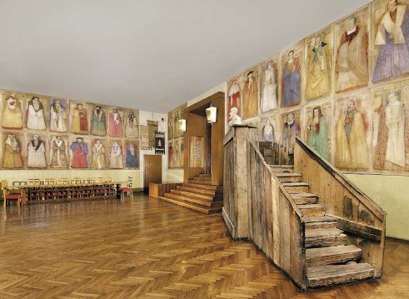
Do we spend too much of our time trying to teach our students?
We need to spend more energy helping them to appreciate feedback, make judgements, manage affect, taking action. (Carless and Boud, 2018)
Galileo: You can’t
teach a man
anything.
You can only help
him to learn.

Slide 14
Students as partners…
Students are partners in learning.
They always have been.
We can’t ‘learn them’!
We haven’t always made it an optimal partnership.
We can.
I could not do what I do nowadays if I did not continue to spend a fair bit of my time working with students – they’ve taught me most of what I know.

Slide 15
Download anytime Phil’s materials on feedback, assessment, learning and lecturing
Expanded discussion of how the factors underpinning learning link to feedback, assessment and large-group teaching:
http://phil-race.co.uk/2016/04/updated-powerpoint-ripples-model/ (Chapter 1 from ‘The Lecturer’s Toolkit, 2015)
https://phil-race.co.uk/2016/10/lthe-tweetchat-lthechat-wed-oct-19-8-00-9-00-pm/ (feedback stuff from my most recent two books)
http://phil-race.co.uk/2015/01/assessment-bits-new-editions/ (extracts on assessment)
http://phil-race.co.uk/2017/05/lectures-and-learning/ (extracts on lecturing)

Slide 16
Teaching, learning and enthusiasm
Knowledge isn’t infectious (unfortunately) but enthusiasm is, and we need to help our students to catch enthusiasm.
We certainly don’t want teaching, assessment or feedback to damage that enthusiasm.

Slide 17
Time-constrained, assessed written Post-it exercise
On a post-it, in your best handwriting, please write your own completion of the starter:
“Making learning happen in large-group contexts with my students nowadays would be much better for me if only I …”
Please swap post-its so that you’ve no idea who has yours.
If chosen, please read out with passion and drama what’s on the post-it you now have.
Please place them all as directed.

Slide 18
Now is the decade of Universities’ dis-content!
Never mind the content – feel the learning

Slide 19
Teaching in modern institutions is moving away from providing subject content, (where everything was about ‘delivery’), towards foregrounding two major functions:
Recognising and accrediting students’ achievement, wherever learning has taken place (i.e. getting the assessment right);
Supporting student learning and engagement (not least by making feedback work well for students).

Slide 20
Face-to-face communication
Making all the channels work

Slide 21

Thirty Second Theatre

Slide 22

Face-to-face one-to-one feedback activity
On the signal to start, please stand up, and work in pairs, moving around the room, talking to different people using the script which follows…
The script:
A ‘Hello’ (or equivalent).
B ‘Hello’ (or equivalent).
A ‘You are late’.
B ‘I know’.
Try to do it completely differently each time.

Slide 23
Constructive Alignment: John Biggs
What will I be expected to show for this?
What does a good one look like, and a bad one?
Where does this fit into the big picture?
When explaining assessment criteria to students, and when linking these to evidence of achievement of the intended learning outcomes, we need to make the most of face-to-face whole group contexts and...
Tone of voice
Body language
Facial expression
Eye contact
The chance to repeat things
The chance to respond to puzzled looks
Some things don’t work nearly so well just on paper or on screens.
Some of the
tools we can
use in
face-to-face
contexts

Slide 24
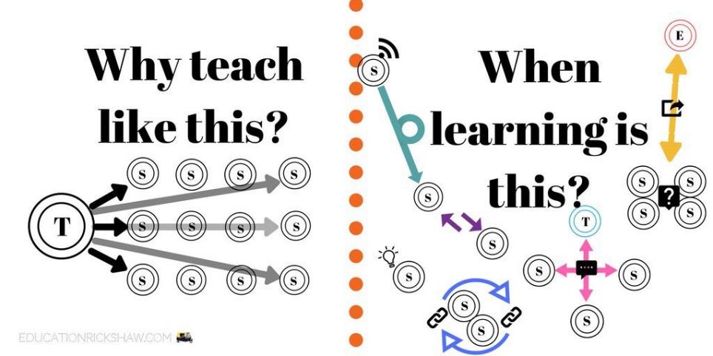
Learning is not linear! Feedback is not unidirectional. But sometimes we pretend that they are! #sketchnote by @SGroshell and @MrZachG #edchat #learning #teachchat

Slide 25
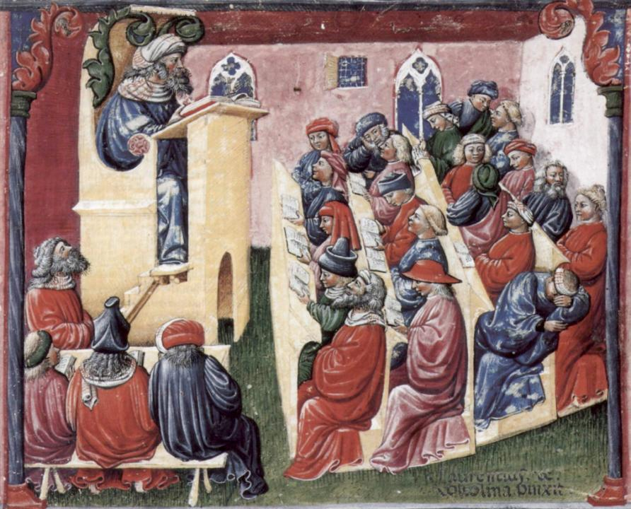
Laurentius de Voltolina
2nd half of 14th Century
Italian Painter

Slide 26
How’s your brain?
My brain is:
Digital
Analogue
Both
Neither
Don’t know
Voting: A = 2 hands, B = 1 hand
C = touch left ear, D = touch right ear
E = scratch your head

Slide 27
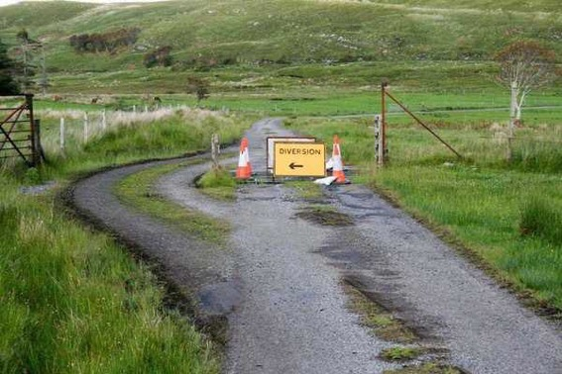

Slide 28
Learning, feedback and assessment:
the ten most important words
Why?
What?
Who?
Where?
When?
How?
Which?
So what?
wtf?
Wow?
And the most powerful four-letter word in the English language...
????

Slide 29
Learning, feedback and assessment: the ten most important words
Why? (rationale)
What? (content)
Who? (people, you, me, them)
Where? (locations)
When? (times)
How? (processes)
Which? (decisions)
So what? (importance?)
Wow? (impact?)
And the most powerful four-letter word in the English language...
else

Slide 30
Go forth and
elsify!

Slide 31
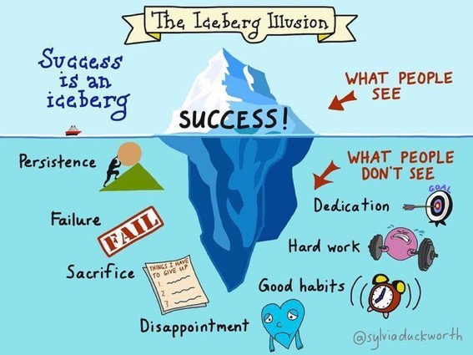

Slide 32
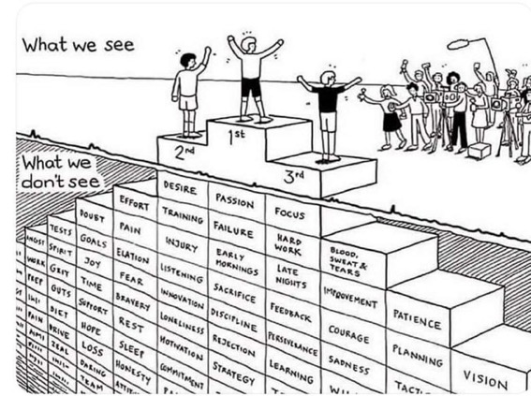
Do we get what we ask for
with intended learning outcomes?
Have we any idea of how many of
these might also have been involved?

Slide 33
How students really learn
Seven factors underpinning successful learning based on asking lots of people about their learning in the last 30 years

Slide 34
Which wavelength should I teach on?
The only one that works for today’s students is WIIFM
What’s in it for me?
Consciously address the ‘so what’ in students’ minds;
Warm up their ‘want’ to learn.
Clarify their ‘need’ to learn.
They learn far more readily if they are continuously aware of the benefits for them of putting energy into their learning.

Slide 35
How Students Really Learn ‘Ripples’ model of learning
Phil Race

Slide 36
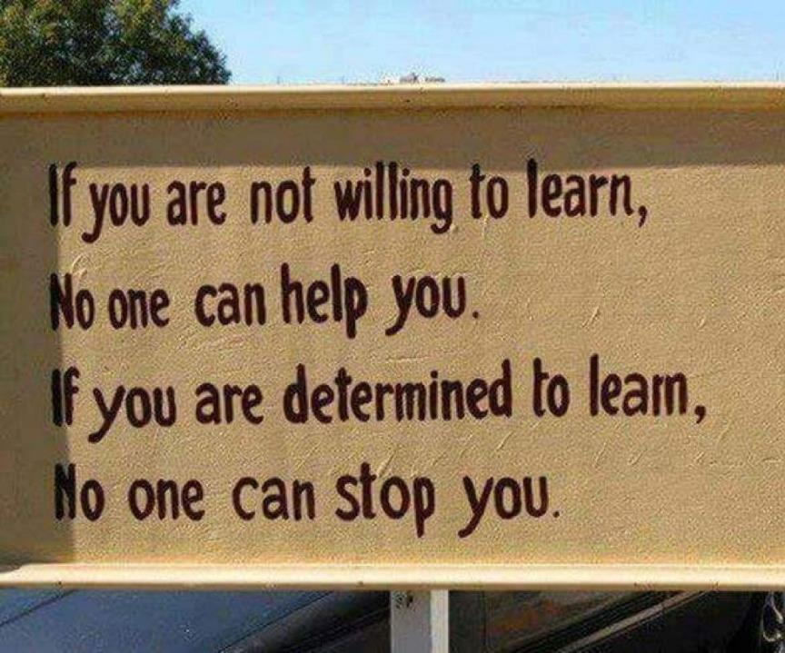

Slide 37
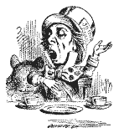
Unless we do something else…
“[The] pupils got it all by heart; and, when Examination-time came, they wrote it down; and the Examiner said ‘Beautiful! What depth!’
They became teachers in their turn, and they said all these things over again; and their pupils wrote it down, and the examiner accepted it; and nobody had the ghost of an idea what it meant” Lewis Carroll, 1893
Active
Experimentation
Abstract
Conceptualisation
Concrete
Experience
Reflective
Observation

Slide 38


Slide 39
What’s wrong
with
this?
Verbalising
Assessing
Feedback
Making sense
Doing
Wanting/
Needing

Slide 40
What’s wrong
with
this?
Verbalising
Assessing
Feedback
Making sense
Doing
Wanting/
Needing

Slide 41
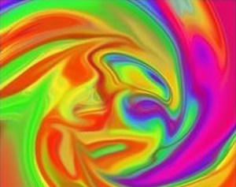
Thanks, Dr Paul Kleiman

Slide 42
Ripples on a pond….
Enhance our students’ want to learn?
Help students to develop ownership of the need to learn?
Keep students learning by doing, practice, trial-and-error, repetition?
Ensure students really use feedback – from us and from each other?
Help students to make sense of what they learn?
Get students deepening their learning by verbalising, explaining things to each other, and to us?
Allow students to deepen their learning by assessing their own learning, and assessing others’ learning – making informed judgements?
What else can we do to use
teaching, assessment and feedback to:
Verbalising
Assessing
making informed judgements
Wanting/
Needing
Doing
Doing
Making sense
Feedback

Slide 43
Characteristics of teachers who get engagement going?
Knows subject material thoroughly
Adopts a scholarly approach to the practice of teaching
Is reflective and regularly reviews own practice
Is well organised and plans curriculum effectively
Is passionate about teaching
Has a student-centred orientation to teaching
Regularly reviews innovations in learning and teaching and tries out ones relevant to own context
Ensures that assessment practices are fit for purpose and contribute to learning
Demonstrates empathy and emotional intelligence

Slide 44
Characteristics of excellent teachers: diamond-9
1
2
3
4
5
6
7
8
9

Slide 45
Characteristics of excellent teachers: diamond-9
1
2
3
4
5
6
7
8
9

Slide 46
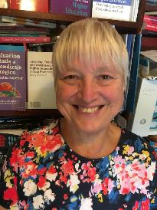
Fishing for feedback?
Feedback is like fish.
If it is not used quickly, it becomes useless.
(Sally Brown).
Give a man a fish,
Feed him for a day.
Teach a man to fish,
Feed him for a lifetime.
(Maimonides: 1135-1204)
Make feedback timely, while it still matters to students, in time for them to use it towards further learning, or to receive further assistance.
(Graham Gibbs)
And he’ll learn to drink beer in boats
And you won’t see him for weeks!
(Australian proverb).

Slide 47
Back to our intended learning outcomes…
Do you now feel better able to:
2 hands = very much better,
one hand = somewhat better,
touch left ear = no better...
Confront and conquer some of the common fears we have with large-group sessions;
Address seven factors underpinning successful learning in large groups;
Explore and prioritise some of the characteristics of ‘excellent teachers’.
Wanting/
Needing
Doing
Making sense
Feedback

Slide 48
Emergent learning outcomes?
What else are you taking away from this session?

Slide 49
Action plan: what else are you going to do?
Jot down three things you’re going to try, to make learning in large groups more enjoyable, efficient and successful for your students.

Slide 50
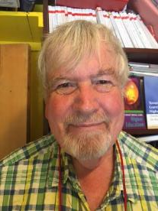
Thank you…
Website: http://phil-race.co.uk
Follow Phil @RacePhil
e-mail: phil@phil-race.co.uk

Slide 51
Useful references and further reading (1)
Bain, K. (2004) What the best College Teachers do, Cambridge: Harvard University Press.
Biggs, J. and Tang, C. (2011) Teaching for Quality Learning at University, Maidenhead: Open University Press.
Bloxham, S. and Boyd, P. (2007) Developing effective assessment in higher education: a practical guide, Maidenhead, Open University Press.
Boud, D. (1995) Enhancing learning through self-assessment, London: Routledge.
Brown, S. and Glasner, A. (eds.) (1999) Assessment Matters in Higher Education, Choosing and Using Diverse Approaches, Maidenhead: Open University Press.
Brown, S. and Race, P. (2012) Using effective assessment to promote learning in Hunt, L. and Chambers, D. (2012) University Teaching in Focus, Victoria, Australia, Acer Press. P74-91.
Brown, S. (2015) Learning , Teaching and Assessment in Higher Education: Global perspectives, London, Palgrave.

Slide 52
Useful references and further reading (2)
Carless, D., Joughin, G., Ngar-Fun Liu et al (2006) How Assessment supports learning: Learning orientated assessment in action Hong Kong: Hong Kong University Press.
Carroll, J. and Ryan, J. (2005) Teaching International students: improving learning for all. London: Routledge SEDA series.
Crosling, G., Thomas, L. and Heagney, M. (2008) Improving student retention in Higher Education, London and New York: Routledge
Crooks, T. (1988) Assessing student performance, HERDSA Green Guide No 8 HERDSA (reprinted 1994).
Dunworth, K. and Sanchez, H.S., (2016). Perceptions of quality in staff-student written feedback in higher education: a case study. Teaching in Higher Education, 21(5), pp.576-589.
Dweck, C. S. (2000) Self Theories: Their Role in Motivation, Personality and Development, Lillington, NC: Taylor & Francis.
Falchikov, N. (2004) Improving Assessment through Student Involvement: Practical Solutions for Aiding Learning in Higher and Further Education, London: Routledge.
Gibbs, G. (1999) Using assessment strategically to change the way students learn, in Brown S. & Glasner, A. (eds.), Assessment Matters in Higher Education: Choosing and Using Diverse Approaches, Maidenhead: SRHE/Open University Press.
Higher Education Academy (2012) A marked improvement; transforming assessment in higher education, York: HEA.

Slide 53
Useful references and further reading (3)
Hawe, E., Lightfoot, U., & Dixon, H. (2017). First-year students working with exemplars: Promoting self-efficacy, self-monitoring and self-regulation. Journal of Further and Higher Education, 1-15.
Hendry, G. D., White, P., & Herbert, C. (2016). Providing Exemplar-Based “Feedforward” before an Assessment: The Role of Teacher Explanation. Active Learning in Higher Education, 17(2), 99-109.
Hounsell, D., McCune, V., Hounsell, J. and Litjens, J., (2008). The quality of guidance and feedback to students. Higher Education Research & Development, 27(1), pp.55-67.
McDowell, L. and Brown, S. (1998) Assessing students: cheating and plagiarism, Newcastle: Red Guide 10/11 University of Northumbria.
Meyer, J.H.F. and Land, R. (2003) ‘Threshold Concepts and Troublesome Knowledge 1 – Linkages to Ways of Thinking and Practising within the Disciplines’ in C. Rust (ed.) Improving Student Learning – Ten years on. Oxford: OCSLD.
Nicol, D. J. and Macfarlane-Dick, D. (2006) Formative assessment and self-regulated learning: A model and seven principles of good feedback practice, Studies in Higher Education Vol 31(2), 199-218.
PASS project Bradford http://www.pass.brad.ac.uk/ Accessed November 2013.
Peelo, M. T., & Wareham, T. (Eds.). (2002). Failing students in higher education. Society for Research into Higher Education.
Pickford, R. and Brown, S. (2006) Assessing skills and practice, London: Routledge.
Rotheram, B. (2009) Sounds Good, JISC project http://www.jisc.ac.uk/whatwedo/programmes/usersandinnovation/soundsgood.aspx

Slide 54
Useful references and further reading (4)
Race, P. (2001) A Briefing on Self, Peer & Group Assessment, in LTSN Generic Centre Assessment Series No 9, LTSN York.
Race P. (2015) The lecturer’s toolkit (4th edition), London: Routledge.
Rust, C., Price, M. and O’Donovan, B. (2003) Improving students’ learning by developing their understanding of assessment criteria and processes, Assessment and Evaluation in Higher Education. 28 (2), 147-164.
Ryan, J. (2000) A Guide to Teaching International Students, Oxford Centre for Staff and Learning Development.
Scoles, J., Huxham, M., & Mcarthur, J. (2013). No longer exempt from good practice: Using exemplars to close the feedback gap for exams. Assessment & Evaluation in Higher Education, 38(6), 631-645.
Stefani, L. and Carroll, J. (2001) A Briefing on Plagiarism, LTSN
Sadler, D. Royce (2010) Beyond feedback: developing student capability in complex appraisal, Assessment & Evaluation in Higher Education, 35: 5, 535-550.
Yorke, M. (1999) Leaving Early: Undergraduate Non-completion in Higher Education, London: Routledge.

