Slide 1
‘Beyond the Tyranny of learning outcomes’
16th November 2018: 13.55 - 14.40 Parallel Session 5
Phil Race
(from Newcastle-upon-Tyne)
BSc PhD PGCE FCIPD PFHEA NTF
Follow Phil @RacePhil
Visiting Professor: University of Plymouth and Edge Hill University
Emeritus Professor, Leeds Beckett University

Slide 2
About Phil…
First a musician
Then a writer
Then a scientist
Then a researcher
Then a lecturer and warden at what is now USW
Got interested in how students learn
And the effects assessment and feedback have on them
And how we teach them
Gradually became an educational developer
And now ‘retired’!?
Currently…
Visiting Prof: Plymouth & Edge Hill
Emeritus Prof: Leeds Beckett
Based at Newcastle, UK
And on trains
And an expert…
on train routes and timetables!
Notes:
2
2

Slide 3
Summary
A provocative and interactive session, looking at what can go wrong with intended learning outcomes (for students and for staff) as presently used in curriculum design, and exploring creative enhancements we can make so they become much more fit for purpose.

Slide 4
Slides and links
You’ll be able to download these slides from my website, after I get home to Newcastle, on http://phil-race.co.uk
Usual rules apply: £1 immediately to the first spotter of each of the first three typos or spelling errors.
P.s. (No takers – my typing/spelling must be getting better!!)

Slide 5
Intended learning outcomes?
By the end of this session, participants will be able to:
Think again about the benefits – and pitfalls – for students and for staff, of intended learning outcomes as they are presently employed.
Explore how intended learning outcomes can be extended (or sometimes replaced?) by collecting learning incomes of students, collecting and evaluating students’ emergent learning outcomes, and formulating intended learning outgoings into the curriculum.
Critically examine which aspects of intended learning outcomes actually allow evidence of achievement to be measured on the basis of written work, and where other forms of assessment may be preferable or even essential.
Action-plan, with fellow participants, up to three definite changes to make regarding how learning outcomes are expressed, presented, measured and evaluated.

Slide 7
Rationale
This workshop will use the experiences (good and bad) of participants on the ways intended learning outcomes are presently used.
Using learning outcomes may have been a significant step forward in curriculum design, replacing content-based lists of topics, but perhaps it is timely to re-visit such key questions such as: to what extent can further developing the ways we use intended learning outcomes improve the learning experience of students, and the teaching approaches of staff?

Slide 8
Task 1
On a pink post-it, please jot down a few words about what you want from this session.
On a purple post-it, please jot down a word or two about what you’re already bringing to this session?
Now please swap post-its randomly.
If chosen, please read out what’s on the post-its you now have, with passion and drama.
Please stick them up on a chart or wall.

Slide 9
Constructive Alignment: John Biggs
What will I be expected to show for this?
What does a good one look like, and a bad one?
Where does this fit into the big picture?
When explaining assessment criteria to students, and when linking these to evidence of achievement of the intended learning outcomes, we need to make the most of face-to-face whole group contexts and...
Tone of voice
Body language
Facial expression
Eye contact
The chance to repeat things
The chance to respond to puzzled looks
Some things don’t work nearly so well just on paper or on screens.
Some of the
tools we can
use in
face-to-face
contexts

Slide 10
“Micro-management of learning is killing creativity” Learning outcomes are very well intentioned, but their use discourages students from thinking outside the tick box, says Robert Nelson (July 12, 2018 THE)
“Internationally, education discourages imaginative growth. Institutions all say that they want creativity to be cultivated and it is often mentioned as a graduate attribute. But the grid of expectations around individual courses makes engaging the imagination uncompetitive for all but an exceptionally talented elite”.
(See the downloadable version of Robert Nelson’s THE piece)

Slide 11
These concerns are not new!
Westera (2001):
…The competence concept is quite troublesome, and it is argued that the term has no significance beyond that which is associated with the term ‘skills’.

Slide 12
“We don’t need those learning outcomes” : Paul Kleiman reports…
“Through the introduction of the new assessment model we have seen a significant improvement in assessment participation and achievement. In a single academic year modular failure has reduced from 18.70% to 0.37%, non-submissions from 10.43% to 0% and extenuating circumstances from 17.39% to 6.59%. The model has made space for teaching staff to spend more time with students.”
Via Twitter, on Kleiman, 2018

Slide 13
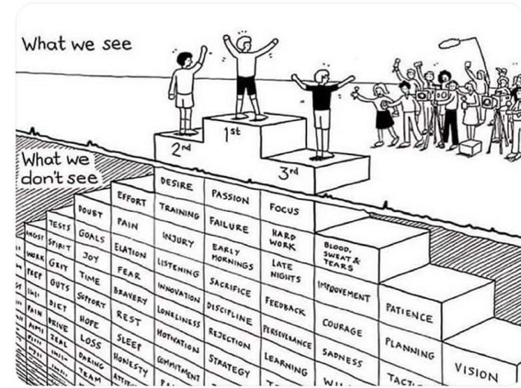
Do we get what we ask for
with intended learning outcomes?
Have we any idea of how many of
these might also have been involved?

Slide 14
Easy one? ILOs for a PGCert?
You might have followed Donna Hurford’s recent survey on SEDA jiscmail of how universities design their learning outcomes (and aims) for such courses.
(See the attached downloadable word document of the paper derived from Donna’s work on this).

Slide 15
Art and Design Pedagogy in Higher Education: Knowledge, Values and Ambiguity in the Creative Curriculum (Routledge Research in Higher Education) Hardcover: 2017
Susan Orr and Alison Shreeve
https://vimeo.com/293922682

Slide 16
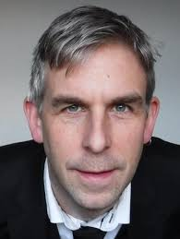
Phil Newton: Swansea Medical School
‘How Common Is Commercial Contract Cheating in Higher Education and Is It Increasing? A Systematic Review’
Front. Educ., 30 August 2018
https://doi.org/10.3389/feduc.2018.00067
https://www.frontiersin.org/articles/10.3389/feduc.2018.00067/full

Slide 17
Matters arising?
I hope to ask you to share your experience, views and ideas regarding:
Why and how learning outcomes may have become ‘a tyranny’?
What else, with hindsight, might be now be included in the ways we use intended outcomes, and what, with foresight, could be added to our approaches?
How might we make better use of students ‘learning incomes’?
Can we improve things by finding out about emergent learning outcomes which occur? (Are these often more important than the intended ones?).
What else important may students have achieved, that they haven’t yet realised? (Unrealised learning outcomes)
How best can we link evidence of achievement to learning outcomes: does written assessment sometimes only measure ghosts of the real achievement, and what evidence can only be assessed orally?
How best can we address learning outgoings – important aspects of learning that can’t be assessed, but will be really valuable five years later in career?

Slide 18
What we’ll try to do?
Collection of participants’ expectations – and some of their relevant learning incomes, (using post-its of two colours, then exchanging randomly, then someone else reading out selected ones), and posting all post-its on a flipchart or two. (10 minutes).
Brief presentation, posing some of the questions listed above to participants, with group discussion of particular questions (possibly in differently constituted sub-groups for different questions), and asking groups to summarise outcomes of their discussions. (15 minutes).
Action planning with participants jotting down ‘takeaway actions they plan to implement’ on post-its, then sharing and discussing them. (10 minutes).
Short, sharp collection of participants’ individual emergent learning outcomes (jotted on post-its of another hue) and displaying them anonymously on a chart as participants leave the session. (5 minutes).

Slide 19
Group Task
In your group, play around with your selected question, and prepare a couple of sentences as response to the question, on a yellow post-it.

Slide 20
Bonus slide: Learning incomes
These may be different for each different learner. By learning incomes, I mean all the things learners are bringing to the learning situation. These include:
what they already know about the subject
what they can already do, related to the subject
other things in their experience which they can link to the new subject.
(Race, 2014)

Slide 21
Bonus slide: Benefits of learning incomes: they help us to:
avoid spending too much time telling the class all sorts of things they already know. We still may need to cover some of these things for the sake of the learners who don’t yet know them, but we can minimize the tedium for those who already do know them.
give learners the chance to explain things they already know to each other – the explainers learn a great deal and we avoid boring them with our own explanations.
spot misconceptions that some of our learners may have about things we’re going to build on. We can then put them right on these as we introduce topics.
build on what members of the class want to find out. This helps learners to feel an increased degree of ownership of what we tell them – in effect, we’re structuring the curriculum around their questions.
(Race, 2014)

Slide 22
Bonus slide: Is the intended outcome ‘Competence’?
'Competence' - I worry about the usage of this word. What does it mean?
'Can do’,
'Can do quickly’,
'Can do well’,
'Can do adequately’,
'Can just about do’,
'Did once’,
'Could do if wanted to’,
'Can do thoroughly’,
'Can appear to do successfully’,
'Can get away with doing’?...

Slide 23
Bonus slide: Some replies included
Can do consistently?
Does do?
Proficiency is a better word
Needs benchmarking with standards and evidence
Can satisfy threshold standards
Just used for ticking boxes
Can do correctly without supervision
So-called ‘Competence’ only applies at the moment it was achieved....it is only dynamic if regularly assessed
Organisations focus on competences rather than capabilities at their peril
My PhD study concluded it’s a complex, nebulous concept but ultimately it’s about what you’re prepared to do to please your employer. So involves moral orientation, action and a standard of performance.. often involving control, power and money

Slide 24
In September: The essay is failing us. Discuss
See my controversial THE piece on essays on the downloadable file

Slide 25
What are your emergent learning outcomes from the last 40 mins?
Volunteers?

Slide 26
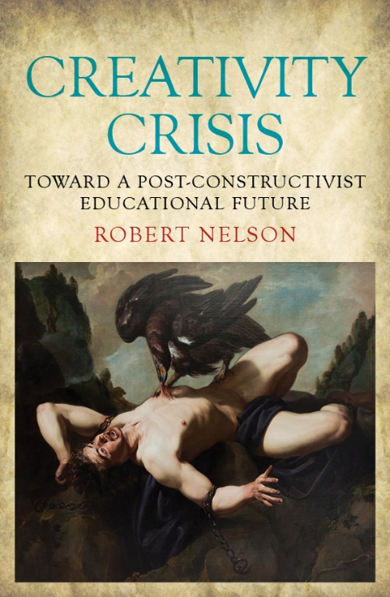
References
Kleiman, P. (2017) ‘Case Study 2 “We Don’t Need Those Learning Outcomes”: assessing creativity and creative assessment’ in Evans, C. and Elkington, S., Transforming Assessment In Higher Education. York: HEAcademy
Nelson, R. (2018) Creativity Crisis: Toward a Post-constructivist Educational Future: Monash University Press;
‘Micro-management of learning is killing creativity Learning outcomes are very well intentioned, but their use discourages students from thinking outside the tick box’ THE, July 12
Race, P. (2014) Making learning happen: 3rd edition, London: Sage.
Westera, W. (2001) Competences in education: a confusion of tongues, j. curriculum studies, 2001, vol. 33, no. 1, 75–88.

Slide 27
Thank you…
Website: http://phil-race.co.uk
Follow Phil @RacePhil
e-mail: phil@phil-race.co.uk

