Slide 1
Streamlining assessment: making assessment and feedback more effective and efficient
Queen Mary University
22 November 2018
Sally Brown NTF, PFHEA, SFSEDA
@ProfSallyBrown http://sally-brown.net
and Phil Race, NTF, PFHEA
@RacePhil http://phil-race.co.uk

Slide 2
The purpose of the sessions today on assessment and feedback
Assessment is a complex, nuanced and highly important process​ and if we want students to engage fully, we must make it really meaningful to them and convince them that there is merit in the activities we ask them to undertake. To focus students’ effort and improve their engagement with learning, we need to take a fresh look at our current practice to make sure assessment is for rather than just of learning, with students learning while they are being assessed rather than it being merely a summative end process. We also need to ensure that we make assessment practices and the giving of feedback manageable for staff and valuable for students.

Slide 3
In this participative workshop, participants will have opportunities to:
Consider how to make assessment truly integrated with the learning process;
Review what kinds of feedback can be helpful to students in achieving their potential;
Discuss how best to engage students with feedback, so that they benefit from all the hard work put in by their assessors;
Discuss how we can make assessment manageable without losing the learning payoff that fit-for-purpose assessment can bring.

Slide 4
Programme
09.00 Tea and coffee on arrival
09.30 Assessment for learning: the fundamentals of effective assessment design and delivery SB
10.45 Coffee
11.00 Using feedback to enhance student learning, foster achievement and promote learning PR
12.30 Lunch
13.30 Streamlining assessment: using assessment effectively and efficiently SB
14.30 Tea
14.45 Practical guidance on engaging students in assessment and feedback (both)

Slide 5
Enhancing Assessment and Feedback
Effective assessment is crucial for student satisfaction and achievement. This session will explore how we can review and revise our assessment approaches so that students have the best possible chance of success, particularly by:
building students' assessment literacy and thereby enabling them better to understand how criteria and assessment practices work;
ensuring that assessment is for not just of learning;
fostering approaches to feedback that mean students take good note of and use the comments and advice provided by their assessors.
By the end of the session, participants will have had opportunities to come to grips with typical problematic aspects of assessment and feedback, and to devise strategies to ensure their own practices and approaches are fit-for-purpose and manageable by students and themselves.

Slide 6
Underpinning premises
Assessment can be a powerful means of focusing student effort and enhancing achievement if it is well designed and constructively aligned (Biggs and Tang, 2011);
We need to deploy a diverse range of tactics to our assessment and feedback to ensure that they work to enhance and extend student learning;
Students need to achieve assessment and feedback literacy to ensure they understand and can benefit from our assessment systems;
Assessment needs to be manageable for staff and students if it is going to engage students in learning activities.

Slide 7
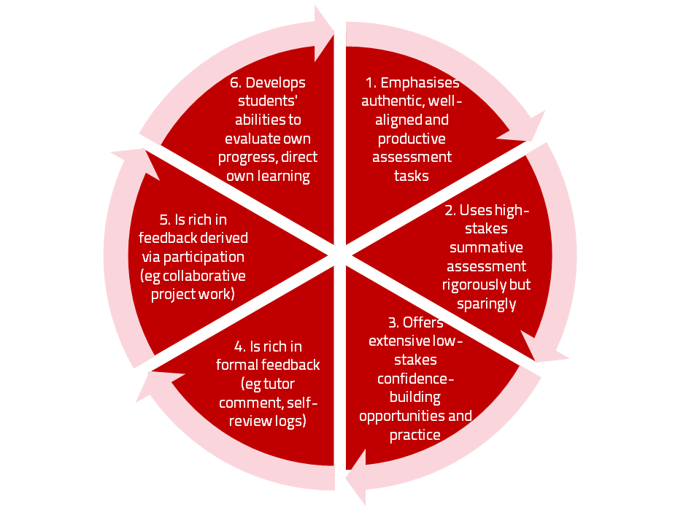
A4L the Northumbria model

Slide 8
Using assessment for learning
(Sambell et al, 2012)
Assessment that is meaningful to students can provide them with a framework for activity;
“Students can escape bad teaching but they can’t escape bad assessment” (Boud, 1995);
Where assessment is fully part of the learning process and integrated within it, the act of being assessed can help students to make sense of their learning;
Assessment should be formative, informative, developmental and remediable.

Slide 9
My fit-for-purpose model of assessment: the key questions
Why are we assessing?
What is it we are actually assessing?
How are we assessing?
Who is best placed to assess?
When should we assess?
Notes:
9

Slide 10
For any assessment activity, we need to be clear about:
Aims: is this an early stage assignment, that is principally about building confidence and helping students see what is required of them, or is it a key element of their summative assessment, designment to gauge fitness to progress, or fitness-to-practice?
Scope: is this testing low level outcomes, like demonstrating recollection of key terms, or is it cognitively more demanding requiring synthesis of multiple elements, critical analysis, evaluation and reflection?
Scale: is this a small scale or a substantial task carrying a heavy weighting? Do students know how much effort and energy is needed to achieve at least a satisfactory level?
Orientation: Is the key aim to demonstrate the achievement of skills and competences, and/or to produce a definite product or is it primarily about demonstrating mastery of appropriate processes?
Constructive alignment: To what extent does the assessment closely link to the learning outcomes (and specifically the verbs used in them)?

Slide 11
So to help us focus on assessment criteria and developing students’ assessment literacy, a game!
This game is designed to help you think about how we can explain the importance of taking assessment criteria seriously in assessment to help students really understand what they need to do to succeed;
Biscuits are a metaphor!

Slide 12
Thinking through the issues raised in the biscuit game
It is often useful to start from individual perspectives at the outset of an assignment and clarify preconceptions;
Assessment is a complex nuanced task with grey areas, and just as agreed definitions of biscuits are not always readily achievable, so also assignments benefit from dialogue to clarify expectations;
Category definitions can sometimes be complicated when setting assignments. It’s helpful in advance of an assessment to agree definitions of what is, for example, a portfolio;
It’s helpful to face the fact that although criteria may be considered to be explicit, the way people grade using criteria can differ substantially;
Assigning grades is an imprecise and inexact activity, and we need to recognise that absolute certainty about grades is not always achievable;
Generic discussion about assessment, and how we grade can help develop assessment literacy.

Slide 13
Formative and summative assessment
Formative assessment is primarily concerned with feedback aimed at prompting improvement, is often continuous and usually involves words.
Summative assessment is concerned with making evaluative judgments, is often end point and involves numbers.

Slide 14
The importance of dialogic feedback (Sadler)
Students need to be exposed to, and gain experience in making judgements about, a variety of works of different quality... They need planned rather than random exposure to exemplars, and experience in making judgements about quality. They need to create verbalised rationales and accounts of how various works could have been done better. Finally, they need to engage in evaluative conversations with teachers and other students.

Slide 15
Assessment literacy: students do better if they can:
Make sense of key terms such as criteria, weightings, and level;
Encounter a variety of assessment methods (e.g. presentations, portfolios, posters, assessed web participation, practicals, vivas etc) and get practice in using them;
Be strategic in their behaviours, putting more work into aspects of an assignment with high weightings, interrogating criteria to find out what is really required and so on;
Gain clarity on how the assessment regulations work in their HEI, including issues concerning submission, resubmission, pass marks, condonement etc.

Slide 16
Students tend to be more convinced about the fairness of the assessment process if
Requirements and procedures are transparent and made readily available to them;
They believe that the tasks they are asked to do are worthwhile and are closely linked to what course documentation indicates they should be able to know and do at the end of the programme i.e. authentic assessment;
They fully understand the ‘rules of the game’.

Slide 17
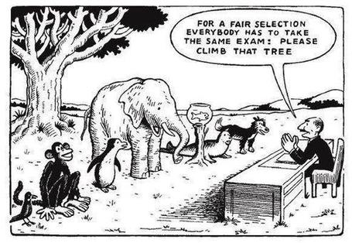

Slide 18
Helping students better understand what is needed of them
This can be achieved in a variety of ways, including:
Using games (like the Biscuit game) can help make students think hard about criteria and required outcomes;
Ensuring that briefings (in the form of documentation, and more importantly, live/ face-to-face briefings, where students can actively interrogate criteria) are useful;
Getting students to self-assess to start a feedback dialogue;
Using exemplars to show students what high quality work in this domain comprises, and what features and aspects are crucial for success.

Slide 19
Assessment for learning: some useful thoughts
1. Tasks should be challenging, demanding higher order learning and integration of knowledge learned in both the university and other contexts;
2. Learning and assessment should be integrated, assessment should not come at the end of learning but should be part of the learning process;
3. Students are involved in self assessment and reflection on their learning, they are involved in judging performance;
4. Assessment should encourage metacognition, promoting thinking about the learning process not just the learning outcomes;
5. Assessment should have a formative function, providing ‘feedforward’ for future learning which can be acted upon. There is opportunity and a safe context for students to expose problems with their study and get help; there should be an opportunity for dialogue about students’ work;

Slide 20
Assessment for learning
6. Assessment expectations should be made visible to students as far as possible;
7. Tasks should involve the active engagement of students developing the capacity to find things out for themselves and learn independently;
8. Tasks should be authentic; worthwhile, relevant and offering students some level of control over their work;
9. Tasks are fit for purpose and align with important learning outcomes;
10. Assessment should be used to evaluate teaching as well as student learning.
(Bloxham and Boyd)

Slide 21
Using feedback to enhance student learning

Slide 22
Activating Learning
Using feedback to enhance student learning, foster achievement and promote learning
QMUL
22nd November, 2018
Phil Race
(from Newcastle-upon-Tyne)
BSc PhD PGCE FCIPD PFHEA NTF
Follow Phil on Twitter: @RacePhil
Visiting Professor: University of Plymouth and Edge Hill University
Emeritus Professor, Leeds Beckett University

Slide 23
About Phil…
First a musician
Then a writer
Then a scientist
Then a researcher
Then a lecturer and warden at what is now USW
Got interested in how students learn
And the effects assessment and feedback have on them
And how we teach them
Gradually became an educational developer
And now ‘retired’!?
Currently…
Visiting Prof: Plymouth & Edge Hill
Emeritus Prof: Leeds Beckett
Based at Newcastle, UK
And on trains
And an expert…
on train routes and timetables!
Notes:
2
2

Slide 24
Announcement about mobile phones and laptops...
Good afternoon everyone – please turn on your ‘phones and computers.
Please post your thoughts, comments and ideas during this session to the hashtag #philatQMUL18 Thanks!
Try #LTHEchat on Wednesday evenings from 20.00-21.00.

Slide 25
Announcement about mobile phones and laptops...
Good afternoon everyone – please turn on your ‘phones and computers.
Please post your thoughts, comments and ideas during this session to the hashtag #philatQMUL18 Thanks!
Try #LTHEchat on Wednesday evenings from 20.00-21.00.

Slide 26
Thought for the day: Einstein
It is simply madness,
to keep doing the same things,
and expect different results.

Slide 27
How do assessment and feedback need to vary across disciplines?
(after Biglan, 1973, Trowler, 2014, Berry O’Donovan, 2018)
Hard
Applied
Pure
Soft

Slide 28
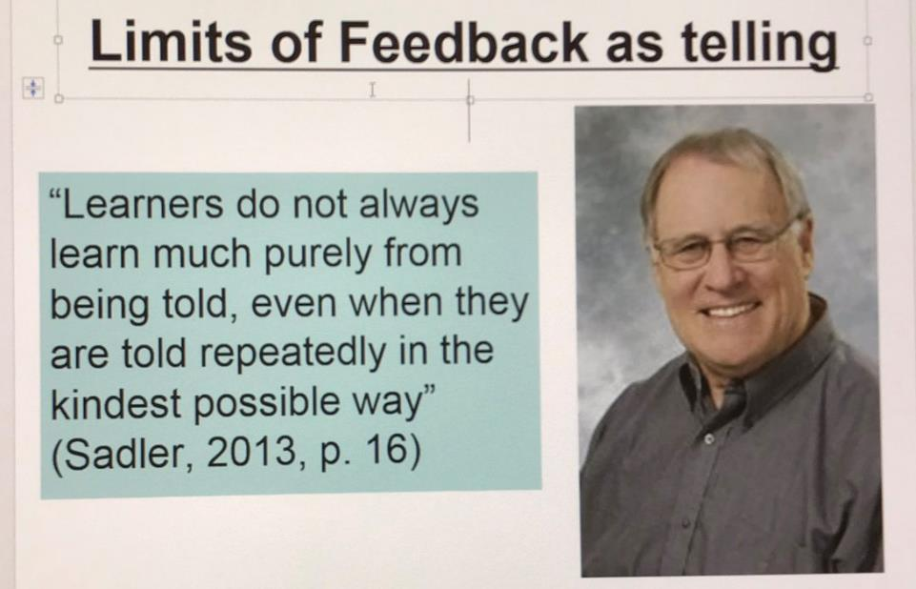
David Carless (on Twitter):
Feedback as telling is seriously overrated!

Slide 29
The most important part of our work
Assessing students’ work, and providing them with feedback is an ever-increasing proportion of the work of teaching staff in universities nowadays, but remains for studtsthe most important side of our work.
A problem is that we sometimes try to soldier-on using the tools of the last century, hence the need to innovate, and make assessment and feedback fit for purpose in the 21st century.

Slide 30
Download anytime Phil’s materials on learning and feedback
http://phil-race.co.uk/2016/04/updated-powerpoint-ripples-model/ (Chapter 1 from ‘The Lecturer’s Toolkit, 2015)
https://phil-race.co.uk/2016/10/lthe-tweetchat-lthechat-wed-oct-19-8-00-9-00-pm/ (feedback stuff from my most recent two books)

Slide 31
Teaching, learning and enthusiasm
Knowledge isn’t infectious (unfortunately) but enthusiasm is, and we need to help our students to catch enthusiasm.
We certainly don’t want feedback to damage that enthusiasm.

Slide 32
Time-constrained assessed written Post-it exercise
On a post-it, in your best handwriting, please write your own completion of the starter:
“Making feedback work well with my students nowadays would be much better for me if only I …”
Please swap post-its so that you’ve no idea who has yours.
If chosen, please read out with passion and drama what’s on the post-it you now have.
Please place them all as directed.

Slide 33
You wrote (1)
Had longer to spend on it, more use of spoken feedback.
All I were doing was teaching – nothing else!
Had the time to write all the feedback that they really need to improve (i.e. correct all of their grammatical mistakes, citations etc.)
If only I knew what they wanted.
Had more time.
Had some autonomy in linking / delinking feedback and assessment.

Slide 34
You wrote (2)
Always had something positive to offer to write for each student.
Had a more nuanced vocabulary and could see the better argument they could have made,
More time to give good quality feedback.
would have more time.
I could initiate them through feedback to learn and understand for themselves.
Had more time to actually discuss it with them face to face rather than just in writing.

Slide 35
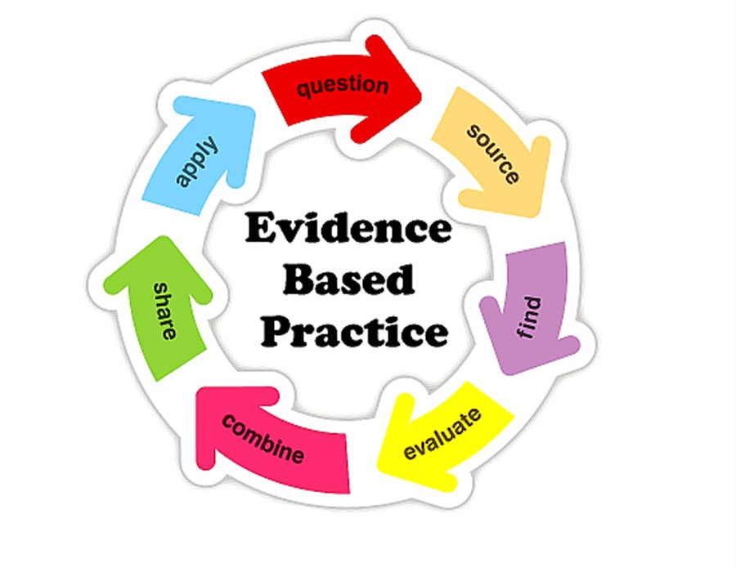

Slide 36
The NSS Assessment and Feedback Agenda (2005-16)
The criteria used in marking have been clear in advance.
Assessment arrangements and marking have been fair.
Feedback on my work has been prompt.
I have received detailed comments on my work.
Feedback on my work has helped me to clarify things I did not understand.

Slide 37
The new NSS statements (2017)
Assessment and feedback
The criteria used in marking have been clear in advance
Marking and assessment have been fair
Feedback on my work has been timely
I have received helpful comments on my work
Student voice
I have had the right opportunities to provide feedback on my course
Staff value students’ views and opinions about the course
It is clear how students’ feedback on the course has been acted on

Slide 38
Feed-forward
Language of feedback
Some feedback
issues
National Student Survey
Timing:
24-hours!
Written, printed,
on-screen
Efficiency
Face to face
oral

Slide 39
Seven factors underpinning successful learning: (Race, 2015)
Verbalising
Assessing
Feedback
Making sense
Doing
Wanting/
Needing
Race, P. (2015) The Lecturer’s Toolkit, 4th Edition: Chapter 1 (Routledge)

Slide 40

Seven factors underpinning successful learning (#rracw, 2015)
Verbalising
Assessing
Feedback
Making sense
Doing
Wanting/
Needing

Slide 41


We can’t carry on trying to use traditional assessment and feedback processes
We can’t continue trying to give students lots of feedback in traditional ways, as there are more students, and research shows that merely ‘telling’ them what to do with their work does not work.
There is now a great deal of work on ‘contract cheating’, for example Newton, P. (2018) https://www.frontiersin.org/articles/10.3389/feduc.2018.00067/full
And traditional written feedback doesn’t work: “Approaches that emphasise feedback as telling are insufficient because students are often not equipped to decode or act on statements satisfactorily, so key messages remain invisible” (Sadler 2010).

Slide 42


Developing students’ feedback literacy
The danger with traditional methods of assessment and feedback is that assessment tends to be done on student’s work by staff, and feedback tends to be one-directional from staff to students.
Carless and Boud (2018) stress that we want students to gain skills in making ‘evaluative judgements’ themselves on their work, rather than staff doing this.
David Carless & David Boud (2018): The development of student feedback literacy: enabling uptake of feedback, Assessment & Evaluation in Higher Education, https://doi.org/10.1080/02602938.2018.1463354

Slide 43
Factors underpinning feedback literacy
Carless and Boud (2018) examine in detail:
Appreciating feedback
Making judgements
Managing affect
Taking action
We need to enable our students to optimise each of these processes, if we wish to use assessment to promote their learning. They suggest that involving students in giving and receiving peer feedback, and in analysing exemplars, should be essential parts of the curriculum.

Slide 44
Task: think about ghastly feedback
Think back to some occasions, academic or otherwise, historic or recent when you received feedback that you would rather not have received;
How did it make you feel?
Thinking of a single example of ghastly feedback that you are prepared to share with another person, briefly outline the context and say why it was such a negative experience.

Slide 45
Feedback needs to have a future focus
Hounsell et al argue that we need to:
‘increase the value of feedback to the students by focusing comments not only on the past and present … but also on the future – what the student might aim to do, or do differently in the next assignment or assessment if they are to continue to do well or to do better’
(Hounsell, McCune, Hounsell and Litjens 2008, p.5).

Slide 46
Quality feedback: 3 functions
“There is wide consensus within the education literature that ‘quality’ feedback should serve three overlapping functions:
an ‘orientational’ purpose that clarifies the student’s performance and achievement;
a ‘transformational’ purpose that enables the student to reflect, improve their performance, and become more autonomous (often termed ‘feed-forward); and
an ‘affective/interpersonal’ dimension that gives the student confidence and motivation, and builds a strong teacher-student relationship”
(Dunworth & Sanchez, 2016, quoted by Winstone and Nash, 2016).

Slide 47

Last September: The essay is failing us. Discuss
See my controversial THE piece on essays on the downloadable file
Posted in the post below this one

Slide 48

Fishing for feedback?
Feedback is like fish.
If it is not used quickly, it becomes useless.
(Sally Brown).
Give a man a fish,
Feed him for a day.
Teach a man to fish,
Feed him for a lifetime.
(Maimonides: 1135-1204)
Make feedback timely, while it still matters to students, in time for them to use it towards further learning, or to receive further assistance.
(Graham Gibbs)
And he’ll learn to drink beer in boats
And you won’t see him for weeks!
(Australian proverb).

Slide 49
Five main problems with assessed essays
They take a great deal of time to mark, let alone the time it takes for students to prepare, draft and compose them.
When most assessment is in the form of essays, students’ skills at essay-writing are repeatedly tested, as the expense sometimes of their understanding of the subject.
Lots of research shows that we’re not at all good at marking essays fairly – different assessors often give the same essay very different marks.
Essay marks in the UK tend to lie between 35% for a poor one and 75% for a very good one, whereas in many other disciplines the marks for an assignment like a lab report can range across the whole 0-100% span more evenly.
With coursework essays, there can be doubt about ‘whodunit?’!

Slide 50
How’s your feedback?
(After Nicol and MacFarlane-Dick, 2006)
1. Helps clarify what good performance is (goals, criteria, expected standards);
2. Facilitates the development of self-assessment (reflection) in learning;
3. Delivers high quality information to students about their learning;
4. Encourages teacher and peer dialogue around learning;
5. Encourages positive motivational beliefs and self-esteem;
6. Provides opportunities to close the gap between current and desired performance;
7. Provides information to teachers that can be used to help shape the teaching.

Slide 51
Bringing assessment and feedback to life
Questions employers might ask at interview that could help us frame some of our assignments
Can you tell us about an occasion when:
you worked together with colleagues in a group to produce a collective outcome?
you had to work autonomously with incomplete information and self-derived data sources?
you developed strategies to solve real life problems and tested them out?
you has a leadership role in a team, and could you tell us your strategies to influence and persuade your colleagues to achieve a collective task?
you had to communicate outcomes from your project work orally, in writing, through social media and/or through a visual medium?

Slide 52
Constructive Alignment: John Biggs
What will I be expected to show for this?
What does a good one look like, and a bad one?
Where does this fit into the big picture?
When explaining assessment criteria to students, and when linking these to evidence of achievement of the intended learning outcomes, we need to make the most of face-to-face whole group contexts and...
  Tone of voice
  Body language
  Facial expression
  Eye contact
  The chance to repeat things
  The chance to respond to puzzled looks
Some things don’t work nearly so well just on paper or on screens.
Some of the
tools we can
use in
face-to-face
contexts

Slide 53

Face to face feedback

Slide 54

Hands-on feedback?

Slide 55
What’s wrong with feedback?
Students get it too late.
And too often, it’s just words on paper.
It doesn’t help them enough.
They often don’t take enough notice of it.

Slide 56
But what’s really wrong with feedback?
Too often it’s one-way – monologic.
What students want is dialogue.
They want to talk to us about their work.
But they’re scared to talk to us, for various reasons:
  In case it leads to lower marks;
  In case they’re ‘found out’;
  In case they feel stupid.

Slide 57
The importance of dialogic assessment
Students need to be exposed to, and gain experience in making judgements about, a variety of works of different quality... They need planned rather than random exposure to exemplars, and experience in making judgements about quality. They need to create verbalised rationales and accounts of how various works could have been done better. Finally, they need to engage in evaluative conversations with teachers and other students. Together, these three provide the means by which students can develop a concept of quality that is similar in essence to that which the teacher possesses, and in particular to understand what makes for high quality. Although providing these experiences for students may appear to add more layers to the task of teaching, it is possible to organise this approach to peer assessment so that it becomes a powerful strategy for higher education teaching. (Sadler 2010)

Slide 58

Royce Sadler on feedback:
Higher education teachers are often frustrated by the modest impact feedback has in improving learning. The status of feedback deserves to be challenged on the grounds that it is essentially about telling. For students to become self-sustaining producers of high quality intellectual and professional goods, they must be equipped to take control of their own learning and performance. (Sadler, 2013)
Sadler, D. R. (2013). Opening up feedback: Teaching learners to see. In Merry, S., Price, M., Carless, D., & Taras, M. (Eds.) Reconceptualising feedback in higher education: Developing dialogue with students. (Ch. 5, 54‑63). London: Routledge.

Slide 59

Thank you…
Website: http://phil-race.co.uk
Follow Phil on Twitter @RacePhil
e-mail: phil@phil-race.co.uk

Slide 60
SALLY’S FURTHER SLIDES ON FEEDBACK
(We didn’t use these at this session)

Slide 61
Fostering student engagement with feedback
Students tend to regard marks like money, and so will put more energy into things that ‘count’ than those they see as options;
Formative feedback, that is developmental and supportive, and given at the right stage so that it guides future performance can be exceptionally powerful in improving achievement and retention;
Feedback and ‘feed-forward’ must be integral to student learning programmes, rather than something that students opt into, so needs to be within live or virtual face-to-face interaction.

Slide 62
Encouraging better use of feedback
Emphasise early on the importance to them of formative feedback;
Consider how best to provide them with feedback.
Provide them with training on why and how feedback is provided;
Get students to practise drafting and delivering feedback;
Get students to focus on comments rather than marks;
Help students to believe they have the agency to improve their work;
Encourage students to think of feedback as a trigger to them taking action;
Give them some examples of helpful feedback as a prompt to discussion.

Slide 63
Good feedback:
(after Brown, S. (2015), Assessment, learning and teaching in higher education: global perspectives, London: Palgrave-MacMillan)
Is dialogic, rather than mono-directional, giving students chances to respond to comments from their markers and seek clarification where necessary.
Helps clarify what good work looks like, so students are really clear about goals, criteria and expected standards, and provides opportunities to close the gap between current and desired performance.

Slide 64
Good feedback:
Actively facilitates students reviewing their own work and reflecting on it, so that they become good judges of the quality of their own work.
Doesn’t just correct errors and indicate problems, potentially leaving students discouraged and demotivated, but also highlights good work and encourages them to believe they can improve and succeed.

Slide 65
Good feedback:
Delivers high-quality information to students about their achievements to date and how they can improve their future work. Where there are errors, students should be able to see what needs to be done to remediate them, and where they are undershooting in terms of achievement, they should be able to perceive how to make their work even better.

Slide 66
Good feedback:
Offers ‘feed-forward’ aiming to ‘increase the value of feedback to the students by focusing comments not only on the past and present … but also on the future – what the student might aim to do, or do differently in the next assignment or assessment if they are to continue to do well or to do better’ (Hounsell, 2008, p.5).
Ensures that the mark isn’t the only thing that students take note of when work is returned, but that they are encouraged to read and use the advice given in feedback and apply it to future assignments.

Slide 67
Five things students really hate about poor feedback
Poorly written comments that are nigh on impossible to decode, especially when impenetrable acronyms or abbreviations are used, or where handwriting is in an unfamiliar alphabet and is illegible.
Cursory and derogatory remarks that leave them feeling demoralised ‘Weak argument’, ‘Shoddy work’, ‘Hopeless’, ‘Under-developed’, and so on.
Value judgements on them as people rather than on the work in hand.

Slide 68
Five things students really hate about poor feedback
Vague comments which give few hints on how to improve or remediate errors: ‘OK as far as it goes’, ‘Needs greater depth of argument’, ‘Inappropriate methodology used’, ‘Not written at the right level’.
Feedback that arrives so late that there are no opportunities to put into practice any guidance suggested in time for the submission of the next assignment.

Slide 69
Encouraging students to recognise and use the feedback we provide for them
Delivery of feedback should not be left to chance, so its best to avoid asking students to pick up marked hard copy assignments from departmental offices;
Electronic submission of assignments has benefits and disadvantages but on balance the former outweigh the latter;
Perhaps require students to guestimate expected marks having read your feedback early in their programmes;
‘Assignment handler’ can deliver feedback electronically and only release marks once students have responded;
Audio files of audio feedback can be highly successful in enabling students to capture ‘live’ oral feedback, and can replace written feedback (e.g. JISC project ‘Sounds good’).

Slide 70
Streamlining assessment

Slide 71
Streamlining assessment: why would we wish to do it?
Huge pressure on resources in higher education;
Larger numbers of students in cohorts;
Ever-increasing demands on staff time;
Staff indicate they spend a disproportionate time on assessment drudgery;
The means exist nowadays to undertake some aspects of assessment more effectively and efficiently.

Slide 72
To give feedback more effectively
& efficiently, we can:
Feedback orally to groups of students;
Write an assignment report;
Use model answers;
Use assignment return sheets;
Use statement banks;
Use technologies for delivering and managing assessment.

Slide 73
Feeding back orally to groups of students: why?
Face-to-face feedback uses tone of voice, emphasis, body language;
Students learn from feedback to each others’ work;
Students can ask questions;
Makes feedback a shared experience.

Slide 74
Feeding back orally to groups of students: how?
Staff mark assignments with minimal in-text comment and provide grades/marks as normal;
At the start of a lecture or seminar, the tutor provides an overview of class performance and orally remediates errors, clarifies; misunderstandings, and praises good practice;
Students have a chance to ask and answer questions;
An audio file can be made available on the VLE.

Slide 75
Written assignment reports: why?
Provides feedback to a group as a whole;
Allows students to know how they are doing by comparison with the rest of the course;
Offers a chance to illustrate good practice;
Minimal comments can be put on scripts;
Generic reports can be delivered quickly electronically before moderation.

Slide 76
Assignment reports: how?
Staff mark assignments with minimal in-text comment and provide grades/marks as normal;
Notes are made of similar points from several students’ work;
A report is compiled which identifies examples of good practice, areas where a number of students made similar errors and additional reading suggestions.

Slide 77
Using ‘expanded’ model answers: why?
They give students a good idea of what can be expected of them;
It is sometimes easier to show students than tell them what we are after;
They can be time efficient;
They show how solutions have been reached;
They demonstrate good practice;
The commentary can indicate why an answer is good.

Slide 78
Using model answers: how?
Staff preparing an assignment can draft a model answer;
Student work (or extracts from several student’s answers) can be anonymised and (with permission) used as a model;
Text can be placed on page with explanatory comments appended (‘exploded text’);
However, caution should be exercised in order to lead students to think only one approach is acceptable.

Slide 79
Assignment return sheets: why?
Proformas save assessors writing the same thing repeatedly;
Helps to keep assessors’ comments on track;
Shows how criteria match up to performance and how marks are derived;
Helps students to see what is valued;
Provides a useful written record.

Slide 80
Assignment return sheets: how?
Criteria presented in assignment brief can be utilised in a proforma;
Variations in weighting can be clearly identified;
A Likert scale or boxes can be used to speed tutor’s responses;
Space can be provided for individual comments.

Slide 81
Sample assignment return proforma
Criterion no | Criterion | Mark (0-5 marks) | Tutor comments and suggestions for further work | Student response
1 | Demonstrates ability to present information clearly logically, accurately and fluently | 3 | This work is written reasonably fluently but there are some typos that would not slip in if spell checker used properly. Also note you don’t use the definite and indefinite articles (‘a’ and ‘the’ appropriately: please refer to the language guidance 17.3 on the VLE | This is something I’ve had problems with over the years but am still working on it
2 | Demonstrates ability to choose and use appropriate software | 5 | Made excellent choices and used it well to suit the context of the problem being addressed | Thank you
3 | Demonstrates ability to use a range of reference materials and cite them appropriately | 1 | Cited only one reference and did so inaccurately Please refer to the ifs referencing guide on the VLE and ensure that you provide all the information required | I've checked it out and see where I was going wrong

Slide 82
Statement banks: why?
Harnesses a resource of comments you already use;
Avoids writing same comments repeatedly;
Allows you to give individual comments additionally to the students who really need them;
Can be automated with use of technology.

Slide 83
Statement banks: how?
Tutor identifies a range of regularly used comments written on students’ work;
These are collated and numbered;
Tutor marks work and writes numbers on text of assignment where specific comments apply, or provides a written (or emailed) detailed commentary which pulls together the appropriate items into continuous prose;
Moodle and other platforms can do much of the drudgery in terms of collating marks, returning work etc. Assignment handler can return comments and only release marks when students have commented.

Slide 84
Computer-assisted assessment: why?
Enables feedback to be given regularly and incrementally;
Saves tutor time for large cohorts and repeated classes;
Can allow instant (or rapid) on screen feedback to e.g. MCQ options;
Saves drudgery, (but not a quick fix);
Is really worth while for large cohorts and where content doesn’t alter fast.

Slide 85
Computer-assisted assignments: how?
Designing them should not be a cottage industry!
Training and support both in designing questions and applying the relevant technology are essential;
Testing and piloting of CAA items is also imperative;
We can make use of existing test packages (e.g. from publishers), colleagues with expertise and advice from software companies (e.g. Moodle, Turnitin, QuestionMark).

Slide 86
Use CAA for rather than of learning
We can employ computer-assisted formative assessment with responses to student work automatically generated by email;
Students seem to really like having the chance to find out how they are doing, and attempt tests several times in an environment where no one else is watching how they do;
We can monitor what is going on across a cohort, so we can concentrate our energies either on students who are repeatedly doing badly or those who are not engaging at all in the activity; Note that Computer-supported assessment can include use of audio feedback via digital sound files, video commentaries and other means of using course Virtual Learning Environments.

Slide 87
Practical guidance on engaging students in assessment and feedback
We didn’t use any of the rest of the slides, but you’re most welcome to them

Slide 88
To better engage learners through feedback and assessment we can:
Make use of real examples and hot-off-the-press data to keep content and tasks current and relevant;
Provide challenges to students’ thinking without letting individuals feel publicly exposed or humiliated;
Relate their learning in class to the forthcoming/ongoing assignment (without slavishly teaching to the exam);
Make spaces for dialogue through formative assessment;
Give them real problems to solve and issues with which to engage;
Identify the skills they need to succeed and provide opportunities to rehearse and develop them;
Never compromise on the quality of the demands we make of them.

Slide 89
Making assessment work well
Intra-tutor and Inter-tutor reliability need to be assured;
Practices and processes need to be transparently fair to all students;
Cheats and plagiarisers need to be deterred/punished;
Assessment needs to be manageable for both staff and students;
Assignments should assess what has been taught/learned, not what it is easy to assess.

Slide 90
Briefings for students: setting the context
Early-stage students are likely to need more reassurance in your briefings in which the tone of your language may be crucial;
We should aim for as much transparency as possible: no student should be having to guess what you are looking for at any stage of their academic careers;
Whenever we use what may be to them an unfamiliar format, briefings should be linked to trial-runs, risk-free rehearsals and Q&A opportunities to clarify any areas of misconceptions;
This is not ‘spoonfeeding’ but instead giving them the knives and forks to feed themselves!

Slide 91
Briefings activity
Imagine this is an early assignment for a First-Year undergraduate cohort;
In groups, list some essential components of an effective assignment brief;
Discuss how your briefings would be different if these were Final Year UGs or PG students;
Use this activity to help you build a checklist of what to include in your future briefings.

Slide 92
Essential components of an effective assignment brief I would suggest include:
Housekeeping arrangements: when does it have to be completed? How must it be submitted? Are you setting limitations around format and layout (e.g. font size, margins, use of figures, tables etc)?
Clarifying the scope of the task: how big is the task? How many words? Approximately how much time would you intend an average student to spend on this work? How many and what kinds of references should they use?
Support: Where can students go for help? How much and what kind of support can they get? (e.g. checking drafts, proofreading);
Good academic conduct: what do they need to know about the appropriate levels of peer support? How might plagiarism regulations impact on them?
Choosing the right medium: is an oral or video briefing best? What kinds of documentary detail do they need? Is the briefing a dialogue or monologue?

Slide 93
What are exemplars, and how can we use them productively?
Exemplars are not model answers. They are carefully selected examples of authentic student work from previous cohorts (anonymised and with permission) or teacher-constructed examples (based on your extensive experience of the kinds of responses and common mistakes students make). They are chosen to typify and illustrate designated levels of quality or competence.
The concrete nature of exemplars means that they are able to convey messages in a way that nothing else can (Sadler, 2002). Carefully selected examples can not only help students to ‘see’ what the teacher expects with regard to the task in hand (Scoles et al, 2013), but also guide their action.

Slide 94
Exemplars can enable students to:
gain a feel for what the final product looks like in terms of layout, structure and language;
develop their insights into the nature of academic writing;
raise awareness of the diverse ways a task might fruitfully (or erroneously) be tackled;
hone students’ evaluative skills.
Act as powerful learning tools (Sadler, 2010), helping students gain insight into the nature of quality and standards, ideally through close analysis and discussion (Hendry et al, 2016). Students typically find exemplars to be more useful than standalone lists of criteria, grids and rubrics (Hawe et al, 2017).

Slide 95
What can we do when using exemplars?
Choose examples which will help students firmly grasp task requirements;
Help students practice applying criteria to samples of work;
Enable students to reflect deeply on, and discuss, what high quality work looks like;
Choose examples to promote self-efficacy;
Carefully orchestrate discussion activities to promote understanding of fruitful learning strategies and approaches;
Use exemplars-based activities to develop students’ skills to monitor their own work while they are producing it;
Help them rate their work by comparison with their peers.

Slide 96
Do your international students understand UK assessment approaches?
Have you clarified the ground rules on issues like pass marks, criterion-referenced assessment and grading systems?
Have you explained how extensions, condonements, and university assessment regulations work?
Are the assignments built around a curriculum international in scope and content? Are tasks and case studies globally orientated?

Slide 97
Are your students aware of all the processes and procedures we use to ensure fair assessment?
Do they know how we require assessors to match grades to achievement of assessment criteria?
Are they familiar with the steps we take to ensure inter-assessor reliability?
Do they understand that moderation processes are in place, for example through exam boards, to ensure that justice is done to each individual?
Do they get to hear about the work of external examiners (or even get to meet them?)?

Slide 98
Planning to implement enhancements in assessment & feedback in your module/programme
As an individual, are there changes you would like to make to your assessment practices?
Thinking about the teams you work with, are there ways in which you could use ideas from today’s session to help make your assessment more authentic?
How could your influence impact more widely on colleagues across the university?

Slide 99
Useful references: 1
Assessment Reform Group (1999) Assessment for Learning: Beyond the black box, Cambridge UK, University of Cambridge School of Education.
Bain, K. (2004) What the best College Teachers do, Cambridge: Harvard University Press.
Biggs, J. and Tang, C. (2011) Teaching for Quality Learning at University, Maidenhead: Open University Press.
Bloxham, S. and Boyd, P. (2007) Developing effective assessment in higher education: a practical guide, Maidenhead, Open University Press.
Boud, D. (1995) Enhancing learning through self-assessment, London: Routledge.
Boud, D. and Associates (2010) Assessment 2020: seven propositions for assessment reform in higher education Sydney: Australian Learning and Teaching Council.

Slide 100
Useful references: 2
Brown, S. (2014) Learning, teaching and assessment in higher education: global perspectives. London: Palgrave Macmillan.
Brown, S. and Glasner, A. (eds.) (1999) Assessment Matters in Higher Education, Choosing and Using Diverse Approaches, Maidenhead: Open University Press.
Brown, S. and Knight, P. (1994) Assessing Learners in Higher Education, London: Kogan Page.
Brown, S. and Race, P. (2012) Using effective assessment to promote learning in Hunt, L. and Chambers, D. (2012) University Teaching in Focus, Victoria, Australia, Acer Press. P74-91
Brown, S. Rust, C. & Gibbs, G. (1994) Strategies for Diversifying Assessment, Oxford: Oxford Centre for Staff Development.

Slide 101
Useful references: 3
Carless, D., Joughin, G., Ngar-Fun Liu et al (2006) How Assessment supports learning: Learning orientated assessment in action Hong Kong: Hong Kong University Press.
Carroll, J. and Ryan, J. (2005) Teaching International students: improving learning for all. London: Routledge SEDA series.
Crooks, T. (1988) Assessing student performance, HERDSA Green Guide No 8 HERDSA (reprinted 1994).
Crosling, G., Thomas, L. and Heagney, M. (2008) Improving student retention in Higher Education, London and New York: Routledge.
Falchikov, N. (2004) Improving Assessment through Student Involvement: Practical Solutions for Aiding Learning in Higher and Further Education, London: Routledge.

Slide 102
Useful references: 4
Gibbs, G. (1999) Using assessment strategically to change the way students learn, in Brown S. & Glasner, A. (eds.), Assessment Matters in Higher Education: Choosing and Using Diverse Approaches, Maidenhead: SRHE/Open University Press.
Higher Education Academy (2012) A marked improvement; transforming assessment in higher education, York: HEA.
Hounsell, D. (2008). The trouble with feedback: New challenges, emerging strategies, Interchange, Spring, Accessed at www.tla.ed.ac.uk/interchange.
Knight, P. and Yorke, M. (2003) Assessment, learning and employability Maidenhead, UK: SRHE/Open University Press.

Slide 103
Useful references: 5
McDowell, L. and Brown, S. (1998) Assessing students: cheating and plagiarism, Newcastle: Red Guide 10/11 University of Northumbria.
Mentkowski, M. and associates (2000) p.82 Learning that lasts: integrating learning development and performance in college and beyond, San Francisco: Jossey-Bass.
Meyer, J.H.F. and Land, R. (2003) ‘Threshold Concepts and Troublesome Knowledge 1 – Linkages to Ways of Thinking and Practising within the Disciplines’ in C. Rust (ed.) Improving Student Learning – Ten years on. Oxford: OCSLD.
Morgan, C., Dunn, L., Parry, S. and O'Reilly, M. (2004) The student assessment handbook: New directions in traditional and online assessment, London, Routledge.

Slide 104
Useful references: 6
Newstead, S. E., Franklyn-Stokes, A., & Armstead, P. (1996) Individual differences in student cheating, Journal of Educational Psychology, 88(2), 229-241
Nicol, D. J. and Macfarlane-Dick, D. (2006) Formative assessment and self-regulated learning: A model and seven principles of good feedback practice, Studies in Higher Education Vol 31(2), 199-218.
PASS project Bradford http://www.pass.brad.ac.uk/ Accessed November 2013.
Peelo, M. T., & Wareham, T. (Eds.). (2002). Failing students in higher education. Society for Research into Higher Education.
Pickford, R. and Brown, S. (2006) Assessing skills and practice, London: Routledge.

Slide 105
Useful references: 7
Race, P. (2001) A Briefing on Self, Peer & Group Assessment, in LTSN Generic Centre Assessment Series No 9, LTSN York.
Race P. (2015) The lecturer’s toolkit (4th edition), London: Routledge.
Race, P. (2014) Making learning happen: 3rd edition, London: Sage.
Rotheram, B. (2009) Sounds Good, JISC project http://www.jisc.ac.uk/whatwedo/programmes/usersandinnovation/soundsgood.aspx
Rust, C., Price, M. and O’Donovan, B. (2003) Improving students’ learning by developing their understanding of assessment criteria and processes, Assessment and Evaluation in Higher Education. 28 (2), 147-164.

Slide 106
Useful references: 8
Ryan, J. (2000) A Guide to Teaching International Students, Oxford Centre for Staff and Learning Development.
Sadler, D. R. (2010) Beyond feedback: Developing student capability in complex appraisal. Assessment & Evaluation in Higher Education, 35(5), 535-550.
Yorke, M. (1999) Leaving Early: Undergraduate Non-completion in Higher Education, London: Routledge.

Slide 107

Phil’s choices
NSS assessment and
feedback criteria
museum
How students really learn
Designing the curriculum
for learning
Content-free test
QAA B6
Smarter
feedback
Quotes about
lectures
7
mlh
Validity, etc
concerns
TST
Literacies
24 hour
feedback
Towards assessment
as learning
T, r and r
What the
gurus tell us
Sally on feedback
HEA slides
A short exam
Strategy
Smarter
assessment
Marks and
self-assessment
Alternatives
to essays
ML3 menu
Fun
Feedback on exams
Main menu

Slide 108
Activating Learning
Using feedback to enhance student learning, foster achievement and promote learning
QMUL
22nd November, 2018
Phil Race
(from Newcastle-upon-Tyne)
BSc PhD PGCE FCIPD PFHEA NTF
Follow Phil on Twitter: @RacePhil
Visiting Professor: University of Plymouth and Edge Hill University
Emeritus Professor, Leeds Beckett University

Slide 109
About Phil…
First a musician
Then a writer
Then a scientist
Then a researcher
Then a lecturer and warden at what is now USW
Got interested in how students learn
And the effects assessment and feedback have on them
And how we teach them
Gradually became an educational developer
And now ‘retired’!?
Currently…
Visiting Prof: Plymouth & Edge Hill
Emeritus Prof: Leeds Beckett
Based at Newcastle, UK
And on trains
And an expert…
on train routes and timetables!
Notes:
2
2

Slide 110
Announcement about mobile phones and laptops...
Good afternoon everyone – please turn on your ‘phones and computers.
Please post your thoughts, comments and ideas during this session to the hashtag #philatQMUL18 Thanks!
Try #LTHEchat on Wednesday evenings from 20.00-21.00.

Slide 111
You will be able to download my main slides
You don’t need to take notes.
I’ll put the main slides I use up on my website later today (http://phil-race.co.uk/)
I won’t post pictures and video-clips, as this would make the file-size too large.
I may sometimes go through slides quite fast, but you can study them as you wish at your leisure.

Slide 112
Thought for the day: Einstein
It is simply madness,
to keep doing the same things,
and expect different results.

Slide 113
How do assessment and feedback need to vary across disciplines?
(after Biglan, 1973, Trowler, 2014, Berry O’Donovan, 2018)
Hard
Applied
Pure
Soft

Slide 114
David Carless (on Twitter):
Feedback as telling is seriously overrated!

Slide 115
The most important part of our work
Assessing students’ work, and providing them with feedback is an ever-increasing proportion of the work of teaching staff in universities nowadays, but remains for studtsthe most important side of our work.
A problem is that we sometimes try to soldier-on using the tools of the last century, hence the need to innovate, and make assessment and feedback fit for purpose in the 21st century.

Slide 116
Download anytime Phil’s materials on learning and feedback
http://phil-race.co.uk/2016/04/updated-powerpoint-ripples-model/ (Chapter 1 from ‘The Lecturer’s Toolkit, 2015)
https://phil-race.co.uk/2016/10/lthe-tweetchat-lthechat-wed-oct-19-8-00-9-00-pm/ (feedback stuff from my most recent two books)

Slide 117
Teaching, learning and enthusiasm
Knowledge isn’t infectious (unfortunately) but enthusiasm is, and we need to help our students to catch enthusiasm.
We certainly don’t want feedback to damage that enthusiasm.

Slide 118
Time-constrained assessed written Post-it exercise
On a post-it, in your best handwriting, please write your own completion of the starter:
“Making feedback work well with my students nowadays would be much better for me if only I …”
Please swap post-its so that you’ve no idea who has yours.
If chosen, please read out with passion and drama what’s on the post-it you now have.
Please place them all as directed.

Slide 120
The NSS Assessment and Feedback Agenda (2005-16)
The criteria used in marking have been clear in advance.
Assessment arrangements and marking have been fair.
Feedback on my work has been prompt.
I have received detailed comments on my work.
Feedback on my work has helped me to clarify things I did not understand.

Slide 121
The new NSS statements (2017)
Assessment and feedback
The criteria used in marking have been clear in advance
Marking and assessment have been fair
Feedback on my work has been timely
I have received helpful comments on my work
Student voice
I have had the right opportunities to provide feedback on my course
Staff value students’ views and opinions about the course
It is clear how students’ feedback on the course has been acted on

Slide 122
Feed-forward
Language of feedback
Some feedback
issues
National Student Survey
Timing:
24-hours!
Written, printed,
on-screen
Efficiency
Face to face
oral

Slide 123
Seven factors underpinning successful learning: (Race, 2015)
Verbalising
Assessing
Feedback
Making sense
Doing
Wanting/
Needing
Race, P. (2015) The Lecturer’s Toolkit, 4th Edition: Chapter 1 (Routledge)

Slide 124
Seven factors underpinning successful learning (#rracw, 2015)
Verbalising
Assessing
Feedback
Making sense
Doing
Wanting/
Needing

Slide 125
We can’t carry on trying to use traditional assessment and feedback processes
We can’t continue trying to give students lots of feedback in traditional ways, as there are more students, and research shows that merely ‘telling’ them what to do with their work does not work.
There is now a great deal of work on ‘contract cheating’, for example Newton, P. (2018) https://www.frontiersin.org/articles/10.3389/feduc.2018.00067/full
And traditional written feedback doesn’t work: “Approaches that emphasise feedback as telling are insufficient because students are often not equipped to decode or act on statements satisfactorily, so key messages remain invisible” (Sadler 2010).

Slide 126
Developing students’ feedback literacy
The danger with traditional methods of assessment and feedback is that assessment tends to be done on student’s work by staff, and feedback tends to be one-directional from staff to students.
Carless and Boud (2018) stress that we want students to gain skills in making ‘evaluative judgements’ themselves on their work, rather than staff doing this.
David Carless & David Boud (2018): The development of student feedback literacy: enabling uptake of feedback, Assessment & Evaluation in Higher Education, https://doi.org/10.1080/02602938.2018.1463354

Slide 127
Factors underpinning feedback literacy
Carless and Boud (2018) examine in detail:
Appreciating feedback
Making judgements
Managing affect
Taking action
We need to enable our students to optimise each of these processes, if we wish to use assessment to promote their learning. They suggest that involving students in giving and receiving peer feedback, and in analysing exemplars, should be essential parts of the curriculum.

Slide 128
Task: think about ghastly feedback
Think back to some occasions, academic or otherwise, historic or recent when you received feedback that you would rather not have received;
How did it make you feel?
Thinking of a single example of ghastly feedback that you are prepared to share with another person, briefly outline the context and say why it was such a negative experience.

Slide 129
Feedback needs to have a future focus
Hounsell et al argue that we need to:
‘increase the value of feedback to the students by focusing comments not only on the past and present … but also on the future – what the student might aim to do, or do differently in the next assignment or assessment if they are to continue to do well or to do better’
(Hounsell, McCune, Hounsell and Litjens 2008, p.5).

Slide 130
Quality feedback: 3 functions
“There is wide consensus within the education literature that ‘quality’ feedback should serve three overlapping functions:
an ‘orientational’ purpose that clarifies the student’s performance and achievement;
a ‘transformational’ purpose that enables the student to reflect, improve their performance, and become more autonomous (often termed ‘feed-forward); and
an ‘affective/interpersonal’ dimension that gives the student confidence and motivation, and builds a strong teacher-student relationship”
(Dunworth & Sanchez, 2016, quoted by Winstone and Nash, 2016).

Slide 131
Last September: The essay is failing us. Discuss
See my controversial THE piece on essays on the downloadable file
Posted 17.11.18

Slide 132
Fishing for feedback?
Feedback is like fish.
If it is not used quickly, it becomes useless.
(Sally Brown).
Give a man a fish,
Feed him for a day.
Teach a man to fish,
Feed him for a lifetime.
(Maimonides: 1135-1204)
Make feedback timely, while it still matters to students, in time for them to use it towards further learning, or to receive further assistance.
(Graham Gibbs)
And he’ll learn to drink beer in boats
And you won’t see him for weeks!
(Australian proverb).

Slide 133


Slide 134
Five main problems with assessed essays
They take a great deal of time to mark, let alone the time it takes for students to prepare, draft and compose them.
When most assessment is in the form of essays, students’ skills at essay-writing are repeatedly tested, as the expense sometimes of their understanding of the subject.
Lots of research shows that we’re not at all good at marking essays fairly – different assessors often give the same essay very different marks.
Essay marks in the UK tend to lie between 35% for a poor one and 75% for a very good one, whereas in many other disciplines the marks for an assignment like a lab report can range across the whole 0-100% span more evenly.
With coursework essays, there can be doubt about ‘whodunit?’!

Slide 135
How’s your feedback?
(After Nicol and MacFarlane-Dick, 2006)
1. Helps clarify what good performance is (goals, criteria, expected standards);
2. Facilitates the development of self-assessment (reflection) in learning;
3. Delivers high quality information to students about their learning;
4. Encourages teacher and peer dialogue around learning;
5. Encourages positive motivational beliefs and self-esteem;
6. Provides opportunities to close the gap between current and desired performance;
7. Provides information to teachers that can be used to help shape the teaching.

Slide 136
Bringing assessment and feedback to life
Questions employers might ask at interview that could help us frame some of our assignments
Can you tell us about an occasion when:
you worked together with colleagues in a group to produce a collective outcome?
you had to work autonomously with incomplete information and self-derived data sources?
you developed strategies to solve real life problems and tested them out?
you has a leadership role in a team, and could you tell us your strategies to influence and persuade your colleagues to achieve a collective task?
you had to communicate outcomes from your project work orally, in writing, through social media and/or through a visual medium?

Slide 137
Constructive Alignment: John Biggs
What will I be expected to show for this?
What does a good one look like, and a bad one?
Where does this fit into the big picture?
When explaining assessment criteria to students, and when linking these to evidence of achievement of the intended learning outcomes, we need to make the most of face-to-face whole group contexts and...
  Tone of voice
  Body language
  Facial expression
  Eye contact
  The chance to repeat things
  The chance to respond to puzzled looks
Some things don’t work nearly so well just on paper or on screens.
Some of the
tools we can
use in
face-to-face
contexts

Slide 138
Face to face feedback

Slide 139
Hands-on feedback?

Slide 140
What’s wrong with feedback?
Students get it too late.
And too often, it’s just words on paper.
It doesn’t help them enough.
They often don’t take enough notice of it.

Slide 141
But what’s really wrong with feedback?
Too often it’s one-way – monologic.
What students want is dialogue.
They want to talk to us about their work.
But they’re scared to talk to us, for various reasons:
  In case it leads to lower marks;
  In case they’re ‘found out’;
  In case they feel stupid.

Slide 142
The importance of dialogic assessment
Students need to be exposed to, and gain experience in making judgements about, a variety of works of different quality... They need planned rather than random exposure to exemplars, and experience in making judgements about quality. They need to create verbalised rationales and accounts of how various works could have been done better. Finally, they need to engage in evaluative conversations with teachers and other students. Together, these three provide the means by which students can develop a concept of quality that is similar in essence to that which the teacher possesses, and in particular to understand what makes for high quality. Although providing these experiences for students may appear to add more layers to the task of teaching, it is possible to organise this approach to peer assessment so that it becomes a powerful strategy for higher education teaching. (Sadler 2010)

Slide 143
Royce Sadler on feedback:
Higher education teachers are often frustrated by the modest impact feedback has in improving learning. The status of feedback deserves to be challenged on the grounds that it is essentially about telling. For students to become self-sustaining producers of high quality intellectual and professional goods, they must be equipped to take control of their own learning and performance. (Sadler, 2013)
Sadler, D. R. (2013). Opening up feedback: Teaching learners to see. In Merry, S., Price, M., Carless, D., & Taras, M. (Eds.) Reconceptualising feedback in higher education: Developing dialogue with students. (Ch. 5, 54‑63). London: Routledge.

Slide 144
Five tips for formative feedback
Help students to want feedback.
Stop them concentrating on the mark.
Get the timing right, while students still care about what they’ve done.
Make feedback interesting - not routine or mundane.
Give at least some feedback very quickly.

Slide 145
Conclusions
Assessment can be a powerful means of focusing student effort if it is well designed and constructively aligned (Biggs and Tang, 2011);
Students in the early stages of their learning journey are likely to need more support and positive feedback than later, when they are more robust and confident;
The first six weeks of the first semester are crucial in helping students understand how assessment works;
No single method of giving feedback is likely to be ubiquitously successful, so it’s worth using a variety of approaches;
Assessment and feedback need to be manageable for staff and students if they is going to engage students in valuable learning activities.

Slide 146
Thank you…
Website: http://phil-race.co.uk
Follow Phil on Twitter @RacePhil
e-mail: phil@phil-race.co.uk

Slide 147
Useful references and further reading (1)
Bain, K. (2004) What the best College Teachers do, Cambridge: Harvard University Press.
Biggs, J. and Tang, C. (2011) Teaching for Quality Learning at University, Maidenhead: Open University Press.
Bloxham, S. and Boyd, P. (2007) Developing effective assessment in higher education: a practical guide, Maidenhead, Open University Press.
Boud, D. (1995) Enhancing learning through self-assessment, London: Routledge.
Brown, S. and Glasner, A. (eds.) (1999) Assessment Matters in Higher Education, Choosing and Using Diverse Approaches, Maidenhead: Open University Press.
Brown, S. and Race, P. (2012) Using effective assessment to promote learning in Hunt, L. and Chambers, D. (2012) University Teaching in Focus, Victoria, Australia, Acer Press. P74-91.
Brown, S. (2015) Learning , Teaching and Assessment in Higher Education: Global perspectives, London, Palgrave.

Slide 148
Useful references and further reading (2)
Carless, D., Joughin, G., Ngar-Fun Liu et al (2006) How Assessment supports learning: Learning orientated assessment in action Hong Kong: Hong Kong University Press.
Carroll, J. and Ryan, J. (2005) Teaching International students: improving learning for all. London: Routledge SEDA series.
Crosling, G., Thomas, L. and Heagney, M. (2008) Improving student retention in Higher Education, London and New York: Routledge
Crooks, T. (1988) Assessing student performance, HERDSA Green Guide No 8 HERDSA (reprinted 1994).
Dunworth, K. and Sanchez, H.S., (2016). Perceptions of quality in staff-student written feedback in higher education: a case study. Teaching in Higher Education, 21(5), pp.576-589.
Dweck, C. S. (2000) Self Theories: Their Role in Motivation, Personality and Development, Lillington, NC: Taylor & Francis.
Falchikov, N. (2004) Improving Assessment through Student Involvement: Practical Solutions for Aiding Learning in Higher and Further Education, London: Routledge.
Gibbs, G. (1999) Using assessment strategically to change the way students learn, in Brown S. & Glasner, A. (eds.), Assessment Matters in Higher Education: Choosing and Using Diverse Approaches, Maidenhead: SRHE/Open University Press.
Higher Education Academy (2012) A marked improvement; transforming assessment in higher education, York: HEA.

Slide 149
Useful references and further reading (3)
Hawe, E., Lightfoot, U., & Dixon, H. (2017). First-year students working with exemplars: Promoting self-efficacy, self-monitoring and self-regulation. Journal of Further and Higher Education, 1-15.
Hendry, G. D., White, P., & Herbert, C. (2016). Providing Exemplar-Based “Feedforward” before an Assessment: The Role of Teacher Explanation. Active Learning in Higher Education, 17(2), 99-109.
Hounsell, D., McCune, V., Hounsell, J. and Litjens, J., (2008). The quality of guidance and feedback to students. Higher Education Research & Development, 27(1), pp.55-67.
McDowell, L. and Brown, S. (1998) Assessing students: cheating and plagiarism, Newcastle: Red Guide 10/11 University of Northumbria.
Meyer, J.H.F. and Land, R. (2003) ‘Threshold Concepts and Troublesome Knowledge 1 – Linkages to Ways of Thinking and Practising within the Disciplines’ in C. Rust (ed.) Improving Student Learning – Ten years on. Oxford: OCSLD.
Nicol, D. J. and Macfarlane-Dick, D. (2006) Formative assessment and self-regulated learning: A model and seven principles of good feedback practice, Studies in Higher Education Vol 31(2), 199-218.
PASS project Bradford http://www.pass.brad.ac.uk/ Accessed November 2013.
Peelo, M. T., & Wareham, T. (Eds.). (2002). Failing students in higher education. Society for Research into Higher Education.
Pickford, R. and Brown, S. (2006) Assessing skills and practice, London: Routledge.
Rotheram, B. (2009) Sounds Good, JISC project http://www.jisc.ac.uk/whatwedo/programmes/usersandinnovation/soundsgood.aspx

Slide 150
Useful references and further reading (4)
Race, P. (2001) A Briefing on Self, Peer & Group Assessment, in LTSN Generic Centre Assessment Series No 9, LTSN York.
Race P. (2015) The lecturer’s toolkit (4th edition), London: Routledge.
Rust, C., Price, M. and O’Donovan, B. (2003) Improving students’ learning by developing their understanding of assessment criteria and processes, Assessment and Evaluation in Higher Education. 28 (2), 147-164.
Ryan, J. (2000) A Guide to Teaching International Students, Oxford Centre for Staff and Learning Development.
Scoles, J., Huxham, M., & Mcarthur, J. (2013). No longer exempt from good practice: Using exemplars to close the feedback gap for exams. Assessment & Evaluation in Higher Education, 38(6), 631-645.
Stefani, L. and Carroll, J. (2001) A Briefing on Plagiarism, LTSN
Sadler, D. Royce (2010) Beyond feedback: developing student capability in complex appraisal,
Assessment & Evaluation in Higher Education, 35: 5, 535-550.
Yorke, M. (1999) Leaving Early: Undergraduate Non-completion in Higher Education, London: Routledge.

