Slide 1
Activating Learning Engagement, enthusiasm, retention and large-groups Manchester Metropolitan University
28th November, 2018
Phil Race
(from Newcastle-upon-Tyne)
BSc PhD PGCE FCIPD PFHEA NTF
Follow Phil on Twitter: @RacePhil
Visiting Professor: University of Plymouth and Edge Hill University
Emeritus Professor, Leeds Beckett University

Slide 2
This slide has two purposes….
To focus the data projector, if necessary, and…
...to persuade colleagues never to put this sort of detail onto a slide!

Slide 3
About Phil…
First a musician
Then a writer
Then a scientist
Then a researcher
Then a lecturer and warden at what is now USW
Got interested in how students learn
And the effects assessment and feedback have on them
And how we teach them
Gradually became an educational developer
And now ‘retired’!?
Currently…
Visiting Prof: Plymouth & Edge Hill
Emeritus Prof: Leeds Beckett
Based at Newcastle, UK
And on trains
And an expert…
on train routes and timetables!
Notes:
2
2

Slide 4
Engagement, Enthusiasm, Retention and Large Groups
In this guest lecture, I’d like to get you thinking about large-group teaching to address the needs and expectations of today’s students.
I’d also like to try to answer your questions, based on over 50 years of experience of trying to help students to learn.

Slide 5
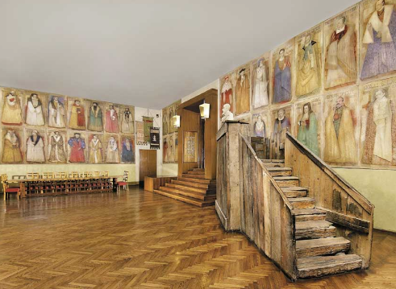
Do we spend too much of our time trying to teach our students?
We need to spend more energy helping them to appreciate feedback, make judgements, manage affect, taking action. (Carless and Boud, 2018)
Galileo: You can’t
teach a man
anything.
You can only help
him to learn.

Slide 6
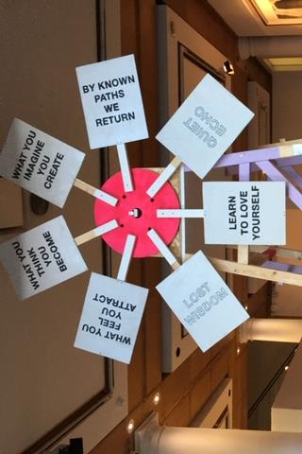
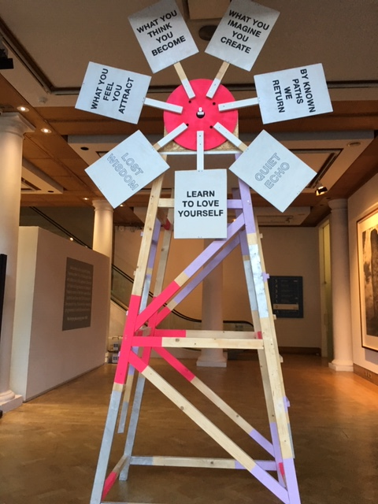

Slide 7
Announcement about mobile phones and laptops...
Good afternoon everyone – please turn on your ‘phones and computers.
Please post your thoughts, comments and ideas during and after this session to the hashtag #philatmmu18 Thanks!
Try #LTHEchat on Wednesday evenings from 20.00-21.00.
Usual rules apply: £1 for the first person to tell me about each of the first three typos in these slides.

Slide 8
Finding out more about you…
In the last 12 months, I’ve completed a MOOC
Indeed
Started one
Helped to design one
Found one
What’s a MOOC?
Voting: A = 2 hands, B = 1 hand
C = touch left ear, D = touch right ear
E = scratch your head

Slide 9
You will be able to download my main slides
You don’t need to take notes.
I’ll put the main slides I use up on my website later today (http://phil-race.co.uk/)
I won’t post pictures and video-clips, as this would make the file-size too large.
I may sometimes go through slides quite fast, but you can study them as you wish at your leisure.

Slide 10
Starter exercise Getting to know each other: an audio-visual approach…
In turn, please..
Say one or two sentences about...
who you are,
where you come from, and
what you do.
In one breath!
(Optional) Share with us one thing that you’re dead good at, or really proud of.

Slide 11
Learning through observing
I’m a strong believer in learning by sitting on others’ sessions.
Seeing how students respond to different things.
Seeing things to try to do myself next time.
Seeing things to try to avoid myself next time.
…Even when not a word is written down or spoken between the observer and the observee.

Slide 13
Intended learning outcome?
By the end of this session, you should be better-able to:
Think about how learning really happens, and how it doesn’t happen, and what we can do to make learning happen.
(I’m having second thoughts about learning outcomes, and some of these are in the session I ran at the SEDA Conference in Birmingham a couple of weeks ago!)

Slide 14
Time-constrained assessed written Post-it exercise
On a post-it, in your best handwriting, please write your own completion of the starter:
“Making learning happen with my students nowadays would be much better for me if only I …”
Please swap post-its so that you’ve no idea who has yours.
If chosen, please read out with passion and drama what’s on the post-it you now have.
Please place them all as directed.

Slide 15
How do teaching, learning, assessment and feedback need to vary across disciplines? (after Biglan, 1973, Trowler, 2014, Berry O’Donovan, 2018)
Hard
Applied
Pure
Soft

Slide 16
How do teaching, learning, assessment and feedback need to vary across disciplines? (after Biglan, 1973, Trowler, 2014, Berry O’Donovan, 2018)
Hard
On the grid, in your own discipline field, please work out where (point or area) you might pin some of the following (and other items of your choice);
A typical exam question
An essay
A report
A quantitative problem to be solved
A critique
A case study
A proposition
A model
A theory
A concept
A job interview
A typical journal paper
A lecture
A lab practical
A review
A proof
Applied
Pure
Soft

Slide 17
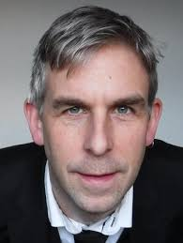
Phil Newton: Swansea Medical School
‘How Common Is Commercial Contract Cheating in Higher Education and Is It Increasing? A Systematic Review’
Front. Educ., 30 August 2018
https://doi.org/10.3389/feduc.2018.00067
https://www.frontiersin.org/articles/10.3389/feduc.2018.00067/full

Slide 18
Students as partners…
Students are partners in learning.
They always have been.
We can’t ‘learn them’!
We haven’t always made it an optimal partnership.
We can.
I could not do what I do nowadays if I did not continue to spend a fair bit of my time working with students – they’ve taught me most of what I know.

Slide 19
David Carless (on Twitter):
Feedback as telling is seriously overrated!

Slide 20
Don’t tell the publishers! Download anytime Phil’s materials on feedback, assessment, learning and lecturing
Expanded discussions of how the factors underpinning learning link to feedback, assessment and large-group teaching:
http://phil-race.co.uk/2016/04/updated-powerpoint-ripples-model/ (Chapter 1 from ‘The Lecturer’s Toolkit, 2015)
https://phil-race.co.uk/2016/10/lthe-tweetchat-lthechat-wed-oct-19-8-00-9-00-pm/ (feedback stuff from my most recent two books)
http://phil-race.co.uk/2015/01/assessment-bits-new-editions/ (extracts on assessment)
http://phil-race.co.uk/2017/05/lectures-and-learning/ (extracts on lecturing)

Slide 21
Teaching, learning, engagement and enthusiasm
Knowledge isn’t infectious (unfortunately) but enthusiasm is, and we need to help our students to catch enthusiasm.
We certainly don’t want teaching, assessment or feedback to damage that enthusiasm.

Slide 22
Engagement: Why talk about it? Because:
Academics and learning support staff report increasing levels of disengagement by students of the ‘iGeneration’;
The nature of the transaction is changing in the light of high fees;
Potentially the nature of student behaviour in higher education is changing radically in terms of academic and other literacies;
Institutions need to ensure that new students enter with, or have the opportunity to acquire, the skills needed for academic success;
HEIs must devise programmes in which the emphasis is on maximising students’ development.

Slide 23
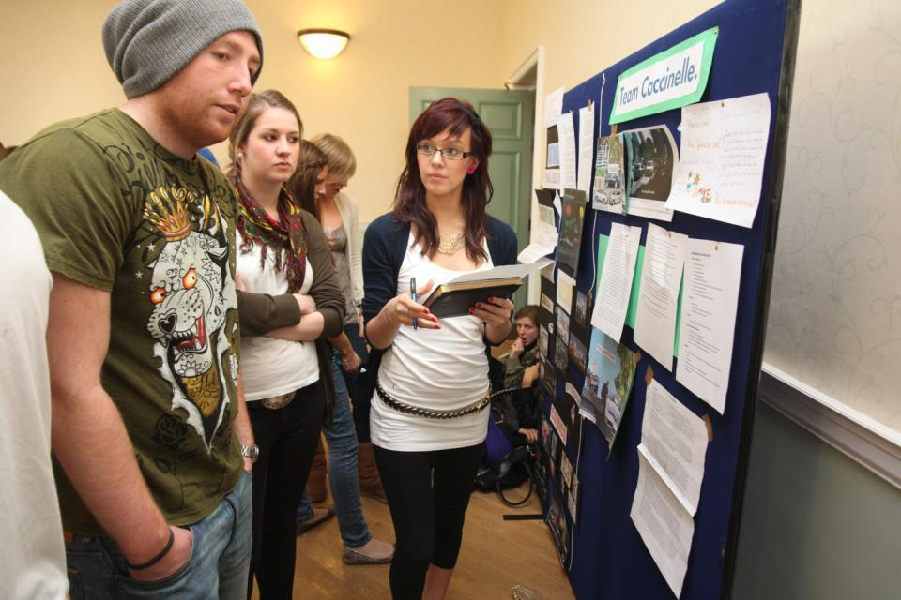
Do these students look engaged?

Slide 24
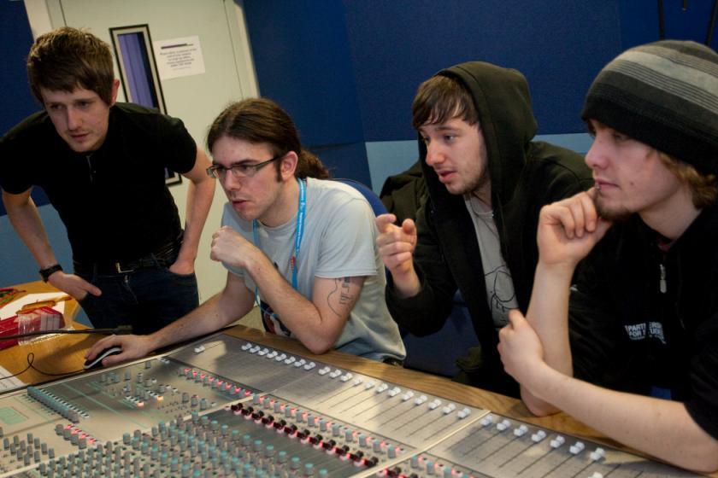
How about these?

Slide 25
Disengaged students
Don’t live up to their potential and fail to achieve their very best;
Make life more difficult for the staff who teach and support them;
Don’t achieve as highly as they might & underperform;
Drop out of higher education, thereby damaging their own prospects and HEIs’ performance indicators;
HEIs suffer both financially and in terms of their status and reputation from high attrition rates.

Slide 26
What kinds of behaviours offer warning signs of risk of drop-out
Failure to register with the library, to download required resources, to return books on time;
Not engaging with fellow students (live or virtually);
Not participating in assessed or unassessed group tasks;
Not submitting work on time (or at all);
Poor marks on early assignments;
Not downloading/picking up or responding to assessed work;
Non attendance, or very poor or intermittent attendance (the big one).

Slide 27
Now is the decade of Colleges’ dis-content!
Never mind the content – feel the learning

Slide 28
Questions employers might ask at interview that might help us frame some of our assignments
Can you tell us about an occasion when:
you worked together with colleagues in a group to produce a collective outcome;
you had to work autonomously with incomplete information and self-derived data sources;
you developed strategies to solve real life problems and tested them out;
you had a leadership role in a team, and could you tell us your strategies to influence and persuade your colleagues to achieve a collective task;
you had to communicate outcomes from your project work orally, in writing, through social media and/or through a visual medium?

Slide 29
Teaching in modern institutions is moving away from providing subject content, (where everything was about ‘delivery’), towards foregrounding two major functions:
Recognising and accrediting students’ achievement, wherever learning has taken place (i.e. getting the assessment right);
Supporting student learning and engagement (not least by making feedback work well for students).

Slide 30
Face-to-face communication
Making all the channels work

Slide 31
Face-to-face one-to-one feedback activity
On the signal to start, please stand up, and work in pairs, moving around the room, talking to different people using the script which follows…
The script:
A ‘Hello’ (or equivalent).
B ‘Hello’ (or equivalent).
A ‘You are late’.
B ‘I know’.
Try to do it completely differently each time.

Slide 32
Constructive Alignment: John Biggs
What will I be expected to show for this?
What does a good one look like, and a bad one?
Where does this fit into the big picture?
When explaining assessment criteria to students, and when linking these to evidence of achievement of the intended learning outcomes, we need to make the most of face-to-face whole group contexts and...
Tone of voice
Body language
Facial expression
Eye contact
The chance to repeat things
The chance to respond to puzzled looks
Some things don’t work nearly so well just on paper or on screens.
Some of the
tools we can
use in
face-to-face
contexts

Slide 33
Face to face feedback

Slide 34
Hands-on feedback?

Slide 35
Learning is not linear! Feedback is not unidirectional. But sometimes we pretend that they are! #sketchnote by @SGroshell and @MrZachG #edchat #learning #teachchat

Slide 36
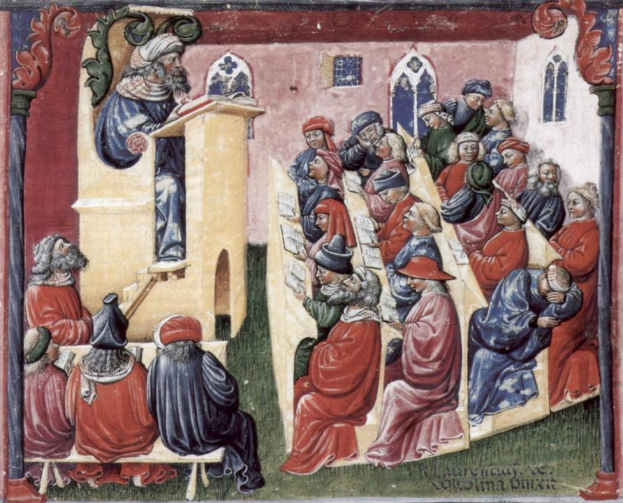
Laurentius de Voltolina
2nd half of 14th Century
Italian Painter

Slide 37
How’s your brain?
My brain is:
Digital
Analogue
Both
Neither
Don’t know
Voting: A = 2 hands, B = 1 hand
C = touch left ear, D = touch right ear
E = scratch your head

Slide 38
Learning, feedback and assessment:
the ten most important words
Why?
What?
Who?
Where?
When?
How?
Which?
So what?
wtf?
Wow?
And the most powerful four-letter word in the English language...
????

Slide 39
Learning, feedback and assessment: the ten most important words
Why? (rationale)
What? (content)
Who? (people, you, me, them)
Where? (locations)
When? (times)
How? (processes)
Which? (decisions)
So what? (importance?)
Wow? (impact?)
And the most powerful four-letter word in the English language...
else

Slide 40
Go forth and
elsify!

Slide 41
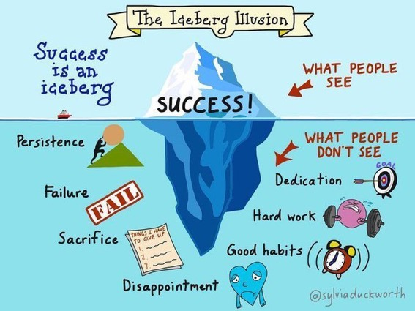

Slide 42
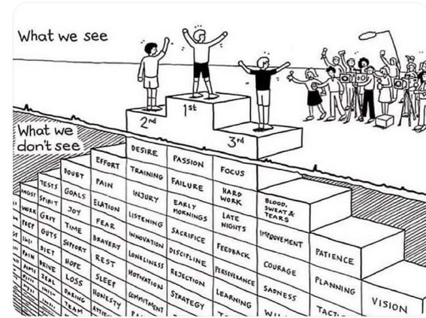
Do we get what we ask for
with intended learning outcomes?
Have we any idea of how many of
these might also have been involved?

Slide 43
How students really learn
Seven factors underpinning successful learning based on asking lots of people about their learning in the last 30 years

Slide 44
How Students Really Learn ‘Ripples’ model of learning
Phil Race

Slide 45
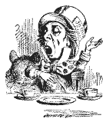
Unless we do something else…
“[The] pupils got it all by heart; and, when Examination-time came, they wrote it down; and the Examiner said ‘Beautiful! What depth!’
They became teachers in their turn, and they said all these things over again; and their pupils wrote it down, and the examiner accepted it; and nobody had the ghost of an idea what it meant” Lewis Carroll, 1893
Active
Experimentation
Abstract
Conceptualisation
Concrete
Experience
Reflective
Observation

Slide 46
Another MCQ
About learning styles,
I think they’re very important
I think they’re a load of rubbish
I know what mine is (or are)
They can’t be changed
They change over time
Voting: A = 2 hands, B = 1 hand
C = touch left ear, D = touch right ear
E = scratch your head

Slide 47
So what about learning styles?
https://www.theguardian.com/education/2017/mar/12/no-evidence-to-back-idea-of-learning-styles?CMP=share_btn_tw
(Link from my Tweet on March 13th 2017 to a letter in the Guardian by prominent folk around the world of education)
Or link to a word document: https://phil-race.co.uk/2017/09/swansea-university-school-management-21st-September/
“No evidence to back idea of learning styles”

Slide 48
What’s wrong
with
this?
Verbalising
Assessing
Feedback
Making sense
Doing
Wanting/
Needing

Slide 49
What’s wrong
with
this?
Verbalising
Assessing
Feedback
Making sense
Doing
Wanting/
Needing

Slide 50
Ripples on a pond….
Enhance our students’ want to learn?
Help students to develop ownership of the need to learn?
Keep students learning by doing, practice, trial-and-error, repetition?
Ensure students really use feedback – from us and from each other?
Help students to make sense of what they learn?
Get students deepening their learning by verbalising, explaining things to each other, and to us?
Allow students to deepen their learning by assessing their own learning, and assessing others’ learning – making informed judgements?
What can we do to use
teaching, assessment and feedback to:
Verbalising
Assessing
making informed judgements
Wanting/
Needing
Doing
Doing
Making sense
Feedback

Slide 51
Which wavelength should I teach on?
The only one that works for today’s students is WIIFM
What’s in it for me?
Consciously address the ‘so what’ in students’ minds;
Warm up their ‘want’ to learn.
Clarify their ‘need’ to learn.
They learn far more readily if they are continuously aware of the benefits for them of putting energy into their learning.

Slide 52
Feed-forward
Language of feedback
Some feedback
issues
National Student Survey
Timing:
24-hours!
Written, printed,
on-screen
Efficiency
Face to face
oral

Slide 53
But what’s really wrong with feedback?
Too often it’s one-way – monologic.
What students want is dialogue.
They want to talk to us about their work.
But they’re scared to talk to us, for various reasons:
In case it leads to lower marks;
In case they’re ‘found out’;
In case they feel stupid.

Slide 54
Fishing for feedback?
Feedback is like fish.
If it is not used quickly, it becomes useless.
(Sally Brown).
Give a man a fish,
Feed him for a day.
Teach a man to fish,
Feed him for a lifetime.
(Maimonides: 1135-1204)
Make feedback timely, while it still matters to students, in time for them to use it towards further learning, or to receive further assistance.
(Graham Gibbs)
And he’ll learn to drink beer in boats
And you won’t see him for weeks!
(Australian proverb).

Slide 55
Drives most learning
Is assessment broken?
Some
assessment
issues
What students think
Assessment as learning
Validity
Whodunit?
Fairness

Slide 56
My main worries about assessment...
Too often, we still tend to try to measure...
...what’s in students’ heads, and what they can do with what’s there...
in terms of two unsatisfactory proxies ...
what comes out of students’ pens in exams;
2. what comes out of their keyboards in essays and reports.

Slide 57
The read-write industry

Slide 58
In the exam room you’re on your own

Slide 59
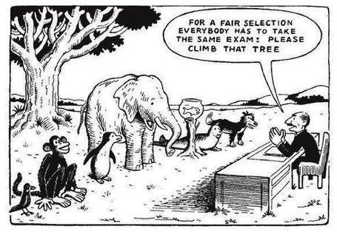

Slide 60
Boud et al 2010: ‘Assessment 2020’
Assessment has most effect when...:
It is used to engage students in learning that is productive.
Feedback is used to actively improve student learning.
Students and teachers become responsible partners in learning and assessment.
Students are inducted into the assessment practices and cultures of higher education.
Assessment for learning is placed at the centre of subject and program design.
Assessment for learning is a focus for staff and institutional development.
Assessment provides inclusive and trustworthy representation of student achievement.

Slide 61
Boud et al, 2010
David Boud (University of Technology, Sydney), Royce Sadler (Griffith University), Gordon Joughin (University of Wollongong), Richard James (University of Melbourne), Mark Freeman (University of Sydney), Sally Kift (Queensland University of Technology), Filip Dochy (University of Leuven), Dai Hounsell (University of Edinburgh), Margaret Price (Oxford Brookes University), Tom Angelo (La Trobe University), Angela Brew (Macquarie University), Ian Cameron (University of Queensland), Denise Chalmers (University of Western Australia), Paul Hager (University of Technology, Sydney), Kerri-Lee Harris (University of Melbourne), Claire Hughes (University of Queensland), Peter Hutchings (Australian Learning and Teaching Council), Kerri-Lee Krause (Griffith University), Duncan Nulty (Griffith University), Ron Oliver (Edith Cowan University), Jon Yorke (Curtin University), Iouri Belski (RMIT University), Ben Bradley (Charles Sturt University), Simone Buzwell (Swinburne University of Technology), Stuart Campbell (University of Western Sydney), Philip Candy (University of Southern Queensland), Peter Cherry (Central Queensland University), Rick Cummings (Murdoch University), Anne Cummins (Australian Catholic University), Elizabeth Deane (Australian National University), Marcia Devlin (Deakin University), Christine Ewan (Australian Learning and Teaching Council), Paul Gadek (James Cook University), Susan Hamilton (University of Queensland), Margaret Hicks (University of South Australia), Marnie Hughes-Warrington (Monash University), Gail Huon (University of Newcastle), Margot Kearns (University of Notre Dame, Sydney), Don Maconachie (University of the Sunshine Coast), Vi McLean (Queensland University of Technology,) Raoul Mortley (Bond University), Kylie O’Brien (Victoria University), Gary O’Donovan (University of Tasmania), Beverley Oliver (Curtin University), Simon Pyke (University of Adelaide), Heather Smigiel (Flinders University), Janet Taylor (Southern Cross University), Keith Trigwell (University of Sydney), Neil Trivett (University of Ballarat), Graham Webb (University of New England).

Slide 62
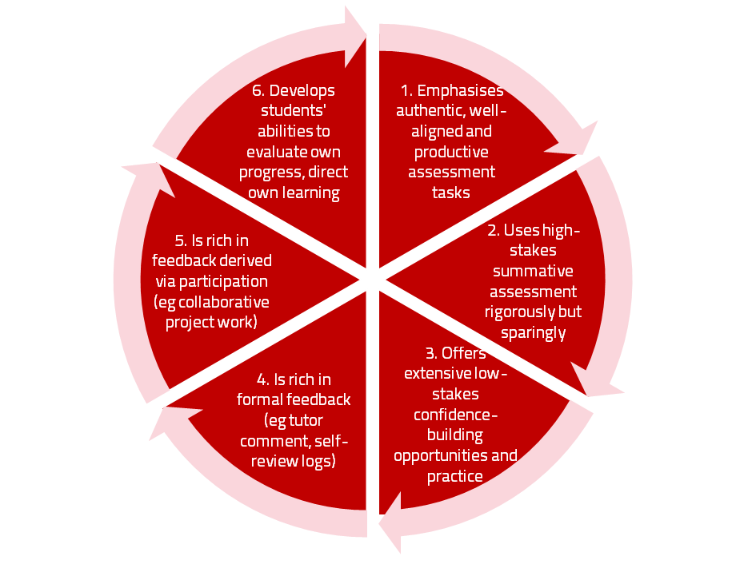
A4L the Northumbria model

Slide 63
Use link below to download the new materials on feedback and assessment produced in 2017 by Kay Sambell, Sally Brown and Phil Race for Edinburgh Napier University
http://staff.napier.ac.uk/services/dlte/ENhance/Pages/ENhanceQuickGuides.aspx

Slide 64
Characteristics of teachers who get engagement going?
Knows subject material thoroughly
Adopts a scholarly approach to the practice of teaching
Is reflective and regularly reviews own practice
Is well organised and plans curriculum effectively
Is passionate about teaching
Has a student-centred orientation to teaching
Regularly reviews innovations in learning and teaching and tries out ones relevant to own context
Ensures that assessment practices are fit for purpose and contribute to learning
Demonstrates empathy and emotional intelligence

Slide 65
Characteristics of excellent teachers: diamond-9
1
2
3
4
5
6
7
8
9

Slide 66
Sally’s conclusions about assessment and feedback
Assessment can be a powerful means of focusing student effort if it is well designed and constructively aligned (Biggs and Tang, 2011);
Students in the early stages of their learning journey are likely to need more support and positive feedback than later, when they are more robust and confident;
The first six weeks of the first semester are crucial in helping students understand how assessment works;
No single method of giving feedback is likely to be ubiquitously successful, so it’s worth using a variety of approaches;
Assessment and feedback need to be manageable for staff and students if they are going to engage students in valuable learning activities.

Slide 67
Back to our intended learning outcome…
Do you now feel better able to:
2 hands = very much better,
one hand = somewhat better,
touch left ear = no better...
Think about how learning really happens, and how it doesn’t happen, and what we can do to make learning happen?
Wanting/
Needing
Doing
Making sense
Feedback

Slide 68
Thank you…
Website: http://phil-race.co.uk
Follow Phil @RacePhil
e-mail: phil@phil-race.co.uk

Slide 69
Useful references and further reading (1)
Bain, K. (2004) What the best College Teachers do, Cambridge: Harvard University Press.
Biggs, J. and Tang, C. (2011) Teaching for Quality Learning at University, Maidenhead: Open University Press.
Bloxham, S. and Boyd, P. (2007) Developing effective assessment in higher education: a practical guide, Maidenhead, Open University Press.
Boud, D. (1995) Enhancing learning through self-assessment, London: Routledge.
Brown, S. and Glasner, A. (eds.) (1999) Assessment Matters in Higher Education, Choosing and Using Diverse Approaches, Maidenhead: Open University Press.
Brown, S. and Race, P. (2012) Using effective assessment to promote learning in Hunt, L. and Chambers, D. (2012) University Teaching in Focus, Victoria, Australia, Acer Press. P74-91.
Brown, S. (2015) Learning , Teaching and Assessment in Higher Education: Global perspectives, London, Palgrave.

Slide 70
Useful references and further reading (2)
Carless, D., Joughin, G., Ngar-Fun Liu et al (2006) How Assessment supports learning: Learning orientated assessment in action Hong Kong: Hong Kong University Press.
Carroll, J. and Ryan, J. (2005) Teaching International students: improving learning for all. London: Routledge SEDA series.
Crosling, G., Thomas, L. and Heagney, M. (2008) Improving student retention in Higher Education, London and New York: Routledge
Crooks, T. (1988) Assessing student performance, HERDSA Green Guide No 8 HERDSA (reprinted 1994).
Dunworth, K. and Sanchez, H.S., (2016). Perceptions of quality in staff-student written feedback in higher education: a case study. Teaching in Higher Education, 21(5), pp.576-589.
Dweck, C. S. (2000) Self Theories: Their Role in Motivation, Personality and Development, Lillington, NC: Taylor & Francis.
Falchikov, N. (2004) Improving Assessment through Student Involvement: Practical Solutions for Aiding Learning in Higher and Further Education, London: Routledge.
Gibbs, G. (1999) Using assessment strategically to change the way students learn, in Brown S. & Glasner, A. (eds.), Assessment Matters in Higher Education: Choosing and Using Diverse Approaches, Maidenhead: SRHE/Open University Press.
Higher Education Academy (2012) A marked improvement; transforming assessment in higher education, York: HEA.

Slide 71
Useful references and further reading (3)
Hawe, E., Lightfoot, U., & Dixon, H. (2017). First-year students working with exemplars: Promoting self-efficacy, self-monitoring and self-regulation. Journal of Further and Higher Education, 1-15.
Hendry, G. D., White, P., & Herbert, C. (2016). Providing Exemplar-Based “Feedforward” before an Assessment: The Role of Teacher Explanation. Active Learning in Higher Education, 17(2), 99-109.
Hounsell, D., McCune, V., Hounsell, J. and Litjens, J., (2008). The quality of guidance and feedback to students. Higher Education Research & Development, 27(1), pp.55-67.
McDowell, L. and Brown, S. (1998) Assessing students: cheating and plagiarism, Newcastle: Red Guide 10/11 University of Northumbria.
Meyer, J.H.F. and Land, R. (2003) ‘Threshold Concepts and Troublesome Knowledge 1 – Linkages to Ways of Thinking and Practising within the Disciplines’ in C. Rust (ed.) Improving Student Learning – Ten years on. Oxford: OCSLD.
Nicol, D. J. and Macfarlane-Dick, D. (2006) Formative assessment and self-regulated learning: A model and seven principles of good feedback practice, Studies in Higher Education Vol 31(2), 199-218.
PASS project Bradford http://www.pass.brad.ac.uk/ Accessed November 2013.
Peelo, M. T., & Wareham, T. (Eds.). (2002). Failing students in higher education. Society for Research into Higher Education.
Pickford, R. and Brown, S. (2006) Assessing skills and practice, London: Routledge.
Rotheram, B. (2009) Sounds Good, JISC project http://www.jisc.ac.uk/whatwedo/programmes/usersandinnovation/soundsgood.aspx

Slide 72
Useful references and further reading (4)
Race, P. (2001) A Briefing on Self, Peer & Group Assessment, in LTSN Generic Centre Assessment Series No 9, LTSN York.
Race P. (2015) The lecturer’s toolkit (4th edition), London: Routledge.
Rust, C., Price, M. and O’Donovan, B. (2003) Improving students’ learning by developing their understanding of assessment criteria and processes, Assessment and Evaluation in Higher Education. 28 (2), 147-164.
Ryan, J. (2000) A Guide to Teaching International Students, Oxford Centre for Staff and Learning Development.
Scoles, J., Huxham, M., & Mcarthur, J. (2013). No longer exempt from good practice: Using exemplars to close the feedback gap for exams. Assessment & Evaluation in Higher Education, 38(6), 631-645.
Stefani, L. and Carroll, J. (2001) A Briefing on Plagiarism, LTSN
Sadler, D. Royce (2010) Beyond feedback: developing student capability in complex appraisal, Assessment & Evaluation in Higher Education, 35: 5, 535-550.
Yorke, M. (1999) Leaving Early: Undergraduate Non-completion in Higher Education, London: Routledge.

