Slide 1
School of Social Sciences assessment workshop
University of Manchester
5th December 2018
Sally Brown NTF, PFHEA, SFSEDA
@ProfSallyBrown http://sally-brown.net
and Phil Race, NTF, PFHEA
@RacePhil http://phil-race.co.uk

Slide 2
The purpose of the sessions today on assessment and feedback
Assessment is crucial to effective student learning, achievement and success, but it has to be meaningful to students and manageable for staff. We argue that assessment and feedback need to be fit-for-purpose and be for rather than just of learning, with students actively learning while they are being assessed, rather than it being merely a summative end process.

Slide 3
In this participative workshop, participants will have opportunities to:
Consider the fundamentals of effective assessment design and delivery;
Review some alternatives to traditional formats such as unseen time-constrained exams and formal essays, that offer assessment that is truly integrated with the learning process;
Discuss how best to engage students with feedback, so that they benefit from all the hard work put in by their assessors;
Decide on some concrete steps that can be taken in the School of Social Sciences to enhance current assessment and feedback practice.

Slide 4
Programme
9.00 Tea and coffee on arrival
9.30 The fundamentals of effective design and delivery SB
10.30 Alternative and innovative assessment formats
11.15
11.30 Engaging students with feedback to help them enhance outcomes PR
12.30 Lunch with informal discussions
1.30 Changing assessment to make a difference: Planning for improvements SB and PR
2.30 Tea
3.00-4.00 School of Economics: Assessment and feedback: improving the student experience (both)

Slide 5
The fundamentals of assessment design and delivery
Effective assessment is crucial for student satisfaction and achievement. This session will explore how we can review and revise our assessment approaches so that students have the best possible chance of success, particularly by:
building students' assessment literacy and thereby enabling them better to understand how criteria and assessment practices work;
ensuring that assessment is for not just of learning;
fostering approaches to feedback that mean students take good note of and use the comments and advice provided by their assessors.
By the end of the session, participants will have had opportunities to come to grips with typical problematic aspects of assessment and feedback, and to devise strategies to ensure their own practices and approaches are fit-for-purpose and manageable by students and themselves.

Slide 6
Underpinning premises
Assessment can be a powerful means of focusing student effort and enhancing achievement if it is well designed and constructively aligned (Biggs and Tang, 2011);
We need to deploy a diverse range of tactics to our assessment and feedback to ensure that they work to enhance and extend student learning;
Students need to achieve assessment literacy to ensure they understand and can benefit from our assessment systems;
Assessment needs to be manageable for staff and students if it is going to engage students in learning activities.

Slide 7
Determining and reviewing subject material: currency, relevance, level
Enhancing quality, seeking continuous improvement
Designing and refining learning outcomes
Evaluating programmes, strengths and areas for improvement
Curriculum
Design
Essentials
Considering delivery modes: face-to-face, online, PBL, blended…
Assuring quality, matching HEI, national and PRSB requirements
Thinking through student support
Designing fit for purpose assessment methods and approaches

Slide 8
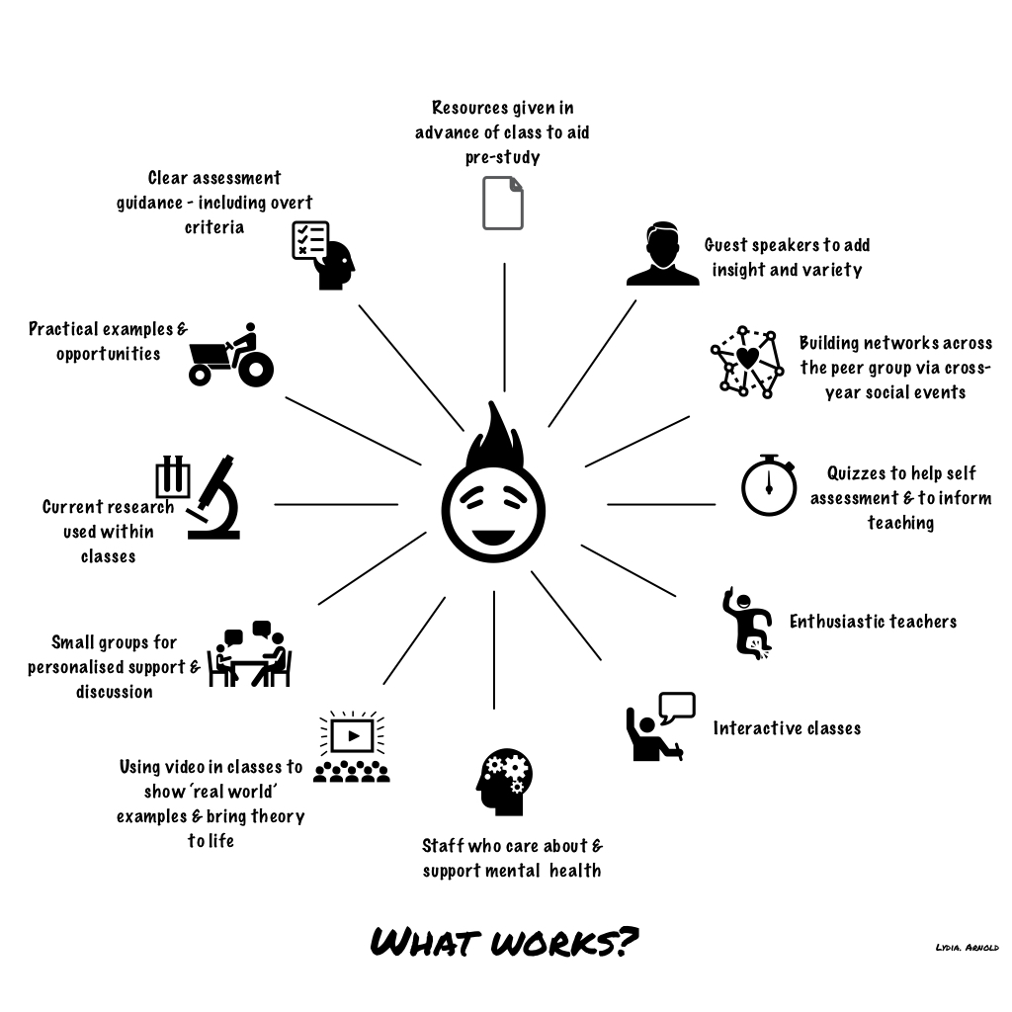

Slide 9
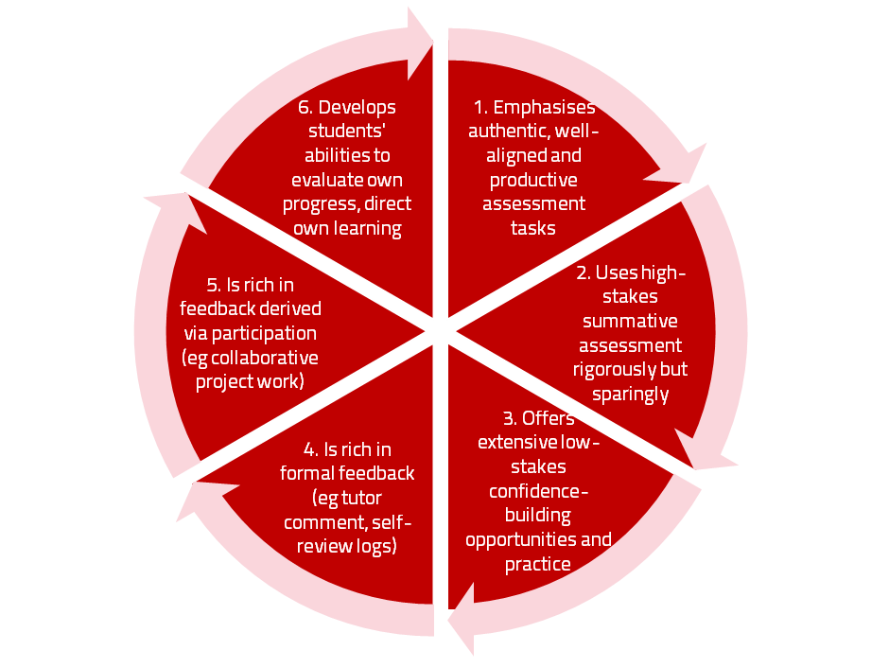
A4L the Northumbria model

Slide 10
Using assessment for learning (Sambell et al, 2012)
Assessment that is meaningful to students can provide them with a framework for activity;
“Students can escape bad teaching but they can’t escape bad assessment” (Boud, 1995);
Where assessment is fully part of the learning process and integrated within it, the act of being assessed can help students to make sense of their learning;
Assessment should be formative, informative, developmental and remediable.

Slide 11
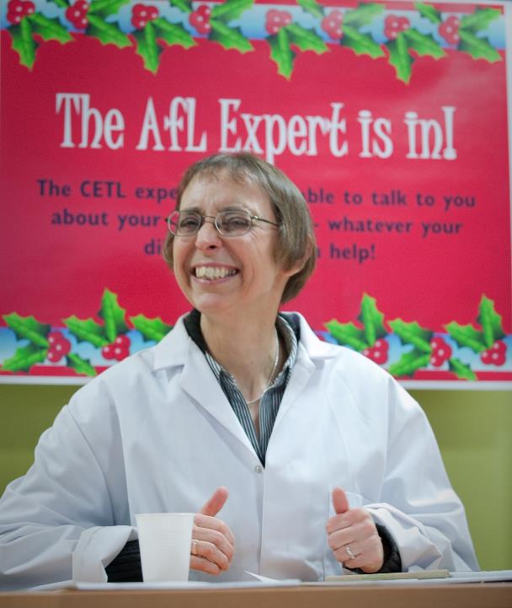

Slide 12
Ten Concerns about exams
These ten concerns are about time-constrained unseen written examinations.
As we explore these, think of how other forms of exam can get round some of these concerns...
open book
open notes
time unconstrained
take-away
in-tray
multiple-choice
others….

Slide 13
Ripples on a pond….
Concerns about traditional exams
Coaching,
explaining, teaching
Assessing
making informed judgements
They don’t do much to increase the ‘want’ to learn.
They are not ideal occasions for learning-by-doing.
The amount of feedback that students receive is not optimal.
They don’t do much to help students to make sense of what they have learned.
Wanting/
Needing
Doing
Doing
Making sense
Feedback

Slide 14
Concerns about traditional exams
We mark them in a rush.
We’re often tired and bored when we mark them.
We’re not good at marking them objectively.
They favour candidates who happen to be skilled at taking exams.
They force students into surface learning, and into rapidly clearing their minds of previous knowledge when preparing for the next exam.
There are many important things which they don’t measure.

Slide 15
Ripples on a pond….
If students are under too much pressure, the want to learn is damaged.
The range of learning-by-doing may be too narrow.
Feedback may be eclipsed by marks or grades.
Students may not have the opportunity to make sense of the feedback they receive.
Coaching,
explaining, teaching
Concerns about continuous assessment
Assessing
making informed judgements
Wanting/
Needing
Doing
Doing
Making sense
Feedback

Slide 16
Concerns about continuous assessment
It may be hard to detect unwanted collaboration.
Too much time may be involved in marking.
Students may not be aware of the criteria used to assess their work.
Students may get the balance wrong between continuous assessment and exams.
Learning may become driven by assessment, and students may only do those things that are assessed.
Too little use may be made of the learning that can be achieved when students assess their own, and each other’s work.

Slide 17
My fit-for-purpose model of assessment: the key questions
Why are we assessing?
What is it we are actually assessing?
How are we assessing?
Who is best placed to assess?
When should we assess?
Notes:
17

Slide 18
For any assessment activity, we need to be clear about:
Aims: is this an early stage assignment, that is principally about building confidence and helping students see what is required of them, or is it a key element of their summative assessment, designment to gauge fitness to progress, or fitness-to-practice?
Scope: is this testing low level outcomes, like demonstrating recollection of key terms, or is it cognitively more demanding requiring synthesis of multiple elements, critical analysis, evaluation and reflection?
Scale: is this a small scale or a substantial task carrying a heavy weighting? Do students know how much effort and energy is needed to achieve at least a satisfactory level?
Orientation: Is the key aim to demonstrate the achievement of skills and competences, and/or to produce a definite product or is it primarily about demonstrating mastery of appropriate processes?
Constructive alignment: To what extent does the assessment closely link to the learning outcomes (and specifically the verbs used in them)?

Slide 19
Formative and summative assessment
Formative assessment is primarily concerned with feedback aimed at prompting improvement, is often continuous and usually involves words.
Summative assessment is concerned with making evaluative judgments, is often end point and involves numbers.

Slide 20
The importance of dialogic feedback (Sadler)
Students need to be exposed to, and gain experience in making judgements about, a variety of works of different quality... They need planned rather than random exposure to exemplars, and experience in making judgements about quality. They need to create verbalised rationales and accounts of how various works could have been done better. Finally, they need to engage in evaluative conversations with teachers and other students.

Slide 21
Assessment literacy: students do better if they can:
Make sense of key terms such as criteria, weightings, and level;
Encounter a variety of assessment methods (e.g. presentations, portfolios, posters, assessed web participation, practicals, vivas etc) and get practice in using them;
Be strategic in their behaviours, putting more work into aspects of an assignment with high weightings, interrogating criteria to find out what is really required and so on;
Gain clarity on how the assessment regulations work in their HEI, including issues concerning submission, resubmission, pass marks, condonement etc.

Slide 22
Students tend to be more convinced about the fairness of the assessment process if
Requirements and procedures are transparent and made readily available to them;
They believe that the tasks they are asked to do are worthwhile and are closely linked to what course documentation indicates they should be able to know and do at the end of the programme i.e. authentic assessment;
They fully understand the ‘rules of the game’.

Slide 23
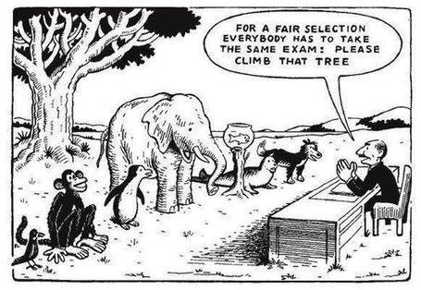

Slide 24
Are your students aware of all the processes and procedures we use to ensure fair assessment?
Do they know how we require assessors to match grades to achievement of assessment criteria?
Are they familiar with the steps we take to ensure inter-assessor reliability?
Do they understand that moderation processes are in place, for example through exam boards, to ensure that justice is done to each individual?
Do they get to hear about the work of external examiners (or even get to meet them?)?

Slide 25
Helping students better understand what is needed of them
This can be achieved in a variety of ways, including:
Using games (like the Biscuit game) can help make students think hard about criteria and required outcomes;
Ensuring that briefings (in the form of documentation, and more importantly, live/ face-to-face briefings, where students can actively interrogate criteria) are useful;
Getting students to self-assess to start a feedback dialogue;
Using exemplars to show students what high quality work in this domain comprises, and what features and aspects are crucial for success.

Slide 26
Assessment for learning: some useful thoughts
1. Tasks should be challenging, demanding higher order learning and integration of knowledge learned in both the university and other contexts;
2. Learning and assessment should be integrated, assessment should not come at the end of learning but should be part of the learning process;
3. Students are involved in self assessment and reflection on their learning, they are involved in judging performance;
4. Assessment should encourage metacognition, promoting thinking about the learning process not just the learning outcomes;
5. Assessment should have a formative function, providing ‘feedforward’ for future learning which can be acted upon. There is opportunity and a safe context for students to expose problems with their study and get help; there should be an opportunity for dialogue about students’ work;

Slide 27
Assessment for learning
6. Assessment expectations should be made visible to students as far as possible;
7. Tasks should involve the active engagement of students developing the capacity to find things out for themselves and learn independently;
8. Tasks should be authentic; worthwhile, relevant and offering students some level of control over their work;
9. Tasks are fit for purpose and align with important learning outcomes;
10. Assessment should be used to evaluate teaching as well as student learning.
(Bloxham and Boyd)

Slide 28
Do your international students understand UK assessment approaches?
Have you clarified the ground rules on issues like pass marks, criterion-referenced assessment and grading systems?
Have you explained how extensions, condonements, and university assessment regulations work?
Are the assignments built around a curriculum international in scope and content? Are tasks and case studies globally orientated?

Slide 29
Alternative and innovative formats

Slide 30
What does innovative mean?
New to context?
New to discipline?
New to level?
New to nation?
New to assessor?

Slide 32
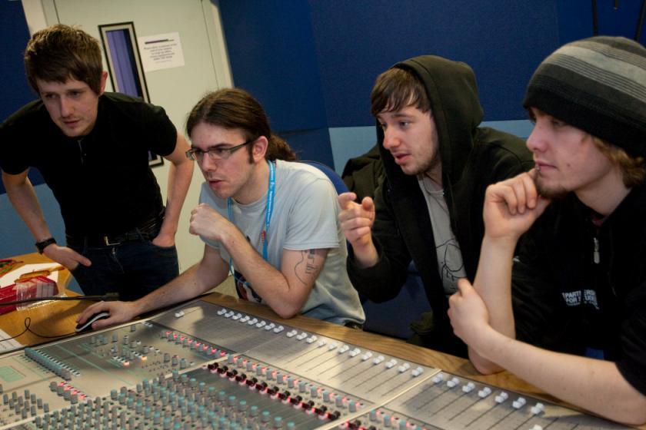
Assessing music technology students

Slide 33
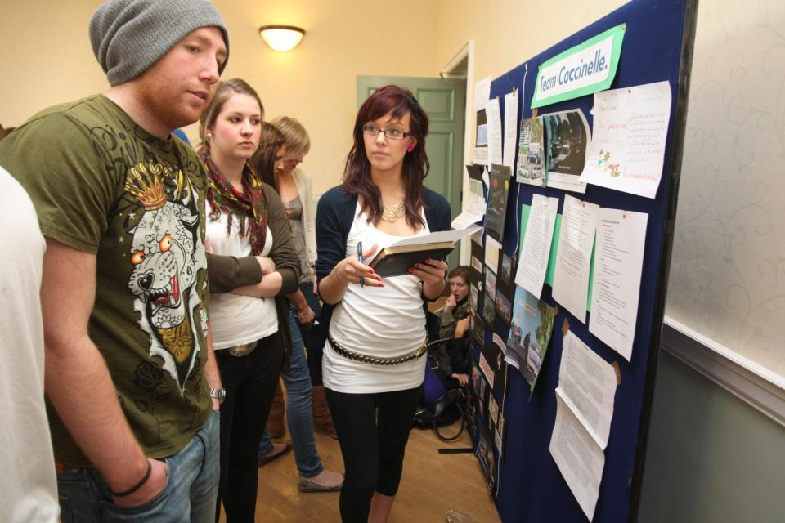
Assessing posters

Slide 34
What do we mean by ‘traditional assessment formats’?
At least 80% of UK higher education assessment uses three main forms;
Unseen time constrained exams of some sort;
Essays where students respond to a stimulus question or title;
Reports of some kind.
These are not necessarily authentic or useful means of assessing students knowledge, capabilities and understanding.

Slide 35
Authentic assessment: what are the principal benefits for stakeholders?
Students undertaking authentic assessments tend to be more fully engaged in learning and hence tend to achieve more highly because they see the sense of what they are doing (Sadler, 2005).
University teachers adopting authentic approaches can use realistic and live contexts within which to frame assessment tasks, which help to make theoretical elements of the course come to life.
Employers value students who can quickly engage in real-life tasks immediately on employment, having practiced and developed relevant skills and competences through their assignments.

Slide 36
Wiggins (1990) says assessment can be regarded as authentic if we can draw valid inferences about quality from the work students produce
He proposes that we should aim to offer students assignments that present the student with the full array of tasks that mirror the priorities and challenges found in the best [teaching] activities and that attend to whether the student can craft polished, thorough and justifiable answers, performances or products.
He says they must involve students being able to cope with potentially ill-structured challenges and roles, with incomplete information, that help them rehearse for the complex ambiguities of adult and professional life.

Slide 37
We often assess what is easy to assess, or proxies of what’s been learned, rather than the learning itself
A valid assessment is one that has close relevance to the criteria, which are in turn constructively aligned to the stated learning outcomes of a programme.
Effective assessment is highly relevant to ensuring that graduates can demonstrate the knowledge, behaviours, qualities and attributes that were described in the course outline or programme specification.
Assignments that require students to write about something, rather than be or do something, may not always be fit-for-purpose.

Slide 38
How can authentic assessment engage students?
Using types of assessment that are much more like the ‘real things’ that academics or professionals do in their chosen fields can engage students in much more meaningful ways.
A useful way to help you ascertain how authentic your assessment is could be to ask yourself where in the programme you help students answer questions in job interviews (Sambell, Brown and Graham, 2017)

Slide 39
Questions employers might ask at interview that might help us frame some of our assignments
Can you tell us about an occasion when:
you worked together with colleagues in a group to produce a collective outcome;
you had to work autonomously with incomplete information and self-derived data sources;
you developed strategies to solve real life problems and tested them out;
you has a leadership role in a team, and could you tell us your strategies to influence and persuade your colleagues to achieve a collective task;
you had to communicate outcomes from your project work orally, in writing, through social media and/or through a visual medium?"

Slide 40
Assessment must engage students in active tasks, e.g.:
Studio critiques
Simulations
Multiple choice questions in class
Oral report (individual or group)
Business/Elevator pitches
Case studies
Annotated bibliographies
Executive summaries
Performances
Artefacts e.g. Paintings, sculptures, engineering drawings
Objective structured clinical exams (OSCEs)
Conference presentations
student-led and managed conferences
Action plans
Reports
Portfolios
Live projects
Final shows
In-tray exercises
Assessed placements
Field work notebooks
Lab books produced in real time
Short-answer questions
Reflective diaries
Logs
Vivas (live oral tests)
Storyboards Critical incident accounts
Teaching packs
Group process tasks
Procedure manuals
Software designs
Presentations (individual or group)
Posters

Slide 41
Making authentic choices: how can we build in authentic assessment? We can use
Team assignments where students work together and independently in a productive, effective and professional way to meet a team goal or achieve a shared objective?
Live projects which require students to gain, develop and demonstrate an understanding of the importance of leadership skills;
Information acquisition and management tasks where they actively access alternative or additional resources from a variety of sources in a wide -range of media;
Multi-element composite tasks such as ePortfolios, (Stefani et al, 2007) which enable students to demonstrate not just final outcomes but also the processes by which these have been achieved

Slide 42
Some further examples of authentic assessment tasks
Research projects, working alongside their lecturers on genuine data collection tasks which result in advances in knowledge and practice relevant to work-based contexts;
Activities that involve students assessing their peers and themselves both as a means of better understanding what is required in terms of standards of performance (Falchikov, 2004) and as processes that involve the development of assessment literacy (Price et al, 2012);
Tasks where the means of presentation of the outcomes form key parts of the assignment, involving them in developing a range of means of communication, e.g. Audio/video packs, teaching packs, social

Slide 43
And…
Provide incremental assessment opportunities?
Use assessment activities that can engage students and be integral to learning?
Constructively align (Biggs 2003) assignments with planned learning outcomes and the curriculum taught?
Provide realistic tasks: students are likely to put more energy into assignments they see as authentic and worth bothering with?
Maximise the dialogic opportunities of student feedback?

Slide 44
Some further examples of authentic assessment tasks
Research projects, working alongside their lecturers on genuine data collection tasks which result in advances in knowledge and practice relevant to work-based contexts;
Activities that involve students assessing their peers and themselves both as a means of better understanding what is required in terms of standards of performance (Falchikov, 2004) and as processes that involve the development of assessment literacy (Price et al, 2012);
Tasks where the means of presentation of the outcomes form key parts of the assignment, involving them in developing a range of means of communication, e.g. Audio/video packs, teaching packs, social

Slide 45
And what about technologies to support better assessment. For example:
Electronic submission and return of assignments, using self-generated statement banks;
Requirements for students to respond to feedback prior to gaining marks e.g. using Assignment Handler;
Guided personal learning pathways through multiple choice questions where rationales are provided for both correct and incorrect answers, and subsequently students are directed to either retests or new areas;
Simulations of practicals skills e.g. aeronautics, surgery, engineering design;
Other forms of simulations e.g. scenarios and case studies;
‘Gameified’ learning, whereby students achieve goals and progress through levels, sometimes individually or sometimes in multiplayer teams.

Slide 46
So what might you like to do to assess your students more effectively?

Slide 47
engaging students with feedback to enhance outcomes

Slide 48
Activating Learning Using feedback to enhance student learning, foster achievement and promote learning
Phil Race
(from Newcastle-upon-Tyne)
BSc PhD PGCE FCIPD PFHEA NTF
Follow Phil on Twitter: @RacePhil
Visiting Professor: University of Plymouth and Edge Hill University
Emeritus Professor, Leeds Beckett University

Slide 49
You will be able to download my main slides
You don’t need to take notes.
I’ll put the main slides I use up on my website later today (http://phil-race.co.uk/)
I won’t post pictures and video-clips, as this would make the file-size too large.
I may sometimes go through slides quite fast, but you can study them as you wish at your leisure.

Slide 50
Thought for the day: Einstein
It is simply madness,
to keep doing the same things,
and expect different results.
This could apply to too much use of:
Written feedback on or about students’ work

Slide 51
Discussion task: taking stock of some feedback approaches
All feedback approaches have their pros and cons. Consider both, for each of the following:
Written (printed) comments on students’ work.
Marks or grades.
Whole-class discussion of an assignment, when it has just been submitted.
Face-to-face 1:1 dialogue with assessor.
Students discussing feedback comments written for other students.
Students giving peer-feedback on each others’ drafts (or final assignments).

Slide 52
Discussion task: taking stock of some feedback approaches
All feedback approaches have their pros and cons. Consider both, for each of the following:
Written (printed) comments on students’ work.
Marks or grades.
Whole-class discussion of an assignment, when it has just been submitted.
Face-to-face 1:1 dialogue with assessor.
Students discussing feedback comments written for other students.
Students giving peer-feedback on each others’ drafts (or final assignments).
Time it takes us.
Timeliness for students.
Learning payoff for students.
‘Affective’ dimensions – how students feel about it.

Slide 53
Feedback and emotions
Probably feedback is for many people the most emotionally charged experience linked to assessment?
How best can we help bring ‘compassion’ into feedback?
It is well worth giving 20 minutes to watch this: (Theo Gilbert and others) https://www.youtube.com/watch?v=3jFVTCuSCOg …​ particularly on how we can help students to learn how to get more from feedback from each other as well as us.

Slide 54
David Carless (on Twitter):
Feedback as telling is seriously overrated!

Slide 55
The most important part of our work
Assessing students’ work, and providing them with feedback is an ever-increasing proportion of the work of teaching staff in universities nowadays, but remains for studtents the most important side of our work.
A problem is that we sometimes try to soldier-on using the tools of the last century, hence the need to innovate, and make assessment and feedback fit for purpose in the 21st century.

Slide 56
Download anytime Phil’s materials on learning and feedback
http://phil-race.co.uk/2016/04/updated-powerpoint-ripples-model/ (Chapter 1 from ‘The Lecturer’s Toolkit, 2015)
https://phil-race.co.uk/2016/10/lthe-tweetchat-lthechat-wed-oct-19-8-00-9-00-pm/ (feedback stuff from my most recent two books)

Slide 57
Teaching, learning and enthusiasm
Knowledge isn’t infectious (unfortunately) but enthusiasm is, and we need to help our students to catch enthusiasm.
We certainly don’t want feedback to damage that enthusiasm.

Slide 58
The NSS Assessment and Feedback Agenda (2005-16)
The criteria used in marking have been clear in advance.
Assessment arrangements and marking have been fair.
Feedback on my work has been prompt.
I have received detailed comments on my work.
Feedback on my work has helped me to clarify things I did not understand.

Slide 59
The new NSS statements (2017)
Assessment and feedback
The criteria used in marking have been clear in advance
Marking and assessment have been fair
Feedback on my work has been timely
I have received helpful comments on my work
Student voice
I have had the right opportunities to provide feedback on my course
Staff value students’ views and opinions about the course
It is clear how students’ feedback on the course has been acted on

Slide 60
Feed-forward
Language of feedback
Some feedback
issues
National Student Survey
Timing:
24-hours!
Written, printed,
on-screen
Efficiency
Face to face
oral

Slide 61
We can’t carry on trying to use traditional assessment and feedback processes
We can’t continue trying to give students lots of feedback in traditional ways, as there are more students, and research shows that merely ‘telling’ them what to do with their work does not work.
There is now a great deal of work on ‘contract cheating’, for example Newton, P. (2018) https://www.frontiersin.org/articles/10.3389/feduc.2018.00067/full
And traditional written feedback doesn’t work: “Approaches that emphasise feedback as telling are insufficient because students are often not equipped to decode or act on statements satisfactorily, so key messages remain invisible” (Sadler 2010).

Slide 62
Developing students’ feedback literacy
The danger with traditional methods of assessment and feedback is that assessment tends to be done on student’s work by staff, and feedback tends to be one-directional from staff to students.
Carless and Boud (2018) stress that we want students to gain skills in making ‘evaluative judgements’ themselves on their work, rather than staff doing this.
David Carless & David Boud (2018): The development of student feedback literacy: enabling uptake of feedback, Assessment & Evaluation in Higher Education, https://doi.org/10.1080/02602938.2018.1463354

Slide 63
Factors underpinning feedback literacy
Carless and Boud (2018) examine in detail:
Appreciating feedback
Making judgements
Managing affect
Taking action
We need to enable our students to optimise each of these processes, if we wish to use assessment to promote their learning. They suggest that involving students in giving and receiving peer feedback, and in analysing exemplars, should be essential parts of the curriculum.

Slide 64
Task: think about ghastly feedback
Think back to some occasions, academic or otherwise, historic or recent when you received feedback that you would rather not have received;
How did it make you feel?
Thinking of a single example of ghastly feedback that you are prepared to share with another person, briefly outline the context and say why it was such a negative experience.

Slide 65
Feedback needs to have a future focus
Hounsell et al argue that we need to:
‘increase the value of feedback to the students by focusing comments not only on the past and present … but also on the future – what the student might aim to do, or do differently in the next assignment or assessment if they are to continue to do well or to do better’
(Hounsell, McCune, Hounsell and Litjens 2008, p.5).

Slide 66
Quality feedback: 3 functions
“There is wide consensus within the education literature that ‘quality’ feedback should serve three overlapping functions:
an ‘orientational’ purpose that clarifies the student’s performance and achievement;
a ‘transformational’ purpose that enables the student to reflect, improve their performance, and become more autonomous (often termed ‘feed-forward); and
an ‘affective/interpersonal’ dimension that gives the student confidence and motivation, and builds a strong teacher-student relationship”
(Dunworth & Sanchez, 2016, quoted by Winstone and Nash, 2016).

Slide 67
How’s your feedback? (After Nicol and MacFarlane-Dick, 2006)
1. Helps clarify what good performance is (goals, criteria, expected standards);
2. Facilitates the development of self-assessment (reflection) in learning;
3. Delivers high quality information to students about their learning;
4. Encourages teacher and peer dialogue around learning;
5. Encourages positive motivational beliefs and self-esteem;
6. Provides opportunities to close the gap between current and desired performance;
7. Provides information to teachers that can be used to help shape the teaching.

Slide 68
Constructive Alignment: John Biggs
What will I be expected to show for this?
What does a good one look like, and a bad one?
Where does this fit into the big picture?
When explaining assessment criteria to students, and when linking these to evidence of achievement of the intended learning outcomes, we need to make the most of face-to-face whole group contexts and...
Tone of voice
Body language
Facial expression
Eye contact
The chance to repeat things
The chance to respond to puzzled looks
Some things don’t work nearly so well just on paper or on screens.
Some of the
tools we can
use in
face-to-face
contexts

Slide 69
Face to face feedback

Slide 70
Hands-on feedback?

Slide 71
What’s wrong with feedback?
Students get it too late.
And too often, it’s just words on paper.
It doesn’t help them enough.
They often don’t take enough notice of it.

Slide 72
But what’s really wrong with feedback?
Too often it’s one-way – monologic.
What students want is dialogue.
They want to talk to us about their work.
But they’re scared to talk to us, for various reasons:
In case it leads to lower marks;
In case they’re ‘found out’;
In case they feel stupid.

Slide 73
The importance of dialogic assessment
Students need to be exposed to, and gain experience in making judgements about, a variety of works of different quality... They need planned rather than random exposure to exemplars, and experience in making judgements about quality. They need to create verbalised rationales and accounts of how various works could have been done better. Finally, they need to engage in evaluative conversations with teachers and other students. Together, these three provide the means by which students can develop a concept of quality that is similar in essence to that which the teacher possesses, and in particular to understand what makes for high quality. Although providing these experiences for students may appear to add more layers to the task of teaching, it is possible to organise this approach to peer assessment so that it becomes a powerful strategy for higher education teaching. (Sadler 2010)

Slide 74
Royce Sadler on feedback:
Higher education teachers are often frustrated by the modest impact feedback has in improving learning. The status of feedback deserves to be challenged on the grounds that it is essentially about telling. For students to become self-sustaining producers of high quality intellectual and professional goods, they must be equipped to take control of their own learning and performance. (Sadler, 2013)
Sadler, D. R. (2013). Opening up feedback: Teaching learners to see. In Merry, S., Price, M., Carless, D., & Taras, M. (Eds.) Reconceptualising feedback in higher education: Developing dialogue with students. (Ch. 5, 54‑63). London: Routledge.

Slide 75
Changing assessment to make a difference: planning for improvements

Slide 76
Planning to implement enhancements in assessment & feedback in your module/programme
As an individual, are there changes you would like to make to your assessment practices?
Thinking about the teams you work with, are there ways in which you could use ideas from today’s session to help make your assessment more authentic?
How could your influence impact more widely on colleagues across the university?

Slide 77
Action plan
Identify three specific actions you plan to undertake in the next academic year to help you make your practice yet more inclusive (some trigger verbs: think about, seek out, read about, find, review, advocate ……);
Identify at least one action that your module or programme team or School can take this year (some trigger verbs: organise, design, agree, plan ……);
Identify something that you think the institution should take on board to help (some trigger verbs: recognise, consult, identify, plan, incorporate ……).

Slide 78
School of economics assessment and feedback: improving the student experience

Slide 79
Enhancing Assessment and Feedback to improve student engagement and achievement
Effective assessment is crucial for student satisfaction and achievement. This session will explore how we can review and revise our assessment approaches so that students have the best possible chance of success, particularly by:
building students' assessment literacy and thereby enabling them better to understand how criteria and assessment practices work;
ensuring that assessment is for not just of learning;
fostering approaches to feedback that mean students take good note of and use the comments and advice provided by their assessors.

Slide 80
Formative and summative assessment
Formative assessment is primarily concerned with feedback aimed at prompting improvement, is often continuous and usually involves words.
Summative assessment is concerned with making evaluative judgments, is often end point and involves numbers.

Slide 81
A4L the Northumbria model

Slide 82
Using assessment for learning (Sambell et al, 2012)
Assessment that is meaningful to students can provide them with a framework for activity;
“Students can escape bad teaching but they can’t escape bad assessment” (Boud, 1995);
Where assessment is fully part of the learning process and integrated within it, the act of being assessed can help students to make sense of their learning;
Assessment should be formative, informative, developmental and remediable.

Slide 83
Assessment literacy: students do better if they can:
Make sense of key terms such as criteria, weightings, and level;
Encounter a variety of assessment methods (e.g. presentations, portfolios, posters, assessed web participation, practicals, vivas etc) and get practice in using them;
Be strategic in their behaviours, putting more work into aspects of an assignment with high weightings, interrogating criteria to find out what is really required and so on;
Gain clarity on how the assessment regulations work in their HEI, including issues concerning submission, resubmission, pass marks, condonement etc.

Slide 84
Assessment for learning: some useful thoughts
1. Tasks should be challenging, demanding higher order learning and integration of knowledge learned in both the university and other contexts;
2. Learning and assessment should be integrated, assessment should not come at the end of learning but should be part of the learning process;
3. Students are involved in self assessment and reflection on their learning, they are involved in judging performance;
4. Assessment should encourage metacognition, promoting thinking about the learning process not just the learning outcomes;
5. Assessment should have a formative function, providing ‘feedforward’ for future learning which can be acted upon. There is opportunity and a safe context for students to expose problems with their study and get help; there should be an opportunity for dialogue about students’ work;

Slide 85
Assessment for learning
6. Assessment expectations should be made visible to students as far as possible;
7. Tasks should involve the active engagement of students developing the capacity to find things out for themselves and learn independently;
8. Tasks should be authentic; worthwhile, relevant and offering students some level of control over their work;
9. Tasks are fit for purpose and align with important learning outcomes;
10. Assessment should be used to evaluate teaching as well as student learning.
(Bloxham and Boyd)

Slide 86
Ensuring assessment focuses efforts and promotes engagement means including reference to:
methodologies: which methods and approaches are most appropriate and efficient for the arts and design context?
agency: who should be undertaking assessment? Tutors, peers, students themselves, employers and clients can all participate in student assessment to good effect, but which is right for particular assessment activities?
timing: end point and continuous assessment can both be valuable, when should we assess students to maximise impact on student learning?
orientation: to what extent in each task would we wish to focus particularly on process or outcomes, or both?
inclusivity: how can we enable all students to achieve their highest personal potential?
efficiency: what can we do to make assessment fully embedded in learning for students?

Slide 87
Making a difference though using good feedback
Students tend to regard marks like money, and so will put more energy into things that ‘count’ than those they see as options;
Formative feedback, that is developmental and supportive, and given at the right stage so that it guides future performance can be exceptionally powerful in improving achievement and retention;
Feedback and ‘feed-forward’ must be integral to student learning programmes, rather than something that students opt into, so needs to be within live or virtual face-to-face interaction.

Slide 88
Using peer assessment and review. You could ask students to:
Note three positive and one more critical point about another’s draft assignment;
Mark using shared criteria a couple of assignments from previous students and then compare marks with each other, before tutor-led plenary;
Informally comment on pre-submission tasks e.g. annotated bibliography;
Give each other formative comments on draft assignments;
Use the same criteria as you to evaluate products of each other’s group tasks e.g. posters;
Discuss a variety of model answers, and following plenary discussion, apply the same principles to peers’ work.

Slide 89
Briefings for students: setting the context
Early-stage students are likely to need more reassurance in your briefings in which the tone of your language may be crucial;
We should aim for as much transparency as possible: no student should be having to guess what you are looking for at any stage of their academic careers;
Whenever we use what may be to them an unfamiliar format, briefings should be linked to trial-runs, risk-free rehearsals and Q&A opportunities to clarify any areas of misconceptions;
This is not ‘spoonfeeding’ but instead giving them the knives and forks to feed themselves!

Slide 90
Essential components of an effective assignment brief I would suggest include:
Housekeeping arrangements: when does it have to be completed? How must it be submitted? Are you setting limitations around format and layout (e.g. font size, margins, use of figures, tables etc)?
Clarifying the scope of the task: how big is the task? How many words? Approximately how much time would you intend an average student to spend on this work? How many and what kinds of references should they use?
Support: Where can students go for help? How much and what kind of support can they get? (e.g. checking drafts, proofreading);
Good academic conduct: what do they need to know about the appropriate levels of peer support? How might plagiarism regulations impact on them?
Choosing the right medium: is an oral or video briefing best? What kinds of documentary detail do they need? Is the briefing a dialogue or monologue?

Slide 91
What are exemplars, and how can we use them productively?
Exemplars are not model answers. They are carefully selected examples of authentic student work from previous cohorts (anonymised and with permission) or teacher-constructed examples (based on your extensive experience of the kinds of responses and common mistakes students make). They are chosen to typify and illustrate designated levels of quality or competence.
The concrete nature of exemplars means that they are able to convey messages in a way that nothing else can (Sadler, 2002). Carefully selected examples can not only help students to ‘see’ what the teacher expects with regard to the task in hand (Scoles et al, 2013), but also guide their action.

Slide 92
Exemplars can enable students to:
gain a feel for what the final product looks like in terms of layout, structure and language;
develop their insights into the nature of academic writing;
raise awareness of the diverse ways a task might fruitfully (or erroneously) be tackled;
hone students’ evaluative skills.
Act as powerful learning tools (Sadler, 2010), helping students gain insight into the nature of quality and standards, ideally through close analysis and discussion (Hendry et al, 2016). Students typically find exemplars to be more useful than standalone lists of criteria, grids and rubrics (Hawe et al, 2017).

Slide 93
What can we do when using exemplars?
Choose examples which will help students firmly grasp task requirements;
Help students practice applying criteria to samples of work;
Enable students to reflect deeply on, and discuss, what high quality work looks like;
Choose examples to promote self-efficacy;
Carefully orchestrate discussion activities to promote understanding of fruitful learning strategies and approaches;
Use exemplars-based activities to develop students’ skills to monitor their own work while they are producing it;
Help them rate their work by comparison with their peers.

Slide 94
Encouraging better use of feedback
Emphasise early on the importance to them of formative feedback;
Consider how best to provide them with feedback.
Provide them with training on why and how feedback is provided;
Get students to practise drafting and delivering feedback;
Get students to focus on comments rather than marks;
Help students to believe they have the agency to improve their work;
Encourage students to think of feedback as a trigger to them taking action;
Give them some examples of helpful feedback as a prompt to discussion.

Slide 95
Good feedback: (after Brown, S. (2015), Assessment, learning and teaching in higher education: global perspectives, London: Palgrave-MacMillan)
Is dialogic, rather than mono-directional, giving students chances to respond to comments from their markers and seek clarification where necessary.
Helps clarify what good work looks like, so students are really clear about goals, criteria and expected standards, and provides opportunities to close the gap between current and desired performance.

Slide 96
Good feedback:
Actively facilitates students reviewing their own work and reflecting on it, so that they become good judges of the quality of their own work.
Doesn’t just correct errors and indicate problems, potentially leaving students discouraged and demotivated, but also highlights good work and encourages them to believe they can improve and succeed.

Slide 97
Good feedback:
Delivers high-quality information to students about their achievements to date and how they can improve their future work. Where there are errors, students should be able to see what needs to be done to remediate them, and where they are undershooting in terms of achievement, they should be able to perceive how to make their work even better.

Slide 98
Good feedback:
Offers ‘feed-forward’ aiming to ‘increase the value of feedback to the students by focusing comments not only on the past and present … but also on the future – what the student might aim to do, or do differently in the next assignment or assessment if they are to continue to do well or to do better’ (Hounsell, 2008, p.5).
Ensures that the mark isn’t the only thing that students take note of when work is returned, but that they are encouraged to read and use the advice given in feedback and apply it to future assignments.

Slide 99
Five things students really hate about poor feedback
Poorly written comments that are nigh on impossible to decode, especially when impenetrable acronyms or abbreviations are used, or where handwriting is in an unfamiliar alphabet and is illegible.
Cursory and derogatory remarks that leave them feeling demoralised ‘Weak argument’, ‘Shoddy work’, ‘Hopeless’, ‘Under-developed’, and so on.
Value judgements on them as people rather than on the work in hand.

Slide 100
Five things students really hate about poor feedback
Vague comments which give few hints on how to improve or remediate errors: ‘OK as far as it goes’, ‘Needs greater depth of argument’, ‘Inappropriate methodology used’, ‘Not written at the right level’.
Feedback that arrives so late that there are no opportunities to put into practice any guidance suggested in time for the submission of the next assignment.

Slide 101
Making assessment work well
Intra-tutor and Inter-tutor reliability need to be assured;
Practices and processes need to be transparently fair to all students;
Cheats and plagiarisers need to be deterred/punished;
Assessment needs to be manageable for both staff and students;
Assignments should assess what has been taught/learned, not what it is easy to assess.

Slide 102
Planning to implement enhancements in assessment & feedback in your module/programme
As an individual, are there changes you would like to make to your assessment practices?
Thinking about the teams you work with, are there ways in which you could use ideas from today’s session to help make your assessment more authentic?
How could your influence impact more widely on colleagues across the university?

Slide 103
Formative and summative assessment
Formative assessment is primarily concerned with feedback aimed at prompting improvement, is often continuous and usually involves words.
Summative assessment is concerned with making evaluative judgments, is often end point and involves numbers.

Slide 104
Useful references: 1
Assessment Reform Group (1999) Assessment for Learning: Beyond the black box, Cambridge UK, University of Cambridge School of Education.
Bain, K. (2004) What the best College Teachers do, Cambridge: Harvard University Press.
Biggs, J. and Tang, C. (2011) Teaching for Quality Learning at University, Maidenhead: Open University Press.
Bloxham, S. and Boyd, P. (2007) Developing effective assessment in higher education: a practical guide, Maidenhead, Open University Press.
Boud, D. (1995) Enhancing learning through self-assessment, London: Routledge.
Boud, D. and Associates (2010) Assessment 2020: seven propositions for assessment reform in higher education Sydney: Australian Learning and Teaching Council.

Slide 105
Useful references: 2
Brown, S. (2014) Learning, teaching and assessment in higher education: global perspectives. London: Palgrave Macmillan.
Brown, S. and Glasner, A. (eds.) (1999) Assessment Matters in Higher Education, Choosing and Using Diverse Approaches, Maidenhead: Open University Press.
Brown, S. and Knight, P. (1994) Assessing Learners in Higher Education, London: Kogan Page.
Brown, S. and Race, P. (2012) Using effective assessment to promote learning in Hunt, L. and Chambers, D. (2012) University Teaching in Focus, Victoria, Australia, Acer Press. P74-91
Brown, S. Rust, C. & Gibbs, G. (1994) Strategies for Diversifying Assessment, Oxford: Oxford Centre for Staff Development.

Slide 106
Useful references: 3
Carless, D., Joughin, G., Ngar-Fun Liu et al (2006) How Assessment supports learning: Learning orientated assessment in action Hong Kong: Hong Kong University Press.
Carroll, J. and Ryan, J. (2005) Teaching International students: improving learning for all. London: Routledge SEDA series.
Crooks, T. (1988) Assessing student performance, HERDSA Green Guide No 8 HERDSA (reprinted 1994).
Crosling, G., Thomas, L. and Heagney, M. (2008) Improving student retention in Higher Education, London and New York: Routledge.
Falchikov, N. (2004) Improving Assessment through Student Involvement: Practical Solutions for Aiding Learning in Higher and Further Education, London: Routledge.

Slide 107
Useful references: 4
Gibbs, G. (1999) Using assessment strategically to change the way students learn, in Brown S. & Glasner, A. (eds.), Assessment Matters in Higher Education: Choosing and Using Diverse Approaches, Maidenhead: SRHE/Open University Press.
Higher Education Academy (2012) A marked improvement; transforming assessment in higher education, York: HEA.
Hounsell, D. (2008). The trouble with feedback: New challenges, emerging strategies, Interchange, Spring, Accessed at www.tla.ed.ac.uk/interchange.
Knight, P. and Yorke, M. (2003) Assessment, learning and employability Maidenhead, UK: SRHE/Open University Press.

Slide 108
Useful references: 5
McDowell, L. and Brown, S. (1998) Assessing students: cheating and plagiarism, Newcastle: Red Guide 10/11 University of Northumbria.
Mentkowski, M. and associates (2000) p.82 Learning that lasts: integrating learning development and performance in college and beyond, San Francisco: Jossey-Bass.
Meyer, J.H.F. and Land, R. (2003) ‘Threshold Concepts and Troublesome Knowledge 1 – Linkages to Ways of Thinking and Practising within the Disciplines’ in C. Rust (ed.) Improving Student Learning – Ten years on. Oxford: OCSLD.
Morgan, C., Dunn, L., Parry, S. and O'Reilly, M. (2004) The student assessment handbook: New directions in traditional and online assessment, London, Routledge.

Slide 109
Useful references: 6
Newstead, S. E., Franklyn-Stokes, A., & Armstead, P. (1996) Individual differences in student cheating, Journal of Educational Psychology, 88(2), 229-241
Nicol, D. J. and Macfarlane-Dick, D. (2006) Formative assessment and self-regulated learning: A model and seven principles of good feedback practice, Studies in Higher Education Vol 31(2), 199-218.
PASS project Bradford http://www.pass.brad.ac.uk/ Accessed November 2013.
Peelo, M. T., & Wareham, T. (Eds.). (2002). Failing students in higher education. Society for Research into Higher Education.
Pickford, R. and Brown, S. (2006) Assessing skills and practice, London: Routledge.

Slide 110
Useful references: 7
Race P. (2015) The lecturer’s toolkit (4th edition), London: Routledge.
Race, P. (2001) A Briefing on Self, Peer & Group Assessment, in LTSN Generic Centre Assessment Series No 9, LTSN York.
Race, P. (2014) Making learning happen: 3rd edition, London: Sage.
Rotheram, B. (2009) Sounds Good, JISC project http://www.jisc.ac.uk/whatwedo/programmes/usersandinnovation/soundsgood.aspx
Rust, C., Price, M. and O’Donovan, B. (2003) Improving students’ learning by developing their understanding of assessment criteria and processes, Assessment and Evaluation in Higher Education. 28 (2), 147-164.

Slide 111
Useful references: 8
Ryan, J. (2000) A Guide to Teaching International Students, Oxford Centre for Staff and Learning Development.
Sadler, D. R. (2010) Beyond feedback: Developing student capability in complex appraisal. Assessment & Evaluation in Higher Education, 35(5), 535-550.
Yorke, M. (1999) Leaving Early: Undergraduate Non-completion in Higher Education, London: Routledge.

