Slide 1
Making feedback effective
6th December, 2018
UCLAN: School of Medicine
Phil Race
(from Newcastle-upon-Tyne)
BSc PhD PGCE FCIPD PFHEA NTF
Follow Phil on Twitter: @RacePhil
Visiting Professor: University of Plymouth and Edge Hill University
Emeritus Professor, Leeds Beckett University

Slide 2
About Phil…
First a musician
Then a writer
Then a scientist
Then a researcher
Then a lecturer and warden at what is now USW
Got interested in how students learn
And the effects assessment and feedback have on them
And how we teach them
Gradually became an educational developer
And now ‘retired’!?
Currently…
Visiting Prof: Plymouth & Edge Hill
Emeritus Prof: Leeds Beckett
Based at Newcastle, UK
And on trains
And an expert…
on train routes and timetables!
Notes:
2
2

Slide 3
Making learning happen
(20th September: Factors underpinning successful teaching).
6th December: Giving effective feedback.
Making feedback effective
7th March: Effective assessment – reinventing assessment.
6th June?: Lecturing styles and methods.

Slide 4
Factors underpinning successful teaching
In this first of four sessions over the year, we looked at the factors underpinning successful learning, and how these link to assessment, and feedback.
Today we’re moving on to something which takes a great deal of our time – and can cause a lot of heartache to some students - feedback.

Slide 5
Thought for the day: Einstein
It is simply madness,
to keep doing the same things,
and expect different results.

Slide 6
Intended learning outcomes
After participating in this session, you should be better-able to:
Confront, re-examine and address some of the problems we have with making feedback work effectively.
Look at what the current literature suggests about making feedback dialogues work well.

Slide 7
Announcement about mobile phones and laptops...
Good morning everyone – please turn on your ‘phones and computers.
Please post your thoughts, comments and ideas during and after this session to the hashtag #philatuclan18 Thanks!
Try #LTHEchat on Wednesday evenings from 20.00-21.00.
Usual rules apply: £1 for the first person to tell me about each of the first three typos in these slides.

Slide 8
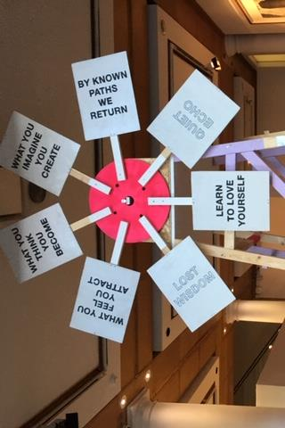
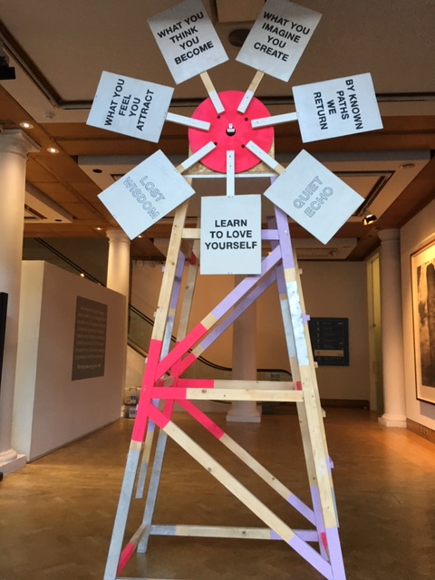

Slide 9
You will be able to download my main slides
You don’t need to take notes.
I’ll put the main slides I use up on my website later today (http://phil-race.co.uk/)
I won’t post pictures and video-clips, as this would make the file-size too large.
I may sometimes go through slides quite fast, but you can study them as you wish at your leisure.

Slide 10
How do teaching, learning, assessment and feedback need to vary across disciplines?
(after Biglan, 1973, Trowler, 2014, Berry O’Donovan, 2018)
Hard
Applied
Pure
Soft

Slide 11
How do teaching, learning, assessment and feedback need to vary across disciplines?
(after Biglan, 1973, Trowler, 2014, Berry O’Donovan, 2018)
Hard
On the grid, in your own discipline field, please work out where (point or area) you might pin some of the following (and other items of your choice);
A typical exam question
An essay
A report
A quantitative problem to be solved
A critique
A case study
A proposition
A model
A theory
A concept
A job interview
A typical journal paper
A lecture
A lab practical
A review
A proof
Applied
Pure
Soft

Slide 12
Discussion task: taking stock of some feedback approaches
All feedback approaches have their pros and cons. Consider both, for each of the following:
Written (printed) comments on students’ work.
Marks or grades.
Whole-class discussion of an assignment, when it has just been submitted.
Face-to-face 1:1 dialogue with assessor.
Students discussing feedback comments written for other students.
Students giving peer-feedback on each others’ drafts (or final assignments).

Slide 13
Discussion task: taking stock of some feedback approaches
All feedback approaches have their pros and cons. Consider both, for each of the following:
Written (printed) comments on students’ work.
Marks or grades.
Whole-class discussion of an assignment, when it has just been submitted.
Face-to-face 1:1 dialogue with assessor.
Students discussing feedback comments written for other students.
Students giving peer-feedback on each others’ drafts (or final assignments).
Time it takes us.
Timeliness for students.
Learning payoff for students.
‘Affective’ dimensions – how students feel about it.

Slide 14
Feedback and emotions
Probably feedback is for many people the most emotionally charged experience linked to assessment?
How best can we help bring ‘compassion’ into feedback?
It is well worth giving 20 minutes to watch this: (Theo Gilbert and others) https://www.youtube.com/watch?v=3jFVTCuSCOg …​ particularly on how we can help students to learn how to get more from feedback from each other as well as us.

Slide 15
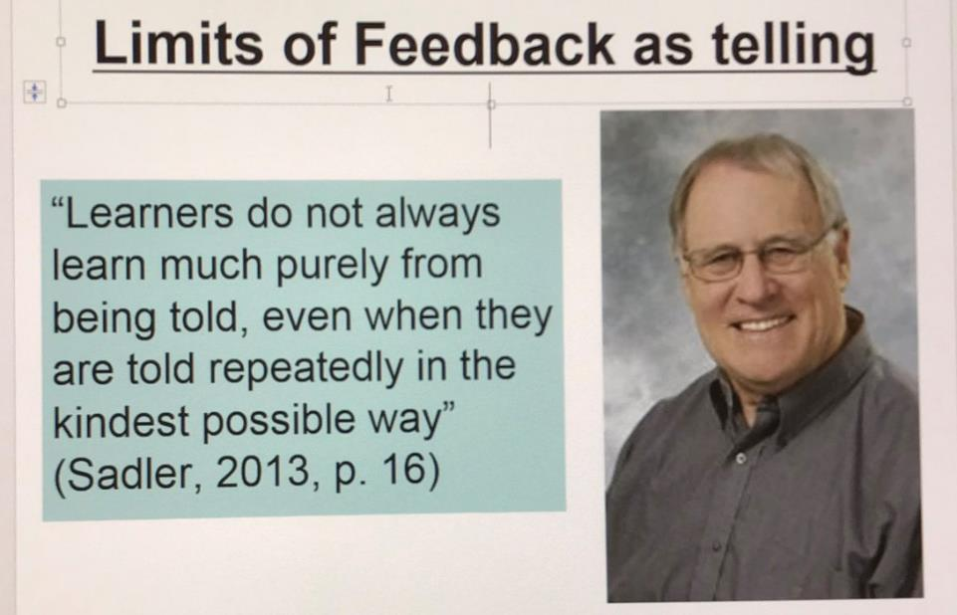
David Carless (on Twitter):
Feedback as telling is seriously overrated!

Slide 16
Download anytime Phil’s materials on learning and feedback
http://phil-race.co.uk/2016/04/updated-powerpoint-ripples-model/ (Chapter 1 from ‘The Lecturer’s Toolkit, 2015)
https://phil-race.co.uk/2016/10/lthe-tweetchat-lthechat-wed-oct-19-8-00-9-00-pm/ (feedback stuff from my most recent two books)

Slide 17
Teaching, learning and enthusiasm
Knowledge isn’t infectious (unfortunately) but enthusiasm is, and we need to help our students to catch enthusiasm.
We certainly don’t want feedback to damage that enthusiasm.

Slide 18
Time-constrained assessed written Post-it exercise
On a post-it, in your best handwriting, please write your own completion of the starter:
“Making feedback work well with my students nowadays would be much better for me if only I …”
Please swap post-its so that you’ve no idea who has yours.
If chosen, please read out with passion and drama what’s on the post-it you now have.
Please place them all as directed.

Slide 19
The NSS Assessment and Feedback Agenda (2005-16)
The criteria used in marking have been clear in advance.
Assessment arrangements and marking have been fair.
Feedback on my work has been prompt.
I have received detailed comments on my work.
Feedback on my work has helped me to clarify things I did not understand.

Slide 20
The new NSS statements (2017)
Assessment and feedback
The criteria used in marking have been clear in advance
Marking and assessment have been fair
Feedback on my work has been timely
I have received helpful comments on my work
Student voice
I have had the right opportunities to provide feedback on my course
Staff value students’ views and opinions about the course
It is clear how students’ feedback on the course has been acted on

Slide 21
Feed-forward
Language of feedback
Some feedback
issues
National Student Survey
Timing:
24-hours!
Written, printed,
on-screen
Efficiency
Face to face
oral

Slide 22
Seven factors underpinning successful learning: (Race, 2015)
Verbalising
Assessing
Feedback
Making sense
Doing
Wanting/
Needing
Race, P. (2015) The Lecturer’s Toolkit, 4th Edition: Chapter 1 (Routledge)

Slide 23

Seven factors underpinning successful learning (#rracw, 2015)
Verbalising
Assessing
Feedback
Making sense
Doing
Wanting/
Needing

Slide 24


We can’t carry on trying to use traditional assessment and feedback processes
We can’t continue trying to give students lots of feedback in traditional ways, as there are more students, and research shows that merely ‘telling’ them what to do with their work does not work.
There is now a great deal of work on ‘contract cheating’, for example Newton, P. (2018) https://www.frontiersin.org/articles/10.3389/feduc.2018.00067/full
And traditional written feedback doesn’t work: “Approaches that emphasise feedback as telling are insufficient because students are often not equipped to decode or act on statements satisfactorily, so key messages remain invisible” (Sadler 2010).

Slide 25
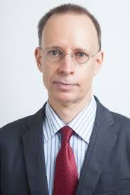

Developing students’ feedback literacy
The danger with traditional methods of assessment and feedback is that assessment tends to be done on student’s work by staff, and feedback tends to be one-directional from staff to students.
Carless and Boud (2018) stress that we want students to gain skills in making ‘evaluative judgements’ themselves on their work, rather than staff doing this.
David Carless & David Boud (2018): The development of student feedback literacy: enabling uptake of feedback, Assessment & Evaluation in Higher Education, https://doi.org/10.1080/02602938.2018.1463354

Slide 26
Factors underpinning feedback literacy
Carless and Boud (2018) examine in detail:
Appreciating feedback
Making judgements
Managing affect
Taking action
We need to enable our students to optimise each of these processes, if we wish to use assessment to promote their learning. They suggest that involving students in giving and receiving peer feedback, and in analysing exemplars, should be essential parts of the curriculum.

Slide 27
Task: think about ghastly feedback
Think back to some occasions, academic or otherwise, historic or recent when you received feedback that you would rather not have received;
How did it make you feel?
Thinking of a single example of ghastly feedback that you are prepared to share with another person, briefly outline the context and say why it was such a negative experience.

Slide 28
Feedback needs to have a future focus
Hounsell et al argue that we need to:
‘increase the value of feedback to the students by focusing comments not only on the past and present … but also on the future – what the student might aim to do, or do differently in the next assignment or assessment if they are to continue to do well or to do better’
(Hounsell, McCune, Hounsell and Litjens 2008, p.5).

Slide 29
Quality feedback: 3 functions
“There is wide consensus within the education literature that ‘quality’ feedback should serve three overlapping functions:
an ‘orientational’ purpose that clarifies the student’s performance and achievement;
a ‘transformational’ purpose that enables the student to reflect, improve their performance, and become more autonomous (often termed ‘feed-forward); and
an ‘affective/interpersonal’ dimension that gives the student confidence and motivation, and builds a strong teacher-student relationship”
(Dunworth & Sanchez, 2016, quoted by Winstone and Nash, 2016).

Slide 30
Ripples on a pond….
Motivates students – helps them to want to learn;
Helps students to identify what they need to do next;
Helps students to take action to improve their learning;
Helps students to make sense of what they are learning;
Helps them to further make sense of their learning by engaging in real dialogue with tutors and peers;
Helps them to make informed judgements on their own work, and each others’ work:
Helps them to reflect on their past work in ways they can use to improve their future work.
Feedback (including feed forward) works well when it:
Coaching,
explaining, teaching
Assessing
making informed judgements
Wanting/
Needing
Doing
Doing
Making sense
Feedback

Slide 31
Feedback works badly when it…
Is just a monologue from tutors to students;
Saps students’ confidence;
Directs students’ activities in inappropriate directions;
Fails to articulate with learning outcomes;
Fails to relate clearly to evidence of achievement of the assessment criteria;
Relates only to what is easy to assess rather than what is at the heart of learning;
Focuses on failings rather than achievements.

Slide 32
Individual task on ways of giving students feedback
Think of the main ways you give feedback to your students. Think also of other ways they get feedback without you being involved.
Privately, make a list of the ways your students get feedback on their learning (not just on their work) – aim for ten or more different ways students get feedback.

Slide 33
Group task
Please go into groups as directed.
As a group, please write each feedback method on a separate post-it, and place the post-its in position on a flipchart as follows…

Slide 34

High learning payoff
for students
Highly efficient
for us
Not highly efficient
for us
Low learning payoff
for students

Slide 35
25
5
High learning payoff
We need to be making
better use of the feedback
processes in this quadrant
16
4
Highly efficient
Not highly efficient
3
5
4
2
1
2
4
Low learning payoff
We need to be making
much less use of the feedback
processes in this quadrant
1
1

Slide 36
Your feedback methods
Low scoring
High scoring:(if done well)

Slide 37
QH Townsville feedback methods
Low scoring
1 systemic feedback
1 no feedback
1 client attendance rates
1 unconstructive feedback (not looking forward)
High scoring:(if done well)
25 verbal...
25 self reflection
25 360 anonymous peer review
20 peers/other staff
20 patient outcomes
16 feedback from other clinicians
16 group feedback verbal
16 learning contracts
16 self assessment PAD
12 face to face 1:1

Slide 38
GMIT feedback methods
High scoring:
25 marking your own assignment
25 group work, role-plays
25 immediate feedback in practical context
24 external feedback
24 grade descriptors in advance – what an excellent piece would look like, what a fail would look like
24 peer-peer study groups
20 trial and error
Low scoring
8 face to face individual feedback
4 written feedback on individual assignments
3 written feedback
2.5 just a mark
2 final exams
1 grade only (lousy)

Slide 39
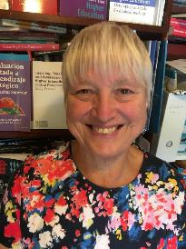
Fishing for feedback?
Feedback is like fish.
If it is not used quickly, it becomes useless.
(Sally Brown).
Give a man a fish,
Feed him for a day.
Teach a man to fish,
Feed him for a lifetime.
(Maimonides: 1135-1204)
Make feedback timely, while it still matters to students, in time for them to use it towards further learning, or to receive further assistance.
(Graham Gibbs)
And he’ll learn to drink beer in boats
And you won’t see him for weeks!
(Australian proverb).

Slide 40
How’s your feedback?
(After Nicol and MacFarlane-Dick, 2006)
1. Helps clarify what good performance is (goals, criteria, expected standards);
2. Facilitates the development of self-assessment (reflection) in learning;
3. Delivers high quality information to students about their learning;
4. Encourages teacher and peer dialogue around learning;
5. Encourages positive motivational beliefs and self-esteem;
6. Provides opportunities to close the gap between current and desired performance;
7. Provides information to teachers that can be used to help shape the teaching.

Slide 41
Bringing assessment and feedback to life
Questions employers might ask at interview that could help us frame some of our assignments
Can you tell us about an occasion when:
you worked together with colleagues in a group to produce a collective outcome?
you had to work autonomously with incomplete information and self-derived data sources?
you developed strategies to solve real life problems and tested them out?
you had a leadership role in a team, and could you tell us your strategies to influence and persuade your colleagues to achieve a collective task?
you had to communicate outcomes from your project work orally, in writing, through social media and/or through a visual medium?

Slide 42
Constructive Alignment: John Biggs
What will I be expected to show for this?
What does a good one look like, and a bad one?
Where does this fit into the big picture?
When explaining assessment criteria to students, and when linking these to evidence of achievement of the intended learning outcomes, we need to make the most of face-to-face whole group contexts and...
  Tone of voice
  Body language
  Facial expression
  Eye contact
  The chance to repeat things
  The chance to respond to puzzled looks
Some things don’t work nearly so well just on paper or on screens.
Some of the
tools we can
use in
face-to-face
contexts

Slide 43

Face to face feedback

Slide 44

Hands-on feedback?

Slide 45
What’s wrong with feedback?
Students get it too late.
And too often, it’s just words on paper.
It doesn’t help them enough.
They often don’t take enough notice of it.

Slide 46
But what’s really wrong with feedback?
Too often it’s one-way – monologic.
What students want is dialogue.
They want to talk to us about their work.
But they’re scared to talk to us, for various reasons:
  In case it leads to lower marks;
  In case they’re ‘found out’;
  In case they feel stupid.

Slide 47
The importance of dialogic assessment
Students need to be exposed to, and gain experience in making judgements about, a variety of works of different quality... They need planned rather than random exposure to exemplars, and experience in making judgements about quality. They need to create verbalised rationales and accounts of how various works could have been done better. Finally, they need to engage in evaluative conversations with teachers and other students. Together, these three provide the means by which students can develop a concept of quality that is similar in essence to that which the teacher possesses, and in particular to understand what makes for high quality. Although providing these experiences for students may appear to add more layers to the task of teaching, it is possible to organise this approach to peer assessment so that it becomes a powerful strategy for higher education teaching. (Sadler 2010)

Slide 48

Royce Sadler on feedback:
Higher education teachers are often frustrated by the modest impact feedback has in improving learning. The status of feedback deserves to be challenged on the grounds that it is essentially about telling. For students to become self-sustaining producers of high quality intellectual and professional goods, they must be equipped to take control of their own learning and performance. (Sadler, 2013)
Sadler, D. R. (2013). Opening up feedback: Teaching learners to see. In Merry, S., Price, M., Carless, D., & Taras, M. (Eds.) Reconceptualising feedback in higher education: Developing dialogue with students. (Ch. 5, 54‑63). London: Routledge.

Slide 49
Modern institutions are moving away from being the providers of content, (where everything used to be about ‘delivery’), towards foregrounding two major functions:
Recognising and accrediting students’ achievement, wherever learning has taken place (i.e. getting the assessment right);
Supporting student learning and engagement (not least by making feedback work well for students, and using real-world situations and simulations to bring learning to life).

Slide 50
Ripples on a pond….
Enhance our students’ want to learn?
Help students to develop ownership of the need to learn?
Keep students learning by doing, practice, trial-and-error, repetition?
Ensure students really us feedback – from us and from each other?
Help students to make sense of what they learn?
Get students deepening their learning by verbalising, explaining things to each other, and to us?
Allow students to deepen their learning by assessing their own learning, and assessing others’ learning – making informed judgements?
What else can we do to use
teaching, assessment and feedback to:
Verbalising
Assessing
making informed judgements
Wanting/
Needing
Doing
Doing
Making sense
Feedback

Slide 51
Looking ahead to the next sessions
Assessment and feedback can be powerful means of focusing student effort and enhancing achievement if well designed (Biggs and Tang, 2011);
Students in the early stages of their learning journey are likely to need more support and positive feedback than later, when they are more robust and confident;
The first six weeks are crucial in helping students understand how assessment and feedback work;
No single method of giving feedback is likely to be ubiquitously successful, so it’s worth using a variety of approaches;
Assessment needs to be manageable for staff and students if it is going to engage students in learning activities.

Slide 52
Back to our intended learning outcomes…
Do you now feel better able to:
2 hands = very much better,
one hand = somewhat better,
touch left ear = no better...
Re-examine some of the problems we have with making feedback work effectively.
Look at what the current literature suggests about making feedback dialogues work well.
Wanting/
Needing
Doing
Making sense
Feedback

Slide 53
May I wish you a very merry Christmas

Slide 54

Thank you…
Website: http://phil-race.co.uk
Follow Phil on Twitter @RacePhil
e-mail: phil@phil-race.co.uk

Slide 55
Useful references and further reading (1)
Bain, K. (2004) What the best College Teachers do, Cambridge: Harvard University Press.
Biggs, J. and Tang, C. (2011) Teaching for Quality Learning at University, Maidenhead: Open University Press.
Bloxham, S. and Boyd, P. (2007) Developing effective assessment in higher education: a practical guide, Maidenhead, Open University Press.
Boud, D. (1995) Enhancing learning through self-assessment, London: Routledge.
Brown, S. and Glasner, A. (eds.) (1999) Assessment Matters in Higher Education, Choosing and Using Diverse Approaches, Maidenhead: Open University Press.
Brown, S. and Race, P. (2012) Using effective assessment to promote learning in Hunt, L. and Chambers, D. (2012) University Teaching in Focus, Victoria, Australia, Acer Press. P74-91.
Brown, S. (2015) Learning , Teaching and Assessment in Higher Education: Global perspectives, London, Palgrave.

Slide 56
Useful references and further reading (2)
Carless, D., Joughin, G., Ngar-Fun Liu et al (2006) How Assessment supports learning: Learning orientated assessment in action Hong Kong: Hong Kong University Press.
Carroll, J. and Ryan, J. (2005) Teaching International students: improving learning for all. London: Routledge SEDA series.
Crosling, G., Thomas, L. and Heagney, M. (2008) Improving student retention in Higher Education, London and New York: Routledge
Crooks, T. (1988) Assessing student performance, HERDSA Green Guide No 8 HERDSA (reprinted 1994).
Dunworth, K. and Sanchez, H.S., (2016). Perceptions of quality in staff-student written feedback in higher education: a case study. Teaching in Higher Education, 21(5), pp.576-589.
Dweck, C. S. (2000) Self Theories: Their Role in Motivation, Personality and Development, Lillington, NC: Taylor & Francis.
Falchikov, N. (2004) Improving Assessment through Student Involvement: Practical Solutions for Aiding Learning in Higher and Further Education, London: Routledge.
Gibbs, G. (1999) Using assessment strategically to change the way students learn, in Brown S. & Glasner, A. (eds.), Assessment Matters in Higher Education: Choosing and Using Diverse Approaches, Maidenhead: SRHE/Open University Press.
Higher Education Academy (2012) A marked improvement; transforming assessment in higher education, York: HEA.

Slide 57
Useful references and further reading (3)
Hawe, E., Lightfoot, U., & Dixon, H. (2017). First-year students working with exemplars: Promoting self-efficacy, self-monitoring and self-regulation. Journal of Further and Higher Education, 1-15.
Hendry, G. D., White, P., & Herbert, C. (2016). Providing Exemplar-Based “Feedforward” before an Assessment: The Role of Teacher Explanation. Active Learning in Higher Education, 17(2), 99-109.
Hounsell, D., McCune, V., Hounsell, J. and Litjens, J., (2008). The quality of guidance and feedback to students. Higher Education Research & Development, 27(1), pp.55-67.
Newton, P. M. (2018) How Common Is Commercial Contract Cheating in Higher Education and Is It Increasing? A Systematic Review https://www.frontiersin.org/articles/10.3389/feduc.2018.00067/full
Nicol, D. J. and Macfarlane-Dick, D. (2006) Formative assessment and self-regulated learning: A model and seven principles of good feedback practice, Studies in Higher Education Vol 31(2), 199-218.
PASS project Bradford http://www.pass.brad.ac.uk/ Accessed November 2013.
Pickford, R. and Brown, S. (2006) Assessing skills and practice, London: Routledge.
Rotheram, B. (2009) Sounds Good, JISC project http://www.jisc.ac.uk/whatwedo/programmes/usersandinnovation/soundsgood.aspx

Slide 58
Useful references and further reading (4)
Race, P. (2001) A Briefing on Self, Peer & Group Assessment, in LTSN Generic Centre Assessment Series No 9, LTSN York.
Race P. (2015) The lecturer’s toolkit (4th edition), London: Routledge.
Rust, C., Price, M. and O’Donovan, B. (2003) Improving students’ learning by developing their understanding of assessment criteria and processes, Assessment and Evaluation in Higher Education. 28 (2), 147-164.
Ryan, J. (2000) A Guide to Teaching International Students, Oxford Centre for Staff and Learning Development.
Scoles, J., Huxham, M., & Mcarthur, J. (2013). No longer exempt from good practice: Using exemplars to close the feedback gap for exams. Assessment & Evaluation in Higher Education, 38(6), 631-645.
Stefani, L. and Carroll, J. (2001) A Briefing on Plagiarism, LTSN
Sadler, D. Royce (2010) Beyond feedback: developing student capability in complex appraisal,
Assessment & Evaluation in Higher Education, 35: 5, 535-550.
Yorke, M. (1999) Leaving Early: Undergraduate Non-completion in Higher Education, London: Routledge.

