Slide 1
Assessment and Feedback – the sharp end of learning
12th December, 2018
University of Derby
Phil Race
(from Newcastle-upon-Tyne)
BSc PhD PGCE FCIPD PFHEA NTF
Follow Phil on Twitter: @RacePhil
Visiting Professor: University of Plymouth and Edge Hill University
Emeritus Professor, Leeds Beckett University

Slide 2
This slide has two purposes….
To focus the data projector, if necessary, and…
...to persuade colleagues never to put this sort of detail onto a slide!

Slide 3
About Phil…
First a musician
Then a writer
Then a scientist
Then a researcher
Then a lecturer and warden at what is now USW
Got interested in how students learn
And the effects assessment and feedback have on them
And how we teach them
Gradually became an educational developer
And now ‘retired’!?
Currently…
Visiting Prof: Plymouth & Edge Hill
Emeritus Prof: Leeds Beckett
Based at Newcastle, UK
And on trains
And an expert…
on train routes and timetables!
Notes:
2
2

Slide 4
Thanks for asking me back to Derby
Were any of you with me last time I was here, on 15th March 2015?
Anyone remember what we did?
I see that there were lots of downloads of the slides from then, but the link on my website got broken! (I’ve just reinstated it for anyone who wants it – but many new ideas today!

Slide 5
Announcement about mobile phones and laptops...
Good afternoon everyone – please turn on your ‘phones and computers.
Please post your thoughts, comments and ideas during this session to the hashtag #philatderby18 Thanks!
Try #LTHEchat on Wednesday evenings from 20.00-21.00.
(Usual rules apply in this presentation: £1 to the first person to spot each of the first 3 typos)

Slide 6
Name labels…
Please write your first name, big and bold, on a sticky label, and stick it to your clothing (not onto a fabric which would be damaged).
βA3
Phil

Slide 7
Download anytime Phil’s materials on feedback, assessment, and learning
Expanded discussion of how the factors underpinning learning link to feedback, assessment and large-group teaching:
http://phil-race.co.uk/2016/04/updated-powerpoint-ripples-model/ (Chapter 1 from ‘The Lecturer’s Toolkit, 2015)
https://phil-race.co.uk/2016/10/lthe-tweetchat-lthechat-wed-oct-19-8-00-9-00-pm/ (feedback stuff from my most recent two books)
http://phil-race.co.uk/2015/01/assessment-bits-new-editions/ (extracts on assessment)

Slide 8
Thought for the day: Einstein
It is simply madness,
to keep doing the same things,
and expect different results.

Slide 9
And there are so many great things in Derby’s assessment and feedback strategy.
https://www.derby.ac.uk/media/derbyacuk/assets/organisation/about-us/learning-enhancement/documents/Assessment-and-Feedback-Strategy-2017-2020.pdf.
And well worth looking at this clip from Coursera from Royce Sadler, whose work informs much of the modern thinking on assessment and feedback…
https://www.coursera.org/lecture/university-teaching/interview-with-prof-royce-sadler-on-understanding-standards-TD6pE

Slide 10
Teaching, learning and enthusiasm
Knowledge isn’t infectious (unfortunately) but enthusiasm is, and we need to help our students to catch enthusiasm.
We certainly don’t want assessment or feedback to damage that enthusiasm.

Slide 11
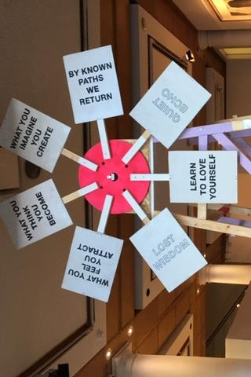
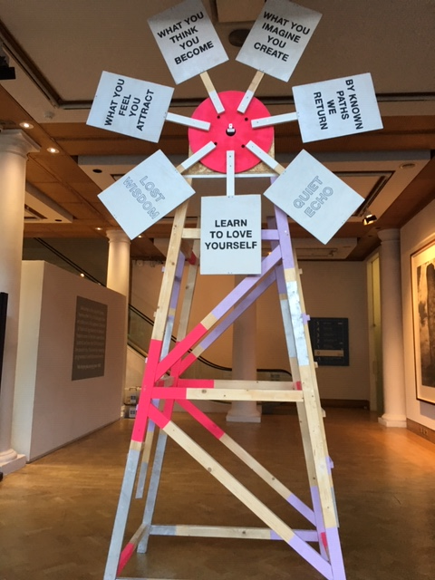

Slide 12
Intended learning outcomes
After participating in this session, you should be better-able to:
Explore some of the main problems we have implementing assessment and feedback using traditional approaches.
Discuss possible ways of addressing some of these problems creatively, so that assessment and feedback can be firmly linked to student learning.

Slide 13
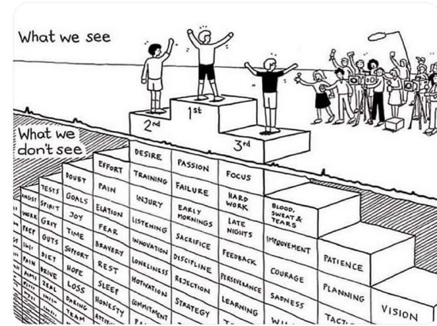
Do we get what we ask for
with intended learning outcomes?
Have we any idea of how many of
these might also have been involved?

Slide 15
Time-constrained, assessed written Post-it exercise
On a post-it, in your best handwriting, please write your own completion of the starter:
“Assessment and feedback would work much better with my students nowadays if only I …”
Please swap post-its so that you’ve no idea who has yours.
If chosen, please read out with passion and drama what’s on the post-it you now have.
Please place them all as directed.

Slide 16
Now is the decade of Universities’ dis-content!
Never mind the content – feel the learning

Slide 17
Teaching in modern institutions is moving away from providing subject content, (where everything was about ‘delivery’), towards foregrounding two major functions:
Recognising and accrediting students’ achievement, wherever learning has taken place (i.e. getting the assessment right);
Supporting student learning and engagement (not least by making feedback work well for students).

Slide 18
We can’t carry on trying to use traditional assessment and feedback processes
We can’t continue trying to give students lots of feedback in traditional ways, as there are more students, and research shows that merely ‘telling’ them what to do with their work does not work.
There is now a great deal of work on ‘contract cheating’, for example Newton, P. (2018) https://www.frontiersin.org/articles/10.3389/feduc.2018.00067/full
And traditional written feedback doesn’t work: “Approaches that emphasise feedback as telling are insufficient because students are often not equipped to decode or act on statements satisfactorily, so key messages remain invisible” (Sadler 2010).

Slide 19
Constructive Alignment: John Biggs
What will I be expected to show for this?
What does a good one look like, and a bad one?
Where does this fit into the big picture?
When explaining assessment criteria to students, and when linking these to evidence of achievement of the intended learning outcomes, we need to make the most of face-to-face whole group contexts and...
Tone of voice
Body language
Facial expression
Eye contact
The chance to repeat things
The chance to respond to puzzled looks
Some things don’t work nearly so well just on paper or on screens.
Some of the
tools we can
use in
face-to-face
contexts

Slide 20
How students really learn
Seven factors underpinning successful learning based on asking lots of people about their learning in the last 30 years

Slide 21
How Students Really Learn ‘Ripples’ model of learning
Phil Race

Slide 23
Which wavelength should I teach on?
The only one that works for today’s students is WIIFM
What’s in it for me?
Consciously address the ‘so what’ in students’ minds;
Warm up their ‘want’ to learn.
Clarify their ‘need’ to learn.
They learn far more readily if they are continuously aware of the benefits for them of putting energy into their learning.

Slide 24
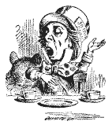
Unless we do something else…
“[The] pupils got it all by heart; and, when Examination-time came, they wrote it down; and the Examiner said ‘Beautiful! What depth!’
They became teachers in their turn, and they said all these things over again; and their pupils wrote it down, and the examiner accepted it; and nobody had the ghost of an idea what it meant” Lewis Carroll, 1893
Active
Experimentation
Abstract
Conceptualisation
Concrete
Experience
Reflective
Observation

Slide 26
What’s wrong
with
this?
Verbalising
Assessing
Feedback
Making sense
Doing
Wanting/
Needing

Slide 27
What’s wrong
with
this?
Verbalising
Assessing
Feedback
Making sense
Doing
Wanting/
Needing

Slide 28
Thanks, Dr Paul Kleiman

Slide 29
Ripples on a pond….
Enhance our students’ want to learn?
Help students to develop ownership of the need to learn?
Keep students learning by doing, practice, trial-and-error, repetition?
Ensure students really use feedback – from us and from each other?
Help students to make sense of what they learn?
Get students deepening their learning by verbalising, explaining things to each other, and to us?
Allow students to deepen their learning by assessing their own learning, and assessing others’ learning – making informed judgements?
What else can we do to use assessment and feedback to:
Verbalising
Assessing
making informed judgements
Wanting/
Needing
Doing
Doing
Making sense
Feedback

Slide 30
Drives most learning
Is assessment broken?
Some
assessment
issues
What students think
Assessment as learning
Validity
Whodunit?
Fairness

Slide 31
My main worries about assessment...
Too often, we still tend to try to measure...
...what’s in students’ heads, and what they can do with what’s there...
in terms of two unsatisfactory proxies ...
what comes out of students’ pens in exams;
2. what comes out of their keyboards in essays and reports.

Slide 32
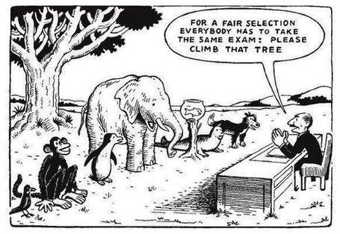

Slide 33
Ten Concerns about exams
These ten concerns are about time-constrained unseen written examinations.
As we explore these, think of how other forms of exam can get round some of these concerns...
open book
open notes
time unconstrained
take-away
in-tray
multiple-choice
others….

Slide 34
Ripples on a pond….
Concerns about traditional exams
Coaching,
explaining, teaching
Assessing
making informed judgements
They don’t do much to increase the ‘want’ to learn.
They are not ideal occasions for learning-by-doing.
The amount of feedback that students receive is not optimal.
They don’t do much to help students to make sense of what they have learned.
Wanting/
Needing
Doing
Doing
Making sense
Feedback

Slide 35
Concerns about traditional exams
We mark them in a rush.
We’re often tired and bored when we mark them.
We’re not good at marking them objectively.
They favour candidates who happen to be skilled at taking exams.
They force students into surface learning, and into rapidly clearing their minds of previous knowledge when preparing for the next exam.
There are many important things which they don’t measure.

Slide 36
Ripples on a pond….
If students are under too much pressure, the want to learn is damaged.
The range of learning-by-doing may be too narrow.
Feedback may be eclipsed by marks or grades.
Students may not have the opportunity to make sense of the feedback they receive.
Coaching,
explaining, teaching
Concerns about continuous assessment
Assessing
making informed judgements
Wanting/
Needing
Doing
Doing
Making sense
Feedback

Slide 37
Concerns about continuous assessment
It may be hard to detect unwanted collaboration.
Too much time may be involved in marking.
Students may not be aware of the criteria used to assess their work.
Students may get the balance wrong between continuous assessment and exams.
Learning may become driven by assessment, and students may only do those things that are assessed.
Too little use may be made of the learning that can be achieved when students assess their own, and each other’s work.

Slide 38
Five main problems with assessed essays
They take a great deal of time to mark, let alone the time it takes for students to prepare, draft and compose them.
When most assessment is in the form of essays, students’ skills at essay-writing are repeatedly tested, as the expense sometimes of their understanding of the subject.
Lots of research shows that we’re not at all good at marking essays fairly – different assessors often give the same essay very different marks.
Essay marks in the UK tend to lie between 35% for a poor one and 75% for a very good one, whereas in many other disciplines the marks for an assignment like a lab report can range across the whole 0-100% span more evenly.
With coursework essays, there can be doubt about ‘whodunit?’!

Slide 39
In September: The essay is failing us. Discuss

Slide 40
How might assessment and feedback need to vary across disciplines? (after Biglan, 1973, Trowler, 2014, Berry O’Donovan, 2018)
Hard
Applied
Pure
Soft

Slide 41
How do teaching, learning, assessment and feedback need to vary across disciplines? (after Biglan, 1973, Trowler, 2014, Berry O’Donovan, 2018)
Hard
On the grid, in your own discipline field, please work out where (point or area) you might pin some of the following (and other items of your choice);
A typical exam question
An essay
A report
A quantitative problem to be solved
A critique
A case study
A proposition
A model
A theory
A concept
A job interview
A typical journal paper
A lecture
A lab practical
A review
A proof
Applied
Pure
Soft

Slide 42
Feed-forward
Language of feedback
Some feedback
issues
National Student Survey
Timing:
24-hours!
Written, printed,
on-screen
Efficiency
Face to face
oral

Slide 43
The NSS Assessment and Feedback Agenda (2005-16)
The criteria used in marking have been clear in advance.
Assessment arrangements and marking have been fair.
Feedback on my work has been prompt.
I have received detailed comments on my work.
Feedback on my work has helped me to clarify things I did not understand.

Slide 44
The new NSS statements (2017)
Assessment and feedback
The criteria used in marking have been clear in advance
Marking and assessment have been fair
Feedback on my work has been timely
I have received helpful comments on my work
Student voice
I have had the right opportunities to provide feedback on my course
Staff value students’ views and opinions about the course
It is clear how students’ feedback on the course has been acted on

Slide 45
David Carless (on Twitter):
Feedback as telling is seriously overrated!

Slide 46
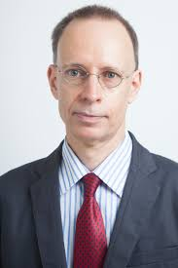
Developing students’ feedback literacy
The danger with traditional methods of assessment and feedback is that assessment tends to be done on student’s work by staff, and feedback tends to be one-directional from staff to students.
Carless and Boud (2018) stress that we want students to gain skills in making ‘evaluative judgements’ themselves on their work, rather than staff doing this.
David Carless & David Boud (2018): The development of student feedback literacy: enabling uptake of feedback, Assessment & Evaluation in Higher Education, https://doi.org/10.1080/02602938.2018.1463354

Slide 47
Factors underpinning feedback literacy
Carless and Boud (2018) examine in detail:
Appreciating feedback
Making judgements
Managing affect
Taking action
We need to enable our students to optimise each of these processes, if we wish to use assessment to promote their learning. They suggest that involving students in giving and receiving peer feedback, and in analysing exemplars, should be essential parts of the curriculum.

Slide 48
Feedback needs to have a future focus
Hounsell et al argue that we need to:
‘increase the value of feedback to the students by focusing comments not only on the past and present … but also on the future – what the student might aim to do, or do differently in the next assignment or assessment if they are to continue to do well or to do better’
(Hounsell, McCune, Hounsell and Litjens 2008, p.5).

Slide 49
Discussion task: taking stock of some feedback approaches
All feedback approaches have their pros and cons. Consider both, for each of the following:
Written (printed) comments on students’ work.
Marks or grades.
Whole-class discussion of an assignment, when it has just been submitted.
Face-to-face 1:1 dialogue with assessor.
Students discussing feedback comments written for other students.
Students giving peer-feedback on each others’ drafts (or final assignments).

Slide 50
Discussion task: taking stock of some feedback approaches
All feedback approaches have their pros and cons. Consider both, for each of the following:
Written (printed) comments on students’ work.
Marks or grades.
Whole-class discussion of an assignment, when it has just been submitted.
Face-to-face 1:1 dialogue with assessor.
Students discussing feedback comments written for other students.
Students giving peer-feedback on each others’ drafts (or final assignments).
Scores out of 10:
Orig A B C D Final
1
2
3
4
5
6

Slide 51
Discussion task: taking stock of some feedback approaches
All feedback approaches have their pros and cons. Consider both, for each of the following:
Written (printed) comments on students’ work.
Marks or grades.
Whole-class discussion of an assignment, when it has just been submitted.
Face-to-face 1:1 dialogue with assessor.
Students discussing feedback comments written for other students.
Students giving peer-feedback on each others’ drafts (or final assignments).
Time it takes us.
Timeliness for students.
Learning payoff for students.
‘Affective’ dimensions – how students feel about it.

Slide 52
Discussion task: taking stock of some feedback approaches
All feedback approaches have their pros and cons. Consider both, for each of the following:
Written (printed) comments on students’ work.
Marks or grades.
Whole-class discussion of an assignment, when it has just been submitted.
Face-to-face 1:1 dialogue with assessor.
Students discussing feedback comments written for other students.
Students giving peer-feedback on each others’ drafts (or final assignments).
Make an individual decision on the practicability score of each approach on a yellow post-it: 0 = of little value, ranging to 10 = highly valuable
On a blue post-it, please add up the scores for your group.
On your original yellow post-it, please write new scores thinking about variable A.
Now do the same thinking about B.
Ditto variable C.
Ditto variable D.
Lastly, add a final score reflecting on the discussion.
On an orange post-it, please add up revised scores for the group after all the discussion.

Slide 53
Feedback and emotions
Probably feedback is for many people the most emotionally charged experience linked to assessment?
How best can we help bring ‘compassion’ into feedback?
It is well worth giving 20 minutes to watch this: (Theo Gilbert and others) https://www.youtube.com/watch?v=3jFVTCuSCOg …​ particularly on how we can help students to learn how to get more from feedback from each other as well as us.

Slide 54
Task: think about ghastly feedback
Think back to some occasions, academic or otherwise, historic or recent when you received feedback that you would rather not have received;
How did it make you feel?
Thinking of a single example of ghastly feedback that you are prepared to share with another person, briefly outline the context and say why it was such a negative experience.

Slide 55
Quality feedback: 3 functions
“There is wide consensus within the education literature that ‘quality’ feedback should serve three overlapping functions:
an ‘orientational’ purpose that clarifies the student’s performance and achievement;
a ‘transformational’ purpose that enables the student to reflect, improve their performance, and become more autonomous (often termed ‘feed-forward); and
an ‘affective/interpersonal’ dimension that gives the student confidence and motivation, and builds a strong teacher-student relationship”
(Dunworth & Sanchez, 2016, quoted by Winstone and Nash, 2016).

Slide 56
The importance of dialogic assessment
Students need to be exposed to, and gain experience in making judgements about, a variety of works of different quality... They need planned rather than random exposure to exemplars, and experience in making judgements about quality. They need to create verbalised rationales and accounts of how various works could have been done better. Finally, they need to engage in evaluative conversations with teachers and other students. Together, these three provide the means by which students can develop a concept of quality that is similar in essence to that which the teacher possesses, and in particular to understand what makes for high quality. Although providing these experiences for students may appear to add more layers to the task of teaching, it is possible to organise this approach to peer assessment so that it becomes a powerful strategy for higher education teaching. (Sadler 2010)

Slide 57
Royce Sadler on feedback:
Higher education teachers are often frustrated by the modest impact feedback has in improving learning. The status of feedback deserves to be challenged on the grounds that it is essentially about telling. For students to become self-sustaining producers of high quality intellectual and professional goods, they must be equipped to take control of their own learning and performance. (Sadler, 2013)
Sadler, D. R. (2013). Opening up feedback: Teaching learners to see. In Merry, S., Price, M., Carless, D., & Taras, M. (Eds.) Reconceptualising feedback in higher education: Developing dialogue with students. (Ch. 5, 54‑63). London: Routledge.

Slide 58
Back to our intended learning outcomes…
Do you now feel better able to:
2 hands = very much better,
one hand = somewhat better,
touch left ear = no better...
Explore some of the main problems we have implementing assessment and feedback using traditional approaches.
Discuss possible ways of addressing some of these problems creatively, so that assessment and feedback can be firmly linked to student learning.
Wanting/
Needing
Doing
Making sense
Feedback

Slide 59
Thank you…
Website: http://phil-race.co.uk
Follow Phil @RacePhil
e-mail: phil@phil-race.co.uk

Slide 60
Useful references and further reading (1)
Bain, K. (2004) What the best College Teachers do, Cambridge: Harvard University Press.
Biggs, J. and Tang, C. (2011) Teaching for Quality Learning at University, Maidenhead: Open University Press.
Bloxham, S. and Boyd, P. (2007) Developing effective assessment in higher education: a practical guide, Maidenhead, Open University Press.
Boud, D. (1995) Enhancing learning through self-assessment, London: Routledge.
Brown, S. and Glasner, A. (eds.) (1999) Assessment Matters in Higher Education, Choosing and Using Diverse Approaches, Maidenhead: Open University Press.
Brown, S. and Race, P. (2012) Using effective assessment to promote learning in Hunt, L. and Chambers, D. (2012) University Teaching in Focus, Victoria, Australia, Acer Press. P74-91.
Brown, S. (2015) Learning , Teaching and Assessment in Higher Education: Global perspectives, London, Palgrave.
Carless, D., Joughin, G., Ngar-Fun Liu et al (2006) How Assessment supports learning: Learning orientated assessment in action Hong Kong: Hong Kong University Press.
Carless, D. and Boud, D. (2018): The development of student feedback literacy: enabling uptake of feedback, Assessment & Evaluation in Higher Education, https://doi.org/10.1080/02602938.2018.1463354

Slide 61
Useful references and further reading (2)
Carroll, J. and Ryan, J. (2005) Teaching International students: improving learning for all. London: Routledge SEDA series.
Crosling, G., Thomas, L. and Heagney, M. (2008) Improving student retention in Higher Education, London and New York: Routledge
Crooks, T. (1988) Assessing student performance, HERDSA Green Guide No 8 HERDSA (reprinted 1994).
Dunworth, K. and Sanchez, H.S., (2016). Perceptions of quality in staff-student written feedback in higher education: a case study. Teaching in Higher Education, 21(5), pp.576-589.
Dweck, C. S. (2000) Self Theories: Their Role in Motivation, Personality and Development, Lillington, NC: Taylor & Francis.
Falchikov, N. (2004) Improving Assessment through Student Involvement: Practical Solutions for Aiding Learning in Higher and Further Education, London: Routledge.
Gibbs, G. (1999) Using assessment strategically to change the way students learn, in Brown S. & Glasner, A. (eds.), Assessment Matters in Higher Education: Choosing and Using Diverse Approaches, Maidenhead: SRHE/Open University Press.
Higher Education Academy (2012) A marked improvement; transforming assessment in higher education, York: HEA.

Slide 62
Useful references and further reading (3)
Hawe, E., Lightfoot, U., & Dixon, H. (2017). First-year students working with exemplars: Promoting self-efficacy, self-monitoring and self-regulation. Journal of Further and Higher Education, 1-15.
Hendry, G. D., White, P., & Herbert, C. (2016). Providing Exemplar-Based “Feedforward” before an Assessment: The Role of Teacher Explanation. Active Learning in Higher Education, 17(2), 99-109.
Hounsell, D., McCune, V., Hounsell, J. and Litjens, J., (2008). The quality of guidance and feedback to students. Higher Education Research & Development, 27(1), pp.55-67.
Newton, P. M. (2018) How Common Is Commercial Contract Cheating in Higher Education and Is It Increasing? A Systematic Review https://www.frontiersin.org/articles/10.3389/feduc.2018.00067/full
Nicol, D. J. and Macfarlane-Dick, D. (2006) Formative assessment and self-regulated learning: A model and seven principles of good feedback practice, Studies in Higher Education Vol 31(2), 199-218.
PASS project Bradford http://www.pass.brad.ac.uk/ Accessed November 2013.
Pickford, R. and Brown, S. (2006) Assessing skills and practice, London: Routledge.
Rotheram, B. (2009) Sounds Good, JISC project http://www.jisc.ac.uk/whatwedo/programmes/usersandinnovation/soundsgood.aspx

Slide 63
Useful references and further reading (4)
Race, P. (2001) A Briefing on Self, Peer & Group Assessment, in LTSN Generic Centre Assessment Series No 9, LTSN York.
Race, P. (2014) Msking Learning Happen (3rd edition), London: Sage.
Race P. (2015) The lecturer’s toolkit (4th edition), London: Routledge.
Rust, C., Price, M. and O’Donovan, B. (2003) Improving students’ learning by developing their understanding of assessment criteria and processes, Assessment and Evaluation in Higher Education. 28 (2), 147-164.
Ryan, J. (2000) A Guide to Teaching International Students, Oxford Centre for Staff and Learning Development.
Scoles, J., Huxham, M., & Mcarthur, J. (2013). No longer exempt from good practice: Using exemplars to close the feedback gap for exams. Assessment & Evaluation in Higher Education, 38(6), 631-645.
Sadler, D. Royce (2010) Beyond feedback: developing student capability in complex appraisal, Assessment & Evaluation in Higher Education, 35: 5, 535-550.
Yorke, M. (1999) Leaving Early: Undergraduate Non-completion in Higher Education, London: Routledge.

