Slide 1
Looking after Yourself
9th January, 2019
Cork Institute of Technology
Learning and Teaching Conversations
Phil Race
(from Newcastle-upon-Tyne)
BSc PhD PGCE FCIPD PFHEA NTF
Follow Phil on Twitter: @RacePhil
Visiting Professor: University of Plymouth and Edge Hill University
Emeritus Professor, Leeds Beckett University

Slide 2
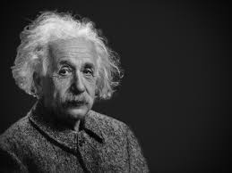
Thought for the day: Einstein
It is simply madness,
to keep doing the same things,
and expect different results.

Slide 3
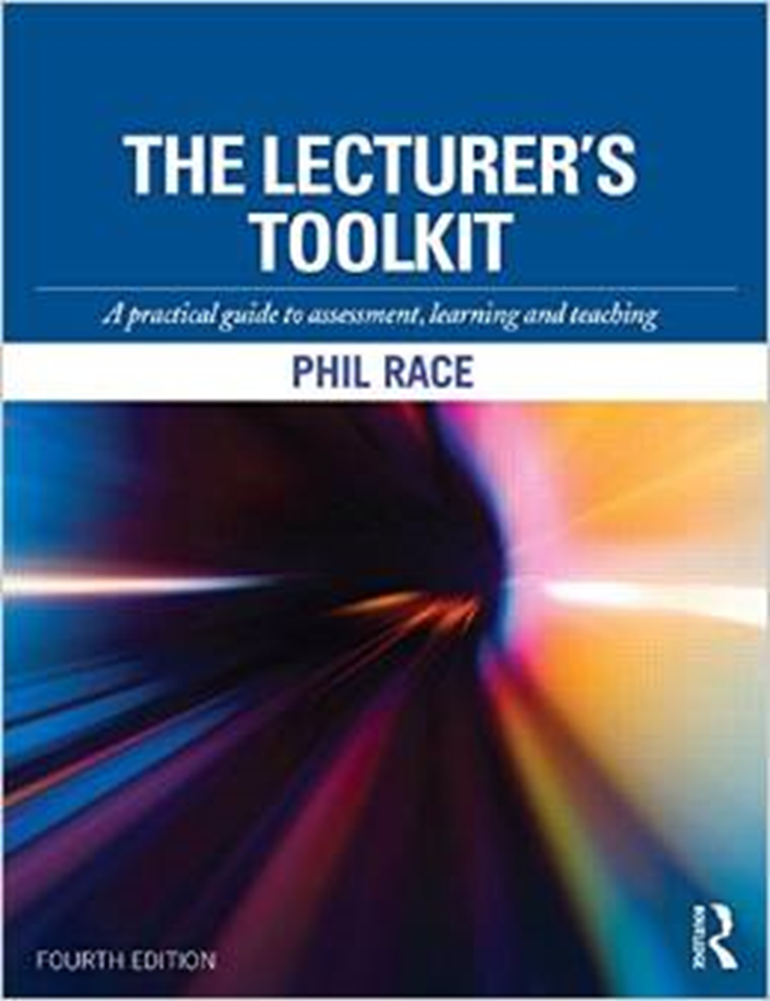
Intended learning outcomes
After participating in this short session, you should be better able to:
Look after yourself better in your professional role.
Help others to adjust their approach where necessary to look after themselves well.
(For more detail, please see Chapter 6 of the 4th edition on ‘The Lecturer’s Toolkit’: 2015, Phil Race – lots of copies around at CIT, and this chapter downloadable from my website for a short while)

Slide 4
Teaching, learning and enthusiasm
Knowledge isn’t infectious (unfortunately) but enthusiasm is, and we need to help our students to catch enthusiasm.
We certainly don’t want assessment or feedback to damage that enthusiasm.

Slide 5
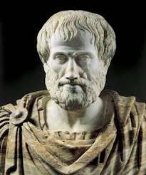
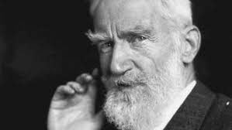
Two old quotes
It is the mark of an educated mind to be able to entertain a thought without accepting it.
(Aristotle)
Success does not consist of never making mistakes, but in not making the same one a second time.
(George Bernard Shaw)

Slide 6
Time-constrained, confidential, written Post-it exercises
On the wrong side of a yellow post-it, in your best handwriting, please write your own short completion of the starter:
“My professional life would feel much better if only I…”
_________________________________
On the wrong side of a pink post-it, please write your own completion of:
“One thing I wish I’d known earlier is….”
Now please stick your post-its wrong face up on the charts.

Slide 7
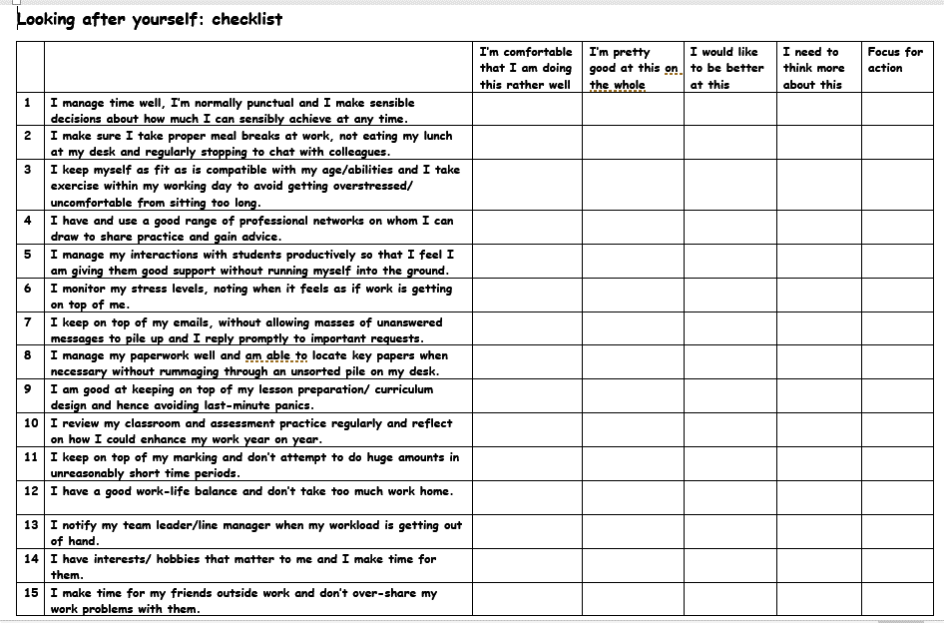

Slide 8
 | Looking after yourself: checklist
1 | I manage time well, I’m normally punctual and I make sensible decisions about how much I can sensibly achieve at any time.
2 | I make sure I take proper meal breaks at work, not eating my lunch at my desk and regularly stopping to chat with colleagues.
3 | I keep myself as fit as is compatible with my age/abilities and I take exercise within my working day to avoid getting overstressed/ uncomfortable from sitting too long.
4 | I have and use a good range of professional networks on whom I can draw to share practice and gain advice.
5 | I manage my interactions with students productively so that I feel I am giving them good support without running myself into the ground.
6 | I monitor my stress levels, noting when it feels as if work is getting on top of me.
7 | I keep on top of my emails, without allowing masses of unanswered messages to pile up and I reply promptly to important requests.
8 | I manage my paperwork well and am able to locate key papers when necessary without rummaging through an unsorted pile on my desk.
9 | I am good at keeping on top of my lesson preparation/ curriculum design and hence avoiding last-minute panics.
10 | I review my classroom and assessment practice regularly and reflect on how I could enhance my work year on year.
11 | I keep on top of my marking and don’t attempt to do huge amounts in unreasonably short time periods.
12 | I have a good work-life balance and don’t take too much work home.
13 | I notify my team leader/line manager when my workload is getting out of hand.
14 | I have interests/ hobbies that matter to me and I make time for them.
15 | I make time for my friends outside work and don’t over-share my work problems with them.

Slide 9
Looking after yourself: checklist
1 I manage time well, I’m normally punctual and I make sensible decisions about how much I can sensibly achieve at any time.
2 I make sure I take proper meal breaks at work, not eating my lunch at my desk and regularly stopping to chat with colleagues.
3 I keep myself as fit as is compatible with my age/abilities and I take exercise within my working day to avoid getting overstressed/ uncomfortable from sitting too long.
4 I have and use a good range of professional networks on whom I can draw to share practice and gain advice.
5 I manage my interactions with students productively so that I feel I am giving them good support without running myself into the ground.
6 I monitor my stress levels, noting when it feels as if work is getting on top of me.
7 I keep on top of my emails, without allowing masses of unanswered messages to pile up and I reply promptly to important requests.
8 I manage my paperwork well and am able to locate key papers when necessary without rummaging through an unsorted pile on my desk.
9 I am good at keeping on top of my lesson preparation/ curriculum design and hence avoiding last-minute panics.
10 I review my classroom and assessment practice regularly and reflect on how I could enhance my work year on year.
11 I keep on top of my marking and don’t attempt to do huge amounts in unreasonably short time periods.
12 I have a good work-life balance and don’t take too much work home.
13 I notify my team leader/line manager when my workload is getting out of hand.
14 I have interests/ hobbies that matter to me and I make time for them.
15 I make time for my friends outside work and don’t over-share my work problems with them.
Looking after yourself: checklist
1 I manage time well, I’m normally punctual and I make sensible decisions about how much I can sensibly achieve at any time.
2 I make sure I take proper meal breaks at work, not eating my lunch at my desk and regularly stopping to chat with colleagues.
3 I keep myself as fit as is compatible with my age/abilities and I take exercise within my working day to avoid getting overstressed/ uncomfortable from sitting too long.
4 I have and use a good range of professional networks on whom I can draw to share practice and gain advice.
5 I manage my interactions with students productively so that I feel I am giving them good support without running myself into the ground.
6 I monitor my stress levels, noting when it feels as if work is getting on top of me.
7 I keep on top of my emails, without allowing masses of unanswered messages to pile up and I reply promptly to important requests.
8 I manage my paperwork well and am able to locate key papers when necessary without rummaging through an unsorted pile on my desk.
9 I am good at keeping on top of my lesson preparation/ curriculum design and hence avoiding last-minute panics.
10 I review my classroom and assessment practice regularly and reflect on how I could enhance my work year on year.
11 I keep on top of my marking and don’t attempt to do huge amounts in unreasonably short time periods.
12 I have a good work-life balance and don’t take too much work home.
13 I notify my team leader/line manager when my workload is getting out of hand.
14 I have interests/ hobbies that matter to me and I make time for them.
15 I make time for my friends outside work and don’t over-share my work problems with them.
1 I manage time well, I’m normally punctual and I make sensible decisions about how much I can sensibly achieve at any time.
2 I make sure I take proper meal breaks at work, not eating my lunch at my desk and regularly stopping to chat with colleagues.
3 I keep myself as fit as is compatible with my age/abilities and I take exercise within my working day to avoid getting overstressed/ uncomfortable from sitting too long.
4 I have and use a good range of professional networks on whom I can draw to share practice and gain advice.
5 I manage my interactions with students productively so that I feel I am giving them good support without running myself into the ground.
6 I monitor my stress levels, noting when it feels as if work is getting on top of me.
7 I keep on top of my emails, without allowing masses of unanswered messages to pile up and I reply promptly to important requests.
8 I manage my paperwork well and am able to locate key papers when necessary without rummaging through an unsorted pile on my desk.
9 I am good at keeping on top of my lesson preparation/ curriculum design and hence avoiding last-minute panics.
10 I review my classroom and assessment practice regularly and reflect on how I could enhance my work year on year.
11 I keep on top of my marking and don’t attempt to do huge amounts in unreasonably short time periods.
12 I have a good work-life balance and don’t take too much work home.
13 I notify my team leader/line manager when my workload is getting out of hand.
14 I have interests/ hobbies that matter to me and I make time for them.
15 I make time for my friends outside work and don’t over-share my work problems with them.

Slide 10
The benefits of observation and reflection
Sitting in, regularly, on colleagues’ sessions is one of the most productive ways to gain ideas to use in your own approaches. You’ll find things they do well which you would like to try, and (just as useful) you’ll notice things that they do less well which you will decide to avoid if at all possible.
(Phil Race – 2015)

Slide 11
More time isn’t the answer
Whenever I start a workshop with a post-it task asking lecturers to complete the starter-sentence: ‘Teaching would be much better if only I …’, up to half of the responses tend to be’...had more time’. However, this is not the best answer to the question. More time isn’t what turns a poor lecturer into a better one; it’s ‘doing better things’ that works, and not just ‘doing the same things better’.

Slide 12
Managing your workload
Don’t waste energy on trying to turn the clock back!
Prioritise your own workload.
Don’t ask for permission to streamline your workload.
Cut your assessment workload.
Look for more efficient ways of giving feedback to your students.
Don’t play ‘email-tennis’.
Make good use of learning resource materials.
Make good use of your administrative and support staff.
Make better use of feedback from students.
Keep your materials well organised.
Don’t carry your entire workload in your mind.

Slide 13
Managing stress (1)
Don’t expect to be stressed, just because everyone else seems to be stressed.
Get better at recognising the physical signs of stress.
Get better at recognising the behavioural effects of stress.
Get better at helping those around you who are stressed.
Increase awareness of how the human body reacts to stress.
Don’t ignore stress.
Get over the myths surrounding stress.
Look to the environmental causes of stress.
Look to the social causes of stress.
Look to the organisational causes of stress.

Slide 14
Managing stress (2)
Cultivate the right to feel stress, and to talk about it.
Don’t be afraid to go to the doctor.
Take a break.
When you take a well-deserved break, don’t waste it by feeling guilty.
Overcome powerlessness with action.
Try counselling.
Try not to personalise a situation into hatred and blame.
Avoid compounding the problem.
Try to adopt a long-term perspective.

Slide 15
Feedback on your teaching
There are many ways of getting feedback about the effectiveness of your teaching.
Students’ body language
Coursework
Informal comments from particular students
Peer feedback from colleagues
Feedback from seeing yourself teach
Stop, start, continue

Slide 17
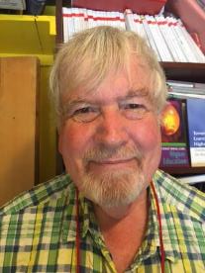
Thank you…
Website: http://phil-race.co.uk
Follow Phil @RacePhil
e-mail: phil@phil-race.co.uk

