Slide 1
Towards assessment as learning – Reinventing assessment and feedback for 2019
January 14th 2019
NUBS
Phil Race
(from Newcastle-upon-Tyne)
BSc PhD PGCE FCIPD PFHEA NTF
Follow Phil on Twitter: @RacePhil
Visiting Professor: University of Plymouth and Edge Hill University
Emeritus Professor, Leeds Beckett University

Slide 2
This slide has two purposes….
To focus the data projector, if necessary, and…
...to persuade colleagues never to put this sort of detail onto a slide!

Slide 3
About Phil…
First a musician
Then a writer
Then a scientist
Then a researcher
Then a lecturer and warden at what is now USW
Got interested in how students learn
And the effects assessment and feedback have on them
And how we teach them
Gradually became an educational developer
And now ‘retired’!?
Currently…
Visiting Prof: Plymouth & Edge Hill
Emeritus Prof: Leeds Beckett
Based at Newcastle, UK
And on trains
And an expert…
on train routes and timetables!
Notes:
2
2

Slide 4
Happy New Year!
How many of you were with me on Wednesday 21st June, 2017, when I ran a session here on ‘Learning, feedback, assessment and large group teaching’?
What was the most important thing you learned then?

Slide 5
Your Programme Development Week
This programme development week will review programme and module methods of assessment so as to establish a School-wide strategy that will enhance student learning, learning support and guidance and the overall quality of methods of assessment and feedback.

Slide 6
Your Aims (1)
Ensuring that methods of assessment are fit for purpose and do actually measure the intended programme and module learning and knowledge outcomes;
Improving student ‘assessment literacy’ and understanding of assessment requirements, marking policy, and the regulations governing student progression;
Improving the quality of assessment guidance and support and feedback - the assessment ‘of’’ as well as assessment ‘for’ learning;
Ensuring that summative assessments by module meet Faculty assessment tariffs;

Slide 7
Your Aims (2)
Ensuring that summative assessments by module meet Faculty assessment tariffs;
How to introduce formative methods of assessment across all programmes and modules;
Reviewing the range of assessment methods to ensure that there is a variety of academic and career-relevant learning and practical skill-development opportunities;
Designing innovative assessments methods which are valued by students and academics;
Reviewing assessment and marking criteria and rubrics to establish common practice.

Slide 8
NUBS aims to ensure that:
All methods of assessment used in NUBS actually measure the intended programme and module learning and knowledge outcomes;
All summative assessments by module meet Faculty policy marking tariffs;
Methods of assessment provide academic and career-relevant learning and practical skill-development opportunities;
The introduction of formative methods of assessment within all programmes and across all modules have been considered.

Slide 9
Towards assessment as learning
Last century, we had lots of assessment of learning.
We still need to do some of this, e.g. to assure fitness to practice.
Some institutions have moved a long way towards assessment for learning.
I believe we now need to make a final jump – assessment as learning.
I’m going to help you to think of the extent to which each of a number of assessment methods can bring assessment and learning closer, and achieve assessment as learning for students.

Slide 10
Intended learning outcomes
After participating in this session, and in the breakout sessions which follow, you should be better-able to:
Identify and confront some of the main problems we have implementing assessment and feedback using traditional approaches.
Discuss possible ways of addressing some of these problems creatively, so that assessment and feedback can be firmly linked to student learning.

Slide 11
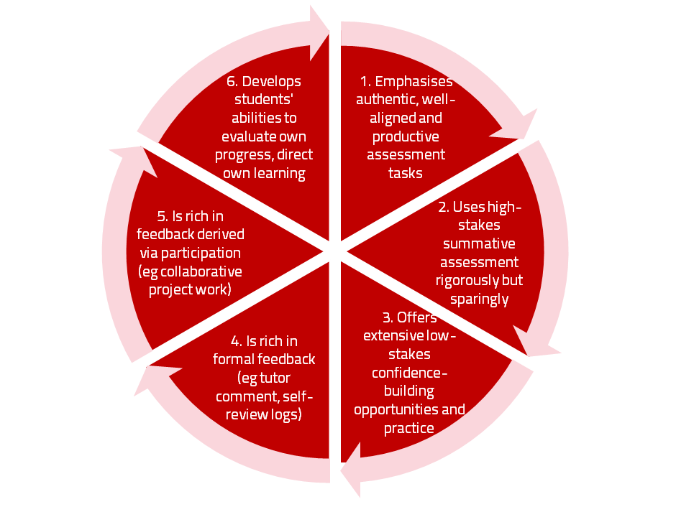
Assessment for learning

Slide 12
Use link below to download the new materials on feedback and assessment produced in 2017-18 by Kay Sambell, Sally Brown and Phil Race for Edinburgh Napier University, (adapted versions for Ireland launched last Thursday in Cork as ‘TACIT guides’)
http://staff.napier.ac.uk/services/dlte/ENhance/Pages/ENhanceQuickGuides.aspx

Slide 13
Today
We will look at the pros and cons of some of the most often-used processes and instruments in our traditional approaches to assessment, and explore what else we can do to improve assessment.
We will also look at how we can use formative assessment to open up feedback dialogues with students to deepen their learning and help them to make the most of our feedback to them. We will explore how best we can make assessment better for students by involving them in self- and peer-assessment.

Slide 14
Download anytime Phil’s materials on feedback, assessment, and learning
Expanded discussion of how the factors underpinning learning link to feedback, assessment and large-group teaching:
http://phil-race.co.uk/2016/04/updated-powerpoint-ripples-model/ (Chapter 1 from ‘The Lecturer’s Toolkit, 2015)
https://phil-race.co.uk/2016/10/lthe-tweetchat-lthechat-wed-oct-19-8-00-9-00-pm/ (feedback stuff from my most recent two books)
http://phil-race.co.uk/2015/01/assessment-bits-new-editions/ (extracts on assessment)

Slide 15
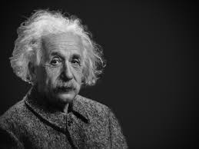
Thought for the day: Einstein
It is simply madness,
to keep doing the same things,
and expect different results.

Slide 16
Reality Check
Which of the following do you actually spend most of your time on…
Actually teaching students?
Preparing materials to teach students?
Assessing students’ work?
Composing feedback on students’ work?
Giving students feedback?
Voting: A = 2 hands, B = 1 hand
C = touch left ear, D = touch right ear
E = scratch your head

Slide 17
Rationale
This session starts from the premise that ‘assessment and feedback are broken’ in higher education at present. We spend far too much time doing them, and burn ourselves out, and are not measuring the right things! We will explore what we can do to make assessment and feedback more fit-for-purpose, and help them to be better drivers for students’ learning.

Slide 18
Why re-invent assessment and feedback now?
They take far too much of our time and energy. Staff are burning themselves out trying to apply old assessment and feedback methods to much larger cohorts of students.
Assessment and feedback are vitally important to students.
Feedback from students continues to show their relative dissatisfaction with assessment and feedback.
Assessment and feedback contribute strongly to the NSS, and therefore also to TEF.
It is madness just to keep trying to do the same things better – we need to be ready to try something else.

Slide 19
Reinventing assessment and feedback
Part of the problem is that we tend to keep on trying to use the processes which used to work well enough years ago, but don’t satisfy today’s student needs and expectations – and often student numbers are higher too.
Later in this session, I will outline a number of ideas for making assessment and feedback work towards better partnership with students, and which also make the processes more effective and efficient, and involve students themselves much more closely in the design of assessment and feedback.
https://www.seda.ac.uk/resources/files/publications_214_Educational%20Developments%2018.2.pdf (2017, pp.21-24)

Slide 20
Finding out more about you…
In the last 12 months,
I’ve completed a MOOC
I’ve started one
I’ve helped to design one
I’ve found one
What’s a MOOC?
Voting: A = 2 hands, B = 1 hand
C = touch left ear, D = touch right ear
E = scratch your head

Slide 21
The NSS Assessment and Feedback Agenda (2005-16)
The criteria used in marking have been clear in advance.
Assessment arrangements and marking have been fair.
Feedback on my work has been prompt.
I have received detailed comments on my work.
Feedback on my work has helped me to clarify things I did not understand.

Slide 22
The present NSS statements (2017)
Assessment and feedback
The criteria used in marking have been clear in advance
Marking and assessment have been fair
Feedback on my work has been timely
I have received helpful comments on my work
Student voice
I have had the right opportunities to provide feedback on my course
Staff value students’ views and opinions about the course
It is clear how students’ feedback on the course has been acted on

Slide 23
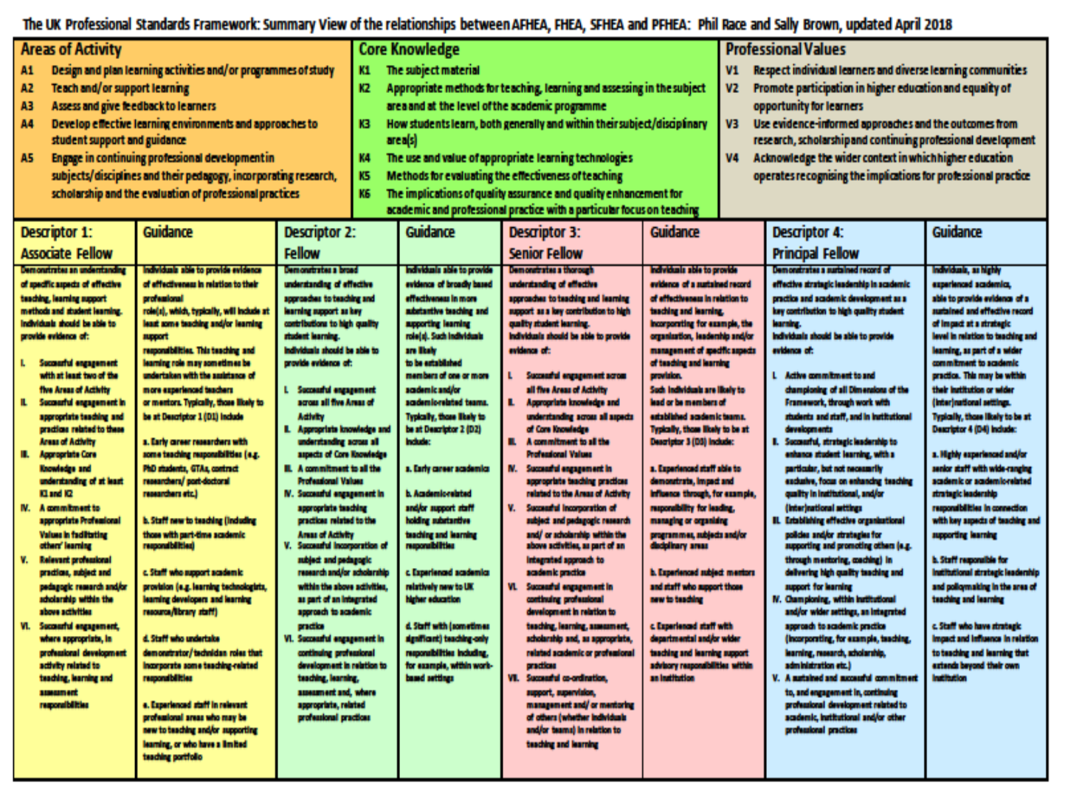

Slide 24
HEA Fellowships? (Professional development relating to teaching, learning and assessment)
How many of you are already: (please raise hands)
Associate Fellow (AFHEA) 23,538
Fellow (FHEA) 75,033
Senior Fellow (SFHEA) 9,557
Principal Fellow (PFHEA) 995
National Teaching Fellow (NTF) c.900
(Numbers at start of 2019; seem to be included in some league tables)

Slide 25
Experience of Royce Sadler on standards, assessment and feedback
Well worth looking at this clip from Coursera from Royce Sadler, who’s work informs much of the modern thinking on assessment and feedback…

Slide 26
Teaching, learning and enthusiasm
Knowledge isn’t infectious (unfortunately) but enthusiasm is, and we need to help our students to catch enthusiasm.
We certainly don’t want assessment or feedback to damage that enthusiasm.

Slide 27
Time-constrained, assessed written Post-it exercise
On a post-it, in your best handwriting, please write your own completion of the starter:
“Assessment and feedback would work much better with my students nowadays if only I …”
Please swap post-its so that you’ve no idea who has yours.
If chosen, please read out with passion and drama what’s on the post-it you now have.
Please place them all as directed.

Slide 28
Now is the decade of Universities’ dis-content!
Never mind the content – feel the learning

Slide 29
Teaching in modern institutions is moving away from providing subject content, (where everything was about ‘delivery’), towards foregrounding two major functions:
Recognising and accrediting students’ achievement, wherever learning has taken place (i.e. getting the assessment right);
Supporting student learning and engagement (not least by making feedback work well for students).

Slide 30
Laurentius de Voltolina
2nd half of 14th Century
Italian Painter

Slide 31
We can’t carry on trying to use traditional assessment and feedback processes
We can’t continue trying to give students lots of feedback in traditional ways, as there are more students, and research shows that merely ‘telling’ them what to do with their work does not work.
There is now a great deal of work on ‘contract cheating’, for example Newton, P. (2018) https://www.frontiersin.org/articles/10.3389/feduc.2018.00067/full
And traditional written feedback doesn’t work: “Approaches that emphasise feedback as telling are insufficient because students are often not equipped to decode or act on statements satisfactorily, so key messages remain invisible” (Sadler 2010).

Slide 32
How’s your brain?
My brain is:
Digital
Analogue
Both
Neither
Don’t know
Voting: A = 2 hands, B = 1 hand
C = touch left ear, D = touch right ear
E = scratch your head

Slide 33
Constructive Alignment: John Biggs
What will I be expected to show for this?
What does a good one look like, and a bad one?
Where does this fit into the big picture?
When explaining assessment criteria to students, and when linking these to evidence of achievement of the intended learning outcomes, we need to make the most of face-to-face whole group contexts and...
Tone of voice
Body language
Facial expression
Eye contact
The chance to repeat things
The chance to respond to puzzled looks
Some things don’t work nearly so well just on paper or on screens.
Some of the
tools we can
use in
face-to-face
contexts

Slide 34
How students really learn
Seven factors underpinning successful learning based on asking lots of people about their learning in the last 30 years

Slide 35
How Students Really Learn ‘Ripples’ model of learning
Phil Race

Slide 37
Which wavelength should I teach on?
The only one that works for today’s students is WIIFM
What’s in it for me?
Consciously address the ‘so what’ in students’ minds;
Warm up their ‘want’ to learn.
Clarify their ‘need’ to learn.
They learn far more readily if they are continuously aware of the benefits for them of putting energy into their learning.

Slide 38
Another MCQ
About learning styles,
I think they’re very important
I think they’re a load of rubbish
I know what mine is (or are)
They can’t be changed
They change over time
Voting: A = 2 hands, B = 1 hand
C = touch left ear, D = touch right ear
E = scratch your head

Slide 39
So what about learning styles?
https://www.theguardian.com/education/2017/mar/12/no-evidence-to-back-idea-of-learning-styles?CMP=share_btn_tw
(Link from my Tweet on March 13th 2017 to a letter in the Guardian by prominent folk around the world of education)
Or link to a word document: https://phil-race.co.uk/2017/09/swansea-university-school-management-21st-September/
“No evidence to back idea of learning styles”

Slide 40
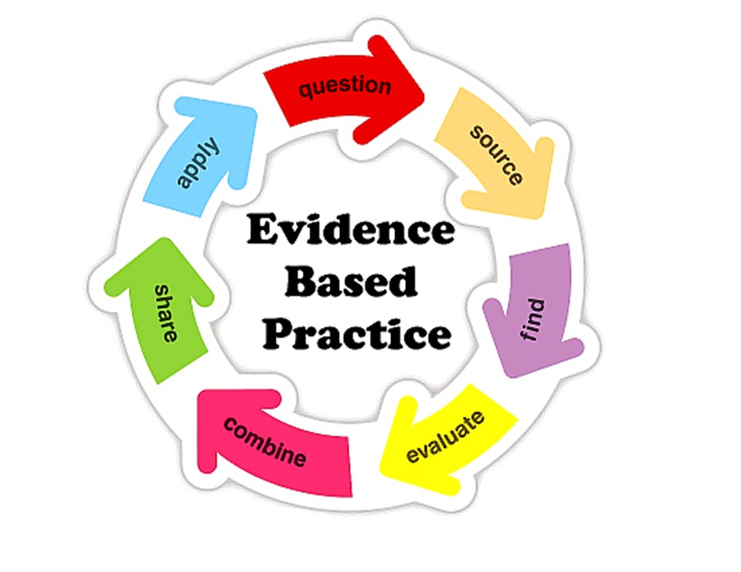

Slide 41
What’s wrong
with
this?
Verbalising
Assessing
Feedback
Making sense
Doing
Wanting/
Needing

Slide 42
What’s wrong
with
this?
Verbalising
Assessing
Feedback
Making sense
Doing
Wanting/
Needing

Slide 43
Thanks, Dr Paul Kleiman

Slide 44
Ripples on a pond….
Enhance our students’ want to learn?
Help students to develop ownership of the need to learn?
Keep students learning by doing, practice, trial-and-error, repetition?
Ensure students really use feedback – from us and from each other?
Help students to make sense of what they learn?
Get students deepening their learning by verbalising, explaining things to each other, and to us?
Allow students to deepen their learning by assessing their own learning, and assessing others’ learning – making informed judgements?
What else can we do to use assessment and feedback to:
Verbalising
Assessing
making informed judgements
Wanting/
Needing
Doing
Doing
Making sense
Feedback

Slide 45
Drives most learning
Is assessment broken?
Some
assessment
issues
We know
what students think
Assessment as learning
Validity
Whodunit?
Fairness

Slide 46
My main worries about assessment...
Too often, we still tend to try to measure...
...what’s in students’ heads, and what they can do with what’s there...
in terms of two unsatisfactory proxies ...
what comes out of students’ pens in exams;
2. what comes out of their keyboards in essays and reports.

Slide 47
Boud et al 2010: ‘Assessment 2020’
Assessment has most effect when...:
It is used to engage students in learning that is productive.
Feedback is used to actively improve student learning.
Students and teachers become responsible partners in learning and assessment.
Students are inducted into the assessment practices and cultures of higher education.
Assessment for learning is placed at the centre of subject and program design.
Assessment for learning is a focus for staff and institutional development.
Assessment provides inclusive and trustworthy representation of student achievement.

Slide 48
Boud et al, 2010
David Boud (University of Technology, Sydney), Royce Sadler (Griffith University), Gordon Joughin (University of Wollongong), Richard James (University of Melbourne), Mark Freeman (University of Sydney), Sally Kift (Queensland University of Technology), Filip Dochy (University of Leuven), Dai Hounsell (University of Edinburgh), Margaret Price (Oxford Brookes University), Tom Angelo (La Trobe University), Angela Brew (Macquarie University), Ian Cameron (University of Queensland), Denise Chalmers (University of Western Australia), Paul Hager (University of Technology, Sydney), Kerri-Lee Harris (University of Melbourne), Claire Hughes (University of Queensland), Peter Hutchings (Australian Learning and Teaching Council), Kerri-Lee Krause (Griffith University), Duncan Nulty (Griffith University), Ron Oliver (Edith Cowan University), Jon Yorke (Curtin University), Iouri Belski (RMIT University), Ben Bradley (Charles Sturt University), Simone Buzwell (Swinburne University of Technology), Stuart Campbell (University of Western Sydney), Philip Candy (University of Southern Queensland), Peter Cherry (Central Queensland University), Rick Cummings (Murdoch University), Anne Cummins (Australian Catholic University), Elizabeth Deane (Australian National University), Marcia Devlin (Deakin University), Christine Ewan (Australian Learning and Teaching Council), Paul Gadek (James Cook University), Susan Hamilton (University of Queensland), Margaret Hicks (University of South Australia), Marnie Hughes-Warrington (Monash University), Gail Huon (University of Newcastle), Margot Kearns (University of Notre Dame, Sydney), Don Maconachie (University of the Sunshine Coast), Vi McLean (Queensland University of Technology,) Raoul Mortley (Bond University), Kylie O’Brien (Victoria University), Gary O’Donovan (University of Tasmania), Beverley Oliver (Curtin University), Simon Pyke (University of Adelaide), Heather Smigiel (Flinders University), Janet Taylor (Southern Cross University), Keith Trigwell (University of Sydney), Neil Trivett (University of Ballarat), Graham Webb (University of New England).

Slide 49
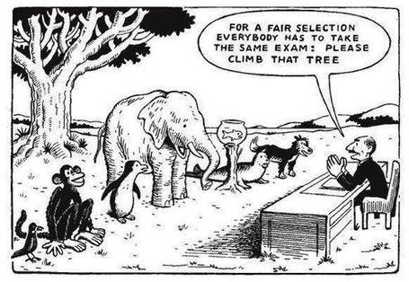

Slide 50
The read-write industry

Slide 51
In the exam room you’re on your own

Slide 52
Ten Concerns about exams
These ten concerns are about time-constrained unseen written examinations.
As we explore these, think of how other forms of exam can get round some of these concerns...
open book
open notes
time unconstrained
take-away
in-tray
multiple-choice
others….

Slide 53
Ripples on a pond….
Concerns about traditional exams
Coaching,
explaining, teaching
Assessing
making informed judgements
They don’t do much to increase the ‘want’ to learn.
They are not ideal occasions for learning-by-doing.
The amount of feedback that students receive is not optimal.
They don’t do much to help students to make sense of what they have learned.
Wanting/
Needing
Doing
Doing
Making sense
Feedback

Slide 54
Concerns about traditional exams
We mark them in a rush.
We’re often tired and bored when we mark them.
We’re not good at marking them objectively.
They favour candidates who happen to be skilled at taking exams.
They force students into surface learning, and into rapidly clearing their minds of previous knowledge when preparing for the next exam.
There are many important things which they don’t measure.

Slide 55
Ripples on a pond….
If students are under too much pressure, the want to learn is damaged.
The range of learning-by-doing may be too narrow.
Feedback may be eclipsed by marks or grades.
Students may not have the opportunity to make sense of the feedback they receive.
Coaching,
explaining, teaching
Concerns about continuous assessment
Assessing
making informed judgements
Wanting/
Needing
Doing
Doing
Making sense
Feedback

Slide 56
Concerns about continuous assessment
It may be hard to detect unwanted collaboration.
Too much time may be involved in marking.
Students may not be aware of the criteria used to assess their work.
Students may get the balance wrong between continuous assessment and exams.
Learning may become driven by assessment, and students may only do those things that are assessed.
Too little use may be made of the learning that can be achieved when students assess their own, and each other’s work.

Slide 57
Five main problems with assessed essays
They take a great deal of time to mark, let alone the time it takes for students to prepare, draft and compose them.
When most assessment is in the form of essays, students’ skills at essay-writing are repeatedly tested, as the expense sometimes of their understanding of the subject.
Lots of research shows that we’re not at all good at marking essays fairly – different assessors often give the same essay very different marks.
Essay marks in the UK tend to lie between 35% for a poor one and 75% for a very good one, whereas in many other disciplines the marks for an assignment like a lab report can range across the whole 0-100% span more evenly.
With coursework essays, there can be doubt about ‘whodunit?’!

Slide 58
In September: The essay is failing us. Discuss

Slide 59
Feed-forward
Language of feedback
Some feedback
issues
National Student Survey
Timing:
24-hours!
Written, printed,
on-screen
Efficiency
Face to face
oral

Slide 60
David Carless (on Twitter):
Feedback as telling is seriously overrated!

Slide 61
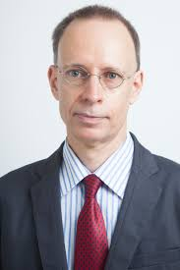
Developing students’ feedback literacy
The danger with traditional methods of assessment and feedback is that assessment tends to be done on student’s work by staff, and feedback tends to be one-directional from staff to students.
Carless and Boud (2018) stress that we want students to gain skills in making ‘evaluative judgements’ themselves on their work, rather than staff doing this.
David Carless & David Boud (2018): The development of student feedback literacy: enabling uptake of feedback, Assessment & Evaluation in Higher Education, https://doi.org/10.1080/02602938.2018.1463354

Slide 62
Factors underpinning feedback literacy
Carless and Boud (2018) examine in detail:
Appreciating feedback
Making judgements
Managing affect
Taking action
We need to enable our students to optimise each of these processes, if we wish to use assessment to promote their learning. They suggest that involving students in giving and receiving peer feedback, and in analysing exemplars, should be essential parts of the curriculum.

Slide 63
Feedback needs to have a future focus
Hounsell et al argue that we need to:
‘increase the value of feedback to the students by focusing comments not only on the past and present … but also on the future – what the student might aim to do, or do differently in the next assignment or assessment if they are to continue to do well or to do better’
(Hounsell, McCune, Hounsell and Litjens 2008, p.5).

Slide 64
Discussion task: taking stock of some feedback approaches
All feedback approaches have their pros and cons. Consider both, for each of the following:
Written (printed) comments on students’ work.
Marks or grades.
Whole-class discussion of an assignment, when it has just been submitted.
Face-to-face 1:1 dialogue with assessor.
Students discussing feedback comments written for other students.
Students giving peer-feedback on each others’ drafts (or final assignments).

Slide 65
Discussion task: taking stock of some feedback approaches
All feedback approaches have their pros and cons. Consider both, for each of the following:
Written (printed) comments on students’ work.
Marks or grades.
Whole-class discussion of an assignment, when it has just been submitted.
Face-to-face 1:1 dialogue with assessor.
Students discussing feedback comments written for other students.
Students giving peer-feedback on each others’ drafts (or final assignments).
Scores out of 10:
Orig A B C D Final
1
2
3
4
5
6

Slide 66
Discussion task: taking stock of some feedback approaches
All feedback approaches have their pros and cons. Consider both, for each of the following:
Written (printed) comments on students’ work.
Marks or grades.
Whole-class discussion of an assignment, when it has just been submitted.
Face-to-face 1:1 dialogue with assessor.
Students discussing feedback comments written for other students.
Students giving peer-feedback on each others’ drafts (or final assignments).
Time it takes us.
Timeliness for students.
Learning payoff for students.
‘Affective’ dimensions – how students feel about it.

Slide 67
Feedback and emotions
Probably feedback is for many people the most emotionally charged experience linked to assessment?
How best can we help bring ‘compassion’ into feedback?
It is well worth giving 20 minutes to watch this: (Theo Gilbert and others) https://www.youtube.com/watch?v=3jFVTCuSCOg …​ particularly on how we can help students to learn how to get more from feedback from each other as well as us.

Slide 68
Task: think about ghastly feedback
Think back to some occasions, academic or otherwise, historic or recent when you received feedback that you would rather not have received;
How did it make you feel?
Thinking of a single example of ghastly feedback that you are prepared to share with another person, briefly outline the context and say why it was such a negative experience.

Slide 69
Quality feedback: 3 functions
There is wide consensus within the education literature that ‘quality’ feedback should serve three overlapping functions:
an ‘orientational’ purpose that clarifies the student’s performance and achievement;
a ‘transformational’ purpose that enables the student to reflect, improve their performance, and become more autonomous (often termed ‘feed-forward); and
an ‘affective/interpersonal’ dimension that gives the student confidence and motivation, and builds a strong teacher-student relationship
(after Dunworth & Sanchez, 2016).

Slide 70
Ripples on a pond….
Motivates students – helps them to want to learn;
Helps students to identify what they need to do next;
Helps students to take action to improve their learning;
Helps students to make sense of what they are learning;
Helps them to further make sense of their learning by engaging in real dialogue with tutors and peers;
Helps them to make informed judgements on their own work, and each others’ work:
Helps them to reflect on their past work in ways they can use to improve their future work.
Feedback (including feed forward) works well when it:
Coaching,
explaining, teaching
Assessing
making informed judgements
Wanting/
Needing
Doing
Doing
Making sense
Feedback

Slide 71
Feedback works badly when it…
Is just a monologue from tutors to students;
Is just in words on paper or on a screen;
Saps students’ confidence;
Is taken no notice of.
Is not even picked up.
Directs students’ activities in inappropriate directions;
Fails to articulate with learning outcomes;
Fails to relate clearly to evidence of achievement of the assessment criteria;
Relates only to what is easy to assess rather than what is at the heart of learning;
Focuses on failings rather than achievements.

Slide 72
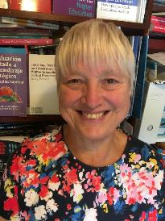
Fishing for feedback?
Feedback is like fish.
If it is not used quickly, it becomes useless.
(Sally Brown).
Give a man a fish,
Feed him for a day.
Teach a man to fish,
Feed him for a lifetime.
(Maimonides: 1135-1204)
Make feedback timely, while it still matters to students, in time for them to use it towards further learning, or to receive further assistance.
(Graham Gibbs)
And he’ll learn to drink beer in boats
And you won’t see him for weeks!
(Australian proverb).

Slide 74
How’s your feedback? (After Nicol and MacFarlane-Dick, 2006)
1. Helps clarify what good performance is (goals, criteria, expected standards);
2. Facilitates the development of self-assessment (reflection) in learning;
3. Delivers high quality information to students about their learning;
4. Encourages teacher and peer dialogue around learning;
5. Encourages positive motivational beliefs and self-esteem;
6. Provides opportunities to close the gap between current and desired performance;
7. Provides information to teachers that can be used to help shape the teaching.

Slide 75
Bringing assessment and feedback to life Questions employers might ask at interview that could help us frame some of our assignments
Can you tell us about an occasion when:
you worked together with colleagues in a group to produce a collective outcome?
you had to work autonomously with incomplete information and self-derived data sources?
you developed strategies to solve real life problems and tested them out?
you had a leadership role in a team, and could you tell us your strategies to influence and persuade your colleagues to achieve a collective task?
you had to communicate outcomes from your project work orally, in writing, through social media and/or through a visual medium?

Slide 76
Face to face feedback

Slide 77
Hands-on feedback?

Slide 78
What’s wrong with feedback?
Students get it too late.
And too often, it’s just words on paper.
It doesn’t help them enough.
They often don’t take enough notice of it.

Slide 79
But what’s really wrong with feedback?
Too often it’s one-way – monologic.
What students want is dialogue.
They want to talk to us about their work.
But they’re scared to talk to us, for various reasons:
In case it leads to lower marks;
In case they’re ‘found out’;
In case they feel stupid.

Slide 80
The importance of dialogic assessment
Students need to be exposed to, and gain experience in making judgements about, a variety of works of different quality... They need planned rather than random exposure to exemplars, and experience in making judgements about quality. They need to create verbalised rationales and accounts of how various works could have been done better. Finally, they need to engage in evaluative conversations with teachers and other students. Together, these three provide the means by which students can develop a concept of quality that is similar in essence to that which the teacher possesses, and in particular to understand what makes for high quality. Although providing these experiences for students may appear to add more layers to the task of teaching, it is possible to organise this approach to peer assessment so that it becomes a powerful strategy for higher education teaching. (Sadler 2010)

Slide 81
Royce Sadler on feedback:
Higher education teachers are often frustrated by the modest impact feedback has in improving learning. The status of feedback deserves to be challenged on the grounds that it is essentially about telling. For students to become self-sustaining producers of high quality intellectual and professional goods, they must be equipped to take control of their own learning and performance. (Sadler, 2013)
Sadler, D. R. (2013). Opening up feedback: Teaching learners to see. In Merry, S., Price, M., Carless, D., & Taras, M. (Eds.) Reconceptualising feedback in higher education: Developing dialogue with students. (Ch. 5, 54‑63). London: Routledge.

Slide 82
Reinventing Assessment Fifteen ideas for making assessment and feedback more effective, efficient and manageable for us, and for students
https://www.seda.ac.uk/resources/files/publications_214_Educational%20Developments%2018.2.pdf (2017, pp.21-24)

Slide 83
Fifteen ideas for making assessment and feedback more effective, efficient and manageable for us, and for students
Design much shorter assessments.
Increase formative assessment and reduce summative assessment.
Don’t just use essays.
Make more use of oral feedback rather than written feedback.
Speed up feedback so students still care about it when they receive it.
Get students giving feedback to each other, and sharing feedback.
Let students right into the meaning of assessment criteria, by explaining and illustrating these in whole-group contexts such as lectures.
Show students a range of evidence of achievement.
Get students themselves formulating evidence of achievement.
Get students themselves designing and applying assessment criteria.
Make the most of feedback to students in small-group contexts, such as tutorials.
Use statement banks to speed up formulating useful feedback.
Get students self-assessing, and give them feedback on their self-assessment.
Try to avoid ‘final language’ in feedback.
Always make assignment design a team effort.

Slide 84
Fifteen ideas for making assessment and feedback more effective, efficient and manageable for us, and for students
Design much shorter assessments.
Increase formative assessment and reduce summative assessment.
Don’t just use essays.
Make more use of oral feedback rather than written feedback.
Speed up feedback so students still care about it when they receive it.
Get students giving feedback to each other, and sharing feedback.
Let students right into the meaning of assessment criteria, by explaining and illustrating these in whole-group contexts such as lectures.

Slide 85
Fifteen ideas for making assessment and feedback more effective, efficient and manageable for us, and for students
Show students a range of evidence of achievement.
Get students themselves formulating evidence of achievement.
Get students themselves designing and applying assessment criteria.
Make the most of feedback to students in small-group contexts, such as tutorials.
Use statement banks to speed up formulating useful feedback.
Get students self-assessing, and give them feedback on their self-assessment.
Try to avoid ‘final language’ in feedback.
Always make assignment design a team effort.

Slide 86
A Design much shorter assessments
(e.g. a 300-word annotated bibliography instead of a 3000-word essay).
We tend to keep using long assessments, because that’s what we’ve always done. As a result, we spend ages marking, and too little time assessing.
Students learn to ‘waffle’ with long assessments. A short assessment can be harder, and more intense. And we achieve better discrimination between best and worst.
Shorter assessments are much, much faster to assess.
Research shows we can actually assess short assessments much more reliably!

Slide 87
B Increase formative assessment and reduce summative assessment
We know that students learn little or nothing from feedback on summative assessments.
Some don’t even collect their marked work.
Students often don’t learn from feedback on supposedly-formative assessments, as they’ve already moved on to the next task.
Formative assessment can be a great learning experience.
Students’ final results can benefit enormously from formative feedback.

Slide 88
C Don’t just use essays
Essays take ages to write, and ages to mark. And we may not know who wrote them! http://phil-race.co.uk/whodunit/
Essays can be fine for giving students feedback, but not for assessment!
Research shows we’re not at all good at assessing essays. Yet the mark or grade becomes much more important to students than the feedback.
Marking can degenerate into copy-editing rather than assessing.
Students are well aware whenever assessment is at all unfair.

Slide 89
D Make more use of oral feedback rather than written feedback
Face-to-face feedback can make good use of tone of voice, encouraging facial gestures, speed of speech, repetition where needed, body language, and so on.
Students in large groups can learn from oral feedback on other students’ triumphs and disasters (with due anonymity).
Even one-to-one, oral feedback can be much more powerful than written.
Oral feedback can be retained and reviewed if ‘packaged up’ in podcasts or audio files.

Slide 90
E Speed up feedback so students still care about it when they receive it
We’ve become preoccupied with the turn-around time for a batch of work for large groups of students.
A lot of feedback can be given at the moment the work is submitted, before marking has even begun.
Immediate feedback means that students still remember what they did – and what they had problems with.
Ideally, give feedback within 24 hours of students doing the work? (https://phil-race.co.uk/2014/01/feedback-24-hours/ )

Slide 91
F Get students giving feedback to each other, and sharing feedback
Students learn a great deal from the process of explaining things to someone else.
It’s often easier to learn from someone who has just mastered a concept than from someone who can’t remember the difficulties learning it.
Students can benefit from much more feedback than we could give them.
Students can learn much more from our feedback to their friends, than our feedback on their own work.

Slide 92
G Let students right into the meaning of assessment criteria, by explaining and illustrating these in whole-group contexts such as lectures
There should be no hidden agendas. Talk assessment every time you see whole groups of students.
Try to avoid talking assessment to individual students seeking to ‘get ahead’.
Make it clear how assessment criteria link to evidence of achievement of published learning outcomes.
Give students safe practice at evidencing their achievement of assessment criteria.

Slide 93
H Show students a range of evidence of achievement
Don’t just show students exemplars of ‘excellent work’.
Let them see what can easily go wrong, and can lose them marks.
When students are aware of a range between ‘excellent’ and ‘poor’, they can strive to be even better than excellent.
The tendency to simply imitate excellent work is diminished.
(See the work of Royce Sadler)

Slide 94
I Get students themselves formulating evidence of achievement
When students have a feeling of ownership of their targets, they put much more into achieving the targets.
When students formulate ‘good’ evidence, we can praise their choices.
When students formulate ‘poor’ evidence, we can point them in a better direction.
We can adopt their targets, when they are better than the ones we first thought of!

Slide 95
J Get students themselves designing and applying assessment criteria
Learning by assessing – ‘making informed judgements’ – is one of the deepest forms of learning.
We can easily give students relevant things to assess in class time, and benefit from dialogue.
Students can often think of better assessment criteria than the ones we first thought of ourselves.
Applying assessment criteria helps students to internalise how to achieve them in their own work.

Slide 96
K Make the most of feedback to students in small-group contexts, such as tutorials
This can be less threatening than one-to-one feedback (oral or written), especially critical feedback, and can be much more manageable for us.
Let students hear feedback on work that is better than theirs (retaining anonymity).
Let students hear feedback on other students’ disasters (retaining anonymity).
Allow students to see ‘where they’re at’ compared to others in the cohort.

Slide 97
L Use statement banks to speed up formulating useful feedback
Especially with online feedback, compile a bank of useful feedback statements.
Make sure that there are sufficient ‘praise’ comments, to counterbalance critical ones.
Get students themselves to compose statements, so that they get a sharper idea of what is wanted in their work.
Make sure that the feedback that different students receive is sufficiently different and personal, rather than just ‘out of the box’.

Slide 98
M Get students self-assessing, and give them feedback on their self-assessment.
Turn self-assessment into a productive dialogue with us.
Ask students what mark or grade they believe the work should be earning.
Ask students what they think they did best, and praise them when indeed they did do this well.
Ask students what they found the hardest part of the task, and praise them when they succeeded, and empathise when they didn’t.
Ask students what they might change if they had another hour to do the task.

Slide 99
Self-Assessment of your Assignment Please respond to the following questions at the point just before handing your work in. This will help me to give you useful feedback about your work, and also will give me useful feedback about how you are finding the programme to date. Thanks.
 | Questions | Your replies to the questions | Tutor’s responses | Your action points
1 | Ωηατ μαρκ (ουτ οφ 100) δο ψου τηινκ τηισ ωορκ δεσερϖεσ?
2 | Ωηατ διδ ψου λικε μοστ αβουτ δοινγ τηισ παρτιχυλαρ πιεχε οφ ωορκ?
3 | Ωηατ διδ ψου λικε λεαστ αβουτ δοινγ τηισ πιεχε οφ ωορκ?
4 | Ωηατ δο ψου τηινκ ισ τηε τηινγ ψου διδ βεστ?
5 | Ωηατ δο ψου τηινκ ψου διδ λεαστ ωελλ?

Slide 100
N Try to avoid ‘final language’ in feedback
‘Final language’ includes words such as ‘excellent’, ‘good’, ‘poor’, ‘adequate’, ‘satisfactory’, and so on – it doesn’t give students ‘anywhere to go next’.
It is better to say things such as:
‘I really like how you approached so-and-so’
‘It might have helped if you’d done such-and such’
‘One thing you did really well was so-and-so’
‘You probably know that such-and-such didn’t really work’

Slide 101
O Always make assessment design a team effort
It doesn't make sense to do this alone without running your ideas past a colleague, quality assurer, student or all three.
This can help avoid the biggest pitfalls around assuring manageability, authenticity, relevance and validity.
Students can be particularly useful sounding boards to ensure that what you are asking students to do is clear and readily understandable.
You won't get into glitches around university systems and regulations if you talk things through in advance with a Faculty manager or registrar.

Slide 102
Fifteen ideas for making assessment and feedback more effective, efficient and manageable for us, and for students
Design much shorter assessments.
Increase formative assessment and reduce summative assessment.
Don’t just use essays.
Make more use of oral feedback rather than written feedback.
Speed up feedback so students still care about it when they receive it.
Get students giving feedback to each other, and sharing feedback.
Let students right into the meaning of assessment criteria, by explaining and illustrating these in whole-group contexts such as lectures.
Show students a range of evidence of achievement.
Get students themselves formulating evidence of achievement.
Get students themselves designing and applying assessment criteria.
Make the most of feedback to students in small-group contexts, such as tutorials.
Use statement banks to speed up formulating useful feedback.
Get students self-assessing, and give them feedback on their self-assessment.
Try to avoid ‘final language’ in feedback.
Always make assignment design a team effort.

Slide 103
Now your turn to make some informed judgements
Please get into twos or threes where you’re sitting.
In a minute, I’ll show again the slide with all 15 ideas on it.
In your group, discuss and argue, arranging your top 9 in a ‘diamond 9’ pattern, just jotting down the relevant letters on a bit of paper.
At any point, insert one better choice, and place it in order among your top 9.
Be ready to justify your top choices to the rest of us.

Slide 104
Pick the best 9 ideas:
Diamond 9
best
next best
3
4
5
6
7
8
9

Slide 105
Extras slipped in responding to questions
Feedback without marks
Marks often destroy the value of our feedback to students!

Slide 106
Feedback versus marks or grades
Feedback may be eclipsed by marks or grades.
Students may be blinded by the mark or grade, and not even try to make sense of the feedback they receive.

Slide 107
Just a mark (or grade) is the least effective form of feedback!
It’s what students look at first.
If the mark is good, they smile and file – quite often they don’t even read the feedback.
If it’s low, they frown and bin it – very often without reading the feedback.

Slide 108
But there are ways round this...
Give students back their work with feedback but with no marks or grades (keeping your record of their marks).
Ask them to work out their marks from the feedback you have given them (and from the feedback you gave to others too).

Slide 109
Suggest that their marks will count!
Tell them that if their self-assessment scores are within (say) 5% of your own scores, the higher number will go forward into their assessment record.
But explain that you will talk individually to those students whose score is different by more than 5% from yours.

Slide 110
Get them to self-assess...
Collect their scores or grades – e.g. pass a sheet round in a lecture.
Most students (e.g. 9 in 10) will be within the 5%.
Arrange to talk to those where the difference is more than 5% or one grade.

Slide 111
Students who under-estimate their grade…
These students often need their esteem boosted.
Remind them about the assessment criteria, and how these illustrate the intended standards associated with the learning outcomes.
Check that they weren’t just trying not to be seen as over-confident.

Slide 112
Students who over-estimate their grade…
This usually indicates they’ve got a blind spot.
Talk them through their work, and find out exactly where they’ve lost marks which they thought they had gained.
Check with them that they can now see what was being looked for.

Slide 113
Developing this idea further…
Think about getting students to indicate their expected score or grade at the point of handing their work in – for example on a self-assessment proforma.
Think about getting students to work out how well they believe they have achieved each of the intended learning outcomes for the work concerned…
Or how well they believe they have met each of the assessment criteria for the work.

Slide 114
Get students to self-assess their work
At the point of handing it in to us!

Slide 115
Using student self-assessment to deepen their learning…
…and to make tutor-marking more effective, and efficient – and to start tutor-student dialogues

Slide 116
Self-Assessment of your Assignment Please respond to the following questions at the point just before handing your work in. This will help me to give you useful feedback about your work, and also will give me useful feedback about how you are finding the programme to date. Thanks.
 | Questions | Your replies to the questions | Tutor’s responses | Your action points
1 | Ωηατ μαρκ (ουτ οφ 100) δο ψου τηινκ τηισ ωορκ δεσερϖεσ?
2 | Ωηατ διδ ψου λικε μοστ αβουτ δοινγ τηισ παρτιχυλαρ πιεχε οφ ωορκ?
3 | Ωηατ διδ ψου λικε λεαστ αβουτ δοινγ τηισ πιεχε οφ ωορκ?
4 | Ωηατ δο ψου τηινκ ισ τηε τηινγ ψου διδ βεστ?
5 | Ωηατ δο ψου τηινκ ψου διδ λεαστ ωελλ?

Slide 117
Self-assessment tutor dialogues
Getting students to really reflect:
A way of evidencing good feedback practice for inspection purposes;
Avoiding wasting your time – and students’ time;
Making sure students actually read your feedback;
Making sure you give your students the feedback they want as well as the feedback they need;
Finding out more about your students;
…and much more.

Slide 118
Some questions to consider for self-assessment-tutor dialogues
1 What do you honestly consider will be a fair score or grade for the work you are handing in?

Slide 119
Some questions to consider for self-assessment-tutor dialogues
2 What do you think was the thing you did best in this assignment?

Slide 120
Some questions to consider for self-assessment-tutor dialogues
3 If you had the chance to do the assignment again from scratch, how (if at all) might you decide to go about it differently?

Slide 121
Some questions to consider for self-assessment-tutor dialogues
4 What did you find the hardest aspect of this assignment?

Slide 122
Some questions to consider for self-assessment-tutor dialogues
5 Please jot down three short questions you would like me to answer about this example of your work:
(1)
(2)
(3)

Slide 123
But this is just a start...
Students would soon get bored if they were to answer the same questions for several successive assignments.
It is best to make the dialogue specific to the subject-matter of the assignment.

Slide 124
Back to our intended learning outcomes…
Do you now feel better able to:
two hands = very much better,
one hand = somewhat better,
touch left ear = no better...
Identify and confront some of the main problems we have implementing assessment and feedback using traditional approaches.
Discuss possible ways of addressing some of these problems creatively, so that assessment and feedback can be firmly linked to student learning.
Wanting/
Needing
Doing
Making sense
Feedback

Slide 125
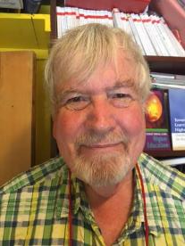
Thank you…
Website: http://phil-race.co.uk
Follow Phil @RacePhil
e-mail: phil@phil-race.co.uk

Slide 126
Useful references and further reading (1)
Bain, K. (2004) What the best College Teachers do, Cambridge: Harvard University Press.
Biggs, J. and Tang, C. (2011) Teaching for Quality Learning at University, Maidenhead: Open University Press.
Bloxham, S. and Boyd, P. (2007) Developing effective assessment in higher education: a practical guide, Maidenhead, Open University Press.
Boud, D. (1995) Enhancing learning through self-assessment, London: Routledge.
Brown, S. and Glasner, A. (eds.) (1999) Assessment Matters in Higher Education, Choosing and Using Diverse Approaches, Maidenhead: Open University Press.
Brown, S. and Race, P. (2012) Using effective assessment to promote learning in Hunt, L. and Chambers, D. (2012) University Teaching in Focus, Victoria, Australia, Acer Press. P74-91.
Brown, S. (2015) Learning , Teaching and Assessment in Higher Education: Global perspectives, London, Palgrave.
Carless, D., Joughin, G., Ngar-Fun Liu et al (2006) How Assessment supports learning: Learning orientated assessment in action Hong Kong: Hong Kong University Press.
Carless, D. and Boud, D. (2018): The development of student feedback literacy: enabling uptake of feedback, Assessment & Evaluation in Higher Education, https://doi.org/10.1080/02602938.2018.1463354

Slide 127
Useful references and further reading (2)
Carroll, J. and Ryan, J. (2005) Teaching International students: improving learning for all. London: Routledge SEDA series.
Crosling, G., Thomas, L. and Heagney, M. (2008) Improving student retention in Higher Education, London and New York: Routledge
Crooks, T. (1988) Assessing student performance, HERDSA Green Guide No 8 HERDSA (reprinted 1994).
Dunworth, K. and Sanchez, H.S., (2016). Perceptions of quality in staff-student written feedback in higher education: a case study. Teaching in Higher Education, 21(5), pp.576-589.
Dweck, C. S. (2000) Self Theories: Their Role in Motivation, Personality and Development, Lillington, NC: Taylor & Francis.
Falchikov, N. (2004) Improving Assessment through Student Involvement: Practical Solutions for Aiding Learning in Higher and Further Education, London: Routledge.
Gibbs, G. (1999) Using assessment strategically to change the way students learn, in Brown S. & Glasner, A. (eds.), Assessment Matters in Higher Education: Choosing and Using Diverse Approaches, Maidenhead: SRHE/Open University Press.
Higher Education Academy (2012) A marked improvement; transforming assessment in higher education, York: HEA.

Slide 128
Useful references and further reading (3)
Hawe, E., Lightfoot, U., & Dixon, H. (2017). First-year students working with exemplars: Promoting self-efficacy, self-monitoring and self-regulation. Journal of Further and Higher Education, 1-15.
Hendry, G. D., White, P., & Herbert, C. (2016). Providing Exemplar-Based “Feedforward” before an Assessment: The Role of Teacher Explanation. Active Learning in Higher Education, 17(2), 99-109.
Hounsell, D., McCune, V., Hounsell, J. and Litjens, J., (2008). The quality of guidance and feedback to students. Higher Education Research & Development, 27(1), pp.55-67.
Newton, P. M. (2018) How Common Is Commercial Contract Cheating in Higher Education and Is It Increasing? A Systematic Review https://www.frontiersin.org/articles/10.3389/feduc.2018.00067/full
Nicol, D. J. and Macfarlane-Dick, D. (2006) Formative assessment and self-regulated learning: A model and seven principles of good feedback practice, Studies in Higher Education Vol 31(2), 199-218.
PASS project Bradford http://www.pass.brad.ac.uk/ Accessed January 2019.
Pickford, R. and Brown, S. (2006) Assessing skills and practice, London: Routledge.
Rotheram, B. (2009) Sounds Good, JISC project http://www.jisc.ac.uk/whatwedo/programmes/usersandinnovation/soundsgood.aspx

Slide 129
Useful references and further reading (4)
Race, P. (2001) A Briefing on Self, Peer & Group Assessment, in LTSN Generic Centre Assessment Series No 9, LTSN York.
Race, P. (2014) Making Learning Happen (3rd edition), London: Sage.
Race, P. (2015) The lecturer’s toolkit (4th edition), London: Routledge.
Race, P. (2017) Fifteen ideas for making assessment and feedback more effective, efficient and manageable for us, and for students: SEDA Developments https://www.seda.ac.uk/resources/files/publications_214_Educational%20Developments%2018.2.pdf (accessed January 2019)
Rust, C., Price, M. and O’Donovan, B. (2003) Improving students’ learning by developing their understanding of assessment criteria and processes, Assessment and Evaluation in Higher Education. 28 (2), 147-164.
Scoles, J., Huxham, M., & McArthur, J. (2013). No longer exempt from good practice: Using exemplars to close the feedback gap for exams. Assessment & Evaluation in Higher Education, 38(6), 631-645.
Sadler, D. Royce (2010) Beyond feedback: developing student capability in complex appraisal, Assessment & Evaluation in Higher Education, 35: 5, 535-550.

