Slide 1

Rethinking assessment and feedback for 2019 onwards
January 16th 2019
QMUL
Phil Race
(from Newcastle-upon-Tyne)
BSc PhD PGCE FCIPD PFHEA NTF
Follow Phil on Twitter: @RacePhil
Visiting Professor: University of Plymouth and Edge Hill University
Emeritus Professor, Leeds Beckett University

Slide 2
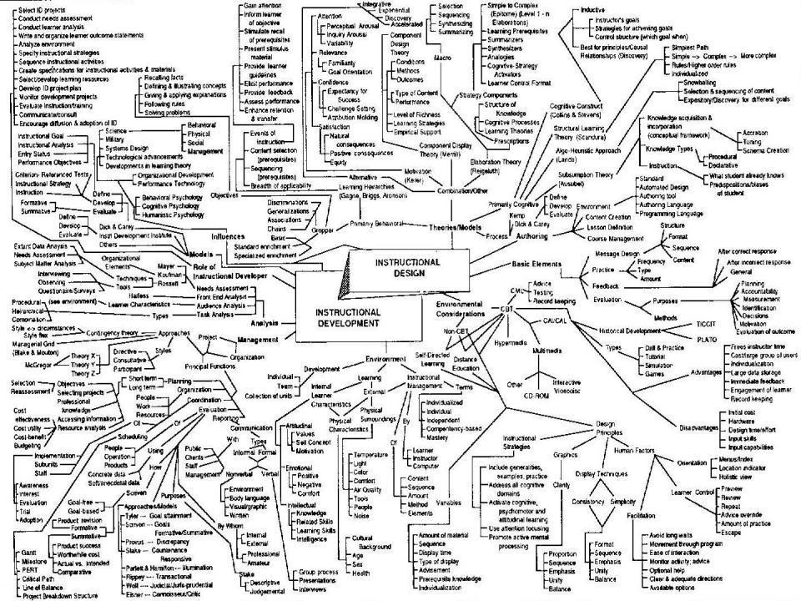
This slide has two purposes….
To focus the data projector, if necessary, and…
...to persuade colleagues never to put this sort of detail onto a slide!

Slide 3
About Phil…
First a musician
Then a writer
Then a scientist
Then a researcher
Then a lecturer and warden at what is now USW
Got interested in how students learn
And the effects assessment and feedback have on them
And how we teach them
Gradually became an educational developer
And now ‘retired’!?
Currently…
Visiting Prof: Plymouth & Edge Hill
Emeritus Prof: Leeds Beckett
Based at Newcastle, UK
And on trains
And an expert…
on train routes and timetables!
Notes:
2
2

Slide 4
Happy New Year!
How many of you were with me on Wednesday 21st November, 2018, when Sally Brown and I ran a session on ‘Streamlining assessment: making assessment and feedback more effective and efficient’?
What was the most important thing you learned then?

Slide 5
Towards assessment as learning
Last century, we had lots of assessment of learning.
We still need to do some of this, e.g. to assure fitness to practice.
Some institutions have moved a long way towards assessment for learning.
I believe we now need to make a final jump – assessment as learning.
I’m going to help you to think of the extent to which each of a number of assessment methods can bring assessment and learning closer, and achieve assessment as learning for students.

Slide 6
Intended learning outcomes
After participating in this session, you should be better-able to:
Identify and confront some of the main problems we have implementing assessment and feedback using traditional approaches.
Discuss possible ways of addressing some of these problems creatively, so that assessment and feedback can be firmly linked to student learning.

Slide 7
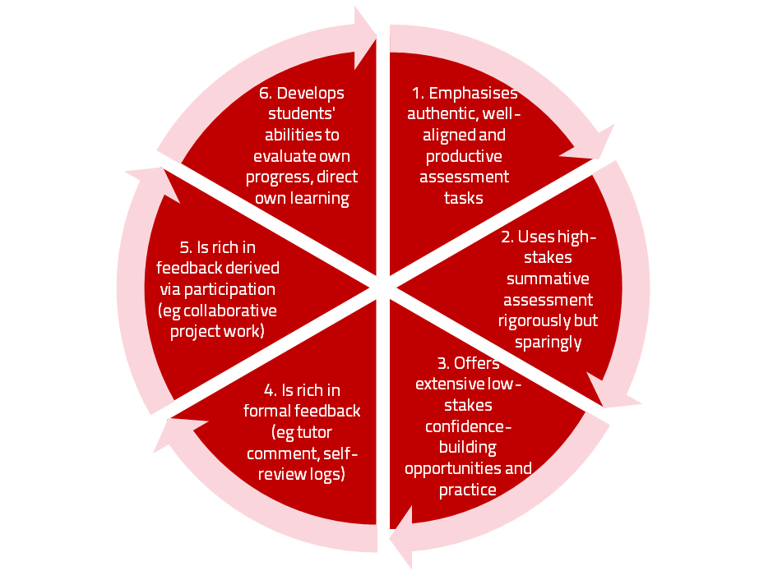
Assessment for learning
Sambell, K., McDowell, L. and Montgomery, C. (2013) Assessment for Learning in Higher Education, London: Routledge.

Slide 8
Use link below to download the new materials on feedback and assessment produced in 2017-18 by Kay Sambell, Sally Brown and Phil Race for Edinburgh Napier University, (adapted versions for Ireland launched last Thursday in Cork as ‘TACIT guides’)
http://staff.napier.ac.uk/services/dlte/ENhance/Pages/ENhanceQuickGuides.aspx

Slide 9
Today
We will look at the pros and cons of some of the most often-used processes and instruments in our traditional approaches to assessment, and explore what else we can do to improve assessment.
We will also look at how we can use formative assessment to open up feedback dialogues with students to deepen their learning and help them to make the most of our feedback to them. We will explore how best we can make assessment better for students by involving them in self- and peer-assessment.

Slide 10
Download anytime Phil’s materials on feedback, assessment, and learning
Expanded discussion of how the factors underpinning learning link to feedback, assessment and large-group teaching:
http://phil-race.co.uk/2016/04/updated-powerpoint-ripples-model/ (Chapter 1 from ‘The Lecturer’s Toolkit, 2015)
https://phil-race.co.uk/2016/10/lthe-tweetchat-lthechat-wed-oct-19-8-00-9-00-pm/ (feedback stuff from my most recent two books)
http://phil-race.co.uk/2015/01/assessment-bits-new-editions/ (extracts on assessment)

Slide 11
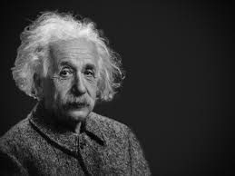
Thought for the day: Einstein
It is simply madness,
to keep doing the same things,
and expect different results.

Slide 12
Reality Check
Which of the following do you actually spend most of your time (apart from research time) on…
Actually teaching students?
Preparing materials to teach students?
Assessing students’ work?
Composing feedback on students’ work?
Giving students feedback?
Voting: A = 2 hands, B = 1 hand
C = touch left ear, D = touch right ear
E = scratch your head

Slide 13
Rationale
This session starts from the premise that ‘assessment and feedback are broken’ in higher education at present. We spend far too much time doing them, and burn ourselves out, and are not measuring the right things! We will explore what we can do to make assessment and feedback more fit-for-purpose, and help them to be better drivers for students’ learning.

Slide 14
Why re-invent assessment and feedback now?
They take far too much of our time and energy. Staff are burning themselves out trying to apply old assessment and feedback methods to much larger cohorts of students.
Assessment and feedback are vitally important to students.
Feedback from students continues to show their relative dissatisfaction with assessment and feedback.
Assessment and feedback contribute strongly to the NSS, and therefore also to TEF.
It is madness just to keep trying to do the same things better – we need to be ready to try something else.

Slide 15
Reinventing assessment and feedback
Part of the problem is that we tend to keep on trying to use the processes which used to work well enough years ago, but don’t satisfy today’s student needs and expectations – and often student numbers are higher too.
Later in this session, I will outline a number of ideas for making assessment and feedback work towards better partnership with students, and which also make the processes more effective and efficient, and involve students themselves much more closely in the design of assessment and feedback.
https://www.seda.ac.uk/resources/files/publications_214_Educational%20Developments%2018.2.pdf (2017, pp.21-24)

Slide 16
Finding out more about you…
In the last 12 months,
I’ve completed a MOOC
I’ve started one
I’ve helped to design one
I’ve found one
What’s a MOOC?
Voting: A = 2 hands, B = 1 hand
C = touch left ear, D = touch right ear
E = scratch your head

Slide 17
The NSS Assessment and Feedback Agenda (2005-16)
The criteria used in marking have been clear in advance.
Assessment arrangements and marking have been fair.
Feedback on my work has been prompt.
I have received detailed comments on my work.
Feedback on my work has helped me to clarify things I did not understand.

Slide 18
The present NSS statements (2017 onwards)
Assessment and feedback
The criteria used in marking have been clear in advance
Marking and assessment have been fair
Feedback on my work has been timely
I have received helpful comments on my work
Student voice
I have had the right opportunities to provide feedback on my course
Staff value students’ views and opinions about the course
It is clear how students’ feedback on the course has been acted on

Slide 19
HEA Fellowships?
(Professional development relating to teaching, learning and assessment)
How many of you are already: (please raise hands)
Associate Fellow (AFHEA) 23,538
Fellow (FHEA) 75,033
Senior Fellow (SFHEA) 9,557
Principal Fellow (PFHEA) 995
National Teaching Fellow (NTF) c.900
(Numbers at start of 2019; seem to be included in some league tables)

Slide 20
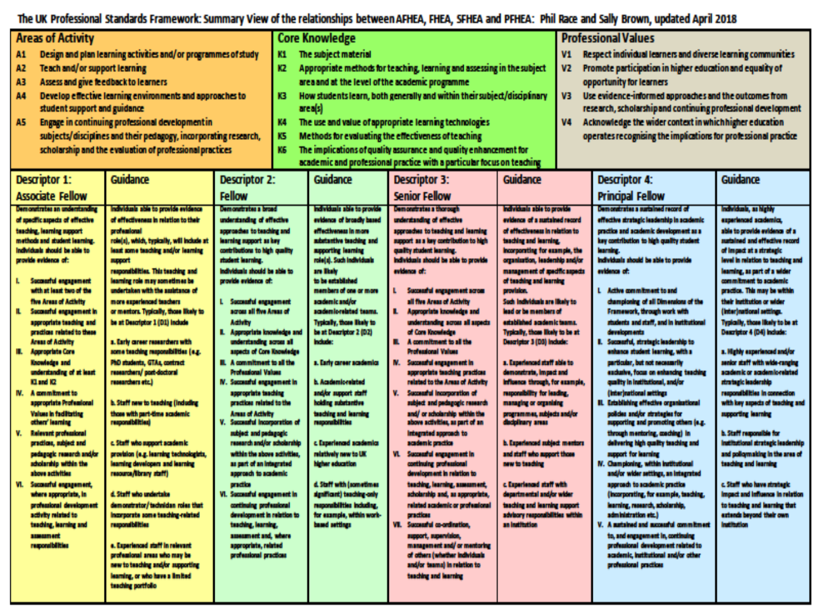

Slide 21
Experience of Royce Sadler on standards, assessment and feedback
Well worth looking at this clip from Coursera from Royce Sadler, who’s work informs much of the modern thinking on assessment and feedback…

Slide 22
Teaching, learning and enthusiasm
Knowledge isn’t infectious (unfortunately) but enthusiasm is, and we need to help our students to catch enthusiasm.
We certainly don’t want assessment or feedback to damage that enthusiasm.

Slide 23
Time-constrained, assessed written Post-it exercise
On a post-it, in your best handwriting, please write your own completion of the starter:
“Assessment and feedback would work much better with my students nowadays if only I …”
Please swap post-its so that you’ve no idea who has yours.
If chosen, please read out with passion and drama what’s on the post-it you now have.
Please place them all as directed.

Slide 24
Now is the decade of
Universities’ dis-content!
Never mind the content – feel the learning

Slide 25
Teaching in modern institutions is moving away from providing subject content, (where everything was about ‘delivery’), towards foregrounding two major functions:
Recognising and accrediting students’ achievement, wherever learning has taken place (i.e. getting the assessment right);
Supporting student learning and engagement (not least by making feedback work well for students).

Slide 26

Laurentius de Voltolina
2nd half of 14th Century
Italian Painter

Slide 27


We can’t carry on trying to use traditional assessment and feedback processes
We can’t continue trying to give students lots of feedback in traditional ways, as there are more students, and research shows that merely ‘telling’ them what to do with their work does not work.
There is now a great deal of work on ‘contract cheating’, for example Newton, P. (2018) https://www.frontiersin.org/articles/10.3389/feduc.2018.00067/full
And traditional written feedback doesn’t work: “Approaches that emphasise feedback as telling are insufficient because students are often not equipped to decode or act on statements satisfactorily, so key messages remain invisible” (Sadler 2010).

Slide 28
How’s your brain?
My brain is:
Digital
Analogue
Both
Neither
Don’t know
Voting: A = 2 hands, B = 1 hand
C = touch left ear, D = touch right ear
E = scratch your head

Slide 29
Constructive Alignment: John Biggs
What will I be expected to show for this?
What does a good one look like, and a bad one?
Where does this fit into the big picture?
When explaining assessment criteria to students, and when linking these to evidence of achievement of the intended learning outcomes, we need to make the most of face-to-face whole group contexts and...
  Tone of voice
  Body language
  Facial expression
  Eye contact
  The chance to repeat things
  The chance to respond to puzzled looks
Some things don’t work nearly so well just on paper or on screens.
Some of the
tools we can
use in
face-to-face
contexts

Slide 30
How students really learn
Seven factors underpinning successful learning based on asking lots of people about their learning in the last 30 years

Slide 31
How Students Really Learn
‘Ripples’ model of learning
Phil Race

Slide 32
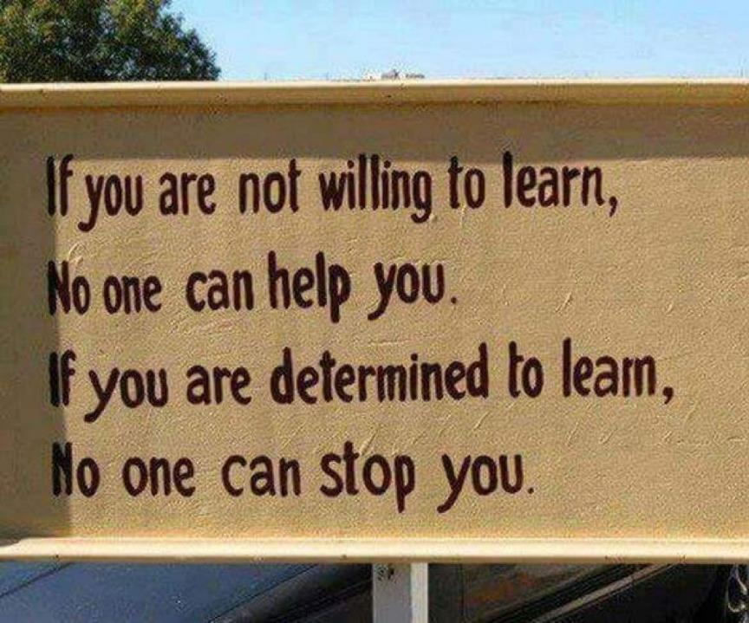

Slide 33
Which wavelength should I teach on?
The only one that works for today’s students is WIIFM
What’s in it for me?
Consciously address the ‘so what’ in students’ minds;
Warm up their ‘want’ to learn.
Clarify their ‘need’ to learn.
They learn far more readily if they are continuously aware of the benefits for them of putting energy into their learning.

Slide 34
Another MCQ
About learning styles,
I think they’re very important
I think they’re a load of rubbish
I know what mine is (or are)
They can’t be changed
They change over time
Voting: A = 2 hands, B = 1 hand
C = touch left ear, D = touch right ear
E = scratch your head

Slide 35
So what about learning styles?
https://www.theguardian.com/education/2017/mar/12/no-evidence-to-back-idea-of-learning-styles?CMP=share_btn_tw
(Link from my Tweet on March 13th 2017 to a letter in the Guardian by prominent folk around the world of education)
Or link to a word document: https://phil-race.co.uk/2017/09/swansea-university-school-management-21st-September/
“No evidence to back idea of learning styles”

Slide 36
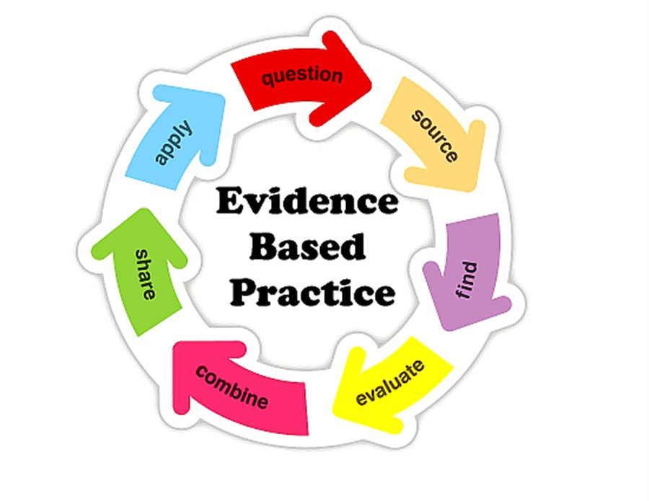

Slide 37
What’s wrong
with
this?
Verbalising
Assessing
Feedback
Making sense
Doing
Wanting/
Needing

Slide 38
What’s wrong
with
this?
Verbalising
Assessing
Feedback
Making sense
Doing
Wanting/
Needing

Slide 39

Thanks, Dr Paul Kleiman

Slide 40
Ripples on a pond….
Enhance our students’ want to learn?
Help students to develop ownership of the need to learn?
Keep students learning by doing, practice, trial-and-error, repetition?
Ensure students really use feedback – from us and from each other?
Help students to make sense of what they learn?
Get students deepening their learning by verbalising, explaining things to each other, and to us?
Allow students to deepen their learning by assessing their own learning, and assessing others’ learning – making informed judgements?
What else can we do to use assessment and feedback to:
Verbalising
Assessing
making informed judgements
Wanting/
Needing
Doing
Doing
Making sense
Feedback

Slide 41
Drives most learning
Is assessment broken?
Some
assessment
issues
We know what students think
Assessment as learning
Validity
Whodunit?
Fairness

Slide 42
My main worries about assessment...
Too often, we still tend to try to measure...
...what’s in students’ heads, and what they can do with what’s there...
in terms of two unsatisfactory proxies ...
what comes out of students’ pens in exams;
2. what comes out of their keyboards in essays and reports.

Slide 43
Boud et al 2010: ‘Assessment 2020’
Assessment has most effect when...:
It is used to engage students in learning that is productive.
Feedback is used to actively improve student learning.
Students and teachers become responsible partners in learning and assessment.
Students are inducted into the assessment practices and cultures of higher education.
Assessment for learning is placed at the centre of subject and program design.
Assessment for learning is a focus for staff and institutional development.
Assessment provides inclusive and trustworthy representation of student achievement.

Slide 44
Boud et al, 2010
David Boud (University of Technology, Sydney), Royce Sadler (Griffith University), Gordon Joughin (University of Wollongong), Richard James (University of Melbourne), Mark Freeman (University of Sydney), Sally Kift (Queensland University of Technology), Filip Dochy (University of Leuven), Dai Hounsell (University of Edinburgh), Margaret Price (Oxford Brookes University), Tom Angelo (La Trobe University), Angela Brew (Macquarie University), Ian Cameron (University of Queensland), Denise Chalmers (University of Western Australia), Paul Hager (University of Technology, Sydney), Kerri-Lee Harris (University of Melbourne), Claire Hughes (University of Queensland), Peter Hutchings (Australian Learning and Teaching Council), Kerri-Lee Krause (Griffith University), Duncan Nulty (Griffith University), Ron Oliver (Edith Cowan University), Jon Yorke (Curtin University), Iouri Belski (RMIT University), Ben Bradley (Charles Sturt University), Simone Buzwell (Swinburne University of Technology), Stuart Campbell (University of Western Sydney), Philip Candy (University of Southern Queensland), Peter Cherry (Central Queensland University), Rick Cummings (Murdoch University), Anne Cummins (Australian Catholic University), Elizabeth Deane (Australian National University), Marcia Devlin (Deakin University), Christine Ewan (Australian Learning and Teaching Council), Paul Gadek (James Cook University), Susan Hamilton (University of Queensland), Margaret Hicks (University of South Australia), Marnie Hughes-Warrington (Monash University), Gail Huon (University of Newcastle), Margot Kearns (University of Notre Dame, Sydney), Don Maconachie (University of the Sunshine Coast), Vi McLean (Queensland University of Technology,) Raoul Mortley (Bond University), Kylie O’Brien (Victoria University), Gary O’Donovan (University of Tasmania), Beverley Oliver (Curtin University), Simon Pyke (University of Adelaide), Heather Smigiel (Flinders University), Janet Taylor (Southern Cross University), Keith Trigwell (University of Sydney), Neil Trivett (University of Ballarat), Graham Webb (University of New England).

Slide 45
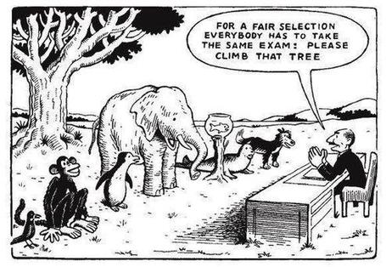

Slide 46

The read-write industry

Slide 47

In the exam room you’re on your own

Slide 48
Ten Concerns about exams
These ten concerns are about time-constrained unseen written examinations.
As we explore these, think of how other forms of exam can get round some of these concerns...
  open book
  open notes
  time unconstrained
  take-away
  in-tray
  multiple-choice
  others….

Slide 49
Ripples on a pond….
Concerns about traditional exams
Coaching,
explaining, teaching
Assessing
making informed judgements
They don’t do much to increase the ‘want’ to learn.
They are not ideal occasions for learning-by-doing.
The amount of feedback that students receive is not optimal.
They don’t do much to help students to make sense of what they have learned.
Wanting/
Needing
Doing
Doing
Making sense
Feedback

Slide 50
Concerns about traditional exams
We mark them in a rush.
We’re often tired and bored when we mark them.
We’re not good at marking them objectively.
They favour candidates who happen to be skilled at taking exams.
They force students into surface learning, and into rapidly clearing their minds of previous knowledge when preparing for the next exam.
There are many important things which they don’t measure.

Slide 51
Ripples on a pond….
If students are under too much pressure, the want to learn is damaged.
The range of learning-by-doing may be too narrow.
Feedback may be eclipsed by marks or grades.
Students may not have the opportunity to make sense of the feedback they receive.
Coaching,
explaining, teaching
Concerns about continuous assessment
Assessing
making informed judgements
Wanting/
Needing
Doing
Doing
Making sense
Feedback

Slide 52
Concerns about continuous assessment
It may be hard to detect unwanted collaboration.
Too much time may be involved in marking.
Students may not be aware of the criteria used to assess their work.
Students may get the balance wrong between continuous assessment and exams.
Learning may become driven by assessment, and students may only do those things that are assessed.
Too little use may be made of the learning that can be achieved when students assess their own, and each other’s work.

Slide 53
Five main problems with assessed essays
They take a great deal of time to mark, let alone the time it takes for students to prepare, draft and compose them.
When most assessment is in the form of essays, students’ skills at essay-writing are repeatedly tested, as the expense sometimes of their understanding of the subject.
Lots of research shows that we’re not at all good at marking essays fairly – different assessors often give the same essay very different marks.
Essay marks in the UK tend to lie between 35% for a poor one and 75% for a very good one, whereas in many other disciplines the marks for an assignment like a lab report can range across the whole 0-100% span more evenly.
With coursework essays, there can be doubt about ‘whodunit?’!

Slide 54
Feed-forward
Language of feedback
Some feedback
issues
National Student Survey
Timing:
24-hours!
Written, printed,
on-screen
Efficiency
Face to face
oral

Slide 55
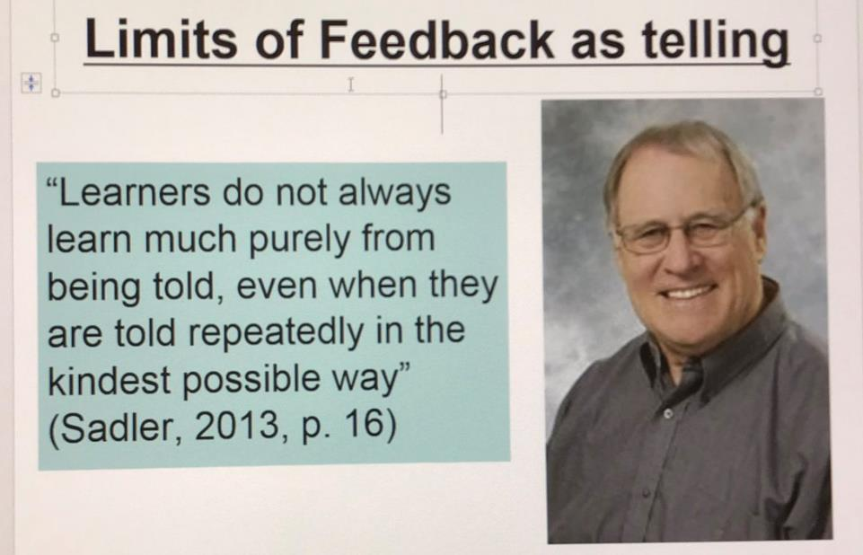
David Carless (on Twitter):
Feedback as telling is seriously overrated!

Slide 56
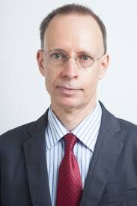

Developing students’ feedback literacy
The danger with traditional methods of assessment and feedback is that assessment tends to be done on student’s work by staff, and feedback tends to be one-directional from staff to students.
Carless and Boud (2018) stress that we want students to gain skills in making ‘evaluative judgements’ themselves on their work, rather than staff doing this.
David Carless & David Boud (2018): The development of student feedback literacy: enabling uptake of feedback, Assessment & Evaluation in Higher Education, https://doi.org/10.1080/02602938.2018.1463354

Slide 57
Factors underpinning feedback literacy
Carless and Boud (2018) examine in detail:
Appreciating feedback
Making judgements
Managing affect
Taking action
We need to enable our students to optimise each of these processes, if we wish to use assessment to promote their learning. They suggest that involving students in giving and receiving peer feedback, and in analysing exemplars, should be essential parts of the curriculum.

Slide 58
Feedback needs to have a future focus
Hounsell et al argue that we need to:
‘increase the value of feedback to the students by focusing comments not only on the past and present … but also on the future – what the student might aim to do, or do differently in the next assignment or assessment if they are to continue to do well or to do better’
(Hounsell, McCune, Hounsell and Litjens 2008, p.5).

Slide 59
Discussion task: taking stock of some feedback approaches
All feedback approaches have their pros and cons. Consider both, for each of the following:
Written (printed) comments on students’ work.
Marks or grades.
Whole-class discussion of an assignment, when it has just been submitted.
Face-to-face 1:1 dialogue with assessor.
Students discussing feedback comments written for other students.
Students giving peer-feedback on each others’ drafts (or final assignments).

Slide 60
Discussion task: taking stock of some feedback approaches
All feedback approaches have their pros and cons. Consider both, for each of the following:
Written (printed) comments on students’ work.
Marks or grades.
Whole-class discussion of an assignment, when it has just been submitted.
Face-to-face 1:1 dialogue with assessor.
Students discussing feedback comments written for other students.
Students giving peer-feedback on each others’ drafts (or final assignments).
Scores out of 10:
Orig A B C D Final
1
2
3
4
5
6

Slide 61
Discussion task: taking stock of some feedback approaches
All feedback approaches have their pros and cons. Consider both, for each of the following:
Written (printed) comments on students’ work.
Marks or grades.
Whole-class discussion of an assignment, when it has just been submitted.
Face-to-face 1:1 dialogue with assessor.
Students discussing feedback comments written for other students.
Students giving peer-feedback on each others’ drafts (or final assignments).
Time it takes us.
Timeliness for students.
Learning payoff for students.
‘Affective’ dimensions – how students feel about it.

Slide 62
Feedback and emotions
Probably feedback is for many people the most emotionally charged experience linked to assessment?
How best can we help bring ‘compassion’ into feedback?
It is well worth giving 20 minutes to watch this: (Theo Gilbert and others) https://www.youtube.com/watch?v=3jFVTCuSCOg …​ particularly on how we can help students to learn how to get more from feedback from each other as well as us.

Slide 63
Task: think about ghastly feedback
Think back to some occasions, academic or otherwise, historic or recent when you received feedback that you would rather not have received;
How did it make you feel?
Thinking of a single example of ghastly feedback that you are prepared to share with another person, briefly outline the context and say why it was such a negative experience.

Slide 64
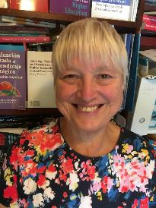
Fishing for feedback?
Feedback is like fish.
If it is not used quickly, it becomes useless.
(Sally Brown).
Give a man a fish,
Feed him for a day.
Teach a man to fish,
Feed him for a lifetime.
(Maimonides: 1135-1204)
Make feedback timely, while it still matters to students, in time for them to use it towards further learning, or to receive further assistance.
(Graham Gibbs)
And he’ll learn to drink beer in boats
And you won’t see him for weeks!
(Australian proverb).

Slide 65
Reinventing Assessment
Fifteen ideas for making assessment and feedback more effective, efficient and manageable for us, and for students
https://www.seda.ac.uk/resources/files/publications_214_Educational%20Developments%2018.2.pdf (2017, pp.21-24)

Slide 66
Fifteen ideas for making assessment and feedback more effective, efficient and manageable for us, and for students
Design much shorter assessments.
Increase formative assessment and reduce summative assessment.
Don’t just use essays.
Make more use of oral feedback rather than written feedback.
Speed up feedback so students still care about it when they receive it.
Get students giving feedback to each other, and sharing feedback.
Let students right into the meaning of assessment criteria, by explaining and illustrating these in whole-group contexts such as lectures.
Show students a range of evidence of achievement.
Get students themselves formulating evidence of achievement.
Get students themselves designing and applying assessment criteria.
Make the most of feedback to students in small-group contexts, such as tutorials.
Use statement banks to speed up formulating useful feedback.
Get students self-assessing, and give them feedback on their self-assessment.
Try to avoid ‘final language’ in feedback.
Always make assignment design a team effort.

Slide 67
Fifteen ideas for making assessment and feedback more effective, efficient and manageable for us, and for students
Design much shorter assessments.
Increase formative assessment and reduce summative assessment.
Don’t just use essays.
Make more use of oral feedback rather than written feedback.
Speed up feedback so students still care about it when they receive it.
Get students giving feedback to each other, and sharing feedback.
Let students right into the meaning of assessment criteria, by explaining and illustrating these in whole-group contexts such as lectures.

Slide 68
Fifteen ideas for making assessment and feedback more effective, efficient and manageable for us, and for students
Show students a range of evidence of achievement.
Get students themselves formulating evidence of achievement.
Get students themselves designing and applying assessment criteria.
Make the most of feedback to students in small-group contexts, such as tutorials.
Use statement banks to speed up formulating useful feedback.
Get students self-assessing, and give them feedback on their self-assessment.
Try to avoid ‘final language’ in feedback.
Always make assignment design a team effort.

Slide 69
Pick the best 9 ideas:
Diamond 9
best
next best
3
4
5
6
7
8
9

Slide 70
Back to our intended learning outcomes…
Do you now feel better able to:
two hands = very much better,
one hand = somewhat better,
touch left ear = no better...
Identify and confront some of the main problems we have implementing assessment and feedback using traditional approaches.
Discuss possible ways of addressing some of these problems creatively, so that assessment and feedback can be firmly linked to student learning.
Wanting/
Needing
Doing
Making sense
Feedback

Slide 71
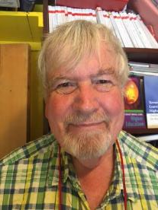
Thank you…
Website: http://phil-race.co.uk
Follow Phil @RacePhil
e-mail: phil@phil-race.co.uk

Slide 72
Useful references and further reading (1)
Bain, K. (2004) What the best College Teachers do, Cambridge: Harvard University Press.
Biggs, J. and Tang, C. (2011) Teaching for Quality Learning at University, Maidenhead: Open University Press.
Bloxham, S. and Boyd, P. (2007) Developing effective assessment in higher education: a practical guide, Maidenhead, Open University Press.
Boud, D. (1995) Enhancing learning through self-assessment, London: Routledge.
Brown, S. and Glasner, A. (eds.) (1999) Assessment Matters in Higher Education, Choosing and Using Diverse Approaches, Maidenhead: Open University Press.
Brown, S. and Race, P. (2012) Using effective assessment to promote learning in Hunt, L. and Chambers, D. (2012) University Teaching in Focus, Victoria, Australia, Acer Press. P74-91.
Brown, S. (2015) Learning , Teaching and Assessment in Higher Education: Global perspectives, London, Palgrave.
Carless, D., Joughin, G., Ngar-Fun Liu et al (2006) How Assessment supports learning: Learning orientated assessment in action Hong Kong: Hong Kong University Press.
Carless, D. and Boud, D. (2018): The development of student feedback literacy: enabling uptake of feedback, Assessment & Evaluation in Higher Education, https://doi.org/10.1080/02602938.2018.1463354

Slide 73
Useful references and further reading (2)
Carroll, J. and Ryan, J. (2005) Teaching International students: improving learning for all. London: Routledge SEDA series.
Crosling, G., Thomas, L. and Heagney, M. (2008) Improving student retention in Higher Education, London and New York: Routledge
Crooks, T. (1988) Assessing student performance, HERDSA Green Guide No 8 HERDSA (reprinted 1994).
Dunworth, K. and Sanchez, H.S., (2016). Perceptions of quality in staff-student written feedback in higher education: a case study. Teaching in Higher Education, 21(5), pp.576-589.
Dweck, C. S. (2000) Self Theories: Their Role in Motivation, Personality and Development, Lillington, NC: Taylor & Francis.
Falchikov, N. (2004) Improving Assessment through Student Involvement: Practical Solutions for Aiding Learning in Higher and Further Education, London: Routledge.
Gibbs, G. (1999) Using assessment strategically to change the way students learn, in Brown S. & Glasner, A. (eds.), Assessment Matters in Higher Education: Choosing and Using Diverse Approaches, Maidenhead: SRHE/Open University Press.
Higher Education Academy (2012) A marked improvement; transforming assessment in higher education, York: HEA.

Slide 74
Useful references and further reading (3)
Hawe, E., Lightfoot, U., & Dixon, H. (2017). First-year students working with exemplars: Promoting self-efficacy, self-monitoring and self-regulation. Journal of Further and Higher Education, 1-15.
Hendry, G. D., White, P., & Herbert, C. (2016). Providing Exemplar-Based “Feedforward” before an Assessment: The Role of Teacher Explanation. Active Learning in Higher Education, 17(2), 99-109.
Hounsell, D., McCune, V., Hounsell, J. and Litjens, J., (2008). The quality of guidance and feedback to students. Higher Education Research & Development, 27(1), pp.55-67.
Newton, P. M. (2018) How Common Is Commercial Contract Cheating in Higher Education and Is It Increasing? A Systematic Review https://www.frontiersin.org/articles/10.3389/feduc.2018.00067/full
Nicol, D. J. and Macfarlane-Dick, D. (2006) Formative assessment and self-regulated learning: A model and seven principles of good feedback practice, Studies in Higher Education Vol 31(2), 199-218.
PASS project Bradford http://www.pass.brad.ac.uk/ Accessed January 2019.
Pickford, R. and Brown, S. (2006) Assessing skills and practice, London: Routledge.
Rotheram, B. (2009) Sounds Good, JISC project http://www.jisc.ac.uk/whatwedo/programmes/usersandinnovation/soundsgood.aspx

Slide 75
Useful references and further reading (4)
Race, P. (2001) A Briefing on Self, Peer & Group Assessment, in LTSN Generic Centre Assessment Series No 9, LTSN York.
Race, P. (2014) Making Learning Happen (3rd edition), London: Sage.
Race, P. (2015) The lecturer’s toolkit (4th edition), London: Routledge.
Race, P. (2017) Fifteen ideas for making assessment and feedback more effective, efficient and manageable for us, and for students: SEDA Developments https://www.seda.ac.uk/resources/files/publications_214_Educational%20Developments%2018.2.pdf (accessed January 2019)
Rust, C., Price, M. and O’Donovan, B. (2003) Improving students’ learning by developing their understanding of assessment criteria and processes, Assessment and Evaluation in Higher Education. 28 (2), 147-164.
Scoles, J., Huxham, M., & McArthur, J. (2013). No longer exempt from good practice: Using exemplars to close the feedback gap for exams. Assessment & Evaluation in Higher Education, 38(6), 631-645.
Sadler, D. Royce (2010) Beyond feedback: developing student capability in complex appraisal, Assessment & Evaluation in Higher Education, 35: 5, 535-550.
Sambell, K., McDowell, L. and Montgomery, C. (2013) Assessment for Learning in Higher Education, London: Routledge.

