Slide 1
Effective assessment – Reinventing assessment
7th March, 2019
UCLAN: School of Medicine
Phil Race
(from Newcastle-upon-Tyne)
BSc PhD PGCE FCIPD PFHEA NTF
Follow Phil on Twitter: @RacePhil
Visiting Professor: University of Plymouth and Edge Hill University
Emeritus Professor, Leeds Beckett University

Slide 2
About Phil…
First a musician
Then a writer
Then a scientist
Then a researcher
Then a lecturer and warden at what is now USW
Got interested in how students learn
And the effects assessment and feedback have on them
And how we teach them
Gradually became an educational developer
And very shortly retired!?
Currently…
Visiting Prof: Plymouth & Edge Hill
Emeritus Prof: Leeds Beckett
Based at Newcastle, UK
And on trains
And an expert…
on train routes and timetables!
Notes:
2
2

Slide 3
Making learning happen
(20th September: Factors underpinning successful teaching).
(6th December: Making feedback effective).
7th March: Effective assessment – reinventing assessment.
6th June??: Lecturing styles and methods.
Date to be revised due to GMC visit?

Slide 4
Download anytime Phil’s materials on feedback, assessment, and learning
Expanded discussion;
https://phil-race.co.uk/2016/10/lthe-tweetchat-lthechat-wed-oct-19-8-00-9-00-pm/ (feedback stuff from my most recent two books)
http://phil-race.co.uk/2015/01/assessment-bits-new-editions/ (extracts on assessment).

Slide 5
Towards assessment as learning
Last century, we had lots of assessment of learning.
We still need to do some of this, e.g. to assure fitness to practice.
Some institutions have moved a long way towards assessment for learning.
I believe we now need to make a final jump – assessment as learning.
I’m going to help you to think of the extent to which each of a number of assessment methods can bring assessment and learning closer, and achieve assessment as learning for students.

Slide 6
Today
We will look at the pros and cons of some of the most often-used processes and instruments in our traditional approaches to assessment, and explore what else we can do to improve assessment.
We will also look at how we can use formative assessment to open up feedback dialogues with students to deepen their learning and help them to make the most of our feedback to them. We will explore how best we can make assessment better for students by involving them in self- and peer-assessment.

Slide 7
Time-constrained assessed written Post-it exercise
On a post-it, in your best handwriting, please write your own completion of the starter:
“Assessment nowadays would be much better for me if only I …”
Please swap post-its so that you’ve no idea who has yours.
If chosen, please read out with passion and drama what’s on the post-it you now have.
Please place them all as directed.

Slide 8
You will be able to download my main slides
You don’t need to take notes.
I’ll put the main slides I use up on my website later today (http://phil-race.co.uk/)
I won’t post pictures and video-clips, as this would make the file-size too large.
I may sometimes go through slides quite fast, but you can study them as you wish at your leisure.

Slide 9
Factors underpinning successful teaching
In sessions last year, we looked at the factors underpinning successful learning, ways of helping students to use effective feedback.
Today on to the very important matter of assessment design. Assessment takes a lot of our time, and a lot of student time, and is crucial for their careers.
“You can escape bad teaching, but you can’t escape bad assessment” (David Boud).

Slide 10
Context
Assessment and feedback can be powerful means of focusing student effort and enhancing achievement if well designed (Biggs and Tang, 2011);
Students in the early stages of their learning journey are likely to need more support and positive feedback than later, when they are more robust and confident;
The first six weeks are crucial in helping students understand how assessment and feedback work;
No single method of assessment is likely to be ubiquitously successful, so it’s worth using a variety of approaches;
Assessment needs to be manageable for staff and students if it is going to engage students in learning activities.

Slide 11
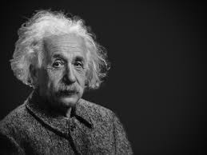
Thought for the day: Einstein
It is simply madness,
to keep doing the same things,
and expect different results.

Slide 12
Announcement about mobile phones and laptops...
Good morning everyone – please turn on your ‘phones and computers.
Please post your thoughts, comments and ideas during and after this session to the hashtag #philatuclan19 Thanks!
Try #LTHEchat on Wednesday evenings from 20.00-21.00. Last night’s on feedback was great!
Usual rules apply: £1 for the first person to tell me about each of the first three typos in these slides.

Slide 13
Intended learning outcome
After participating in this session, you should be better-able to:
Confront, re-examine and address some of the problems we have with assessment.

Slide 14
Reinventing Assessment Fifteen ideas for making assessment and feedback more effective, efficient and manageable for us, and for students
https://www.seda.ac.uk/resources/files/publications_214_Educational%20Developments%2018.2.pdf (2017, pp.21-24)

Slide 15
Why re-invent assessment and feedback now?
They take far too much of our time and energy. Staff are burning themselves out trying to apply old assessment and feedback methods to much larger cohorts of students.
Assessment and feedback are vitally important to students.
Feedback from students continues to show their relative dissatisfaction with assessment and feedback.
Assessment and feedback contribute strongly to the NSS, and therefore also to TEF.
It is madness just to keep trying to do the same things better – we need to be ready to try something else.

Slide 16
Reinventing assessment and feedback
Part of the problem is that we tend to keep on trying to use the processes which used to work well enough years ago, but don’t satisfy today’s student needs and expectations – and often student numbers are higher too.
Later in this session, I will outline a number of ideas for making assessment and feedback work towards better partnership with students, and which also make the processes more effective and efficient, and involve students themselves much more closely in the design of assessment and feedback.
https://www.seda.ac.uk/resources/files/publications_214_Educational%20Developments%2018.2.pdf (2017, pp.21-24)

Slide 17
Fifteen ideas for making assessment and feedback more effective, efficient and manageable for us, and for students
Design much shorter assessments.
Increase formative assessment and reduce summative assessment.
Don’t just use essays.
Make more use of oral feedback rather than written feedback.
Speed up feedback so students still care about it when they receive it.
Get students giving feedback to each other, and sharing feedback.
Let students right into the meaning of assessment criteria, by explaining and illustrating these in whole-group contexts such as lectures.
Show students a range of evidence of achievement.
Get students themselves formulating evidence of achievement.
Get students themselves designing and applying assessment criteria.
Make the most of feedback to students in small-group contexts, such as tutorials.
Use statement banks to speed up formulating useful feedback.
Get students self-assessing, and give them feedback on their self-assessment.
Try to avoid ‘final language’ in feedback.
Always make assignment design a team effort.

Slide 18
Your initial thoughts on these 15
Please make an alphabetical list A, B, …O.
Give each of the 15 a score 10 = brilliant, 1 = not one to try, and in between.
Now on a post-it, please draw 9 boxes.
Diamond-9 the top 9 using your list, entering the top-scoring letter in the top box, down to lesser-scoring letters in the other boxes.
best
next best

Slide 19
Which letter scored highest on your post-it?
Your top scoring letters:
Your next-top scoring letters:

Slide 20
Pick the best 9 ideas:
Diamond 9
l.l.o.j.n.n.l.m.k.h.c.c.h.
c.k.c.k.h.c.c.f.c.c.n.b.g.
3
4
5
6
7
8
9

Slide 21
Experience of Royce Sadler on standards, assessment and feedback
Well worth looking at this clip from Coursera from Royce Sadler, who’s work informs much of the modern thinking on assessment and feedback…

Slide 22
HEA Fellowships? (Professional development relating to teaching, learning and assessment)
How many of you are already: (please raise hands)
Associate Fellow (AFHEA) 23,538
Fellow (FHEA) 75,033
Senior Fellow (SFHEA) 9,557
Principal Fellow (PFHEA) 995
National Teaching Fellow (NTF) c.900
(Numbers at start of 2019; seem to be included in some league tables)

Slide 23
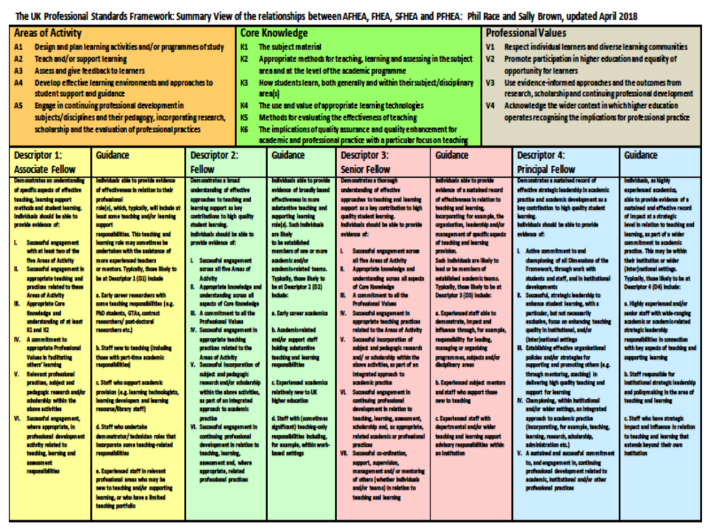

Slide 24
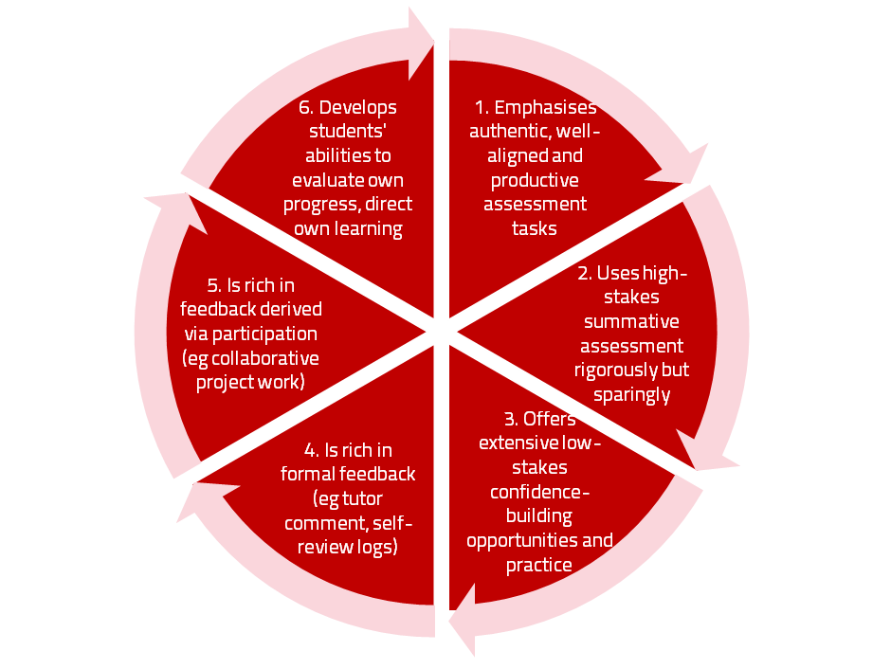
Assessment for learning

Slide 25
Use link below to download the new materials on feedback and assessment produced in 2017-18 by Kay Sambell, Sally Brown and Phil Race for Edinburgh Napier University, (adapted versions for Ireland launched last Thursday in Cork as ‘TACIT guides’)
http://staff.napier.ac.uk/services/dlte/ENhance/Pages/ENhanceQuickGuides.aspx

Slide 26
Teaching, learning and enthusiasm
Knowledge isn’t infectious (unfortunately) but enthusiasm is, and we need to help our students to catch enthusiasm.
We certainly don’t want feedback to damage that enthusiasm.

Slide 27
The NSS Assessment and Feedback Agenda (2005-16)
The criteria used in marking have been clear in advance.
Assessment arrangements and marking have been fair.
Feedback on my work has been prompt.
I have received detailed comments on my work.
Feedback on my work has helped me to clarify things I did not understand.

Slide 28
The new NSS statements (2017)
Assessment and feedback
The criteria used in marking have been clear in advance
Marking and assessment have been fair
Feedback on my work has been timely
I have received helpful comments on my work
Student voice
I have had the right opportunities to provide feedback on my course
Staff value students’ views and opinions about the course
It is clear how students’ feedback on the course has been acted on

Slide 29
Seven factors underpinning successful learning: (Race, 2015)
Verbalising
Assessing
Feedback
Making sense
Doing
Wanting/
Needing
Race, P. (2015) The Lecturer’s Toolkit, 4th Edition: Chapter 1 (Routledge)

Slide 30
What’s wrong
with
this?
Verbalising
Assessing
Feedback
Making sense
Doing
Wanting/
Needing

Slide 31
What’s wrong
with
this?
Verbalising
Assessing
Feedback
Making sense
Doing
Wanting/
Needing

Slide 32
Thanks, Dr Paul Kleiman

Slide 33
Constructive Alignment: John Biggs
What will I be expected to show for this?
What does a good one look like, and a bad one?
Where does this fit into the big picture?
When explaining assessment criteria to students, and when linking these to evidence of achievement of the intended learning outcomes, we need to make the most of face-to-face whole group contexts and...
Tone of voice
Body language
Facial expression
Eye contact
The chance to repeat things
The chance to respond to puzzled looks
Some things don’t work nearly so well just on paper or on screens.
Some of the
tools we can
use in
face-to-face
contexts

Slide 34
Drives most learning
Is assessment broken?
Some
assessment
issues
We know
what students think
Assessment as learning
Validity
Whodunit?
Fairness

Slide 35
My main worries about assessment...
Too often, we still tend to try to measure...
...what’s in students’ heads, and what they can do with what’s there...
in terms of two unsatisfactory proxies ...
what comes out of students’ pens in exams;
2. what comes out of their keyboards in essays and reports.

Slide 36
Boud et al 2010: ‘Assessment 2020’
Assessment has most effect when...:
It is used to engage students in learning that is productive.
Feedback is used to actively improve student learning.
Students and teachers become responsible partners in learning and assessment.
Students are inducted into the assessment practices and cultures of higher education.
Assessment for learning is placed at the centre of subject and program design.
Assessment for learning is a focus for staff and institutional development.
Assessment provides inclusive and trustworthy representation of student achievement.

Slide 37
Boud et al, 2010
David Boud (University of Technology, Sydney), Royce Sadler (Griffith University), Gordon Joughin (University of Wollongong), Richard James (University of Melbourne), Mark Freeman (University of Sydney), Sally Kift (Queensland University of Technology), Filip Dochy (University of Leuven), Dai Hounsell (University of Edinburgh), Margaret Price (Oxford Brookes University), Tom Angelo (La Trobe University), Angela Brew (Macquarie University), Ian Cameron (University of Queensland), Denise Chalmers (University of Western Australia), Paul Hager (University of Technology, Sydney), Kerri-Lee Harris (University of Melbourne), Claire Hughes (University of Queensland), Peter Hutchings (Australian Learning and Teaching Council), Kerri-Lee Krause (Griffith University), Duncan Nulty (Griffith University), Ron Oliver (Edith Cowan University), Jon Yorke (Curtin University), Iouri Belski (RMIT University), Ben Bradley (Charles Sturt University), Simone Buzwell (Swinburne University of Technology), Stuart Campbell (University of Western Sydney), Philip Candy (University of Southern Queensland), Peter Cherry (Central Queensland University), Rick Cummings (Murdoch University), Anne Cummins (Australian Catholic University), Elizabeth Deane (Australian National University), Marcia Devlin (Deakin University), Christine Ewan (Australian Learning and Teaching Council), Paul Gadek (James Cook University), Susan Hamilton (University of Queensland), Margaret Hicks (University of South Australia), Marnie Hughes-Warrington (Monash University), Gail Huon (University of Newcastle), Margot Kearns (University of Notre Dame, Sydney), Don Maconachie (University of the Sunshine Coast), Vi McLean (Queensland University of Technology,) Raoul Mortley (Bond University), Kylie O’Brien (Victoria University), Gary O’Donovan (University of Tasmania), Beverley Oliver (Curtin University), Simon Pyke (University of Adelaide), Heather Smigiel (Flinders University), Janet Taylor (Southern Cross University), Keith Trigwell (University of Sydney), Neil Trivett (University of Ballarat), Graham Webb (University of New England).

Slide 38
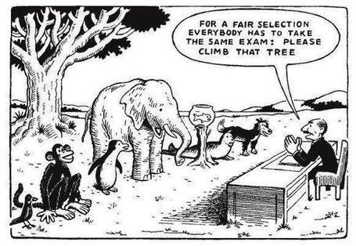

Slide 39
The read-write industry

Slide 40
In the exam room you’re on your own

Slide 41
Ten Concerns about exams
These ten concerns are about time-constrained unseen written examinations.
As we explore these, think of how other forms of exam can get round some of these concerns...
open book
open notes
time unconstrained
take-away
in-tray
multiple-choice
others….

Slide 42
Ripples on a pond….
Concerns about traditional exams
Coaching,
explaining, teaching
Assessing
making informed judgements
They don’t do much to increase the ‘want’ to learn.
They are not ideal occasions for learning-by-doing.
The amount of feedback that students receive is not optimal.
They don’t do much to help students to make sense of what they have learned.
Wanting/
Needing
Doing
Doing
Making sense
Feedback

Slide 43
Concerns about traditional exams
We mark them in a rush.
We’re often tired and bored when we mark them.
We’re not good at marking them objectively.
They favour candidates who happen to be skilled at taking exams.
They force students into surface learning, and into rapidly clearing their minds of previous knowledge when preparing for the next exam.
There are many important things which they don’t measure.

Slide 44
Ripples on a pond….
If students are under too much pressure, the want to learn is damaged.
The range of learning-by-doing may be too narrow.
Feedback may be eclipsed by marks or grades.
Students may not have the opportunity to make sense of the feedback they receive.
Coaching,
explaining, teaching
Concerns about continuous assessment
Assessing
making informed judgements
Wanting/
Needing
Doing
Doing
Making sense
Feedback

Slide 45
Concerns about continuous assessment
It may be hard to detect unwanted collaboration.
Too much time may be involved in marking.
Students may not be aware of the criteria used to assess their work.
Students may get the balance wrong between continuous assessment and exams.
Learning may become driven by assessment, and students may only do those things that are assessed.
Too little use may be made of the learning that can be achieved when students assess their own, and each other’s work.

Slide 46
Five main problems with assessed essays
They take a great deal of time to mark, let alone the time it takes for students to prepare, draft and compose them.
When most assessment is in the form of essays, students’ skills at essay-writing are repeatedly tested, as the expense sometimes of their understanding of the subject.
Lots of research shows that we’re not at all good at marking essays fairly – different assessors often give the same essay very different marks.
Essay marks in the UK tend to lie between 35% for a poor one and 75% for a very good one, whereas in many other disciplines the marks for an assignment like a lab report can range across the whole 0-100% span more evenly.
With coursework essays, there can be doubt about ‘whodunit?’!

Slide 47
The importance of dialogic assessment
Students need to be exposed to, and gain experience in making judgements about, a variety of works of different quality... They need planned rather than random exposure to exemplars, and experience in making judgements about quality. They need to create verbalised rationales and accounts of how various works could have been done better. Finally, they need to engage in evaluative conversations with teachers and other students. Together, these three provide the means by which students can develop a concept of quality that is similar in essence to that which the teacher possesses, and in particular to understand what makes for high quality. Although providing these experiences for students may appear to add more layers to the task of teaching, it is possible to organise this approach to peer assessment so that it becomes a powerful strategy for higher education teaching. (Sadler 2010)

Slide 48
Modern institutions are moving away from being the providers of content, (where everything used to be about ‘delivery’), towards foregrounding two major functions:
Recognising and accrediting students’ achievement, wherever learning has taken place (i.e. getting the assessment right);
Supporting student learning and engagement (not least by making feedback work well for students, and using real-world situations and simulations to bring learning to life).

Slide 49
Ripples on a pond….
Enhance our students’ want to learn?
Help students to develop ownership of the need to learn?
Keep students learning by doing, practice, trial-and-error, repetition?
Ensure students really us feedback – from us and from each other?
Help students to make sense of what they learn?
Get students deepening their learning by verbalising, explaining things to each other, and to us?
Allow students to deepen their learning by assessing their own learning, and assessing others’ learning – making informed judgements?
What else can we do to use
teaching, assessment and feedback to:
Verbalising
Assessing
making informed judgements
Wanting/
Needing
Doing
Doing
Making sense
Feedback

Slide 50
Bringing assessment and feedback to life Questions employers might ask at interview that could help us frame some of our assignments
Can you tell us about an occasion when:
you worked together with colleagues in a group to produce a collective outcome?
you had to work autonomously with incomplete information and self-derived data sources?
you developed strategies to solve real life problems and tested them out?
you had a leadership role in a team, and could you tell us your strategies to influence and persuade your colleagues to achieve a collective task?
you had to communicate outcomes from your project work orally, in writing, through social media and/or through a visual medium?

Slide 51
Reinventing Assessment Fifteen ideas for making assessment and feedback more effective, efficient and manageable for us, and for students
https://www.seda.ac.uk/resources/files/publications_214_Educational%20Developments%2018.2.pdf (2017, pp.21-24)

Slide 52
Fifteen ideas for making assessment and feedback more effective, efficient and manageable for us, and for students
Design much shorter assessments.
Increase formative assessment and reduce summative assessment.
Don’t just use essays.
Make more use of oral feedback rather than written feedback.
Speed up feedback so students still care about it when they receive it.
Get students giving feedback to each other, and sharing feedback.
Let students right into the meaning of assessment criteria, by explaining and illustrating these in whole-group contexts such as lectures.
Show students a range of evidence of achievement.
Get students themselves formulating evidence of achievement.
Get students themselves designing and applying assessment criteria.
Make the most of feedback to students in small-group contexts, such as tutorials.
Use statement banks to speed up formulating useful feedback.
Get students self-assessing, and give them feedback on their self-assessment.
Try to avoid ‘final language’ in feedback.
Always make assignment design a team effort.

Slide 53
A Design much shorter assessments
(e.g. a 300-word annotated bibliography instead of a 3000-word essay).
We tend to keep using long assessments, because that’s what we’ve always done. As a result, we spend ages marking, and too little time assessing.
Students learn to ‘waffle’ with long assessments. A short assessment can be harder, and more intense. And we achieve better discrimination between best and worst.
Shorter assessments are much, much faster to assess.
Research shows we can actually assess short assessments much more reliably!

Slide 54
B Increase formative assessment and reduce summative assessment
We know that students learn little or nothing from feedback on summative assessments.
Some don’t even collect their marked work.
Students often don’t learn from feedback on supposedly-formative assessments, as they’ve already moved on to the next task.
Formative assessment can be a great learning experience.
Students’ final results can benefit enormously from formative feedback.

Slide 55
C Don’t just use essays
Essays take ages to write, and ages to mark. And we may not know who wrote them! http://phil-race.co.uk/whodunit/
Essays can be fine for giving students feedback, but not for assessment!
Research shows we’re not at all good at assessing essays. Yet the mark or grade becomes much more important to students than the feedback.
Marking can degenerate into copy-editing rather than assessing.
Students are well aware whenever assessment is at all unfair.

Slide 56
D Make more use of oral feedback rather than written feedback
Face-to-face feedback can make good use of tone of voice, encouraging facial gestures, speed of speech, repetition where needed, body language, and so on.
Students in large groups can learn from oral feedback on other students’ triumphs and disasters (with due anonymity).
Even one-to-one, oral feedback can be much more powerful than written.
Oral feedback can be retained and reviewed if ‘packaged up’ in podcasts or audio files.

Slide 57
E Speed up feedback so students still care about it when they receive it
We’ve become preoccupied with the turn-around time for a batch of work for large groups of students.
A lot of feedback can be given at the moment the work is submitted, before marking has even begun.
Immediate feedback means that students still remember what they did – and what they had problems with.
Ideally, give feedback within 24 hours of students doing the work? (https://phil-race.co.uk/2014/01/feedback-24-hours/ )

Slide 58
F Get students giving feedback to each other, and sharing feedback
Students learn a great deal from the process of explaining things to someone else.
It’s often easier to learn from someone who has just mastered a concept than from someone who can’t remember the difficulties learning it.
Students can benefit from much more feedback than we could give them.
Students can learn much more from our feedback to their friends, than our feedback on their own work.

Slide 59
G Let students right into the meaning of assessment criteria, by explaining and illustrating these in whole-group contexts such as lectures
There should be no hidden agendas. Talk assessment every time you see whole groups of students.
Try to avoid talking assessment to individual students seeking to ‘get ahead’.
Make it clear how assessment criteria link to evidence of achievement of published learning outcomes.
Give students safe practice at evidencing their achievement of assessment criteria.

Slide 60
H Show students a range of evidence of achievement
Don’t just show students exemplars of ‘excellent work’.
Let them see what can easily go wrong, and can lose them marks.
When students are aware of a range between ‘excellent’ and ‘poor’, they can strive to be even better than excellent.
The tendency to simply imitate excellent work is diminished.
(See the work of Royce Sadler)

Slide 61
I Get students themselves formulating evidence of achievement
When students have a feeling of ownership of their targets, they put much more into achieving the targets.
When students formulate ‘good’ evidence, we can praise their choices.
When students formulate ‘poor’ evidence, we can point them in a better direction.
We can adopt their targets, when they are better than the ones we first thought of!

Slide 62
J Get students themselves designing and applying assessment criteria
Learning by assessing – ‘making informed judgements’ – is one of the deepest forms of learning.
We can easily give students relevant things to assess in class time, and benefit from dialogue.
Students can often think of better assessment criteria than the ones we first thought of ourselves.
Applying assessment criteria helps students to internalise how to achieve them in their own work.

Slide 63
K Make the most of feedback to students in small-group contexts, such as tutorials
This can be less threatening than one-to-one feedback (oral or written), especially critical feedback, and can be much more manageable for us.
Let students hear feedback on work that is better than theirs (retaining anonymity).
Let students hear feedback on other students’ disasters (retaining anonymity).
Allow students to see ‘where they’re at’ compared to others in the cohort.

Slide 64
L Use statement banks to speed up formulating useful feedback
Especially with online feedback, compile a bank of useful feedback statements.
Make sure that there are sufficient ‘praise’ comments, to counterbalance critical ones.
Get students themselves to compose statements, so that they get a sharper idea of what is wanted in their work.
Make sure that the feedback that different students receive is sufficiently different and personal, rather than just ‘out of the box’.

Slide 65
M Get students self-assessing, and give them feedback on their self-assessment.
Turn self-assessment into a productive dialogue with us.
Ask students what mark or grade they believe the work should be earning.
Ask students what they think they did best, and praise them when indeed they did do this well.
Ask students what they found the hardest part of the task, and praise them when they succeeded, and empathise when they didn’t.
Ask students what they might change if they had another hour to do the task.

Slide 66
N Try to avoid ‘final language’ in feedback
‘Final language’ includes words such as ‘excellent’, ‘good’, ‘poor’, ‘adequate’, ‘satisfactory’, and so on – it doesn’t give students ‘anywhere to go next’.
It is better to say things such as:
‘I really like how you approached so-and-so’
‘It might have helped if you’d done such-and such’
‘One thing you did really well was so-and-so’
‘You probably know that such-and-such didn’t really work’

Slide 67
O Always make assessment design a team effort
It doesn't make sense to do this alone without running your ideas past a colleague, quality assurer, student or all three.
This can help avoid the biggest pitfalls around assuring manageability, authenticity, relevance and validity.
Students can be particularly useful sounding boards to ensure that what you are asking students to do is clear and readily understandable.
You won't get into glitches around university systems and regulations if you talk things through in advance with a Faculty manager or registrar.

Slide 68
Fifteen ideas for making assessment and feedback more effective, efficient and manageable for us, and for students
Design much shorter assessments.
Increase formative assessment and reduce summative assessment.
Don’t just use essays.
Make more use of oral feedback rather than written feedback.
Speed up feedback so students still care about it when they receive it.
Get students giving feedback to each other, and sharing feedback.
Let students right into the meaning of assessment criteria, by explaining and illustrating these in whole-group contexts such as lectures.
Show students a range of evidence of achievement.
Get students themselves formulating evidence of achievement.
Get students themselves designing and applying assessment criteria.
Make the most of feedback to students in small-group contexts, such as tutorials.
Use statement banks to speed up formulating useful feedback.
Get students self-assessing, and give them feedback on their self-assessment.
Try to avoid ‘final language’ in feedback.
Always make assignment design a team effort.

Slide 69
Now your turn to make some informed judgements
Please get into twos or threes where you’re sitting.
In a minute, I’ll show again the slide with all 15 ideas on it.
In your group, discuss and argue, arranging your top 9 in a ‘diamond 9’ pattern, just jotting down the relevant letters on a bit of paper.

Slide 70
Your revised prioritisation (homework):
Diamond 9
best
next best
3
4
5
6
7
8
9

Slide 71
Back to our intended learning outcome
Do you now feel better able to:
2 hands = very much better,
one hand = somewhat better,
touch left ear = no better...
Confront, re-examine and address some of the problems we have with assessment?
Wanting/
Needing
Doing
Making sense
Feedback

Slide 72
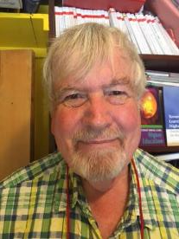
Thank you…
Website: http://phil-race.co.uk
Follow Phil @RacePhil
e-mail: phil@phil-race.co.uk

Slide 73
Useful references and further reading (1)
Bain, K. (2004) What the best College Teachers do, Cambridge: Harvard University Press.
Biggs, J. and Tang, C. (2011) Teaching for Quality Learning at University, Maidenhead: Open University Press.
Bloxham, S. and Boyd, P. (2007) Developing effective assessment in higher education: a practical guide, Maidenhead, Open University Press.
Boud, D. (1995) Enhancing learning through self-assessment, London: Routledge.
Brown, S. and Glasner, A. (eds.) (1999) Assessment Matters in Higher Education, Choosing and Using Diverse Approaches, Maidenhead: Open University Press.
Brown, S. and Race, P. (2012) Using effective assessment to promote learning in Hunt, L. and Chambers, D. (2012) University Teaching in Focus, Victoria, Australia, Acer Press. P74-91.
Brown, S. (2015) Learning , Teaching and Assessment in Higher Education: Global perspectives, London, Palgrave.

Slide 74
Useful references and further reading (2)
Carless, D., Joughin, G., Ngar-Fun Liu et al (2006) How Assessment supports learning: Learning orientated assessment in action Hong Kong: Hong Kong University Press.
Carroll, J. and Ryan, J. (2005) Teaching International students: improving learning for all. London: Routledge SEDA series.
Crosling, G., Thomas, L. and Heagney, M. (2008) Improving student retention in Higher Education, London and New York: Routledge
Crooks, T. (1988) Assessing student performance, HERDSA Green Guide No 8 HERDSA (reprinted 1994).
Dunworth, K. and Sanchez, H.S., (2016). Perceptions of quality in staff-student written feedback in higher education: a case study. Teaching in Higher Education, 21(5), pp.576-589.
Dweck, C. S. (2000) Self Theories: Their Role in Motivation, Personality and Development, Lillington, NC: Taylor & Francis.
Falchikov, N. (2004) Improving Assessment through Student Involvement: Practical Solutions for Aiding Learning in Higher and Further Education, London: Routledge.
Gibbs, G. (1999) Using assessment strategically to change the way students learn, in Brown S. & Glasner, A. (eds.), Assessment Matters in Higher Education: Choosing and Using Diverse Approaches, Maidenhead: SRHE/Open University Press.
Higher Education Academy (2012) A marked improvement; transforming assessment in higher education, York: HEA.

Slide 75
Useful references and further reading (3)
Hawe, E., Lightfoot, U., & Dixon, H. (2017). First-year students working with exemplars: Promoting self-efficacy, self-monitoring and self-regulation. Journal of Further and Higher Education, 1-15.
Hendry, G. D., White, P., & Herbert, C. (2016). Providing Exemplar-Based “Feedforward” before an Assessment: The Role of Teacher Explanation. Active Learning in Higher Education, 17(2), 99-109.
Hounsell, D., McCune, V., Hounsell, J. and Litjens, J., (2008). The quality of guidance and feedback to students. Higher Education Research & Development, 27(1), pp.55-67.
Newton, P. M. (2018) How Common Is Commercial Contract Cheating in Higher Education and Is It Increasing? A Systematic Review https://www.frontiersin.org/articles/10.3389/feduc.2018.00067/full
Nicol, D. J. and Macfarlane-Dick, D. (2006) Formative assessment and self-regulated learning: A model and seven principles of good feedback practice, Studies in Higher Education Vol 31(2), 199-218.
PASS project Bradford http://www.pass.brad.ac.uk/ Accessed November 2013.
Pickford, R. and Brown, S. (2006) Assessing skills and practice, London: Routledge.
Rotheram, B. (2009) Sounds Good, JISC project http://www.jisc.ac.uk/whatwedo/programmes/usersandinnovation/soundsgood.aspx

Slide 76
Useful references and further reading (4)
Race, P. (2001) A Briefing on Self, Peer & Group Assessment, in LTSN Generic Centre Assessment Series No 9, LTSN York.
Race P. (2015) The lecturer’s toolkit (4th edition), London: Routledge.
Rust, C., Price, M. and O’Donovan, B. (2003) Improving students’ learning by developing their understanding of assessment criteria and processes, Assessment and Evaluation in Higher Education. 28 (2), 147-164.
Ryan, J. (2000) A Guide to Teaching International Students, Oxford Centre for Staff and Learning Development.
Scoles, J., Huxham, M., & Mcarthur, J. (2013). No longer exempt from good practice: Using exemplars to close the feedback gap for exams. Assessment & Evaluation in Higher Education, 38(6), 631-645.
Stefani, L. and Carroll, J. (2001) A Briefing on Plagiarism, LTSN
Sadler, D. Royce (2010) Beyond feedback: developing student capability in complex appraisal, Assessment & Evaluation in Higher Education, 35: 5, 535-550.
Yorke, M. (1999) Leaving Early: Undergraduate Non-completion in Higher Education, London: Routledge.

