Slide 1
Enhancing student experience of classroom engagement
13th March 2019
UNN: Faculty of Business and Law
Phil Race
(from Newcastle-upon-Tyne)
BSc PhD PGCE FCIPD PFHEA NTF
Follow Phil on Twitter: @RacePhil
Visiting Professor: University of Plymouth and Edge Hill University
Emeritus Professor, Leeds Beckett University

Slide 2
This slide has two purposes….
To focus the data projector, if necessary, and…
...to persuade colleagues never to put this sort of detail onto a slide!

Slide 3
About Phil…
First a musician
Then a writer
Then a scientist
Then a researcher
Then a lecturer and warden at what is now USW
Got interested in how students learn
And the effects assessment and feedback have on them
And how we teach them
Gradually became an educational developer
And retiring in June!
Currently…
Visiting Prof: Plymouth & Edge Hill
Emeritus Prof: Leeds Beckett
Based at Newcastle, UK
And on trains
And an expert…
on train routes and timetables!
Notes:
2
2

Slide 4
You will be able to download my main slides
You don’t need to take notes.
I’ll put the main slides I use up on my website later today (http://phil-race.co.uk/)
I may sometimes go through slides quite fast, but you can study them as you wish at your leisure.

Slide 5
Time-constrained Post-it exercise
On a post-it, in your best handwriting, please write your own completion of the starter:
“making student engagement happen effectively would be much better for me if only I …”
Please swap post-its so that you’ve no idea who has yours.
If chosen, please read out with passion and drama the post-it you now have.
Please place them all on the chart as directed.

Slide 6
You can download much of my published work
http://phil-race.co.uk/2016/04/updated-powerpoint-ripples-model/ (Chapter 1 from ‘The Lecturer’s Toolkit, 2015)
https://phil-race.co.uk/2016/10/lthe-tweetchat-lthechat-wed-oct-19-8-00-9-00-pm/ (feedback stuff from my most recent two books)
https://phil-race.co.uk/2018/02/feedback-feedforward-just-tips-including-students/ (just the feedback tips!)
http://phil-race.co.uk/2015/01/assessment-bits-new-editions/ (extracts on assessment)
http://phil-race.co.uk/2017/05/lectures-and-learning/ (extracts on lecturing)

Slide 7
Mobile phones and laptops...
Please turn on your ‘phones, tablets and computers.
Please post your thoughts, questions, comments and ideas during this session to the hashtag #philatunn19 Thanks!
Try #LTHEchat on Wednesday evenings from 20.00-21.00. (Tonight’s is on ‘authenticity in assessment’)

Slide 8
Students as partners…
Students are partners in learning.
They always have been.
We can’t ‘learn them’!
We haven’t always made it an optimal partnership.
We can.
I could not do what I do nowadays if I did not continue to spend a fair bit of my time working with students – they’ve taught me most of what I know.

Slide 10
1
Staff are good at explaining things
25
I feel part
of a
community
of staff
and
students
2
Staff have made the subject interesting
National
Student Survey: 2017 statements relevant to lectures
8
The criteria used in marking have been clear in advance
3
The course is intellectually stimulating
4
The course has challenged me to achieve my best work

Slide 11
Teaching, learning and enthusiasm
Knowledge isn’t infectious (unfortunately) but enthusiasm is, and we need to help our students to catch enthusiasm.
We certainly don’t want teaching, assessment or feedback to damage that enthusiasm.

Slide 12
Sally Brown on lectures (2015)
Many argue that the era of lectures has passed, that it is archaic to expect students to sit physically present in the same room as the lecturer, passively listening to and noting what is said, and thereby absorbing content.
If you sit at the back of the lecture theatre and watch what students are actually doing on their laptops and mobile devices, it is evident that few students nowadays simply sit and make traditional lecture notes with pens and paper.

Slide 13
Disengaged students
Don’t live up to their potential and fail to achieve their very best;
Make life more difficult for the staff who teach and support them;
Drop out of higher education, thereby damaging their own prospects and institutions’ performance indicators;
Institutions suffer both financially and in terms of their status and reputation from high attrition rates.

Slide 14
What annoys students in class?
Staff who don’t appear to have done good preparation of content material;
Material at the wrong level, that is too easy or goes right over their heads;
Lecturers who seem jaded, unenthusiastic or uninterested in what they are teaching;
Teaching formats that never change and over-use Power Point;
Lack of interaction between the lecturer and students;
Issues around timing, particularly over-running and rushing at the end.

Slide 15
Making Lectures Unmissable in our digital age
Start reasonably punctually. (Punctuality is about respect).
Make good use of intended learning outcomes. (Targets).
Always link lectures to assessment. (That’s what they need)
Lecturers should be seen and heard.
Don’t keep slides up too long. (Use ‘B’)
Avoid death by bullet point.
Try to cause the learners to like you. (Smile).
Think of what learners will be doing during the lecture.
Get learners note-making, not just note-taking.
Don’t put too much into that first lecture. (No second chance to make the right first impression).

Slide 16
Making Lectures Unmissable
Be kind to learners’ brains. (Concentration spans minutes)
Bring in some appropriate humour.
But don’t use humour if it’s not working!
Give learners something to take away.
Flag up related sessions.
Think twice about giving out handout copies of your PowerPoint slides.
Keep yourself tuned into WIIFM.
Don’t be unkind to learners who missed your last lecture.
Don’t over-run. (You might over-run, but they won’t).
Pave the way towards your next lecture.

Slide 17
How to lecture?
How to lecture...

Slide 18
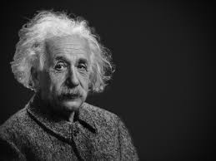
Thought for the day: Einstein
It is simply madness,
to keep doing the same things,
and expect different results.

Slide 19
Outline programme
1300 Introductions and participants’ expectations: post-it round.
1320 Discussion of major trends in teaching, learning and assessment in the present age: ‘what the gurus say’;
1340 How students really learn – seven underpinning factors we can address in our teaching.
1410 Interaction in large groups: some techniques and problems
1430 Refreshment break
1500 Exercise (group) analysing and prioritising attributes of excellent teachers.
1530 Links between learning and assessment and feedback.
1600 Action-planning to enhance student experience.
1630 Close of workshop.

Slide 20
The agenda
In the first part of this workshop, I’d like to get you thinking afresh about how learning happens, and how best we can help students to engage, learning effectively, efficiently, and enjoyably.
I’d like to share my worries about some of the things which I think can get in the way of effective learning, and later share some ideas about what we can do with teaching, feedback and assessment to make learning happen well.

Slide 21
Name labels…
Please write your first name, big and bold, on a coded sticky label, and stick it to your clothing (not onto a fabric which would be damaged).
βA3
Phil

Slide 22
Getting to know each other: a face-to-face thing…
In turn, please..
Say one or two sentences about...
who you are,
where you come from, and
what you do.
In one breath!
(Optional) Share with us one thing that you’re dead good at, or really proud of.

Slide 23
Intended learning outcomes
After participating in this workshop, you should be better-able to:
Identify and address seven factors which underpin student engagement.
Explore interactive processes which can enhance student engagement in large-group contexts.
Analyse and prioritise key characteristics of excellent teachers.
Effectively balance visual and verbal learning contexts.
Link learning effectively to assessment and feedback to students.

Slide 24
VASCULAR learning outcomes (after Brown, 2019)
Verifiable: Can we tell when they’ve been achieved? And can students?
Action orientated: Do they lead to real and useful activity?
Singular: i.e. not portmanteau outcomes combining two or more into one, making it difficult to assess if differently achieved, but readily matchable to student work produced?
Constructively aligned? (Biggs and Tang, 2011) so that there is clear alignment between aims (What do students need to be able to know and do?), what is taught/ learned, how these are assessed and evaluated);
Understandable i.e. using language codes that are meaningful to all stakeholders?
Level-appropriate? Suitable and differentiable between 1st year, 2nd year, 3rd year, Masters, other PG?
Affective-inclusive i.e. not just covering actions but capabilities in the affective domain?
Regularly reviewed? Not just stuck in history and always fit-for-purpose.

Slide 25
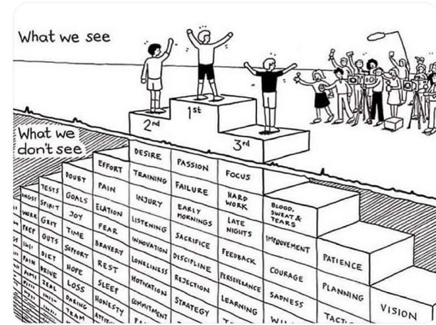
Do we get what we ask for
with intended learning outcomes?
Have we any idea of how many of
these might also have been involved?

Slide 26
Learning, feedback and assessment:
the ten most important words
Why?
What?
Who?
Where?
When?
How?
Which?
So what?
wtf?
Wow?
And the most powerful four-letter word in the English language...
????

Slide 27
‘what’ is getting ever less important
Columbia University research published recently (2011) in Science magazine shows that people are much less prepared to remember ‘what’, but better at remembering where to access information, and how to do so.
Betsy Sparrow, one of the principal researchers, concludes that the internet has become ‘an external memory source that we can access at any time. ... Just as we learn through transactive memory who knows what in our families and offices, we are learning what the computer ‘knows’ and when we should attend to where we have stored information in our computer-based memories. We are becoming symbiotic with our computer tools.
Published Online July 14 2011 < Science Express Index Science DOI: 10.1126/science.1207745
Report: Google Effects on Memory: Cognitive Consequences of Having Information at Our Fingertips Betsy Sparrow,*, Jenny Liu, Daniel M. Wegner

Slide 28
Learning, feedback and assessment:
the ten most important words
Why? (rationale)
What? (content)
Who? (people, you, me, them)
Where? (locations)
When? (times)
How? (processes)
Which? (decisions)
So what? (importance?)
Wow? (impact?)
And the most powerful four-letter word in the English language...
????

Slide 29
Reality Check
Which of the following do you actually spend most of your time on…
Actually teaching students?
Preparing materials to teach students?
Assessing students’ work?
Composing feedback on students’ work?
Giving students feedback?
Voting: A = 2 hands, B = 1 hand
C = touch left ear, D = touch right ear
E = scratch your head

Slide 30
Modern institutions are moving away from being the providers of content, (where everything used to be about ‘delivery’), towards foregrounding two major functions:
Recognising and accrediting students’ achievement, wherever learning has taken place (i.e. getting the assessment right);
Supporting student learning and engagement (not least by making feedback work well for students, and using real-world situations and simulations to bring learning to life).

Slide 31
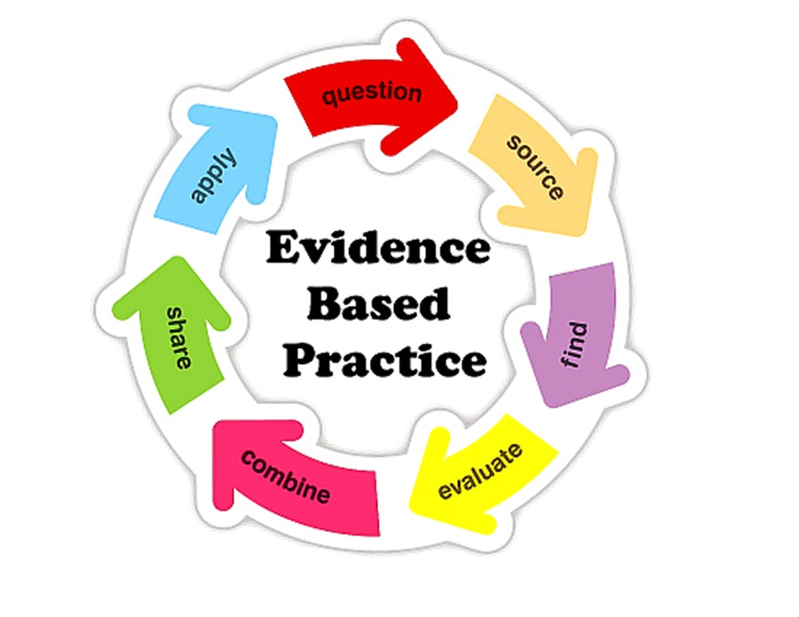

Slide 32
HEA Fellowships? (Professional development relating to teaching, learning and assessment)
How many of you are already: (please raise hands)
Associate Fellow (AFHEA) 23,538
Fellow (FHEA) 75,033
Senior Fellow (SFHEA) 9,557
Principal Fellow (PFHEA) 995
National Teaching Fellow (NTF) c.900
(Numbers at start of 2019; seem to be included in some league tables)

Slide 33
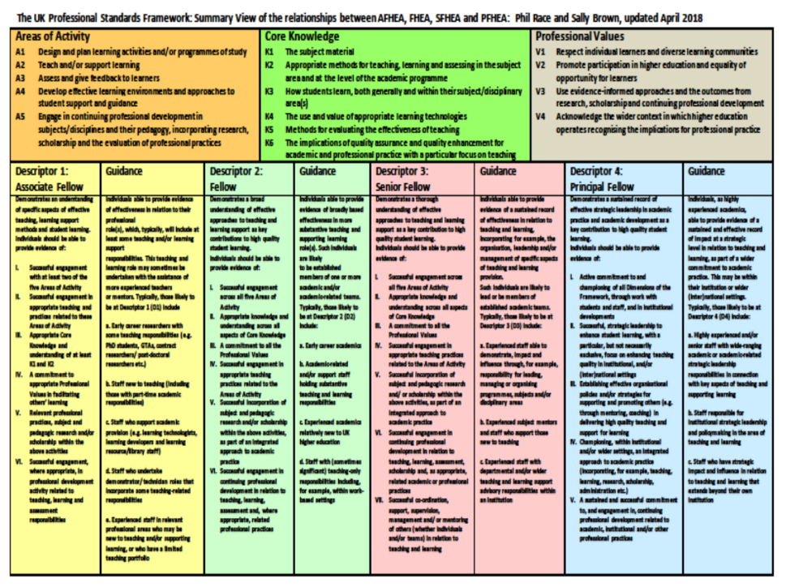

Slide 34
How students really learn
Seven factors underpinning successful learning based on asking everyone about their learning in the last 30 years!

Slide 35
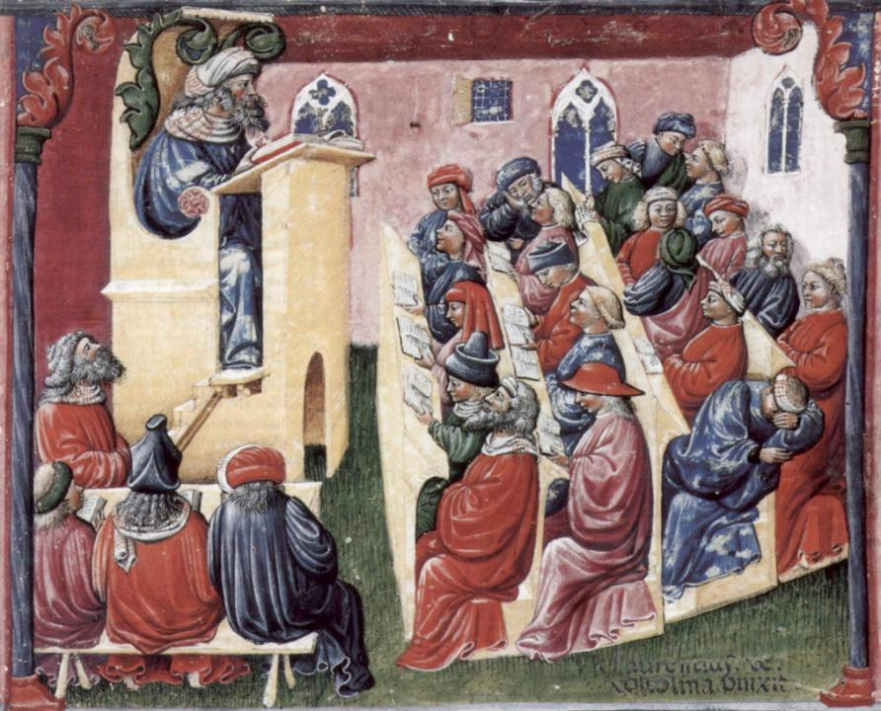
Laurentius de Voltolina
2nd half of 14th Century
Italian Painter

Slide 37
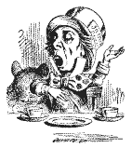
Unless we do something else…
“[The] pupils got it all by heart; and, when Examination-time came, they wrote it down; and the Examiner said ‘Beautiful! What depth!’
They became teachers in their turn, and they said all these things over again; and their pupils wrote it down, and the examiner accepted it; and nobody had the ghost of an idea what it meant” Lewis Carroll, 1893
Active
Experimentation
Abstract
Conceptualisation
Concrete
Experience
Reflective
Observation

Slide 38
Constructive Alignment: John Biggs
What will I be expected to show for this?
What does a good one look like, and a bad one?
Where does this fit into the big picture?
When explaining assessment criteria to students, and when linking these to evidence of achievement of the intended learning outcomes, we need to make the most of face-to-face whole group contexts and...
Tone of voice
Body language
Facial expression
Eye contact
The chance to repeat things
The chance to respond to puzzled looks
Some things don’t work nearly so well just on paper or on screens.
Some of the
tools we can
use in
face-to-face
contexts

Slide 39
How you learn:
Please make a little grid with four boxes, with numbers 1-4 in the corners.
1
2
3
4

Slide 40
1: How do you learn well?
Think (don’t write anything yet) of something that you’re good at, something that you know you do well.
How did you become good at it? Write a few words in box 1.

Slide 41
Most people’s views...
practice
trial and error
having a go
repetition
experimenting

Slide 42
Task: who said this?
‘Learning is experience,
Everything else is just information’
‘Everything should be made as simple as possible,
but not simpler’.
(Albert Einstein, 1879-1955).

Slide 43
The first quote on experiential learning?
“One must learn by doing the thing; though you think you know it, you have no certainty until you try”.
(Sophocles, 495-406 BC)

Slide 44
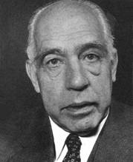
Another...
An expert is a man who has made all the mistakes,
which can be made,
in a very narrow field.
(Niels Bohr, 1885-1962)
Therefore we need to allow learners to make mistakes, and help them to gain feedback in a constructive environment, to help them towards becoming experts.

Slide 45
Next to feelings
The educational psychologists got it wrong last century.
They went into cognition, metacognition, memory and that sort of stuff.
Interesting, but dull.
Much more important: feelings.
Professor Alan Mortiboys gets right into this with his lifechanging work on emotional intelligence.
Meanwhile....

Slide 46
2: What makes you feel good?
Think of something about yourself that you feel good about.
How can you justify feeling good about this? What’s your evidence to support this feeling? Write a few words in box 2.

Slide 47
Most people’s views...
feedback
other people’s reactions
praise
gaining confidence
seeing the results

Slide 48
3: What can go wrong?
Think of something that you’re not good at, perhaps as a result of a bad learning experience.
What went wrong, and whose (if anyone’s) fault may it have been? Write a few words in box 3.

Slide 49
Most people’s views...
did not really want to learn it
could not see the point
bad teaching
could not make sense of it

Slide 50
Is there anyone there?
What station are you broadcasting on?

Slide 51
Which wavelength should I teach on?
The only one that works for today’s students is WIIFM
What’s in it for me?
Consciously address the ‘so what’ in students’ minds;
Warm up their ‘want’ to learn.
Clarify their ‘need’ to learn.
They learn far more readily if they are continuously aware of the benefits for them of putting energy into their learning.

Slide 52
4: And if there isn’t a ‘want’?
Think of something that you did learn successfully, but at the time you didn’t want to learn it.
What kept you going, so that you did indeed succeed in learning it?

Slide 53
Most people’s views...
strong support and encouragement
did not want to be seen not able to do it
needed to do it for what I wanted next

Slide 54
Five of the seven factors underpinning successful learning
learning by doing
learning from feedback
wanting to learn
needing to learn
...

Slide 55
Five of the seven factors underpinning successful learning
learning by doing
learning from feedback
wanting to learn
needing to learn
making sense – ‘getting one’s head round it’

Slide 56
Traditional views...
active experimentation
concrete experience
reflective observation
abstract conceptualisation

Slide 57
Is it a cycle?
Active
Experimentation
Abstract
Conceptualisation
Concrete
Experience
Reflective
Observation

Slide 58
What’s missing in this old cycle?
Engagement?
Feelings?
Active
Experimentation
Inspiration?
Judgments?
Desire?
Abstract
Conceptualisation
Concrete
Experience
Communication?
Enthusiasm?
Reflective
Observation

Slide 59
But what about learning styles?
https://www.theguardian.com/education/2017/mar/12/no-evidence-to-back-idea-of-learning-styles?CMP=share_btn_tw
(Link from my Tweet on March 13th 2017 to a letter in the Guardian by prominent folk around the world of education)
Or link to a word document: https://phil-race.co.uk/2017/09/swansea-university-school-management-21st-September/
“No evidence to back idea of learning styles”

Slide 60
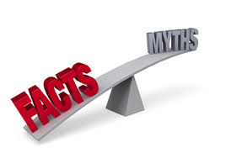

Slide 61
Is this a cycle?
- No! It’s not a cycle
Wanting/Needing
Making sense
Doing
Feedback

Slide 62
Ripples on a pond….
Wanting/
Needing

Slide 63
Ripples on a pond….
Wanting/
Needing
Doing

Slide 64
Ripples on a pond….
Wanting/
Needing
Doing
Making sense

Slide 65
Ripples on a pond….
Wanting/
Needing
Doing
Making sense
Feedback

Slide 66
But there are still two things missing
One has never really ‘got’ something until one has done both of two more things...

Slide 67
5: Think back to your own teaching
Think of something you’ve taught for some time. Think back particularly to the first time you taught it.
To what extent did you find that you ‘had your head around it’ much better after teaching it for the first time?
Very much better: raise two hands
Somewhat better: raise one hand
No better: touch left ear!

Slide 68
Ripples on a pond….
Verbalising
Wanting/
Needing
Doing
Making sense
Feedback

Slide 69
6: Now think about assessing
Still thinking of the first time you taught that particular topic, think back to the first time you measured students’ learning of the topic.
To what extent did you find that after assessing students work, you yourself had ‘made sense’ of the topic even more deeply?
Very much better: raise two hands
Somewhat better: raise one hand
No better: touch left ear!

Slide 70
Ripples on a pond….
Verbalising
Assessing
making informed judgements
Wanting/
Needing
Doing
Making sense
Feedback

Slide 71
What’s wrong
with
this?
Verbalising
Assessing
Feedback
Making sense
Doing
Wanting/
Needing

Slide 72
What’s wrong
with
this?
Verbalising
Assessing
Feedback
Making sense
Doing
Wanting/
Needing

Slide 73
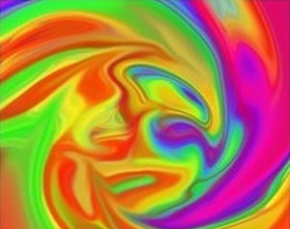
Thanks, Dr Paul Kleiman

Slide 74
Ripples on a pond….
Enhance our students’ want to learn?
Help students to develop ownership of the need to learn?
Keep students learning by doing, practice, trial-and-error, repetition?
Ensure students really use feedback – from us and from each other?
Help students to make sense of what they learn?
Get students deepening their learning by verbalising, explaining things to each other, and to us?
Allow students to deepen their learning by assessing their own learning, and assessing others’ learning – making informed judgements?
What else can we do to:
Verbalising
Assessing
making informed judgements
Wanting/
Needing
Doing
Doing
Making sense
Feedback

Slide 75
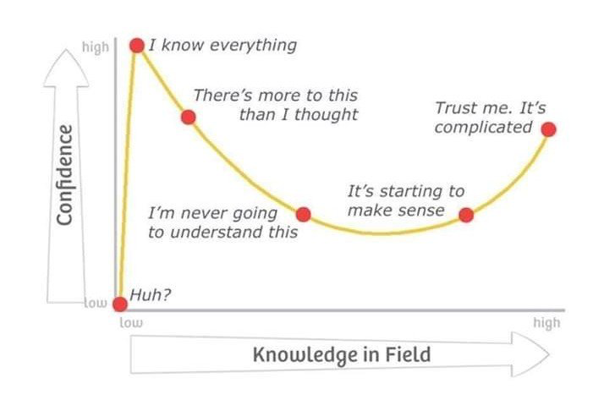
Adapted from Kruger, J. and Dunning, D. 2009

Slide 76
Characteristics of teachers who get engagement going?
Knows subject material thoroughly
Adopts a scholarly approach to the practice of teaching
Is reflective and regularly reviews own practice
Is well organised and plans curriculum effectively
Is passionate about teaching
Has a student-centred orientation to teaching
Regularly reviews innovations in learning and teaching and tries out ones relevant to own context
Ensures that assessment practices are fit for purpose and contribute to learning
Demonstrates empathy and emotional intelligence

Slide 77
Characteristics of excellent teachers: diamond-9
1
2
3
4
5
6
7
8
9

Slide 78
Characteristics of excellent teachers: diamond-9
E,E,H,E
I,F,A,A
D,I,D,I
4
5
6
7
8
J Get students to co-create
Extensively uses active learning
Links to real world
Signposts to big picture
G,A,G,B

Slide 79
Towards assessment as learning
Phil Race
(from Newcastle-upon-Tyne)
BSc PhD PGCE FCIPD PFHEA NTF
Follow Phil on Twitter: @RacePhil
Visiting Professor: University of Plymouth and Edge Hill University
Emeritus Professor, Leeds Beckett University

Slide 80
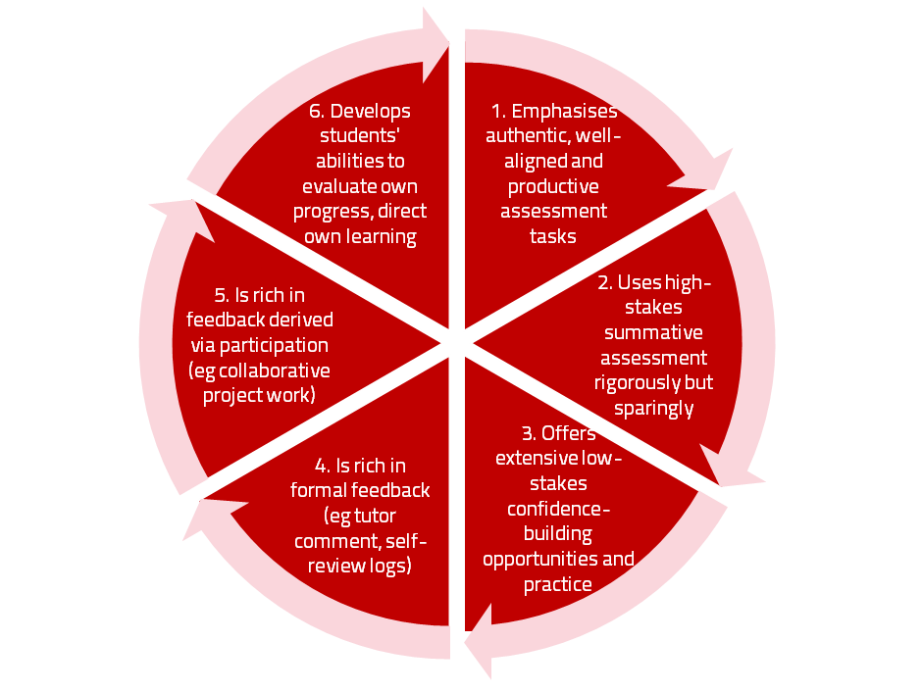
Assessment for learning

Slide 81
Use link below to download the new materials on feedback and assessment produced in 2017-18 by Kay Sambell, Sally Brown and Phil Race for Edinburgh Napier University, (adapted versions for Ireland launched last Thursday in Cork as ‘TACIT guides’)
http://staff.napier.ac.uk/services/dlte/ENhance/Pages/ENhanceQuickGuides.aspx

Slide 82
Rationale
This session starts from the premise that ‘assessment and feedback are broken’ in higher education at present. We spend far too much time doing them, and burn ourselves out, and are not measuring the right things! We will explore what we can do to make assessment and feedback more fit-for-purpose, and help them to be better drivers for students’ learning.

Slide 83
Why re-invent assessment and feedback now?
They take far too much of our time and energy. Staff are burning themselves out trying to apply old assessment and feedback methods to much larger cohorts of students.
Assessment and feedback are vitally important to students.
Feedback from students continues to show their relative dissatisfaction with assessment and feedback.
Assessment and feedback contribute strongly to the NSS, and therefore also to TEF.
It is madness just to keep trying to do the same things better – we need to be ready to try something else.

Slide 84
Reinventing assessment and feedback
Part of the problem is that we tend to keep on trying to use the processes which used to work well enough years ago, but don’t satisfy today’s student needs and expectations – and often student numbers are higher too.
Later in this session, I will outline a number of ideas for making assessment and feedback work towards better partnership with students, and which also make the processes more effective and efficient, and involve students themselves much more closely in the design of assessment and feedback.
https://www.seda.ac.uk/resources/files/publications_214_Educational%20Developments%2018.2.pdf (2017, pp.21-24)

Slide 85
The NSS Assessment and Feedback Agenda (2005-16)
The criteria used in marking have been clear in advance.
Assessment arrangements and marking have been fair.
Feedback on my work has been prompt.
I have received detailed comments on my work.
Feedback on my work has helped me to clarify things I did not understand.

Slide 86
The present NSS statements (2017)
Assessment and feedback
The criteria used in marking have been clear in advance
Marking and assessment have been fair
Feedback on my work has been timely
I have received helpful comments on my work
Student voice
I have had the right opportunities to provide feedback on my course
Staff value students’ views and opinions about the course
It is clear how students’ feedback on the course has been acted on

Slide 87
Experience of Royce Sadler on standards, assessment and feedback
Well worth looking at this clip from Coursera from Royce Sadler, who’s work informs much of the modern thinking on assessment and feedback…

Slide 88
We can’t carry on trying to use traditional assessment and feedback processes
We can’t continue trying to give students lots of feedback in traditional ways, as there are more students, and research shows that merely ‘telling’ them what to do with their work does not work.
There is now a great deal of work on ‘contract cheating’, for example Newton, P. (2018) https://www.frontiersin.org/articles/10.3389/feduc.2018.00067/full
And traditional written feedback doesn’t work: “Approaches that emphasise feedback as telling are insufficient because students are often not equipped to decode or act on statements satisfactorily, so key messages remain invisible” (Sadler 2010).

Slide 89
Drives most learning
Is assessment broken?
Some
assessment
issues
We know
what students think
Assessment as learning
Validity
Whodunit?
Fairness

Slide 90
My main worries about assessment...
Too often, we still tend to try to measure...
...what’s in students’ heads, and what they can do with what’s there...
in terms of two unsatisfactory proxies ...
what comes out of students’ pens in exams;
2. what comes out of their keyboards in essays and reports.

Slide 91
Boud et al 2010: ‘Assessment 2020’
Assessment has most effect when...:
It is used to engage students in learning that is productive.
Feedback is used to actively improve student learning.
Students and teachers become responsible partners in learning and assessment.
Students are inducted into the assessment practices and cultures of higher education.
Assessment for learning is placed at the centre of subject and program design.
Assessment for learning is a focus for staff and institutional development.
Assessment provides inclusive and trustworthy representation of student achievement.

Slide 92
Boud et al, 2010
David Boud (University of Technology, Sydney), Royce Sadler (Griffith University), Gordon Joughin (University of Wollongong), Richard James (University of Melbourne), Mark Freeman (University of Sydney), Sally Kift (Queensland University of Technology), Filip Dochy (University of Leuven), Dai Hounsell (University of Edinburgh), Margaret Price (Oxford Brookes University), Tom Angelo (La Trobe University), Angela Brew (Macquarie University), Ian Cameron (University of Queensland), Denise Chalmers (University of Western Australia), Paul Hager (University of Technology, Sydney), Kerri-Lee Harris (University of Melbourne), Claire Hughes (University of Queensland), Peter Hutchings (Australian Learning and Teaching Council), Kerri-Lee Krause (Griffith University), Duncan Nulty (Griffith University), Ron Oliver (Edith Cowan University), Jon Yorke (Curtin University), Iouri Belski (RMIT University), Ben Bradley (Charles Sturt University), Simone Buzwell (Swinburne University of Technology), Stuart Campbell (University of Western Sydney), Philip Candy (University of Southern Queensland), Peter Cherry (Central Queensland University), Rick Cummings (Murdoch University), Anne Cummins (Australian Catholic University), Elizabeth Deane (Australian National University), Marcia Devlin (Deakin University), Christine Ewan (Australian Learning and Teaching Council), Paul Gadek (James Cook University), Susan Hamilton (University of Queensland), Margaret Hicks (University of South Australia), Marnie Hughes-Warrington (Monash University), Gail Huon (University of Newcastle), Margot Kearns (University of Notre Dame, Sydney), Don Maconachie (University of the Sunshine Coast), Vi McLean (Queensland University of Technology,) Raoul Mortley (Bond University), Kylie O’Brien (Victoria University), Gary O’Donovan (University of Tasmania), Beverley Oliver (Curtin University), Simon Pyke (University of Adelaide), Heather Smigiel (Flinders University), Janet Taylor (Southern Cross University), Keith Trigwell (University of Sydney), Neil Trivett (University of Ballarat), Graham Webb (University of New England).

Slide 93
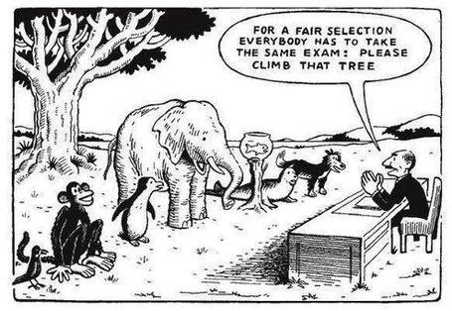

Slide 94
The read-write industry

Slide 95
In the exam room you’re on your own

Slide 96
Ten Concerns about exams
These ten concerns are about time-constrained unseen written examinations.
As we explore these, think of how other forms of exam can get round some of these concerns...
open book
open notes
time unconstrained
take-away
in-tray
multiple-choice
others….

Slide 97
Ripples on a pond….
Concerns about traditional exams
Coaching,
explaining, teaching
Assessing
making informed judgements
They don’t do much to increase the ‘want’ to learn.
They are not ideal occasions for learning-by-doing.
The amount of feedback that students receive is not optimal.
They don’t do much to help students to make sense of what they have learned.
Wanting/
Needing
Doing
Doing
Making sense
Feedback

Slide 98
Concerns about traditional exams
We mark them in a rush.
We’re often tired and bored when we mark them.
We’re not good at marking them objectively.
They favour candidates who happen to be skilled at taking exams.
They force students into surface learning, and into rapidly clearing their minds of previous knowledge when preparing for the next exam.
There are many important things which they don’t measure.

Slide 99
Ripples on a pond….
If students are under too much pressure, the want to learn is damaged.
The range of learning-by-doing may be too narrow.
Feedback may be eclipsed by marks or grades.
Students may not have the opportunity to make sense of the feedback they receive.
Coaching,
explaining, teaching
Concerns about continuous assessment
Assessing
making informed judgements
Wanting/
Needing
Doing
Doing
Making sense
Feedback

Slide 100
Concerns about continuous assessment
It may be hard to detect unwanted collaboration.
Too much time may be involved in marking.
Students may not be aware of the criteria used to assess their work.
Students may get the balance wrong between continuous assessment and exams.
Learning may become driven by assessment, and students may only do those things that are assessed.
Too little use may be made of the learning that can be achieved when students assess their own, and each other’s work.

Slide 101
Five main problems with assessed essays
They take a great deal of time to mark, let alone the time it takes for students to prepare, draft and compose them.
When most assessment is in the form of essays, students’ skills at essay-writing are repeatedly tested, as the expense sometimes of their understanding of the subject.
Lots of research shows that we’re not at all good at marking essays fairly – different assessors often give the same essay very different marks.
Essay marks in the UK tend to lie between 35% for a poor one and 75% for a very good one, whereas in many other disciplines the marks for an assignment like a lab report can range across the whole 0-100% span more evenly.
With coursework essays, there can be doubt about ‘whodunit?’!

Slide 102
Feed-forward
Language of feedback
Some feedback
issues
National Student Survey
Timing:
24-hours!
Written, printed,
on-screen
Efficiency
Face to face
oral

Slide 103
David Carless (on Twitter):
Feedback as telling is seriously overrated!

Slide 104
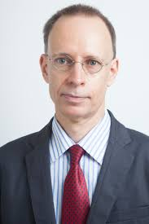
Developing students’ feedback literacy
The danger with traditional methods of assessment and feedback is that assessment tends to be done on student’s work by staff, and feedback tends to be one-directional from staff to students.
Carless and Boud (2018) stress that we want students to gain skills in making ‘evaluative judgements’ themselves on their work, rather than staff doing this.
David Carless & David Boud (2018): The development of student feedback literacy: enabling uptake of feedback, Assessment & Evaluation in Higher Education, https://doi.org/10.1080/02602938.2018.1463354

Slide 105
Factors underpinning feedback literacy
Carless and Boud (2018) examine in detail:
Appreciating feedback
Making judgements
Managing affect
Taking action
We need to enable our students to optimise each of these processes, if we wish to use assessment to promote their learning. They suggest that involving students in giving and receiving peer feedback, and in analysing exemplars, should be essential parts of the curriculum.

Slide 106
Feedback needs to have a future focus
Hounsell et al argue that we need to:
‘increase the value of feedback to the students by focusing comments not only on the past and present … but also on the future – what the student might aim to do, or do differently in the next assignment or assessment if they are to continue to do well or to do better’
(Hounsell, McCune, Hounsell and Litjens 2008, p.5).

Slide 107
Feedback and emotions
Probably feedback is for many people the most emotionally charged experience linked to assessment?
How best can we help bring ‘compassion’ into feedback?
It is well worth giving 20 minutes to watch this: (Theo Gilbert and others) https://www.youtube.com/watch?v=3jFVTCuSCOg …​ particularly on how we can help students to learn how to get more from feedback from each other as well as us.

Slide 108
Task: think about ghastly feedback
Think back to some occasions, academic or otherwise, historic or recent when you received feedback that you would rather not have received;
How did it make you feel?
Thinking of a single example of ghastly feedback that you are prepared to share with another person, briefly outline the context and say why it was such a negative experience.

Slide 109
Reinventing Assessment Fifteen ideas for making assessment and feedback more effective, efficient and manageable for us, and for students
https://www.seda.ac.uk/resources/files/publications_214_Educational%20Developments%2018.2.pdf (2017, pp.21-24)

Slide 110
Fifteen ideas for making assessment and feedback more effective, efficient and manageable for us, and for students
Design much shorter assessments.
Increase formative assessment and reduce summative assessment.
Don’t just use essays.
Make more use of oral feedback rather than written feedback.
Speed up feedback so students still care about it when they receive it.
Get students giving feedback to each other, and sharing feedback.
Let students right into the meaning of assessment criteria, by explaining and illustrating these in whole-group contexts such as lectures.
Show students a range of evidence of achievement.
Get students themselves formulating evidence of achievement.
Get students themselves designing and applying assessment criteria.
Make the most of feedback to students in small-group contexts, such as tutorials.
Use statement banks to speed up formulating useful feedback.
Get students self-assessing, and give them feedback on their self-assessment.
Try to avoid ‘final language’ in feedback.
Always make assignment design a team effort.

Slide 111
A Design much shorter assessments
(e.g. a 300-word annotated bibliography instead of a 3000-word essay).
We tend to keep using long assessments, because that’s what we’ve always done. As a result, we spend ages marking, and too little time assessing.
Students learn to ‘waffle’ with long assessments. A short assessment can be harder, and more intense. And we achieve better discrimination between best and worst.
Shorter assessments are much, much faster to assess.
Research shows we can actually assess short assessments much more reliably!

Slide 112
B Increase formative assessment and reduce summative assessment
We know that students learn little or nothing from feedback on summative assessments.
Some don’t even collect their marked work.
Students often don’t learn from feedback on supposedly-formative assessments, as they’ve already moved on to the next task.
Formative assessment can be a great learning experience.
Students’ final results can benefit enormously from formative feedback.

Slide 113
C Don’t just use essays
Essays take ages to write, and ages to mark. And we may not know who wrote them! http://phil-race.co.uk/whodunit/
Essays can be fine for giving students feedback, but not for assessment!
Research shows we’re not at all good at assessing essays. Yet the mark or grade becomes much more important to students than the feedback.
Marking can degenerate into copy-editing rather than assessing.
Students are well aware whenever assessment is at all unfair.

Slide 114
D Make more use of oral feedback rather than written feedback
Face-to-face feedback can make good use of tone of voice, encouraging facial gestures, speed of speech, repetition where needed, body language, and so on.
Students in large groups can learn from oral feedback on other students’ triumphs and disasters (with due anonymity).
Even one-to-one, oral feedback can be much more powerful than written.
Oral feedback can be retained and reviewed if ‘packaged up’ in podcasts or audio files.

Slide 115
E Speed up feedback so students still care about it when they receive it
We’ve become preoccupied with the turn-around time for a batch of work for large groups of students.
A lot of feedback can be given at the moment the work is submitted, before marking has even begun.
Immediate feedback means that students still remember what they did – and what they had problems with.
Ideally, give feedback within 24 hours of students doing the work? (https://phil-race.co.uk/2014/01/feedback-24-hours/ )

Slide 116
F Get students giving feedback to each other, and sharing feedback
Students learn a great deal from the process of explaining things to someone else.
It’s often easier to learn from someone who has just mastered a concept than from someone who can’t remember the difficulties learning it.
Students can benefit from much more feedback than we could give them.
Students can learn much more from our feedback to their friends, than our feedback on their own work.

Slide 117
G Let students right into the meaning of assessment criteria, by explaining and illustrating these in whole-group contexts such as lectures
There should be no hidden agendas. Talk assessment every time you see whole groups of students.
Try to avoid talking assessment to individual students seeking to ‘get ahead’.
Make it clear how assessment criteria link to evidence of achievement of published learning outcomes.
Give students safe practice at evidencing their achievement of assessment criteria.

Slide 118
H Show students a range of evidence of achievement
Don’t just show students exemplars of ‘excellent work’.
Let them see what can easily go wrong, and can lose them marks.
When students are aware of a range between ‘excellent’ and ‘poor’, they can strive to be even better than excellent.
The tendency to simply imitate excellent work is diminished.
(See the work of Royce Sadler)

Slide 119
I Get students themselves formulating evidence of achievement
When students have a feeling of ownership of their targets, they put much more into achieving the targets.
When students formulate ‘good’ evidence, we can praise their choices.
When students formulate ‘poor’ evidence, we can point them in a better direction.
We can adopt their targets, when they are better than the ones we first thought of!

Slide 120
J Get students themselves designing and applying assessment criteria
Learning by assessing – ‘making informed judgements’ – is one of the deepest forms of learning.
We can easily give students relevant things to assess in class time, and benefit from dialogue.
Students can often think of better assessment criteria than the ones we first thought of ourselves.
Applying assessment criteria helps students to internalise how to achieve them in their own work.

Slide 121
K Make the most of feedback to students in small-group contexts, such as tutorials
This can be less threatening than one-to-one feedback (oral or written), especially critical feedback, and can be much more manageable for us.
Let students hear feedback on work that is better than theirs (retaining anonymity).
Let students hear feedback on other students’ disasters (retaining anonymity).
Allow students to see ‘where they’re at’ compared to others in the cohort.

Slide 122
L Use statement banks to speed up formulating useful feedback
Especially with online feedback, compile a bank of useful feedback statements.
Make sure that there are sufficient ‘praise’ comments, to counterbalance critical ones.
Get students themselves to compose statements, so that they get a sharper idea of what is wanted in their work.
Make sure that the feedback that different students receive is sufficiently different and personal, rather than just ‘out of the box’.

Slide 123
M Get students self-assessing, and give them feedback on their self-assessment.
Turn self-assessment into a productive dialogue with us.
Ask students what mark or grade they believe the work should be earning.
Ask students what they think they did best, and praise them when indeed they did do this well.
Ask students what they found the hardest part of the task, and praise them when they succeeded, and empathise when they didn’t.
Ask students what they might change if they had another hour to do the task.

Slide 124
N Try to avoid ‘final language’ in feedback
‘Final language’ includes words such as ‘excellent’, ‘good’, ‘poor’, ‘adequate’, ‘satisfactory’, and so on – it doesn’t give students ‘anywhere to go next’.
It is better to say things such as:
‘I really like how you approached so-and-so’
‘It might have helped if you’d done such-and such’
‘One thing you did really well was so-and-so’
‘You probably know that such-and-such didn’t really work’

Slide 125
O Always make assessment design a team effort
It doesn't make sense to do this alone without running your ideas past a colleague, quality assurer, student or all three.
This can help avoid the biggest pitfalls around assuring manageability, authenticity, relevance and validity.
Students can be particularly useful sounding boards to ensure that what you are asking students to do is clear and readily understandable.
You won't get into glitches around university systems and regulations if you talk things through in advance with a Faculty manager or registrar.

Slide 126
Fifteen ideas for making assessment and feedback more effective, efficient and manageable for us, and for students
Design much shorter assessments.
Increase formative assessment and reduce summative assessment.
Don’t just use essays.
Make more use of oral feedback rather than written feedback.
Speed up feedback so students still care about it when they receive it.
Get students giving feedback to each other, and sharing feedback.
Let students right into the meaning of assessment criteria, by explaining and illustrating these in whole-group contexts such as lectures.
Show students a range of evidence of achievement.
Get students themselves formulating evidence of achievement.
Get students themselves designing and applying assessment criteria.
Make the most of feedback to students in small-group contexts, such as tutorials.
Use statement banks to speed up formulating useful feedback.
Get students self-assessing, and give them feedback on their self-assessment.
Try to avoid ‘final language’ in feedback.
Always make assignment design a team effort.

Slide 127
Pick the best 9 ideas:
Diamond 9
best
next best
3
4
5
6
7
8
9

Slide 128
Your results...

Slide 129
Back to our intended learning outcomes
Do you now feel better-able to:
(raise two hands = very much better,
Raise one hand = somewhat better
Scratch left ear = no better)
Identify and address seven factors which underpin student engagement?
Explore interactive processes which can enhance student engagement in large-group contexts?
Analyse and prioritise key characteristics of excellent teachers?
Effectively balance visual and verbal learning contexts?
Link learning effectively to assessment and feedback to students?

Slide 130
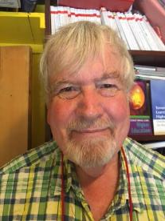
Thank you…
Website: http://phil-race.co.uk
Follow Phil @RacePhil
e-mail: phil@phil-race.co.uk

Slide 131
Useful references and further reading (1)
Bain, K. (2004) What the best College Teachers do, Cambridge: Harvard University Press.
Biggs, J. and Tang, C. (2011) Teaching for Quality Learning at University, Maidenhead: Open University Press.
Bloxham, S. and Boyd, P. (2007) Developing effective assessment in higher education: a practical guide, Maidenhead, Open University Press.
Boud, D. (1995) Enhancing learning through self-assessment, London: Routledge.
Brown, S. and Glasner, A. (eds.) (1999) Assessment Matters in Higher Education, Choosing and Using Diverse Approaches, Maidenhead: Open University Press.
Brown, S. and Race, P. (2012) Using effective assessment to promote learning in Hunt, L. and Chambers, D. (2012) University Teaching in Focus, Victoria, Australia, Acer Press. P74-91.
Brown, S. (2015) Learning , Teaching and Assessment in Higher Education: Global perspectives, London, Palgrave.
Carless, D., Joughin, G., Ngar-Fun Liu et al (2006) How Assessment supports learning: Learning orientated assessment in action Hong Kong: Hong Kong University Press.
Carless, D. and Boud, D. (2018): The development of student feedback literacy: enabling uptake of feedback, Assessment & Evaluation in Higher Education, https://doi.org/10.1080/02602938.2018.1463354

Slide 132
Useful references and further reading (2)
Carroll, J. and Ryan, J. (2005) Teaching International students: improving learning for all. London: Routledge SEDA series.
Crosling, G., Thomas, L. and Heagney, M. (2008) Improving student retention in Higher Education, London and New York: Routledge
Crooks, T. (1988) Assessing student performance, HERDSA Green Guide No 8 HERDSA (reprinted 1994).
Dunworth, K. and Sanchez, H.S., (2016). Perceptions of quality in staff-student written feedback in higher education: a case study. Teaching in Higher Education, 21(5), pp.576-589.
Dweck, C. S. (2000) Self Theories: Their Role in Motivation, Personality and Development, Lillington, NC: Taylor & Francis.
Falchikov, N. (2004) Improving Assessment through Student Involvement: Practical Solutions for Aiding Learning in Higher and Further Education, London: Routledge.
Gibbs, G. (1999) Using assessment strategically to change the way students learn, in Brown S. & Glasner, A. (eds.), Assessment Matters in Higher Education: Choosing and Using Diverse Approaches, Maidenhead: SRHE/Open University Press.
Higher Education Academy (2012) A marked improvement; transforming assessment in higher education, York: HEA.

Slide 133
Useful references and further reading (3)
Hawe, E., Lightfoot, U., & Dixon, H. (2017). First-year students working with exemplars: Promoting self-efficacy, self-monitoring and self-regulation. Journal of Further and Higher Education, 1-15.
Hendry, G. D., White, P., & Herbert, C. (2016). Providing Exemplar-Based “Feedforward” before an Assessment: The Role of Teacher Explanation. Active Learning in Higher Education, 17(2), 99-109.
Hounsell, D., McCune, V., Hounsell, J. and Litjens, J., (2008). The quality of guidance and feedback to students. Higher Education Research & Development, 27(1), pp.55-67.
Newton, P. M. (2018) How Common Is Commercial Contract Cheating in Higher Education and Is It Increasing? A Systematic Review https://www.frontiersin.org/articles/10.3389/feduc.2018.00067/full
Nicol, D. J. and Macfarlane-Dick, D. (2006) Formative assessment and self-regulated learning: A model and seven principles of good feedback practice, Studies in Higher Education Vol 31(2), 199-218.
PASS project Bradford http://www.pass.brad.ac.uk/ Accessed January 2019.
Pickford, R. and Brown, S. (2006) Assessing skills and practice, London: Routledge.
Rotheram, B. (2009) Sounds Good, JISC project http://www.jisc.ac.uk/whatwedo/programmes/usersandinnovation/soundsgood.aspx

Slide 134
Useful references and further reading (4)
Race, P. (2001) A Briefing on Self, Peer & Group Assessment https://phil-race.co.uk/archive-of-downloads-from-previous-website/
Race, P. (2014) Making Learning Happen (3rd edition), London: Sage.
Race, P. (2015) The lecturer’s toolkit (4th edition), London: Routledge.
Race, P. (2017) Fifteen ideas for making assessment and feedback more effective, efficient and manageable for us, and for students: SEDA Developments https://www.seda.ac.uk/resources/files/publications_214_Educational%20Developments%2018.2.pdf (accessed January 2019)
Rust, C., Price, M. and O’Donovan, B. (2003) Improving students’ learning by developing their understanding of assessment criteria and processes, Assessment and Evaluation in Higher Education. 28 (2), 147-164.
Scoles, J., Huxham, M., & McArthur, J. (2013). No longer exempt from good practice: Using exemplars to close the feedback gap for exams. Assessment & Evaluation in Higher Education, 38(6), 631-645.
Sadler, D. Royce (2010) Beyond feedback: developing student capability in complex appraisal, Assessment & Evaluation in Higher Education, 35: 5, 535-550.

