Slide 1
‘Beyond the Tyranny of learning outcomes?’
28th March 2019 ANTF Symposium,
Birmingham City University
Phil Race
(from Newcastle-upon-Tyne)
BSc PhD PGCE FCIPD PFHEA NTF
Follow Phil @RacePhil
Visiting Professor: University of Plymouth and Edge Hill University
Emeritus Professor, Leeds Beckett University

Slide 2
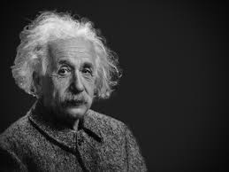
Thought for the day: Einstein
It is simply madness,
to keep doing the same things,
and expect different results.

Slide 3
About Phil…
First a musician
Then a writer
Then a scientist
Then a researcher
Then a lecturer and warden at what is now USW
Got interested in how students learn
And the effects assessment and feedback have on them
And how we teach them
Gradually became an educational developer
And retiring in June!
Currently…
Visiting Prof: Plymouth & Edge Hill
Emeritus Prof: Leeds Beckett
Based at Newcastle, UK
And on trains
And an expert…
on train routes and timetables!
Notes:
2
2

Slide 4
Summary
A provocative and interactive session, looking at what can go wrong with intended learning outcomes (for students and for staff) as presently used in curriculum design, and exploring creative enhancements we can make so they become much more fit for purpose, not least VASCULAR learning outcomes!

Slide 5
Slides and links
You’ll be able to download these slides from my website, after I get home to Newcastle, or possibly before, on http://phil-race.co.uk
Usual rules apply: £1 immediately to the first spotter of each of the first three typos or spelling errors.

Slide 6
Intended learning outcomes?
By the end of this session, participants will be able to:
Think again about the benefits – and pitfalls – for students and for staff, of intended learning outcomes as they are presently employed.
Explore how intended learning outcomes can be extended (or sometimes replaced?) by collecting learning incomes of students, collecting and evaluating students’ emergent learning outcomes, and formulating intended learning outgoings into the curriculum.
Breath life into the whole picture of outcomes, by VASCULAR approaches (Sally Brown, 2019)
https://sally-brown.net/2019/03/08/invigorating-the-curriculum-with-vascular-learning-outcomes/

Slide 8
Rationale
This workshop will use the experiences (good and bad) of participants on the ways intended learning outcomes are presently used.
Using learning outcomes may have been a significant step forward in curriculum design, replacing content-based lists of topics, but perhaps it is timely to re-visit such key questions such as: to what extent can further developing the ways we use intended learning outcomes improve the learning experience of students, and the teaching approaches of staff?

Slide 9
Abstract
With the widespread adoption of ‘constructive alignment’ approaches, that we’ve all been expected to swear allegiance to over the last couple of decades, I’ve become increasingly worried that ‘intended learning outcomes’ have become too dominant in the overall picture of how we structure our teaching, and how we try to measure students’ learning…..
This workshop aims to allow us to bring our collective experience to bear on working out how we can reconsider how, where, when – and indeed whether the intended learning outcomes we use to define student learning fit in, and what else we may need to do to harmonize our teaching and provision to students’ lived experience of learning.

Slide 10
SMART learning outcomes?
Specific,
Measureable,
Achievable,
Realistic,
Time-constrained.

Slide 11
Task 1
On a purple post-it, please jot down a few words about what you want from this session.
On a blue post-it, please jot down a word or two about what you’re already bringing to this session?
Now please swap post-its randomly.
If chosen, please read out what’s on the post-its you now have, with passion and drama.
Please stick them up on a chart or wall.

Slide 12
Constructive Alignment: John Biggs
What will I be expected to show for this?
What does a good one look like, and a bad one?
Where does this fit into the big picture?
When explaining assessment criteria to students, and when linking these to evidence of achievement of the intended learning outcomes, we need to make the most of face-to-face whole group contexts and...
Tone of voice
Body language
Facial expression
Eye contact
The chance to repeat things
The chance to respond to puzzled looks
Some things don’t work nearly so well just on paper or on screens.
Some of the
tools we can
use in
face-to-face
contexts

Slide 13
“Micro-management of learning is killing creativity” Learning outcomes are very well intentioned, but their use discourages students from thinking outside the tick box, says Robert Nelson (July 12, 2018 THE)
“Internationally, education discourages imaginative growth. Institutions all say that they want creativity to be cultivated and it is often mentioned as a graduate attribute. But the grid of expectations around individual courses makes engaging the imagination uncompetitive for all but an exceptionally talented elite”.

Slide 14
These concerns are not new!
Westera (2001):
…The competence concept is quite troublesome, and it is argued that the term has no significance beyond that which is associated with the term ‘skills’.

Slide 15
“We don’t need those learning outcomes” : Paul Kleiman reports…
“Through the introduction of the new assessment model we have seen a significant improvement in assessment participation and achievement. In a single academic year modular failure has reduced from 18.70% to 0.37%, non-submissions from 10.43% to 0% and extenuating circumstances from 17.39% to 6.59%. The model has made space for teaching staff to spend more time with students.”
Via Twitter, on Kleiman, 2018

Slide 16
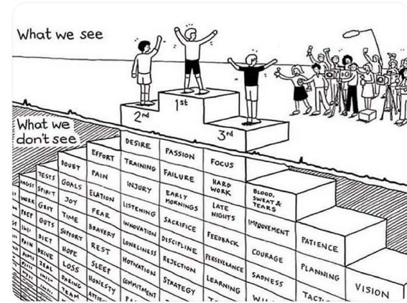
Do we get what we ask for
with intended learning outcomes?
Have we any idea of how many of
these might also have been involved?

Slide 17
Art and Design Pedagogy in Higher Education: Knowledge, Values and Ambiguity in the Creative Curriculum (Routledge Research in Higher Education) Hardcover: 2017
Susan Orr and Alison Shreeve
https://vimeo.com/293922682

Slide 18
Matters arising?
I hope to ask you to share your experience regarding:
Why and how learning outcomes may have become ‘a tyranny’?
What else, with hindsight, might be now be included in the ways we use intended outcomes, and what, with foresight, could be added to our approaches?
How might we make better use of students ‘learning incomes’?
Can we improve things by finding out about emergent learning outcomes which occur? (Are these often more important than the intended ones?).
How best can we address learning outgoings – important aspects of learning that can’t be assessed, but will be really valuable five years later in career?
How can Sally’s VASCULAR approach remedy the problems?

Slide 19
Learning incomes
These may be different for each different learner. By learning incomes, I mean all the things learners are bringing to the learning situation. These include:
what they already know about the subject
what they can already do, related to the subject
other things in their experience which they can link to the new subject.
(Race, 2014)

Slide 20
Benefits of learning incomes: they help us to:
avoid spending too much time telling the class all sorts of things they already know. We still may need to cover some of these things for the sake of the learners who don’t yet know them, but we can minimize the tedium for those who already do know them.
give learners the chance to explain things they already know to each other – the explainers learn a great deal and we avoid boring them with our own explanations.
spot misconceptions that some of our learners may have about things we’re going to build on. We can then put them right on these as we introduce topics.
build on what members of the class want to find out. This helps learners to feel an increased degree of ownership of what we tell them – in effect, we’re structuring the curriculum around their questions.
(Race, 2014)

Slide 21
VASCULAR learning outcomes
https://sally-brown.net/2019/03/08/invigorating-the-curriculum-with-vascular-learning-outcomes/
Verifiable: Can we tell when they’ve been achieved? And can students?
Action orientated: Do they lead to real and useful activity?
Singular: i.e. not portmanteau outcomes combining two or more into one, making it difficult to assess if differently achieved, but readily matchable to student work produced?
Constructively aligned? (Biggs and Tang, 2011) so that there is clear alignment between aims (What do students need to be able to know and do?, What is taught / learned, how these are assessed and evaluated);
Understandable i.e. using language codes that are meaningful to all stakeholders?
Level-appropriate? Suitable and differentiable between1st year, 2nd year, 3rd year, Masters, other PG, NTFs?
Affective-inclusive i.e. not just covering actions but capabilities in the affective domain?
Regularly reviewed? Not just stuck in history and always fit-for-purpose.

Slide 22
What are your emergent learning outcomes from the last 40 mins?
Volunteers?

Slide 23
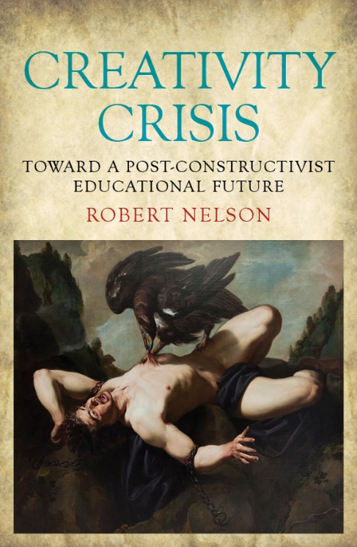
References
Kleiman, P. (2017) ‘Case Study 2 “We Don’t Need Those Learning Outcomes”: assessing creativity and creative assessment’ in Evans, C. and Elkington, S., Transforming Assessment In Higher Education. York: HEAcademy
Nelson, R. (2018) Creativity Crisis: Toward a Post-constructivist Educational Future: Monash University Press;
‘Micro-management of learning is killing creativity Learning outcomes are very well intentioned, but their use discourages students from thinking outside the tick box’ THE, July 12
Race, P. (2014) Making learning happen: 3rd edition, London: Sage.
Westera, W. (2001) Competences in education: a confusion of tongues, j. curriculum studies, 2001, vol. 33, no. 1, 75–88.
Race, P (2019) Beyond the tyranny of learning outcomes, The Lecturer’s Toolkit, 5th editon, if ever finished!

Slide 24
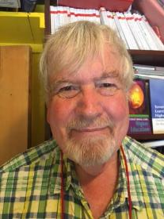
Thank you…
Website: http://phil-race.co.uk
Follow Phil @RacePhil
e-mail: phil@phil-race.co.uk

