Slide 1
Enhancing student experience of classroom engagement
8th May 2019
Kings Inn College of Law, Dublin
Phil Race
(from Newcastle-upon-Tyne)
BSc PhD PGCE FCIPD PFHEA NTF
Follow Phil on Twitter: @RacePhil
Visiting Professor: University of Plymouth and Edge Hill University
Emeritus Professor, Leeds Beckett University

Slide 2
This slide has two purposes….
To focus the data projector, if necessary, and…
...to persuade colleagues never to put this sort of detail onto a slide!

Slide 3
Looking across the Tyne from outside the Sage, Gateshead

Slide 5
About Phil…
First a musician
Then a writer
Then a scientist
Then a researcher
Then a lecturer and warden at what is now USW
Got interested in how students learn
And the effects assessment and feedback have on them
And how we teach them
Gradually became an educational developer
And retiring in June!
Currently…
Visiting Prof: Plymouth & Edge Hill
Emeritus Prof: Leeds Beckett
Based at Newcastle, UK
And on trains
And an expert…
on train routes and timetables!
Notes:
2
2

Slide 6
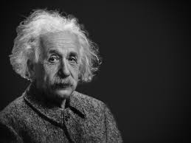
Thought for the day: Einstein
It is simply madness,
to keep doing the same things,
and expect different results.

Slide 7
How many of you were with me on Saturday 15th May 2010?
I ran a session on smarter teaching of large and small groups.
Anyone remember anything in particular about what we did 9 years ago?

Slide 8
Your request
To address:
maximising student performance in tutorials;
dealing with students of different levels of ability.
I interpret this as maximising engagement of students particularly in small groups, and when the students have different starting places.

Slide 9
Setting your priorities?
1
Urgent and important
2
Urgent,
not Important
3
Not urgent,
but important
4
Not urgent,
not important

Slide 10
The three questions always in each student’s mind…
What will I be expected to show for this?
What does a good one look like, and a bad one?
Where does this fit into the big picture?

Slide 11
You will be able to download my main slides
You don’t need to take notes.
I’ll put the main slides I use up on my website tonight (http://phil-race.co.uk/)
I may sometimes go through slides quite fast, but you can study them as you wish at your leisure.

Slide 12
5 reasons for making groupwork work for students
When you ask students several years down the line what was the most productive experiences they had while learning, they will often refer to group activities;
Group work can be helpful in preventing students feeling isolated, which can be the case if much of their study time is solitary;
Group work can provide contexts in which theory learned on courses can be applied to practical contexts, and can help to bring the learning to life for students;
The ability to manage interpersonal issues that often arise within group work are key graduate attributes, required by almost every career or profession;
Employers have been telling us for years that they want to employ people capable of working straightaway as team members.

Slide 13
Time-constrained Post-it exercise
On a post-it, in your best handwriting, please write your own completion of the starter:
“making student engagement happen effectively would be much better for me if only I …”
Please swap post-its so that you’ve no idea who has yours.
If chosen, please read out with passion and drama the post-it you now have.
Please place them all on the chart as directed.

Slide 14
You can download free much of my published work
http://phil-race.co.uk/2016/04/updated-powerpoint-ripples-model/ (Chapter 1 from ‘The Lecturer’s Toolkit, 2015)
https://phil-race.co.uk/2014/12/making-small-group-teaching-work/ (where you can download Chapter 4 of the Toolkit)
http://phil-race.co.uk/2017/05/lectures-and-learning/ (extracts on lecturing)

Slide 15
Mobile phones and laptops...
Please turn on your ‘phones, tablets and laptops.
Please post your thoughts, questions, comments and ideas during this session to the hashtag #philatKingsInn19 Thanks!
Try #LTHEchat on Wednesday evenings from 20.00-21.00.

Slide 16
#LTHEchat is held on Wednesdays, term-time, 8-9 pm:, one hour, one or two convenors, 6 questions, c.200 international participants.

Slide 17
Students as partners…
Students are partners in learning.
They always have been.
We can’t do their learning for them, or without them.
We haven’t always made it an optimal partnership.
We can.
I could not do what I do nowadays if I did not continue to spend a fair bit of my time working with students – they’ve taught me most of what I know.

Slide 18
Teaching, learning and enthusiasm
Knowledge isn’t infectious (unfortunately) but enthusiasm is, and we need to help our students to catch enthusiasm.
We certainly don’t want teaching, assessment or feedback to damage that enthusiasm.

Slide 19
Constructive Alignment: John Biggs
What will I be expected to show for this?
What does a good one look like, and a bad one?
Where does this fit into the big picture?
When explaining assessment criteria to students, and when linking these to evidence of achievement of the intended learning outcomes, we need to make the most of face-to-face whole group contexts and...
Tone of voice
Body language
Facial expression
Eye contact
The chance to repeat things
The chance to respond to puzzled looks
Some things don’t work nearly so well just on paper or on screens.
Some of the
tools we can
use in
face-to-face
contexts

Slide 20
Face to face feedback

Slide 21
Hands-on feedback?

Slide 22
Addressing the 2020s: Eight concurrent, related paradigm shifts
Online information and the internet now just normal, ‘digital’ has now ‘grown up’, and is no longer something different.
More attention to learning, rather than teaching.
Less focus on classes as ‘transmission’ occasions.
Learning-centred approach to assessment of student outcomes.
Greater focus on feedback dialogues, and development of feedback literacy by students.
Increased recognition of the skills, attitudes and behaviours graduates need to be work-ready.
Responsibility of institutions to prepare students through knowledge, orientation and behaviours for active citizenship in their own communities, nations and globally.
Increased recognition of the need for teaching staff to be trained, qualified and accredited as teachers.

Slide 23
Numbers?
One for sorrow,
Two for joy,
Three for a girl,
Four for a boy,
Five for silver,
Six for gold,
Seven for Customer Service,
Eight to listen to these options again.

Slide 24
Coming out shortly…
Naomi Winstone and David Carless
Designing effective feedback processes in higher education
Routledge, 2019

Slide 25
A good reason to let students work from exemplars
Emulation is an ancient and still almost universal learning method
(Sadler, 1989, p.128-9)

Slide 26
Disengaged students
Don’t live up to their potential and fail to achieve their very best;
Make life more difficult for the staff who teach and support them;
Drop out of higher education, thereby damaging their own prospects and institutions’ performance indicators;
Institutions suffer both financially and in terms of their status and reputation from high attrition rates.

Slide 27
What annoys students in class?
Staff who don’t appear to have done good preparation of content material;
Material at the wrong level, that is too easy or goes right over their heads;
Lecturers who seem jaded, unenthusiastic or uninterested in what they are teaching;
Teaching formats that never change and over-use Power Point;
Lack of interaction between the lecturer and students;
Issues around timing, particularly over-running and rushing at the end.

Slide 28
Name labels…
Please write your first name, big and bold, on a coded sticky label, and stick it to your clothing (not onto a fabric which would be damaged).
βA3
Phil

Slide 29
Getting to know each other: a face-to-face thing…
In turn, please..
Say one or two sentences about...
who you are,
where you come from, and
what you do.
In one breath!
(Optional) Share with us one thing that you’re dead good at, or really proud of.

Slide 30
Intended learning outcomes
After participating this evening, you should be better-able to:
Keep students engaged in class sessions;
Work effectively with students of different motivation and ability.

Slide 31
Beyond the tyranny of intended learning outcomes?
What about our learning aspirations?
What about their learning aspirations?
What about their learning incomes?
What about their learning outputs?
What about their emergent learning outcomes?
What about our intended learning outgoings?

Slide 32
VASCULAR learning outcomes (after Brown, 2019)
Verifiable: Can we tell when they’ve been achieved? And can students?
Action orientated: Do they lead to real and useful activity?
Singular: i.e. not portmanteau outcomes combining two or more into one, making it difficult to assess if differently achieved, but readily matchable to student work produced?
Constructively aligned? (Biggs and Tang, 2011) so that there is clear alignment between aims (What do students need to be able to know and do?), what is taught/ learned, how these are assessed and evaluated);
Understandable i.e. using language codes that are meaningful to all stakeholders?
Level-appropriate? Suitable and differentiable between 1st year, 2nd year, 3rd year, Masters, other PG?
Affective-inclusive i.e. not just covering actions but capabilities in the affective domain?
Regularly reviewed? Not just stuck in history and always fit-for-purpose.

Slide 33
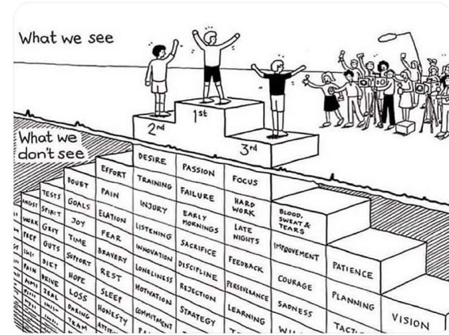
Do we get what we ask for
with intended learning outcomes?
Have we any idea of how many of
these might also have been involved?

Slide 34
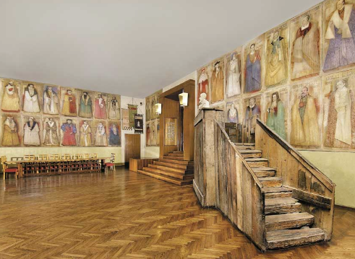
Do we spend too much of our time trying to teach our students?
We need to spend more energy helping them to appreciate feedback, make judgements, manage affect, taking action. (Carless and Boud, 2018)
Galileo: You can’t
teach a man
anything.
You can only help
him to learn.

Slide 35
Keeping students engaged:
the ten most important words
Why?
What?
Who?
Where?
When?
How?
Which?
So what?
wtf?
Wow?
And the most powerful four-letter word in the English language...
????

Slide 36
‘what’ is getting ever less important
Columbia University research published (2011) in Science magazine shows that people are much less prepared to remember ‘what’, but better at remembering where to access information, and how to do so.
Betsy Sparrow, one of the principal researchers, concludes that the internet has become ‘an external memory source that we can access at any time. ... Just as we learn through transactive memory who knows what in our families and offices, we are learning what the computer ‘knows’ and when we should attend to where we have stored information in our computer-based memories. We are becoming symbiotic with our computer tools.
Published Online July 14 2011 < Science Express Index Science DOI: 10.1126/science.1207745
Report: Google Effects on Memory: Cognitive Consequences of Having Information at Our Fingertips Betsy Sparrow,*, Jenny Liu, Daniel M. Wegner

Slide 37
Keeping students engaged:
the ten most important words
Why? (rationale)
What? (content)
Who? (people, you, me, them)
Where? (locations)
When? (times)
How? (processes)
Which? (decisions)
So what? (importance?)
Wow? (impact?)
And the most powerful four-letter word in the English language...
????

Slide 39
How students really learn
Seven factors underpinning successful learning based on asking everyone about their learning in the last 30 years!

Slide 40
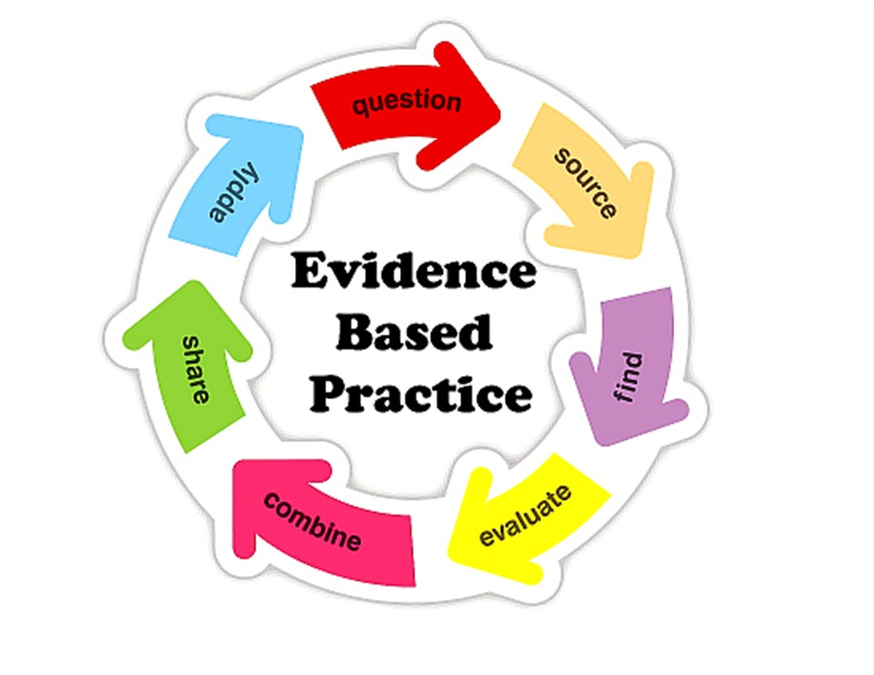

Slide 41
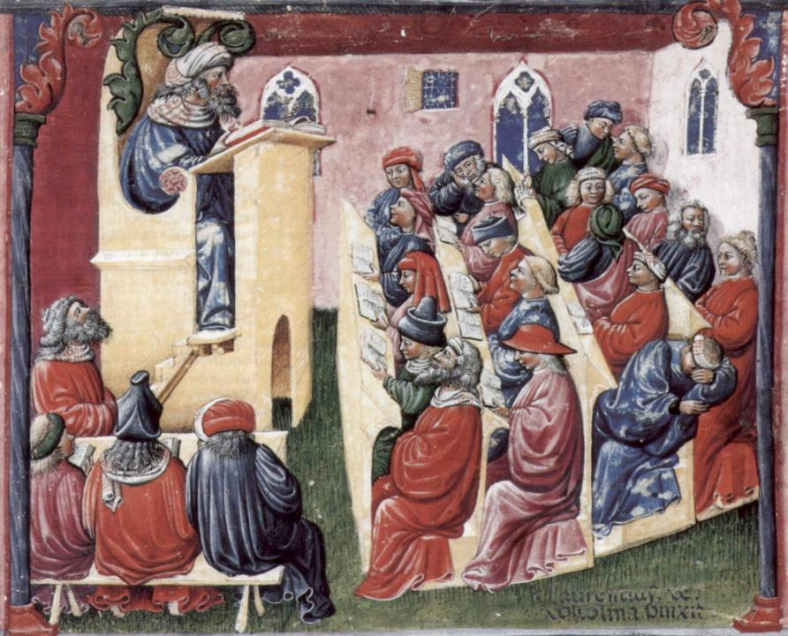
Laurentius de Voltolina
2nd half of 14th Century
Italian Painter

Slide 42
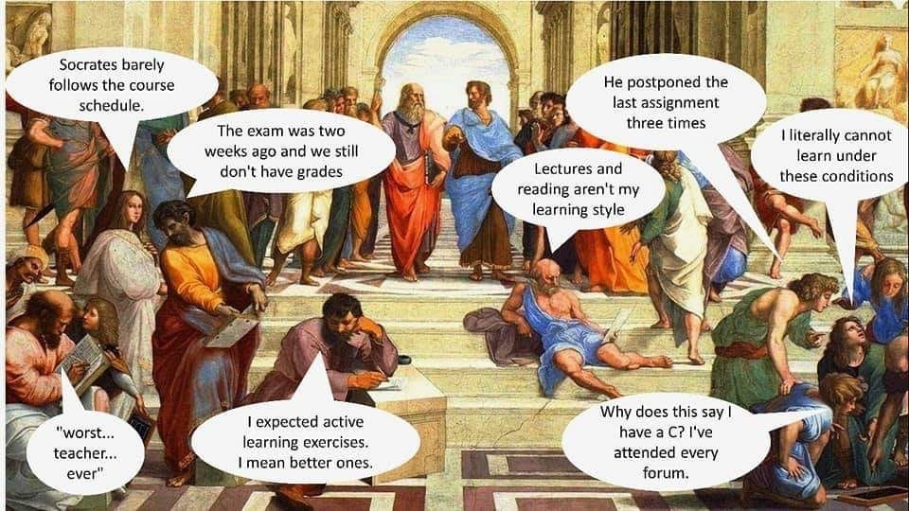

Slide 43
The chairs are mobile, the students will have their mobiles, but the room layout is still historic?

Slide 45
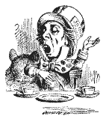
Unless we do something else…
“[The] pupils got it all by heart; and, when Examination-time came, they wrote it down; and the Examiner said ‘Beautiful! What depth!’
They became teachers in their turn, and they said all these things over again; and their pupils wrote it down, and the examiner accepted it; and nobody had the ghost of an idea what it meant” Lewis Carroll, 1893
Active
Experimentation
Abstract
Conceptualisation
Concrete
Experience
Reflective
Observation

Slide 46
Constructive Alignment: John Biggs
What will I be expected to show for this?
What does a good one look like, and a bad one?
Where does this fit into the big picture?
When explaining assessment criteria to students, and when linking these to evidence of achievement of the intended learning outcomes, we need to make the most of face-to-face whole group contexts and...
Tone of voice
Body language
Facial expression
Eye contact
The chance to repeat things
The chance to respond to puzzled looks
Some things don’t work nearly so well just on paper or on screens.
Some of the
tools we can
use in
face-to-face
contexts

Slide 47
Task: who said this?
‘Learning is experience, everything else is just information’
Or this…
‘Everything should be made as simple as possible, but not simpler’.
(Albert Einstein, 1879-1955).

Slide 48
Is there anyone there?
What station are you broadcasting on?

Slide 49
Which wavelength should I teach on?
The only one that works for today’s students is WIIFM
What’s in it for me?
Consciously address the ‘so what’ in students’ minds;
Warm up their ‘want’ to learn.
Clarify their ‘need’ to learn.
They learn far more readily if they are continuously aware of the benefits for them of putting energy into their learning.

Slide 50
Five of the seven factors underpinning successful learning
learning by doing
learning from feedback
wanting to learn
needing to learn
making sense – ‘getting one’s head round it’

Slide 51
Traditional views...
active experimentation
concrete experience
reflective observation
abstract conceptualisation

Slide 52
Is it a cycle?
Active
Experimentation
Abstract
Conceptualisation
Concrete
Experience
Reflective
Observation

Slide 53
What’s missing in this old cycle?
Engagement?
Feelings?
Active
Experimentation
Inspiration?
Judgments?
Desire?
Abstract
Conceptualisation
Concrete
Experience
Communication?
Enthusiasm?
Reflective
Observation

Slide 54
But what about learning styles?
https://www.theguardian.com/education/2017/mar/12/no-evidence-to-back-idea-of-learning-styles?CMP=share_btn_tw
(Link from my Tweet on March 13th 2017 to a letter in the Guardian by prominent folk around the world of education)
Or link to a word document: https://phil-race.co.uk/2017/09/swansea-university-school-management-21st-September/
“No evidence to back idea of learning styles”

Slide 56
Ripples on a pond….
Wanting/
Needing
Doing
Making sense
Feedback

Slide 57
Ripples on a pond….
Verbalising
Wanting/
Needing
Doing
Making sense
Feedback

Slide 58
Ripples on a pond….
Verbalising
Assessing
making informed judgements
Wanting/
Needing
Doing
Making sense
Feedback

Slide 59
What’s wrong
with
this?
Verbalising
Assessing
Feedback
Making sense
Doing
Wanting/
Needing

Slide 60
What’s wrong
with
this?
Verbalising
Assessing
Feedback
Making sense
Doing
Wanting/
Needing

Slide 61
Thanks, Dr Paul Kleiman

Slide 62
Ripples on a pond….
Enhancing our students’ want to learn;
Helping students to develop ownership of the need to learn;
Keeping students learning by doing, practice, trial-and-error, repetition;
Ensuring students really use feedback – from us and from each other;
Helping students to make sense of what they learn;
Getting students deepening their learning by verbalising, explaining things to each other, and to us;
Allowing students to deepen their learning by assessing their own learning, and assessing others’ learning – making informed judgements.
We can enhance students engagement by:
Verbalising
Assessing
making informed judgements
Wanting/
Needing
Doing
Doing
Making sense
Feedback

Slide 63
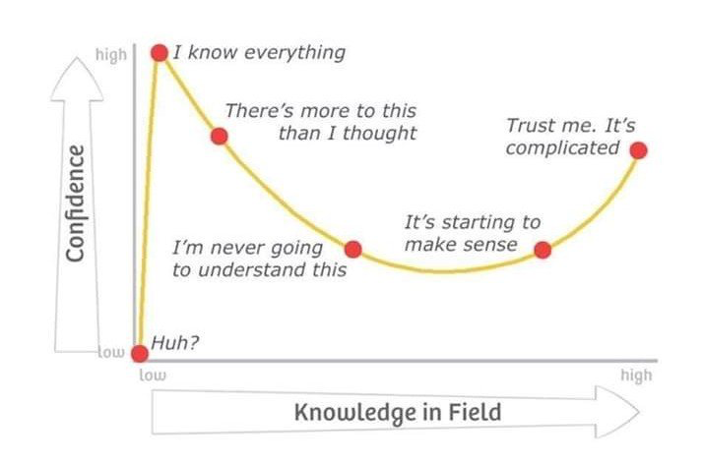
Adapted from Kruger, J. and Dunning, D. 2009

Slide 64
What does the concept of “resilience” mean to you? How can resilience help us to understand “productive failure”?
I always think of trees. To withstand the storm they need deep roots and a healthy support system. They bend and perhaps lose the odd branch...but they don’t break and continue to grow. (Paul Kleiman)

Slide 65
Characteristics of teachers who get engagement going?
Knows subject material thoroughly
Adopts a scholarly approach to the practice of teaching
Is reflective and regularly reviews own practice
Is well organised and plans curriculum effectively
Is passionate about teaching
Has a student-centred orientation to teaching
Regularly reviews innovations in learning and teaching and tries out ones relevant to own context
Ensures that assessment practices are fit for purpose and contribute to learning
Demonstrates empathy and emotional intelligence

Slide 66
Characteristics of excellent teachers: diamond-9
1
2
3
4
5
6
7
8
9

Slide 67
Characteristics of excellent teachers: diamond-9

Slide 68
Experience of Royce Sadler on standards, assessment and feedback
Well worth looking at this clip from a MOOC on Coursera from Royce Sadler, who’s work informs much of the modern thinking on assessment and feedback…

Slide 69
We can’t carry on trying to use traditional assessment and feedback processes
We can’t continue trying to give students lots of feedback in traditional ways, as there are more students, and research shows that merely ‘telling’ them what to do with their work does not work.
There is now a great deal of work on ‘contract cheating’, for example Newton, P. (2018) https://www.frontiersin.org/articles/10.3389/feduc.2018.00067/full
And traditional written feedback doesn’t work: “Approaches that emphasise feedback as telling are insufficient because students are often not equipped to decode or act on statements satisfactorily, so key messages remain invisible” (Sadler 2010).

Slide 70
Developing students’ feedback literacy
The danger with traditional methods of assessment and feedback is that assessment tends to be done on student’s work by staff, and feedback tends to be one-directional from staff to students.
Carless and Boud (2018) stress that we want students to gain skills in making ‘evaluative judgements’ themselves on their work, rather than staff doing this.
David Carless & David Boud (2018): The development of student feedback literacy: enabling uptake of feedback, Assessment & Evaluation in Higher Education, https://doi.org/10.1080/02602938.2018.1463354

Slide 71
Factors underpinning feedback literacy
Carless and Boud (2018) examine in detail:
Appreciating feedback
Making judgements
Managing affect
Taking action
We need to enable our students to optimise each of these processes, if we wish to use assessment to promote their learning. They suggest that involving students in giving and receiving peer feedback, and in analysing exemplars, should be essential parts of the curriculum.

Slide 72
Back to our intended learning outcomes
Do you now feel better-able to:
(raise two hands = very much better,
Raise one hand = somewhat better
Scratch left ear = no better)
Keep students engaged in class sessions;
Work effectively with students of different motivation and ability.

Slide 73
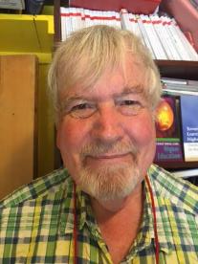
Thank you…
Website: http://phil-race.co.uk
Follow Phil @RacePhil
e-mail: phil@phil-race.co.uk

Slide 74
Useful references and further reading (1)
Bain, K. (2004) What the best College Teachers do, Cambridge: Harvard University Press.
Biggs, J. and Tang, C. (2011) Teaching for Quality Learning at University, Maidenhead: Open University Press.
Bloxham, S. and Boyd, P. (2007) Developing effective assessment in higher education: a practical guide, Maidenhead, Open University Press.
Boud, D. (1995) Enhancing learning through self-assessment, London: Routledge.
Brown, S. and Glasner, A. (eds.) (1999) Assessment Matters in Higher Education, Choosing and Using Diverse Approaches, Maidenhead: Open University Press.
Brown, S. and Race, P. (2012) Using effective assessment to promote learning in Hunt, L. and Chambers, D. (2012) University Teaching in Focus, Victoria, Australia, Acer Press. P74-91.
Brown, S. (2015) Learning , Teaching and Assessment in Higher Education: Global perspectives, London, Palgrave.
Carless, D., Joughin, G., Ngar-Fun Liu et al (2006) How Assessment supports learning: Learning orientated assessment in action Hong Kong: Hong Kong University Press.
Carless, D. and Boud, D. (2018): The development of student feedback literacy: enabling uptake of feedback, Assessment & Evaluation in Higher Education, https://doi.org/10.1080/02602938.2018.1463354

Slide 75
Useful references and further reading (2)
Carroll, J. and Ryan, J. (2005) Teaching International students: improving learning for all. London: Routledge SEDA series.
Crosling, G., Thomas, L. and Heagney, M. (2008) Improving student retention in Higher Education, London and New York: Routledge
Crooks, T. (1988) Assessing student performance, HERDSA Green Guide No 8 HERDSA (reprinted 1994).
Dunworth, K. and Sanchez, H.S., (2016). Perceptions of quality in staff-student written feedback in higher education: a case study. Teaching in Higher Education, 21(5), pp.576-589.
Dweck, C. S. (2000) Self Theories: Their Role in Motivation, Personality and Development, Lillington, NC: Taylor & Francis.
Falchikov, N. (2004) Improving Assessment through Student Involvement: Practical Solutions for Aiding Learning in Higher and Further Education, London: Routledge.
Gibbs, G. (1999) Using assessment strategically to change the way students learn, in Brown S. & Glasner, A. (eds.), Assessment Matters in Higher Education: Choosing and Using Diverse Approaches, Maidenhead: SRHE/Open University Press.
Higher Education Academy (2012) A marked improvement; transforming assessment in higher education, York: HEA.

Slide 76
Useful references and further reading (3)
Hawe, E., Lightfoot, U., & Dixon, H. (2017). First-year students working with exemplars: Promoting self-efficacy, self-monitoring and self-regulation. Journal of Further and Higher Education, 1-15.
Hendry, G. D., White, P., & Herbert, C. (2016). Providing Exemplar-Based “Feedforward” before an Assessment: The Role of Teacher Explanation. Active Learning in Higher Education, 17(2), 99-109.
Hounsell, D., McCune, V., Hounsell, J. and Litjens, J., (2008). The quality of guidance and feedback to students. Higher Education Research & Development, 27(1), pp.55-67.
Newton, P. M. (2018) How Common Is Commercial Contract Cheating in Higher Education and Is It Increasing? A Systematic Review https://www.frontiersin.org/articles/10.3389/feduc.2018.00067/full
Nicol, D. J. and Macfarlane-Dick, D. (2006) Formative assessment and self-regulated learning: A model and seven principles of good feedback practice, Studies in Higher Education Vol 31(2), 199-218.
PASS project Bradford http://www.pass.brad.ac.uk/ Accessed January 2019.
Pickford, R. and Brown, S. (2006) Assessing skills and practice, London: Routledge.
Rotheram, B. (2009) Sounds Good, JISC project http://www.jisc.ac.uk/whatwedo/programmes/usersandinnovation/soundsgood.aspx

Slide 77
Useful references and further reading (4)
Race, P. (2001) A Briefing on Self, Peer & Group Assessment https://phil-race.co.uk/archive-of-downloads-from-previous-website/
Race, P. (2014) Making Learning Happen (3rd edition), London: Sage.
Race, P. (2015) The lecturer’s toolkit (4th edition), London: Routledge.
Race, P. (2017) Fifteen ideas for making assessment and feedback more effective, efficient and manageable for us, and for students: SEDA Developments https://www.seda.ac.uk/resources/files/publications_214_Educational%20Developments%2018.2.pdf (accessed January 2019)
Rust, C., Price, M. and O’Donovan, B. (2003) Improving students’ learning by developing their understanding of assessment criteria and processes, Assessment and Evaluation in Higher Education. 28 (2), 147-164.
Scoles, J., Huxham, M., & McArthur, J. (2013). No longer exempt from good practice: Using exemplars to close the feedback gap for exams. Assessment & Evaluation in Higher Education, 38(6), 631-645.
Sadler, D. Royce (2010) Beyond feedback: developing student capability in complex appraisal, Assessment & Evaluation in Higher Education, 35: 5, 535-550.

