Slide 1
Beyond the essay: innovative use of existing assessment modes to develop students’ assessment literacy – and save you hours writing feedback that isn’t used!
24th May 2019
University of Sussex Business School
Phil Race
(from Newcastle-upon-Tyne)
BSc PhD PGCE FCIPD PFHEA NTF
Follow Phil on Twitter: @RacePhil
Visiting Professor: University of Plymouth and Edge Hill University
Emeritus Professor, Leeds Beckett University

Slide 2
This slide has two purposes….
To focus the data projector, if necessary, and…
...to persuade colleagues never to put this sort of detail onto a slide!

Slide 3
Looking across the Tyne from outside the Sage, Gateshead

Slide 4
About Phil…
First a musician
Then a writer
Then a scientist
Then a researcher
Then a lecturer and warden at what is now USW
Got interested in how students learn
And the effects assessment and feedback have on them
And how we teach them
Gradually became an educational developer
And retiring in June!
Currently…
Visiting Prof: Plymouth & Edge Hill
Emeritus Prof: Leeds Beckett
Based at Newcastle, UK
And on trains
And an expert…
on train routes and timetables!
Notes:
2
2

Slide 6
You will be able to download my main slides
You don’t need to take notes.
I’ll put the main slides I use up on my website tonight (http://phil-race.co.uk/)
I may sometimes go through slides quite fast, but you can study them as you wish at your leisure.

Slide 7
You can download free much of my published work
http://phil-race.co.uk/2016/04/updated-powerpoint-ripples-model/ (Chapter 1 from ‘The Lecturer’s Toolkit, 2015)
https://phil-race.co.uk/2016/10/lthe-tweetchat-lthechat-wed-oct-19-8-00-9-00-pm/ (feedback stuff from my most recent two books)
https://phil-race.co.uk/2018/02/feedback-feedforward-just-tips-including-students/ (just the feedback tips!)
http://phil-race.co.uk/2015/01/assessment-bits-new-editions/ (extracts on assessment)
http://phil-race.co.uk/2017/05/lectures-and-learning/ (extracts on lecturing)

Slide 8
Mobile phones and laptops...
Please turn on your ‘phones, tablets and laptops.
Please post your thoughts, questions, comments and ideas during this session to the hashtag #philatsussex19 Thanks!
Try #LTHEchat on Wednesday evenings from 20.00-21.00. (This week’s was on ‘The Hidden Curriculum’, and was a real belter!).

Slide 9
#LTHEchat is held on Wednesdays, term-time, 8-9 pm:, one hour, one or two convenors, 6 questions, c.200 international participants.

Slide 10
Name labels…
Please write your first name, big and bold, on a coded sticky label, and stick it to your clothing (not onto a fabric which would be damaged).
βA3
Phil

Slide 11
Getting to know each other: a face-to-face thing…
In turn, please..
Say one or two sentences about...
who you are,
where you come from, and
what you do.
In one breath!
(Optional) Share with us one thing that you’re dead good at, or really proud of.

Slide 12
Time-constrained written post-it exercise
On a post-it, in your best handwriting, please write your own completion of the starter:
“Assessing students’ learning would be much better for me if only I…”
Please swap post-its so that you’ve no idea who has yours.
If chosen, please read out with passion and drama the post-it you now have.
Please place them all on the chart as directed.

Slide 13
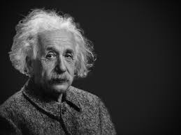
Thought for the day: Einstein
It is simply madness,
to keep doing the same things,
and expect different results.

Slide 14
Rationale
This session starts from the premise that ‘assessment and feedback are broken’ in higher education at present. We spend far too much time doing them, and burn ourselves out, and are not measuring the right things! We will explore what we can do to make assessment and feedback more fit-for-purpose, and help them to be better drivers for students’ learning.

Slide 15
Intended learning outcomes
After participating today, you should be better-able to:
Choose assessment methods which are reliable, and avoid contract cheating.
Help more students to get better feedback in less time.

Slide 16
Beyond the tyranny of intended learning outcomes?
What about our learning aspirations?
What about their learning aspirations?
What about their learning incomes?
What about their learning outputs?
What about their emergent learning outcomes?
What about our intended learning outgoings?

Slide 17
VASCULAR learning outcomes (after Brown, 2019)
Verifiable: Can we tell when they’ve been achieved? And can students?
Action orientated: Do they lead to real and useful activity?
Singular: i.e. not portmanteau outcomes combining two or more into one, making it difficult to assess if differently achieved, but readily matchable to student work produced?
Constructively aligned? (Biggs and Tang, 2011) so that there is clear alignment between aims (What do students need to be able to know and do?), what is taught/ learned, how these are assessed and evaluated);
Understandable i.e. using language codes that are meaningful to all stakeholders?
Level-appropriate? Suitable and differentiable between 1st year, 2nd year, 3rd year, Masters, other PG?
Affective-inclusive i.e. not just covering actions but capabilities in the affective domain?
Regularly reviewed? Not just stuck in history and always fit-for-purpose.

Slide 18
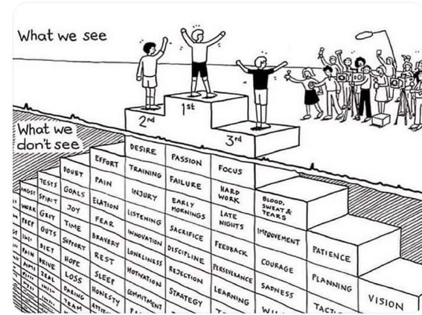
Do we get what we ask for
with intended learning outcomes?
Have we any idea of how many of
these might also have been involved?

Slide 19
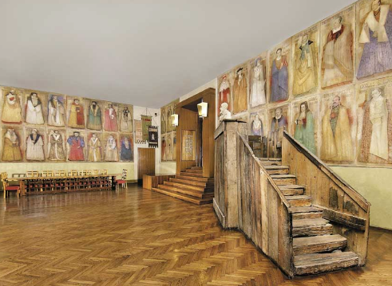
Do we spend too much of our time trying to teach our students?
We need to spend more energy helping them to appreciate feedback, make judgements, manage affect, taking action. (Carless and Boud, 2018)
Galileo: You can’t
teach a man
anything.
You can only help
him to learn.

Slide 20
Reality Check
Which of the following do you actually spend most of your time on…
Actually teaching students?
Preparing materials to teach students?
Assessing students’ work?
Composing feedback on students’ work?
Giving students feedback?
Voting: A = 2 hands, B = 1 hand
C = touch left ear, D = touch right ear
E = scratch your head

Slide 21
Addressing the 2020s: Eight concurrent, related paradigm shifts
Online information and the internet now just normal, ‘digital’ has now ‘grown up’, and is no longer something different.
More attention to learning, rather than teaching.
Less focus on classes as ‘transmission’ occasions.
Learning-centred approach to assessment of student outcomes.
Greater focus on feedback dialogues, and development of feedback literacy by students.
Increased recognition of the skills, attitudes and behaviours graduates need to be work-ready.
Responsibility of institutions to prepare students through knowledge, orientation and behaviours for active citizenship in their own communities, nations and globally.
Increased recognition of the need for teaching staff to be trained, qualified and accredited as teachers.

Slide 22
Now is the decade of Universities’ dis-content!
Never mind the content – feel the learning

Slide 23
Teaching in modern institutions is moving away from providing subject content, (where everything was about ‘delivery’), towards foregrounding two major functions:
Recognising and accrediting students’ achievement, wherever learning has taken place (i.e. getting the assessment right);
Supporting student learning and engagement (not least by making feedback work well for students).

Slide 24
Finding out more about you…
In the last 12 months,
I’ve completed a MOOC
I’ve started one
I’ve helped to design one
I’ve found one
What’s a MOOC?
Voting: A = 2 hands, B = 1 hand
C = touch left ear, D = touch right ear
E = scratch your head

Slide 25
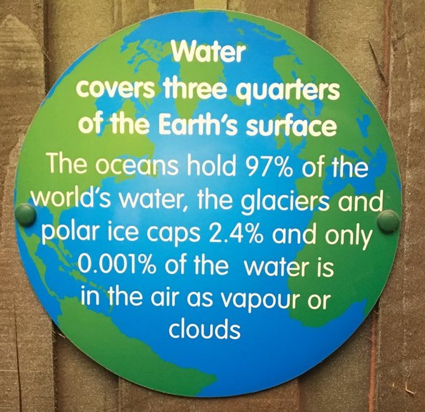

Slide 26
Drives most learning
Is assessment broken?
Some
assessment
issues
We know
what students think
Assessment as learning
Validity
Whodunit?
Fairness

Slide 27
Feed-forward
Language of feedback
Some feedback
issues
National Student Survey
Timing:
24-hours!
Written, printed,
on-screen
Efficiency
Face to face
oral

Slide 28
Fishing for feedback?
Feedback is like fish.
If it is not used quickly, it becomes useless.
(Sally Brown).
Give a man a fish,
Feed him for a day.
Teach a man to fish,
Feed him for a lifetime.
(Maimonides: 1135-1204)
Make feedback timely, while it still matters to students, in time for them to use it towards further learning, or to receive further assistance.
(Graham Gibbs)
And he’ll learn to drink beer in boats
And you won’t see him for weeks!
(Australian proverb).

Slide 29
How to get feedback to a large group of students within 24 hours
There are serious reservations about written feedback, but we can make even this work much better than it did.
The next few slides are about a way of giving students feedback on their work within 24 hours of them doing it.
There are three or more ‘yes, but...’s with this idea, but please hold these for around four minutes.

Slide 30
Set the hand-in time to be at a whole-group session
E.g. next Tuesday’s 10-11 lecture,
Deadline = 1003.
Let them pile up all their work at the front.
At 1003, hand out to everyone a coloured sheet, containing numbered points.
(so you can say in feedback ‘please see point 3, blue sheet’ and so on).

Slide 31
The blue sheet can contain....
Illustration of what is expected as evidence of achievement of each of the intended learning outcomes
Likely mistakes
Features of a good answer
Frequently needed explanations
Things you otherwise would have to write time and time again on students’ work.
Let the students study this for 3 minutes until 1006 – it goes rather quiet!

Slide 32
At 1006...
Go into face-to-face oral mode, until 1009....
Spend a few minutes de-briefing the whole group and talking them through one point on the handout…
…adding tone-of-voice, facial expression, body language, emphasis, and so on to the feedback.

Slide 33
The rationale...
Since most of the students will still have been doing the work in the last 24 hours before handing it in, you’re giving them feedback while they still remember what they were doing.
They know what they didn’t do.
They know what they missed out because they couldn’t understand it.

Slide 34
Now take away their work to mark – in a third of the time it used to take you!
You waste far less writing the same old things on one piece of work after another, regarding frequently occurring mistakes;
Instead, you need just to write ‘please see point 4, blue sheet’ (which takes seconds).
You can now make your comments relate more to each individual piece of work;
This means when students get their marked work back with feedback, they are more likely to use it, as it’s personal to them.

Slide 35
Use link below to download the materials on feedback and assessment produced in 2017-18 by Kay Sambell, Sally Brown and Phil Race for Edinburgh Napier University.
http://staff.napier.ac.uk/services/dlte/ENhance/Pages/ENhanceQuickGuides.aspx

Slide 36
Napier University Quick Guides
1 Commenting Constructively Quick Guide.pdf
2 Getting Students to Engage Quick Guide.pdf
3 Giving Formative Feedback Prior to Submission Quick Guide.pdf
4 Streamlining Feedback on Summative Tasks Quick Guide.pdf
5 Alternatives to Traditional Exams Quick Guide.pdf
6 Alternatives to Essays Quick Guide.pdf
7 Getting Students to Self-assess Quick Guide.pdf
8 Assessment Literacy.pdf​
9 Exemplars Quick Guide.pdf
10 Supporting International Students in their Assessment Quick Guide.pdf
11 Using a Simple Feedback Stamp to Provide Incremental Feedback on Work-in-progress in the Art Design Context.pdf
12 Helping Students to Benefit From Feedback on Exams.pdf
13 Meeting the challenges of Programme Focused Assessment.pdf
14 Combatting Contract Cheating.pdf​

Slide 37
The present NSS statements (2017)
Assessment and feedback
The criteria used in marking have been clear in advance
Marking and assessment have been fair
Feedback on my work has been timely
I have received helpful comments on my work
Student voice
I have had the right opportunities to provide feedback on my course
Staff value students’ views and opinions about the course
It is clear how students’ feedback on the course has been acted on

Slide 38
My main worries about assessment...
Too often, we still tend to try to measure...
...what’s in students’ heads, and what they can do with what’s there...
in terms of two unsatisfactory proxies ...
what comes out of students’ pens in exams;
2. what comes out of their keyboards in essays and reports.

Slide 39
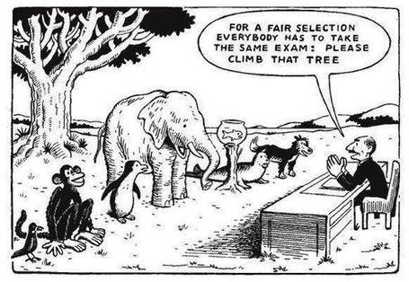

Slide 40
Five main problems with assessed essays
They take a great deal of time to mark, let alone the time it takes for students to prepare, draft and compose them.
When most assessment is in the form of essays, students’ skills at essay-writing are repeatedly tested, as the expense sometimes of their understanding of the subject.
Lots of research shows that we’re not at all good at marking essays fairly – different assessors often give the same essay very different marks.
Essay marks in the UK tend to lie between 35% for a poor one and 75% for a very good one, whereas in many other disciplines the marks for an assignment like a lab report can range across the whole 0-100% span more evenly.
With coursework essays, there can be doubt about ‘whodunit?’!

Slide 41
Marking exercise...
You are given two essays, on the same topic:
‘Technology made large populations possible; large populations make technology indispensable’ .
I’m shortly going to ask each of you to mark them out of 20.
You can ask questions (but I may hedge!).
Please do not confer.
Please write your marks on the sticky side of small post-its, and place them on the flipchart, being really careful to put them in the correct column.

Slide 42
Last September: The essay is failing us. Discuss

Slide 43
We can’t carry on trying to use traditional assessment and feedback processes
We can’t continue trying to give students lots of feedback in traditional ways, as there are more students, and research shows that merely ‘telling’ them what to do with their work does not work.
There is now a great deal of work on ‘contract cheating’, for example Newton, P. (2018) https://www.frontiersin.org/articles/10.3389/feduc.2018.00067/full
And traditional written feedback doesn’t work: “Approaches that emphasise feedback as telling are insufficient because students are often not equipped to decode or act on statements satisfactorily, so key messages remain invisible” (Sadler 2010).

Slide 44
Developing students’ feedback literacy
The danger with traditional methods of assessment and feedback is that assessment tends to be done on student’s work by staff, and feedback tends to be one-directional from staff to students.
Carless and Boud (2018) stress that we want students to gain skills in making ‘evaluative judgements’ themselves on their work, rather than staff doing this.
David Carless & David Boud (2018): The development of student feedback literacy: enabling uptake of feedback, Assessment & Evaluation in Higher Education, https://doi.org/10.1080/02602938.2018.1463354

Slide 45
Factors underpinning feedback literacy
Carless and Boud (2018) examine in detail:
Appreciating feedback
Making judgements
Managing affect
Taking action
We need to enable our students to optimise each of these processes, if we wish to use assessment to promote their learning. They suggest that involving students in giving and receiving peer feedback, and in analysing exemplars, should be essential parts of the curriculum.

Slide 46
Coming out shortly…
Naomi Winstone and David Carless
Designing effective feedback processes in higher education
Routledge, 2019

Slide 47
The three questions always in each student’s mind…
What will I be expected to show for this?
What does a good one look like, and a bad one?
Where does this fit into the big picture?

Slide 48
HEA Fellowships? (Professional development relating to teaching, learning and assessment)
How many of you are already: (please raise hands)
Associate Fellow (AFHEA) 23,538
Fellow (FHEA) 75,033
Senior Fellow (SFHEA) 9,557
Principal Fellow (PFHEA) 995
National Teaching Fellow (NTF) c.900
(Numbers at start of 2019; seem to be included in some league tables)

Slide 49
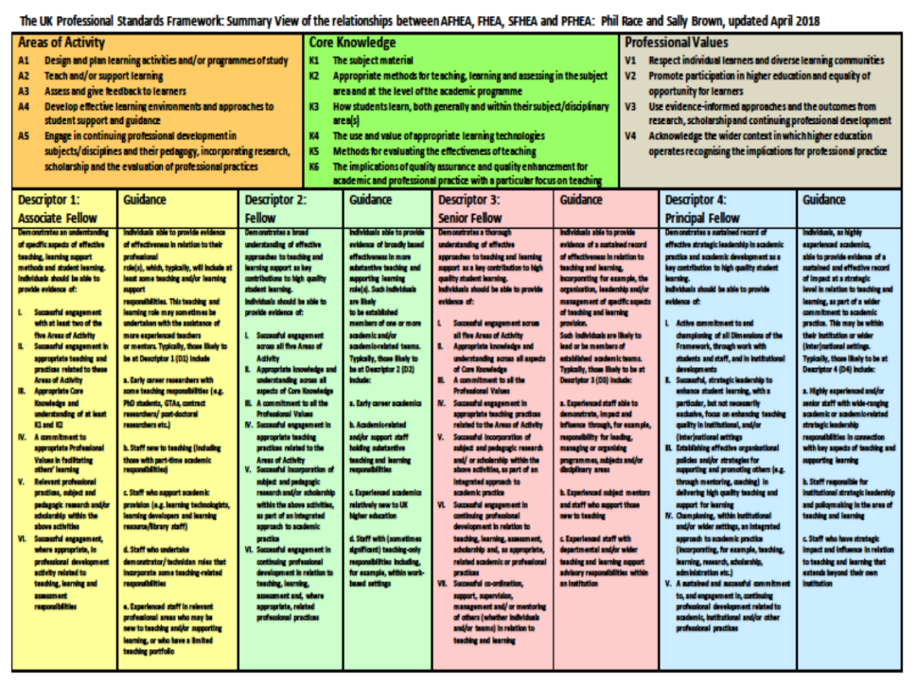

Slide 50
Setting your priorities?
1
Urgent and important
2
Urgent,
not Important
3
Not urgent,
but important
4
Not urgent,
not important

Slide 51
Students as partners…
Students are partners in learning.
They always have been.
We can’t do their learning for them, or without them.
We haven’t always made it an optimal partnership.
We can.
I could not do what I do nowadays if I did not continue to spend a fair bit of my time working with students – they’ve taught me most of what I know.

Slide 52
Teaching, learning and enthusiasm
Knowledge isn’t infectious (unfortunately) but enthusiasm is, and we need to help our students to catch enthusiasm.
We certainly don’t want teaching, assessment or feedback to damage that enthusiasm.

Slide 53
Constructive Alignment: John Biggs
What will I be expected to show for this?
What does a good one look like, and a bad one?
Where does this fit into the big picture?
When explaining assessment criteria to students, and when linking these to evidence of achievement of the intended learning outcomes, we need to make the most of face-to-face whole group contexts and...
Tone of voice
Body language
Facial expression
Eye contact
The chance to repeat things
The chance to respond to puzzled looks
Some things don’t work nearly so well just on paper or on screens.
Some of the
tools we can
use in
face-to-face
contexts

Slide 54
Face to face feedback

Slide 55
Hands-on feedback?

Slide 56
Numbers?
One for sorrow,
Two for joy,
Three for a girl,
Four for a boy,
Five for silver,
Six for gold,
Seven for Customer Service,
Eight to listen to these options again.

Slide 57
A good reason to let students work from exemplars
Emulation is an ancient and still almost universal learning method
(Sadler, 1989, p.128-9)

Slide 58
Disengaged students
Don’t live up to their potential and fail to achieve their very best;
Make life more difficult for the staff who teach and support them;
Drop out of higher education, thereby damaging their own prospects and institutions’ performance indicators;
Institutions suffer both financially and in terms of their status and reputation from high attrition rates.

Slide 59
What annoys students in class?
Staff who don’t appear to have done good preparation of content material;
Material at the wrong level, that is too easy or goes right over their heads;
Lecturers who seem jaded, unenthusiastic or uninterested in what they are teaching;
Teaching formats that never change and over-use Power Point;
Lack of interaction between the lecturer and students;
Issues around timing, particularly over-running and rushing at the end.

Slide 60
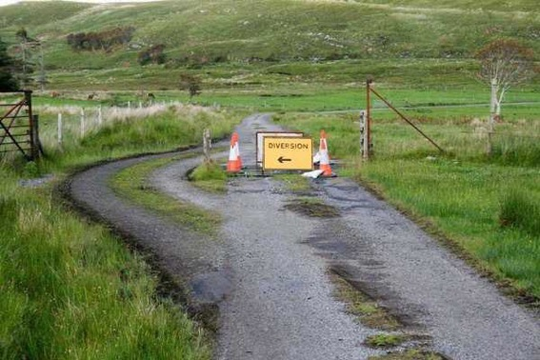

Slide 61
Keeping students engaged:
the ten most important words
Why?
What?
Who?
Where?
When?
How?
Which?
So what?
wtf?
Wow?
And the most powerful four-letter word in the English language...
????

Slide 62
‘what’ is getting ever less important
Columbia University research published (2011) in Science magazine shows that people are much less prepared to remember ‘what’, but better at remembering where to access information, and how to do so.
Betsy Sparrow, one of the principal researchers, concludes that the internet has become ‘an external memory source that we can access at any time. ... Just as we learn through transactive memory who knows what in our families and offices, we are learning what the computer ‘knows’ and when we should attend to where we have stored information in our computer-based memories. We are becoming symbiotic with our computer tools.
Published Online July 14 2011 < Science Express Index Science DOI: 10.1126/science.1207745
Report: Google Effects on Memory: Cognitive Consequences of Having Information at Our Fingertips Betsy Sparrow,*, Jenny Liu, Daniel M. Wegner

Slide 63
Keeping students engaged:
the ten most important words
Why? (rationale)
What? (content)
Who? (people, you, me, them)
Where? (locations)
When? (times)
How? (processes)
Which? (decisions)
So what? (importance?)
Wow? (impact?)
And the most powerful four-letter word in the English language...
????

Slide 65
How students really learn
Seven factors underpinning successful learning based on asking everyone about their learning in the last 30 years!

Slide 66
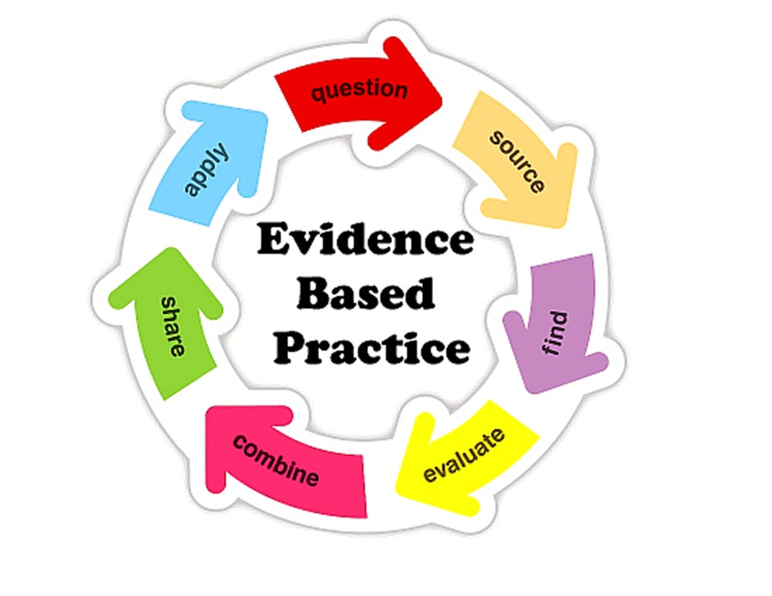

Slide 67
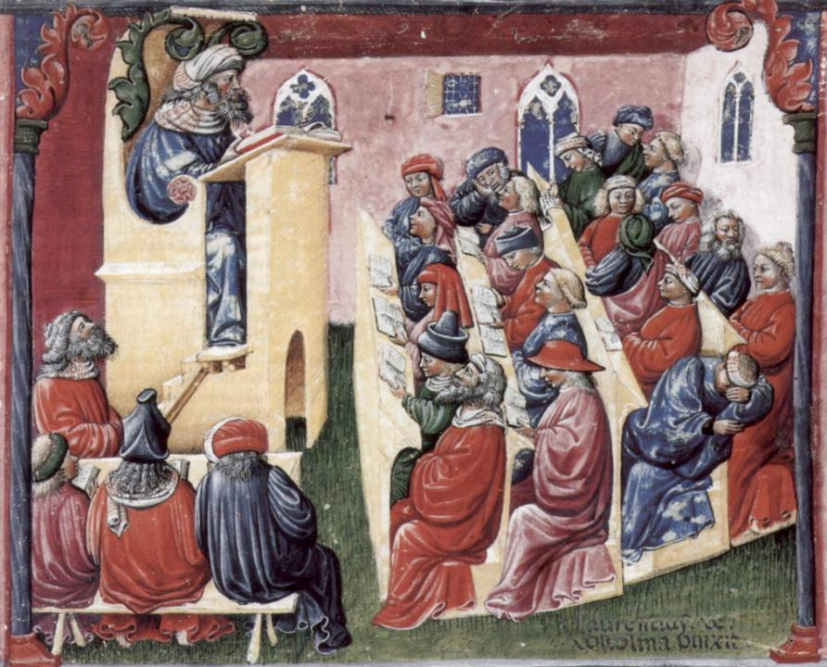
Laurentius de Voltolina
2nd half of 14th Century
Italian Painter

Slide 68
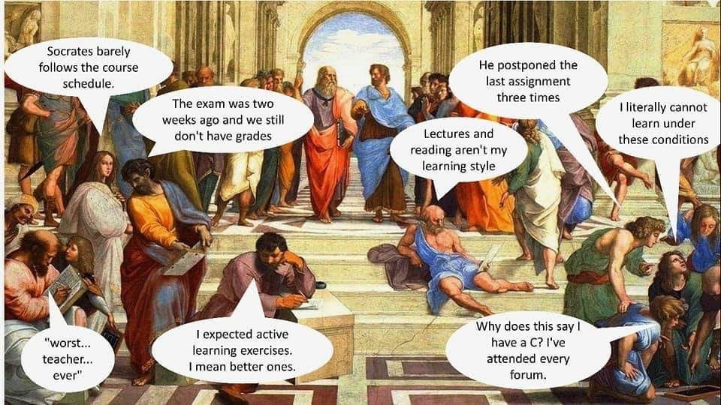

Slide 69
The chairs are mobile, the students will have their mobiles, but the room layout is still historic?

Slide 71
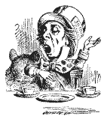
Unless we do something else…
“[The] pupils got it all by heart; and, when Examination-time came, they wrote it down; and the Examiner said ‘Beautiful! What depth!’
They became teachers in their turn, and they said all these things over again; and their pupils wrote it down, and the examiner accepted it; and nobody had the ghost of an idea what it meant” Lewis Carroll, 1893
Active
Experimentation
Abstract
Conceptualisation
Concrete
Experience
Reflective
Observation

Slide 72
Which wavelength should I teach on?
The only one that works for today’s students is WIIFM
What’s in it for me?
Consciously address the ‘so what’ in students’ minds;
Warm up their ‘want’ to learn.
Clarify their ‘need’ to learn.
They learn far more readily if they are continuously aware of the benefits for them of putting energy into their learning.

Slide 73
Five of the seven factors underpinning successful learning
learning by doing
learning from feedback
wanting to learn
needing to learn
making sense – ‘getting one’s head round it’

Slide 74
Traditional views...
active experimentation
concrete experience
reflective observation
abstract conceptualisation

Slide 75
Is it a cycle?
Active
Experimentation
Abstract
Conceptualisation
Concrete
Experience
Reflective
Observation

Slide 76
What’s missing in this old cycle?
Engagement?
Feelings?
Active
Experimentation
Inspiration?
Judgments?
Desire?
Abstract
Conceptualisation
Concrete
Experience
Communication?
Enthusiasm?
Reflective
Observation

Slide 77
Another MCQ
About learning styles,
I think they’re very important
I think they’re a load of rubbish
I know what mine is (or are)
They can’t be changed
They change over time
Voting: A = 2 hands, B = 1 hand
C = touch left ear, D = touch right ear
E = scratch your head

Slide 78
But what about learning styles?
https://www.theguardian.com/education/2017/mar/12/no-evidence-to-back-idea-of-learning-styles?CMP=share_btn_tw
(Link from my Tweet on March 13th 2017 to a letter in the Guardian by prominent folk around the world of education)
Or link to a word document: https://phil-race.co.uk/2017/09/swansea-university-school-management-21st-September/
“No evidence to back idea of learning styles”

Slide 80
Ripples on a pond….
Wanting/
Needing
Doing
Making sense
Feedback

Slide 81
Ripples on a pond….
Verbalising
Wanting/
Needing
Doing
Making sense
Feedback

Slide 82
Ripples on a pond….
Verbalising
Assessing
making informed judgements
Wanting/
Needing
Doing
Making sense
Feedback

Slide 83
What’s wrong
with
this?
Verbalising
Assessing
Feedback
Making sense
Doing
Wanting/
Needing

Slide 84
What’s wrong
with
this?
Verbalising
Assessing
Feedback
Making sense
Doing
Wanting/
Needing

Slide 85
Thanks, Dr Paul Kleiman

Slide 86
Ripples on a pond….
Enhancing our students’ want to learn;
Helping students to develop ownership of the need to learn;
Keeping students learning by doing, practice, trial-and-error, repetition;
Ensuring students really use feedback – from us and from each other;
Helping students to make sense of what they learn;
Getting students deepening their learning by verbalising, explaining things to each other, and to us;
Allowing students to deepen their learning by assessing their own learning, and assessing others’ learning – making informed judgements.
We can enhance students engagement by:
Verbalising
Assessing
making informed judgements
Wanting/
Needing
Doing
Doing
Making sense
Feedback

Slide 87
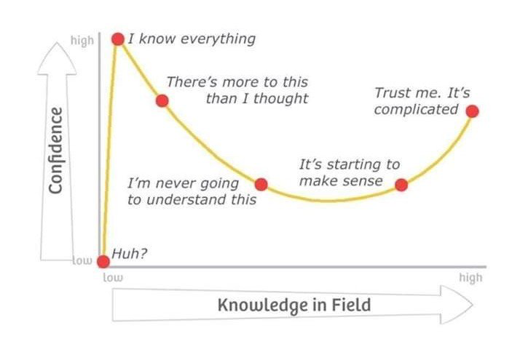
Adapted from Kruger, J. and Dunning, D. 2009

Slide 88
What does the concept of “resilience” mean to you? How can resilience help us to understand “productive failure”?
I always think of trees. To withstand the storm they need deep roots and a healthy support system. They bend and perhaps lose the odd branch...but they don’t break and continue to grow. (Paul Kleiman)

Slide 89
Experience of Royce Sadler on standards, assessment and feedback
Well worth looking at this clip from a MOOC on Coursera from Royce Sadler, who’s work informs much of the modern thinking on assessment and feedback…

Slide 90
Back to our intended learning outcomes
Do you now feel better-able to:
(raise two hands = very much better,
Raise one hand = somewhat better
Scratch left ear = no better)
Choose assessment methods which are reliable, and avoid contract cheating?
Help more students to get better feedback in less time?

Slide 91
Thank you…
Website: http://phil-race.co.uk
Follow Phil @RacePhil
e-mail: phil@phil-race.co.uk

Slide 92
Useful references and further reading (1)
Bain, K. (2004) What the best College Teachers do, Cambridge: Harvard University Press.
Biggs, J. and Tang, C. (2011) Teaching for Quality Learning at University, Maidenhead: Open University Press.
Bloxham, S. and Boyd, P. (2007) Developing effective assessment in higher education: a practical guide, Maidenhead, Open University Press.
Boud, D. (1995) Enhancing learning through self-assessment, London: Routledge.
Brown, S. and Glasner, A. (eds.) (1999) Assessment Matters in Higher Education, Choosing and Using Diverse Approaches, Maidenhead: Open University Press.
Brown, S. and Race, P. (2012) Using effective assessment to promote learning in Hunt, L. and Chambers, D. (2012) University Teaching in Focus, Victoria, Australia, Acer Press. P74-91.
Brown, S. (2015) Learning , Teaching and Assessment in Higher Education: Global perspectives, London, Palgrave.
Carless, D., Joughin, G., Ngar-Fun Liu et al (2006) How Assessment supports learning: Learning orientated assessment in action Hong Kong: Hong Kong University Press.
Carless, D. and Boud, D. (2018): The development of student feedback literacy: enabling uptake of feedback, Assessment & Evaluation in Higher Education, https://doi.org/10.1080/02602938.2018.1463354

Slide 93
Useful references and further reading (2)
Carroll, J. and Ryan, J. (2005) Teaching International students: improving learning for all. London: Routledge SEDA series.
Crosling, G., Thomas, L. and Heagney, M. (2008) Improving student retention in Higher Education, London and New York: Routledge
Crooks, T. (1988) Assessing student performance, HERDSA Green Guide No 8 HERDSA (reprinted 1994).
Dunworth, K. and Sanchez, H.S., (2016). Perceptions of quality in staff-student written feedback in higher education: a case study. Teaching in Higher Education, 21(5), pp.576-589.
Dweck, C. S. (2000) Self Theories: Their Role in Motivation, Personality and Development, Lillington, NC: Taylor & Francis.
Falchikov, N. (2004) Improving Assessment through Student Involvement: Practical Solutions for Aiding Learning in Higher and Further Education, London: Routledge.
Gibbs, G. (1999) Using assessment strategically to change the way students learn, in Brown S. & Glasner, A. (eds.), Assessment Matters in Higher Education: Choosing and Using Diverse Approaches, Maidenhead: SRHE/Open University Press.
Higher Education Academy (2012) A marked improvement; transforming assessment in higher education, York: HEA.

Slide 94
Useful references and further reading (3)
Hawe, E., Lightfoot, U., & Dixon, H. (2017). First-year students working with exemplars: Promoting self-efficacy, self-monitoring and self-regulation. Journal of Further and Higher Education, 1-15.
Hendry, G. D., White, P., & Herbert, C. (2016). Providing Exemplar-Based “Feedforward” before an Assessment: The Role of Teacher Explanation. Active Learning in Higher Education, 17(2), 99-109.
Hounsell, D., McCune, V., Hounsell, J. and Litjens, J., (2008). The quality of guidance and feedback to students. Higher Education Research & Development, 27(1), pp.55-67.
Newton, P. M. (2018) How Common Is Commercial Contract Cheating in Higher Education and Is It Increasing? A Systematic Review https://www.frontiersin.org/articles/10.3389/feduc.2018.00067/full
Nicol, D. J. and Macfarlane-Dick, D. (2006) Formative assessment and self-regulated learning: A model and seven principles of good feedback practice, Studies in Higher Education Vol 31(2), 199-218.
PASS project Bradford http://www.pass.brad.ac.uk/ Accessed January 2019.
Pickford, R. and Brown, S. (2006) Assessing skills and practice, London: Routledge.
Rotheram, B. (2009) Sounds Good, JISC project http://www.jisc.ac.uk/whatwedo/programmes/usersandinnovation/soundsgood.aspx

Slide 95
Useful references and further reading (4)
Race, P. (2001) A Briefing on Self, Peer & Group Assessment https://phil-race.co.uk/archive-of-downloads-from-previous-website/
Race, P. (2014) Making Learning Happen (3rd edition), London: Sage.
Race, P. (2015) The lecturer’s toolkit (4th edition), London: Routledge.
Race, P. (2017) Fifteen ideas for making assessment and feedback more effective, efficient and manageable for us, and for students: SEDA Developments https://www.seda.ac.uk/resources/files/publications_214_Educational%20Developments%2018.2.pdf (accessed January 2019)
Rust, C., Price, M. and O’Donovan, B. (2003) Improving students’ learning by developing their understanding of assessment criteria and processes, Assessment and Evaluation in Higher Education. 28 (2), 147-164.
Scoles, J., Huxham, M., & McArthur, J. (2013). No longer exempt from good practice: Using exemplars to close the feedback gap for exams. Assessment & Evaluation in Higher Education, 38(6), 631-645.
Sadler, D. Royce (2010) Beyond feedback: developing student capability in complex appraisal, Assessment & Evaluation in Higher Education, 35: 5, 535-550.

