Slide 1

Helping students to take charge of their learning processes
5th June 2019
Solstice 2019: Edge Hill University
Phil Race
(from Newcastle-upon-Tyne)
BSc PhD PGCE FCIPD PFHEA NTF
Follow Phil on Twitter: @RacePhil
Visiting Professor: Edge Hill University and University of Plymouth
Emeritus Professor Leeds Beckett University

Slide 2
About Phil…
First a musician
Then a writer
Then a scientist
Then a researcher
Then a lecturer and warden at what is now USW
Got interested in how students learn
And the effects assessment and feedback have on them
And how we teach them
Gradually became an educational developer
And retiring next week!
Currently…
Visiting Prof: Plymouth & Edge Hill
Emeritus Prof: Leeds Beckett
Based at Newcastle UK
And on trains
And an expert…
on train routes and timetables!
Notes:
2
2

Slide 3
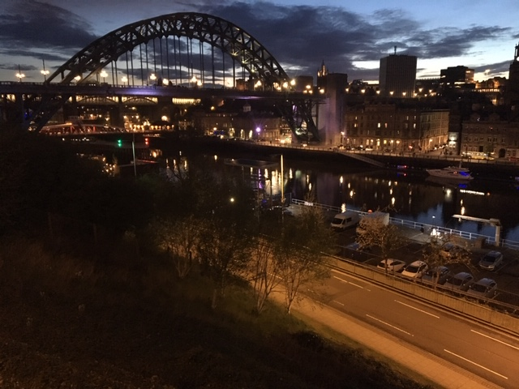
Looking across the Tyne from outside the Sage Gateshead

Slide 4
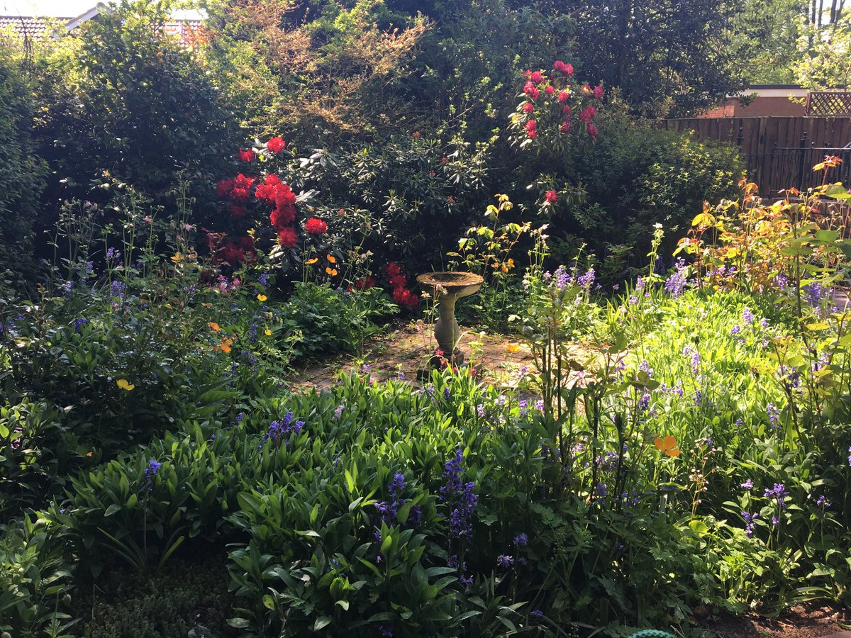

Slide 5
You will be able to download my main slides
You don’t need to take notes.
I’ll put the main slides I use up on my website tonight (http://phil-race.co.uk/)
I may sometimes go through slides quite fast but you can study them as you wish at your leisure.

Slide 6
Intended learning outcome
After participating today you should be better-able to:
Help your students to improve their learning skills.

Slide 7
I might leave you to take charge of your own learning processes!
Peter Hartley and I might go for an impromptu coffee discussion while we leave you to it!

Slide 8
You can download free much of my published work
http://phil-race.co.uk/2016/04/updated-powerpoint-ripples-model/ (Chapter 1 from ‘The Lecturer’s Toolkit 2015)
https://phil-race.co.uk/2016/10/lthe-tweetchat-lthechat-wed-oct-19-8-00-9-00-pm/ (feedback stuff from my most recent two books)
https://phil-race.co.uk/2018/02/feedback-feedforward-just-tips-including-students/ (just the feedback tips!)
http://phil-race.co.uk/2015/01/assessment-bits-new-editions/ (extracts on assessment)
http://phil-race.co.uk/2017/05/lectures-and-learning/ (extracts on lecturing)

Slide 9
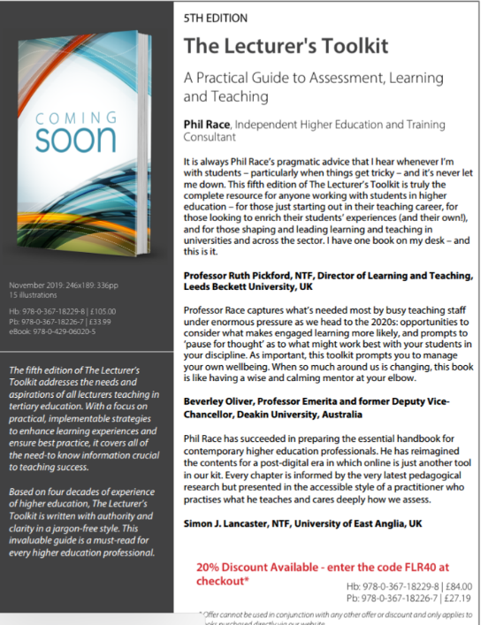
5th Edition in press
Expected to come out in December 2019

Slide 10
The three questions always in each student’s mind…
What will I be expected to show for this?
What does a good one look like and a bad one?
Where does this fit into the big picture?

Slide 11

Coming out shortly…
Naomi Winstone and David Carless
Designing effective feedback processes in higher education
Routledge 2019

Slide 12
Mobile phones and laptops...
Please turn on your ‘phones tablets and laptops.
Please post your thoughts questions comments and ideas during this session to the hashtag #philatsolstice19 Thanks!
Try #LTHEchat on Wednesday evenings from 20.00-21.00.

Slide 13

#LTHEchat is held on Wednesdays term-time
8-9 pm: one hour one or two convenors
6 questions c.200 international participants.

Slide 14
Time-constrained written post-it exercise
On a post-it in your best handwriting please write your own completion of the starter:
“Helping students to take charge of their learning would be much better for me if only…”
Please swap post-its so that you’ve no idea who has yours.
If chosen please read out with passion and drama the post-it you now have.
Please place them all on the chart as directed.

Slide 15
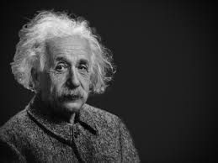
Thought for the day: Einstein
It is simply madness
to keep doing the same things
and expect different results.

Slide 16
Teaching learning and enthusiasm
Knowledge isn’t infectious (unfortunately) but enthusiasm is and we need to help our students to catch enthusiasm.
We certainly don’t want teaching assessment or feedback to damage that enthusiasm.

Slide 17


Slide 18
Numbers?
One for sorrow
Two for joy
Three for a girl
Four for a boy
Five for silver
Six for gold
Seven for Customer Service
Eight to listen to these options again.

Slide 19
How students really learn
http://phil-race.co.uk/2016/04/updated-powerpoint-ripples-model/ (Chapter 1 from ‘The Lecturer’s Toolkit 2015)

Slide 20
What’s wrong
with
this?
Verbalising
Assessing
Feedback
Making sense
Doing
Wanting/
Needing

Slide 21
What’s wrong
with
this?
Verbalising
Assessing
Feedback
Making sense
Doing
Wanting/
Needing

Slide 22
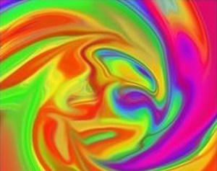
Thanks Dr Paul Kleiman

Slide 23

Safety Curtain

Slide 24
 | Taking charge of your learning: a self-evaluation checklist (Devised by Prof Phil Race June 2019) | I’m comfortable that I am doing this rather well | I’m pretty good at this on the whole | I would like to become better at this | I need to think more about this | Focus for action
 | I feel that I know why I’m here what I’m here for and how to go about realising my ambitions successfully.
 | I avoid just ‘collecting the stuff’ (notes weblinks handouts) and regularly get to grips with the material rather than leaving it for later.
 | I’m really keen to learn. I enjoy learning and am willing to do my best with new topics ideas and situations.
 | I really need to learn and succeed. I’m determined to be successful in my studies and do everything I need to do to excel at assessments.
 | I ask myself ‘what exactly am I expected to become able to do with this?’ for each class session chapter book idea web reference and so on.
 | I tend to learn best by getting stuck in and practising things until I can do them well.
 | I avoid putting off things which need doing. I’m good at keeping up with what I need to do on a day-to-day basis.
1 | I manage time effectively I’m normally punctual and I make sensible decisions about how much I can sensibly achieve at any time.
 | I feel best when I can really make sense of concepts and ideas and keep up with the sense-making as I go rather than hoping it will happen later.
 | When I get positive feedback on what I’ve done I resist ‘shrugging it off’ and instead try to build on what I’ve done well.
 | When I get critical feedback on what I’ve done I resist being hurt or defensive and try to work out exactly what to do to make things better.
 | I find it really useful to explain things I’m learning to friends relatives and anyone who will listen – this helps me make sense of it better.
 | I self-assess everything I do for assessment before submitting it so I internalise the criteria which others will use to assess my work.
 | I try to find out ‘what does a ‘good’ example of this look like and what does a ‘poor’ example look like?’ for everything I do for assessment.
 | Always on my mind is the question ‘where does this particular bit fit into the bigger picture of my module course degree life?’
6 | I monitor my stress levels as I study and know when it feels as if things are getting on top of me and seek help from people who can help.
 | I’m there! Except in emergency I go to class sessions rather than try to catch up from ‘captured sessions’ fellow-students’ notes and so on.

Slide 25
I’m comfortable that I am doing this rather well | I’m pretty good at this on the whole | I would like to become better at this | I need to think more about this | Focus for action
4 | 3 | 2 | 1 | *

Slide 26
* Setting priorities?
1
Urgent and important
2
Urgent
not Important
3
Not urgent
but important
4
Not urgent
not important

Slide 27
I’m comfortable that I am doing this rather well | I’m pretty good at this on the whole | I would like to become better at this | I need to think more about this | Focus for action
I feel that I know why I’m here, what I’m here for, and how to go about realising my ambitions successfully.
I avoid just ‘collecting the stuff’ (notes, weblinks, handouts) and regularly get to grips with the material rather than leaving it for later.
I’m really keen to learn. I enjoy learning and am willing to do my best with new topics ideas and situations.
I really need to learn and succeed. I’m determined to be successful in my studies and do everything I need to do to excel at assessments.
I ask myself ‘what exactly am I expected to become able to do with this?’ for each class session, chapter, book, idea, web reference, and so on.
I tend to learn best by getting stuck in and practising things until I can do them well.
I avoid putting off things which need doing. I’m good at keeping up with what I need to do on a day-to-day basis.
I manage time effectively. I’m normally punctual, and I make sensible decisions about how much I can sensibly achieve at any time.
I feel best when I can really make sense of concepts and ideas, and keep up with the sense-making as I go, rather than hoping it will happen later.

Slide 28
I’m comfortable that I am doing this rather well | I’m pretty good at this on the whole | I would like to become better at this | I need to think more about this | Focus for action
When I get positive feedback on what I’ve done, I resist ‘shrugging it off’ and instead try to build on what I’ve done well.
When I get critical feedback on what I’ve done, I resist being hurt or defensive, and try to work out exactly what to do to make things better.
I find it really useful to explain things I’m learning to friends, relatives and anyone who will listen – this helps me make sense of it better.
I self-assess everything I do for assessment before submitting it, so I internalise the criteria which others will use to assess my work.
I try to find out ‘what does a ‘good’ example of this look like, and what does a ‘poor’ example look like?’ for everything I do for assessment.
Always on my mind is the question ‘where does this particular bit fit into the bigger picture of my module, course, degree, life?’
I monitor my stress levels as I study, and know when it feels as if things are getting on top of me, and seek help from people who can help.
I’m there! Except in emergency I go to class sessions rather than try to catch up from ‘captured sessions’, fellow-students’ notes, and so on.

Slide 29
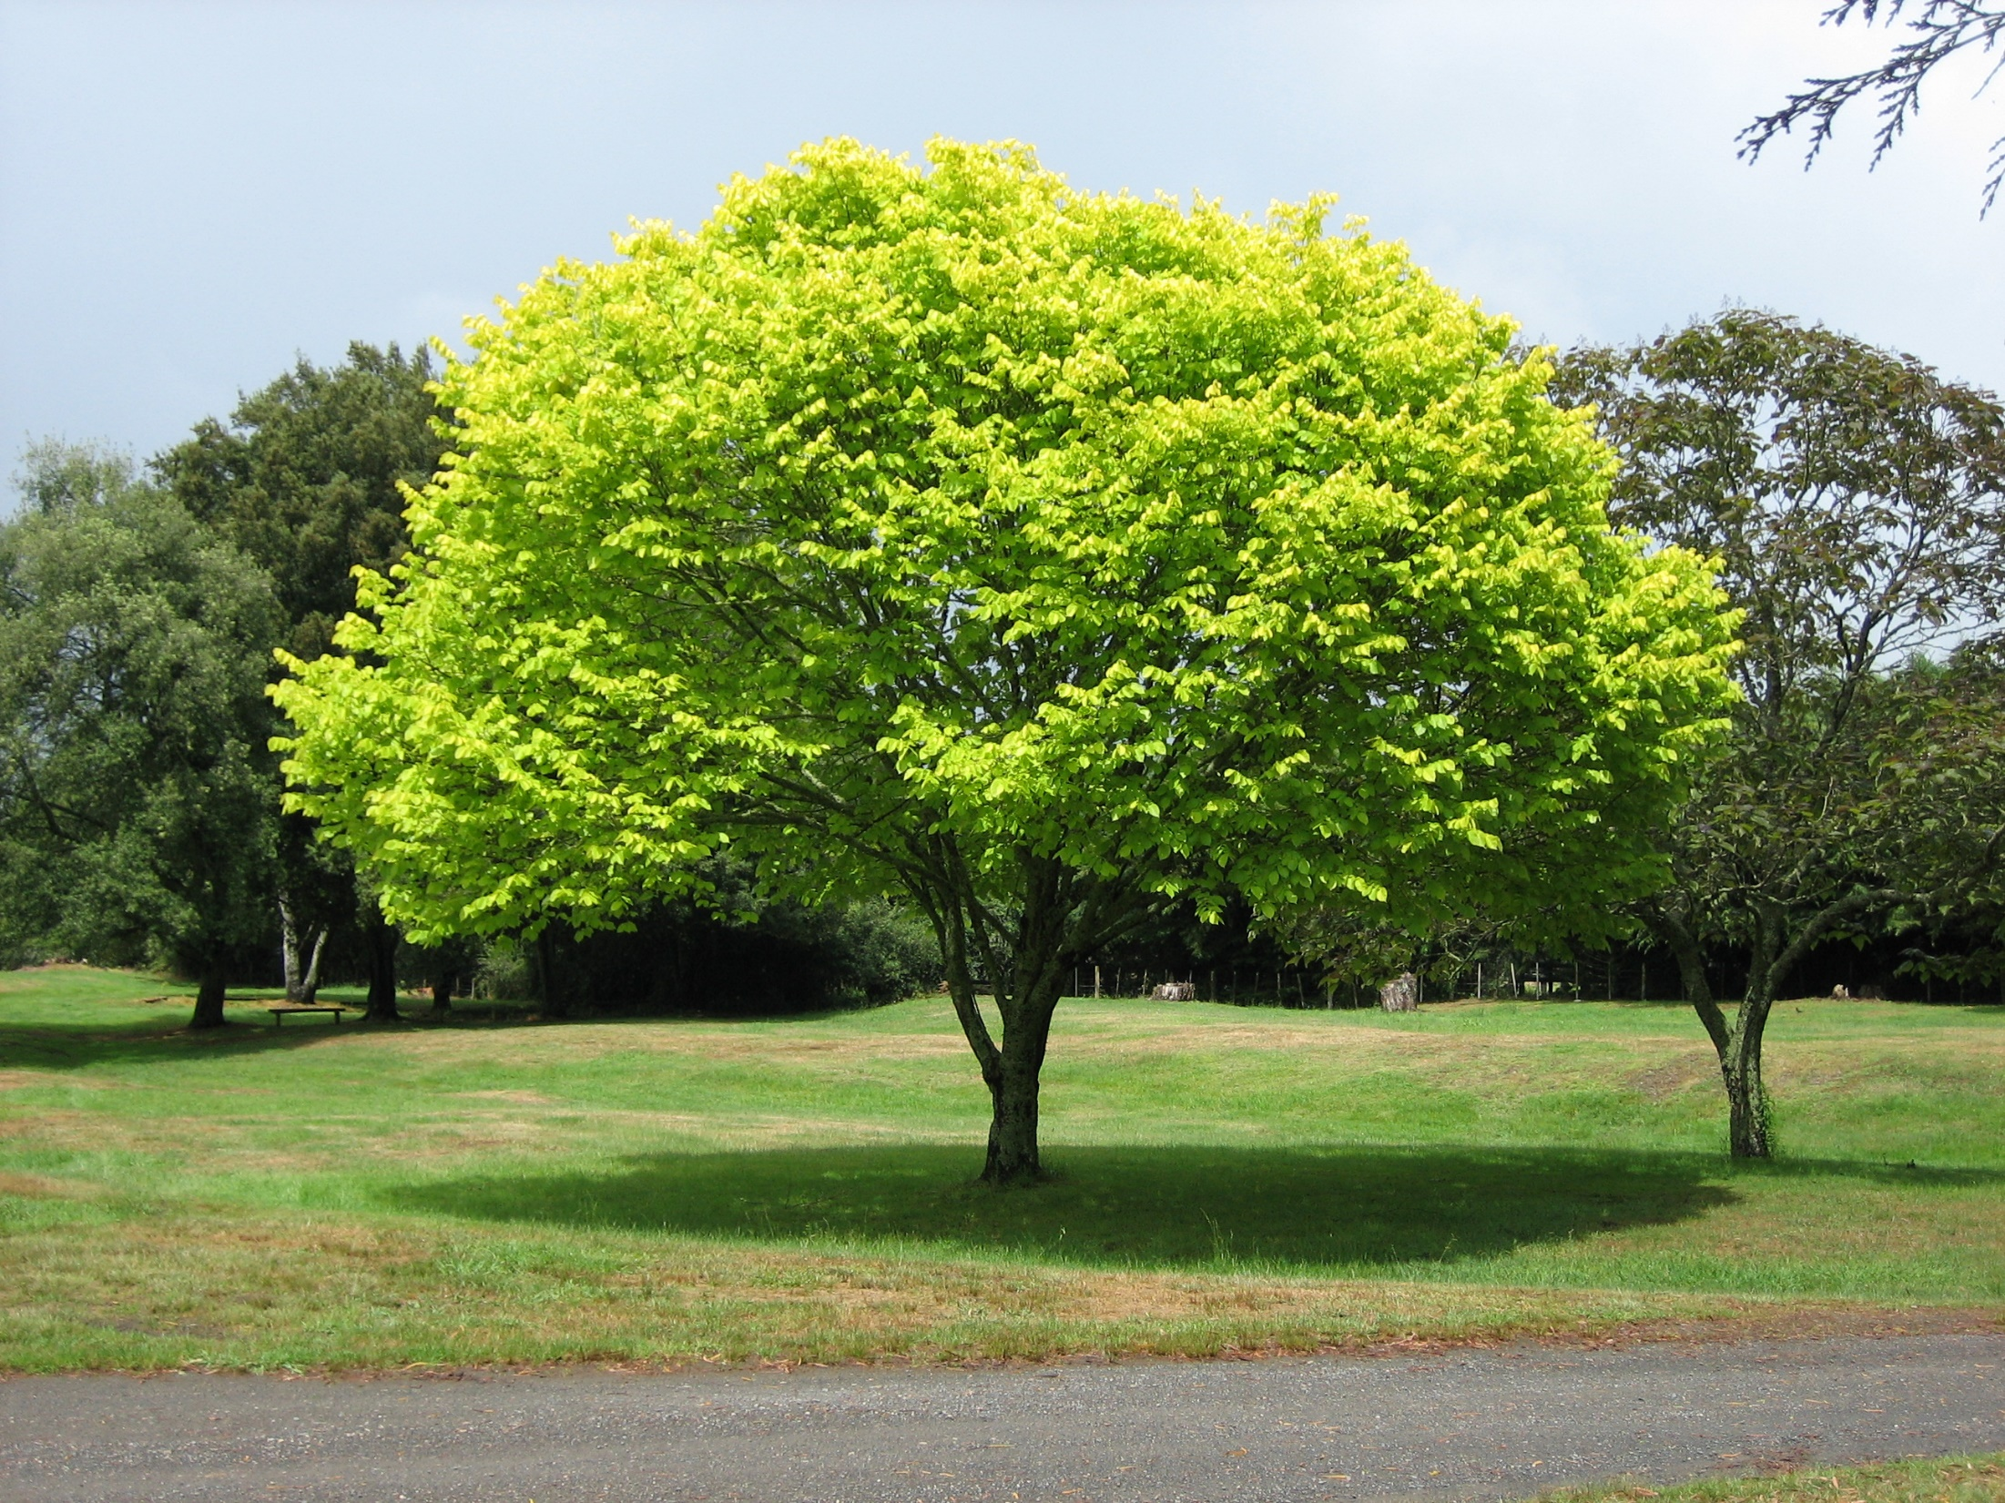
What does the concept of “resilience” mean to you? How can resilience help us to understand “productive failure”?
I always think of trees. To withstand the storm they need deep roots and a healthy support system. They bend and perhaps lose the odd branch...but they don’t break and continue to grow. (Paul Kleiman)

Slide 30
Back to our intended learning outcomes
Do you now feel better-able to:
(raise two hands = very much better
Raise one hand = somewhat better
Scratch left ear = no better)
Help your students to improve their learning skills?

Slide 31
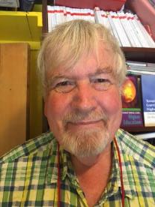
Thank you…
Website: http://phil-race.co.uk
Follow Phil @RacePhil
e-mail: phil@phil-race.co.uk

