Slide 1
Totally Theatrical Theatres!
Fun, Frolics and Creativity
12th June 2019
University of Lincoln
Phil Race
(from Newcastle-upon-Tyne)
BSc PhD PGCE FCIPD PFHEA NTF
Follow Phil on Twitter: @RacePhil
Visiting Professor: University of Plymouth and Edge Hill University
Emeritus Professor Leeds Beckett University

Slide 2
This slide has two purposes….
To focus the data projector if necessary and…
...to persuade colleagues never to put this sort of detail onto a slide!

Slide 3
About Phil…
First a musician
Then a writer
Then a scientist
Then a researcher
Then a lecturer and warden at what is now USW
Got interested in how students learn
And the effects assessment and feedback have on them
And how we teach them
Gradually became an educational developer
And retired yesterday!
Currently…
Visiting Prof: Edge Hill and Plymouth
Emeritus Prof: Leeds Beckett
Based at Newcastle UK
And on trains
And an expert…
on train routes and timetables!
Notes:
2
2

Slide 5
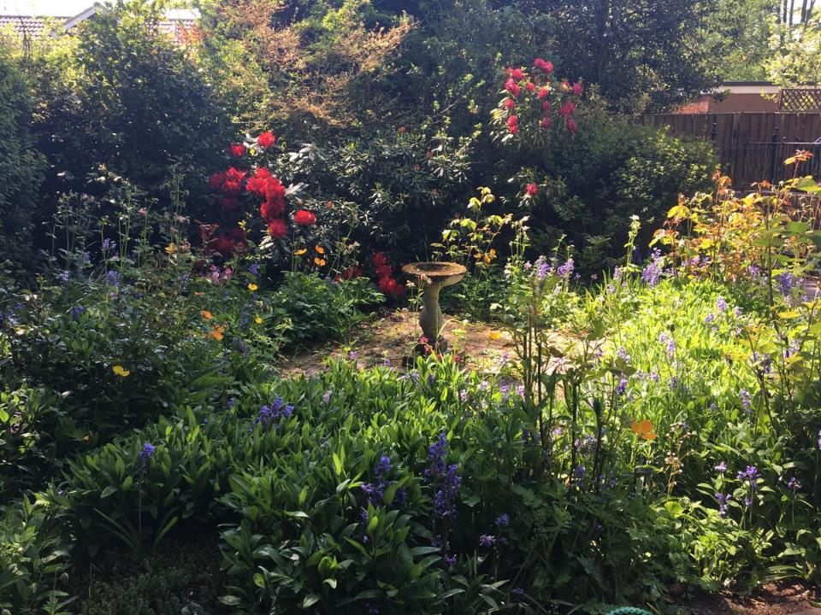

Slide 6
Looking across the Tyne from outside the Sage Gateshead

Slide 7
You will be able to download my main slides
You don’t need to take notes.
I’ll put the main slides I use up on my website tomorrow (http://phil-race.co.uk/)
I may sometimes go through slides quite fast but you can study them as you wish at your leisure.

Slide 8
You can download free much of my published work
http://phil-race.co.uk/2016/04/updated-powerpoint-ripples-model/ (Chapter 1 from ‘The Lecturer’s Toolkit 2015)
https://phil-race.co.uk/2016/10/lthe-tweetchat-lthechat-wed-oct-19-8-00-9-00-pm/ (feedback stuff from my most recent two books)
https://phil-race.co.uk/2018/02/feedback-feedforward-just-tips-including-students/ (just the feedback tips!)
http://phil-race.co.uk/2015/01/assessment-bits-new-editions/ (extracts on assessment)
http://phil-race.co.uk/2017/05/lectures-and-learning/ (extracts on lecturing)

Slide 9
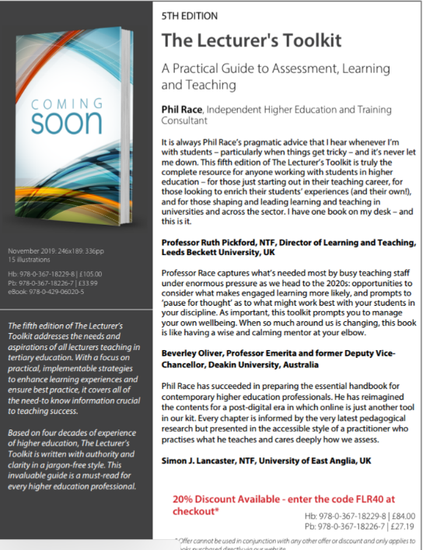
5th Edition in press
Expected to come out in December 2019

Slide 10
The three questions always in each student’s mind…
What will I be expected to show for this?
What does a good one look like and a bad one?
Where does this fit into the big picture?

Slide 11
Addressing the 2020s: Eight concurrent, related paradigm shifts
Online information and the internet now just normal, ‘digital’ has now ‘grown up’, and is no longer something different.
More attention to learning, rather than teaching.
Less focus on classes as ‘transmission’ occasions.
Learning-centred approach to assessment of student outcomes.
Greater focus on feedback dialogues, and development of feedback literacy by students.
Increased recognition of the skills, attitudes and behaviours graduates need to be work-ready.
Responsibility of institutions to prepare students through knowledge, orientation and behaviours for active citizenship in their own communities, nations and globally.
Increased recognition of the need for teaching staff to be trained, qualified and accredited as teachers.

Slide 12
Intended learning outcomes
After participating today you should be better-able to:
Have more fun in lecture theatres.
Give your students more fun in lecture theatres!
Make more learning happen while students are with you.
(including their learning!)
Increase your student attendance.

Slide 13
Beyond the tyranny of intended learning outcomes?
What about our learning aspirations?
What about their learning aspirations?
What about their learning incomes?
What about their learning outputs?
What about their emergent learning outcomes?
What about our intended learning outgoings?

Slide 14
Finding out more about you…
In the last 12 months,
I’ve completed a MOOC
I’ve started one
I’ve helped to design one
I’ve found one
What’s a MOOC?
Voting: A = 2 hands, B = 1 hand
C = touch left ear, D = touch right ear
E = scratch your head

Slide 15
Mobile phones and laptops...
Please turn on your ‘phones tablets and laptops.
Please post your thoughts questions comments and ideas during this session to the hashtag #philatlincoln19 Thanks!
Try #LTHEchat on Wednesday evenings from 20.00-21.00.

Slide 16
#LTHEchat is held on Wednesdays, term-time 8-9 pm: one hour, one or two convenors, 6 questions, c.200 international participants.

Slide 17
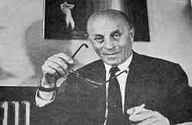
Disruptive Technology?
“A disruptive technology is an innovation providing a product or service that is so compelling that everyone rapidly abandons their current way of doing things and flocks to what is new”.
Previous ones included…
Chalk?
Print?
The Biro?
Slides?
The OHP?
Handouts?
PowerPoint?
MOOCs?
Bíró László József
(surname placed first per Hungarian convention) (29 September 1899 – 24 October 1985) was the inventor of the modern ballpoint pen.

Slide 18
chalk

Slide 19
The underhand projector

Slide 20
Time-constrained assessed, written post-it exercise
On a post-it in your best handwriting please write your own completion of the starter:
“Putting lecture theatres to good use would be much better if only I …”
Please swap post-its so that you’ve no idea who has yours.
If chosen please read out with passion and drama the post-it you now have.

Slide 21
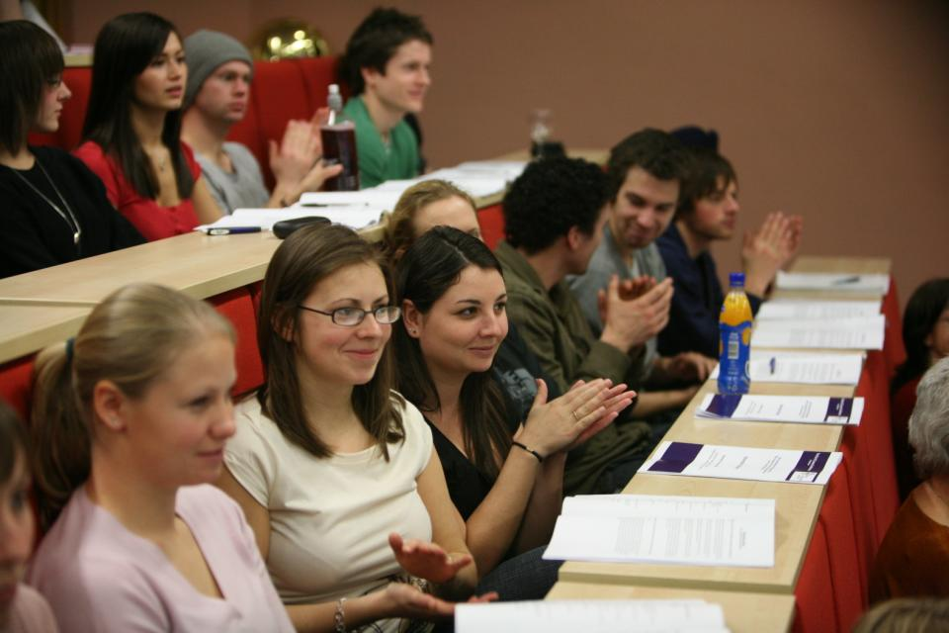
Nowadays...

Slide 22
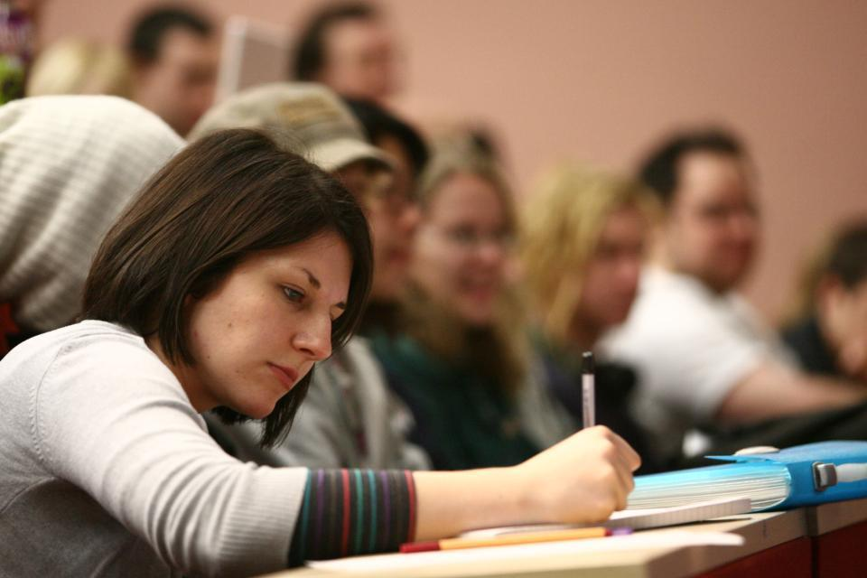
Got it?

Slide 23
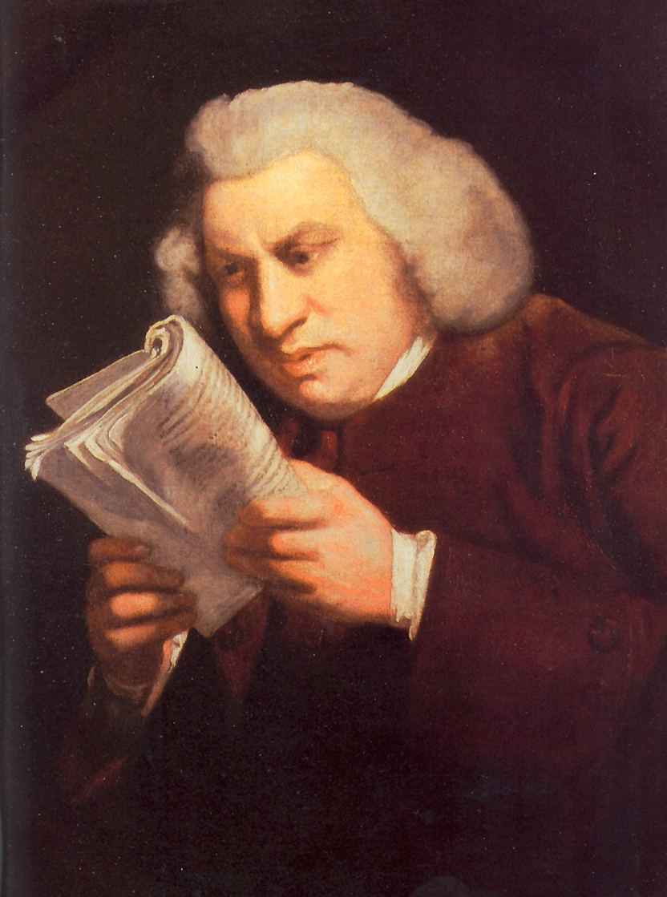
Lectures
Lectures were once useful, but now, when all can read, and books are so numerous, lectures are unnecessary.
(Samuel Johnson, 1709-1784)

Slide 24
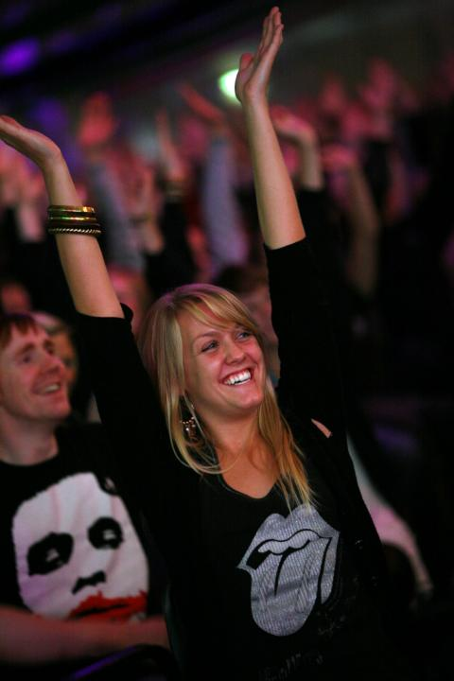
Yes

Slide 25
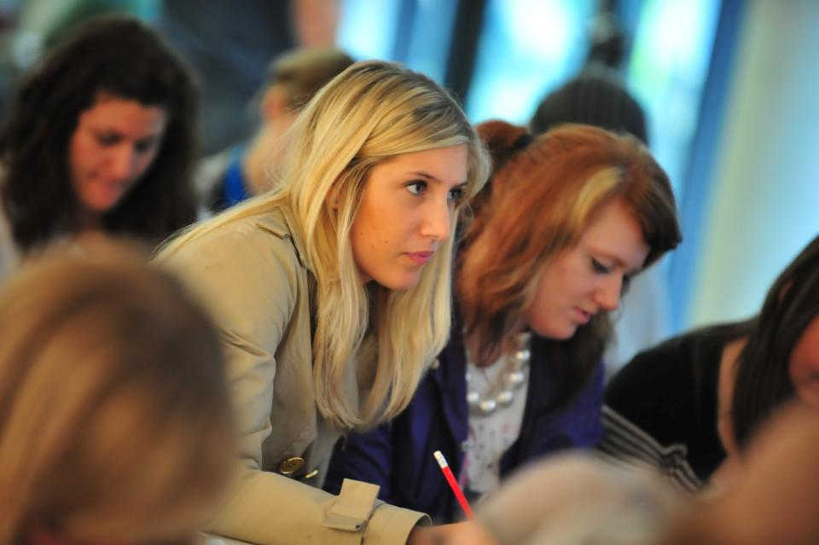
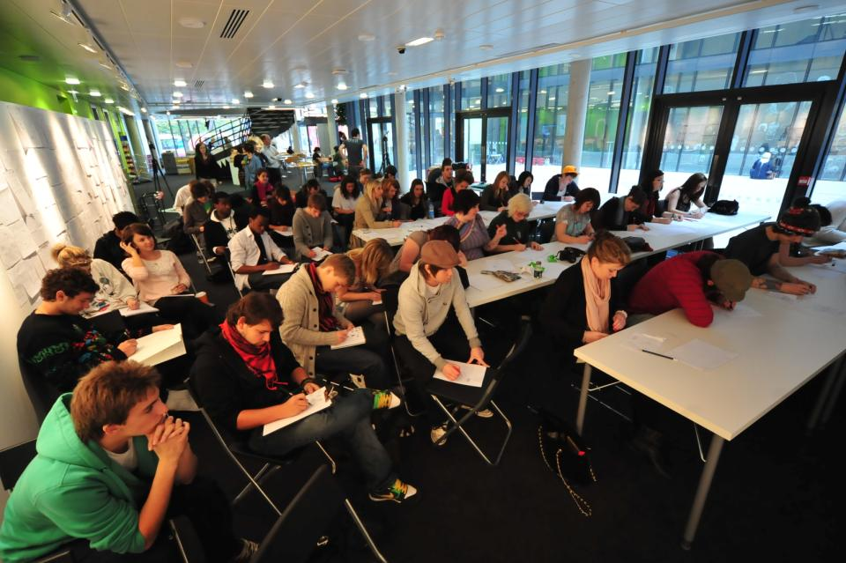
Not always the ideal environment

Slide 26
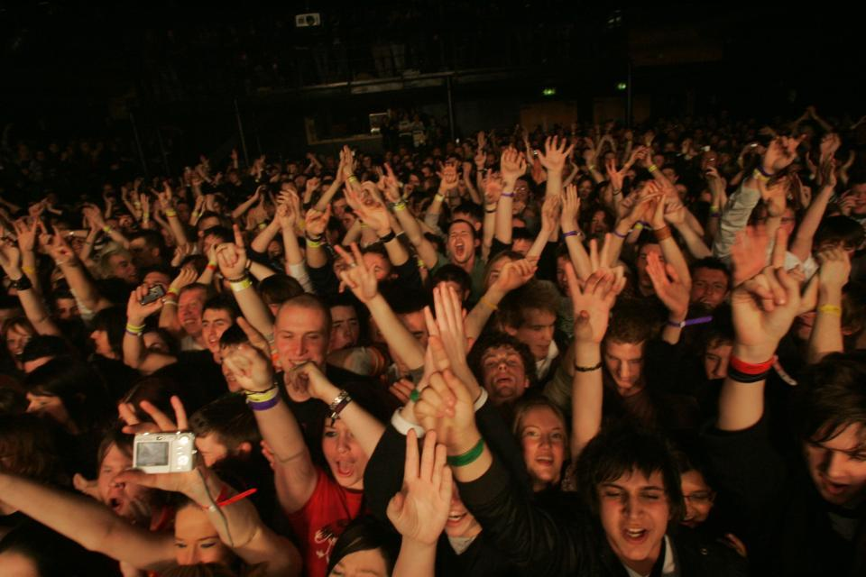
Just sometimes: wow!

Slide 27
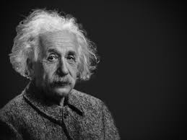
Thought for the day: Einstein
It is simply madness
to keep doing the same things
and expect different results.

Slide 28
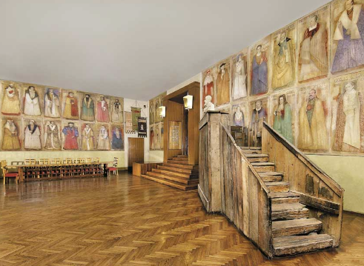
Do we spend too much of our time trying to teach our students?
We need to spend more energy helping them to appreciate feedback, make judgements, manage affect, taking action. (Carless and Boud, 2018)
Galileo: You can’t
teach a man
anything.
You can only help
him to learn.

Slide 29
Coming out shortly…
Naomi Winstone and David Carless
Designing effective feedback processes in higher education
Routledge 2019

Slide 30
What annoys students in class?
Staff who don’t appear to have done good preparation of content material;
Material at the wrong level, that is too easy or goes right over their heads;
Lecturers who seem jaded, unenthusiastic or uninterested in what they are teaching;
Teaching formats that never change and over-use PowerPoint;
Lack of interaction between the lecturer and students;
Issues around timing, particularly over-running and rushing at the end.
Nicked from Sally

Slide 31
Students as partners…
Students are partners in learning.
They always have been.
We haven’t always made it an optimal partnership.
We can.
I could not do what I do nowadays if I did not continue to spend a fair bit of my time working with students – they’ve taught me most of what I know.

Slide 33
Teaching, learning and enthusiasm
Knowledge isn’t infectious (unfortunately) but enthusiasm is, and we need to help our students to catch enthusiasm.
We certainly don’t want teaching, assessment or feedback to damage that enthusiasm.

Slide 35
HEA Fellowships? (Professional development relating to teaching, learning and assessment)
How many of you are already: (please raise hands)
Associate Fellow (AFHEA) 23,538
Fellow (FHEA) 75,033
Senior Fellow (SFHEA) 9,557
Principal Fellow (PFHEA) 995
National Teaching Fellow (NTF) c.900
(Numbers at start of 2019; seem to be included in some league tables)

Slide 36
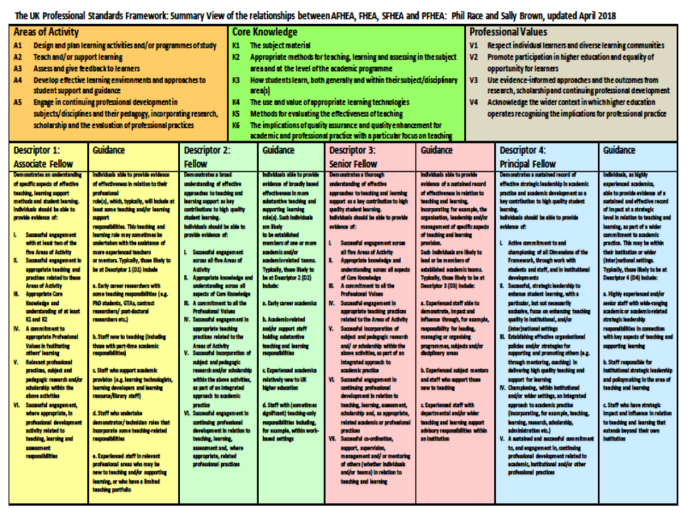
https://phil-race.co.uk/2017/11/ukpsf-page-updated-november-14th/

Slide 37
Thirty second theatre

Slide 38
Face-to-face one-to-one feedback activity
On the signal to start, please stand up, and work in pairs, moving around the room, talking to different people using the script which follows…
The script:
A ‘Hello’ (or equivalent).
B ‘Hello’ (or equivalent).
A ‘You are late’.
B ‘I know’.
Try to do it completely differently each time.

Slide 39
What will I be expected to show for this?
What does a good one look like, and a bad one?
Where does this fit into the big picture?
When explaining assessment criteria to students, and when linking these to evidence of achievement of the intended learning outcomes, we need to make the most of face-to-face whole group contexts and...
Tone of voice
Body language
Facial expression
Eye contact
The chance to repeat things
The chance to respond to puzzled looks
Some things don’t work nearly so well just on paper or on screens.
Some of the
tools we can
use in
face-to-face
contexts

Slide 40
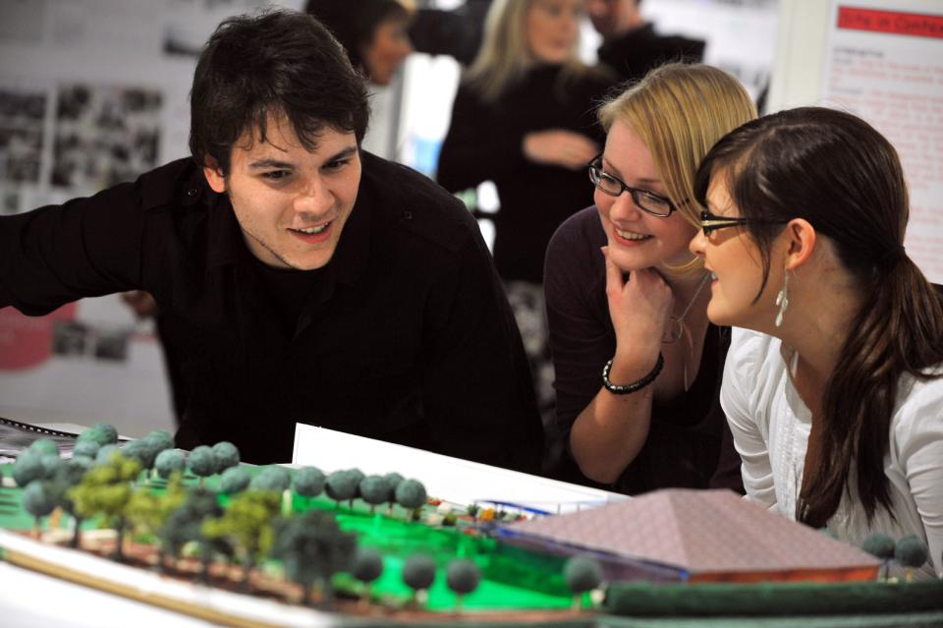
Working together interactively

Slide 41
Learning is not linear! Feedback is not unidirectional. But sometimes we pretend that they are! #sketchnote by @SGroshell and @MrZachG #edchat #learning #teachchat

Slide 42
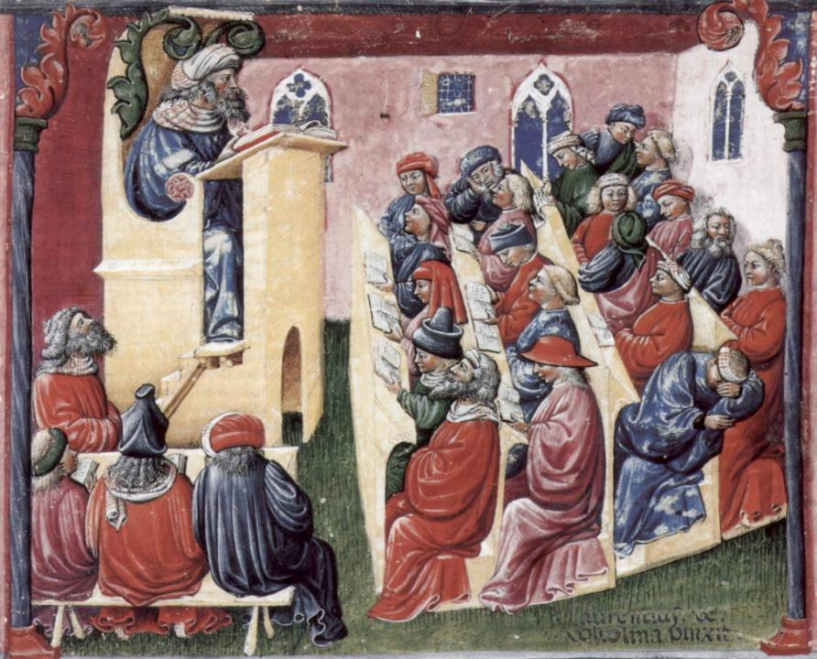
Laurentius de Voltolina
2nd half of 14th Century
Italian Painter

Slide 43
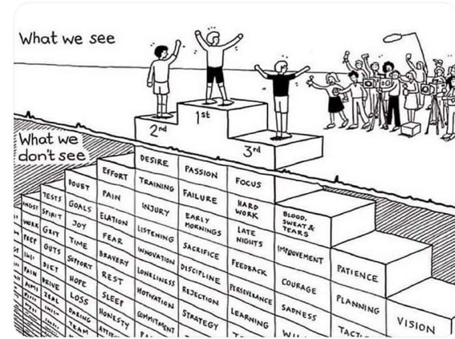
Do we get what we ask for
with intended learning outcomes?
Have we any idea of how many of
these might also have been involved?

Slide 44
How’s your brain?
My brain is:
Digital
Analogue
Both
Neither
Don’t know
Voting: A = 2 hands, B = 1 hand
C = touch left ear, D = touch right ear
E = scratch your head

Slide 45
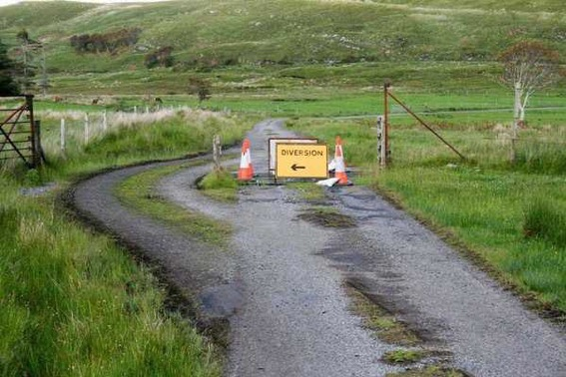

Slide 46
Keeping students engaged:
the ten most important words
Why?
What?
Who?
Where?
When?
How?
Which?
So what?
wtf?
Wow?
And the most powerful four-letter word in the English language...
????

Slide 47
‘what’ is getting ever less important
Columbia University research published (2011) in Science magazine shows that people are much less prepared to remember ‘what’, but better at remembering where to access information, and how to do so.
Betsy Sparrow, one of the principal researchers, concludes that the internet has become ‘an external memory source that we can access at any time. ... Just as we learn through transactive memory who knows what in our families and offices, we are learning what the computer ‘knows’ and when we should attend to where we have stored information in our computer-based memories. We are becoming symbiotic with our computer tools.
Published Online July 14 2011 < Science Express Index Science DOI: 10.1126/science.1207745
Report: Google Effects on Memory: Cognitive Consequences of Having Information at Our Fingertips Betsy Sparrow,*, Jenny Liu, Daniel M. Wegner

Slide 48
Keeping students engaged:
the ten most important words
Why? (rationale)
What? (content)
Who? (people, you, me, them)
Where? (locations)
When? (times)
How? (processes)
Which? (decisions)
So what? (importance?)
Wow? (impact?)
And the most powerful four-letter word in the English language...
????

Slide 49
Making sessions unmissable
Make good use of intended learning outcomes. (and incomes, outgoings, + emergent ones).
Always link sessions to assessment. (That’s what they need)
Don’t keep slides up too long. (Use ‘B’)
Avoid death by bullet point.
Try to cause the learners to like you. (Smile).
Think of what learners will be doing.
Bring in some appropriate humour.
Keep yourself tuned into WIIFM.
S

Slide 50
WIIFM What’s in it for me?
Consciously address the ‘so what’ in students’ minds;
Warm up their ‘want’ to learn.
Clarify their ‘need’ to learn.
Address their questions:
What will I be expected to show for this?
What does a good one look like and a bad one?
Where does this fit into the big picture?

Slide 51
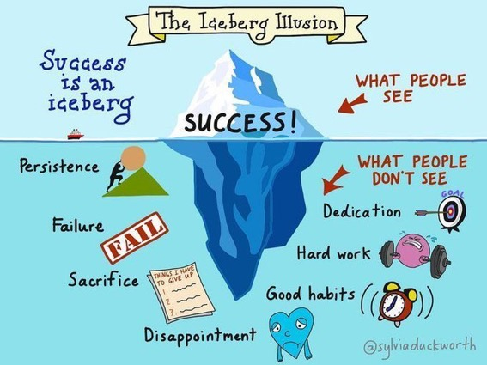

Slide 52
How students really learn
http://phil-race.co.uk/2016/04/updated-powerpoint-ripples-model/ (Chapter 1 from ‘The Lecturer’s Toolkit 2015)

Slide 53
How Students Really Learn ‘Ripples’ model of learning
Phil Race

Slide 55
Unless we do something else…
“[The] pupils got it all by heart; and, when Examination-time came, they wrote it down; and the Examiner said ‘Beautiful! What depth!’
They became teachers in their turn, and they said all these things over again; and their pupils wrote it down, and the examiner accepted it; and nobody had the ghost of an idea what it meant” Lewis Carroll, 1893
Active
Experimentation
Abstract
Conceptualisation
Concrete
Experience
Reflective
Observation

Slide 57
What’s wrong
with
this?
Verbalising
Assessing
Feedback
Making sense
Doing
Wanting/
Needing

Slide 58
What’s wrong
with
this?
Verbalising
Assessing
Feedback
Making sense
Doing
Wanting/
Needing

Slide 59
Thanks, Dr Paul Kleiman

Slide 60
Safety Curtain

Slide 61
Back to our intended learning outcomes
Do you now feel better-able to:
(raise two hands = very much better
Raise one hand = somewhat better
Scratch left ear = no better)
Have more fun in lecture theatres?
Give your students more fun in lecture theatres!
Make more learning happen while students are with you?
Increase your student attendance?

Slide 62
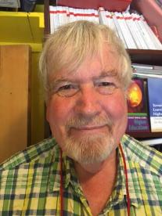
Thank you…
Website: http://phil-race.co.uk
Follow Phil @RacePhil
e-mail: phil@phil-race.co.uk

