Slide 1
Helping students to take charge of their learning processes
17th June 2019
European First-Year Experience Conference 2019 CIT
Phil Race
(from Newcastle-upon-Tyne)
BSc PhD PGCE FCIPD PFHEA NTF
Follow Phil on Twitter: @RacePhil
Visiting Professor: University of Plymouth and Edge Hill University
Emeritus Professor Leeds Beckett University

Slide 2
This slide has two purposes….
To focus the data projector if necessary and…
...to persuade colleagues never to put this sort of detail onto a slide!

Slide 3
About Phil…
First a musician
Then a writer
Then a scientist
Then a researcher
Then a lecturer and warden at what is now USW
Got interested in how students learn
And the effects assessment and feedback have on them
And how we teach them
Gradually became an educational developer
And retired?
Currently…
Visiting Prof: Plymouth & Edge Hill
Emeritus Prof: Leeds Beckett
Based at Newcastle UK
And on trains
And an expert…
on train routes and timetables!
Notes:
2
2

Slide 4
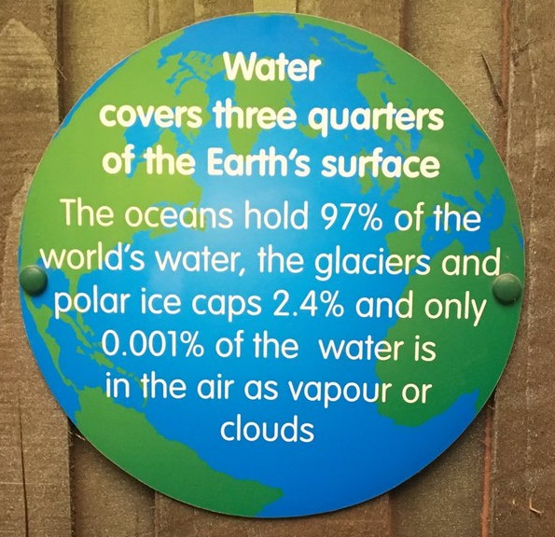

Slide 5
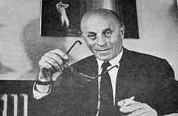
Disruptive Technology?
“A disruptive technology is an innovation providing a product or service that is so compelling that everyone rapidly abandons their current way of doing things and flocks to what is new”.
Previous ones included…
Chalk?
Print?
The Biro?
Slides?
The OHP?
Handouts?
PowerPoint?
MOOCs?
Bíró László József
(surname placed first per Hungarian convention) (29 September 1899 – 24 October 1985) was the inventor of the modern ballpoint pen.

Slide 6
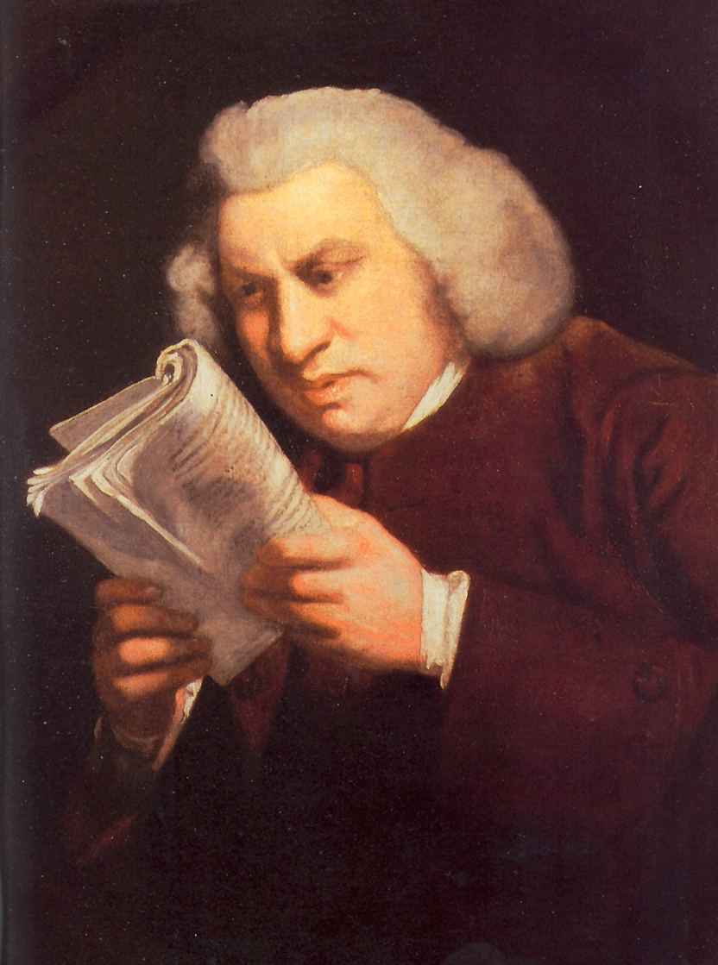
Lectures
Lectures were once useful, but now, when all can read, and books are so numerous, lectures are unnecessary.
(Samuel Johnson, 1709-1784)

Slide 7
Yes

Slide 8
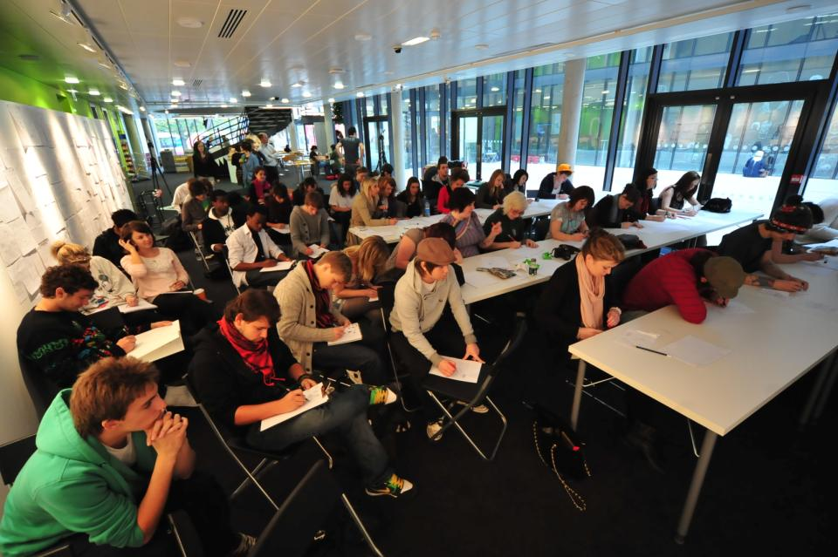
Not always the ideal environment

Slide 9
Just sometimes: wow!

Slide 10
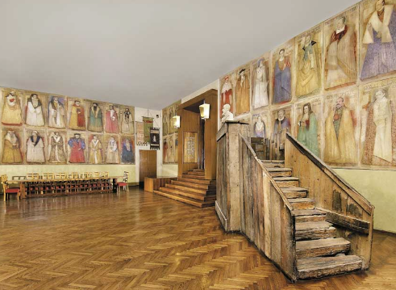
Do we spend too much of our time trying to teach our students?
We need to spend more energy helping them to appreciate feedback, make judgements, manage affect, taking action. (Carless and Boud, 2018)
Galileo: You can’t
teach a man
anything.
You can only help
him to learn.

Slide 11
What annoys students in class?
Staff who don’t appear to have done good preparation of content material;
Material at the wrong level, that is too easy or goes right over their heads;
Lecturers who seem jaded, unenthusiastic or uninterested in what they are teaching;
Teaching formats that never change and over-use PowerPoint;
Lack of interaction between the lecturer and students;
Issues around timing, particularly over-running and rushing at the end.
Nicked from Sally

Slide 12
Students as partners…
Students are partners in learning.
They always have been.
We haven’t always made it an optimal partnership.
We can.
I could not do what I do nowadays if I did not continue to spend a fair bit of my time working with students – they’ve taught me most of what I know.

Slide 13
Thirty second theatre

Slide 14
Face-to-face one-to-one feedback activity
On the signal to start, please stand up, and work in pairs, moving around the room, talking to different people using the script which follows…
The script:
A ‘Hello’ (or equivalent).
B ‘Hello’ (or equivalent).
A ‘You are late’.
B ‘I know’.
Try to do it completely differently each time.

Slide 15
What will I be expected to show for this?
What does a good one look like, and a bad one?
Where does this fit into the big picture?
When explaining assessment criteria to students, and when linking these to evidence of achievement of the intended learning outcomes, we need to make the most of face-to-face whole group contexts and...
Tone of voice
Body language
Facial expression
Eye contact
The chance to repeat things
The chance to respond to puzzled looks
Some things don’t work nearly so well just on paper or on screens.
Some of the
tools we can
use in
face-to-face
contexts

Slide 16
Learning is not linear! Feedback is not unidirectional. But sometimes we pretend that they are! #sketchnote by @SGroshell and @MrZachG #edchat #learning #teachchat

Slide 17
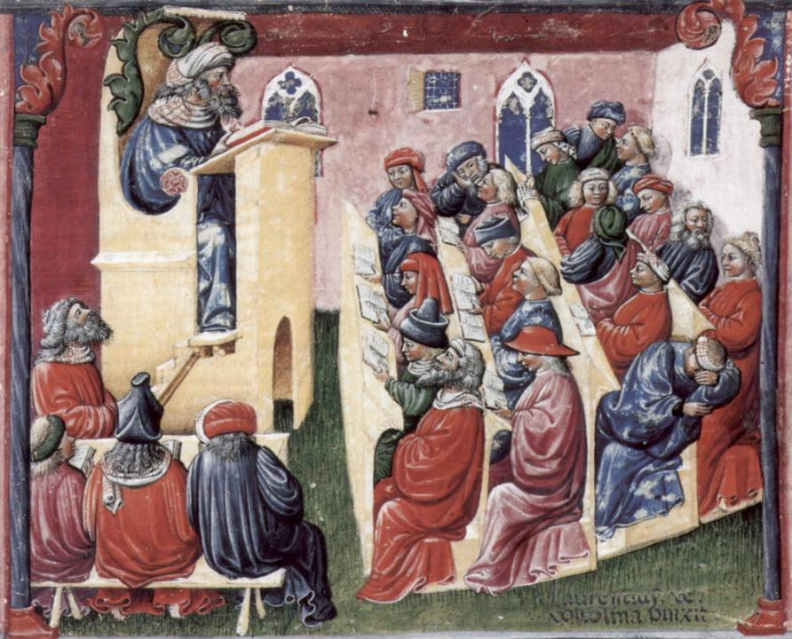
Laurentius de Voltolina
2nd half of 14th Century
Italian Painter

Slide 18
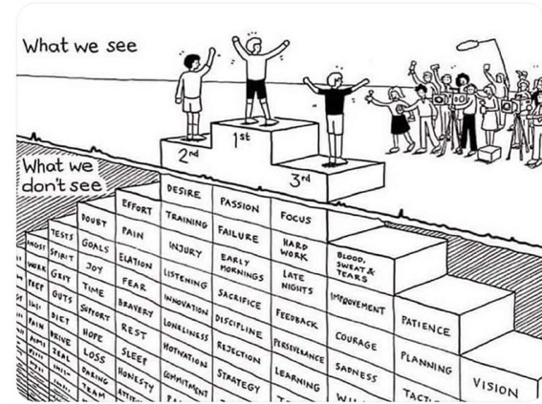
Do we get what we ask for
with intended learning outcomes?
Have we any idea of how many of
these might also have been involved?

Slide 19
Keeping students engaged:
the ten most important words
Why?
What?
Who?
Where?
When?
How?
Which?
So what?
wtf?
Wow?
And the most powerful four-letter word in the English language...
????

Slide 20
‘what’ is getting ever less important
Columbia University research published (2011) in Science magazine shows that people are much less prepared to remember ‘what’, but better at remembering where to access information, and how to do so.
Betsy Sparrow, one of the principal researchers, concludes that the internet has become ‘an external memory source that we can access at any time. ... Just as we learn through transactive memory who knows what in our families and offices, we are learning what the computer ‘knows’ and when we should attend to where we have stored information in our computer-based memories. We are becoming symbiotic with our computer tools.
Published Online July 14 2011 < Science Express Index Science DOI: 10.1126/science.1207745
Report: Google Effects on Memory: Cognitive Consequences of Having Information at Our Fingertips Betsy Sparrow,*, Jenny Liu, Daniel M. Wegner

Slide 21
Keeping students engaged:
the ten most important words
Why? (rationale)
What? (content)
Who? (people, you, me, them)
Where? (locations)
When? (times)
How? (processes)
Which? (decisions)
So what? (importance?)
Wow? (impact?)
And the most powerful four-letter word in the English language...
????

Slide 22
Making sessions unmissable
Make good use of intended learning outcomes. (and incomes, outgoings, + emergent ones).
Always link sessions to assessment. (That’s what they need)
Don’t keep slides up too long. (Use ‘B’)
Avoid death by bullet point.
Try to cause the learners to like you. (Smile).
Think of what learners will be doing.
Bring in some appropriate humour.
Keep yourself tuned into WIIFM.
S

Slide 23
WIIFM What’s in it for me?
Consciously address the ‘so what’ in students’ minds;
Warm up their ‘want’ to learn.
Clarify their ‘need’ to learn.
Address their questions:
What will I be expected to show for this?
What does a good one look like and a bad one?
Where does this fit into the big picture?

Slide 24
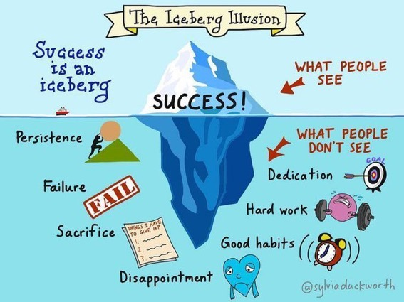

Slide 25
You will be able to download my main slides
You don’t need to take notes.
I’ll put the main slides I use up on my website tonight (http://phil-race.co.uk/)
I may sometimes go through slides quite fast but you can study them as you wish at your leisure.

Slide 26
You can download free much of my published work
http://phil-race.co.uk/2016/04/updated-powerpoint-ripples-model/ (Chapter 1 from ‘The Lecturer’s Toolkit 2015)
https://phil-race.co.uk/2016/10/lthe-tweetchat-lthechat-wed-oct-19-8-00-9-00-pm/ (feedback stuff from my most recent two books)
https://phil-race.co.uk/2018/02/feedback-feedforward-just-tips-including-students/ (just the feedback tips!)
http://phil-race.co.uk/2015/01/assessment-bits-new-editions/ (extracts on assessment)
http://phil-race.co.uk/2017/05/lectures-and-learning/ (extracts on lecturing)

Slide 27
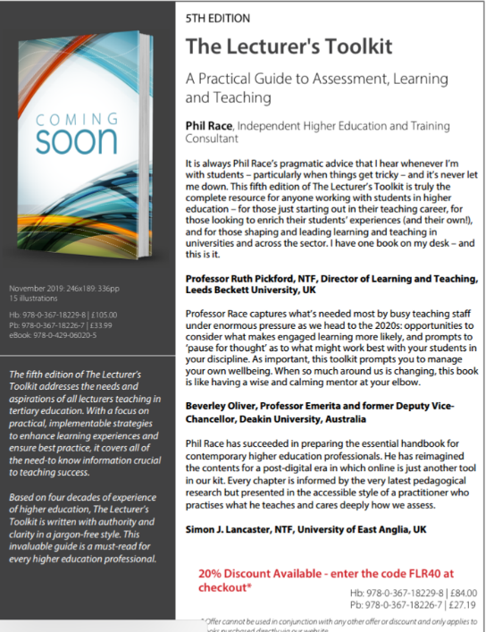
5th Edition in press
Expected to come out in December 2019

Slide 28
The three questions always in each student’s mind…
What will I be expected to show for this?
What does a good one look like and a bad one?
Where does this fit into the big picture?

Slide 29
Addressing the 2020s: Eight concurrent, related paradigm shifts
Online information and the internet now just normal, ‘digital’ has now ‘grown up’, and is no longer something different.
More attention to learning, rather than teaching.
Less focus on classes as ‘transmission’ occasions.
Learning-centred approach to assessment of student outcomes.
Greater focus on feedback dialogues, and development of feedback literacy by students.
Increased recognition of the skills, attitudes and behaviours graduates need to be work-ready.
Responsibility of institutions to prepare students through knowledge, orientation and behaviours for active citizenship in their own communities, nations and globally.
Increased recognition of the need for teaching staff to be trained, qualified and accredited as teachers.

Slide 30
Mobile phones and laptops...
Please turn on your ‘phones tablets and laptops.
Please post your thoughts questions comments and ideas during this session to the hashtag #philatefye19 Thanks!
Try #LTHEchat on Wednesday evenings from 20.00-21.00.

Slide 31
Getting to know each other: a face-to-face thing…
In turn please..
Say one or two sentences about...
who you are
where you come from and
what you do.
In one breath!
(Optional) Share with us one thing that you’re dead good at or really proud of.

Slide 32
Time-constrained written post-it exercise
On a post-it in your best handwriting please write your own completion of the starter:
“Helping students to take charge of their learning would be much better for me if only I…”
Please swap post-its so that you’ve no idea who has yours.
If chosen please read out with passion and drama the post-it you now have.
Please place them all on the chart as directed.

Slide 33
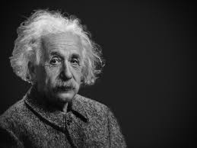
Thought for the day: Einstein
It is simply madness
to keep doing the same things
and expect different results.

Slide 34
Rationale
This interactive session aims to help participants identify the key factors which underpin students' successful learning and help students find out how they are placed regarding essential skills and attitudes using a self-assessment checklist.
The session will also address how staff can help students to identify areas of strength and weakness in their present position so that they can build on strengths and address weaknesses.

Slide 35
And…
Included in the session will be discussion of how staff can help students to do the above and how students can use each other to build their confidence in learning techniques.
The teaching and learning contexts in which students learn will span large-group sessions small-group learning VLE-based learning independent learning and also the best usage of feedback from staff and fellow-students.

Slide 36
Intended learning outcome
After participating today you should be better-able to:
Help your students to improve their learning skills.

Slide 37
Coming out shortly…
Naomi Winstone and David Carless
Designing effective feedback processes in higher education
Routledge 2019

Slide 38
The three questions always in each student’s mind…
What will I be expected to show for this?
What does a good one look like and a bad one?
Where does this fit into the big picture?

Slide 39
Setting your priorities?
1
Urgent and important
2
Urgent
not Important
3
Not urgent
but important
4
Not urgent
not important

Slide 40
Teaching learning and enthusiasm
Knowledge isn’t infectious (unfortunately) but enthusiasm is and we need to help our students to catch enthusiasm.
We certainly don’t want teaching assessment or feedback to damage that enthusiasm.

Slide 41
Numbers?
One for sorrow
Two for joy
Three for a girl
Four for a boy
Five for silver
Six for gold
Seven for Customer Service
Eight to listen to these options again.

Slide 42
Disengaged students
Don’t live up to their potential and fail to achieve their very best;
Make life more difficult for the staff who teach and support them;
Drop out of higher education thereby damaging their own prospects and institutions’ performance indicators;
Institutions suffer both financially and in terms of their status and reputation from high attrition rates.

Slide 44
How students really learn
http://phil-race.co.uk/2016/04/updated-powerpoint-ripples-model/ (Chapter 1 from ‘The Lecturer’s Toolkit 2015)

Slide 45
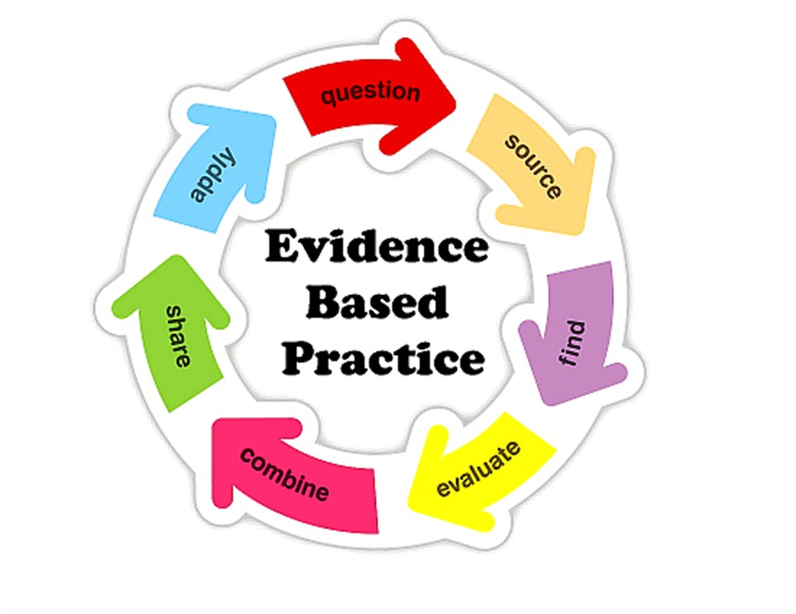

Slide 46
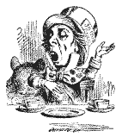
Unless we do something else…
“[The] pupils got it all by heart; and when Examination-time came they wrote it down; and the Examiner said ‘Beautiful! What depth!’
They became teachers in their turn and they said all these things over again; and their pupils wrote it down and the examiner accepted it; and nobody had the ghost of an idea what it meant” Lewis Carroll 1893
Active
Experimentation
Abstract
Conceptualisation
Concrete
Experience
Reflective
Observation

Slide 47
Ripples on a pond….
Wanting/
Needing
Doing
Making sense
Feedback

Slide 48
Ripples on a pond….
Verbalising
Wanting/
Needing
Doing
Making sense
Feedback

Slide 49
Ripples on a pond….
Verbalising
Assessing
making informed judgements
Wanting/
Needing
Doing
Making sense
Feedback

Slide 50
What’s wrong
with
this?
Verbalising
Assessing
Feedback
Making sense
Doing
Wanting/
Needing

Slide 51
What’s wrong
with
this?
Verbalising
Assessing
Feedback
Making sense
Doing
Wanting/
Needing

Slide 52
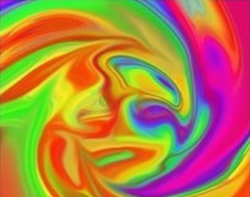
Thanks Dr Paul Kleiman

Slide 53
Safety Curtain

Slide 54
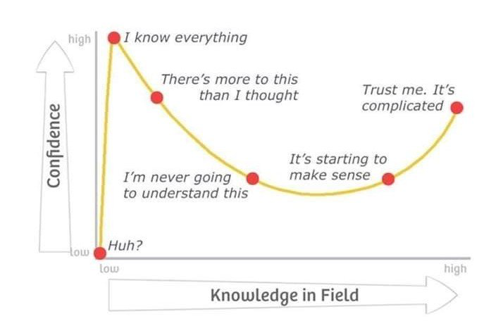
Adapted from Kruger J. and Dunning D. 2009

Slide 56
But what about learning styles?
https://www.theguardian.com/education/2017/mar/12/no-evidence-to-back-idea-of-learning-styles?CMP=share_btn_tw
(Link from my Tweet on March 13th 2017 to a letter in the Guardian by prominent folk around the world of education)
Or link to a word document: https://phil-race.co.uk/2017/09/swansea-university-school-management-21st-September/
“No evidence to back idea of learning styles”

Slide 57
I’m comfortable that I am doing this rather well | I’m pretty good at this on the whole | I would like to become better at this | I need to think more about this | Focus for action
4 | 3 | 2 | 1 | *

Slide 58
I’m comfortable that I am doing this rather well | I’m pretty good at this on the whole | I would like to become better at this | I need to think more about this | Focus for action
I feel that I know why I’m here, what I’m here for, and how to go about realising my ambitions successfully.
I avoid just ‘collecting the stuff’ (notes, weblinks, handouts) and regularly get to grips with the material rather than leaving it for later.
I’m really keen to learn. I enjoy learning and am willing to do my best with new topics ideas and situations.
I really need to learn and succeed. I’m determined to be successful in my studies and do everything I need to do to excel at assessments.
I ask myself ‘what exactly am I expected to become able to do with this?’ for each class session, chapter, book, idea, web reference, and so on.
I tend to learn best by getting stuck in and practising things until I can do them well.
I avoid putting off things which need doing. I’m good at keeping up with what I need to do on a day-to-day basis.
I manage time effectively. I’m normally punctual, and I make sensible decisions about how much I can sensibly achieve at any time.
I feel best when I can really make sense of concepts and ideas, and keep up with the sense-making as I go, rather than hoping it will happen later.

Slide 59
I’m comfortable that I am doing this rather well | I’m pretty good at this on the whole | I would like to become better at this | I need to think more about this | Focus for action
When I get positive feedback on what I’ve done, I resist ‘shrugging it off’ and instead try to build on what I’ve done well.
When I get critical feedback on what I’ve done, I resist being hurt or defensive, and try to work out exactly what to do to make things better.
I find it really useful to explain things I’m learning to friends, relatives and anyone who will listen – this helps me make sense of it better.
I self-assess everything I do for assessment before submitting it, so I internalise the criteria which others will use to assess my work.
I try to find out ‘what does a ‘good’ example of this look like, and what does a ‘poor’ example look like?’ for everything I do for assessment.
Always on my mind is the question ‘where does this particular bit fit into the bigger picture of my module, course, degree, life?’
I monitor my stress levels as I study, and know when it feels as if things are getting on top of me, and seek help from people who can help.
I’m there! Except in emergency I go to class sessions rather than try to catch up from ‘captured sessions’, fellow-students’ notes, and so on.

Slide 60
Back to our intended learning outcome
Do you now feel better-able to:
(raise two hands = very much better
Raise one hand = somewhat better
Scratch left ear = no better)
Help your students to improve their learning skills?

Slide 61
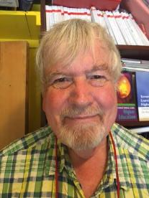
Thank you…
Website: http://phil-race.co.uk
Follow Phil @RacePhil
e-mail: phil@phil-race.co.uk

Slide 62
Useful references and further reading (1)
Bain K. (2004) What the best College Teachers do Cambridge: Harvard University Press.
Biggs J. and Tang C. (2011) Teaching for Quality Learning at University Maidenhead: Open University Press.
Bloxham S. and Boyd P. (2007) Developing effective assessment in higher education: a practical guide Maidenhead Open University Press.
Boud D. (1995) Enhancing learning through self-assessment London: Routledge.
Brown S. and Glasner A. (eds.) (1999) Assessment Matters in Higher Education Choosing and Using Diverse Approaches Maidenhead: Open University Press.
Brown S. and Race P. (2012) Using effective assessment to promote learning in Hunt L. and Chambers D. (2012) University Teaching in Focus Victoria Australia Acer Press. P74-91.
Brown S. (2015) Learning Teaching and Assessment in Higher Education: Global perspectives London Palgrave.
Carless D. Joughin G. Ngar-Fun Liu et al (2006) How Assessment supports learning: Learning orientated assessment in action Hong Kong: Hong Kong University Press.
Carless D. and Boud D. (2018): The development of student feedback literacy: enabling uptake of feedback Assessment & Evaluation in Higher Education https://doi.org/10.1080/02602938.2018.1463354

Slide 63
Useful references and further reading (2)
Carroll J. and Ryan J. (2005) Teaching International students: improving learning for all. London: Routledge SEDA series.
Crosling G. Thomas L. and Heagney M. (2008) Improving student retention in Higher Education London and New York: Routledge
Crooks T. (1988) Assessing student performance HERDSA Green Guide No 8 HERDSA (reprinted 1994).
Dunworth K. and Sanchez H.S. (2016). Perceptions of quality in staff-student written feedback in higher education: a case study. Teaching in Higher Education 21(5) pp.576-589.
Dweck C. S. (2000) Self Theories: Their Role in Motivation Personality and Development Lillington NC: Taylor & Francis.
Falchikov N. (2004) Improving Assessment through Student Involvement: Practical Solutions for Aiding Learning in Higher and Further Education London: Routledge.
Gibbs G. (1999) Using assessment strategically to change the way students learn in Brown S. & Glasner A. (eds.) Assessment Matters in Higher Education: Choosing and Using Diverse Approaches Maidenhead: SRHE/Open University Press.
Higher Education Academy (2012) A marked improvement; transforming assessment in higher education York: HEA.

Slide 64
Useful references and further reading (3)
Hawe E. Lightfoot U. & Dixon H. (2017). First-year students working with exemplars: Promoting self-efficacy self-monitoring and self-regulation. Journal of Further and Higher Education 1-15.
Hendry G. D. White P. & Herbert C. (2016). Providing Exemplar-Based “Feedforward” before an Assessment: The Role of Teacher Explanation. Active Learning in Higher Education 17(2) 99-109.
Hounsell D. McCune V. Hounsell J. and Litjens J. (2008). The quality of guidance and feedback to students. Higher Education Research & Development 27(1) pp.55-67.
Newton P. M. (2018) How Common Is Commercial Contract Cheating in Higher Education and Is It Increasing? A Systematic Review https://www.frontiersin.org/articles/10.3389/feduc.2018.00067/full
Nicol D. J. and Macfarlane-Dick D. (2006) Formative assessment and self-regulated learning: A model and seven principles of good feedback practice Studies in Higher Education Vol 31(2) 199-218.
PASS project Bradford http://www.pass.brad.ac.uk/ Accessed January 2019.
Pickford R. and Brown S. (2006) Assessing skills and practice London: Routledge.
Rotheram B. (2009) Sounds Good JISC project http://www.jisc.ac.uk/whatwedo/programmes/usersandinnovation/soundsgood.aspx

Slide 65
Useful references and further reading (4)
Race P. (2001) A Briefing on Self Peer & Group Assessment https://phil-race.co.uk/archive-of-downloads-from-previous-website/
Race P. (2014) Making Learning Happen (3rd edition) London: Sage.
Race P. (2015) The lecturer’s toolkit (4th edition) London: Routledge.
Race P. (2017) Fifteen ideas for making assessment and feedback more effective efficient and manageable for us and for students: SEDA Developments https://www.seda.ac.uk/resources/files/publications_214_Educational%20Developments%2018.2.pdf (accessed January 2019)
Rust C. Price M. and O’Donovan B. (2003) Improving students’ learning by developing their understanding of assessment criteria and processes Assessment and Evaluation in Higher Education. 28 (2) 147-164.
Scoles J. Huxham M. & McArthur J. (2013). No longer exempt from good practice: Using exemplars to close the feedback gap for exams. Assessment & Evaluation in Higher Education 38(6) 631-645.
Sadler D. Royce (2010) Beyond feedback: developing student capability in complex appraisal Assessment & Evaluation in Higher Education 35: 5 535-550.

