Slide 2
Towards assessment as learning
June 19th 2019
University College, Cork
Phil Race
(from Newcastle-upon-Tyne)
BSc PhD PGCE FCIPD PFHEA NTF
Follow Phil on Twitter: @RacePhil
Visiting Professor: University of Plymouth and Edge Hill University
Emeritus Professor, Leeds Beckett University

Slide 3
This slide has two purposes….
To focus the data projector, if necessary, and…
...to persuade colleagues never to put this sort of detail onto a slide!

Slide 4
About Phil…
First a musician
Then a writer
Then a scientist
Then a researcher
Then a lecturer and warden at what is now USW
Got interested in how students learn
And the effects assessment and feedback have on them
And how we teach them
Gradually became an educational developer
And now ‘retired’?
Currently…
Visiting Prof: Plymouth & Edge Hill
Emeritus Prof: Leeds Beckett
Based at Newcastle, UK
And on trains
And an expert…
on train routes and timetables!
Notes:
2
2

Slide 5
Download anytime Phil’s materials on feedback, assessment, and learning
Expanded discussion of how the factors underpinning learning link to feedback, assessment and large-group teaching:
http://phil-race.co.uk/2016/04/updated-powerpoint-ripples-model/ (Chapter 1 from ‘The Lecturer’s Toolkit, 2015)
https://phil-race.co.uk/2016/10/lthe-tweetchat-lthechat-wed-oct-19-8-00-9-00-pm/ (feedback stuff from my most recent two books)
http://phil-race.co.uk/2015/01/assessment-bits-new-editions/ (extracts on assessment)

Slide 6
Mobile phones and laptops...
Please turn on your ‘phones tablets and laptops.
Please post your thoughts questions comments and ideas during this session to the hashtag #philatucc19 Thanks!
Try #LTHEchat on Wednesday evenings from 20.00-21.00.

Slide 7
#LTHEchat is held on Wednesdays, term-time 8-9 pm: one hour, one or two convenors, 6 questions, c.200 international participants.

Slide 8
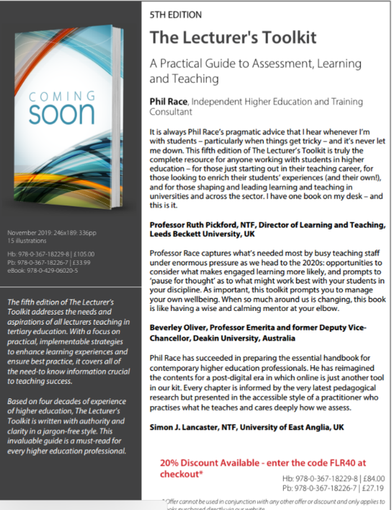
5th Edition in press
Expected to come out in December 2019

Slide 9
Addressing the 2020s: Eight concurrent, related paradigm shifts
Online information and the internet now just normal, ‘digital’ has now ‘grown up’, and is no longer something different.
More attention to learning, rather than teaching.
Less focus on classes as ‘transmission’ occasions.
Learning-centred approach to assessment of student outcomes.
Greater focus on feedback dialogues, and development of feedback literacy by students.
Increased recognition of the skills, attitudes and behaviours graduates need to be work-ready.
Responsibility of institutions to prepare students through knowledge, orientation and behaviours for active citizenship in their own communities, nations and globally.
Increased recognition of the need for teaching staff to be trained, qualified and accredited as teachers.

Slide 10
The three questions always in each student’s mind…
What will I be expected to show for this?
What does a good one look like and a bad one?
Where does this fit into the big picture?

Slide 11
Towards assessment as learning
Last century, we had lots of assessment of learning.
We still need to do some of this, e.g. to assure fitness to practice.
Some institutions have moved a long way towards assessment for learning.
I believe we now need to make a final jump – assessment as learning.
I’m going to help you to think of the extent to which each of a number of assessment methods can bring assessment and learning closer, and achieve assessment as learning for students.

Slide 12
Today
We will look at the pros and cons of some of the most often-used processes and instruments in our traditional approaches to assessment, and explore what else we can do to improve assessment.
We will also look at how we can use formative assessment to open up feedback dialogues with students to deepen their learning and help them to make the most of our feedback to them. We will explore how best we can make assessment better for students by involving them in self- and peer-assessment.

Slide 13
Intended learning outcomes
After participating in this session, you should be better-able to:
Identify and confront some of the main problems we have implementing assessment and feedback using traditional approaches.
Discuss possible ways of addressing some of these problems creatively, so that assessment and feedback can be firmly linked to student learning.

Slide 14
Face-to-face one-to-one feedback activity
On the signal to start, please stand up, and work in pairs, moving around the room, talking to different people using the script which follows…
The script:
A ‘Hello’ (or equivalent).
B ‘Hello’ (or equivalent).
A ‘You are late’.
B ‘I know’.
Try to do it completely differently each time.

Slide 15
Setting your priorities?
1
Urgent and important
2
Urgent
not Important
3
Not urgent
but important
4
Not urgent
not important

Slide 16
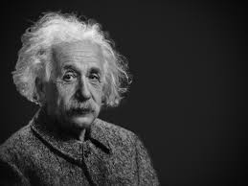
Thought for the day: Einstein
It is simply madness,
to keep doing the same things,
and expect different results.

Slide 17
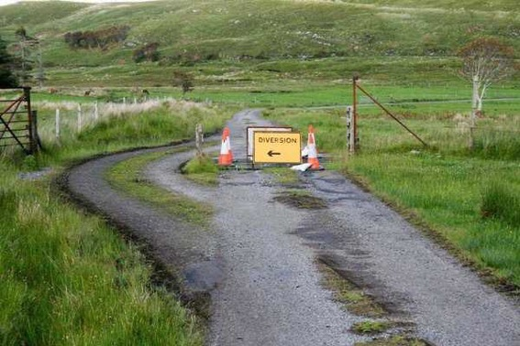

Slide 18
Assessment and feedback:
the ten most important words
Why?
What?
Who?
Where?
When?
How?
Which?
So what?
wtf?
Wow?
And the most powerful four-letter word in the English language...
????

Slide 19
‘what’ is getting ever less important
Columbia University research published (2011) in Science magazine shows that people are much less prepared to remember ‘what’, but better at remembering where to access information, and how to do so.
Betsy Sparrow, one of the principal researchers, concludes that the internet has become ‘an external memory source that we can access at any time. ... Just as we learn through transactive memory who knows what in our families and offices, we are learning what the computer ‘knows’ and when we should attend to where we have stored information in our computer-based memories. We are becoming symbiotic with our computer tools.
Published Online July 14 2011 < Science Express Index Science DOI: 10.1126/science.1207745
Report: Google Effects on Memory: Cognitive Consequences of Having Information at Our Fingertips Betsy Sparrow,*, Jenny Liu, Daniel M. Wegner

Slide 20
Assessment and feedback:
the ten most important words
Why? (rationale)
What? (content)
Who? (people, you, me, them)
Where? (locations)
When? (times)
How? (processes)
Which? (decisions)
So what? (importance?)
Wow? (impact?)
And the most powerful four-letter word in the English language...
????

Slide 21
Assessment and feedback:
the ten most important words
Why? (rationale)
What? (content)
Who? (people, you, me, them)
Where? (locations)
When? (times)
How? (processes)
Which? (decisions)
So what? (importance?)
Wow? (impact?)
And the most powerful four-letter word in the English language...
else

Slide 22
Go forth and
elsify!

Slide 23
Reality Check
Which of the following do you actually spend most of your time (apart from research time) on…
Actually teaching students?
Preparing materials to teach students?
Assessing students’ work?
Composing feedback on students’ work?
Giving students feedback?
Voting: A = 2 hands, B = 1 hand
C = touch left ear, D = touch right ear
E = scratch your head

Slide 24
Rationale
This session starts from the premise that ‘assessment and feedback are broken’ in higher education at present. We spend far too much time doing them, and burn ourselves out, and are not measuring the right things! We will explore what we can do to make assessment and feedback more fit-for-purpose, and help them to be better drivers for students’ learning.

Slide 25
Why re-invent assessment and feedback now?
They take far too much of our time and energy. Staff are burning themselves out trying to apply old assessment and feedback methods to much larger cohorts of students.
Assessment and feedback are vitally important to students.
Feedback from students continues to show their relative dissatisfaction with assessment and feedback.
Assessment and feedback contribute strongly to the NSS, and therefore also to TEF.
It is madness just to keep trying to do the same things better – we need to be ready to try something else.

Slide 26
Reinventing assessment and feedback
Part of the problem is that we tend to keep on trying to use the processes which used to work well enough years ago, but don’t satisfy today’s student needs and expectations – and often student numbers are higher too.
See also
https://www.seda.ac.uk/resources/files/publications_214_Educational%20Developments%2018.2.pdf (2017, pp.21-24)

Slide 27
Experience of Royce Sadler on standards, assessment and feedback
Well worth looking at this clip from Coursera from Royce Sadler, who’s work informs much of the modern thinking on assessment and feedback…

Slide 28
Time-constrained, assessed written Post-it exercise
On a post-it, in your best handwriting, please write your own completion of the starter:
“Assessment and feedback would work much better with my students nowadays if only I …”
Please swap post-its so that you’ve no idea who has yours.
If chosen, please read out with passion and drama what’s on the post-it you now have.
Please place them all as directed.

Slide 29
Now is the decade of Universities’ dis-content!
Never mind the content – feel the learning

Slide 30
Teaching in modern institutions is moving away from providing subject content, (where everything was about ‘delivery’), towards foregrounding two major functions:
Recognising and accrediting students’ achievement, wherever learning has taken place (i.e. getting the assessment right);
Supporting student learning and engagement (not least by making feedback work well for students).

Slide 31
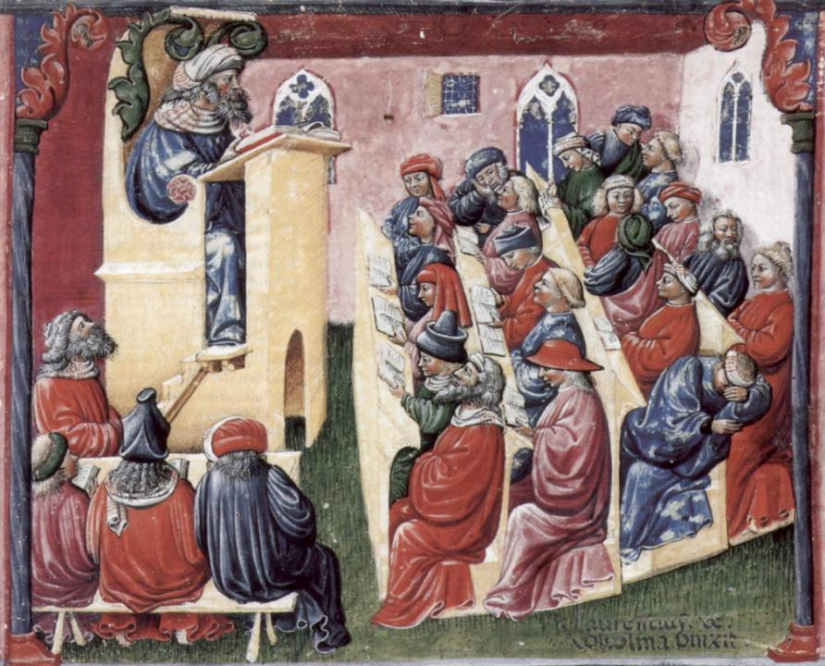
Laurentius de Voltolina
2nd half of 14th Century
Italian Painter

Slide 32
We can’t carry on trying to use traditional assessment and feedback processes
We can’t continue trying to give students lots of feedback in traditional ways, as there are more students, and research shows that merely ‘telling’ them what to do with their work does not work.
There is now a great deal of work on ‘contract cheating’, for example Newton, P. (2018) https://www.frontiersin.org/articles/10.3389/feduc.2018.00067/full
And traditional written feedback doesn’t work: “Approaches that emphasise feedback as telling are insufficient because students are often not equipped to decode or act on statements satisfactorily, so key messages remain invisible” (Sadler 2010).

Slide 33
What will I be expected to show for this?
What does a good one look like, and a bad one?
Where does this fit into the big picture?
When explaining assessment criteria to students, and when linking these to evidence of achievement of the intended learning outcomes, we need to make the most of face-to-face whole group contexts and...
Tone of voice
Body language
Facial expression
Eye contact
The chance to repeat things
The chance to respond to puzzled looks
Some things don’t work nearly so well just on paper or on screens.
Some of the
tools we can
use in
face-to-face
contexts

Slide 34
How students really learn
http://phil-race.co.uk/2016/04/updated-powerpoint-ripples-model/ (Chapter 1 from ‘The Lecturer’s Toolkit 2015)

Slide 36
WIIFM What’s in it for me?
Consciously address the ‘so what’ in students’ minds;
Warm up their ‘want’ to learn.
Clarify their ‘need’ to learn.
Address their questions:
What will I be expected to show for this?
What does a good one look like and a bad one?
Where does this fit into the big picture?

Slide 37
Another MCQ
About learning styles,
I think they’re very important
I think they’re a load of rubbish
I know what mine is (or are)
They can’t be changed
They change over time
Voting: A = 2 hands, B = 1 hand
C = touch left ear, D = touch right ear
E = scratch your head

Slide 38
Teaching, learning and enthusiasm
Knowledge isn’t infectious (unfortunately) but enthusiasm is, and we need to help our students to catch enthusiasm.
We certainly don’t want teaching, assessment or feedback to damage that enthusiasm.

Slide 40
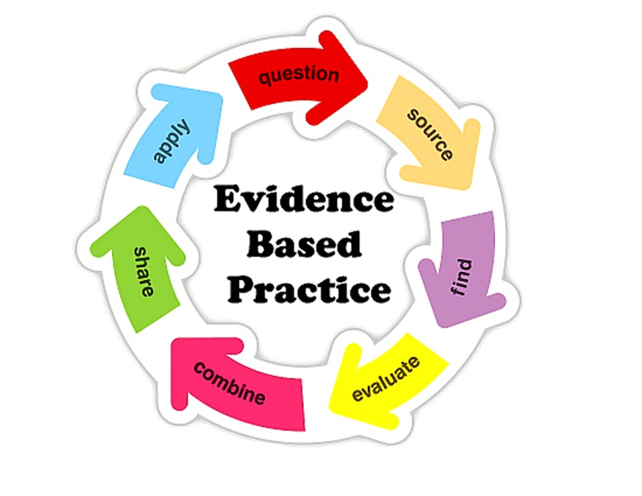

Slide 41
So what about learning styles?
https://www.theguardian.com/education/2017/mar/12/no-evidence-to-back-idea-of-learning-styles?CMP=share_btn_tw
(Link from my Tweet on March 13th 2017 to a letter in the Guardian by prominent folk around the world of education)
Or link to a word document: https://phil-race.co.uk/2017/09/swansea-university-school-management-21st-September/
“No evidence to back idea of learning styles”

Slide 42
What’s wrong
with
this?
Verbalising
Assessing
Feedback
Making sense
Doing
Wanting/
Needing

Slide 43
What’s wrong
with
this?
Verbalising
Assessing
Feedback
Making sense
Doing
Wanting/
Needing

Slide 44
Thanks, Dr Paul Kleiman

Slide 45
Safety Curtain

Slide 46
Ripples on a pond….
Enhance our students’ want to learn?
Help students to develop ownership of the need to learn?
Keep students learning by doing, practice, trial-and-error, repetition?
Ensure students really use feedback – from us and from each other?
Help students to make sense of what they learn?
Get students deepening their learning by verbalising, explaining things to each other, and to us?
Allow students to deepen their learning by assessing their own learning, and assessing others’ learning – making informed judgements?
What else can we do to use assessment and feedback to:
Verbalising
Assessing
making informed judgements
Wanting/
Needing
Doing
Doing
Making sense
Feedback

Slide 47
Drives most learning
Is assessment broken?
Some
assessment
issues
We know what students think
Assessment as learning
Validity
Whodunit?
Fairness

Slide 48
My main worries about assessment...
Too often, we still tend to try to measure...
...what’s in students’ heads, and what they can do with what’s there...
in terms of two unsatisfactory proxies ...
what comes out of students’ pens in exams;
2. what comes out of their keyboards in essays and reports.

Slide 49
Boud et al 2010: ‘Assessment 2020’
Assessment has most effect when...:
It is used to engage students in learning that is productive.
Feedback is used to actively improve student learning.
Students and teachers become responsible partners in learning and assessment.
Students are inducted into the assessment practices and cultures of higher education.
Assessment for learning is placed at the centre of subject and program design.
Assessment for learning is a focus for staff and institutional development.
Assessment provides inclusive and trustworthy representation of student achievement.

Slide 50
Boud et al, 2010
David Boud (University of Technology, Sydney), Royce Sadler (Griffith University), Gordon Joughin (University of Wollongong), Richard James (University of Melbourne), Mark Freeman (University of Sydney), Sally Kift (Queensland University of Technology), Filip Dochy (University of Leuven), Dai Hounsell (University of Edinburgh), Margaret Price (Oxford Brookes University), Tom Angelo (La Trobe University), Angela Brew (Macquarie University), Ian Cameron (University of Queensland), Denise Chalmers (University of Western Australia), Paul Hager (University of Technology, Sydney), Kerri-Lee Harris (University of Melbourne), Claire Hughes (University of Queensland), Peter Hutchings (Australian Learning and Teaching Council), Kerri-Lee Krause (Griffith University), Duncan Nulty (Griffith University), Ron Oliver (Edith Cowan University), Jon Yorke (Curtin University), Iouri Belski (RMIT University), Ben Bradley (Charles Sturt University), Simone Buzwell (Swinburne University of Technology), Stuart Campbell (University of Western Sydney), Philip Candy (University of Southern Queensland), Peter Cherry (Central Queensland University), Rick Cummings (Murdoch University), Anne Cummins (Australian Catholic University), Elizabeth Deane (Australian National University), Marcia Devlin (Deakin University), Christine Ewan (Australian Learning and Teaching Council), Paul Gadek (James Cook University), Susan Hamilton (University of Queensland), Margaret Hicks (University of South Australia), Marnie Hughes-Warrington (Monash University), Gail Huon (University of Newcastle), Margot Kearns (University of Notre Dame, Sydney), Don Maconachie (University of the Sunshine Coast), Vi McLean (Queensland University of Technology,) Raoul Mortley (Bond University), Kylie O’Brien (Victoria University), Gary O’Donovan (University of Tasmania), Beverley Oliver (Curtin University), Simon Pyke (University of Adelaide), Heather Smigiel (Flinders University), Janet Taylor (Southern Cross University), Keith Trigwell (University of Sydney), Neil Trivett (University of Ballarat), Graham Webb (University of New England).

Slide 51
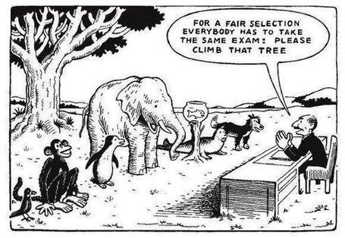

Slide 52
The read-write industry

Slide 53
In the exam room you’re on your own

Slide 54
Feed-forward
Language of feedback
Some feedback
issues
National Student Survey
Timing:
24-hours!
Written, printed,
on-screen
Efficiency
Face to face
oral

Slide 55
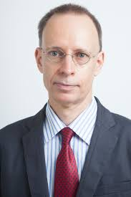
Developing students’ feedback literacy
The danger with traditional methods of assessment and feedback is that assessment tends to be done on student’s work by staff, and feedback tends to be one-directional from staff to students.
Carless and Boud (2018) stress that we want students to gain skills in making ‘evaluative judgements’ themselves on their work, rather than staff doing this.
David Carless & David Boud (2018): The development of student feedback literacy: enabling uptake of feedback, Assessment & Evaluation in Higher Education, https://doi.org/10.1080/02602938.2018.1463354

Slide 56
Coming out shortly…
Naomi Winstone and David Carless
Designing effective feedback processes in higher education
Routledge 2019

Slide 57
Task: think about ghastly feedback
Think back to some occasions, academic or otherwise, historic or recent when you received feedback that you would rather not have received;
How did it make you feel?
Thinking of a single example of ghastly feedback that you are prepared to share with another person, briefly outline the context and say why it was such a negative experience.

Slide 58
Quality feedback: 3 functions
There is wide consensus within the education literature that ‘quality’ feedback should serve three overlapping functions:
an ‘orientational’ purpose that clarifies the student’s performance and achievement;
a ‘transformational’ purpose that enables the student to reflect, improve their performance, and become more autonomous (often termed ‘feed-forward); and
an ‘affective/interpersonal’ dimension that gives the student confidence and motivation, and builds a strong teacher-student relationship
(after Dunworth & Sanchez, 2016).

Slide 59
Back to our intended learning outcomes…
Do you now feel better able to:
two hands = very much better,
one hand = somewhat better,
touch left ear = no better...
Identify and confront some of the main problems we have implementing assessment and feedback using traditional approaches.
Discuss possible ways of addressing some of these problems creatively, so that assessment and feedback can be firmly linked to student learning.
Wanting/
Needing
Doing
Making sense
Feedback

Slide 60
Thank you…
Website: http://phil-race.co.uk
Follow Phil @RacePhil
e-mail: phil@phil-race.co.uk

Slide 61
Useful references and further reading (1)
Bain, K. (2004) What the best College Teachers do, Cambridge: Harvard University Press.
Biggs, J. and Tang, C. (2011) Teaching for Quality Learning at University, Maidenhead: Open University Press.
Bloxham, S. and Boyd, P. (2007) Developing effective assessment in higher education: a practical guide, Maidenhead, Open University Press.
Boud, D. (1995) Enhancing learning through self-assessment, London: Routledge.
Brown, S. and Glasner, A. (eds.) (1999) Assessment Matters in Higher Education, Choosing and Using Diverse Approaches, Maidenhead: Open University Press.
Brown, S. and Race, P. (2012) Using effective assessment to promote learning in Hunt, L. and Chambers, D. (2012) University Teaching in Focus, Victoria, Australia, Acer Press. P74-91.
Brown, S. (2015) Learning , Teaching and Assessment in Higher Education: Global perspectives, London, Palgrave.
Carless, D., Joughin, G., Ngar-Fun Liu et al (2006) How Assessment supports learning: Learning orientated assessment in action Hong Kong: Hong Kong University Press.
Carless, D. and Boud, D. (2018): The development of student feedback literacy: enabling uptake of feedback, Assessment & Evaluation in Higher Education, https://doi.org/10.1080/02602938.2018.1463354

Slide 62
Useful references and further reading (2)
Carroll, J. and Ryan, J. (2005) Teaching International students: improving learning for all. London: Routledge SEDA series.
Crosling, G., Thomas, L. and Heagney, M. (2008) Improving student retention in Higher Education, London and New York: Routledge
Crooks, T. (1988) Assessing student performance, HERDSA Green Guide No 8 HERDSA (reprinted 1994).
Dunworth, K. and Sanchez, H.S., (2016). Perceptions of quality in staff-student written feedback in higher education: a case study. Teaching in Higher Education, 21(5), pp.576-589.
Dweck, C. S. (2000) Self Theories: Their Role in Motivation, Personality and Development, Lillington, NC: Taylor & Francis.
Falchikov, N. (2004) Improving Assessment through Student Involvement: Practical Solutions for Aiding Learning in Higher and Further Education, London: Routledge.
Gibbs, G. (1999) Using assessment strategically to change the way students learn, in Brown S. & Glasner, A. (eds.), Assessment Matters in Higher Education: Choosing and Using Diverse Approaches, Maidenhead: SRHE/Open University Press.
Higher Education Academy (2012) A marked improvement; transforming assessment in higher education, York: HEA.

Slide 63
Useful references and further reading (3)
Hawe, E., Lightfoot, U., & Dixon, H. (2017). First-year students working with exemplars: Promoting self-efficacy, self-monitoring and self-regulation. Journal of Further and Higher Education, 1-15.
Hendry, G. D., White, P., & Herbert, C. (2016). Providing Exemplar-Based “Feedforward” before an Assessment: The Role of Teacher Explanation. Active Learning in Higher Education, 17(2), 99-109.
Hounsell, D., McCune, V., Hounsell, J. and Litjens, J., (2008). The quality of guidance and feedback to students. Higher Education Research & Development, 27(1), pp.55-67.
Newton, P. M. (2018) How Common Is Commercial Contract Cheating in Higher Education and Is It Increasing? A Systematic Review https://www.frontiersin.org/articles/10.3389/feduc.2018.00067/full
Nicol, D. J. and Macfarlane-Dick, D. (2006) Formative assessment and self-regulated learning: A model and seven principles of good feedback practice, Studies in Higher Education Vol 31(2), 199-218.
PASS project Bradford http://www.pass.brad.ac.uk/ Accessed January 2019.
Pickford, R. and Brown, S. (2006) Assessing skills and practice, London: Routledge.
Rotheram, B. (2009) Sounds Good, JISC project http://www.jisc.ac.uk/whatwedo/programmes/usersandinnovation/soundsgood.aspx

Slide 64
Useful references and further reading (4)
Race, P. (2001) A Briefing on Self, Peer & Group Assessment, in LTSN Generic Centre Assessment Series No 9, LTSN York.
Race, P. (2014) Making Learning Happen (3rd edition), London: Sage.
Race, P. (2015) The lecturer’s toolkit (4th edition), London: Routledge.
Race, P. (2017) Fifteen ideas for making assessment and feedback more effective, efficient and manageable for us, and for students: SEDA Developments https://www.seda.ac.uk/resources/files/publications_214_Educational%20Developments%2018.2.pdf (accessed January 2019)
Rust, C., Price, M. and O’Donovan, B. (2003) Improving students’ learning by developing their understanding of assessment criteria and processes, Assessment and Evaluation in Higher Education. 28 (2), 147-164.
Scoles, J., Huxham, M., & McArthur, J. (2013). No longer exempt from good practice: Using exemplars to close the feedback gap for exams. Assessment & Evaluation in Higher Education, 38(6), 631-645.
Sadler, D. Royce (2010) Beyond feedback: developing student capability in complex appraisal, Assessment & Evaluation in Higher Education, 35: 5, 535-550.

