Slide 1
‘Beyond the Tyranny of learning outcomes?’
27th June 2019 DEAP Conference,
Leeds Beckett University
Phil Race
(from Newcastle-upon-Tyne)
BSc PhD PGCE FCIPD PFHEA NTF
Follow Phil @RacePhil
Visiting Professor: University of Plymouth and Edge Hill University
Emeritus Professor, Leeds Beckett University

Slide 3
About Phil…
First a musician
Then a writer
Then a scientist
Then a researcher
Then a lecturer and warden at what is now USW
Got interested in how students learn
And the effects assessment and feedback have on them
And how we teach them
Gradually became an educational developer
Now retired!
Currently…
Visiting Prof: Plymouth & Edge Hill
Emeritus Prof: Leeds Beckett
Based at Newcastle, UK
And on trains
And an expert…
on train routes and timetables!
Notes:
2
2

Slide 5
Looking across the Tyne from outside the Sage Gateshead

Slide 6
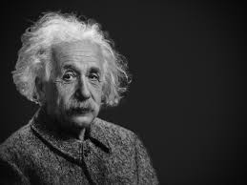
Thought for the day: Einstein
It is simply madness,
to keep doing the same things,
and expect different results.

Slide 7
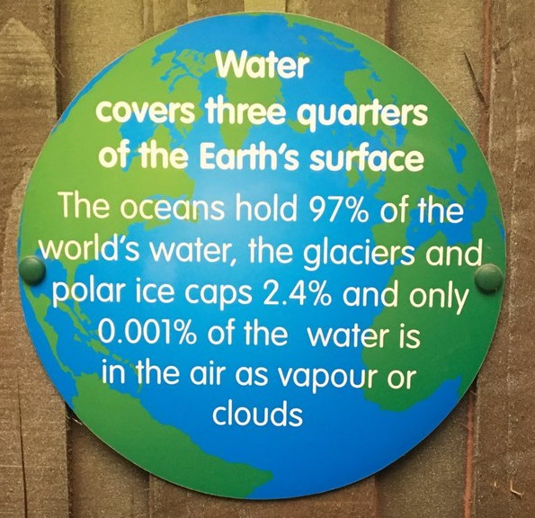

Slide 8
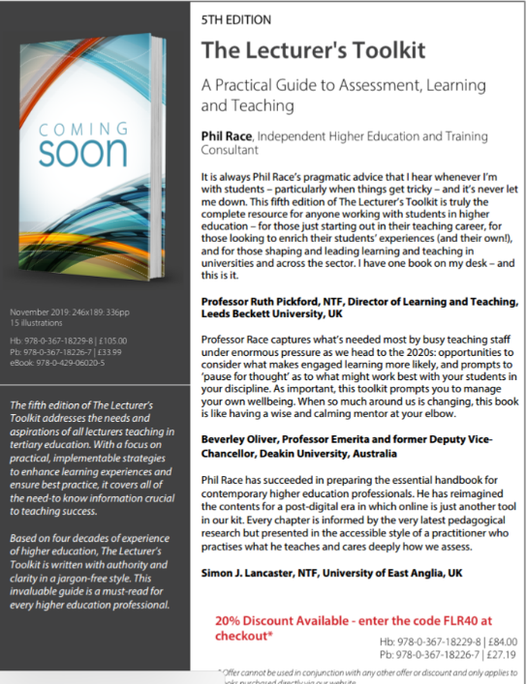
5th Edition in press
Expected to come out in December 2019

Slide 9
Addressing the 2020s: Eight concurrent, related paradigm shifts
Online information and the internet now just normal, ‘digital’ has now ‘grown up’, and is no longer something different.
More attention to learning, rather than teaching.
Less focus on classes as ‘transmission’ occasions.
Learning-centred approach to assessment of student outcomes.
Greater focus on feedback dialogues, and development of feedback literacy by students.
Increased recognition of the skills, attitudes and behaviours graduates need to be work-ready.
Responsibility of institutions to prepare students through knowledge, orientation and behaviours for active citizenship in their own communities, nations and globally.
Increased recognition of the need for teaching staff to be trained, qualified and accredited as teachers.

Slide 10
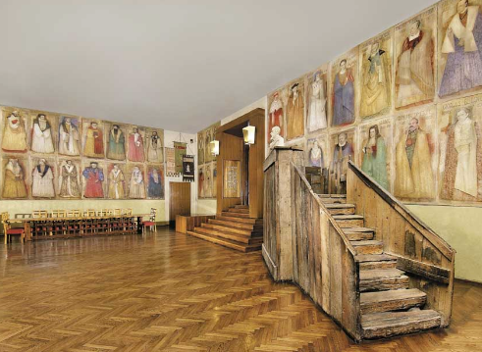
Do we spend too much of our time trying to teach our students?
Kid 1: "I taught my dog to speak"
Kid 2: "Really, what can he say?"
Kid 1: "I said I taught him to speak, I didn't say he learnt it!"
We need to spend more energy helping them to appreciate feedback, make judgements, manage affect, taking action. (Carless and Boud, 2018) (Listened to both yesterday in Manchester).
Galileo: You can’t
teach a man
anything.
You can only help
him to learn.

Slide 11
The three questions always in each student’s mind…
What will I be expected to show for this?
What does a good one look like and a bad one?
Where does this fit into the big picture?

Slide 12
Setting your priorities?
1
Urgent and important
2
Urgent
not Important
3
Not urgent
but important
4
Not urgent
not important

Slide 13
Feedback
Formative, helping to shape and improve future performances, that is Feed-forward;
Energising: helping students to feel motivated and inclined to work towards Enhancement;
Efficient: enabling you to maximise your helpful commentary while minimising your Effort;
Dialogic, involving interaction with and between students, plus Developmental comments;
Benevolent: students should Believe you have their Best interests at heart;
Action-orientated: that is leading students to Actually Advancing their Achievement;
Constructive rather than destructive, taking note of the affective impact of our Comments;
Kindly: when putting across tough messages, we need to remember the affective impact. (Sally Brown, 2019)

Slide 14
Summary
A provocative and interactive session, looking at what can go wrong with intended learning outcomes (for students and for staff) as presently used in curriculum design, and exploring creative enhancements we can make so they become much more fit for purpose, not least VASCULAR learning outcomes!

Slide 15
What I said I’d do
Have ‘intended learning outcomes’ become too dominant in the overall picture of how we structure our teaching, and how we try to measure our students’ learning?
This workshop aims to allow us to bring our collective experience to bear on working out how we can reconsider how, where, when – and indeed whether the intended learning outcomes we use to define student learning fit in, and what else we may need to do to harmonise our teaching and provision to students’ lived experience of learning.

Slide 16
Mobile phones and laptops...
Please turn on your ‘phones tablets and laptops.
Please post your thoughts questions comments and ideas during this session to the hashtag #philatdeap19 Thanks!
Try #LTHEchat on Wednesday evenings from 20.00-21.00.

Slide 17
#LTHEchat is held on Wednesdays, term-time 8-9 pm: one hour, one or two convenors, 6 questions, c.200 international participants.

Slide 18
Slides and links
You’ll be able to download these slides from my website, after I get home to Newcastle, or possibly before, on http://phil-race.co.uk
Usual rules apply: £1 immediately to the first spotter of each of the first three typos or spelling errors.

Slide 19
Intended learning outcomes?
By the end of this session, participants will be able to:
Remember, and address, three questions in every student’s mind, for most of the time.
Explore how intended learning outcomes can be extended (or sometimes replaced?) by collecting learning incomes of students, collecting and evaluating students’ emergent learning outcomes, and formulating intended learning outgoings into the curriculum.
Breath life into the whole picture of outcomes, by VASCULAR approaches (Sally Brown, 2019)
https://sally-brown.net/2019/03/08/invigorating-the-curriculum-with-vascular-learning-outcomes/

Slide 21
Rationale
This workshop will use the experiences (good and bad) of participants on the ways intended learning outcomes are presently used.
Using learning outcomes may have been a significant step forward in curriculum design, replacing content-based lists of topics, but perhaps it is timely to re-visit such key questions such as: to what extent can further developing the ways we use intended learning outcomes improve the learning experience of students, and the teaching approaches of staff?

Slide 22
Background
With the widespread adoption of ‘constructive alignment’ approaches, that we’ve all been expected to swear allegiance to over the last couple of decades, I’ve become increasingly worried that ‘intended learning outcomes’ have become too dominant in the overall picture of how we structure our teaching, and how we try to measure students’ learning…..
This workshop aims to allow us to bring our collective experience to bear on working out how we can reconsider how, where, when – and indeed whether the intended learning outcomes we use to define student learning fit in, and what else we may need to do to harmonize our teaching and provision to students’ lived experience of learning.

Slide 23
SMART learning outcomes?
Specific,
Measurable,
Achievable,
Realistic,
Time-constrained.

Slide 24
Task 1
On a pink post-it, please jot down a few words about what you want from this session.
On an orange post-it, please jot down a word or two about what you’re already bringing to this session?
Now please swap post-its randomly.
If chosen, please read out what’s on the post-its you now have, with passion and drama.
Please stick them up on a chart or wall.

Slide 25
What will I be expected to show for this?
What does a good one look like, and a bad one?
Where does this fit into the big picture?
When explaining assessment criteria to students, and when linking these to evidence of achievement of the intended learning outcomes, we need to make the most of face-to-face whole group contexts and...
Tone of voice
Body language
Facial expression
Eye contact
The chance to repeat things
The chance to respond to puzzled looks
Some things don’t work nearly so well just on paper or on screens.
Some of the
tools we can
use in
face-to-face
contexts

Slide 26
“Micro-management of learning is killing creativity” Learning outcomes are very well intentioned, but their use discourages students from thinking outside the tick box, says Robert Nelson (July 12, 2018 THE)
“Internationally, education discourages imaginative growth. Institutions all say that they want creativity to be cultivated and it is often mentioned as a graduate attribute. But the grid of expectations around individual courses makes engaging the imagination uncompetitive for all but an exceptionally talented elite”.

Slide 27
These concerns are not new!
Westera (2001):
…The competence concept is quite troublesome, and it is argued that the term has no significance beyond that which is associated with the term ‘skills’.

Slide 28
“We don’t need those learning outcomes” : Paul Kleiman reports…
“Through the introduction of the new assessment model we have seen a significant improvement in assessment participation and achievement. In a single academic year modular failure has reduced from 18.70% to 0.37%, non-submissions from 10.43% to 0% and extenuating circumstances from 17.39% to 6.59%. The model has made space for teaching staff to spend more time with students.”
Via Twitter, on Kleiman, 2018

Slide 29
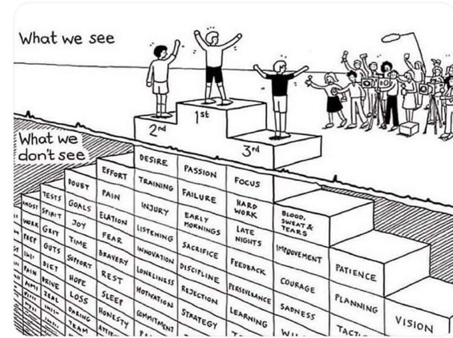
Do we get what we ask for
with intended learning outcomes?
Have we any idea of how many of
these might also have been involved?

Slide 30
Matters arising?
I hope to ask you to share your experience regarding:
Why and how learning outcomes may have become ‘a tyranny’?
What else, with hindsight, might be now be included in the ways we use intended outcomes, and what, with foresight, could be added to our approaches?
How might we make better use of students ‘learning incomes’?
Can we improve things by finding out about emergent learning outcomes which occur? (Are these often more important than the intended ones?).
How best can we address learning outgoings – important aspects of learning that can’t be assessed, but will be really valuable five years later in career?
How can Sally’s VASCULAR approach remedy the problems?

Slide 31
How students really learn
http://phil-race.co.uk/2016/04/updated-powerpoint-ripples-model/ (Chapter 1 from ‘The Lecturer’s Toolkit 2015)

Slide 32
WIIFM What’s in it for me?
Consciously address the ‘so what’ in students’ minds;
Warm up their ‘want’ to learn.
Clarify their ‘need’ to learn.
Address their questions:
What will I be expected to show for this?
What does a good one look like and a bad one?
Where does this fit into the big picture?

Slide 33
Teaching, learning and enthusiasm
Knowledge isn’t infectious (unfortunately) but enthusiasm is, and we need to help our students to catch enthusiasm.
We certainly don’t want teaching, assessment or feedback to damage that enthusiasm.

Slide 35
So what about learning styles?
https://www.theguardian.com/education/2017/mar/12/no-evidence-to-back-idea-of-learning-styles?CMP=share_btn_tw
(Link from my Tweet on March 13th 2017 to a letter in the Guardian by prominent folk around the world of education)
Or link to a word document: https://phil-race.co.uk/2017/09/swansea-university-school-management-21st-September/
“No evidence to back idea of learning styles”

Slide 36
What’s wrong
with
this?
Verbalising
Assessing
Feedback
Making sense
Doing
Wanting/
Needing

Slide 37
What’s wrong
with
this?
Verbalising
Assessing
Feedback
Making sense
Doing
Wanting/
Needing

Slide 38
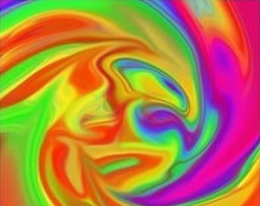
Thanks, Dr Paul Kleiman

Slide 39
Safety Curtain

Slide 40
Learning incomes
These may be different for each different learner. By learning incomes, I mean all the things learners are bringing to the learning situation. These include:
what they already know about the subject
what they can already do, related to the subject
other things in their experience which they can link to the new subject.
(Race, 2014)

Slide 41
Benefits of learning incomes: they help us to:
avoid spending too much time telling the class all sorts of things they already know. We still may need to cover some of these things for the sake of the learners who don’t yet know them, but we can minimize the tedium for those who already do know them.
give learners the chance to explain things they already know to each other – the explainers learn a great deal and we avoid boring them with our own explanations.
spot misconceptions that some of our learners may have about things we’re going to build on. We can then put them right on these as we introduce topics.
build on what members of the class want to find out. This helps learners to feel an increased degree of ownership of what we tell them – in effect, we’re structuring the curriculum around their questions.
(Race, 2014)

Slide 42
VASCULAR learning outcomes
https://sally-brown.net/2019/03/08/invigorating-the-curriculum-with-vascular-learning-outcomes/
Verifiable: Can we tell when they’ve been achieved? And can students?
Action orientated: Do they lead to real and useful activity?
Singular: i.e. not portmanteau outcomes combining two or more into one, making it difficult to assess if differently achieved, but readily matchable to student work produced?
Constructively aligned? (Biggs and Tang, 2011) so that there is clear alignment between aims (What do students need to be able to know and do?, What is taught / learned, how these are assessed and evaluated);
Understandable i.e. using language codes that are meaningful to all stakeholders?
Level-appropriate? Suitable and differentiable between1st year, 2nd year, 3rd year, Masters, other PG, NTFs?
Affective-inclusive i.e. not just covering actions but capabilities in the affective domain?
Regularly reviewed? Not just stuck in history and always fit-for-purpose.

Slide 43
What are your emergent learning outcomes from the last 40 mins?
Volunteers?

Slide 44
Back to our intended learning outcomes?
Are you now better able to?
one hand = much better
two hands = somewhat better
touch left ear = no better
Remember, and address, three questions in every student’s mind, for most of the time?
Explore how intended learning outcomes can be extended (or sometimes replaced?) by collecting learning incomes of students, collecting and evaluating students’ emergent learning outcomes, and formulating intended learning outgoings into the curriculum?
Breath life into the whole picture of outcomes, by VASCULAR approaches (Sally Brown, 2019)?

Slide 45
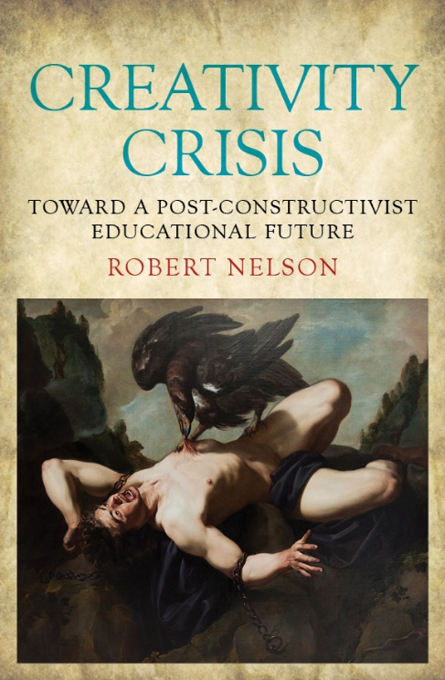
References
Kleiman, P. (2017) ‘Case Study 2 “We Don’t Need Those Learning Outcomes”: assessing creativity and creative assessment’ in Evans, C. and Elkington, S., Transforming Assessment In Higher Education. York: HEAcademy
Nelson, R. (2018) Creativity Crisis: Toward a Post-constructivist Educational Future: Monash University Press;
‘Micro-management of learning is killing creativity Learning outcomes are very well intentioned, but their use discourages students from thinking outside the tick box’ THE, July 12
Race, P. (2014) Making learning happen: 3rd edition, London: Sage.
Westera, W. (2001) Competences in education: a confusion of tongues, j. curriculum studies, 2001, vol. 33, no. 1, 75–88.
Race, P (2019) Beyond the tyranny of learning outcomes, The Lecturer’s Toolkit, 5th editon, now in press.

Slide 46
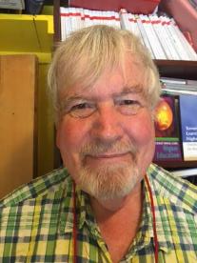
Thank you…
Website: http://phil-race.co.uk
Follow Phil @RacePhil
e-mail: phil@phil-race.co.uk

