Slide 1

Phil’s choices
NSS assessment and
feedback criteria
museum
How students really learn
Content-free test
S
QAA B6
Smarter
feedback
Quotes about
lectures
7
mlh
Designing the curriculum
for learning
Validity etc
concerns
TST
Literacies
24 hour
feedback
Towards assessment
as learning
T r and r
What the
gurus tell us
Sally on feedback
HEA slides
A short exam
Strategy
Smarter
assessment
Marks and
self-assessment
Alternatives
to essays
ML3 menu
Fun
Feedback on exams
Main menu

Slide 2

‘Beyond the Tyranny of learning outcomes?’
10th July 2019
Sheffield Hallam University
Phil Race
(from Newcastle-upon-Tyne)
BSc PhD PGCE FCIPD PFHEA NTF
Follow Phil @RacePhil
Visiting Professor: University of Plymouth and Edge Hill University
Emeritus Professor, Leeds Beckett University

Slide 3
The three questions always in each student’s mind…
What will I be expected to show for this?
What does a good one look like and a bad one?
Where does this fit into the big picture?

Slide 4
Slides and links
You’ll be able to download these slides from my website, after I get home to Newcastle, or possibly before, on http://phil-race.co.uk
Usual rules apply: £1 immediately to the first spotter of each of the first three typos or spelling errors.

Slide 5
Intended learning outcomes?
By the end of this session, participants will be able to:
Remember, and address, three questions in every student’s mind, for most of the time.
Explore how intended learning outcomes can be extended (or sometimes replaced?) by collecting learning incomes of students, collecting and evaluating students’ emergent learning outcomes, and formulating intended learning outgoings into the curriculum.
Breath life into the whole picture of outcomes, by VASCULAR approaches (Sally Brown, 2019)
https://sally-brown.net/2019/03/08/invigorating-the-curriculum-with-vascular-learning-outcomes/

Slide 6
Rationale
This workshop will use the experiences (good and bad) of participants on the ways intended learning outcomes are presently used.
Using learning outcomes may have been a significant step forward in curriculum design, replacing content-based lists of topics, but perhaps it is timely to re-visit such key questions such as: to what extent can further developing the ways we use intended learning outcomes improve the learning experience of students, and the teaching approaches of staff?

Slide 7
Background
With the widespread adoption of ‘constructive alignment’ approaches, that we’ve all been expected to swear allegiance to over the last couple of decades, I’ve become increasingly worried that ‘intended learning outcomes’ have become too dominant in the overall picture of how we structure our teaching, and how we try to measure students’ learning…..
This workshop aims to allow us to bring our collective experience to bear on working out how we can reconsider how, where, when – and indeed whether the intended learning outcomes we use to define student learning fit in, and what else we may need to do to harmonize our teaching and provision to students’ lived experience of learning.

Slide 8
SMART learning outcomes?
Specific,
Measurable,
Achievable,
Realistic,
Time-constrained.

Slide 9
Task 1
On a white post-it, please jot down a few words about what you want from this session.
On an green post-it, please jot down a word or two about what you’re already bringing to this session?
Now please swap post-its randomly.
If chosen, please read out what’s on the post-its you now have, with passion and drama.
Please stick them up on a chart or wall.

Slide 10
“Micro-management of learning is killing creativity” Learning outcomes are very well intentioned, but their use discourages students from thinking outside the tick box, says Robert Nelson (July 12, 2018 THE)
“Internationally, education discourages imaginative growth. Institutions all say that they want creativity to be cultivated and it is often mentioned as a graduate attribute. But the grid of expectations around individual courses makes engaging the imagination uncompetitive for all but an exceptionally talented elite”.

Slide 11
These concerns are not new!
Westera (2001):
…The competence concept is quite troublesome, and it is argued that the term has no significance beyond that which is associated with the term ‘skills’.

Slide 12
“We don’t need those learning outcomes” : Paul Kleiman reports…
“Through the introduction of the new assessment model we have seen a significant improvement in assessment participation and achievement. In a single academic year modular failure has reduced from 18.70% to 0.37%, non-submissions from 10.43% to 0% and extenuating circumstances from 17.39% to 6.59%. The model has made space for teaching staff to spend more time with students.”
Via Twitter, on Kleiman, 2018

Slide 13
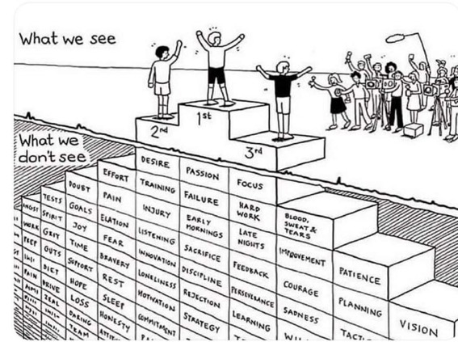
Do we get what we ask for
with intended learning outcomes?
Have we any idea of how many of
these might also have been involved?

Slide 14
Matters arising?
I hope to ask you to share your experience regarding:
Why and how learning outcomes may have become ‘a tyranny’?
What else, with hindsight, might be now be included in the ways we use intended outcomes, and what, with foresight, could be added to our approaches?
How might we make better use of students ‘learning incomes’?
Can we improve things by finding out about emergent learning outcomes which occur? (Are these often more important than the intended ones?).
How best can we address learning outgoings – important aspects of learning that can’t be assessed, but will be really valuable five years later in career?
How can Sally’s VASCULAR approach remedy the problems?

Slide 15
Learning incomes
These may be different for each different learner. By learning incomes, I mean all the things learners are bringing to the learning situation. These include:
what they already know about the subject
what they can already do, related to the subject
other things in their experience which they can link to the new subject.
(Race, 2014)

Slide 16
Benefits of learning incomes: they help us to:
avoid spending too much time telling the class all sorts of things they already know. We still may need to cover some of these things for the sake of the learners who don’t yet know them, but we can minimize the tedium for those who already do know them.
give learners the chance to explain things they already know to each other – the explainers learn a great deal and we avoid boring them with our own explanations.
spot misconceptions that some of our learners may have about things we’re going to build on. We can then put them right on these as we introduce topics.
build on what members of the class want to find out. This helps learners to feel an increased degree of ownership of what we tell them – in effect, we’re structuring the curriculum around their questions.
(Race, 2014)

Slide 17
VASCULAR learning outcomes
https://sally-brown.net/2019/03/08/invigorating-the-curriculum-with-vascular-learning-outcomes/
Verifiable: Can we tell when they’ve been achieved? And can students?
Action orientated: Do they lead to real and useful activity?
Singular: i.e. not portmanteau outcomes combining two or more into one, making it difficult to assess if differently achieved, but readily matchable to student work produced?
Constructively aligned? (Biggs and Tang, 2011) so that there is clear alignment between aims (What do students need to be able to know and do?, What is taught / learned, how these are assessed and evaluated);
Understandable i.e. using language codes that are meaningful to all stakeholders?
Level-appropriate? Suitable and differentiable between1st year, 2nd year, 3rd year, Masters, other PG, NTFs?
Affective-inclusive i.e. not just covering actions but capabilities in the affective domain?
Regularly reviewed? Not just stuck in history and always fit-for-purpose.

Slide 18
What are your emergent learning outcomes from the last 40 mins?
Volunteers?

Slide 19
Back to our intended learning outcomes?
Are you now better able to?
one hand = much better
two hands = somewhat better
touch left ear = no better
Remember, and address, three questions in every student’s mind, for most of the time?
Explore how intended learning outcomes can be extended (or sometimes replaced?) by collecting learning incomes of students, collecting and evaluating students’ emergent learning outcomes, and formulating intended learning outgoings into the curriculum?
Breath life into the whole picture of outcomes, by VASCULAR approaches (Sally Brown, 2019)?

Slide 20
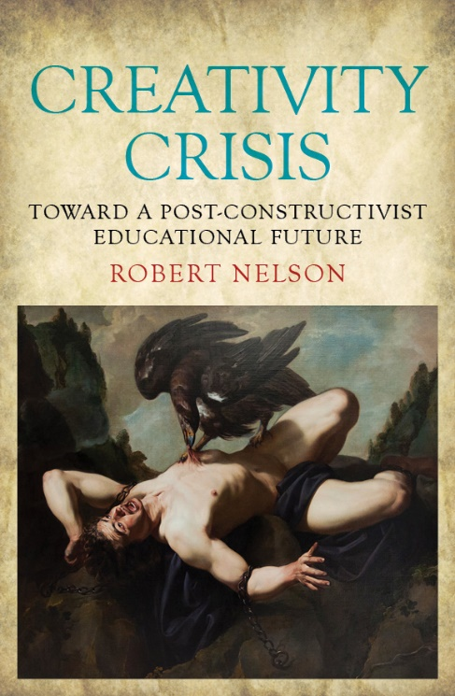
References
Kleiman, P. (2017) ‘Case Study 2 “We Don’t Need Those Learning Outcomes”: assessing creativity and creative assessment’ in Evans, C. and Elkington, S., Transforming Assessment In Higher Education. York: HEAcademy
Nelson, R. (2018) Creativity Crisis: Toward a Post-constructivist Educational Future: Monash University Press;
‘Micro-management of learning is killing creativity Learning outcomes are very well intentioned, but their use discourages students from thinking outside the tick box’ THE, July 12
Race, P. (2014) Making learning happen: 3rd edition, London: Sage.
Westera, W. (2001) Competences in education: a confusion of tongues, j. curriculum studies, 2001, vol. 33, no. 1, 75–88.
Race, P (2019) Beyond the tyranny of learning outcomes, The Lecturer’s Toolkit, 5th editon, now in press.

Slide 21

Thank you…
Website: http://phil-race.co.uk
Follow Phil @RacePhil
e-mail: phil@phil-race.co.uk

