Slide 1
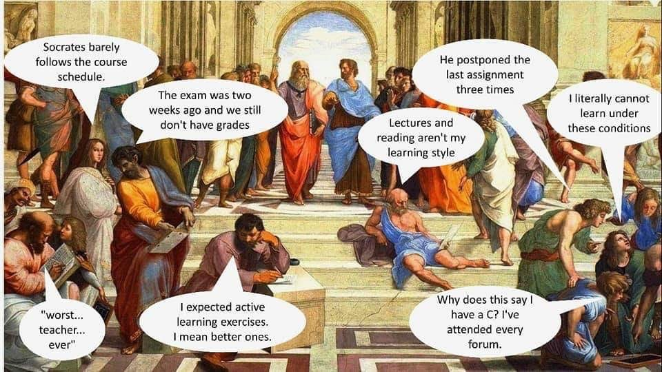

Slide 2
Department Away Day - Wednesday 10th July
Morning programme:
08:45 Registration (Refreshments)
09:00 Intro, H&S & Welcome (David Wood)
Achievements & New Starters (Susan Wakefield)
Athena SWAN intro (Sarah Burns)
09:15 Outstanding Teaching & Learning - Guest Speaker (Phil Race)
10:45 Morning break - Refreshments
11:00 Outstanding Teaching & Learning Activity (Chris Payne)
11:50 Break for Lunch (provided)

Slide 3

Outstanding learning for the 2020s
July 10th 2019
Sheffield Hallam University
Faculty of Health and Wellbeing
Phil Race
(from Newcastle-upon-Tyne)
BSc PhD PGCE FCIPD PFHEA NTF
Follow Phil on Twitter: @RacePhil
Visiting Professor: University of Plymouth and Edge Hill University
Emeritus Professor, Leeds Beckett University

Slide 4
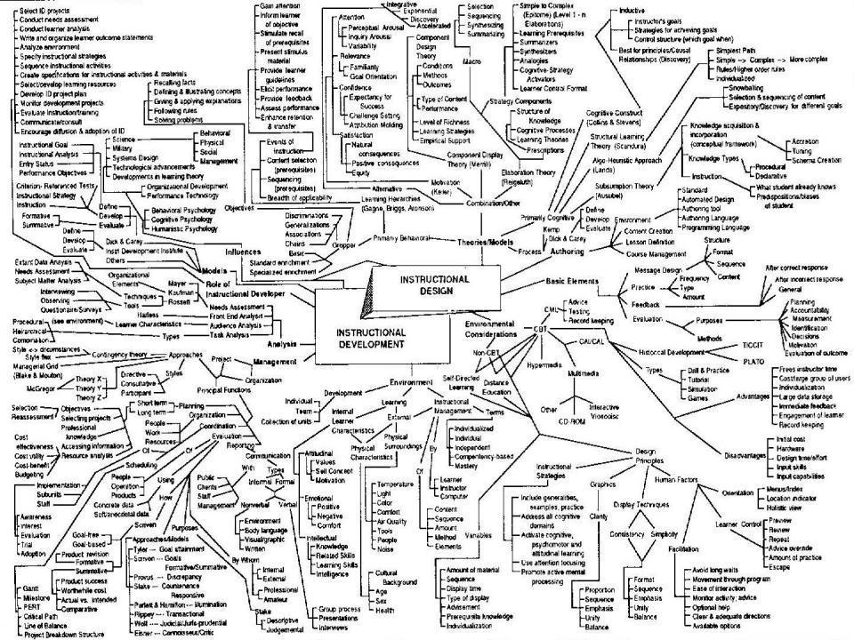
This slide has two purposes….
To focus the data projector if necessary and…
...to persuade colleagues never to put this sort of detail onto a slide!

Slide 5
About Phil…
First a musician
Then a writer
Then a scientist
Then a researcher
Then a lecturer and warden at what is now USW
Got interested in how students learn
And the effects assessment and feedback have on them
And how we teach them
Gradually became an educational developer
And retired now!
Currently…
Visiting Prof: Edge Hill and Plymouth
Emeritus Prof: Leeds Beckett
Based at Newcastle UK
And on trains
And an expert…
on train routes and timetables!
Notes:
2
2

Slide 6
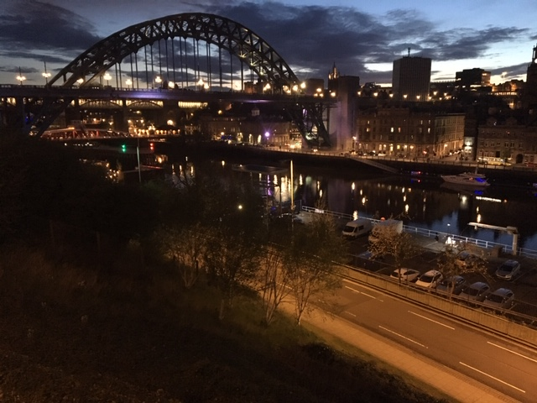
Looking across the Tyne from outside the Sage Gateshead

Slide 7
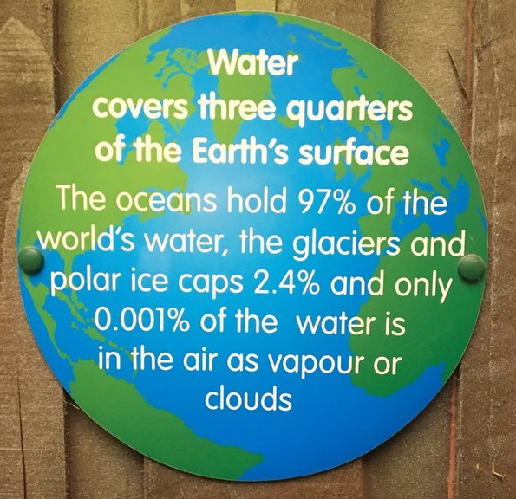
A bit more in Manchester?

Slide 8
You will be able to download my main slides
You don’t need to take notes.
I’ll put the main slides I use up on my website tomorrow (http://phil-race.co.uk/)
I may sometimes go through slides quite fast but you can study them as you wish at your leisure.

Slide 9
You can download free much of my published work
http://phil-race.co.uk/2016/04/updated-powerpoint-ripples-model/ (Chapter 1 from ‘The Lecturer’s Toolkit 2015)
https://phil-race.co.uk/2016/10/lthe-tweetchat-lthechat-wed-oct-19-8-00-9-00-pm/ (feedback stuff from my most recent two books)
https://phil-race.co.uk/2018/02/feedback-feedforward-just-tips-including-students/ (just the feedback tips!)
http://phil-race.co.uk/2015/01/assessment-bits-new-editions/ (extracts on assessment)
http://phil-race.co.uk/2017/05/lectures-and-learning/ (extracts on lecturing)

Slide 10
Setting your priorities?
1
Urgent and important
2
Urgent
not Important
3
Not urgent
but important
4
Not urgent
not important

Slide 11
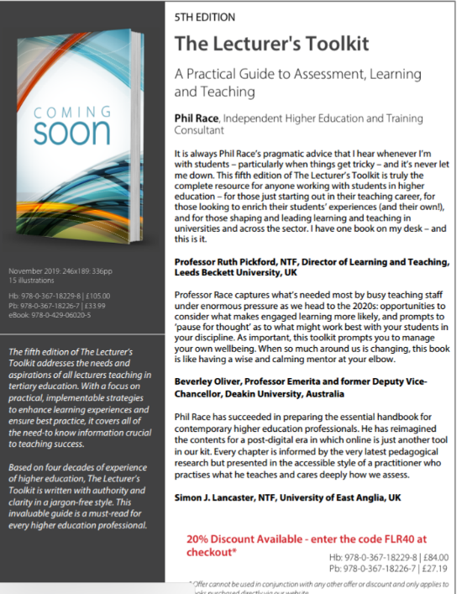
5th Edition in press
Expected to come out in December 2019

Slide 12
The three questions always in each student’s mind…
What will I be expected to show for this?
What does a good one look like and a bad one?
Where does this fit into the big picture?

Slide 13

s

Slide 14
Addressing the 2020s: Eight concurrent, related paradigm shifts
Online information and the internet now just normal, ‘digital’ has now ‘grown up’, and is no longer something different.
More attention to learning, rather than teaching.
Less focus on classes as ‘transmission’ occasions.
Learning-centred approach to assessment of student outcomes.
Greater focus on feedback dialogues, and development of feedback literacy by students.
Increased recognition of the skills, attitudes and behaviours graduates need to be work-ready.
Responsibility of institutions to prepare students through knowledge, orientation and behaviours for active citizenship in their own communities, nations and globally.
Increased recognition of the need for teaching staff to be trained, qualified and accredited as teachers.

Slide 15
Intended learning outcomes?
After participating this morning, I hope you’ll be better-able to:
Attune to eight paradigm shifts affecting higher education now.
Respond to how students really learn.
Help students to benefit from feedback dialogues.
Think towards assessment as learning, rather than of learning.

Slide 16
Finding out more about you…
In the last 12 months,
I’ve completed a MOOC
I’ve started one
I’ve helped to design one
I’ve found one
What’s a MOOC?
Voting: A = 2 hands, B = 1 hand
C = touch left ear, D = touch right ear
E = scratch your head

Slide 17

Mobile phones and laptops...
Please turn on your ‘phones tablets and laptops.
Please post your thoughts questions comments and ideas during this session to the hashtag #philatshu19 Thanks!
Try #LTHEchat on Wednesday evenings from 20.00-21.00.

Slide 18

#LTHEchat is held on Wednesdays, term-time 8-9 pm: one hour, one or two convenors, 6 questions, c.200 international participants.

Slide 19
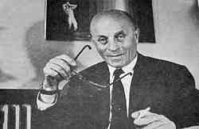
Past disruptive paragigms?
“A disruptive technology is an innovation providing a product or service that is so compelling that everyone rapidly abandons their current way of doing things and flocks to what is new”.
Previous ones included…
Chalk?
Print?
The Biro?
Slides?
The OHP?
Handouts?
PowerPoint?
MOOCs?
Bíró László József
(surname placed first per Hungarian convention) (29 September 1899 – 24 October 1985) was the inventor of the modern ballpoint pen.

Slide 20
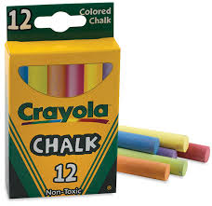
chalk

Slide 21

The underhand projector

Slide 22
Time-constrained assessed, written post-it exercise
On a post-it in your best handwriting please write your own completion of the starter:
“Making outstanding learning happen would be much better if only I …”
Please swap post-its so that you’ve no idea who has yours.
If chosen please read out with passion and drama the post-it you now have.

Slide 23
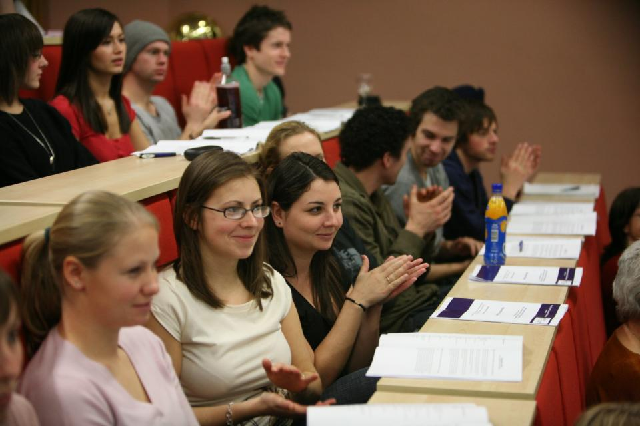
Nowadays...

Slide 24

Got it?

Slide 25
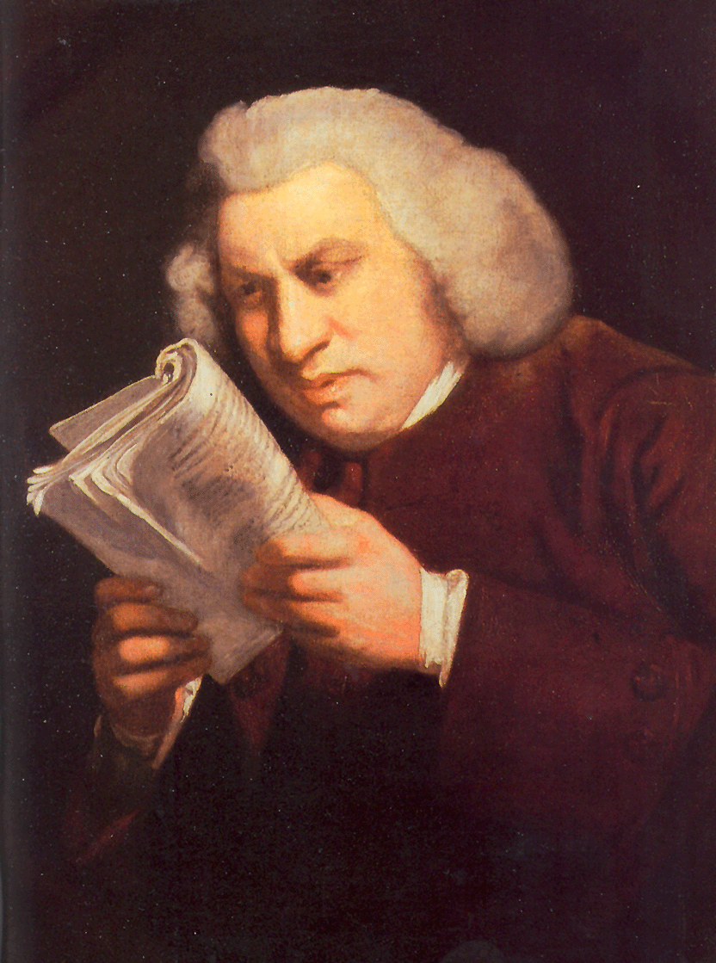
Lectures
Lectures were once useful, but now, when all can read, and books are so numerous, lectures are unnecessary.
(Samuel Johnson, 1709-1784)

Slide 26

Yes

Slide 27
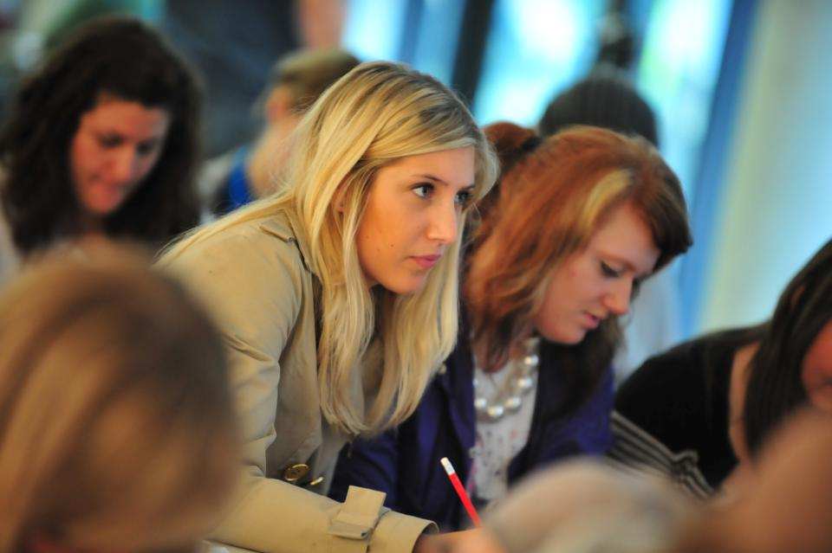
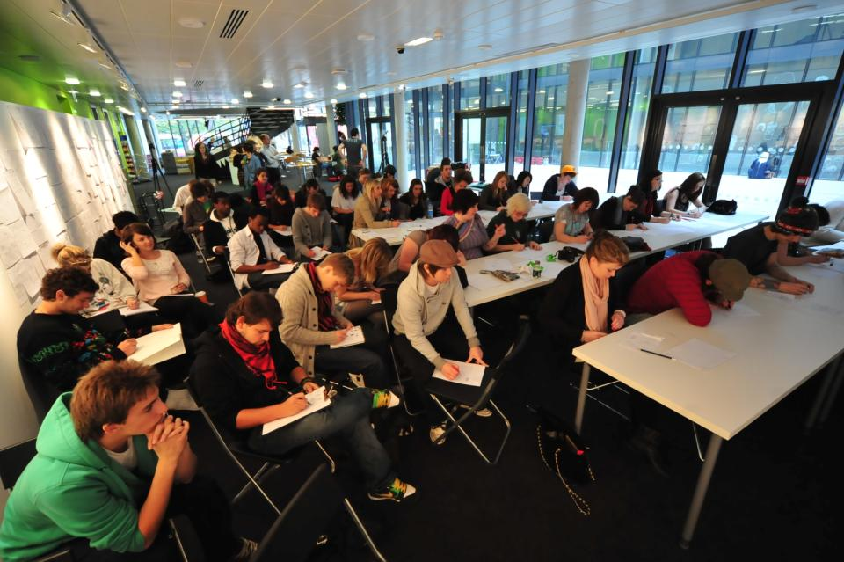
Not always the ideal environment

Slide 28
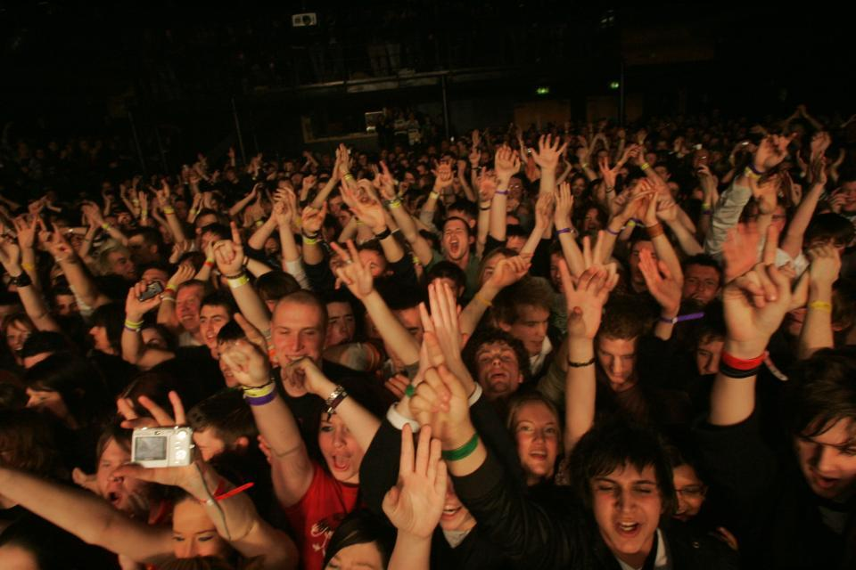
Just sometimes: wow!

Slide 29
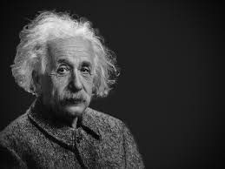
Thought for the day: Einstein
It is simply madness
to keep doing the same things
and expect different results.

Slide 30
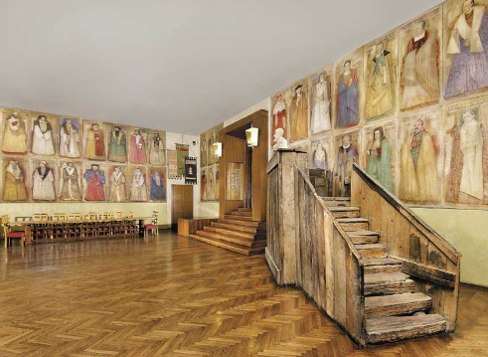
Do we spend too much of our time trying to teach our students?
We need to spend more energy helping them to appreciate feedback, make judgements, manage affect, taking action. (Carless and Boud, 2018)
Galileo: You can’t
teach a man
anything.
You can only help
him to learn.

Slide 31

Coming out shortly…
Naomi Winstone and David Carless
Designing effective feedback processes in higher education
Routledge 2019

Slide 32
What annoys students in class?
Staff who don’t appear to have done good preparation of content material;
Material at the wrong level, that is too easy or goes right over their heads;
Lecturers who seem jaded, unenthusiastic or uninterested in what they are teaching;
Teaching formats that never change and over-use PowerPoint;
Lack of interaction between the lecturer and students;
Issues around timing, particularly over-running and rushing at the end.
Nicked from Sally

Slide 33
Students as partners…
Students are partners in learning.
They always have been.
We haven’t always made it an optimal partnership.
We can.
I could not do what I do nowadays if I did not continue to spend a fair bit of my time working with students – they’ve taught me most of what I know.

Slide 34
Teaching, learning and enthusiasm
Knowledge isn’t infectious (unfortunately) but enthusiasm is, and we need to help our students to catch enthusiasm.
We certainly don’t want teaching, assessment or feedback to damage that enthusiasm.

Slide 35


Slide 36
HEA Fellowships? (Professional development relating to teaching, learning and assessment)
How many of you are already: (please raise hands)
Associate Fellow (AFHEA) 26,308
Fellow (FHEA) 80,125
Senior Fellow (SFHEA) 11,022
Principal Fellow (PFHEA) 1,118
National Teaching Fellow (NTF) c.900
(Numbers at July 5th , 2019; seem to be included in some league tables)

Slide 37
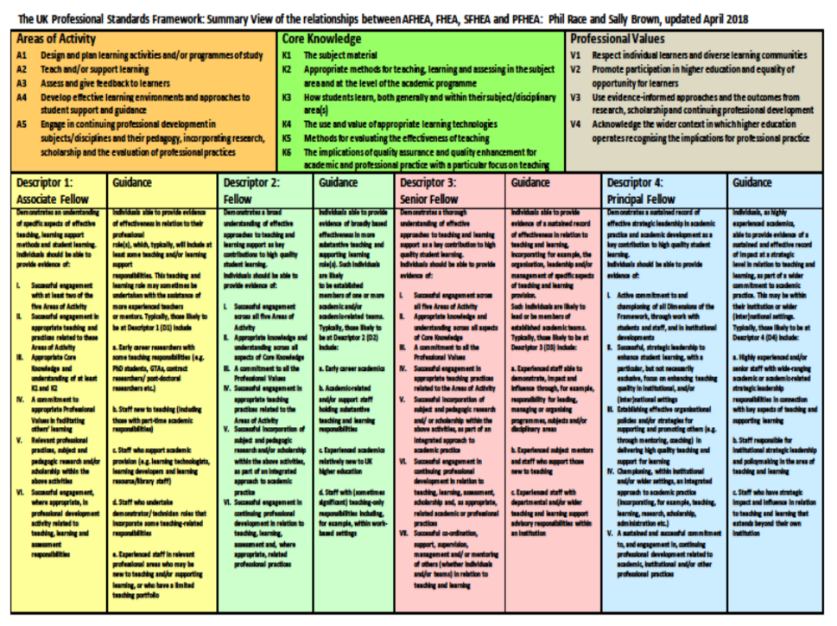
https://phil-race.co.uk/2017/11/ukpsf-page-updated-november-14th/

Slide 38
Thirty second theatre

Slide 39

Face-to-face one-to-one feedback activity
On the signal to start, please stand up, and work in pairs, moving around the room, talking to different people using the script which follows…
The script:
A ‘Hello’ (or equivalent).
B ‘Hello’ (or equivalent).
A ‘You are late’.
B ‘I know’.
Try to do it completely differently each time.

Slide 40
What will I be expected to show for this?
What does a good one look like, and a bad one?
Where does this fit into the big picture?
When explaining assessment criteria to students, and when linking these to evidence of achievement of the intended learning outcomes, we need to make the most of face-to-face whole group contexts and...
Tone of voice
Body language
Facial expression
Eye contact
The chance to repeat things
The chance to respond to puzzled looks
Some things don’t work nearly so well just on paper or on screens.
Some of the
tools we can
use in
face-to-face
contexts

Slide 41
Feedback
Formative, helping to shape and improve future performances, that is Feed-forward;
Energising: helping students to feel motivated and inclined to work towards Enhancement;
Efficient: enabling you to maximise your helpful commentary while minimising your Effort;
Dialogic, involving interaction with and between students, plus Developmental comments;
Benevolent: students should Believe you have their Best interests at heart;
Action-orientated: that is leading students to Actually Advancing their Achievement;
Constructive rather than destructive, taking note of the affective impact of our Comments;
Kindly: when putting across tough messages, we need to remember the affective impact. (Sally Brown, 2019)

Slide 42
Link to videos made by Sue Beckingham of SHU
https://www.youtube.com/watch?v=3fWvtbojDfA&feature=youtu.be Video of Vascular Acrostic
https://t.co/LIrQvA1JZd Video of Feedback Acrostic

Slide 43
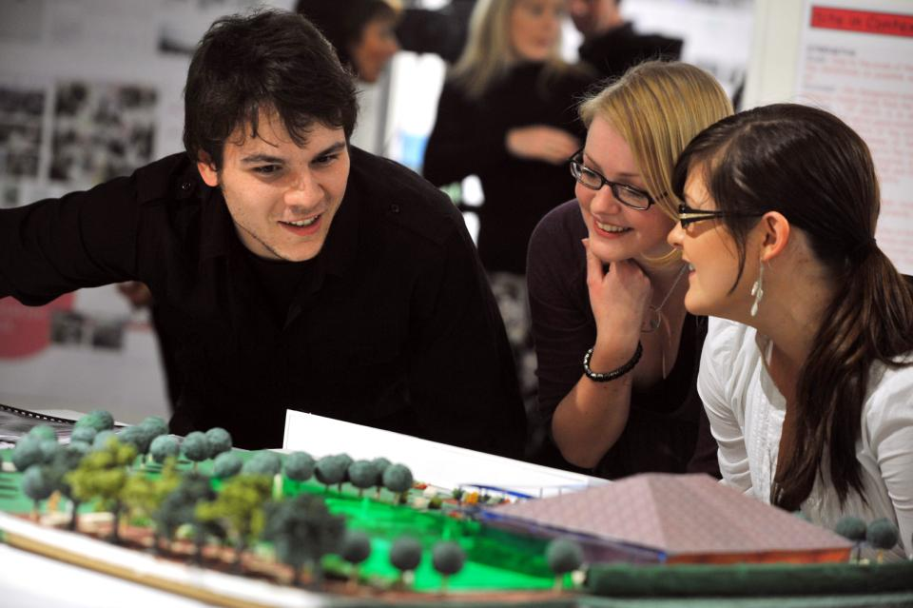
Working together interactively

Slide 44
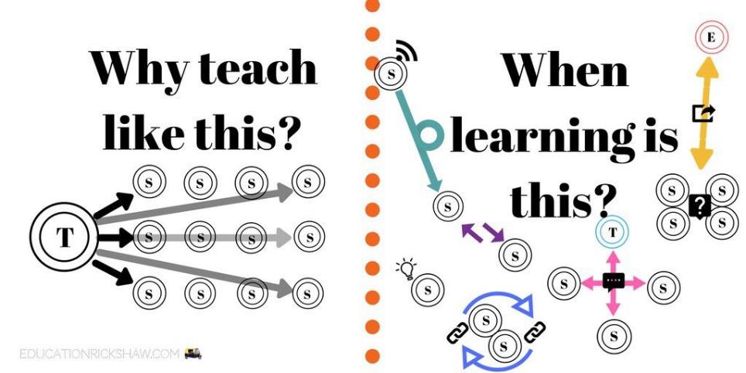
Learning is not linear! Feedback is not unidirectional. But sometimes we pretend that they are! #sketchnote by @SGroshell and @MrZachG #edchat #learning #teachchat

Slide 45
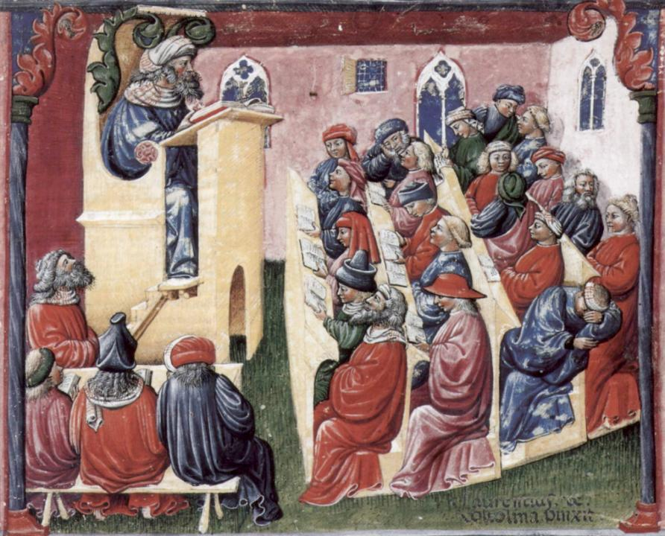
Laurentius de Voltolina
2nd half of 14th Century
Italian Painter

Slide 46
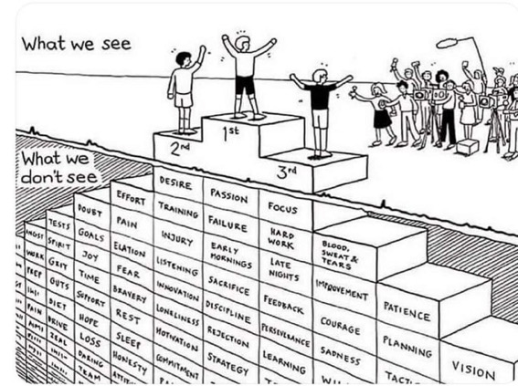
Do we get what we ask for
with intended learning outcomes?
Have we any idea of how many of
these might also have been involved?

Slide 47
How’s your brain?
My brain is:
Digital
Analogue
Both
Neither
Don’t know
Voting: A = 2 hands, B = 1 hand
C = touch left ear, D = touch right ear
E = scratch your head

Slide 48
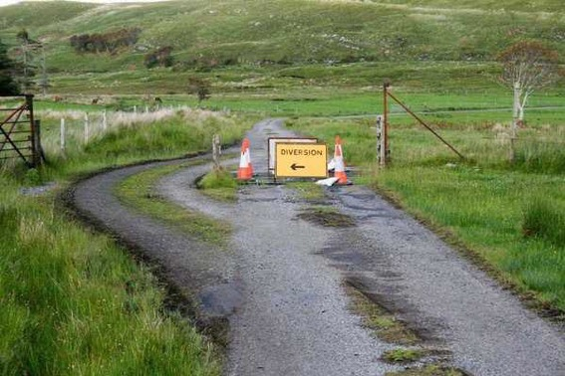

Slide 49
Keeping students engaged:
the ten most important words
Why?
What?
Who?
Where?
When?
How?
Which?
So what?
wtf?
Wow?
And the most powerful four-letter word in the English language...
????

Slide 50
‘what’ is getting ever less important
Columbia University research published (2011) in Science magazine shows that people are much less prepared to remember ‘what’, but better at remembering where to access information, and how to do so.
Betsy Sparrow, one of the principal researchers, concludes that the internet has become ‘an external memory source that we can access at any time. ... Just as we learn through transactive memory who knows what in our families and offices, we are learning what the computer ‘knows’ and when we should attend to where we have stored information in our computer-based memories. We are becoming symbiotic with our computer tools.
Published Online July 14 2011 < Science Express Index Science DOI: 10.1126/science.1207745
Report: Google Effects on Memory: Cognitive Consequences of Having Information at Our Fingertips Betsy Sparrow,*, Jenny Liu, Daniel M. Wegner

Slide 51
Keeping students engaged:
the ten most important words
Why? (rationale)
What? (content)
Who? (people, you, me, them)
Where? (locations)
When? (times)
How? (processes)
Which? (decisions)
So what? (importance?)
Wow? (impact?)
And the most powerful four-letter word in the English language...
????

Slide 52
Keeping students engaged:
the ten most important words
Why? (rationale)
What? (content)
Who? (people, you, me, them)
Where? (locations)
When? (times)
How? (processes)
Which? (decisions)
So what? (importance?)
Wow? (impact?)
And the most powerful four-letter word in the English language...
else

Slide 53
Go forth and
elsify!

Slide 54
Making sessions unmissable
Make good use of intended learning outcomes. (and incomes, outgoings, + emergent ones).
Always link sessions to assessment. (That’s what they need)
Don’t keep slides up too long. (Use ‘B’)
Avoid death by bullet point.
Try to cause the learners to like you. (Smile).
Think of what learners will be doing.
Bring in some appropriate humour.
Keep yourself tuned into WIIFM.
S

Slide 55
WIIFM What’s in it for me?
Consciously address the ‘so what’ in students’ minds;
Warm up their ‘want’ to learn.
Clarify their ‘need’ to learn.
Address their questions:
What will I be expected to show for this?
What does a good one look like and a bad one?
Where does this fit into the big picture?

Slide 56
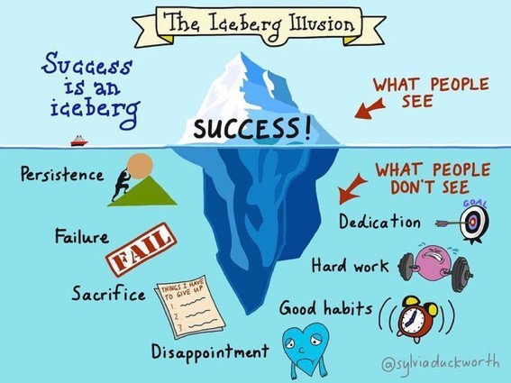

Slide 57
How students really learn
http://phil-race.co.uk/2016/04/updated-powerpoint-ripples-model/ (including Chapter 1 from ‘The Lecturer’s Toolkit 2015 – not much changed in 2019).

Slide 58
How Students Really Learn ‘Ripples’ model of learning
Phil Race

Slide 59
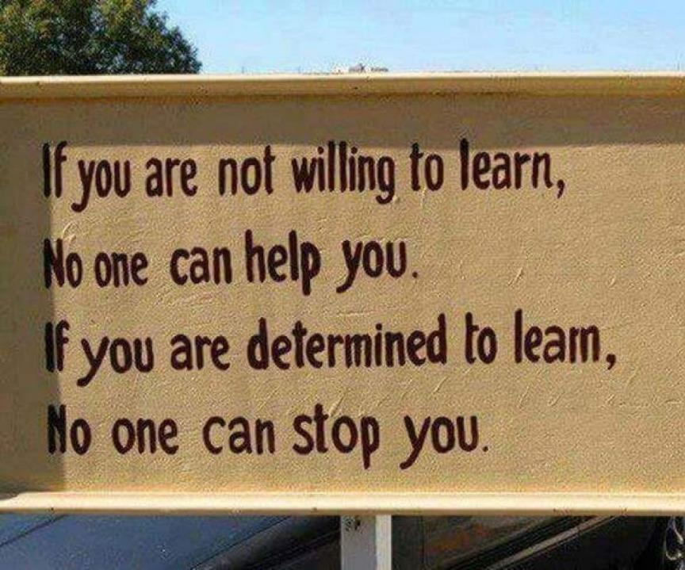

Slide 60

Unless we do something else…
“[The] pupils got it all by heart; and, when Examination-time came, they wrote it down; and the Examiner said ‘Beautiful! What depth!’
They became teachers in their turn, and they said all these things over again; and their pupils wrote it down, and the examiner accepted it; and nobody had the ghost of an idea what it meant” Lewis Carroll, 1893
Active
Experimentation
Abstract
Conceptualisation
Concrete
Experience
Reflective
Observation

Slide 61


Slide 62
What’s wrong
with
this?
Verbalising
Assessing
Feedback
Making sense
Doing
Wanting/
Needing

Slide 63
What’s wrong
with
this?
Verbalising
Assessing
Feedback
Making sense
Doing
Wanting/
Needing

Slide 64
What’s wrong
with
this?
Verbalising
Assessing
Feedback
Making sense
Doing
fun
Wanting/
Needing

Slide 65

Thanks, Dr Paul Kleiman

Slide 66

Safety Curtain

Slide 67
Ripples on a pond….
Enhance our students’ want to learn?
Help students to develop ownership of the need to learn?
Keep students learning by doing, practice, trial-and-error, repetition?
Ensure students really use feedback – from us and from each other?
Help students to make sense of what they learn?
Get students deepening their learning by verbalising, explaining things to each other, and to us?
Allow students to deepen their learning by assessing their own learning, and assessing others’ learning – making informed judgements?
What else can we do to use
teaching, assessment and feedback to:
Verbalising
Assessing
making informed judgements
Wanting/
Needing
Doing
Doing
Making sense
Feedback

Slide 68
Towards assessment as learning
Last century, we had lots of assessment of learning.
We still need to do some of this, e.g. to assure fitness to practice.
Some institutions have moved a long way towards assessment for learning.
I believe we now need to make a final jump – assessment as learning.
I’m going to help you to think of the extent to which each of a number of assessment methods can bring assessment and learning closer, and achieve assessment as learning for students.

Slide 69
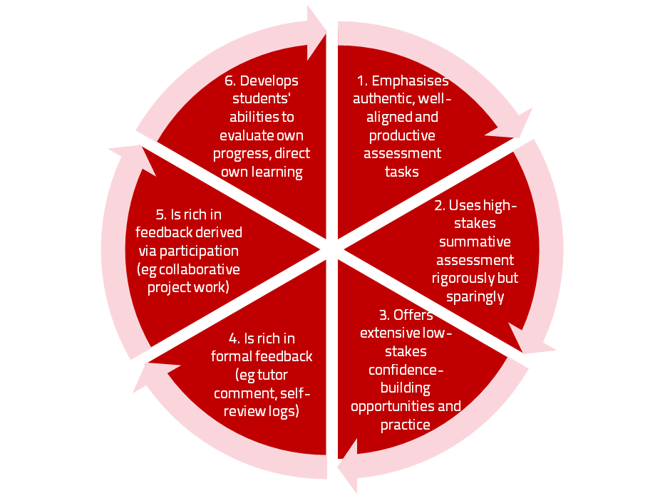
Assessment for learning

Slide 70
Use link below to download the materials on feedback and assessment produced in 2017-18 by Kay Sambell, Sally Brown and Phil Race for Edinburgh Napier University
http://staff.napier.ac.uk/services/dlte/ENhance/Pages/ENhanceQuickGuides.aspx

Slide 71
Experience of Royce Sadler on standards, assessment and feedback
Well worth looking at this clip from Coursera from Royce Sadler, who’s work informs much of the modern thinking on assessment and feedback…

Slide 72
Back to our intended learning outcomes
Do you now feel better-able to:
(raise two hands = very much better
Raise one hand = somewhat better
Scratch left ear = no better)
Attune to eight paradigm shifts affecting higher education now?
Respond to how students really learn?
Help students to benefit from feedback dialogues?
Think towards assessment as learning, rather than of learning?

Slide 73
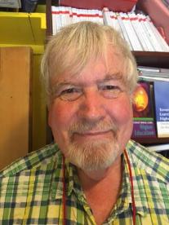
Thank you…
Website: http://phil-race.co.uk
Follow Phil @RacePhil
e-mail: phil@phil-race.co.uk

