Slide 1
Plymouth College of Art Teaching and Learning day
2nd October 2019
Sally Brown NTF, PFHEA, SFSEDA
@ProfSallyBrown http://sally-brown.net
Phil Race, NTF, PFHEA
@RacePhil http://phil-race.co.uk

Slide 2
Enhancing learning and teaching
Sally Brown and Phil Race

Slide 3
Central to student satisfaction, retention and positive regard for our programmes are excellent curriculum design, delivery and assessment.
This needs to be developed strategically using contemporary evidence-based approaches and research-informed principles, involving a constructively aligned programme level cycle comprising:
Determining and reviewing subject material: reviewing currency, relevance, level;
Designing and refining learning outcomes, which are the lifeblood of learning;
Considering delivery modes including face-to-face, online, PBL, and blended approaches;
Thinking through student support to maximise engagement;
Designing fit-for-purpose assessment methods and approaches;
Assuring quality, matching HEI, national and PRSB requirements;
Evaluating programmes, exploring strengths and areas for improvement;
Enhancing quality, seeking continuous improvement.

Slide 4
Good curriculum design considers the whole student experience including:
The ways in which we organise students’ learning opportunities;
Coherence and logical sequencing of content teaching, skills development and practical and other activities;
Progression from initial support to growing independence of learning;
Systematic opportunities for students to develop the various academic literacies they need;
This implies using a programme focused approach to curriculum design, delivery and assessment and the end of the cantonisation of the curriculum.

Slide 5
Determining and reviewing subject material: currency, relevance, level
Enhancing quality, seeking continuous improvement
Designing and refining learning outcomes
Evaluating programmes, strengths and areas for improvement
Curriculum
Design
Essentials
Considering delivery modes: face-to-face, online, PBL, blended…
Assuring quality, matching HEI, national and PRSB requirements
Thinking through student support
Designing fit for purpose assessment methods and approaches

Slide 7
Are your learning outcomes SMART or VASCULAR? The usual ‘requirements’ are that they be:
Specific;
Measurable;
Achievable;
Realistic;
Time constrained.

Slide 8
VASCULAR learning outcomes
Verifiable: Can we tell when they’ve been achieved? And can students?
Action orientated: Do they lead to real and useful activity?
Singular: i.e. not portmanteau outcomes combining two or more into one, making it difficult to assess if differently achieved, but readily matchable to student work produced?
Constructively aligned? (Biggs and Tang, 2011) so that there is clear alignment between aims (What do students need to be able to know and do?), what is taught/ learned, how these are assessed and evaluated);
Understandable i.e. using language codes that are meaningful to all stakeholders?
Level-appropriate? Suitable and differentiable between1st year, 2nd year, 3rd year, Masters, other PG?
Affective-inclusive i.e. not just covering actions but capabilities in the affective domain?
Regularly reviewed? Not just stuck in history and always fit-for-purpose.

Slide 9
Laurentius de Voltolina
2nd half of 14th Century
Italian Painter

Slide 10
What major changes have impacted on HE teaching and learning globally over the last decade and what’s coming up on the horizon?
The increased focus on student satisfaction and value for money leading to changing expectations about student engagement;
The availability of vast data sets institutionally and nationally;
The effect on institutional strategies of promoting the research agenda, often at the expense of support for teaching initiatives;
The intensification of encouragement to seek professional recognition for teaching expertise particularly HEA Fellowships;
Changes in learning paradigms and knowledge construction as the central role of ‘content delivery’ in curriculum development has been challenged.

Slide 11
Changing students’ attitudes to engagement. Is it true? How do we know?
Many suggest students are more demanding of staff time and have higher expectations than previously;
Many HEIs are reporting worsening attendance, there certainly seems to be an attitude among some students that “well, I am paying for it so it’s up to me if I come in or not”
Some report a more litigious approach among dissatisfied students and their parents.

Slide 12
Changing students’ behaviours. Is it true? How do we know?
Reading: Academic book sales seem to be dropping, students are said not to use library books as much as they did, more and more reading is on-line with consequential changes to tolerances of length, breadth and depth;
Writing: it is suggested that students (and HE staff!) often find writing with a pen and paper in exams and in lectures an alien concept, but our practices haven’t kept pace;
Learning: with the power of the internet at our fingers, many are querying the value of learning stuff. Isn’t it enough just to know how to find information? What do academic and professional staff think? What do students think?

Slide 13
Delivering content…..
is less like delivering a parcel (the postman model) and more like delivering a baby (the midwife model).
University staff can advise, guide, intervene when things so wrong, but in the end only the student can bring learning into life!!
Content can be gleaned from many sources (e.g. MIT and our UK Open University (as well as websites like mine and Phil’s) are putting more and more content into open access areas).

Slide 14
The Maieutic model
Maieutics is a complex procedure of research introduced by Socrates, embracing the Socratic method in its widest sense. It is based on the idea that the truth is latent in the mind of every human being due to her/his innate reason but has to be “given birth” by answering questions (or problems) intelligently proposed. The word is derived from the Greek “μαιευτικός”, pertaining to midwifery.

Slide 15
What are you aiming to teach?
Content knowledge?
Critical thinking?
Problem identification and solution-finding?
Left-field and creative thinking?
The ability to work with incomplete information and changing circumstances?
Application of knowledge to practical contexts?
Plus other things you can identify

Slide 16
What’s important in terms of professional skills?
Use of specialist equipment?
Manual dexterity?
Awareness of health and safety?
Financial/marketing skills?
Self-awareness, stress management, resilience?
What else?

Slide 17
What’s important in terms of social and interactive capabilities?
The ability to form and work effectively in teams?
Leadership (and followership/collective responsibility)?
Emotional intelligence and the capability to recognise and work with the needs, strengths and weaknesses, and limitations of others?
Resilience in the face of failure, self-awareness, stress management, resilience, coping strategies and the ability to bounce-back?
The capability to recognise when additional support/guidance/advice is needed and to seek it out?
Plus other things you can identify

Slide 18
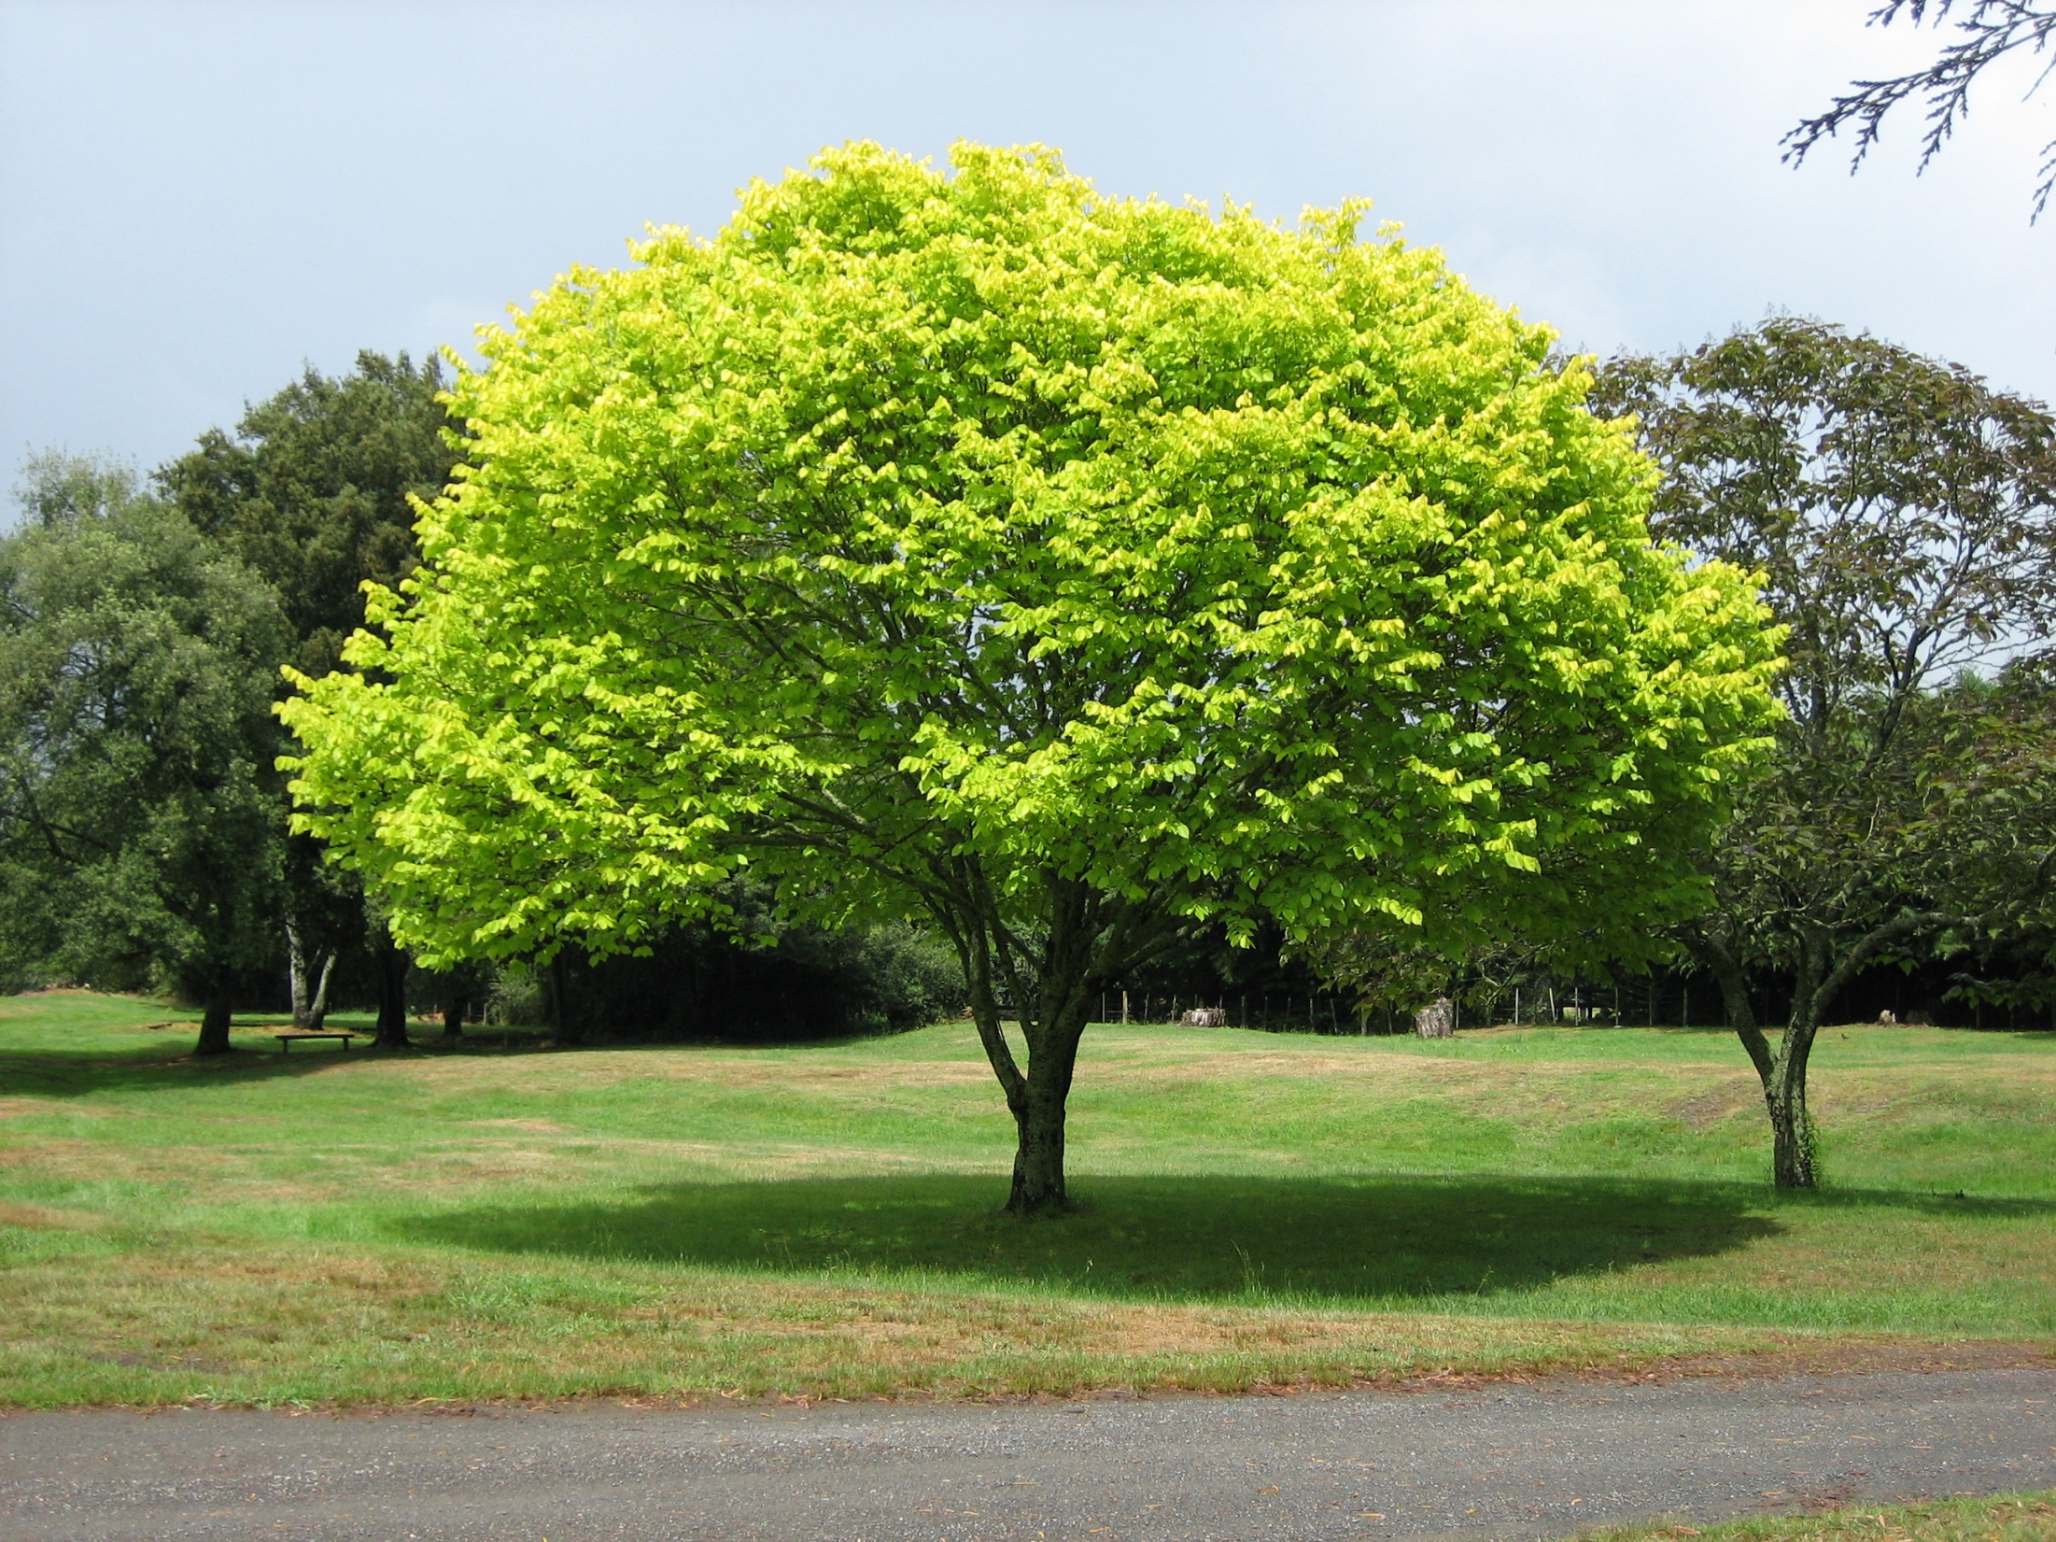
What does the concept of “resilience” mean to you? How can resilience help us to understand “productive failure”?
I always think of trees. To withstand the storm they need deep roots and a healthy support system. They bend and perhaps lose the odd branch...but they don’t break and continue to grow. (Paul Kleiman)

Slide 19
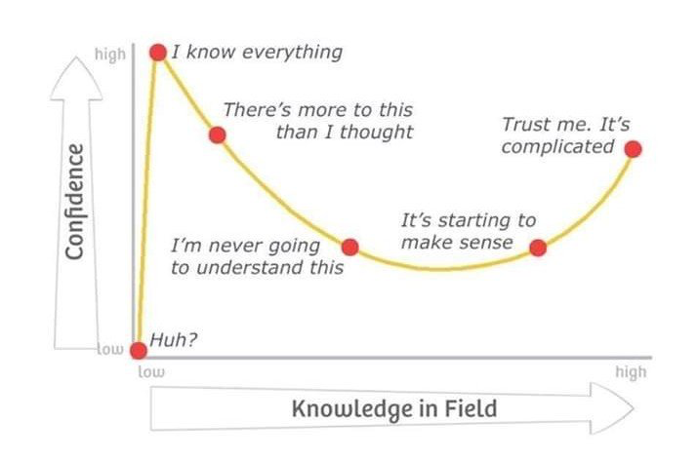
Adapted from Kruger, J. and Dunning, D., 2009

Slide 20
Making learning Interesting
Phil Race

Slide 21
Making learning interesting
Phil Race
(from Newcastle-upon-Tyne)
BSc PhD PGCE FCIPD PFHEA NTF
Follow Phil on Twitter: @RacePhil
Visiting Professor: University of Plymouth and Edge Hill University
Emeritus Professor Leeds Beckett University

Slide 22
This slide has two purposes….
To focus the data projector if necessary and…
...to persuade colleagues never to put this sort of detail onto a slide!

Slide 23
You can download free much of my published work
http://phil-race.co.uk/2016/04/updated-powerpoint-ripples-model/ (Chapter 1 from ‘The Lecturer’s Toolkit 2015)
https://phil-race.co.uk/2016/10/lthe-tweetchat-lthechat-wed-oct-19-8-00-9-00-pm/ (feedback stuff from my most recent two books)
https://phil-race.co.uk/2018/02/feedback-feedforward-just-tips-including-students/ (just the feedback tips!)
http://phil-race.co.uk/2015/01/assessment-bits-new-editions/ (extracts on assessment)
http://phil-race.co.uk/2017/05/lectures-and-learning/ (extracts on lecturing)

Slide 24
The three questions always in each student’s mind…
What will I be expected to show for this?
What does a good one look like and a bad one?
Where does this fit into the big picture?

Slide 25
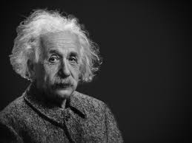
Thought for the day: Einstein
It is simply madness
to keep doing the same things
and expect different results.

Slide 26
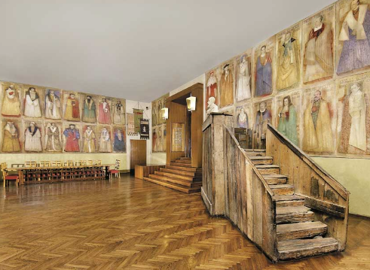
Do we spend too much of our time trying to teach our students?
We need to spend more energy helping them to appreciate feedback, make judgements, manage affect, taking action. (Carless and Boud, 2018)
Galileo: You can’t
teach a man
anything.
You can only help
him to learn.

Slide 27
Teaching, learning and enthusiasm
Knowledge isn’t infectious (unfortunately) but enthusiasm is, and we need to help our students to catch enthusiasm.
We certainly don’t want teaching, assessment or feedback to damage that enthusiasm.

Slide 29
What will I be expected to show for this?
What does a good one look like, and a bad one?
Where does this fit into the big picture?
When explaining assessment criteria to students, and when linking these to evidence of achievement of the intended learning outcomes, we need to make the most of face-to-face whole group contexts and...
Tone of voice
Body language
Facial expression
Eye contact
The chance to repeat things
The chance to respond to puzzled looks
Some things don’t work nearly so well just on paper or on screens.
Some of the
tools we can
use in
face-to-face
contexts

Slide 30
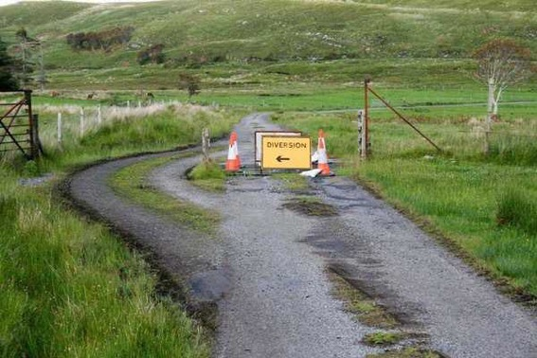

Slide 31
Keeping students engaged:
the ten most important words
Why?
What?
Who?
Where?
When?
How?
Which?
So what?
wtf?
Wow?
And the most powerful four-letter word in the English language...
????

Slide 32
‘what’ is getting ever less important
Columbia University research published (2011) in Science magazine shows that people are much less prepared to remember ‘what’, but better at remembering where to access information, and how to do so.
Betsy Sparrow, one of the principal researchers, concludes that the internet has become ‘an external memory source that we can access at any time. ... Just as we learn through transactive memory who knows what in our families and offices, we are learning what the computer ‘knows’ and when we should attend to where we have stored information in our computer-based memories. We are becoming symbiotic with our computer tools.
Published Online July 14 2011 < Science Express Index Science DOI: 10.1126/science.1207745
Report: Google Effects on Memory: Cognitive Consequences of Having Information at Our Fingertips Betsy Sparrow,*, Jenny Liu, Daniel M. Wegner

Slide 33
Keeping students engaged:
the ten most important words
Why? (rationale)
What? (content)
Who? (people, you, me, them)
Where? (locations)
When? (times)
How? (processes)
Which? (decisions)
So what? (importance?)
Wow? (impact?)
And the most powerful four-letter word in the English language...
????

Slide 34
Keeping students engaged:
the ten most important words
Why? (rationale)
What? (content)
Who? (people, you, me, them)
Where? (locations)
When? (times)
How? (processes)
Which? (decisions)
So what? (importance?)
Wow? (impact?)
And the most powerful four-letter word in the English language...
else

Slide 35
Go forth and
elsify!

Slide 36
Making sessions unmissable
Make good use of intended learning outcomes. (and incomes, outgoings, + emergent ones).
Always link sessions to assessment. (That’s what they need)
Don’t keep slides up too long. (Use ‘B’)
Avoid death by bullet point.
Try to cause the learners to like you. (Smile).
Think of what learners will be doing.
Bring in some appropriate humour.
Keep yourself tuned into WIIFM.
S

Slide 37
WIIFM
What’s in it for me?
Consciously address the ‘so what’ in students’ minds;
Warm up their ‘want’ to learn.
Clarify their ‘need’ to learn.
Address their questions:
What will I be expected to show for this?
What does a good one look like and a bad one?
Where does this fit into the big picture?

Slide 38
How students really learn
http://phil-race.co.uk/2016/04/updated-powerpoint-ripples-model/ (Chapter 1 from ‘The Lecturer’s Toolkit 2015)

Slide 39
How Students Really Learn ‘Ripples’ model of learning
Phil Race

Slide 40
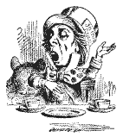
Unless we do something else…
“[The] pupils got it all by heart; and, when Examination-time came, they wrote it down; and the Examiner said ‘Beautiful! What depth!’
They became teachers in their turn, and they said all these things over again; and their pupils wrote it down, and the examiner accepted it; and nobody had the ghost of an idea what it meant” Lewis Carroll, 1893
Active
Experimentation
Abstract
Conceptualisation
Concrete
Experience
Reflective
Observation

Slide 41
What’s wrong
with
this?
Verbalising
Assessing
Feedback
Making sense
Doing
Wanting/
Needing

Slide 42
What’s wrong
with
this?
Verbalising
Assessing
Feedback
Making sense
Doing
Wanting/
Needing

Slide 43
What’s wrong
with
this?
Verbalising
Assessing
Feedback
Making sense
Doing
fun
Wanting/
Needing

Slide 44
Thanks, Dr Paul Kleiman

Slide 45
Assessment for learning and fit for purpose assessment
Sally Brown

Slide 46
Designing assessment as a central part of curriculum design
Assessment is a complex, nuanced and highly important process​ and if we want students to engage fully, we must make it really meaningful to them and convince them that there is merit in the activities we ask them to undertake. To focus students’ effort and improve their engagement with learning, we need to take a fresh look at our current practice to make sure assessment is for rather than just of learning, with students learning while they are being assessed rather than it being merely a summative end process. We also need to ensure that we make assessment practices and the giving of feedback manageable for staff and valuable for students.

Slide 48
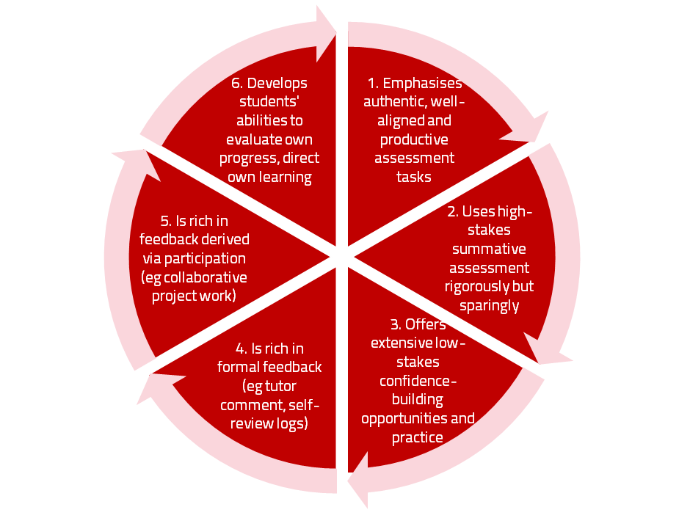
A4L the Northumbria model

Slide 49
Underpinning premises for A4L
Assessment can be a powerful means of focusing student effort and enhancing achievement if it is well designed and constructively aligned (Biggs and Tang, 2011);
We need to deploy a diverse range of tactics to our assessment and feedback to ensure that they work to enhance and extend student learning;
Students need to achieve assessment literacy to ensure they understand and can benefit from our assessment systems;
Assessment needs to be manageable for staff and students if it is going to engage students in learning activities.

Slide 50
Using assessment for learning (Sambell et al, 2012)
Assessment that is meaningful to students can provide them with a framework for activity;
“Students can escape bad teaching but they can’t escape bad assessment” (Boud, 1995);
Where assessment is fully part of the learning process and integrated within it, the act of being assessed can help students to make sense of their learning;
Assessment should be formative, informative, developmental and remediable.

Slide 51
My fit-for-purpose model of assessment: the key questions
Why are we assessing?
What is it we are actually assessing?
How are we assessing?
Who is best placed to assess?
When should we assess?
Notes:
51

Slide 52
For any assessment activity, we need to be clear about:
Aims: is this an early stage assignment, that is principally about building confidence and helping students see what is required of them, or is it a key element of their summative assessment, designment to gauge fitness to progress, or fitness-to-practice?
Scope: is this testing low level outcomes, like demonstrating recollection of key terms, or is it cognitively more demanding requiring synthesis of multiple elements, critical analysis, evaluation and reflection?
Scale: is this a small scale or a substantial task carrying a heavy weighting? Do students know how much effort and energy is needed to achieve at least a satisfactory level?
Orientation: Is the key aim to demonstrate the achievement of skills and competences, and/or to produce a definite product or is it primarily about demonstrating mastery of appropriate processes?
Constructive alignment: To what extent does the assessment closely link to the learning outcomes (and specifically the verbs used in them)?

Slide 53
Formative and summative assessment
Formative assessment is primarily concerned with feedback aimed at prompting improvement, is often continuous and usually involves words.
Summative assessment is concerned with making evaluative judgments, is often end point and involves numbers.

Slide 54
The importance of dialogic feedback (Sadler)
Students need to be exposed to, and gain experience in making judgements about, a variety of works of different quality... They need planned rather than random exposure to exemplars, and experience in making judgements about quality. They need to create verbalised rationales and accounts of how various works could have been done better. Finally, they need to engage in evaluative conversations with teachers and other students.

Slide 55
Assessment literacy: students do better if they can:
Make sense of key terms such as criteria, weightings, and level;
Encounter a variety of assessment methods (e.g. presentations, portfolios, posters, assessed web participation, practicals, vivas etc) and get practice in using them;
Be strategic in their behaviours, putting more work into aspects of an assignment with high weightings, interrogating criteria to find out what is really required and so on;
Gain clarity on how the assessment regulations work in their HEI, including issues concerning submission, resubmission, pass marks, condonement etc.

Slide 56
Students tend to be more convinced about the fairness of the assessment process if
Requirements and procedures are transparent and made readily available to them;
They believe that the tasks they are asked to do are worthwhile and are closely linked to what course documentation indicates they should be able to know and do at the end of the programme i.e. authentic assessment;
They fully understand the ‘rules of the game’.

Slide 57
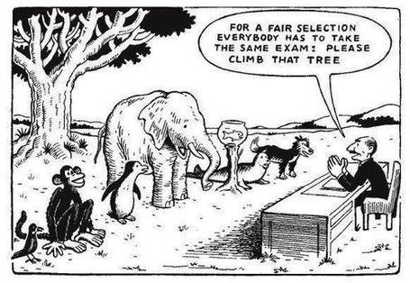

Slide 58
Assessment for learning: some useful thoughts
1. Tasks should be challenging, demanding higher order learning and integration of knowledge learned in both the university and other contexts;
2. Learning and assessment should be integrated, assessment should not come at the end of learning but should be part of the learning process;
3. Students are involved in self assessment and reflection on their learning, they are involved in judging performance;
4. Assessment should encourage metacognition, promoting thinking about the learning process not just the learning outcomes;
5. Assessment should have a formative function, providing ‘feedforward’ for future learning which can be acted upon. There is opportunity and a safe context for students to expose problems with their study and get help; there should be an opportunity for dialogue about students’ work;

Slide 59
Assessment for learning
6. Assessment expectations should be made visible to students as far as possible;
7. Tasks should involve the active engagement of students developing the capacity to find things out for themselves and learn independently;
8. Tasks should be authentic; worthwhile, relevant and offering students some level of control over their work;
9. Tasks are fit for purpose and align with important learning outcomes;
10. Assessment should be used to evaluate teaching as well as student learning.
(Bloxham and Boyd)

Slide 60
Do your international students understand UK assessment approaches?
Have you clarified the ground rules on issues like pass marks, criterion-referenced assessment and grading systems?
Have you explained how extensions, condonements, and university assessment regulations work?
Are the assignments built around a curriculum international in scope and content? Are tasks and case studies globally orientated?

Slide 61
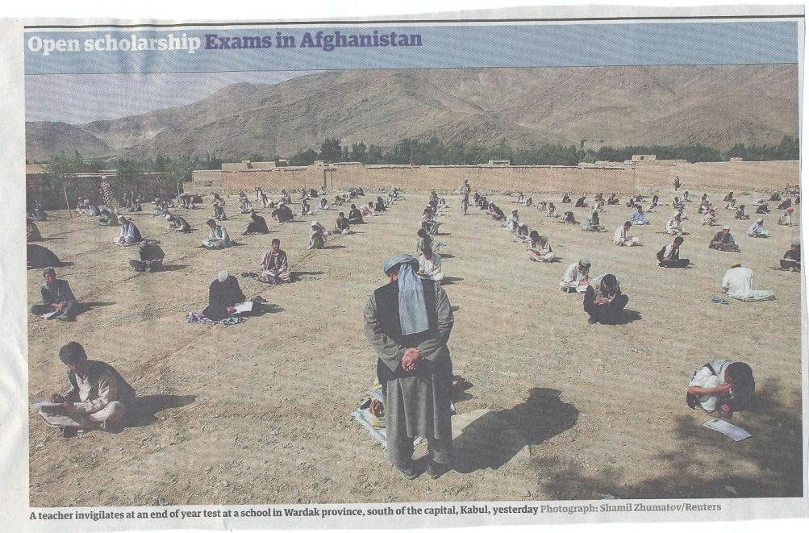

Slide 62
What do we mean by ‘traditional assessment formats’?
At least 80% of UK higher education assessment uses three main forms;
Unseen time constrained exams of some sort;
Essays where students respond to a stimulus question or title;
Reports of some kind.
These are not necessarily authentic or useful means of assessing students knowledge, capabilities and understanding.

Slide 63
We often assess what is easy to assess, or proxies of what’s been learned, rather than the learning itself
A valid assessment is one that has close relevance to the criteria, which are in turn constructively aligned to the stated learning outcomes of a programme.
Effective assessment is highly relevant to ensuring that graduates can demonstrate the knowledge, behaviours, qualities and attributes that were described in the course outline or programme specification.
Assignments that require students to write about something, rather than be or do something, may not always be fit-for-purpose.

Slide 64
Questions employers might ask at interview that might help us frame some of our assignments
Can you tell us about an occasion when:
you worked together with colleagues in a group to produce a collective outcome;
you had to work autonomously with incomplete information and self-derived data sources;
you developed strategies to solve real life problems and tested them out;
you had a leadership role in a team, and could you tell us your strategies to influence and persuade your colleagues to achieve a collective task;
you had to communicate outcomes from your project work orally, in writing, through social media and/or through a visual medium?"

Slide 65
Diverse format assignments for authenticity could include:
Simulations (paper-based or computer-based) .
Multiple choice questions , with subsequent questions seeking out rationales for answers.
Scripts for Business/Elevator pitches.
Case studies for interrogation.
The requirement to write executive summaries of complex documents.
Reports of Project outputs.
Action plans based on project activity undertaken.
In-tray exercises where students are required to prioritise and use a variety of documents, graphs, tables etc in real time.
Short-answer questions which can be marked electronically.
Reflective commentaries of practical experience. Critical incident accounts, where students are asked, for example following a placement or project, to write say 200 words on Context, Action taken, Rationale for action, Literature review guiding choice of action, Report of outturn, Indication of what has been learned and what would be done differently next time.

Slide 66
Effective feedback practices
Phil Race

Slide 67
Feedback and emotions
Probably feedback is for many people the most emotionally charged experience linked to assessment?
How best can we help bring ‘compassion’ into feedback?
It is well worth giving 20 minutes to watch this: (Theo Gilbert and others) https://www.youtube.com/watch?v=3jFVTCuSCOg …​ particularly on how we can help students to learn how to get more from feedback from each other as well as us.

Slide 68
David Carless (on Twitter):
Feedback as telling is seriously overrated!

Slide 69
Developing students’ feedback literacy
The danger with traditional methods of assessment and feedback is that assessment tends to be done on student’s work by staff, and feedback tends to be one-directional from staff to students.
Carless and Boud (2018) stress that we want students to gain skills in making ‘evaluative judgements’ themselves on their work, rather than staff doing this.
David Carless & David Boud (2018): The development of student feedback literacy: enabling uptake of feedback, Assessment & Evaluation in Higher Education, https://doi.org/10.1080/02602938.2018.1463354

Slide 70
Now out…
Naomi Winstone and David Carless
Designing effective feedback processes in higher education
Routledge, 2019

Slide 71
Experience of Royce Sadler on standards, assessment and feedback
Well worth looking at this clip from a MOOC on Coursera from Royce Sadler, who’s work informs much of the modern thinking on assessment and feedback…

Slide 72
Factors underpinning feedback literacy
Carless and Boud (2018) examine in detail:
Appreciating feedback
Making judgements
Managing affect
Taking action
We need to enable our students to optimise each of these processes, if we wish to use assessment to promote their learning. They suggest that involving students in giving and receiving peer feedback, and in analysing exemplars, should be essential parts of the curriculum.

Slide 73
Task: think about ghastly feedback
Think back to some occasions, academic or otherwise, historic or recent when you received feedback that you would rather not have received;
How did it make you feel?
Thinking of a single example of ghastly feedback that you are prepared to share with another person, briefly outline the context and say why it was such a negative experience.

Slide 74
Feedback needs to have a future focus
Hounsell et al argue that we need to:
‘increase the value of feedback to the students by focusing comments not only on the past and present … but also on the future – what the student might aim to do, or do differently in the next assignment or assessment if they are to continue to do well or to do better’
(Hounsell, McCune, Hounsell and Litjens 2008, p.5).

Slide 75
Quality feedback: 3 functions
“There is wide consensus within the education literature that ‘quality’ feedback should serve three overlapping functions:
an ‘orientational’ purpose that clarifies the student’s performance and achievement;
a ‘transformational’ purpose that enables the student to reflect, improve their performance, and become more autonomous (often termed ‘feed-forward); and
an ‘affective/interpersonal’ dimension that gives the student confidence and motivation, and builds a strong teacher-student relationship”
(Dunworth & Sanchez, 2016, quoted by Winstone and Nash, 2016).

Slide 76
Ripples on a pond….
Motivates students – helps them to want to learn;
Helps students to identify what they need to do next;
Helps students to take action to improve their learning;
Helps students to make sense of what they are learning;
Helps them to further make sense of their learning by engaging in real dialogue with tutors and peers;
Helps them to make informed judgements on their own work, and each others’ work:
Helps them to reflect on their past work in ways they can use to improve their future work.
Feedback (including feed forward) works well when it:
Coaching,
explaining, teaching
Assessing
making informed judgements
Wanting/
Needing
Doing
Doing
Making sense
Feedback

Slide 77
Feedback works badly when it…
Is just a monologue from tutors to students;
Saps students’ confidence;
Directs students’ activities in inappropriate directions;
Fails to articulate with learning outcomes;
Fails to relate clearly to evidence of achievement of the assessment criteria;
Relates only to what is easy to assess rather than what is at the heart of learning;
Focuses on failings rather than achievements.

Slide 78
What’s wrong with feedback?
Students get it too late.
And too often, it’s just words on paper.
It doesn’t help them enough.
They often don’t take enough notice of it.

Slide 79
But what’s really wrong with feedback?
Too often it’s one-way – monologic.
What students want is dialogue.
They want to talk to us about their work.
But they’re scared to talk to us, for various reasons:
In case it leads to lower marks;
In case they’re ‘found out’;
In case they feel stupid.

Slide 80
Feedback
Formative, helping to shape and improve future performances, that is Feed-forward;
Energising: helping students to feel motivated and inclined to work towards Enhancement;
Efficient: enabling you to maximise your helpful commentary while minimising your Effort;
Dialogic, involving interaction with and between students, plus Developmental comments;
Benevolent: students should Believe you have their Best interests at heart;
Action-orientated: that is leading students to Actually Advancing their Achievement;
Constructive rather than destructive, taking note of the affective impact of our Comments;
Kindly: when putting across tough messages, we need to remember the affective impact. (Sally Brown, 2019)

Slide 81
Feed-forward
Language of feedback
Some feedback
issues
National Student Survey
Timing:
24-hours!
Written, printed,
on-screen
Efficiency
Face to face
oral

Slide 82
Fishing for feedback?
Feedback is like fish.
If it is not used quickly, it becomes useless.
(Sally Brown).
Give a man a fish,
Feed him for a day.
Teach a man to fish,
Feed him for a lifetime.
(Maimonides: 1135-1204)
Make feedback timely, while it still matters to students, in time for them to use it towards further learning, or to receive further assistance.
(Graham Gibbs)
And he’ll learn to drink beer in boats
And you won’t see him for weeks!
(Australian proverb).

Slide 83
Napier University Quick Guides
1 Commenting Constructively Quick Guide.pdf
2 Getting Students to Engage Quick Guide.pdf
3 Giving Formative Feedback Prior to Submission Quick Guide.pdf
4 Streamlining Feedback on Summative Tasks Quick Guide.pdf
5 Alternatives to Traditional Exams Quick Guide.pdf
6 Alternatives to Essays Quick Guide.pdf
7 Getting Students to Self-assess Quick Guide.pdf
8 Assessment Literacy.pdf​
9 Exemplars Quick Guide.pdf
10 Supporting International Students in their Assessment Quick Guide.pdf
11 Using a Simple Feedback Stamp to Provide Incremental Feedback on Work-in-progress in the Art Design Context.pdf
12 Helping Students to Benefit From Feedback on Exams.pdf
13 Meeting the challenges of Programme Focused Assessment.pdf
14 Combatting Contract Cheating.pdf​

Slide 84
The present NSS statements (2017)
Assessment and feedback
The criteria used in marking have been clear in advance
Marking and assessment have been fair
Feedback on my work has been timely
I have received helpful comments on my work
Student voice
I have had the right opportunities to provide feedback on my course
Staff value students’ views and opinions about the course
It is clear how students’ feedback on the course has been acted on

Slide 85
Setting your priorities?
1
Urgent and important
2
Urgent,
not Important
3
Not urgent,
but important
4
Not urgent,
not important

Slide 86
Face to face feedback

Slide 87
Hands-on feedback?

Slide 88
How to get feedback to a large group of students within 24 hours
There are serious reservations about written feedback, but we can make even this work much better than it did.
The next few slides are about a way of giving students feedback on their work within 24 hours of them doing it.
There are three or more ‘yes, but...’s with this idea, but please hold these for around four minutes.

Slide 89
Set the hand-in time to be at a whole-group session
E.g. next Tuesday’s 10-11 lecture,
Deadline = 1003.
Let them pile up all their work at the front.
At 1003, hand out to everyone a coloured sheet, containing numbered points.
(so you can say in feedback ‘please see point 3, blue sheet’ and so on).

Slide 90
The blue sheet can contain....
Illustration of what is expected as evidence of achievement of each of the intended learning outcomes
Likely mistakes
Features of a good answer
Frequently needed explanations
Things you otherwise would have to write time and time again on students’ work.
Let the students study this for 3 minutes until 1006 – it goes rather quiet!

Slide 91
At 1006...
Go into face-to-face oral mode, until 1009....
Spend a few minutes de-briefing the whole group and talking them through one point on the handout…
…adding tone-of-voice, facial expression, body language, emphasis, and so on to the feedback.

Slide 92
The rationale...
Since most of the students will still have been doing the work in the last 24 hours before handing it in, you’re giving them feedback while they still remember what they were doing.
They know what they didn’t do.
They know what they missed out because they couldn’t understand it.

Slide 93
Now take away their work to mark – in a third of the time it used to take you!
You waste far less writing the same old things on one piece of work after another, regarding frequently occurring mistakes;
Instead, you need just to write ‘please see point 4, blue sheet’ (which takes seconds).
You can now make your comments relate more to each individual piece of work;
This means when students get their marked work back with feedback, they are more likely to use it, as it’s personal to them.

Slide 94
Set
hand-in deadline to be at lecture
Prepare ‘blue sheet’ with anticipated
generic feedback
Summary: providing feedback within 24 hours
Collect students’ work at start of lecture
Take away work to mark in a third of the time
Hand out ‘blue sheet’
Talk class through one important point, then resume lecture
Let students read blue sheet for short while

Slide 95
Feedback without marks
Marks often destroy the value of our feedback to students!

Slide 96
Feedback versus marks or grades
Feedback may be eclipsed by marks or grades.
Students may be blinded by the mark or grade, and not even try to make sense of the feedback they receive.

Slide 97
Just a mark (or grade) is the least effective form of feedback!
It’s what students look at first.
If the mark is good, they smile and file – quite often they don’t even read the feedback.
If it’s low, they frown and bin it – very often without reading the feedback.

Slide 98
But there are ways round this...
Give students back their work with feedback but with no marks or grades (keeping your record of their marks).
Ask them to work out their marks from the feedback you have given them (and from the feedback you gave to others too).

Slide 99
Suggest that their marks will count!
Tell them that if their self-assessment scores are within (say) 5% of your own scores, the higher number will go forward into their assessment record.
But explain that you will talk individually to those students whose score is different by more than 5% from yours.

Slide 100
Get them to self-assess...
Collect their scores or grades – e.g. pass a sheet round in a lecture.
Most students (e.g. 9 in 10) will be within the 5%.
Arrange to talk to those where the difference is more than 5% or one grade.

Slide 101
Students who under-estimate their grade…
These students often need their esteem boosted.
Remind them about the assessment criteria, and how these illustrate the intended standards associated with the learning outcomes.
Check that they weren’t just trying not to be seen as over-confident.

Slide 102
Students who over-estimate their grade…
This usually indicates they’ve got a blind spot.
Talk them through their work, and find out exactly where they’ve lost marks which they thought they had gained.
Check with them that they can now see what was being looked for.

Slide 103
Developing this idea further…
Think about getting students to indicate their expected score or grade at the point of handing their work in – for example on a self-assessment proforma.
Think about getting students to work out how well they believe they have achieved each of the intended learning outcomes for the work concerned…
Or how well they believe they have met each of the assessment criteria for the work.

Slide 104
Get students to self-assess their work
At the point of handing it in to us!

Slide 105
Using student self-assessment to deepen their learning…
…and to make tutor-marking more effective, and efficient – and to start tutor-student dialogues

Slide 106
Self-Assessment of your Assignment Please respond to the following questions at the point just before handing your work in. This will help me to give you useful feedback about your work, and also will give me useful feedback about how you are finding the programme to date. Thanks.
 | Questions | Your replies to the questions | Tutor’s responses | Your action points
1 | Ωηατ μαρκ (ουτ οφ 100) δο ψου τηινκ τηισ ωορκ δεσερϖεσ?
2 | Ωηατ διδ ψου λικε μοστ αβουτ δοινγ τηισ παρτιχυλαρ πιεχε οφ ωορκ?
3 | Ωηατ διδ ψου λικε λεαστ αβουτ δοινγ τηισ πιεχε οφ ωορκ?
4 | Ωηατ δο ψου τηινκ ισ τηε τηινγ ψου διδ βεστ?
5 | Ωηατ δο ψου τηινκ ψου διδ λεαστ ωελλ?

Slide 107
Self-assessment tutor dialogues
Getting students to really reflect:
A way of evidencing good feedback practice for inspection purposes;
Avoiding wasting your time – and students’ time;
Making sure students actually read your feedback;
Making sure you give your students the feedback they want as well as the feedback they need;
Finding out more about your students;
…and much more.

Slide 108
Some questions to consider for self-assessment-tutor dialogues
1 What do you honestly consider will be a fair score or grade for the work you are handing in?

Slide 109
Some questions to consider for self-assessment-tutor dialogues
2 What do you think was the thing you did best in this assignment?

Slide 110
Some questions to consider for self-assessment-tutor dialogues
3 If you had the chance to do the assignment again from scratch, how (if at all) might you decide to go about it differently?

Slide 111
Some questions to consider for self-assessment-tutor dialogues
4 What did you find the hardest aspect of this assignment?

Slide 112
Some questions to consider for self-assessment-tutor dialogues
5 Please jot down three short questions you would like me to answer about this example of your work:
(1)
(2)
(3)

Slide 113
Energising your group work: bringing learning to life
Sally Brown

Slide 114
Link to UAL Assessment criteria
This is a link to the short video we showed at the start of the afternoon session…
https://www.youtube.com/watch?v=n1IXAFN_79I

Slide 115
Task one: Brainstorm
How can small group work help students feel more positive and engaged?

Slide 116
Task two: By letter
Why should you use small groups with students? Why shouldn't you?

Slide 117
Five reasons why you shouldn’t do small group work
It can be more complicated to organise and may involve more liaison with managers, time-tablers and others who might prefer you just to give lectures;
Not all HE teachers and supporters of learning are comfortable with managing group work and, in particular, the perceived loss of control that comes from handing over activities to student groups for enactment;
It’s quite difficult to give students equivalent (if not identical experience) when they are working in diverse groups;
There are often concerns about differential workloads by students resulting in the same mark for every student in the group;
Students often really dislike group work at the time they are doing it and it can be a significant cause of complaints (but see the first point on next slide).

Slide 118
And five reasons why you should
When you ask students several years down the line what was the most productive experiences they had while, learning, they will often refer to group activities;
Group work can be helpful in preventing students feeling isolated, which can be the case if all their study time is solitary, especially in subject areas (e.g. Literature studies) where there is traditionally quite a low proportion of their time is in class contact;
Group work can provide contexts in which theory learned on their courses can be applied to practical contexts, and can help to bring the learning to life for students;
The ability to manage interpersonal issues that often arise within group work are key graduate attributes required by almost every career or profession;
Employers have been telling us for years that they want to employ people capable of working straightaway as team members, often in interdisciplinary units.

Slide 119
Task three: by number
How do small group tasks develop employability Skills?

Slide 120
Small-group skills are precisely those required in employment and research, where graduates need to be able to:
work in teams;
listen to others’ ideas sympathetically and critically;
think creatively and originally;
formulate and ask questions skilfully;
show skills in explaining things fluently and convincingly;
build on others’ existing work;
collaborate on projects;
contribute skillfully to producing reports, publications and action plans;
work together online with fellow-learners;
manage time and processes effectively;
see projects through to a conclusion;
cope with the normal difficulties of face-to-face interactions between human beings.

Slide 121
When students go for interview by prospective employers, questions they might be asked include: Can you tell us about an occasion when:
you worked together with colleagues in a group to produce a collective outcome?
you had to work autonomously with incomplete information and self-derived data sources, and check with other people whether you were on the right lines?
you developed strategies to solve real life problems and tested them out by discussion them with colleagues?
you had a leadership role in a team, and could you tell us about your strategies to influence and persuade your colleagues to achieve a collective task?
you had to communicate outcomes from your project work orally, and collectively put these outcomes into writing, or disseminate them through social media or through a visual medium?

Slide 122
TASk four: by symbol
What size of group works best to get maximum participation of students?

Slide 123
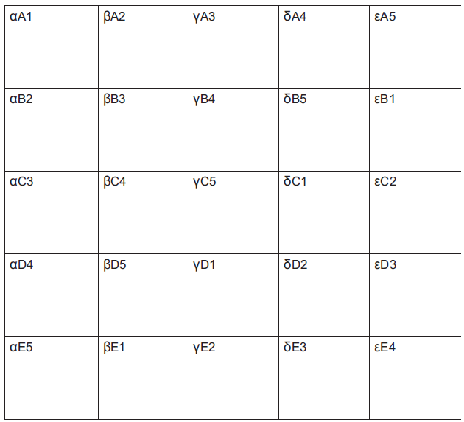
Cross overs using Greek letters, Latinate letters and numbers
A cross over for 25 people. Can be scaled up to hundreds!

Slide 124
Task Five: Individual reflection
What are some of the hazards of working in tiny groups? Very big groups?

Slide 125
Deciding on group size for tasks: each has benefits and disadvantages
Pairs;
Threes (triads);
Fours;
Fives;
Six or sevens;
More (bad idea!)

Slide 126
TASK six: in PAirs
What means do you use to compose groups for group tasks: what are the benefits and hazards?

Slide 127
Forming groups:
Friendship groups;
Locational groups;
Alphabetical (family name) groups;
Random groups;
Number groups:
Astrological star sign groups;
Learning teams
Hybrid teams.

Slide 128
TASk seven: in Fours
Looking at the UKPSF on the next slide, for which elements could you use these kinds of activities as evidence?

Slide 130
Task eight: Brainstorm
What kinds of behaviours sabotage small group work

Slide 131
Task Nine: Fishbowl
What kinds of ground rules can small groups set?

Slide 132
Ground rules could include:
Respect the opinions and viewpoints of others, listening and responding appropriately;
Respect for each other’s valid reasoning: the ability to detect poor argument and to engage in respectful dialogue;
A commitment to regular attendance and to cooperation with others in independent group work involving debate and dialogue;
Active use of concepts and modes of reasoning that have been introduced in the module content;
A commitment to shared reflection;
A commitment to collective responsibility once decisions have been made.
* Adapted from Foreman-Peck (2010) p32

Slide 133
Of the techniques used today, which do you think has been 1. most fun, and 2. most productive of learning?
Brainstorming:
Cross overs;
Buzz groups …. Leading into Snowballing;
Fishbowls
What else can we use?

Slide 134
References on group work and other reading
Creme, P., 2008. A space for academic play: Student learning journals as transitional writing. Arts and Humanities in Higher Education, 7(1), pp.49-64.
Curran, V.R., Sharpe, D., Forristall, J. and Flynn, K., 2008. Student satisfaction and perceptions of small group process in case-based interprofessional learning. Medical Teacher, 30(4), pp.431-433.
Foreman-Peck. L (2010) ‘Fairness in group-work assessment in higher education; an action case study’ in Foreman-Peck, L. and McDowell, L. (2010) Aims Ethics and Values in group work assessment, Newcastle, Northumbria University

Slide 135
Ask us anything!
Phil Race and Sally Brown

Slide 136
Useful references: 1
Assessment Reform Group (1999) Assessment for Learning: Beyond the black box, Cambridge UK, University of Cambridge School of Education.
Bain, K. (2004) What the best College Teachers do, Cambridge: Harvard University Press.
Biggs, J. and Tang, C. (2011) Teaching for Quality Learning at University, Maidenhead: Open University Press.
Bloxham, S. and Boyd, P. (2007) Developing effective assessment in higher education: a practical guide, Maidenhead, Open University Press.
Boud, D. (1995) Enhancing learning through self-assessment, London: Routledge.
Boud, D. and Associates (2010) Assessment 2020: seven propositions for assessment reform in higher education Sydney: Australian Learning and Teaching Council.

Slide 137
Useful references: 2
Brown, S. (2012) Assimilate compendium, Leeds, Leeds Met Press
Brown, S. (2012) ‘What are the perceived differences between assessing at Masters level and undergraduate level assessment? Some findings from an NTFS–funded project’ Innovations in Education and Teaching International, forthcoming
Brown, S., Deignan, T. Race, P. and Priestley, J. (2012) ‘Assessing students at Masters Level: learning points for Educational Developers’ Educational Developments, SEDA, Birmingham.
Brown, S (2012) ‘Diverse and innovative assessment at Masters Level: alternatives to conventional written assignments’ in AISHE-J: The All Ireland Journal of Teaching and Learning in Higher Education Vol 4, No 2.
Brown, S. (2014) Learning, teaching and assessment in higher education: global perspectives. London: Palgrave Macmillan.

Slide 138
Useful references: 3
Brown, S. and Glasner, A. (eds.) (1999) Assessment Matters in Higher Education, Choosing and Using Diverse Approaches, Maidenhead: Open University Press.
Brown, S. and Knight, P. (1994) Assessing Learners in Higher Education, London: Kogan Page.
Brown, S. and Race, P. (2012) Using effective assessment to promote learning in Hunt, L. and Chambers, D. (2012) University Teaching in Focus, Victoria, Australia, Acer Press. P74-91
Brown, S. Rust, C. & Gibbs, G. (1994) Strategies for Diversifying Assessment, Oxford: Oxford Centre for Staff Development.
Creme, P., 2008. A space for academic play: Student learning journals as transitional writing. Arts and Humanities in Higher Education, 7(1), pp.49-64.
Curran, V.R., Sharpe, D., Forristall, J. and Flynn, K., 2008. Student satisfaction and perceptions of small group process in case-based interprofessional learning. Medical Teacher, 30(4), pp.431-433.

Slide 139
Useful references: 4
Carless, D., Joughin, G., Ngar-Fun Liu et al (2006) How Assessment supports learning: Learning orientated assessment in action Hong Kong: Hong Kong University Press.
Carless, D. & Boud, D. (2018): The development of student feedback literacy: enabling uptake of feedback, Assessment & Evaluation in Higher Education, DOI:10.1080/02602938.2018.1463354
Carroll, J. and Ryan, J. (2005) Teaching International students: improving learning for all. London: Routledge SEDA series.
Crooks, T. (1988) Assessing student performance, HERDSA Green Guide No 8 HERDSA (reprinted 1994).
Crosling, G., Thomas, L. and Heagney, M. (2008) Improving student retention in Higher Education, London and New York: Routledge.
Falchikov, N. (2004) Improving Assessment through Student Involvement: Practical Solutions for Aiding Learning in Higher and Further Education, London: Routledge.

Slide 140
Useful references: 5
Foreman-Peck. L (2010) ‘Fairness in group-work assessment in higher education; an action case study’ in Foreman-Peck, L. and McDowell, L. (2010) Aims Ethics and Values in group work assessment, Newcastle, Northumbria University
Gibbs, G. (1999) Using assessment strategically to change the way students learn, in Brown S. & Glasner, A. (eds.), Assessment Matters in Higher Education: Choosing and Using Diverse Approaches, Maidenhead: SRHE/Open University Press.
Higher Education Academy (2012) A marked improvement; transforming assessment in higher education, York: HEA.
Hounsell, D. (2008). The trouble with feedback: New challenges, emerging strategies, Interchange, Spring, Accessed at www.tla.ed.ac.uk/interchange.
Knight, P. and Yorke, M. (2003) Assessment, learning and employability Maidenhead, UK: SRHE/Open University Press.

Slide 141
Useful references: 6
McDowell, L. and Brown, S. (1998) Assessing students: cheating and plagiarism, Newcastle: Red Guide 10/11 University of Northumbria.
Mentkowski, M. and associates (2000) p.82 Learning that lasts: integrating learning development and performance in college and beyond, San Francisco: Jossey-Bass.
Meyer, J.H.F. and Land, R. (2003) ‘Threshold Concepts and Troublesome Knowledge 1 – Linkages to Ways of Thinking and Practising within the Disciplines’ in C. Rust (ed.) Improving Student Learning – Ten years on. Oxford: OCSLD.
Morgan, C., Dunn, L., Parry, S. and O'Reilly, M. (2004) The student assessment handbook: New directions in traditional and online assessment, London, Routledge.

Slide 142
Useful references: 7
Newstead, S. E., Franklyn-Stokes, A., & Armstead, P. (1996) Individual differences in student cheating, Journal of Educational Psychology, 88(2), 229-241
Nicol, D. J. and Macfarlane-Dick, D. (2006) Formative assessment and self-regulated learning: A model and seven principles of good feedback practice, Studies in Higher Education Vol 31(2), 199-218.
PASS project Bradford http://www.pass.brad.ac.uk/ Accessed November 2013.
Peelo, M. T., & Wareham, T. (Eds.). (2002). Failing students in higher education. Society for Research into Higher Education.
Pickford, R. and Brown, S. (2006) Assessing skills and practice, London: Routledge.

Slide 143
Useful references: 8
Race P. (2020) The lecturer’s toolkit (5th edition), London: Routledge.
Race, P. (2001) A Briefing on Self, Peer & Group Assessment, in LTSN Generic Centre Assessment Series No 9, LTSN York.
Race, P. (2014) Making learning happen: 3rd edition, London: Sage.
Rotheram, B. (2009) Sounds Good, JISC project http://www.jisc.ac.uk/whatwedo/programmes/usersandinnovation/soundsgood.aspx
Rust, C., Price, M. and O’Donovan, B. (2003) Improving students’ learning by developing their understanding of assessment criteria and processes, Assessment and Evaluation in Higher Education. 28 (2), 147-164.

Slide 144
Useful references: 9
Ryan, J. (2000) A Guide to Teaching International Students, Oxford Centre for Staff and Learning Development.
Sadler, D. R. (2010) Beyond feedback: Developing student capability in complex appraisal. Assessment & Evaluation in Higher Education, 35(5), 535-550.
Seymour, D. (2005) Learning Outcomes and Assessment: developing assessment criteria for Masters-level dissertations. Brookes eJournal of Learning and Teaching 1(2).
Winstone, N. and Carless, D. (2020) ‘Designing effective feedback processes in Higher Education: a learning-focussed approach’ Routledge London and New York
Yorke, M. (1999) Leaving Early: Undergraduate Non-completion in Higher Education, London: Routledge.

