Slide 1
Spaces, Places and Communities of Learning
Bringing your teaching to life: practical tips to inspire learning
Heriot Watt University
9th October 2019
Sally Brown NTF, PFHEA, SFSEDA
@ProfSallyBrown http://sally-brown.net
Phil Race, NTF, PFHEA, FCIPD
@RacePhil http://phil-race.co.uk

Slide 2
In this presentation, we will aim to:
Review eight paradigm shifts in higher education practice;
Consider seven factors that underpin learning (Race 2019):
Consider what constitutes excellent teaching;
Propose some ways in which each of us can inspire learning in our classrooms.

Slide 3
Addressing the 2020s:
Eight concurrent, related paradigm shifts
Online information and the internet now just normal, ‘digital’ has now ‘grown up’, and is no longer something different.
More attention to learning, rather than teaching.
Less focus on classes as ‘transmission’ occasions.
Learning-centred approach to assessment of student outcomes.
Greater focus on feedback dialogues, and development of feedback literacy by students.
Increased recognition of the skills, attitudes and behaviours graduates need to be work-ready.
Responsibility of institutions to prepare students for active citizenship in their own communities, nations and globally.
Increased recognition of the need for teaching staff to be trained, qualified and accredited as teachers.

Slide 4
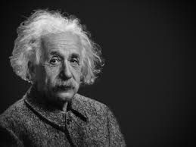
Einstein
It is simply madness
to keep doing the same things
and expect different results.

Slide 5
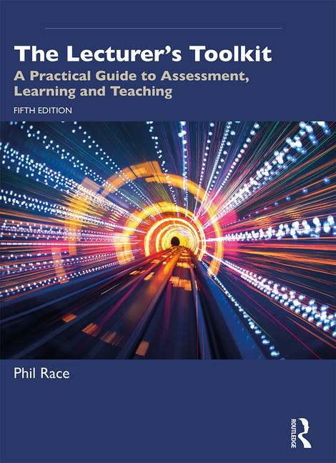
5th Edition in press
Expected to come out in October 2019
Flyer can be downloaded from Phil-Race.co.uk
See also ‘In at the Deep End’ published by Heriot Watt

Slide 6
The three questions always in each student’s mind…
What will I be expected to show for this?
What does a good one look like and a bad one?
Where does this fit into the big picture?

Slide 7
Teaching, learning and enthusiasm
Knowledge isn’t infectious (unfortunately) but enthusiasm is, and we need to help our students to catch enthusiasm.
We certainly don’t want teaching, assessment or feedback to damage that enthusiasm.

Slide 8
What will I be expected to show for this?
What does a good one look like, and a bad one?
Where does this fit into the big picture?
When explaining assessment criteria to students, and when linking these to evidence of achievement of the intended learning outcomes, we need to make the most of face-to-face whole group contexts and...
  Tone of voice
  Body language
  Facial expression
  Eye contact
  The chance to repeat things
  The chance to respond to puzzled looks
Some things don’t work nearly so well just on paper or on screens.
Some of the
tools we can
use in
face-to-face
contexts

Slide 9
Responding to students:
the ten most important words
Why? (rationale)
What? (content)
Who? (people, you, me, them)
Where? (locations)
When? (times)
How? (processes)
Which? (decisions)
So what? (importance?)
Wow? (impact?)
And
????

Slide 10
Responding to students:
the ten most important words
Why? (rationale)
What? (content)
Who? (people, you, me, them)
Where? (locations)
When? (times)
How? (processes)
Which? (decisions)
So what? (importance?)
Wow? (impact?)
And else

Slide 11
Seven factors underpinning how students really learn
Wanting to learn
Needing to learn
Learning by doing
Making sense of what is being learned
Learning through feedback
Verbalising – putting learning into spoken words
Learning by assessing – making informed judgements

Slide 12
Verbalising
Assessing
Feedback
Making sense
Doing
Wanting/
Needing

Slide 13
Verbalising
Assessing
Feedback
Making sense
Doing
Wanting/
Needing

Slide 14

Thanks, Dr Paul Kleiman

Slide 15
Ripples on a pond….
Enhance our students’ want to learn?
Help students to develop ownership of the need to learn?
Keep students learning by doing, practice, trial-and-error, repetition?
Ensure students really use feedback – from us and from each other?
Help students to make sense of what they learn?
Get students deepening their learning by verbalising, explaining things to each other, and to us?
Allow students to deepen their learning by assessing their own learning, and assessing others’ learning – making informed judgements?
Verbalising
What else can we do to use
teaching, assessment and feedback to:
Assessing
making informed judgements
Wanting/
Needing
Doing
Doing
Making sense
Feedback

Slide 16
What constitutes excellent teaching?

Slide 17
Some characteristics of excellent teaching as described in the scholarly literature (inter alia Bain 2004, Biggs and Tang, 2011, Ramsden, 1991)
Knows subject material thoroughly
Adopts a scholarly approach to the practice of teaching
Is reflective and regularly reviews own practice
Is well organised and plans curriculum effectively
Is passionate about teaching
Has a student-centred orientation to teaching
Regularly reviews innovations in learning and teaching and tries out ones relevant to own context
Ensures that assessment practices are fit for purpose and contribute to learning
Demonstrates empathy and emotional intelligence

Slide 18
How do HEIs know if we are offering excellent student experiences?
Students are satisfied, learn well, achieve highly and have fulfilling learning experiences;
Students develop a range of competences they need including problem solving, working with others and self-management;
We as practioners are satisfied, motivated and find our workloads manageable;
Quality assurers and Professional and Subject bodies like what we do and have no complaints about systems and processes;
University managers are confident that the student experience offered is of high quality (and deal with few complaints).

Slide 19
Three indicative criteria from the UK National Teaching Fellowship scheme (AdvanceHE)
Criterion 1: Individual excellence:
Evidence of enhancing and transforming student outcomes and/or the teaching profession: demonstrating impact commensurate with the individual’s context and the opportunities afforded by it.
Criterion 2: Raising the profile of excellence:
Evidence of supporting colleagues and influencing support for student learning and/or the teaching profession; demonstrating impact and engagement beyond the nominee’s immediate academic or professional role.
Criterion 3: Developing excellence:
Show the nominee’s commitment to and impact of ongoing professional development with regard to teaching and learning and/or learning support.

Slide 20
Assessment is a crucial feature of learning
Assessment can be a powerful means of focusing student effort and enhancing achievement if it is well designed and constructively aligned (Biggs and Tang, 2011);
Students learn through both formative and summative assessment;
We need to deploy a diverse range of tactics to our assessment and feedback to ensure that they work to enhance and extend student learning;
Students need to achieve assessment literacy to ensure they understand and can benefit from our assessment systems.

Slide 21
Formative and summative assessment
Formative assessment is primarily concerned with feedback aimed at prompting improvement, is often continuous and usually involves words.
Summative assessment is concerned with making evaluative judgments, is often end point and involves numbers.

Slide 22
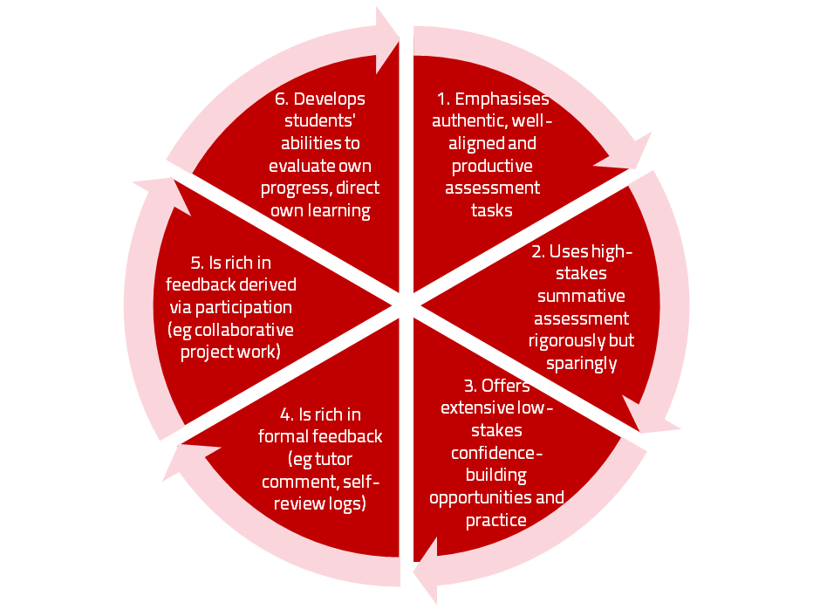
A4L the Northumbria model

Slide 23
The importance of dialogic feedback (Sadler)
Students need to be exposed to, and gain experience in making judgements about, a variety of works of different quality... They need planned rather than random exposure to exemplars, and experience in making judgements about quality. They need to create verbalised rationales and accounts of how various works could have been done better. Finally, they need to engage in evaluative conversations with teachers and other students.

Slide 24
Assessment for learning: some useful thoughts
1. Tasks should be challenging, demanding higher order learning and integration of knowledge learned in both the university and other contexts;
2. Learning and assessment should be integrated, assessment should not come at the end of learning but should be part of the learning process;
3. Students are involved in self assessment and reflection on their learning, they are involved in judging performance;
4. Assessment should encourage metacognition, promoting thinking about the learning process not just the learning outcomes;
5. Assessment should have a formative function, providing ‘feedforward’ for future learning which can be acted upon. There is opportunity and a safe context for students to expose problems with their study and get help; there should be an opportunity for dialogue about students’ work;

Slide 25
Assessment for learning
6. Assessment expectations should be made visible to students as far as possible;
7. Tasks should involve the active engagement of students developing the capacity to find things out for themselves and learn independently;
8. Tasks should be authentic; worthwhile, relevant and offering students some level of control over their work;
9. Tasks are fit for purpose and align with important learning outcomes;
10. Assessment should be used to evaluate teaching as well as student learning.
(Bloxham and Boyd)

Slide 26
Practical tips to inspire learners
Teach thoughtfully with consideration for your learners and be honest if you are asked questions you can’t immediately answer;
Spend as much time thinking about how you will structure learning activities within a teaching session as about the content of what is being taught;
Make convincing links between what you are teaching students today and what you have done previously, as well as signposting forward to future learning;
Build in flexibility in the activities you expect students to do so you finish on time;

Slide 27
How can you can inspire learning in your classrooms?
Be prepared: look at the learning outcomes for the course/ programme and work out what you need to cover in this particular session:
Be heard: use voice amplification or project your voice;
Be comfortable in yourself: make sure you feel you know your learning spaces well, be they physical or virtual;
Be confident in how you project yourself: you may at first just be acting confidently, but in time this will become your habitus.
Be interactive: break the time available into manageable chunks and make it clear what you expect students to be doing at any particular point in the lecture.

Slide 28

Laurentius de Voltolina
2nd half of 14th Century
Italian Painter

Slide 29
Think about the spaces and places in which you are teaching
Visit the places, live or virtual, where you will be teaching ahead of classes ahead of time so you can work out logistics and practicalities;
Situations where students are working with one another can happen even in unpromising spaces if you are creative in the activities (but pairs and triads for example work better than larger groups in tiered lecture theatres);
Online and virtual learning needs careful preparation so that students have opportunities to share ideas with one another and have chances to ask questions (and get them answered) for example using text chat or Twitter.

Slide 30
More than anything, be yourself!
You may admire others who inspire you and fear you might never be able to emulate them. Don’t try! It’s more important to be yourself, as natural as you can. Don’t feel you need to be an ace performer or comedian, just aim to do a good job and think about the students’ needs before your own anxieties.
Focus as much as you can on making learning happen through what students do and how they work with one another, rather than feeling that the sole responsibility for their learning lies with you.

Slide 31
Useful references: 1
Bain, K. (2004) What the best College Teachers do, Cambridge: Harvard University Press.
Biggs, J. and Tang, C. (2011) Teaching for Quality Learning at University, Maidenhead: Open University Press.
Brown, S. (2014) Learning, teaching and assessment in higher education: global perspectives. London: Palgrave Macmillan.
Carroll, J. and Ryan, J. (2005) Teaching International students: improving learning for all. London: Routledge SEDA series.
Lizzio, A., (2011) The student lifecycle: An integrative framework for guiding practice. Brisbane: Griffith University.
Mentkowski, M. and associates (2000) p.82 Learning that lasts: integrating learning development and performance in college and beyond, San Francisco: Jossey-Bass.

Slide 32
Useful references: 2
Meyer, J.H.F. and Land, R. (2003) ‘Threshold Concepts and Troublesome Knowledge 1 – Linkages to Ways of Thinking and Practising within the Disciplines’ in C. Rust (ed.) Improving Student Learning – Ten years on. Oxford: OCSLD.
Morgan, M. ed., (2013) Improving the student experience: A practical guide for universities and colleges. Routledge.
National Teaching Fellowships Scheme https://www.advance-he.ac.uk/awards/teaching-excellence-awards#ntf accessed October 2019
Race P. (2019) The lecturer’s toolkit (5th edition), London: Routledge.
Rust, C., Price, M. and O’Donovan, B. (2003) Improving students’ learning by developing their understanding of assessment criteria and processes, Assessment and Evaluation in Higher Education. 28 (2), 147-164.

Slide 33
Useful references: 3
Rust, C., Price, M. and O’Donovan, B. (2003) Improving students’ learning by developing their understanding of assessment criteria and processes, Assessment and Evaluation in Higher Education. 28 (2), 147-164.
Sambell, K., McDowell, L. and Montgomery, C., (2012) Assessment for learning in higher education. Routledge.
Sambell, K., Brown, S. and Graham, L., (2017) Professionalism in Practice: key directions in higher education learning, teaching and assessment. Springer.

