Slide 1
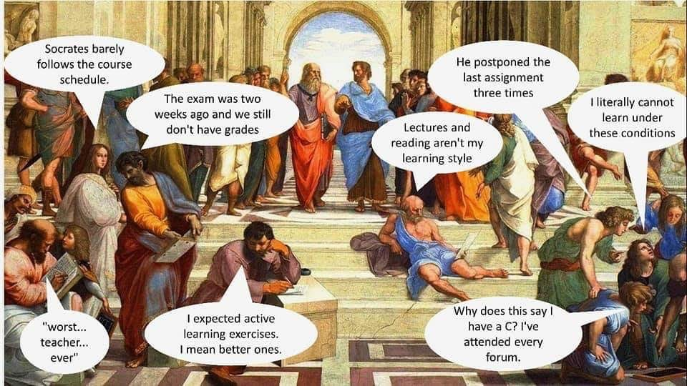

Slide 2

Addressing in practical ways the shifting paradigms in HE for the 2020s
14th November 2019
New frontiers in educational and curriculum development
Phil Race
(from Newcastle-upon-Tyne)
BSc PhD PGCE FCIPD PFHEA NTF
Follow Phil on Twitter: @RacePhil
Visiting Professor: University of Plymouth and Edge Hill University
Emeritus Professor, Leeds Beckett University

Slide 3
About Phil…
First a musician
Then a writer
Then a scientist
Then a researcher
Then a lecturer and warden at what is now USW
Got interested in how students learn
And the effects assessment and feedback have on them
And how we teach them
Gradually became an educational developer
And retired now!
Currently…
Visiting Prof: Edge Hill and Plymouth
Emeritus Prof: Leeds Beckett
Based at Newcastle UK
Notes:
2
2

Slide 4

You will be able to download my main slides
You don’t need to take notes.
I’ll put the main slides I use up on my website tonight (http://phil-race.co.uk/)
I may sometimes go through slides quite fast but you can study them as you wish at your leisure.

Slide 5
Intended learning outcomes?
By the end of this session, delegates will be able to:
Gain perspectives on the key changing paradigms of higher education as we approach the 2020s;
Prioritise areas to address as ‘important and urgent’;
Formulate and share practical and realistic ideas on how they aim to address these areas;
Take away learning from each other’s ideas and plans.

Slide 6
VASCULAR learning outcomes
https://sally-brown.net/2019/03/08/invigorating-the-curriculum-with-vascular-learning-outcomes/
Verifiable: Can we tell when they’ve been achieved? And can students?
Action orientated: Do they lead to real and useful activity?
Singular: i.e. not portmanteau outcomes combining two or more into one, making it difficult to assess if differently achieved, but readily matchable to student work produced?
Constructively aligned? (Biggs and Tang, 2011) so that there is clear alignment between aims (What do students need to be able to know and do?, What is taught / learned, how these are assessed and evaluated);
Understandable i.e. using language codes that are meaningful to all stakeholders?
Level-appropriate? Suitable and differentiable between1st year, 2nd year, 3rd year, Masters, other PG, NTFs?
Affective-inclusive i.e. not just covering actions but capabilities in the affective domain?
Regularly reviewed? Not just stuck in history and always fit-for-purpose.

Slide 7
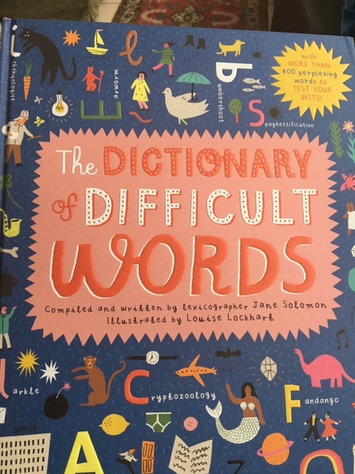
Learning by writing?
This workshop is based on my learning journey of over half-a-century, working both with students and staff, and helping them address the considerable variety of emerging trends as we approach the 2020s.
It is triggered by my preparation of the 5th edition of ‘The Lecturer’s Toolkit’ (now just out), through which I became increasingly aware of the changing paradigms now affecting teaching, learning, feedback and assessment in higher education.

Slide 8

5th Edition now out
Flyer can be downloaded from Phil-Race.co.uk

Slide 9
Standing on the shoulders of giants
The paradigms addressed are reflected in the ongoing work of David Carless, Naomi Winstone and David Nicol on feedback literacy and dialogues, the work of Phil Newton and Philip Dawson on addressing contract cheating and plagiarism in the digital age, the ‘VASCULAR’ approach of breathing new life into the use of learning outcomes by Sally Brown, and the pros and cons of ‘lecture capture’ as explored by Emily Nordmann et al.

Slide 10
On the blurb…
With so many things are now happening in higher education, the possibility of getting swamped has increased to the extent that colleagues can feel that they can’t keep up with the increased pace and pressure, and the ‘looking after yourself’ dimension needs to be foregrounded, alongside concern for students’ reactions to the increased competitiveness of higher education.
After briefly surveying eight paradigm shifts now occurring, participants will be invited to focus in to some practical, achievable steps which they can realistically take to address just some of the changes happening in teaching, learning, feedback and assessment, and make then share with each other some intended plans for enhancing the quality of students’ learning experience in the contexts they address. A key dimension in these plans is intended to be the realistic achievability of them, in ways which will help staff both to manage effectively their own stress levels, and at the same time help students to achieve a healthy balance in how they spend their time and energy in higher education in the 2020s.

Slide 11
Provisional session activities
‘2020s vision’: brief presentation of eight paradigm shifts now shaping higher education.
Participant activity briefing: choosing one or two ‘urgent and important’ areas to address in their own work, arising from addressing the changing paradigms. The action-plans will be drafted under the headings ‘What?’, ‘Why?’, How?’ and ‘When?’.
Sharing of draft action-plans: pair discussions in three rounds of different pairings (the aim being that participants will deepen their thinking on the action plans by explaining to others, and gain ideas from others on alternative plans).
‘Emergent learning outcomes’: post-it task where each participant summarises one or two things they now plan to do, based on their thinking and discussion during the workshop.
(Post event: with participants’ permission, I will transcribe the emergent learning outcomes post-its, and place these as a ‘workshop products’ file on the SEDA conference website, and on mine).

Slide 12
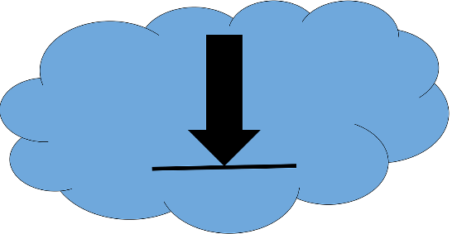
You can download free much of my published work
http://phil-race.co.uk/2016/04/updated-powerpoint-ripples-model/ (Chapter 1 from ‘The Lecturer’s Toolkit 2015)
https://phil-race.co.uk/2016/10/lthe-tweetchat-lthechat-wed-oct-19-8-00-9-00-pm/ (feedback stuff from my most recent two books)
https://phil-race.co.uk/2018/02/feedback-feedforward-just-tips-including-students/ (just the feedback tips!)
http://phil-race.co.uk/2015/01/assessment-bits-new-editions/ (extracts on assessment)
http://phil-race.co.uk/2017/05/lectures-and-learning/ (extracts on lecturing)

Slide 13


The three questions always in each student’s mind…
What will I be expected to show for this?
What does a good one look like and a bad one?
Where does this fit into the big picture?

Slide 14

s

Slide 15
Addressing the 2020s: Eight concurrent, related paradigm shifts
Online information and the internet now just normal, ‘digital’ has now ‘grown up’, and is no longer something different.
More attention to learning, rather than teaching.
Less focus on classes as ‘transmission’ occasions.
Learning-centred approach to assessment of student outcomes.

Slide 16
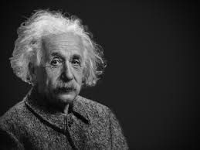
Thought for the day: Einstein
It is simply madness
to keep doing the same things
and expect different results.

Slide 17
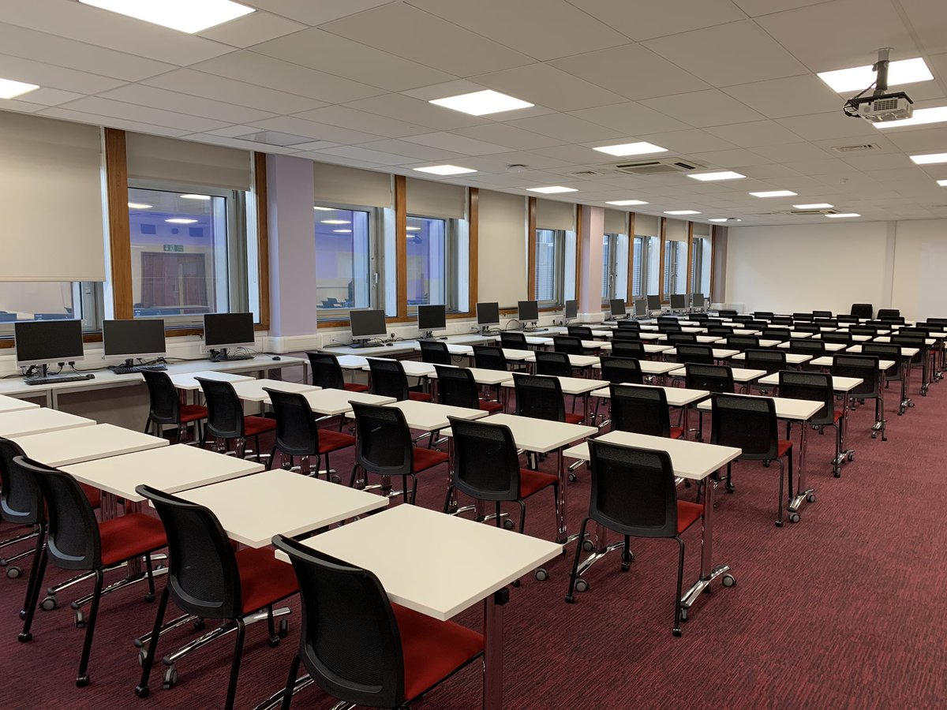
BYOD MCQ exam at Imperial
Alastair Gemmill (@AlastairGem)
Getting ready for ‪@imperialcollege‬ Faculty of Engineering’s first BYOD mock exam this morning using WISEflow, 2 groups of 90, MCQ! pic.twitter.com/YDTI9Y7A46

Slide 18


Digital testing at Utrecht University
 | Utrecht University (@UtrechtUni)
30/10/2019, 15:31 Digital testing at UU at unprecedented speed - Utrecht University uu.nl/en/news/digita…

Slide 19
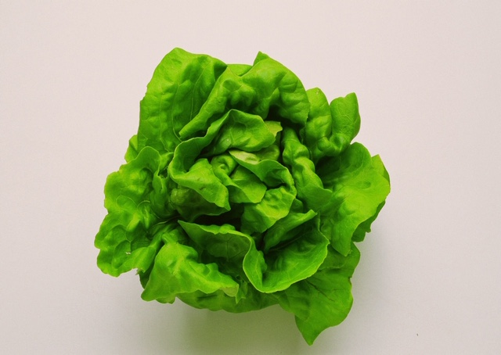
Teaching, learning and enthusiasm
Knowledge isn’t infectious (unfortunately) but enthusiasm is, and we need to help our students to catch enthusiasm.
We certainly don’t want teaching, assessment or feedback to damage that enthusiasm.

Slide 20


Slide 21

How students really learn
http://phil-race.co.uk/2016/04/updated-powerpoint-ripples-model/ (including Chapter 1 from ‘The Lecturer’s Toolkit 2015 – not much changed in new edition).

Slide 22

Thanks, Dr Paul Kleiman

Slide 23
Ripples on a pond….
Enhance our students’ want to learn?
Help students to develop ownership of the need to learn?
Keep students learning by doing, practice, trial-and-error, repetition?
Ensure students really use feedback – from us and from each other?
Help students to make sense of what they learn?
Get students deepening their learning by verbalising, explaining things to each other, and to us?
Allow students to deepen their learning by assessing their own learning, and assessing others’ learning – making informed judgements?
What else can we do to use
teaching, assessment and feedback to:
Verbalising
Assessing
making informed judgements
Wanting/
Needing
Doing
Doing
Making sense
Feedback

Slide 24
What will I be expected to show for this?
What does a good one look like, and a bad one?
Where does this fit into the big picture?
When explaining assessment criteria to students, and when linking these to evidence of achievement of the intended learning outcomes, we need to make the most of face-to-face whole group contexts and...
Tone of voice
Body language
Facial expression
Eye contact
The chance to repeat things
The chance to respond to puzzled looks
Some things don’t work nearly so well just on paper or on screens.
Some of the
tools we can
use in
face-to-face
contexts

Slide 25
Addressing the 2020s: Eight concurrent, related paradigm shifts
Greater focus on feedback dialogues, and development of feedback literacy by students.
Increased recognition of the skills, attitudes and behaviours graduates need to be work-ready.
Responsibility of institutions to prepare students for active citizenship in their own communities, nations and globally.
Increased recognition of the need for teaching staff to be trained, qualified and accredited as teachers.

Slide 26
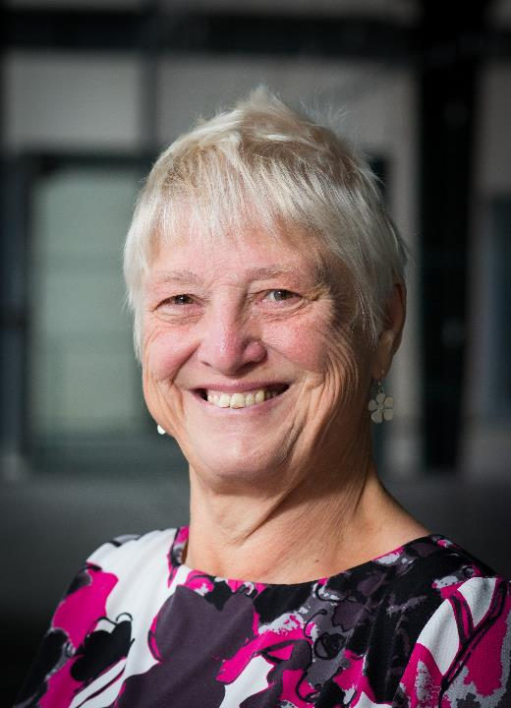
Feedback
Formative, helping to shape and improve future performances, that is Feed-forward;
Energising: helping students to feel motivated and inclined to work towards Enhancement;
Efficient: enabling you to maximise your helpful commentary while minimising your Effort;
Dialogic, involving interaction with and between students, plus Developmental comments;
Benevolent: students should Believe you have their Best interests at heart;
Action-orientated: that is leading students to Actually Advancing their Achievement;
Constructive rather than destructive, taking note of the affective impact of our Comments;
Kindly: when putting across tough messages, we need to remember the affective impact. (Sally Brown, 2019)

Slide 27

Link to videos made by Sue Beckingham of SHU
https://www.youtube.com/watch?v=3fWvtbojDfA&feature=youtu.be
Video of Vascular Acrostic
https://t.co/LIrQvA1JZd
Video of Feedback Acrostic

Slide 28

My favourite new book…
Naomi Winstone and David Carless
Designing effective feedback processes in higher education
Routledge 2019

Slide 29
Use link below to download the materials on feedback and assessment produced in 2017-18 by Kay Sambell, Sally Brown and Phil Race for Edinburgh Napier University
https://staff.napier.ac.uk/services/dlte/Pages/QuickGuides.aspx

Slide 30
Employers need ‘deep skills’?
I very much like the words of @JedKolko: 12/04/2019:
“Not ‘soft skills’. Instead, deep skills. Communication, social intelligence, and emotional intelligence are deep skills that are increasingly valuable, under-appreciated, and often strongest among those traditionally disadvantaged in the labour market. Plus, robots can't do them”. (Jed Kolko, 2019)

Slide 31
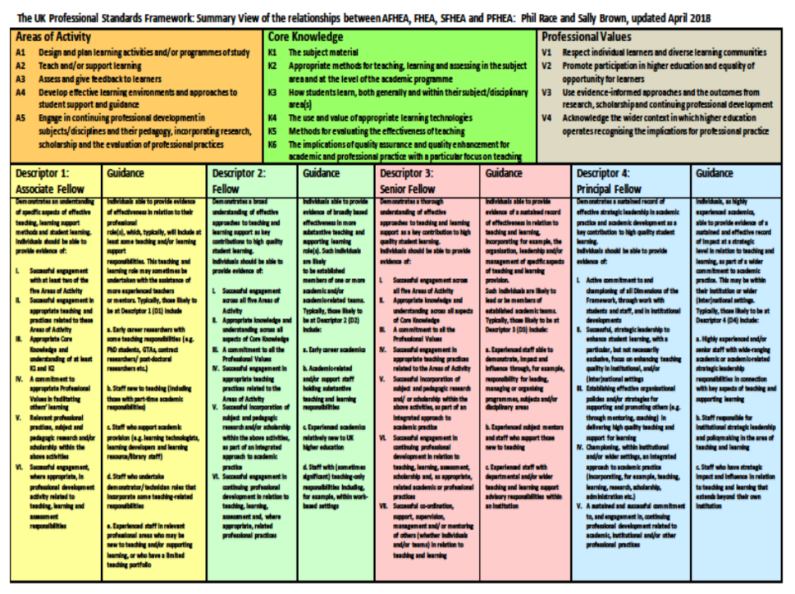

https://phil-race.co.uk/2017/11/ukpsf-page-updated-november-14th/

Slide 32
HEA Fellowships (Professional development relating to teaching, learning and assessment)
How many of you are already: (please raise hands)
Associate Fellow (AFHEA) 23,538
Fellow (FHEA) 83,304
Senior Fellow (SFHEA) 11,850
Principal Fellow (PFHEA) 1,166
National Teaching Fellow (NTF) c.950
(Numbers on 12.11.2019)

Slide 33
Setting your priorities?
1
Urgent and important
2
Urgent
not Important
3
Not urgent
but important
4
Not urgent
not important

Slide 34
Briefing 1: identifying and planning
Choose one or two ‘urgent and important’ areas to address in your own work, arising from addressing the changing paradigms.
Mentally please draft action-plans under the headings ‘What?’, ‘Why?’, How?’ and ‘When’.

Slide 35
Briefing 2 - sharing
Share your ideas with folk sitting near to you – and learn from their plans.

Slide 36
Experience of Royce Sadler on standards, assessment and feedback
Well worth looking at this clip from Coursera from Royce Sadler, who’s work informs much of the modern thinking on assessment and feedback…

Slide 37

Briefing 3: Emergent learning outcomes
Please write very clearly, and summarise one or two things you now plan to do, based on your thinking and discussion during the workshop
(5 minutes).

Slide 38
Post-conference
With participants’ permission, I will transcribe the emergent learning outcomes post-its, and place these as a ‘workshop products’ file on the SEDA conference website and on mine.

Slide 39
Back to our intended learning outcomes
Do you now feel better-able to:
(raise two hands = very much better; raise one hand = somewhat better; scratch left ear = no better)
Gain perspectives on the key changing paradigms of higher education as we approach the 2020s?
Prioritise areas to address as ‘important and urgent’?
Formulate and share practical and realistic ideas on how they aim to address these areas?
Take away learning from each other’s ideas and plans?

Slide 40
References
Brown, S. (2019) Invigorating the curriculum with VASCLULAR learning outcomes SEDA blog, accessible via https://sally-brown.net/2019/03/08/invigorating-the-curriculum-with-vascular-learning-outcomes/ (accessed November 2019)
Carless, D and Boud, D. (2018) The development of student feedback literacy: enabling uptake of feedback, Assessment & Evaluation in Higher Education, https://doi.org/10.1080/02602938.2018.1463354 (Accessed November 2019)
Nicol, D. (2010) From monologue to dialogue: improving written feedback processes in mass higher education. Assessment & Evaluation in Higher Education, 35(5), 501-517.
Nordmann, E., Kuepper-Tetzel, C.E., Robson, L., Phillipson, S., Lipan, G. and McGeorge, P, (2018) Lecture capture: Practical recommendations for students and lecturers. https://psyarxiv.com/sd7u4 : https://osf.io/esd2q/ (accessed November 2019).
Race, P. (2020) The Lecturer’s Toolkit: 5th edition, London: Routledge.
Winstone and Carless (2019) Designing effective feedback processes in higher education, - a learning focused approach, London: Routledge.

Slide 41
Thank you…
Website: http://phil-race.co.uk
Follow Phil @RacePhil
e-mail: phil@phil-race.co.uk

