Slide 1
I was born under a wandering star – where next in learning, feedback, and assessment?
Leeds: 15th November 2019
New frontiers in educational and curriculum development
Phil Race
(from Newcastle-upon-Tyne)
BSc PhD PGCE FCIPD PFHEA NTF
Follow Phil on Twitter: @RacePhil
Visiting Professor: University of Plymouth and Edge Hill University
Emeritus Professor, Leeds Beckett University

Slide 2
https://www.youtube.com/watch?v=TyaOW4K83i8

Slide 3
Intended learning outcomes?
By the end of this session, you may:
Have shared some things you really liked at this conference;
Have decided, asked, and had a meaningful vote on a ‘big teaching and learning question for 2020’;
Have publicly committed to ‘One thing I’m going to do as a direct result of being at this conference’;
Have chosen a card.

Slide 4
Wandering on…
In a half-century journeying in the sector, I’ve wandered from talking, listening and writing about physics and chemistry to educational development, always learning. This interactive and participative keynote, including post-its of course, aims to send you away from the conference with some thoughtful perspectives on the conference highlights as well as some clear strategies to take forward into the next stage of the great adventure.

Slide 5
From @HalehMoravej on Twitter

Slide 6
I like sitting on fences!

Slide 7
SEDA – ever facing the unknown
The very nature of frontiers suggests the unknown beyond, but pioneers who aim to succeed need to be well equipped for everything we encounter, including the known knowns but also the unknown unknowns.
SEDA conferences have long been milestones along the journey for pioneers in learning, feedback and assessment, sharing the known knowns and gathering wisdom and energy to bring to bear on the unknown unknowns of the post-compulsory education scene.

Slide 8
SEDA events
Our events provide much-needed refreshment opportunities on our journey, in the company of fellow-travellers who share in the mission to find ever better ways and means of helping student learning to happen effectively, and to accredit achievement, and advance our own learning.

Slide 9
Onwards and upwards
The contributions to this conference bear witness to the breadth and diversity of the bank of knowledge, excitement, insight and shared reflection the SEDA community, which we can harness to lead the future forward, with the only guarantee being that we can never expect to know in advance all the challenges which the future will bring.

Slide 10
Six words/phrases which bother me…
Really – now cured by copy editor Kat in India.
Excellence – only half of anything is above average.
Metrics – if you can measure it, it probably isn’t what you were trying to measure?
Learning hours – as if they could be measured. Learning payoff is more important.
Neurolinguistic programming – !!!
Assessed essays – we don’t know who did them and we can’t mark them reliably.

Slide 11
Summary of yesterday’s workshop: Addressing the 2020s: Eight concurrent, related paradigm shifts
Online information and the internet now just normal, ‘digital’ has now ‘grown up’, and is no longer something different.
More attention to learning, rather than teaching.
Less focus on classes as ‘transmission’ occasions.
Learning-centred approach to assessment of student outcomes.
Greater focus on feedback dialogues, and development of feedback literacy by students.
Increased recognition of the skills, attitudes and behaviours graduates need to be work-ready.
Responsibility of institutions to prepare students for active citizenship in their own communities, nations and globally.
Increased recognition of the need for teaching staff to be trained, qualified and accredited as teachers.
Further details were covered in my workshop yesterday with this title, slides at https://phil-race.co.uk/2019/11/14th-15th-november-at-seda-conference-in-leeds/

Slide 12
The next few slides show how I’ve navigated around my laptop using hidden slides and action buttons!

Slide 13
Phil’s choices…
About Phil
fun
Lunch
lt
Safety first
eu
Cats
tax
Content-free test
Writing mcqs
Cats 1
serenity
P
Cats2
Theory
humour
D
A fresh look at learning
OO
Hazards for students
Room layout
puns
Rev
Statements exercise
9
Canada
emp
checklist
Lectures
Flexible learning strategy
What?
ripples
U
Self-assessment tutor dialogue
Feedback from students
starters
More
quotes
Handouts
Plagiarism and cheating
Feedback
To students
Logo
N
Feedback
without marks
radio
Asst driv
Making learning happen
Feedback choices
Saturday, 16 November 2019
cp
back
final
Get yourself published
Action planning
T
windaaz
ssc
α
Assessing
groups
E-lect
delphi
Test slide
Learning from glass
Study skills books
mcqx
What’s this?
Group formation etc.
Niels Bohr
books
delphi
tube
Editing learning outcomes
Feedback sayings
Critical feedback
G
Linking learning outcomes to assessment
Principles
BOOK
Competence
Marking
coffee
ship
geek
Why fix assessment?
MM
Computer aided assessment
New el
clever
w
el
i
More el
R D Laing
20
???
Bloom
Name
labels
Disabled
Lao
Musts
AA
Anxiety
B s/p
more
Noah
Quick feedback

Slide 14
Phil’s Main Menu
Ripples: s
Towards assessment
as learning
s
Time and task management
t
950
test
Post-its: expectations exercise
New ass slides
Helping students to
build on feedback
htdu
What we do
when we teach
More/less
10a
ca
Learning and
using names
Assessment
menu
Feedback
menu
C
Learning outcomes
Lp
L
U
Flexible learning strategy
og
Lewis Carroll
TST
24 hour
feedback
Thirty second theatre
How students really learn
supp
Help students to learn
More starter questions
w
cd
Content-free test
t
checklist
New feedback
methods
T
Choices
Learning outcomes
Fun
7
sl
doodling
Room layout
Feedback from students
Assessment works well when:
Designing the curriculum
for learning
a
a
r
How are you organising your studies?
tst2
Org menu
Quotes about
lectures
Emotional intelligence
Assessing groups
Exam question exercise
GP
Smarter assessment
Teaching smarter
Large groups
Retention
Menu Assessment
Why students leave
Self-assessment
dialogues
SCL?
Feedback to students:
Payoff and efficiency
Ten tips: formative feedback
end
…Examples
Ruth’s quiz
Inclusive teaching issues...
Exam dilemmas
A short examC
Feedback without marks
What works for students
Voting rounds
What can I do when…?
M
mlh
What the gurus tell us
GG:A
ML3 menu
GG:F

Slide 15
Making learning happen
Factors underpinning
learning
NSS lecture
agenda
Getting students to ask questions
Language
of learning
What’s missing in
learning cycles?
Upsides,
downsides
What kinds
of learners?
Towards
inspiring
lectures
Stages in
curriculum
design
MC menu
Main menu
Aspects of
small group
learning
Peer observation
steps
Fun
Exam dilemmas
Tutor, peer
and self-
assessment
Questions about small
Group learning
Ways personal
tutors can help
Observing
and reflecting
Some assessment
issues
How can we assess what
students have learned
Some feedback
issues
CMA and hand-marking
Assessment agency
24 hour feedback
Critical incident
accounts
Word constrained
writing
Quality of
assessment

Slide 16
Phil’s choices
NSS assessment and
feedback criteria
museum
How students really learn
Designing the curriculum
for learning
Content-free test
QAA B6
Smarter
feedback
Quotes about
lectures
7
mlh
Validity, etc
concerns
TST
Literacies
24 hour
feedback
Towards assessment
as learning
T, r and r
What the
gurus tell us
Sally on feedback
HEA slides
A short exam
Strategy
Smarter
assessment
Marks and
self-assessment
Alternatives
to essays
ML3 menu
Fun
Feedback on exams
Main menu

Slide 17
Who said this?
If you always do what you’ve always done, you’ll always get what you’ve always got.
Therefore, we’ve got to be prepared to try something
else.

Slide 18
Ripples on a pond….
Enhance our students’ want to learn?
Help students to develop ownership of the need to learn?
Keep students learning by doing, practice, trial-and-error, repetition?
Ensure students really use feedback – from us and from each other?
Help students to make sense of what they learn?
Get students deepening their learning by verbalising, explaining things to each other, and to us?
Allow students to deepen their learning by assessing their own learning, and assessing others’ learning – making informed judgements?
What else can we do to use
teaching, assessment and feedback to:
Verbalising
Assessing
making informed judgements
Wanting/
Needing
Doing
Doing
Making sense
Feedback

Slide 19
Ripples on a pond….
Assessing
making informed judgements
Wanting/
Needing
Doing
Doing
Making sense
Feedback

Slide 20
Thanks, Dr Paul Kleiman

Slide 21
Hits
Some things I really liked about this conference.

Slide 22
Does change mean progress?
the challenge for HE
Dr Mark Glynn
mark.glynn@dcu.ie
@glynnmark
http://bit.ly/mgseda2019
Notes:
Good morning ladies and gentleman
My name is Mark Glynn. my contact details are on the slide and in the interest of openness you will notice a link down the bottom of the slide to a copy of my slides. I will also tweet this out later with the hashtag of the conference. Please feel free to copy, paste or harvest any element of the presentation that is of interest to you.
“Change is inevitable, but progress depends on what we do with that change” - Charles Whelan.
As mentioned in the call for contributions - The extent and pace of change in higher education has increased dramatically over the last few years and there is no sign of this slowing down. So what do we change, how do we influence change? As individuals, as educational developers and as an association of staff developers we can be in a very influential position when it comes to change.
We all come from different institutions , different structures, different levels of resources at our disposal. Investment in resources and funding is crucial when it comes to change. How can we optimise this investment at a local, national and international level to ensure change results in progress . This session will outline approaches involving teaching and learning that DCU have taken to manage these changes, embrace them in order to progress while ensuring that the end of goal of student learning is always foremost in our minds.

Slide 23
Fraud triangle (Cressey, 1953)
Pressure
Opportunity
Rationalisation
Notes:
Let’s borrow a theory from business - the fraud triangle developed by Cressy in 1953 and apply it to plagiarism. Why do students cheat - pressure, opportunity and rationalisation. If the size of the triangle represents the potential for students to cheat as staff developers we should support our academics to reduce the size of this triangle. Excellent initiatives like the TESTA approach can be implemented to provide a programmatic view of assessment. I know that David Walker is a champion of the testa approach. Having this information and indeed taking a programmatic approach to assessment can help reduce pressure on students.
Something some academics are guilty of is providing the same assessment year after year which provides opportunity to plagiarise. Changing the assessment type maybe from an essay to an a video will reduce the opportunity for plagiarism

Slide 24
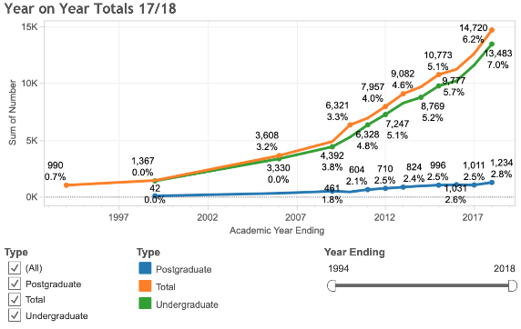
Number of students reporting a disability
Notes:
(hairband - Abbie Moriarty)

Slide 25
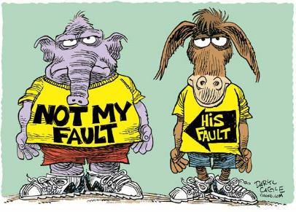
New frontiers in improving the way we support and relate to students
Michelle Morgan
14 November 2019
SEDA
Annual T&L Conference
Leeds
@it_se

Slide 26
Changes in UG participation
Massification
F-FT
M-FT
F-PT
M-PT
Source: Extracted from HESA data

Slide 27
Changes in PG participation
PG traditionally study seen as supporting ‘continuing professional development’
Specialisation
Professional requirements (e.g. obtain chartered status)
In 1994/5:
Masters most popular course in 1994 was the MBA
PG Other PT courses almost as popular as FT PGT
Part-time was the main mode
Used to give the individual the edge in the job market
Mature learners
As with UG, thought people invest in PG when the economy is weak
In 2015/16:
Other PG FT and PT courses have declined dramatically. Masters absorbed as exit quals
PGT still dominates PG study participation but FT has taken a dip and PT study declined dramatically
UK enrolments by type of qualification
2003.4-2015.16
Source: extracted from HESA data 2017

Slide 28
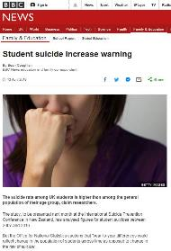
Mental health
Increase in anxiety and depression amongst teenagers
Levels of mental illness, mental distress and low well being amongst students in HE are increasing
Increase in mental health disclosure in past 10 years (IPPR, 2017)
In 2015, UK domiciled 5 times that of 2006
First year = 5% in 2006/7 to 17% in 2015/6
Females more likely to disclose a mental health condition
In 2009/10 Females and males equally likely to disclose with 0.5%
In 2015/16 Female disclosure was 2.5% and males 1.4%
Undergraduates more likely to disclose than postgraduates
EU, OS and top 2 socio-economic groups less likely to disclose
Students who experienced mental health issues more likely to withdraw (increase in fitness to study processes)
79% increase in HE suicides between 2006/7 and 2016/17
Better statistical reporting
Mental illness not as hidden
Positive approach to disclosure
As student numbers increase, proportion of mental health occurrences likely to rise.
Source: IPPR (2017)
www.ippr.org/publications/not-by-degrees
https://www.universitiesuk.ac.uk/minding-our-future

Slide 29
Who is more engaged with their university? Both are full-time first year students
Student 1
Attends all lectures and seminars
No extra curricula activity
Lives on campus
Does limited extra reading
Has 25 hours contact time a week
Timetable split over 3 full days
Do not undertake paid work
Dyslexic
19 years old Social Class 2
Student 2
Attends 80% of all lectures and seminars
Course representative
Lives 15 miles away /public transport
Does all of the extra reading
Has 12 hours contact time a week
Timetable split over 4 days
Undertakes 15 Hours paid work a week
Mental health issues
19 Years old care leaver

Slide 30
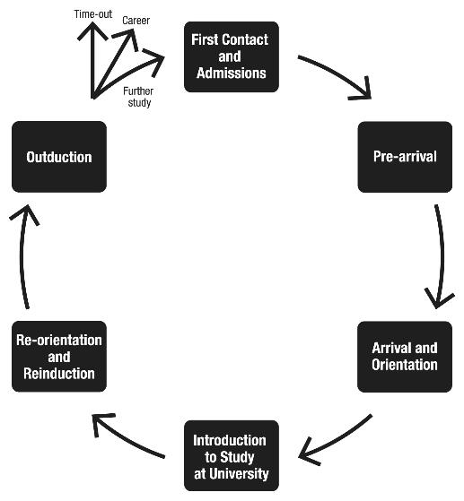
Staff pinch points
HE not just about knowledge but preparing individuals for work
Bridging gaps between
school/college and HE
Increasing UG/PGT student numbers
Increased administration and lack of support
Chasing metrics
NSS/PTES/DHLE/LEO
The Student Experience Transitions Model
The student as consumer
rising expectations
Increase in OS students
One size fits all approach due to pro cess demands
No ‘troughs’ anymore, just ‘peaks’
Operating global context
Shift to e-Learning-Technology and digital innovation
Semesterisation challenges
Increased QA processes
Lack of resources
Rising costs and shifting funding
Feedback issues
Expectation of having a teaching
qualification/Fellowship of HEA
Balancing research with teaching
Obtaining funding for research
Limited time to ‘hit the ground walking’ W Proctor

Slide 31
Looking after yourself checklist 1
I manage time well, I’m normally punctual and I make sensible decisions about how much I can sensibly achieve at any time.
I make sure I take proper meal breaks at work, not eating my lunch at my desk and regularly stopping to chat with colleagues.
I keep myself as fit as is compatible with my age/abilities and I take exercise within my working day to avoid getting overstressed/ uncomfortable from sitting too long.
I have and use a good range of professional networks on whom I can draw to share practice and gain advice.
I manage my interactions with students productively so that I feel I am giving them good support without running myself into the ground.
I monitor my stress levels, noting when it feels as if work is getting on top of me.
I keep on top of my emails, without allowing masses of unanswered messages to pile up and I reply promptly to important requests.

Slide 32
Looking after yourself checklist 2
I manage my paperwork well and am able to locate key papers when necessary without rummaging through an unsorted pile on my desk.
I am good at keeping on top of my lesson preparation/ curriculum design and hence avoiding last-minute panics.
I review my classroom and assessment practice regularly and reflect on how I could enhance my work year on year.
I keep on top of my marking and don’t attempt to do huge amounts in unreasonably short time periods.
I have a good work-life balance and don’t take too much work home.
I notify my team leader/line manager when my workload is getting out of hand.
I have interests/ hobbies that matter to me and I make time for them.
I make time for my friends outside work and don’t over-share my work problems with them.

Slide 33
https://phil-race.co.uk/2019/01/cork-institute-of-technology-8th-9th-january/
Later version of the ‘looking after yourself’ quiz now in Toolkit!

Slide 34
Challenges I’m taking away
To learn more about how to fill my new iPod!

Slide 35
Postcard round
In very clear handwriting…
please jot down ‘one thing I’m going to do, as a direct result of being at this conference…’ and are willing to have published in an anonymous list of conference outcomes.
Please swap postcards, till you no longer know whose you have.
If picked, please read out what’s on the postcard you now have.
Please leave them all with me.

Slide 36
Raise hands if you have definite intentions to do something?

Slide 37
Your big ‘yes-no’ teaching and learning questions for 2020, followed by meaningful votes: Rules:
Must be a question, not a statement, and capable of being answered yes or no.
Must be asked in just one breath.
Must be asked to the microphone, so everyone can hear it, and your tone-of-voice etc.
Show of hands vote after a brief response from me:
Two hands = yes One hand = no

Slide 38
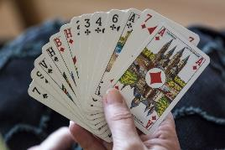
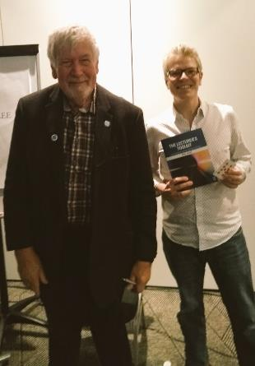
Now for the playing card
Please take your card.
If you don’t like that one, do feel free to exchange it for another one.
The selected card is:

Slide 39
Back to our intended learning outcomes
Do you now feel you have achieved….
(raise two hands = very much better; raise one hand = somewhat better; scratch left ear = no better)
Having shared some things you really liked at this conference?
Having decided, asked, and had a meaningful vote on a ‘big teaching and learning question for 2020’?
Having publicly committed to ‘One thing I’m going to do as a direct result of being at this conference’?
Having chosen a card?

Slide 40
References
Brown, S. (2019) Invigorating the curriculum with VASCLULAR learning outcomes SEDA blog, accessible via https://sally-brown.net/2019/03/08/invigorating-the-curriculum-with-vascular-learning-outcomes/ (accessed November 2019)
Carless, D and Boud, D. (2018) The development of student feedback literacy: enabling uptake of feedback, Assessment & Evaluation in Higher Education, https://doi.org/10.1080/02602938.2018.1463354 (Accessed November 2019)
Nicol, D. (2010) From monologue to dialogue: improving written feedback processes in mass higher education. Assessment & Evaluation in Higher Education, 35(5), 501-517.
Nordmann, E., Kuepper-Tetzel, C.E., Robson, L., Phillipson, S., Lipan, G. and McGeorge, P, (2018) Lecture capture: Practical recommendations for students and lecturers. https://psyarxiv.com/sd7u4 : https://osf.io/esd2q/ (accessed November 2019).
Race, P. (2020) The Lecturer’s Toolkit: 5th edition, London: Routledge.
Winstone and Carless (2019) Designing effective feedback processes in higher education, - a learning focused approach, London: Routledge.

Slide 41
Thank you…
Website: http://phil-race.co.uk
Follow Phil @RacePhil
e-mail: phil@phil-race.co.uk

Slide 42
Safety Curtain

